Slide 1
Understanding and Managing the Risks of Analytics
Randy Stiles
Special Advisor for the President, Analytics
Colorado College
This presentation leaves copyright of the content to the presenter. Unless otherwise noted in the materials, uploaded content carries the Creative Commons Attribution-NonCommercial-ShareAlike license, which grants usage to the general public with the stipulated criteria.
March 18, 2013

Slide 2
Part 1: Background

Slide 3

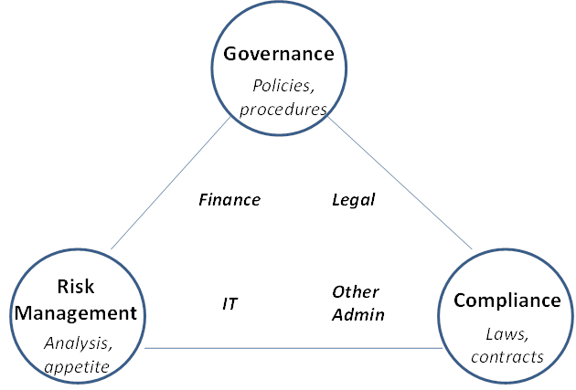
Risk Management

Slide 4

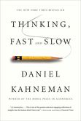

Making Decisions
Neuroscience
Behavioral Economics
Moral Psychology

Slide 5
Analytics in Higher Education
EDUCAUSE Analytics Sprint
Analytics on Higher Education's Doorstep
July 24–26, 2012 │ Online
“The use of data, statistical analysis, and explanatory and predictive models to gain insights and act on complex issues.”
EDUCAUSE

Slide 6
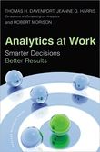
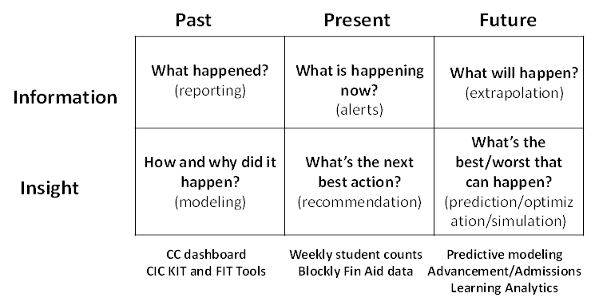
Questions Addressed by Analytics

Slide 7
Part 2: My Recent Projects

Slide 8
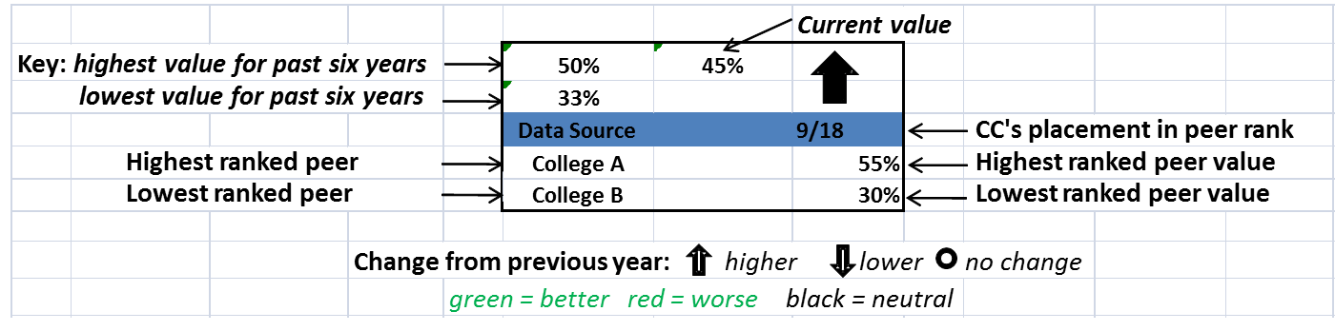
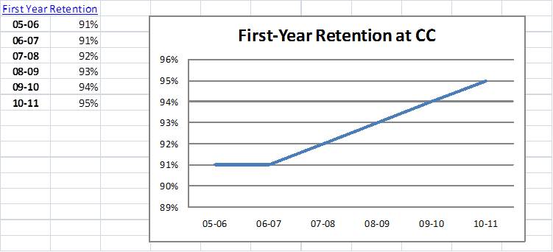
Dashboards
For the President
For the Trustees
For the CIO

Slide 9
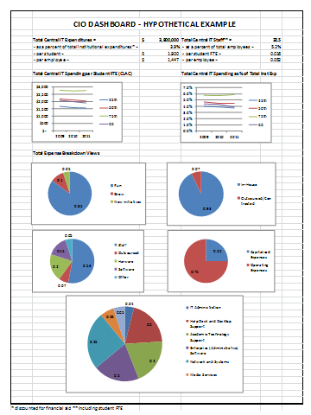
The IT Budget – Multiple Views
High-level expense and staffing metrics
Benchmarked trends in key metrics
Various expense breakdowns

Slide 10

Accreditation
Disruptive Forces in Higher Education
Outcomes-oriented accreditation
Online learning

Slide 11
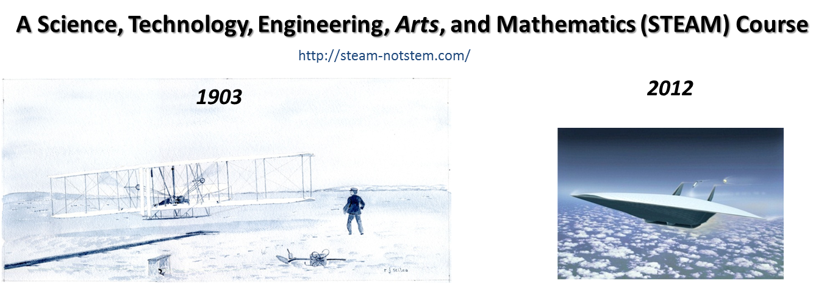
Blended Learning and Learning Analytics
Physics 220: The Physics and Meaning of Flight

Slide 12
Part 3: Risks of Analytics

Slide 13

Risks for Institutional Leaders
Inappropriate of premature use of analytics
Countercultural use of analytics
Saying “no” or “not now” to analytics

Slide 14

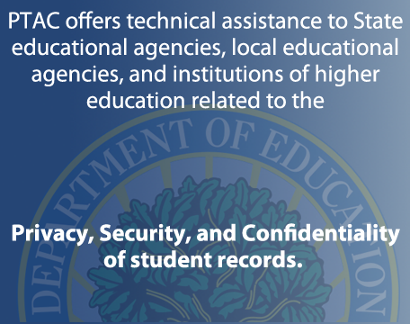
Governance Risks
Data Governance Checklist
Training Videos
http://ptac.ed.gov/

Slide 15
Quality Risks
Accessibility
Appropriate Amount of Data
Believability
Completeness
Concise Representation
Consistent Representation
Ease of Manipulation
Free-of-Error
Interpretability
Objectivity
Relevancy
Reputation
Security
Timeliness
Understandability
Value-Added
Thomas Davenport
Stephen Few
Edward Tufte
16 data quality dimensions: Pipino, Lee and Wang

Slide 16
Compliance Risks
FERPA
HIPAA
SOX
GLB
States
Red Flag
…
The Higher Education Compliance Alliance was created to provide the higher education community with a centralized repository of information and resources for compliance with federal laws and regulations.
http://www.higheredcompliance.org/

Slide 17

Other Risks
3rd Parties/SaaS
Learning Analytics – new
electronic “footprints”
Thomas J. Trappler, “If It’s In the Cloud, Get It On Paper: Contract Issues,” EDUCAUSE Quarterly, 33, no. 2., 2010
http://www.solaresearch.org/

Slide 18

Key Organizational Competencies
Information Management
Analytical Skills and Tools
Data-Oriented Culture

Slide 19
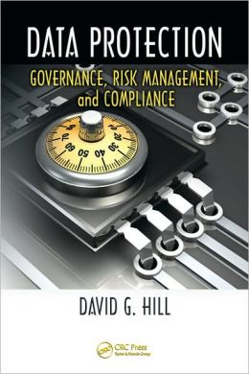
Data Protection - for CIOs and IT Staff
Additional Risk Management Considerations
Business continuity vs disaster recovery
Physical and logical data
Classifying data value
Degrees (or layers) of Data Protection
Data Protection Technologies

Slide 20
Recommended Readings
Cost and value of CLAC colleges: Robert Archibald and David Feldman, Why Does College Cost So Much? Oxford University Press, 2011.
2. Disruptive innovation in higher-ed: Clayton Christensen and Henry J. Erying, The Innovative University: Changing the DNA of Higher Education from the Inside Out, Jossey Bass, 2011.
3. Analytics (BI type): Davenport, Thomas, Jeanne Harris, and Robert Morison, Analytics at Work: Smarter Decisions, Better Results, Cambridge, MA: Harvard Business School Press, 2010.
4. Learning Analytics: Siemens, George, and Phil Long. “Penetrating the Fog: Analytics in Learning and Education.” EDUCAUSE Review 46, no. 5 (September/October 2011).
5. Data quality: Leo Pipino, Yang Lee, and Richard Yang, “Data Quality Assessment,” Communications of the ACM, April, 2002/Vol 45, No.4.
6. Meaningful information: Stephen Few, Now You See It: Simple Visualization Techniques for Quantitative Analysis, Analytics Press, 2009.
7. Risk Management for CIOs: David G. Hill, Data Protection: Governance, Risk management and Compliance, CRC Press, 2009.
8. Risks of Analytics: Randall J. Stiles, Understanding and Managing the Risks of Analytics in Higher Education: a Guide, EDUCAUSE, 2012.

Slide 21
Increased
Value
Cost
Scrutiny
Accountability
Higher-Education Governance
and
Decision-making
Transformative forces
Online learning
Outcomes focus
Levels – institutional, program, course, student/faculty
Human decision-making (complex, potentially biased)
Yes
Enhanced by analytics?
No
Yes (but where are the minefields?)
No or Not Now (but why not?)
Risk Management
Risk Management
INSTITUTIONAL
LEADERS
Inappropriate or premature use?
Poorer decisions and results?
Falling behind?
Counter-cultural?
ANALYTICS
TEAM
Data & Information
Governance
Data & Information
Quality
Data & Info
Compliance
SPECIAL
TOPICS
What about
security and privacy in
Learning Analytics?
What about
third parties, e.g., Cloud or SaaS?

Slide 22
Two Take Aways
Are the IT infrastructure and staffing strategic resources to be optimized or expenses to be minimized at your institution?
Is your IT organization working on building and sustaining relationships with key decision-makers?

Slide 23
QUESTIONS?
Randy Stiles
rstiles@coloradocollege.edu

