Slide 1

ECAR Research
2012 in Review—2013 Preview
Susan Grajek
Midwest Regional Conference
March 19, 2013

Slide 2

Todays Agenda
Introduction to ECAR
Review of selected 2012 research
Full 2013 research agenda
Write for EDUCAUSE

Slide 3
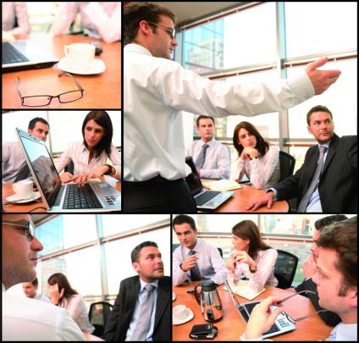
EDUCAUSE Center for Applied Research (ECAR)
Established in 2001 to provide research-based evidence to support effective decision making in higher education.
Nearly 500 colleges and universities subscribe to ECAR.

Slide 4





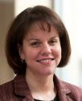



EDUCAUSE RESEARCH STAFF
Susan Grajek,
Vice President,
Data, Research, and Analytics
Eden Dahlstrom, Senior Research Analyst
Jacqueline Bichsel, Senior Research Analyst
Pam Arroway,
Senior Statistician
Leah Lang,
Senior IT Metrics and Benchmarking Analyst
Joanna Grama, Portfolio Manager
Tyson Anderson, Data Visualization Specialist
Kate Hellweg, Research Associate
Mike Roedema, Statistician

Slide 5



Three primary Research product lines
Core Data Service
Research Studies
Research Bulletins

Slide 6


Slide 7

Deep Dive: 2012 Top Ten IT Issues and ecar research offerings
Issue: Supporting the trends toward IT consumerization and bring-your-own device
Issue: Using analytics to support critical institutional outcomes
Issue: Supporting the research mission through high-performance computing, large data, and analytics
Theme: Improving student success
Theme: Managing the IT organization

Slide 8
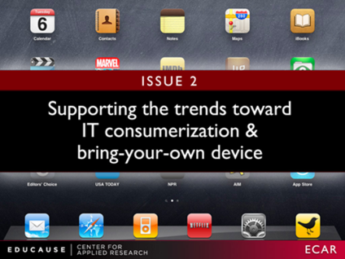
IT Issue: IT Consumerization and BYOD
“Faculty, staff, and students no longer need the IT organization as an intermediary in their adoption and application of the most commonly used technologies. They arrive with mature personal computing environments…”

Slide 9
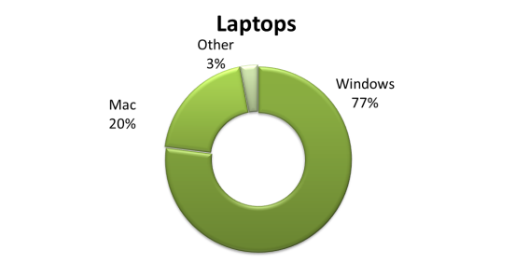
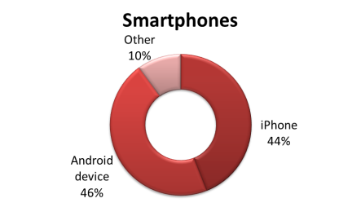
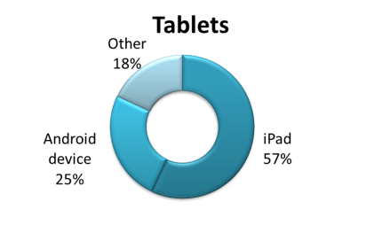
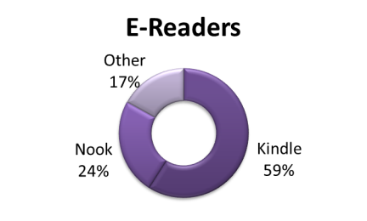
Students and IT Study, 2012
Prolific and Diverse BYO Technology

Slide 10
MORE AND MORE DEVICES

Slide 11
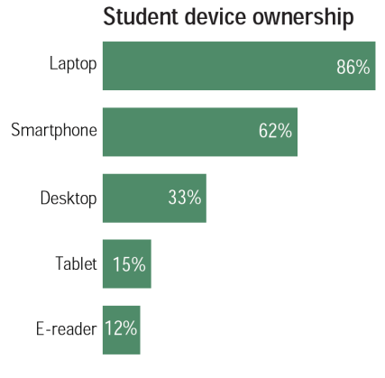
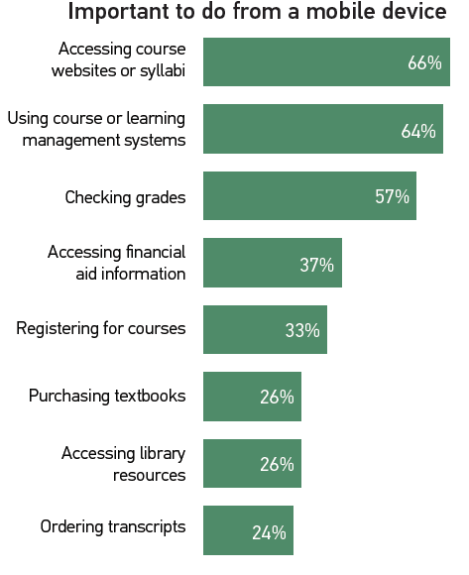
Students and IT Study, 2012
Extreme Mobility Still Supplemental

Slide 12
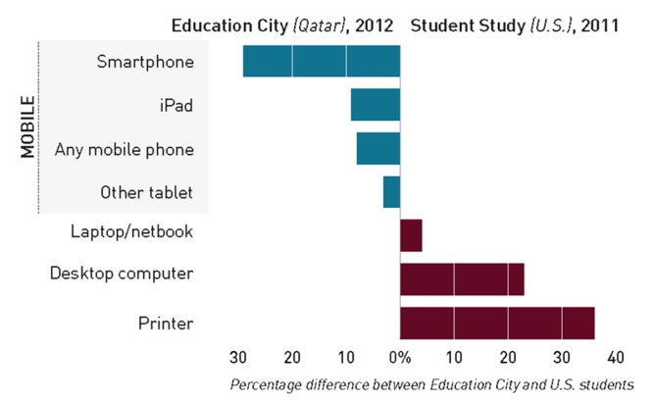
Student Mobile Computing Practices: Lessons Learned from Qatar (2012)
Qatar and U.S. Student differences

Slide 13

IT Issue: Using Analytics
"Accountability and, increasingly, the need to give students the information they require are driving the use of analytics in higher education.”

Slide 14
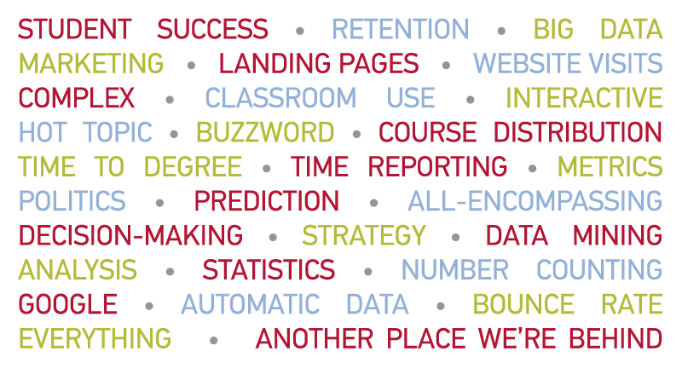
ANALYTICS IN HIGHER EDUCATION (2012)
WHEN I HEAR ANALYTICS, I THINK OF…

Slide 15
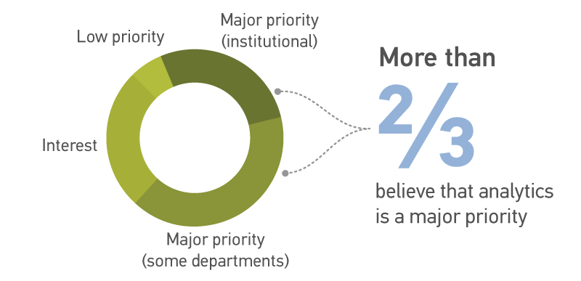
Analytics in Higher Education (2012)
Analytics Is a Priority

Slide 16
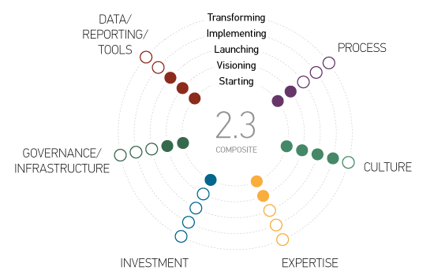
Analytics in Higher Education (2012)
ECAR Analytics Maturity Index
http://www.educause.edu/ecar/research-publications/ecar-analytics-maturity-index-higher-education

Slide 17
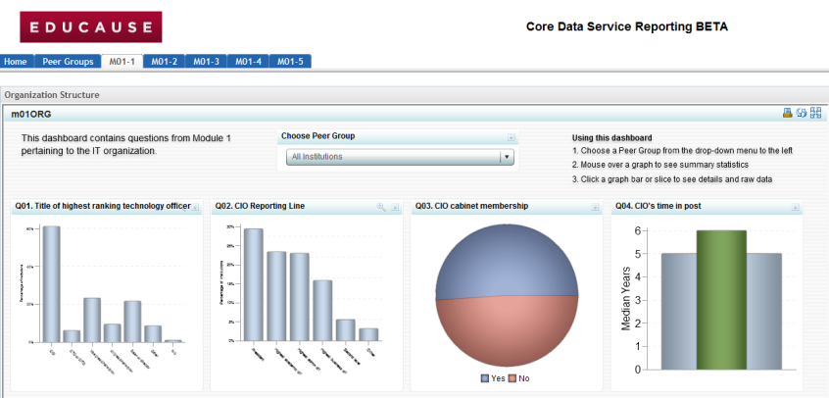
2013 PREVIEW-Analytics
Core Data Service Reporting Tool, Open Beta Launch (anticipated January 2013)

Slide 18

It issue: Research computing
“Ensuring adequate infrastructure for researchers is challenging higher education institutions, in terms of both physical and human resources, at a pace unseen before.”

Slide 19
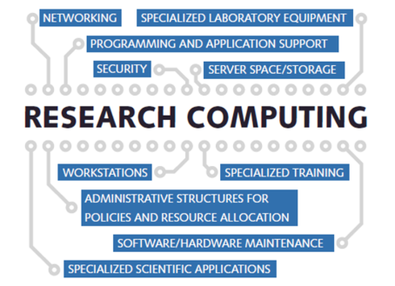
Research Computing, 2012
Contemporary Definition of research computing
Any service or infrastructure provided to faculty or research staff for the purpose of performing research at a higher education institution
Highly resource intensive; demanding of computing infrastructure, hardware, software, and personnel

Slide 20
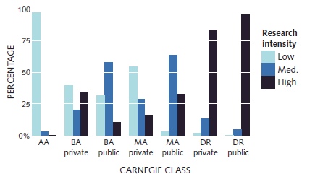
Research Computing, 2012
Research Intensity

Slide 21
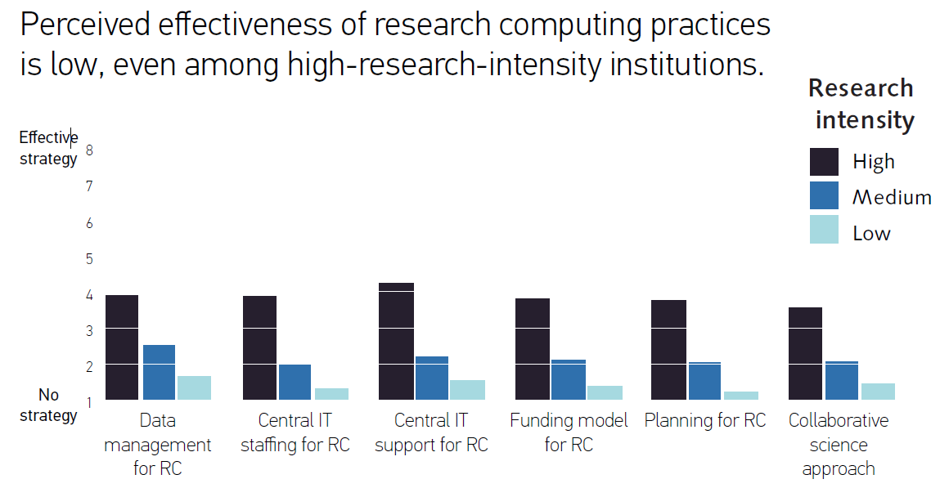
Research Computing, 2012 perceived effectiveness

Slide 22
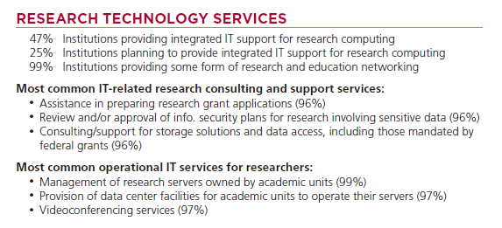
Core Data Service Almanacs, 2012
Summary data on research computing

Slide 23

Theme: Improving student success
“[W]e are doing a lot of studying, research, and soul-searching about how to deal with the problem of helping the high school student perform better and allowing the student to succeed.” Roger Flahive, CIO, County College of Morris

Slide 24
Community Colleges, 2012
Students Prefer Online Learning Options
Preferred Learning
Environment
No online components
Some online components
Completely online
Institution Offers
Entirely Online Courses
Students Have Taken
an Online Course
Yes
No
2011 SS – Q18, 18c, 18d – online learning

Slide 25
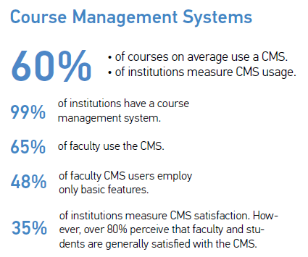
CLASSROOM TECHNOLOGY, 2012
COURSE MANAGEMENT SYSTEMS
Half of institutions preload their CMS with basic content. Those that do report significantly more student satisfaction with the CMS.

Slide 26
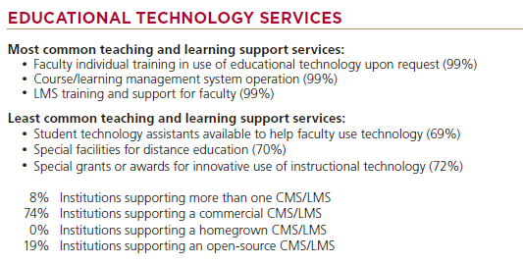
Core Data Service Almanacs, 2012
Summary data on learning technologies

Slide 27

Theme: Managing the it organization
“[I]institutional decision-making that accounts for information technology will benefit by examining total cost of ownership, switching costs, user-support needs, system requirements, market forces and trends, and IT skill and expertise capacity.” Ann Kovalchick, CIO, Drake University

Slide 28
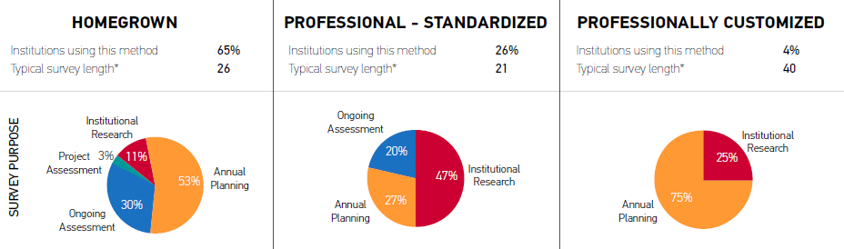
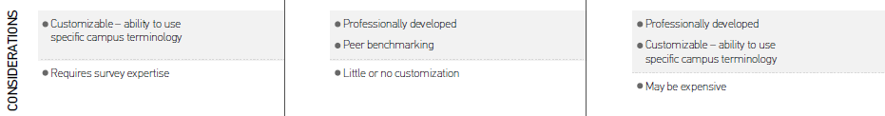
MEASURING USER SATISFACTION, 2012
USE OF SURVEYS TO MEASURE SATISFACTION

Slide 29
2011 ENTERPRISE APPLICATION MARKET
CORE APPLICATIONS
Key Findings
  Almost every university delivers six core applications
  LMS & CMS applications are the most homogenous
  Open-source options are more widespread in LMS and CMS than other application areas.
  Grants-management solutions—both for pre-award and for post-award application—are the most commonly homegrown tools among the application areas in our study.

Slide 30
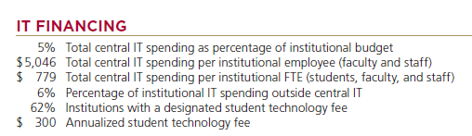
Core Data Service Almanacs, 2012
Summary data on IT organizations

Slide 31
2013 Full Research Agenda
Study: ERP cost drivers (in collaboration with CAUDIT) (January 2013)
Study: IT Consumerization/BYOD (February-March 2013)
Study: Cost of IT (April 2013)
Study: E-Learning (May/June 2013)
Study: Update on mobile IT (August 2013)
Study: Student Technology Use (September 2013)
Study: IT Workforce issues (November 2013)
2013 Core Data Service spotlights, almanacs, and reports
Research Bulletins
Gartner IT Reports (Quarterly)

Slide 32
ECAR Subscriptions
Subscriptions are being renewed right now!
Or become a new subscriber to ECAR.
http://www.educause.edu/ecar

Slide 33

EDUCAUSE Needs You!
We encourage submissions and proposals from the doers, strategic thinkers, and innovators involved in higher education information technology.
Share your research findings in an ECAR Research Bulletin
Contribute to an ECAR case study
Write for EDUCAUSE Review Online
Contribute to an ELI case study

Slide 34
THANK YOU!
Susan Grajek, sgrajek@educause.edu http://www.educause.edu/ecar http://www.educause.edu/research-and-publications/research/core-data-service

