Slide 1





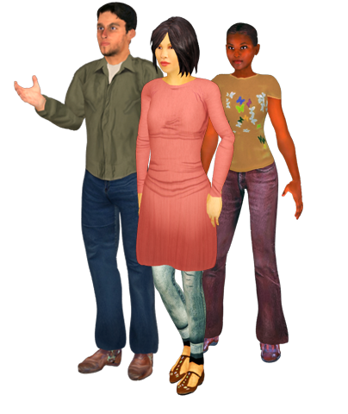
Notes:
Hi, may name is Kevin Abbott and I work at Western Michigan University for the office of Information Technology. As Project Lead for 3D and Interactive Media. The area that I work in, media production, creates media for a wide variety of university projects, and my role often involves exploring how media can be used the meet the needs of the university. A lot of the work I have done over the years involves the integration of digital media, such as projections and animations, into live performance.
Broncoland Game and Broncoland Tour are video games designed to enhance recruiting and student success at Western Michigan University. Designed and built entirely in-house by a team of IT staff and WMU students. Both the game and tour take place on a 3D version of the WMU campus. The project is an example of leveraging media expertise within IT to invent and create unique assets for the institution. The presentation will explore all facets of the project, including funding, production, and delivery. Attendees will see how such a project might be feasible within their organizations.

Slide 2



21st Century Student Committee
  Attrition Subcommittee
Student Orientation
  A crash-course on College and WMU
Notes:
In 2010 I was asked to join a committee which at the time was called the millennial student committee,. The committee was started when a faculty member in Social Work, Robert Wertkin, began to feel increasingly out of touch with his students. Dr. Wertkin’s concerns were shared by our Provost, Tim Greene, and a committee was formed to set out to understand the specific needs of our latest generation of students.
I was asked to serve on this committee and ended up joining the attrition subcommittee. In one of our early meetings we were discussing Student Orientation , where freshman are given a crash course on the university in 2 days, resulting in a fist full of colored xerox’s to guide them as they begin their stay at the University.
This discussion got me thinking about the KALAMAZOO PROMISE, a program were students who graduate from the public schools get free tuition to any public university in the state. The year before we had seen the attrition number s for the first group, an they weren’t good. At the time I say these numbers it occurred to me how difficult it must be for a student who had never planned to go to college, who’s parents probably never went and had no real support structure, to succeed a university.
This got me thinking about other ways to reach incoming students,
and I blurtedout somewhat flippantly – “We out to make a game out of this and put it online”.
One thing led to another, the idea has spread around and before I knew it we were off and running,

Slide 3


Games are a media that students are already engaged with
Learning through experience
A safe environment to fail in
Projects a positive image
Notes:
We thought a game would be a good format for several reasons. First, games ar a media that the students are already engaged in. All students play games of one kind or another, so it seemed a good choice.
The primary reason we choose to put this into a game is because we wanted the students to experience, rather this simply be told, about what a student should do to be successful at college. With any school there is simply too much information to to be able to recall it effectively. Our hope is that by experiencing it there will be a greater chance to embed it.
The game also provides a safe environment where students can fail without consequence. Many students post their worst GPA of their career during that first semester, and may suffer because of it.
We also fel tthat a game will provide good marketing material, and our hope is that students may feel that we are reaching towards them.

Slide 4

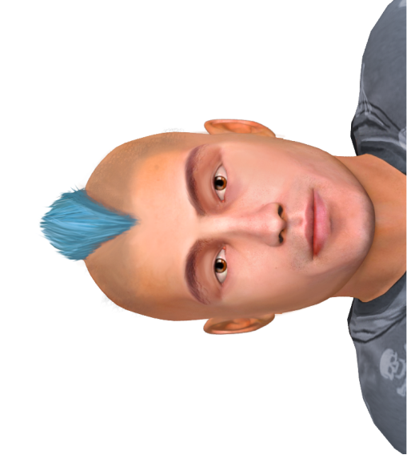
Help students excel when they arrive and avoid common first-semester pitfalls.
Give them an understanding of the primary mechanics of college.
Allow them to experience common problems they may face, and show then which campus services can help them solve those problems
Help them to feel comfortable with our campus
Notes:
The primary, overarching goal of broncoland is to prepare them the excel when they arrive, so that they are more likely to stay and complete their degree.
Like a game, college can be broken down into a set of mechanics, or actions which a student must take in order to complete their degree. Our game is designed aroudn these mechanics in order to give them an understading of how to succeed at the game of college.
There are some who will succeed, some who will fail, and many in the middle.
Common pitfalls and

Slide 5

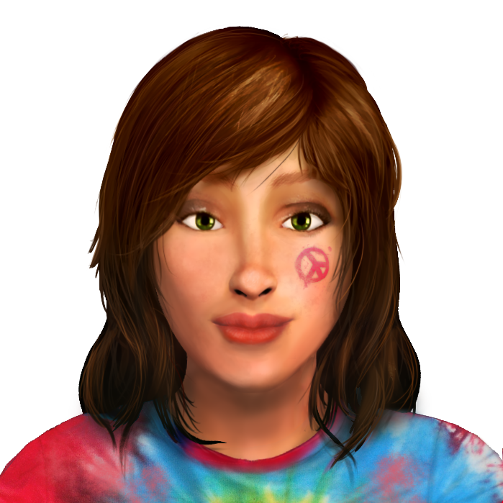
Information Technology
Academic Affairs
Admissions
First Year Experience

Slide 6

Studio A
  Existing Equipment from Grant
  Place to Work
Digital Media Courses
Studio Internship

Slide 7
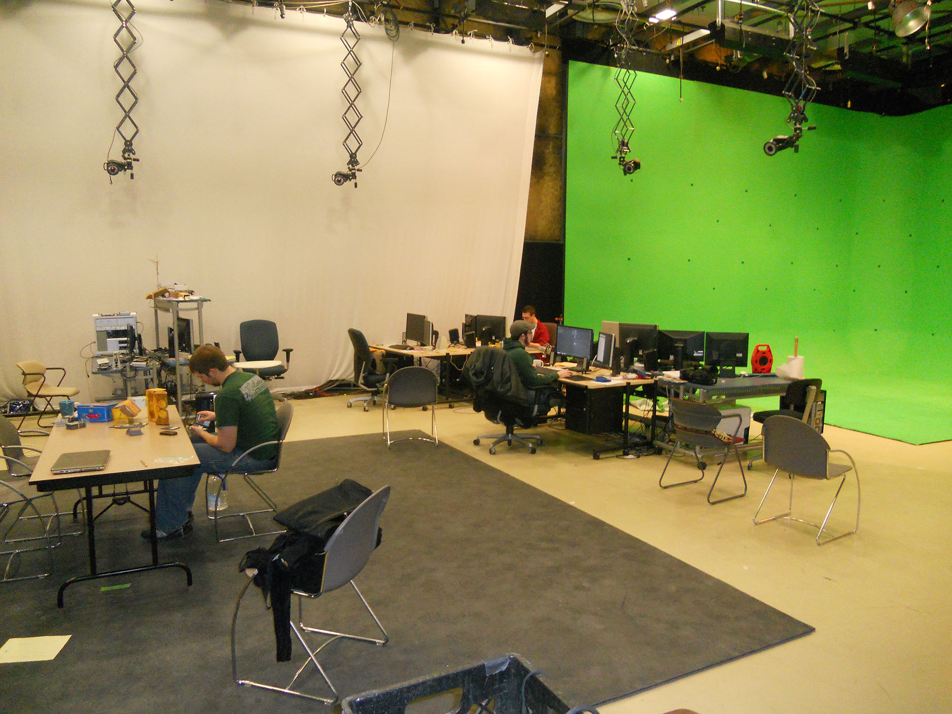

Slide 8

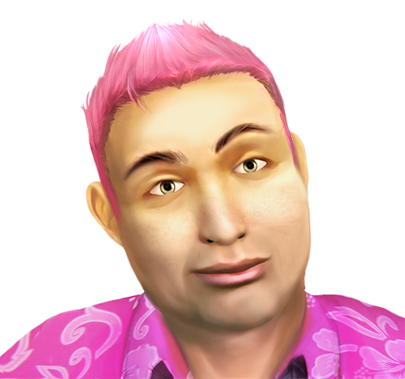
No digital media program in place
Real project experience
Another positive marketing piece
Notes:
Approachable
Flexible Delivery
Character Models
Character Animation

Slide 9


Unity 3D Game Engine
  Approachable Workflow
  Web, Desktop and Mobile Delivery
3DS Max
Adobe Photoshop
www.unity3d.com
Notes:
Approachable
Flexible Delivery
Character Models
Character Animation

Slide 10


Limitations of Student Staffing
  Limited Hours
  Limited Experience
Many jobs to do
  Programming, Art
  Visual Design, Game Design
  Interface Design
  Audio, Writing
  Web Development
Notes:
Students –
Inexperienced
Limited Hours
They Graduate!
Overall Inexperience
Too Many Hats
Project Director, Designer, Programmer

Slide 11

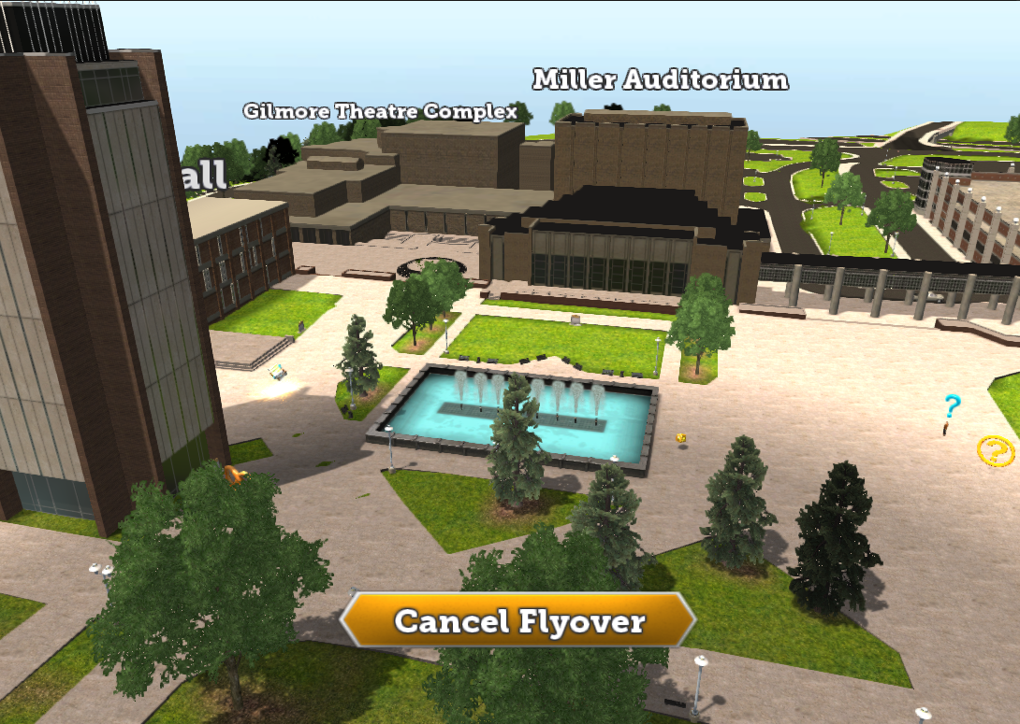
50+ Buildings
Roads
Sidewalks
Terrain
Props
3 External Campuses
Notes:
Difficult Decision to go with 3D
Wanted to create something with a longer life
Wanted to give students to the experience of “being there” in the hopes of creating a sense of familiarity.
Lots of work – XX Buildings
Changes midstream – Western View, Sangern, Res Halls

Slide 12
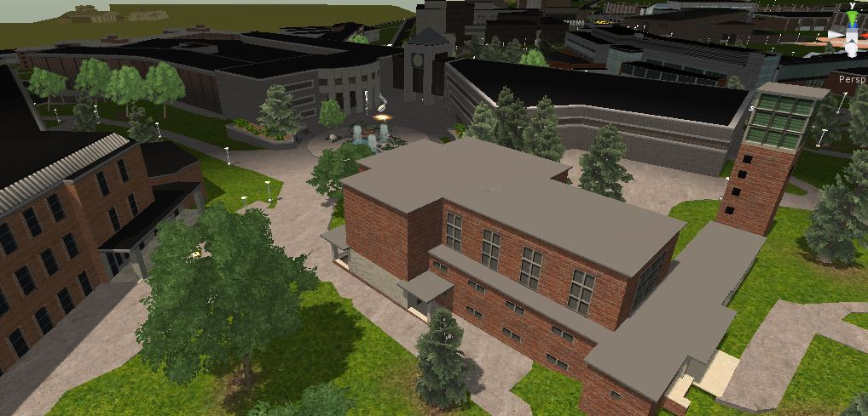
Notes:
Difficult Decision to go with 3D
Wanted to create something with a longer life
Wanted to give students to the experience of “being there” in the hopes of creating a sense of familiarity.
Lots of work – XX Buildings
Changes midstream – Western View, Sangern, Res Halls

Slide 13
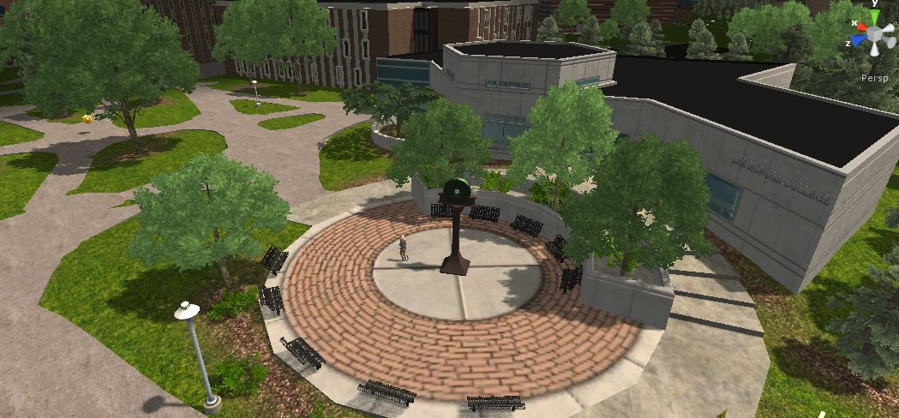
Notes:
Difficult Decision to go with 3D
Wanted to create something with a longer life
Wanted to give students to the experience of “being there” in the hopes of creating a sense of familiarity.
Lots of work – XX Buildings
Changes midstream – Western View, Sangern, Res Halls

Slide 14
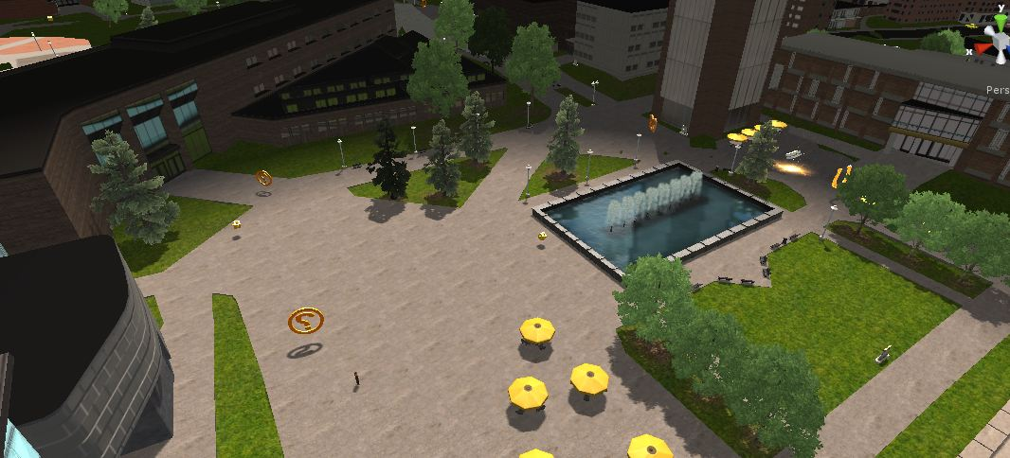
Notes:
Difficult Decision to go with 3D
Wanted to create something with a longer life
Wanted to give students to the experience of “being there” in the hopes of creating a sense of familiarity.
Lots of work – XX Buildings
Changes midstream – Western View, Sangern, Res Halls

Slide 15

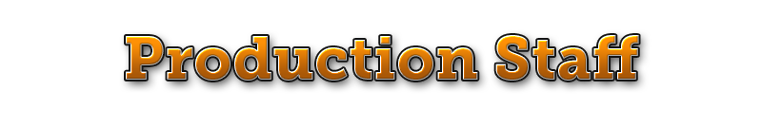
Director/Designer/Programmer
Art Director
5-8 Students

Slide 16

20-minute Experience
Clickable Buildings
Collect 15 Golden Horseshoes
Collect 50 Bronco Blocks
Web and Desktop Delivery
1,000 Visitors/Month

Slide 17


Time & Movement
Linear & Open World
Avoiding Arbitrary Gameplay
Creating an overarching experience while also providing specific details.
Scoring System
Notes:
College has a unique blend of time-specific requirements (classes and events) and at-will requirements (homework).
How to chunk the time
1:1 Experience would fail
A delicate balance.
Ideas that failed
Integrating with Michigan HS Online Course Requirements
The decision to go 3D
Tour as Precursor to the Game

Slide 18

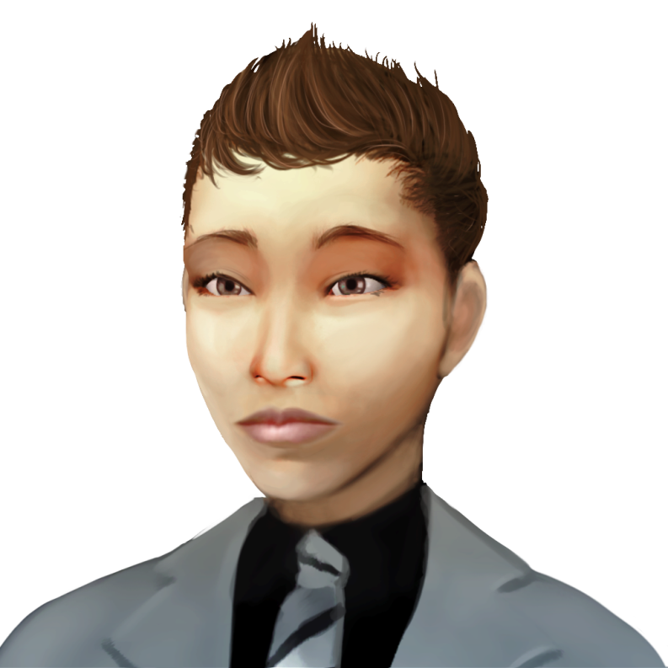
10 Week Semester
Attend Classes
Complete Homework
Make Friends
Attend Events
Eat and Workout
Level Up - Social and Spirit

Slide 19


The key to testing is...free food
Positive Results
  Open World Style
  Discovery of Groups & Services
  Consequences
Notes:
Non-player characters move around on their own.
Update Broncoland Tour
Additional Voice-Over Recording & Sound Effects
Merge Tour and Game into single downloadable
Save Games

Slide 20


Orientation Release (June 2013)
Integration with First Year Seminar
New & Improved Features
  Badge System
  Character Attributes
Notes:
Non-player characters move around on their own.
Update Broncoland Tour
Additional Voice-Over Recording & Sound Effects
Merge Tour and Game into single downloadable
Save Games

Slide 21

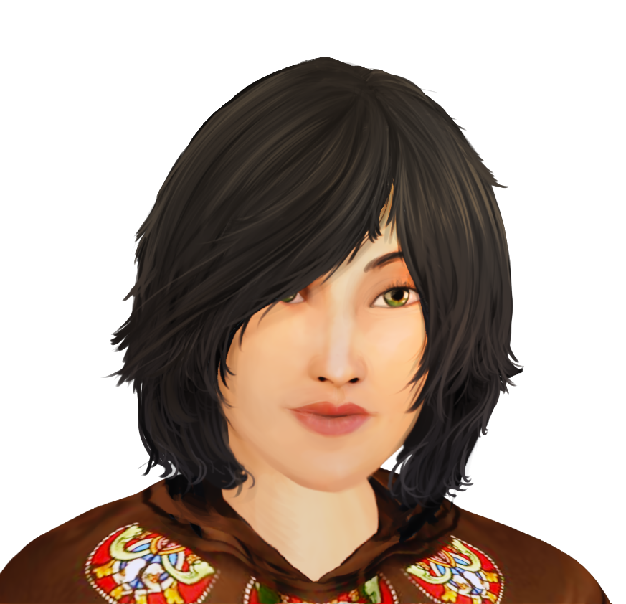
Staffing
  Lead Programmer
  Art Director
  Lead Designer
Game/Media Program
Production Facility
Notes:
Non-player characters move around on their own.
Update Broncoland Tour
Additional Voice-Over Recording & Sound Effects
Merge Tour and Game into single downloadable
Save Games

Slide 22

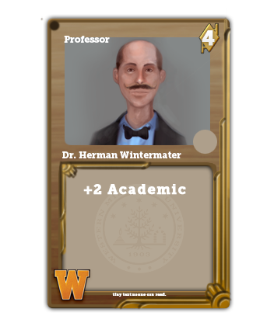
Use actual student schedules
Create a more populated & active campus
Interactive 3D Dorm Room
Mobile Version
Card Game

Slide 23

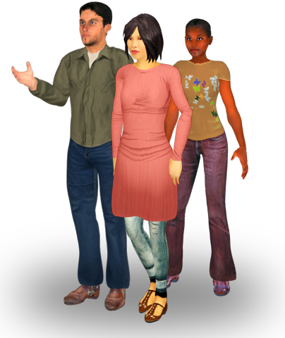
kevin.abbott@wmich.edu
www.wmich.edu/broncoland

Slide 24
kevin.abbott@wmich.edu
www.wmich.edu/broncoland

