Slide 1
Macro Analytics: Getting in the Game
Martin Klubeck & Donald Padgett
University of Notre Dame
March 19th, 2013
Notes:
Good morning!
An old pro at presentations always recommended that you start briefings with an activity or introduction to get everyone relaxed and in the mood…

Slide 2

Notes:
Yup. Good, now that we did that,…

Slide 3

Macro Analytics – A definition
Targets
Expectations
Notes:
Another pro suggested that you tell them what you’re going to tell them, tell them, and then tell them what you told them.
Here’s what we’re going to tell you today.

Slide 4
Macro Analytics:
A Common Language
What it is…
The Leader’s Point of View

Slide 5

Branches
Measures
Leaves
Limbs
Data
Information
Trunk
Metric
Roots
The Question

Slide 6


Micro
vs. Macro

Slide 7


Notes:
As a leader we suggest you look at your metrics from a Macro Analytical view point. This in part means looking at the forest, not the trees…and definitely not a the weed level. You have to look at it from the 10,000 foot level, better would be the 30,000 level

Slide 8
Targets
Notes:
The KEY problem is if we’re setting Targets, by definition, we’re chasing data. We are looking at a measure and instead of using it to inform, we’re using it to create a goal or a criteria success.

Slide 9


Notes:
Targets are NOT a good tool for Motivating or inspiring the workforce
There are unintended consequences

Slide 10


TARGETS
Notes:
Management views it as motivating, the worker views it as blatant manipulation – Jumping through hoops

Slide 11


The Bottom Line:
No more targets
Especially moving targets
Chase Data
Too low level – at the Measure level
Incomplete story – Turns Indicators into Goals
Can win the battle but lose the war
Notes:
No more Targets. No more Stretch Goals! NO MORE MOVING Targets!
Targets create an Us vs. Them. Ranges moves us to WE instead of Me, and Ours instead of Mine.

Slide 12
Expectations
Notes:
Based on overall (Macro level) performance – not moving the needle. We don’t set expectations…Expectations are determined by the current performance and the data. It’s the “norm.” How well do we perform currently, given the current environment, the current tools, resources, knowledge and abilities of our staff?

Slide 13


Notes:
We’re NOT talking about these types of expectations…

Slide 14

Notes:
Or even these types of expectations…
Assumptions vs. Expectations
Unlike leader expectations which are bases on process analytics assumptions tend to be narrow in focus and lack supporting documentation.

Slide 15
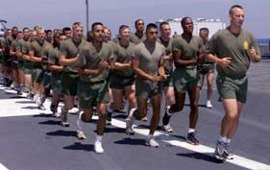

EXPECTATIONS
Meeting Expectations is Success
Why a Range?
Notes:
True expectations – if don’t have expectations, determine what the norm is. The data normally will tell you.
Without a range, you only have good and bad. Or the equivalent of a target or goal. By using a range, you can determine if you fail to meet, meet, or exceed expectations. Even when it seems to be a “go-no-go” situation, like being open 24 hours, there are expectations of what that means…is it full service at all hours? Is it a drive-through only? If you succeed in being open 24 hours, 95% of the time, does that meet expectations.
A range gives the managers something to lead with vs. something to shoot at.
From the employee viewpoint, it makes the metrics non-threatening because it is not a tool for motivating which also means it’s not a tool for judging.

Slide 16
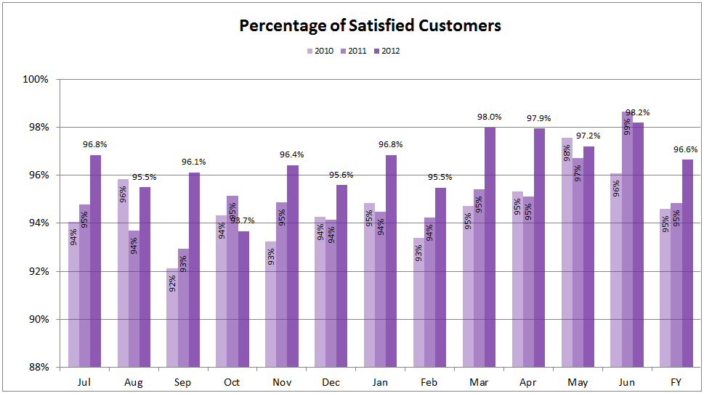
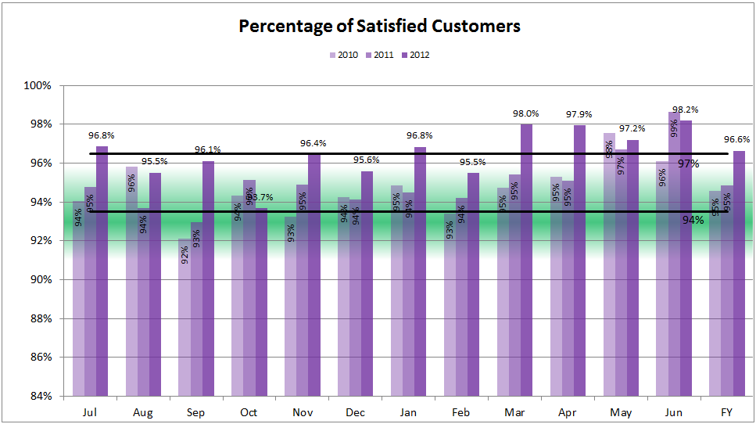
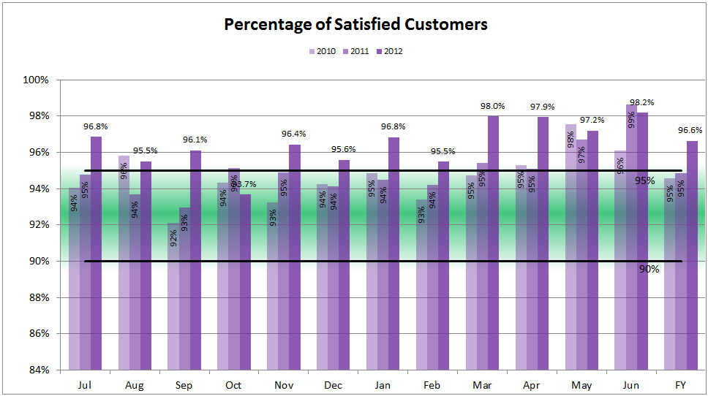
What is this telling us?

Slide 17
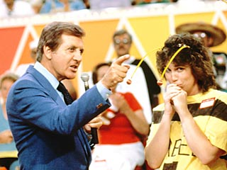

Notes:
This isn’t the game we had in mind.
While Targets often come across like this - proper utilization of expectations greatly reduces the risk for leaders, managers and staff.

Slide 18
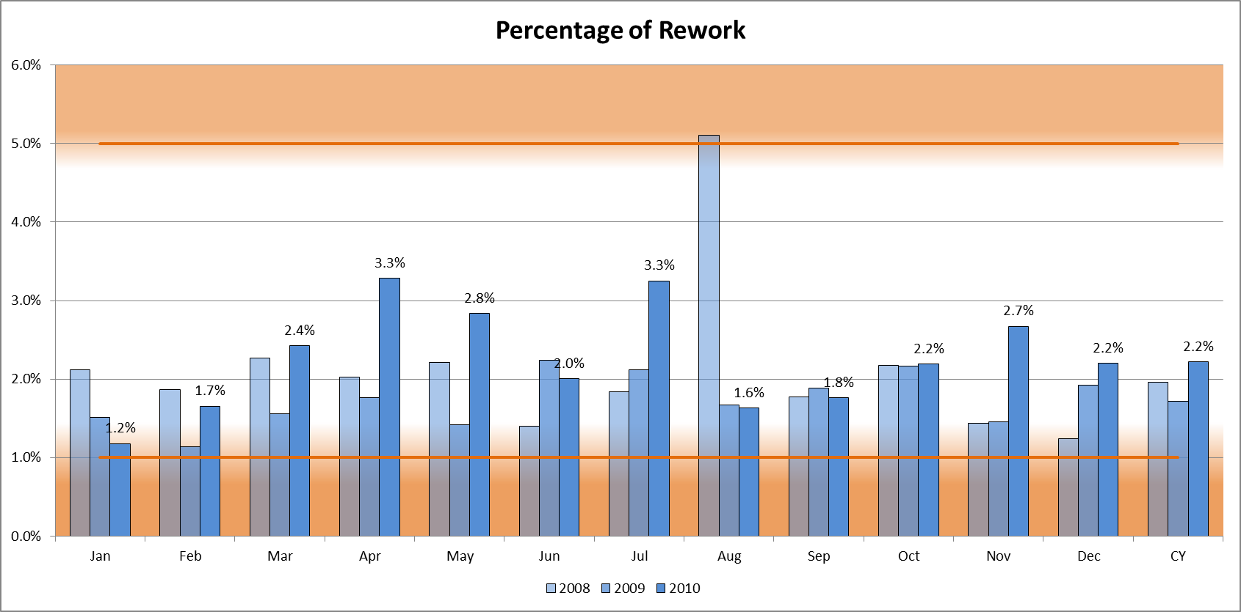
Below Expectations
Exceeding Expectations
Notes:
Industry standards may depict a different set of expectations then your data…and that’s ok

Slide 19
Macro Analytics – A definition
Targets
Expectations
Notes:
Just as few see any benefit in Micro Management we hope everyone can now see the benefits Macro Analytics offers leaders at all levels though out your organizations.
Targets limit vision, buy in and flexibility - there is a better way
Expectations allow leaders to focus on the big picture, promotes teamwork while avoiding Micro level related activities.

Slide 20

Questions?

Slide 21
Suggested References

Slide 22
SUGGESTED REFERENCES
Online References
LinkedIn.com Groups
IT Metrics – CEITPS
Metrics: Analytics, Data, and Metrics….oh my!
thepalladiumgroup.com
Search on “Metrics”
Twitter (I tweet occasionally)
Dilbert Cartoons

Slide 23
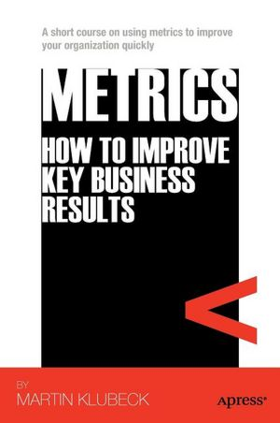
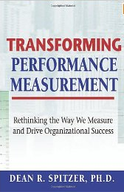
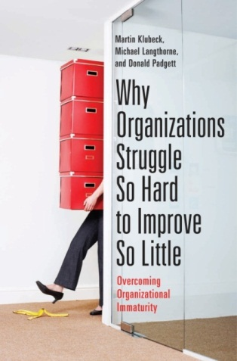
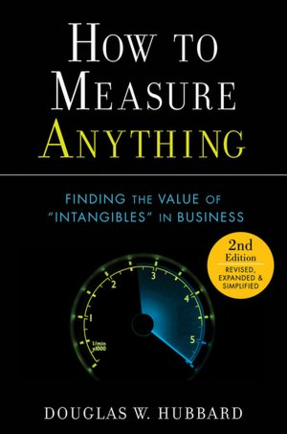
SUGGESTED REFERENCES
Print Matter
Metrics: How to Improve Key Business Results
Transformational Measures
Why Organizations Struggle So Hard to Improve So Little
How to Measure Anything

Slide 24

Contact us
Don Padgett dpadgett@nd.edu
Martin Klubeck mklubeck@nd.edu

