Slide 1

Incorporating Data-Driven Decision-Making into Application Design
Kim Griffin, Sr. BI Analyst
Lauren Zajac, Director of Pre and Post-Award Administration, Department of Medicine
The University of Chicago

Slide 2
Overview
The University of Chicago implemented an automated research administration system in late June 2011
A team of 3 from the BIS group designed and built a reporting environment that went live just 2 weeks later
Today we’ll share our experiences of working with end users such as Lauren Zajac from the Department of Medicine during the design phase to look ahead to incorporate data-driven decision needs into our design

Slide 3

Background
The University of Chicago
  5,300+ undergraduates
  10,000+ graduate/professional students
  2,200+ faculty and academic
  personnel
  FY2012: 2,200 proposals ♦ $1.7 Billion
  FY2012: 1800 awards ♦ $488M
  FY2012: expenditures ♦ $435M
Notes:
6% increase in awards from FY11
Medicine: proposals 547, $410M
Medicine: award $112M

Slide 4

Background
AURA, the new electronic research admin system
  Includes a companion data warehouse and reporting environment
  More than a dozen pre-built reports, along with an ad hoc query building tool
Notes:
AURA = automating university-wide RA

Slide 5
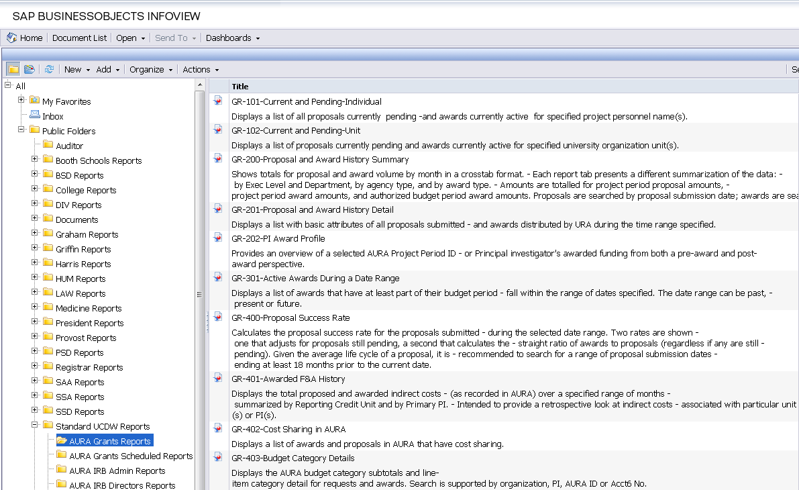
Reporting Environment

Slide 6
Design
  The data warehouse and app design teams worked closely with users to incorporate requirements for data-driven decision-making
    Review your plans for the BI environment
    Involve resources for answering questions on business rules
    Help conceptualize life after the new system
    Data warehouse team should attend application design sessions, in addition to holding their own specific to the data warehouse
  Working in partnership up front made downstream so much easier
    Concurrent with DW sometimes slowed down meetings but
    Very few times have had to go back to tech team to make changes related to data

Slide 7
Design
  Data Fairies do not Exist!
  Have to be wary of data integrity
    Minimize amount of data created ad hoc
    Want people who own the data to create it (for example, in this application, the units create title, not the central office)
  Be mindful of whether data elements will push to data warehouse, and take extra special care of those, particularly when making changes from original design
  Data conversion
    Pay attention to what you’re NOT converting, as much as what you are
  If you want to report on it, you have to capture it in the system! For example, to calculate turnaround time for handling clinical trial contracts, we worked with application team to store milestone dates
Notes:
Also with change management include BIS in change design to incorporate those enhancements in the ETLDW

Slide 8
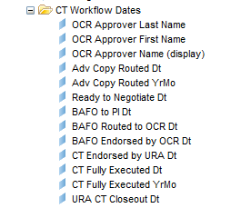
Design
One requirement was to track turnaround time for certain workflows, such as clinical trials
We worked with users from the central office and the end units to develop a milestone timeline to support this need
The application stores the dates, and they are included in the ad-hoc environment
Notes:
Will some questions elicit multiple responses where you had expected a single data point? If so -> your developer may need to add a bridge table to your data model to accommodate this
Cross-reference your reporting requirements with the specs -> are all of the data elements you need being captured in the system?

Slide 9
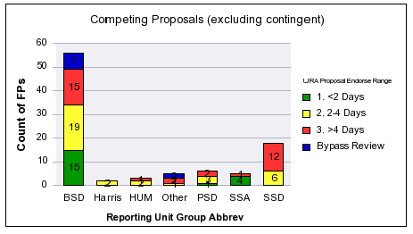
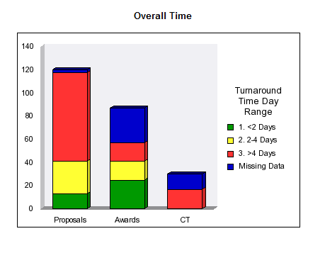
Turnaround Time Metrics

Slide 10
The Department of Medicine Perspective
The “user” experience
  DOM is the largest department in the University, coordinating approximately
    80% of the Clinical Trials for the University
    547 proposals 547, totaling $410M last fiscal year
    $112M in awards last fiscal year
Or…You want to replace my Shadow System??

Slide 11
The Department of Medicine Perspective
In 2005 we worked with our in-house programming team to develop a web-based front-end, SQL back-end database to track our grants and contracts information
It wasn’t the most beautiful system (MAUVE??) but it allowed us to easily locate and edit records for our large portfolio.

Slide 12
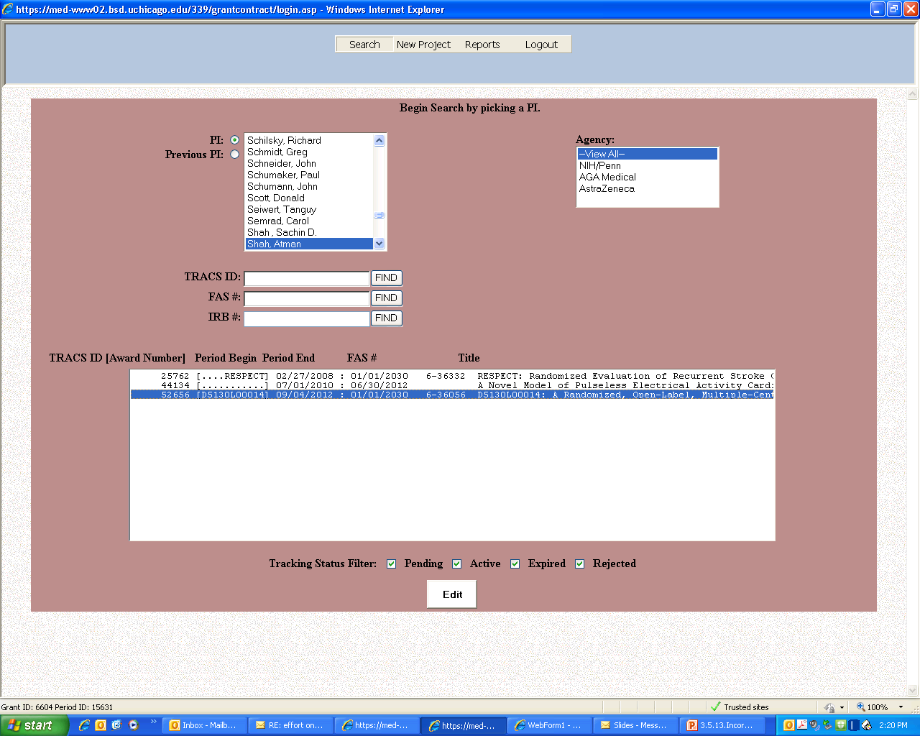

Slide 13
The Department of Medicine Perspective
The system was also designed to provide a series of reports, that were
  very easy to run
  provide proposal and award information
  By section/subunit of the Department or by Principal Investigator
  At a variety of time points (Monthly, Quarterly, Annually)
We also linked in financial data to demonstrate the earnings for some of our milestone-based contracts/clinical trials

Slide 14
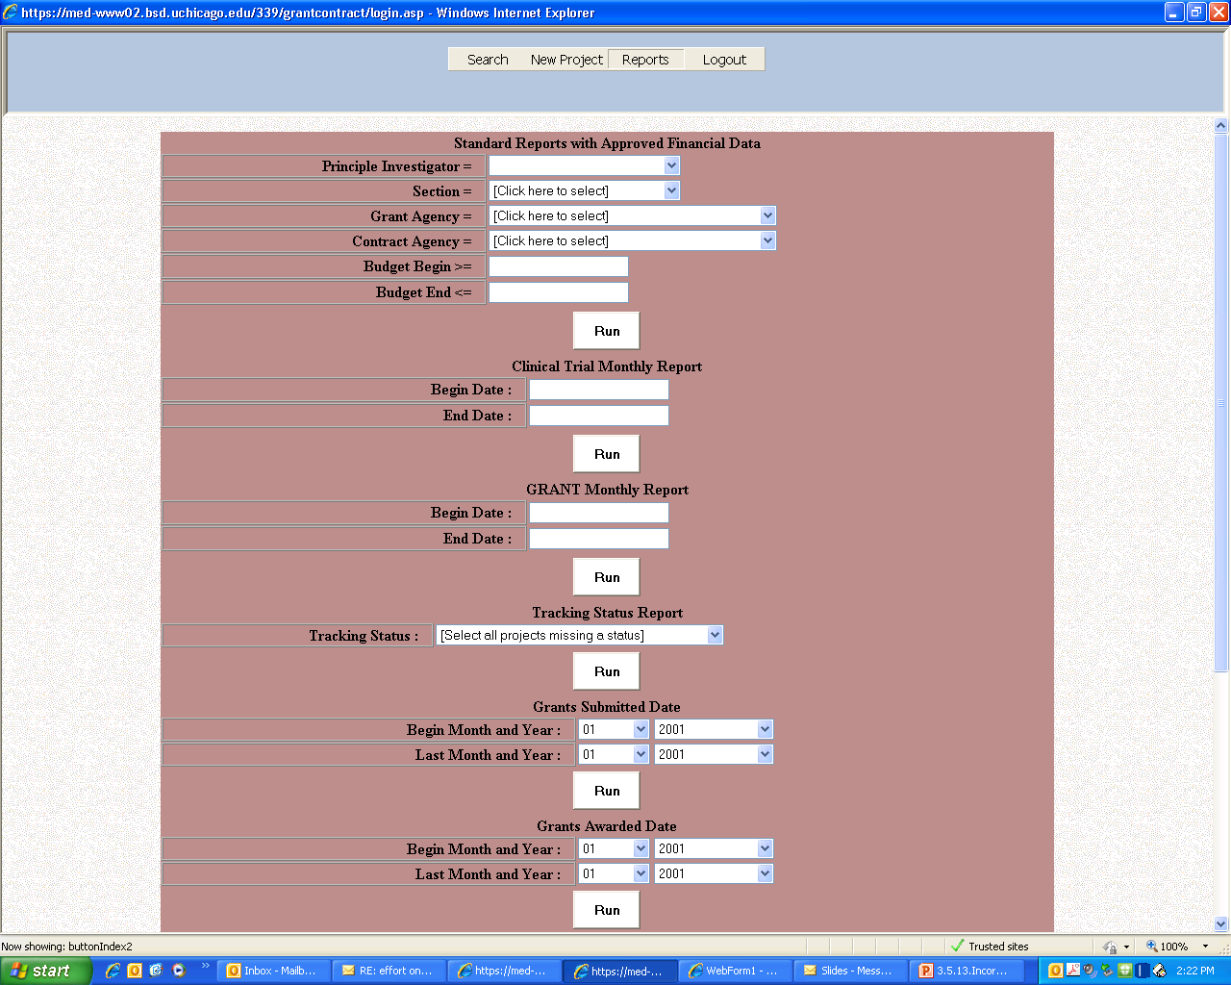

Slide 15
The Department of Medicine Perspective
Yes we loved our shadow system, but we had some limitations:
  static database, and it was only available within our Department
  lacked security-anyone who has access can not only see everything-they can also edit everything!
  unavailable to assist with System-to-System submissions (Dreaded Double Data Entry)
  So…we were ready to help participate in the AURA design sessions

Slide 16
The Department of Medicine Perspective

Slide 17
Reporting Environment

Slide 18
The Department of Medicine Perspective
Our goal-to surpass the reporting needs available in our shadow system (while taking advantage of the new functionality available in AURA)
We were active participants in all phases of the design sessions, and are very happy with all of the reporting capabilities of AURA.
We now use our shadow system only as a way to “audit” the AURA reports.

Slide 19
The Department of Medicine Perspective
Helpful Reports
  GR-101 Current and Pending Individual:
    Displays a list of all proposals currently pending and awards currently active for specified project personnel name(s).
    We not only use this on a regular basis to “audit” our Agency-required Other Support pages, we also use this to ensure that all records are closed or transferred when we have a faculty member leave the U of C
  GR-102 Current and Pending Unit
    Displays a list of proposals currently pending and awards currently active for specified university organization unit
    We run this report for the Section administrators to keep them informed of the activity for their area.

Slide 20
The Department of Medicine Perspective
Helpful Reports (con’t)
  GR-201
    Displays a list with basic attributes of all proposals submitted and awards distributed by URA during the time range specified
    This report is critical for the compilation of data for our annual report, as we are able to segregate the data by fiscal year
  GR-400 Proposal Success Rate:
    Calculates the proposal success rate for the proposals submitted during the selected date range. Displays the success rate by number of awards, and by amount of awards. Given the average life cycle of a proposal, it is recommended to search for a range of proposal submission dates ending at least 18 months prior to the current date

Slide 21
The Department of Medicine Perspective
Helpful Reports (con’t)
  GR-901 Weekly Awards Distributed
    Displays a list of awards distributed in the prior week, and a list of awards still in process
    This is a weekly feed that is sent to a number of recipients
    This report is critical as we not only use it to measure that awards are processed in a timely fashion, but also to ensure that Principal Investigators get “credit” on our intranet for new awards.

