Slide 1
Building a Professional Media Services Support Team
Copyright Scott Tiner, 2009. This work is the intellectual property of the author. Permission is granted for this material to be shared for non-commercial, educational purposes, provided that this copyright statement appears on the reproduced materials and notice is given that the copying is by permission of the author. To disseminate otherwise or to republish requires written permission from the author.
Notes:
Evolution of A/V over the past seven years. How our institutions needs to adjust to these changes.

Slide 2
Scott Tiner
Manager of Digital Media and Event Support
  Classroom Installation, Design and Support
  Event Support
  Video Pre-Production
  Video Production
  Video Post-Production

Slide 3
Bates College
Lewiston, Maine
    Liberal Arts
    ~1,700 Enrolled Students
    50 A/V Equipped Classrooms on Campus
    62 Spaces on Campus with installed Technology

Slide 4
Who Are You?
Technology Managers and other direct support professionals
Director Level
CIO Level
How many feel they have a really good understanding of the AV operations at their school?
Equivalent to the understanding of IT.
Notes:
A/V Operations: how many events are supported? How much time does each event take? How many events are recorded? How many classroom trouble calls? What is procedure to respond to a trouble call? How much does a typical installation cost? 5 out of 6

Slide 5
Themes
How A/V has evolved.
  Has your staffing evolved?
  Have your policies evolved?
Are your staff members A/V professionals?
Do you give your staff training opportunities?
Do you recognize how much A/V has changed?
Value of A/V in today’s higher ed institution?

Slide 6
Changes in A/V
Compare this to IT from 1994-2000.
  Reality of laptops, networks, internet, e-mail, etc. became a crucial component of higher education institutions.
  Are the same people who were fixing computers in 1994 running your network in 2000?
Notes:
If those same people are, how did they make that transition? What support was provided? Assume they were trained, because institutions recognized the value of the position and skills that were needed. I think we recognize the value of A/V, we just don’t know much about the industry

Slide 7
A/V 2002-2009
2002
  TV/VCR (DVD was only 4 yrs old, VHS still king of rented movies)
  Slide Projectors
  Overhead projectors
2009
LCD Projector, Plasma TV, Document Cameras
Video-conferencing
Digital Signage
Video Streaming
Blu-Ray and Digital Video Technologies
Class Capture
In-class response

Slide 8
A/V in 2002
Think about your organization in 2002
  Who was in Media Services?
  How many rooms did they support?
    How much technology was in those rooms?
  What qualifications did they have for the job?
  How did they get the jobs?

Slide 9
Bates in 2002
We
  video taped every request that was made.
  supported every event that went on at the College.
  hired out every installation.
  hired out most classroom support.
  moved a LOT of equipment around.
  managed the equipment loaner pool.
4 full time staff members. No specialties, everyone did everything.
Positions were considered the least skilled positions in Information& Library Services.
Notes:
DON’T READ WHAT WE DID, THAT IS NEXT

Slide 10
It worked..
We covered events.
  But we were never proud of the events.
We supported classrooms.
  But a broken dvd player or lcd projector, could be out of use for several days.
We outsourced new installations
  And it cost A LOT of money.
We recorded many events
  But often nothing was done with the end product
We could tell people how to edit video
  But we could not provide equipment or services.
Notes:
Paying premiums to get outside support in after hours,
Staff member covered in vhs tapes

Slide 11
Change comes slowly
Staffing
  We were fortunate to have some staff turn over and hired some really great people. I can’t diminish the value of good staff members.
  Kristen Carey
  Bryan Gould
  Colin Kelley

Slide 12
Change comes slowly
Lessons Learned
  14 Classrooms Equipped with installations in 2002.
    Were growing at a rate of 3 rooms per year.
  With the increase in classrooms installations, there was an increase in problems.
  As the technology spread, use became more widespread and expected. Therefore, the technology needed to be reliable.
  We realized we needed staff who could support these rooms, rather than just call in trouble calls to a vendor.
Notes:
As there was more technology around the campus more faculty begin relying on in it their courses. The more they relied on it, the more important it became to get problems fixed quickly. In 2002, there were not many faculty who used the technology every single day, and would be out of business if it did not work. So, the idea of waiting for a company to come fix the problem made sense. Today, that is not the case. Many faculty use the equipment every day and could not teach their class without it. They understand that sometimes things break and they may be without for a single class, but they expect it to be fixed by the next session.

Slide 13
Change comes slowly
Our model had to change from one of carrying a projector and laptop to a classroom and setting it up, to one of technician to fix installed spaces.
  This required a different (more advanced) set of skills.
Resources:
  Crestron Training, A+ program
  Extron School of Technologies
  ICIA Online Training and in-class training
Notes:
The resources here are not just random resources, these are resources that we took advantage of in order to meet our goals.

Slide 14
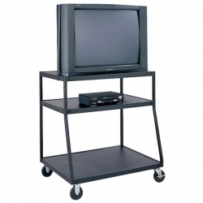
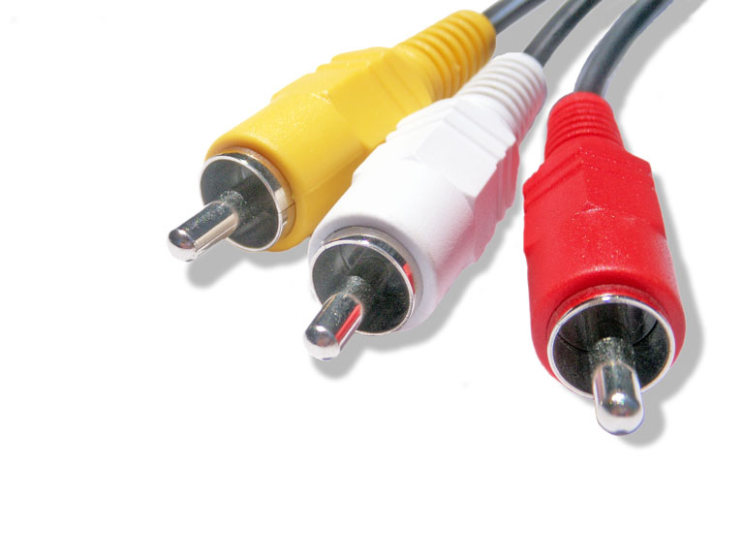
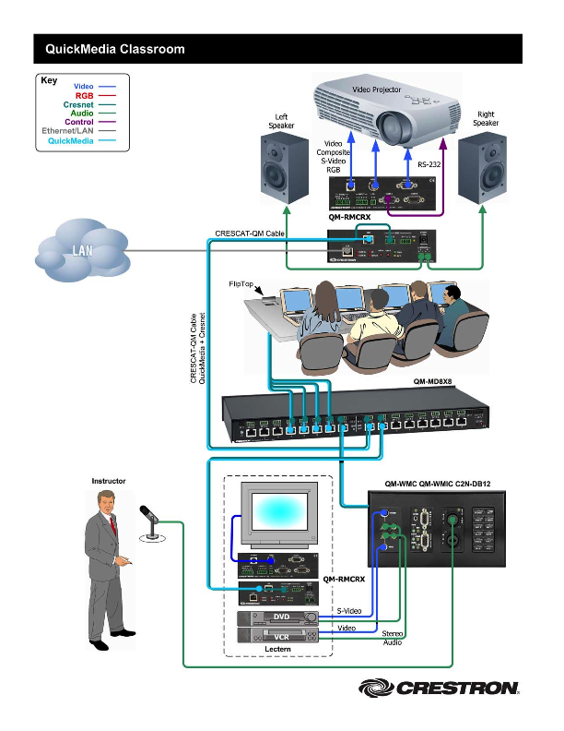
Notes:
Yellow to yellow, white to white, red to red, problem fixed!

Slide 15
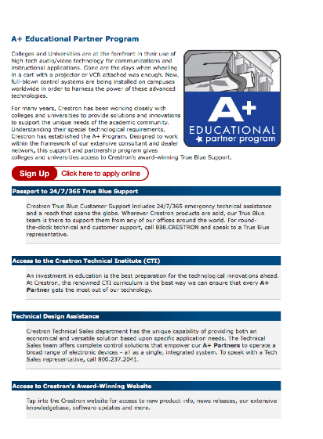
Crestron
A+ Program
  Personal contact with representative
  Design Help
  MSRP
Notes:
Point out the resources shown on the webpage

Slide 16
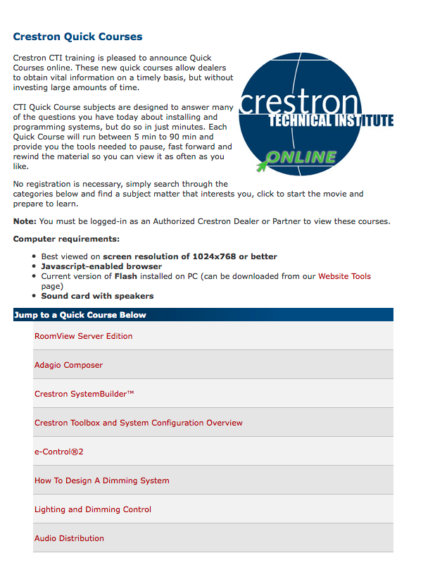
Crestron
A+ Program
Online Courses

Slide 17
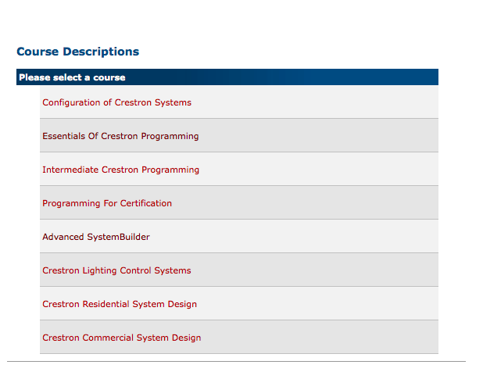
Crestron
A+ Program
Online Courses
On-site courses
  Certification
Notes:
Courses are not very expensive. you pay for travel and lodging and crestron takes care of the rest

Slide 18
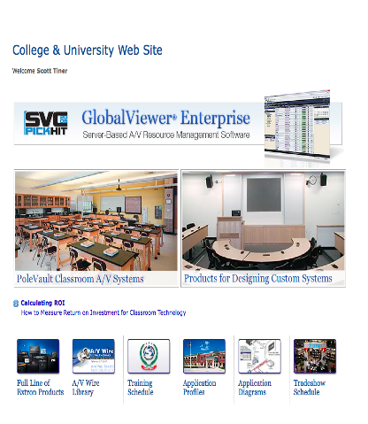
Extron
Web Site
  Setup Account
  MSRP

Slide 19
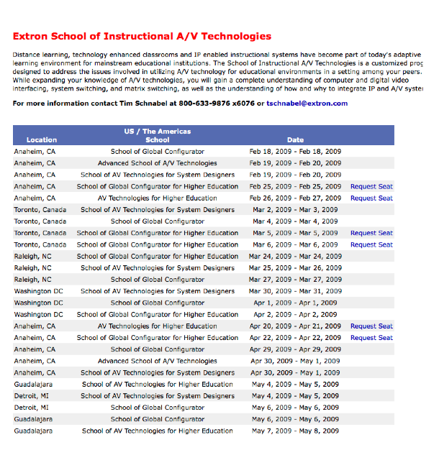
Extron
Web Site
  Setup Account
  MSRP
Training
  certification
Notes:
Also has a certification program

Slide 20
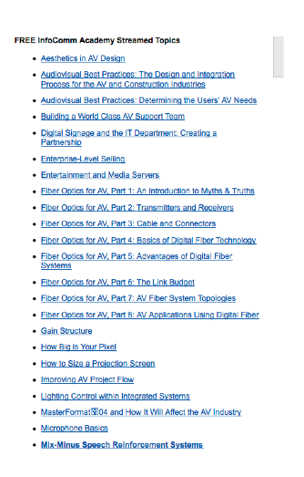
ICIA
Online Training
  Streaming video
    This is only half the list

Slide 21
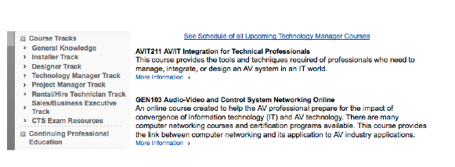
ICIA
Online Training
  Streaming video
    This is only half the list
Numerous Online and on-site courses

Slide 22
Second Lesson
As prices of technology continued to drop, the pace of installations picked up.
Typical classroom installations were costing about as much in installation and programming as they were in equipment.
We realized we had in-house staff with enough technical knowledge to perform installations.
Notes:
START
So, after the training, we were able to fix problems on our own. If a projector died, we could take it down,put a new one up, change any of the connectors, and re-program the system. This saved time and money! Most importantly, it got the room up and running again quickly.
We gave in-house installs a lot of thought before we did them. We wanted to be sure they were professional installs, not hack jobs. We only did one at a time for the first few tries, to be sure we knew what we were doing.

Slide 23
We should not do this
Videotaping Events
  2004 – 70 requests for events to be videotaped.
      Calculates to 2.5 event per week.
      Average of 2 hours per event.
      80% of them on “off-time”, nights and weekends.
Some events were clearly important:
  Inauguration of new President
  Commencement
Others were questionable
  Record a class for an athlete who was out
  Record a student presentation so that they could send it home to their parents.
Notes:
FIRST:
In-house installs quickly became a very clear value to the college. We started to think about the things we were doing in which the value was not so clear, while taking time away from something of clear value.
WHEN SLIDE IS DONE
While I hate to judge the value of any request, sometimes we have to. If we are spending our time recording some of these events, rather than supporting classrooms or faculty and students in our DMC, are we providing the best value to the college.

Slide 24
We should not do this
What we began to notice
  VHS tapes piled up around us.
      We had videotaped events, that people did not event want.
  Higher quality was needed in some cases.
    Our Media Relations group wanted to use some of the video for promotional purposes.
    Certain academic departments wanted to use snippets of guest lectures for academic use.
    These requests required higher quality, digital recording. Of course, that means more time.
Notes:
These issues really drove the point home.

Slide 25
Staging
Types of Events we would setup for:
  Sound in a field house, at a dinner for 400-600.
  Video presentations in a concert hall with no installed A/V equipment.
Large amounts of time:
  Typical setup and tear down requires at least 2 hours before and 2 hours after event. Add in the actual event and we had a full day of work dedicated to a 20 minute speech with 10 PowerPoint slides.
Notes:
Again, this is an issue of not wanting to judge the events, I know they are important to the convener, but we have to ask what is the opportunity cost of each of these events.

Slide 26
Staging
Equipment
  We did not have the proper equipment to serve all these events, but we did not educate people about that.
    Result: 400 people in a field house watching a video on a 9x12 rear projection screen, with a 2000 Lumen projector. In other words, a very bad experience.
  We never had backup equipment. If something broke, it was done. The event failed and all the invested time wasted.
Reputation
  The reputation of the group suffered due to events. It was our most public face, and if we could not get that right, how could we do anything else right?

Slide 27
Final Lessons
If you can not do it right, don’t do it!
The Conversation
  “The A/V this weekend was the best we have ever had. Everything looked and sounded great.”
First Reaction: “Oh Great.”
Second Reaction: “Of Course!”
Notes:
Not trained
Do it four times per year
Did not have the right equipment
For us, this sealed the deal, we were going to outsource these events in the future
As noted, Bates is pretty small and does not have a whole lot of these events. It may be that in your institution it makes sense to do these events in-house. I just stress to make sure you have the correct staffing and equipment to do it.

Slide 28
Final Lessons
Do those things which can not, or should not, be outsourced, and do them well.
  Classroom Installation
  Classroom Support
  Video Editing Support
    1.5 FTE’s assigned to video editing
    Trained in Pro application
      Final Cut Pro
      DVD Studio Pro
      Flash CS3
      Working on Apple Certification

Slide 29
Outsource the rest
Ask about the value of service you are providing to the college. Compare that with the real cost of the service. Include what you are not doing because you are providing that service.
  Our example:
    After one year of outsourcing video recording requests we spent $15,000 to record about 34 events. This equals about one event per week.
    After one year of outsourcing event support, we spent about $14,000 on 15 events. This equals about one every other week.
    Total of ~$29,000 spent on outsourcing. We could not have hired a full time staff member to do this.
    This summer we installed 6 classrooms with full installations, at a cost of $15,000, for a total of $90,000.
    We estimate this would have cost $22,000 per room if we outsourced it, for a total of $132,000.
    Saving $42,000, or almost 3 full rooms!

Slide 30
In 2008
Organize like an A/V Company
People should have specific defined roles. Understanding what others do is important but being a jack of all trades, does not provide a lot of value.
So, like an A/V company, we have the following divisions:
  Design
  Install
  Technical Support
  Staging
  Post Production

Slide 31
It works..
We support events.
  We arrange for outsourcing of any event in a space without installed technology, and they turn out great.
We support classrooms.
  Most fixes are done within a day.
We do 90% of new installations in house
  And it saves A LOT of money, and provides a strong foundation for future repairs.
We record all events
  And it is all done via outside vendors
We teach people how to edit video
  And we have developed some remarkable projects.

Slide 32
Resources
ICIA – InfoComm International
  THE premier A/V professional’s trade group
    Online Training
    Onsite Training
    Annual Conference ( You HAVE to go to this).
      Training courses at the session
Certification
  ANSI certified
  -D and –I
Online Community

Slide 33
Resources
EduComm
  www.educommconference.com
    Links to recorded sessions from previous years
The annual conference happens at the same time as InfoComm.
Fantastic opportunity to meet colleagues from around the country.
Notes:
Important because Technology Managers are not the best at getting out and meeting and sharing with our colleagues.

Slide 34
Resources
rAVe newsletters
www.kayyerave.com
  rAVe Ed
  rAVe Pro
  rAVe Digital Signage
  rAVe Home
  rAVe rental and Staging
Notice that rAVe recognize the differences between each of these specialties.

Slide 35
Expectations of staff
Certification
  Puts your staff on the same level as consultants, sales people and installers.
Education - Programming
  Allows your staff to fix problems in house. At least it allows them know what is possible, as opposed to being told what is possible.
Provide you with data
  How many events were supported?
  What is the real cost of these events?
  How much money was spent on room installs.
Have the ability to talk with faculty about how they use the classrooms, and design rooms to fit those needs.

Slide 36
Where we are now
Installing 7-8 rooms per year, in-house.
Our own technician who is Crestron trained and working on certification.
RoomView support
DMC – editing lab, editing suites, viewing room
Notes:
Talk about RoomView support:
-online help page from the touchpanel
Two way communication with the touchpanel
control of TP from RoomView
online status of projectors for security and repair
Troubleshooting tips on the TP
Support of DMC is not subject to running out to support a classroom or setup a staged event.

Slide 37
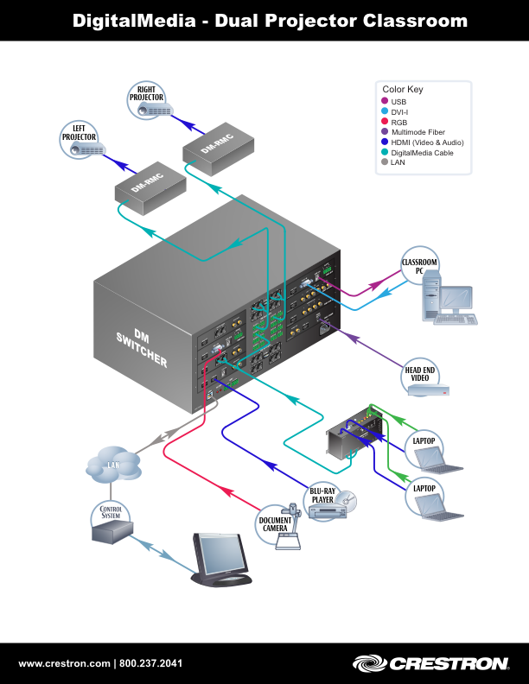
Today and the future
  Digital Video
    HDMI
    HDCP
    16:9 and 16:10
    aspect ratio
    - IT/AV Convergence

Slide 38
What did you think?
Your input is important to us!
Click on “Evaluate This Session” on the Mid-Atlantic Regional program page.

