Slide 1

After the IT Merger: Adjusting to Meet Challenges
Worcester Polytechnic Institute & Connecticut College
NERCOMP 2009

Slide 2
After the IT Merger: Adjusting to Meet Challenges at Worcester Polytechnic Institute
Matt Hall, Gordon Library
Kate Beverage, Academic Technology Center

Slide 3
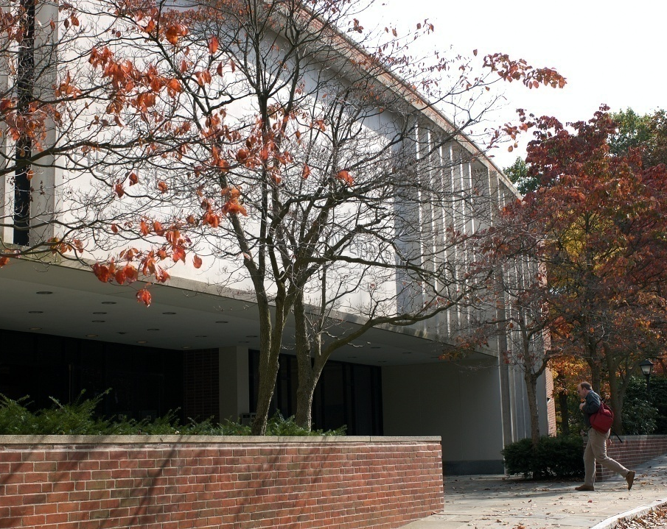
WPI Agenda
WPI IT History
Staffing
Programs/Programming
Physical Structure/Space

Slide 4
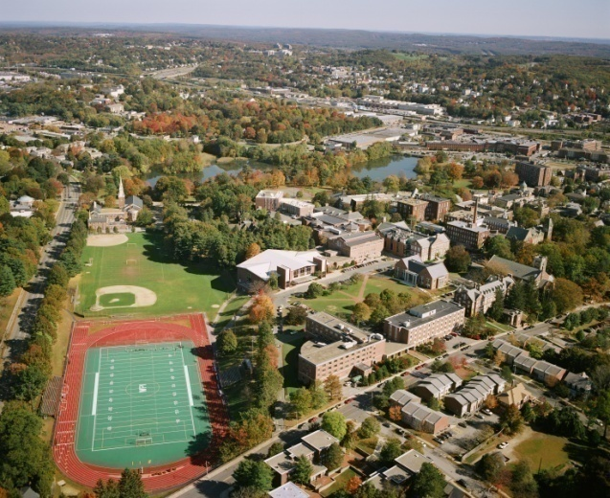
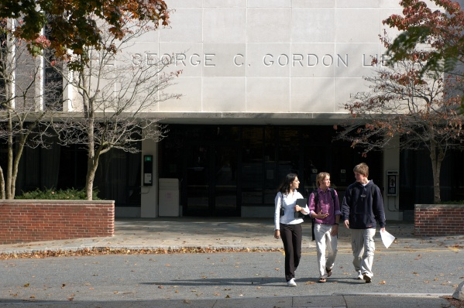
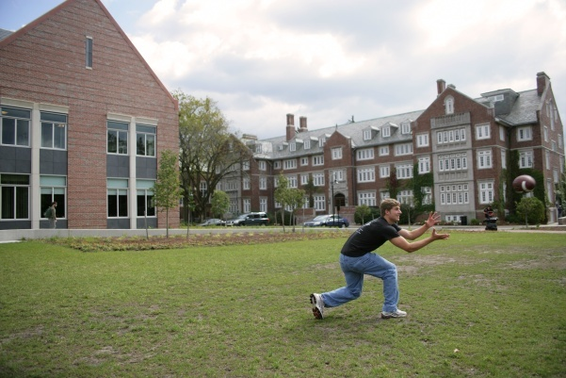
About WPI
Urban campus (residential area)
3000+ undergraduates
1000+ part- and full-time graduate students
26% women; 74% men
Students from 43 states; 70 countries
“WPI Plan” – Project-based learning
Four 7-week terms

Slide 5
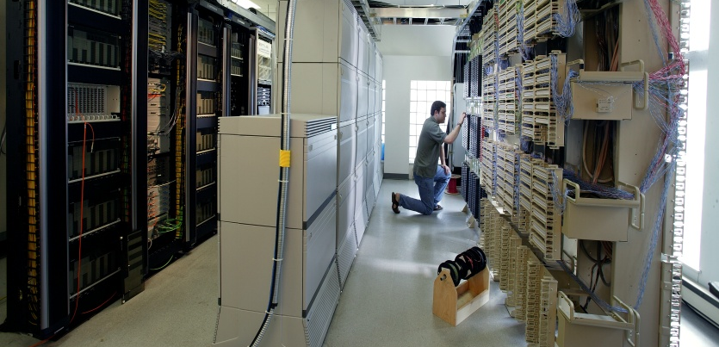
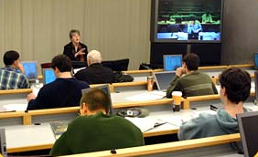
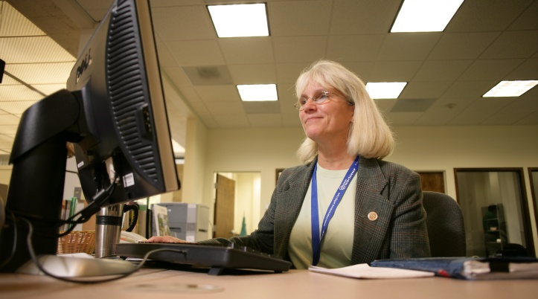
About WPI’s IT Division
IT comprises:
  Computing & Communications Center (CCC)
  Academic Technology Center (ATC)
  Gordon Library
Overview of services:
www.wpi.edu/Admin/IT/Services/overview.html

Slide 6
IT Organization circa 1998
Office for IT
Computing & Communications Center
Administrative Computing
Academic/Res Computing
UNIX, Network Operations
Tech HelpDesk
PC Shop
Gordon Library
Circulation, ILL
Reference
Technical Services
Archives
Academic Technology Center
Advanced Distance Learning Network
Web Development Office

Slide 7
IT 1998-2009: Selected Events
1998:
Office for Information Technology established at WPI
2007:
Approval given for library renovation project
2008: Instructional Technology Specialist hired
2002: Collaborative Tech Suites
introduced
1998-2000:
Visioning/ Planning
2007:
Technology for Teaching and Learning Group evolves
2009: Technology for Teaching and Learning Group moves to library in new renovation
2000
Library Vision
formulated

Slide 8

IT Organization - 2009
Computing and Communications Center
Support Services
Academic/Res Computing
Academic Technology Center
Technology for Teaching and Learning
Software Applications
Gordon Library
Access Services, ILL
Reference/Instruction
UNIX, Network Operations
PC Shop
Collection Management
Archives
Campus Media Services
AV Systems
Systems
Administrative Computing

Slide 9
IT Challenges
No “one-stop shopping”
Understanding campus technology needs from multiple perspectives
Collaboration models ever-changing
Cultural differences between departments
Supporting distance learning students
Notes:
9

Slide 10
Programs/Services: IT Liaisons
Formed Summer 2006
Liaisons work with faculty and academic departments to:
  gain an understanding of research and instructional technology needs
  make appropriate technology recommendations
  provide a convenient point of contact for faculty and staff to services within the IT Division
“One-stop” shopping
Notes:
10

Slide 11

Encouraging the Heart
1 day workshop with “Gordon Group” members
Foster Gordon Group community and values
Celebrate accomplishments of colleagues
Recognize interdepartmental contributions
Cultural differences between departments
Notes:
11

Slide 12
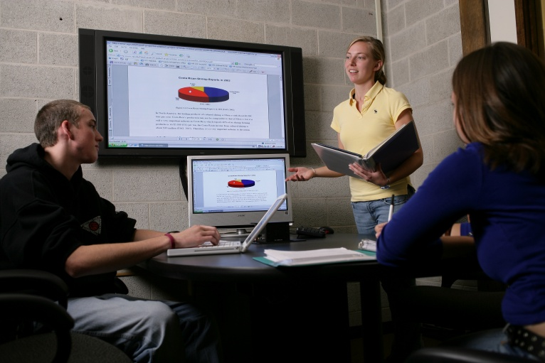
New Initiative for AY2009-2010:
Presentation Spaces
Student space for rehearsing and recording mock presentations
Gordon Group evaluating “kits”
Informational meetings with faculty/students
Future Directions:
Space design
Usage policies
Presentation services
Understanding technology needs from multiple perspectives
Notes:
12

Slide 13
Staffing: Common Core Values
  Copyright: http://www.wpi.edu/Pubs/Policies/Copyright/
  Linking Faculty with Content and Contacts
  Multimedia Presentations
  Technology Resources that Assist with Research
    SharePoint
    myWPI
    Researching Companies/
    Sponsors with Web
    conferencing
“One-stop” shopping and collaboration models

Slide 14
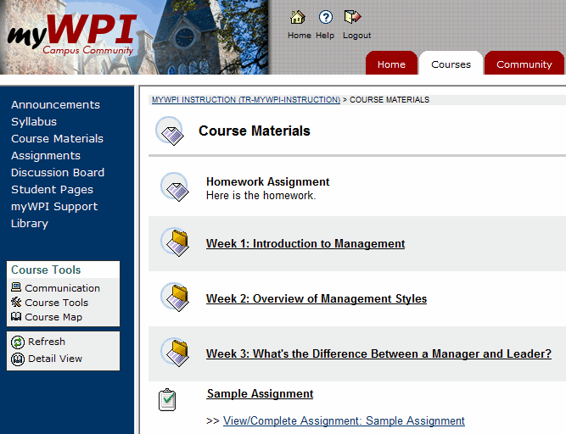
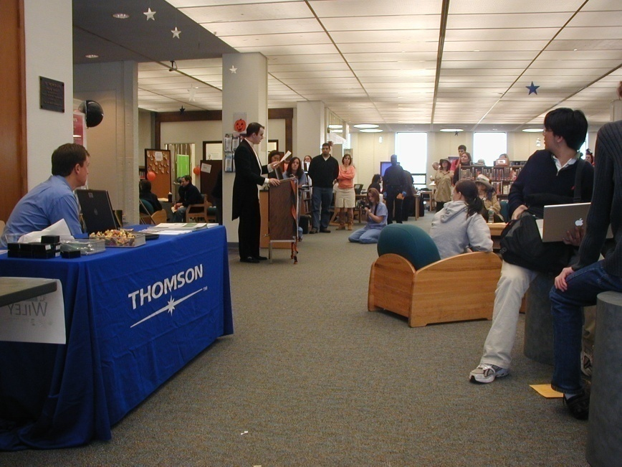
Staffing: Outreach
Partnering with Distance Faculty/Students
Staffing events
Collaboration models & supporting distance students

Slide 15
Staffing: Supporting each other
Supporting reference librarians with technology questions – single Point of Service
  Staff professional development
  Cross-referrals from student groups
  Physical presence in Reference area
Connecting Systems administrators and Software trainers with people
Collaboration models changing & cultural differences

Slide 16
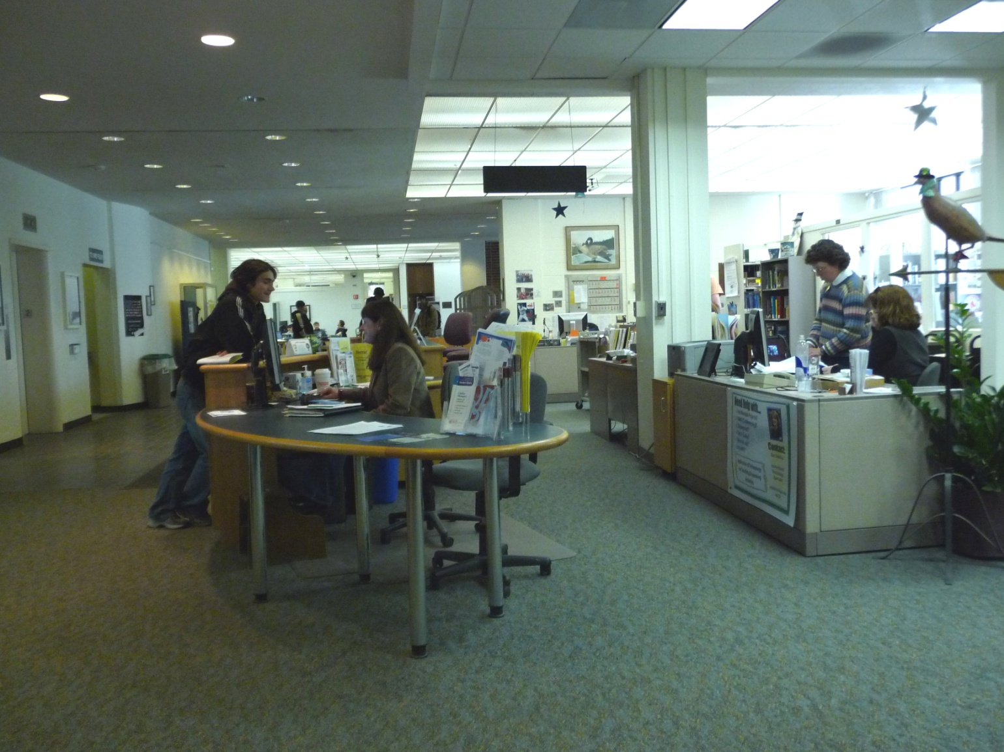
The ATC Point of Service Desk
“One-stop” shopping

Slide 17
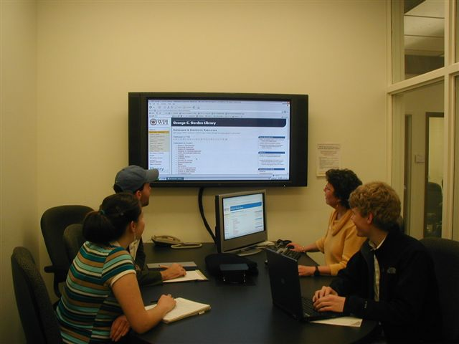
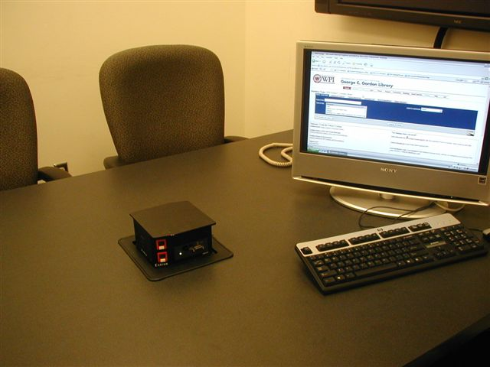
Space: Tech Suites
Understanding technology needs & collaboration models

Slide 18
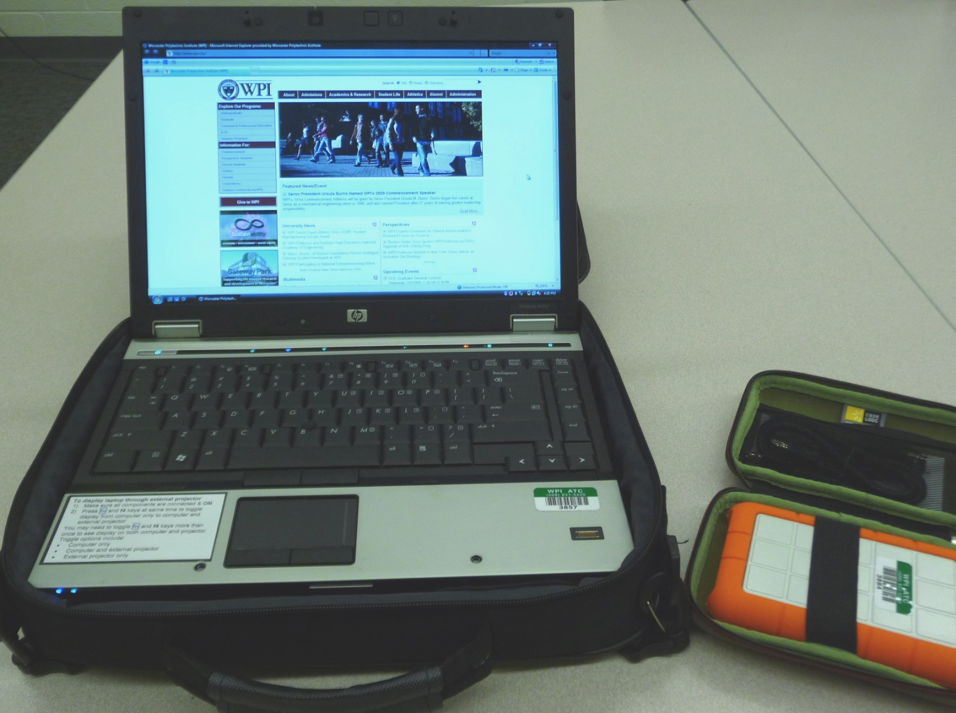
New Student Services: Equipment
Understanding technology needs from multiple perspectives

Slide 19
Gathering feedback
Formal and informal surveys of students, faculty, and staff indicate:
  Usage of space, technology
  Technical needs
  Training needs
  Departmental meetings, student governance meetings
  Library Student Advisory Committee
  http://www.wpi.edu/Academics/Library/About/studentlibcomm.html
Understanding technology needs from multiple perspectives

Slide 20

Looking ahead…
Summer 2009

Slide 21
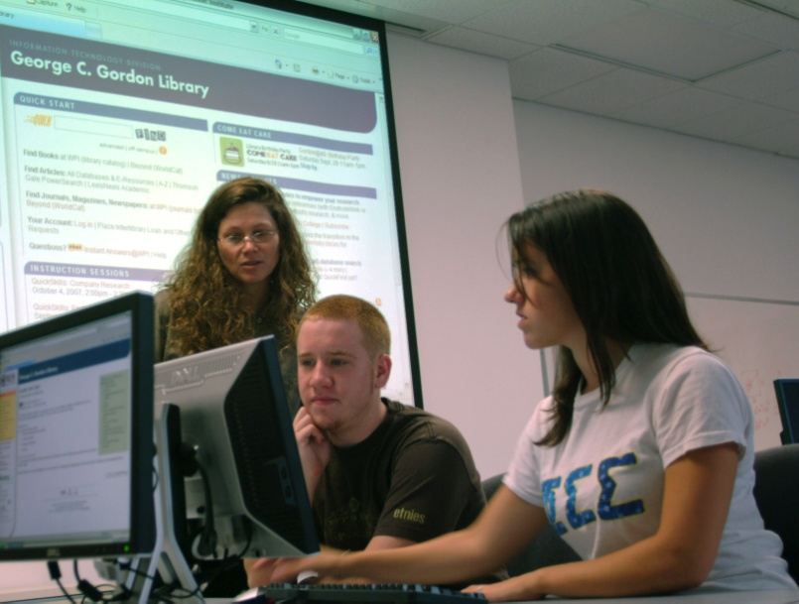
The Gordon Group
Planned 2010: Computing and Communications Center
Support Services
2009: Academic Technology Center
Technology for Teaching and Learning
Gordon Library
Access Services, ILL
Reference/Instruction
Archives
Systems
Software Applications
Collection Management

Slide 22
Gordon Group Goals
Create an information commons
  Engaging space to support teaching, learning, and scholarship
  Dynamically link multimedia and technology to research and teaching
  Cultivate innovation; convenient points of service
Design flexible, individual and group collaboration and study space within library building
Blend existing services and innovate new services with greater collaboration among IT units, faculty, students
More efficiency and collaboration among staff to improve workflow and back office operations

Slide 23
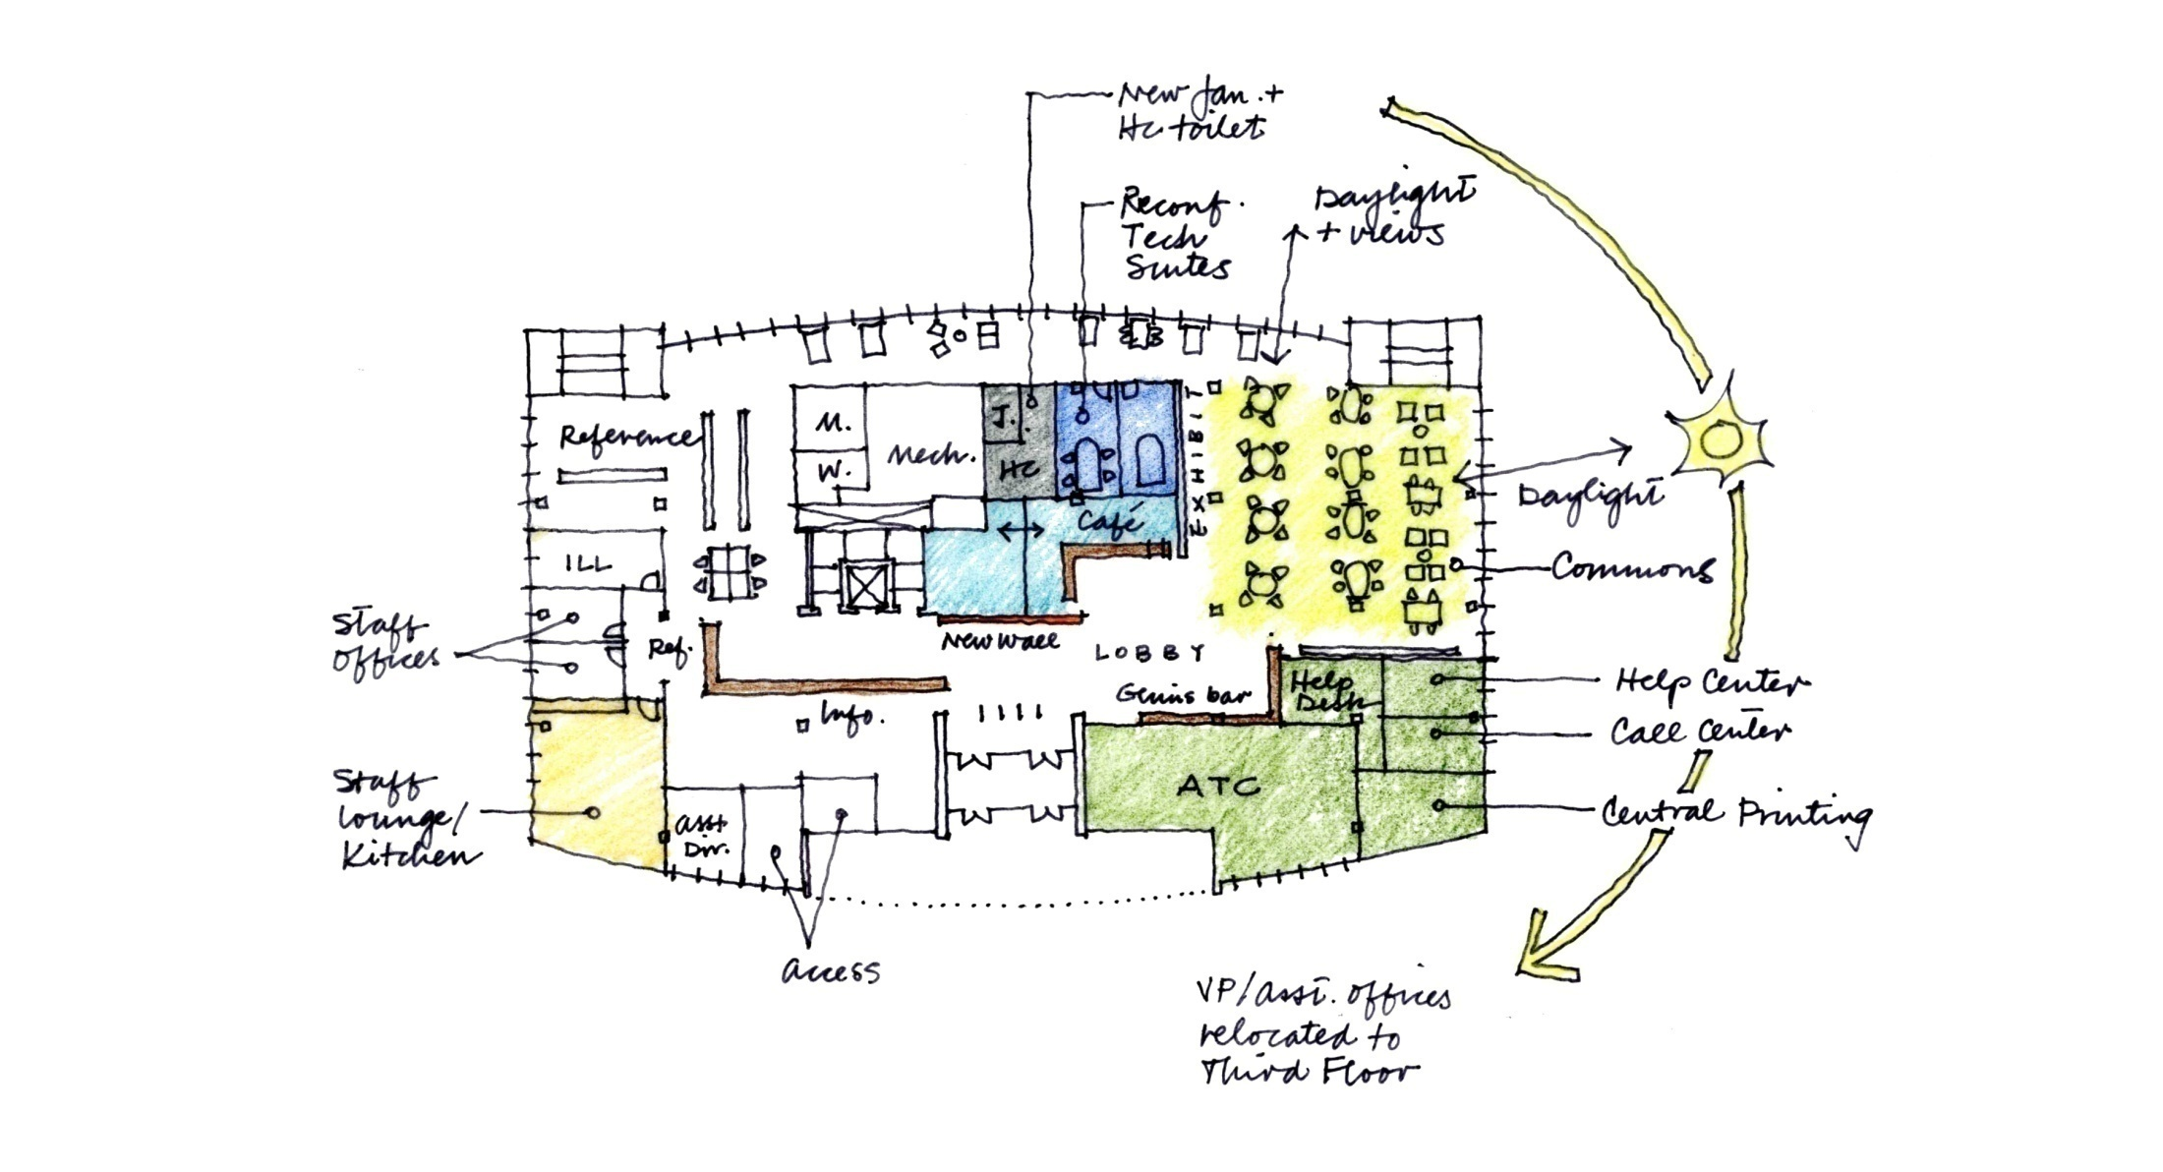

New Plan

Slide 24
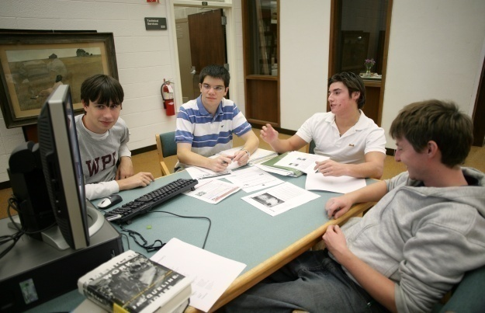
Student Staff Opportunities
Where do students fit?
  Interdepartmental cross-training
  Working for other Gordon Group teams
  Recognition for student contributions
Notes:
24

Slide 25
Looking ahead
Emerging Opportunities
  Librarians and Academic Technologists working with faculty and students to support curriculum in new and innovative ways
  HelpDesk User Services TTL

Slide 26
Contact
Kate Beverage
Manager, Technology for Teaching and Learning
Academic Technology Center
kbeverage@wpi.edu
Erin DeSilva
Instructional Technology Specialist
Academic Technology Center
edesilva@wpi.edu
Matt Hall
Associate Director of Library Services
George C. Gordon Library
mhall@wpi.edu

Slide 27
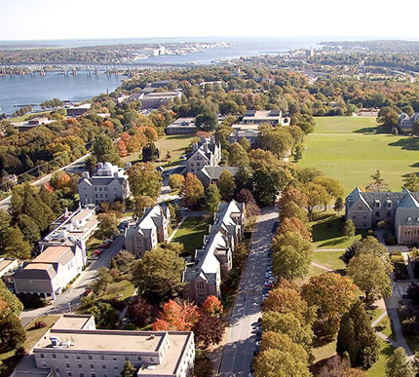
After the IT Merger at Connecticut College:
Adjusting to Meet Challenges
Chris E. Penniman
Director of Instructional Technology
Connecticut College
March 10, 2009
Nercomp 2009

Slide 28
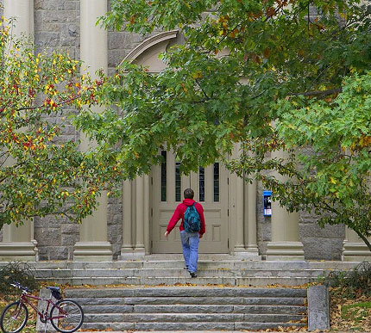
Presentation Outline
About Connecticut College
Merging of computing
and library organizations
  Original merger
  How the organization evolves
Challenges for the department
Opportunities for the department
Benefits to the department and to the college community

Slide 29
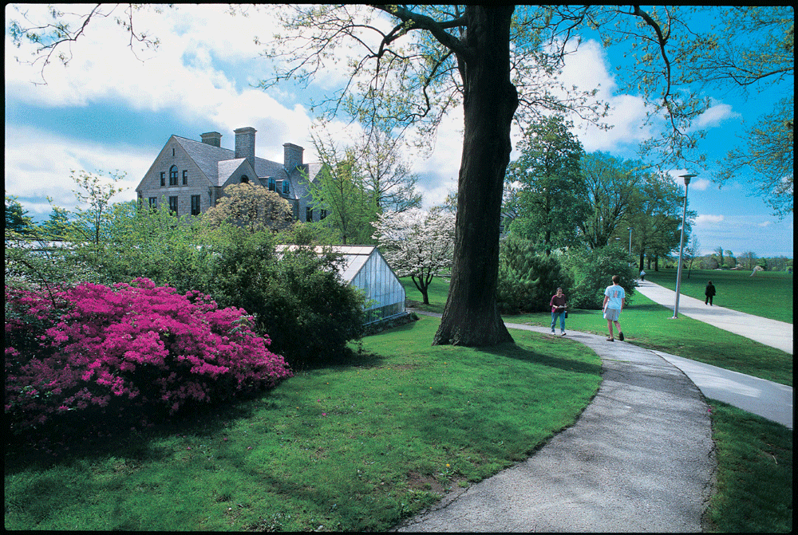
Connecticut College
Small, private, highly selective liberal arts college
New London, CT
1850 students
Collaborative
environment
Planning is integral
Focus on
Strategic Priorities

Slide 30
Computing and Library merged in 1995
Recommended by the Strategic Planning Team for Technology
Combined: Academic Computing, Administrative Computing, Telecommunications, Networking, Language Lab, Media Services, Libraries
Formed Information Services (IS) department
Under the leadership of the Dean of Information Services/Librarian of the College

Slide 31
Just after the Merger

Slide 32
The First Step after the Merger:
Foster Communication
and Collaboration
Established regularly scheduled meetings to share information
  Leadership Team
  All IS staff
Created opportunities for collaboration
  Activity groups
  Task forces
  Search committees for vacant positions

Slide 33
Organizational Structure
One Year after the Merger

Slide 34
The Next Step:
Ask IS staff to create a better organizational structure
Goals:
  Focus on user needs
  Improve and clarify services
  Build on the team structure
  Consolidate and maximize use of resources
  Reduce duplication of services and staffing
  Increase efficiency

Slide 35
The Resulting Organization

Slide 36
Information Services Today
Vice President of IS and Librarian of the College
Admin. & Fin. Support
Research Support & Instruction
Information Resources
Technical Support
Visual Resources
Media Services /Cable TV
Computer Labs
Instructional Project Development
Research and Instructional Librarians
Special Projects Coordination
Serials
Bibliographic Info. Management/ Acquisitions
Circulation/ Reserve
Interlibrary Loan / CTW Circulation
Greer Music Libary
CTW Collaborative Collect. Project
Admin. Information Systems
Computer Purchasing & Training
Computer Support Services
Networks, Servers, Telecomm
Web Support
Special Collections and Archives
Special Collections
College Archives
Instructional Technology

Slide 37
Challenges
Convergence of different traditions
  Management structure
  Professional development support
Maintaining a balance in meeting the needs of all operations within IS
  Developing an annual plan with goals that crosses team boundaries
  Sharing financial planning and budget allocation
  Developing a sense of common mission
Dealing with change

Slide 38
Opportunities
Flexibility
  Each vacant position is evaluated
    Typically a new job description is written
  Organizational structure can be changed more readily
    As technology and needs change positions and groups can be moved to other teams
Staff have a better understanding of other areas of information services

Slide 39
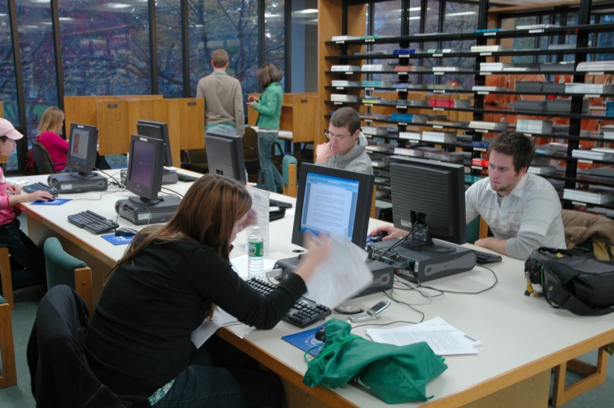
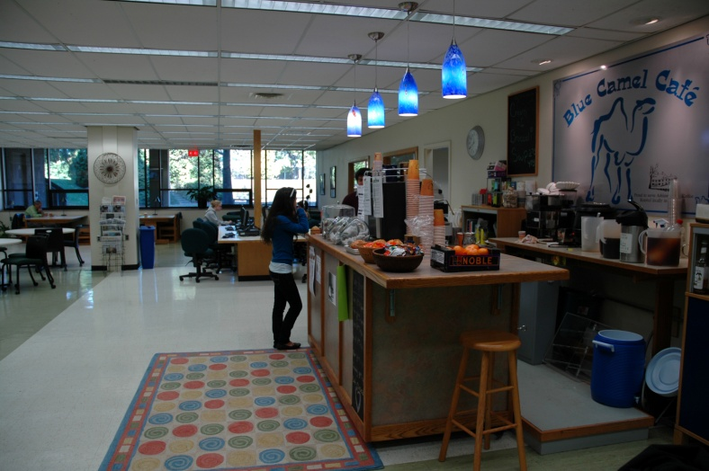
Opportunities cont.
Facilitates staff collaboration
on projects
  Information Commons and Blue Camel Café
    Library staff
    Instructional Technology staff
    Technical Support staff

Slide 40
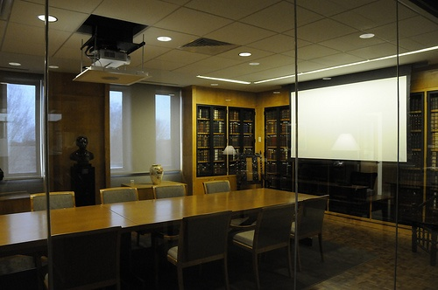
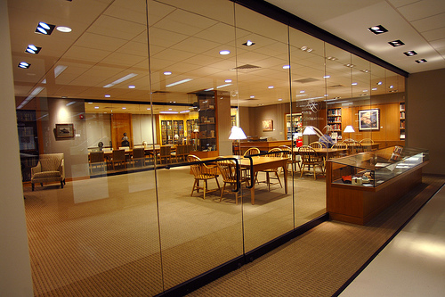
Opportunities cont.
Collaborations
Linda Lear Center for Special Collections and Archives
Special Collections staff
Instructional Technology staff
Technical Support staff

Slide 41
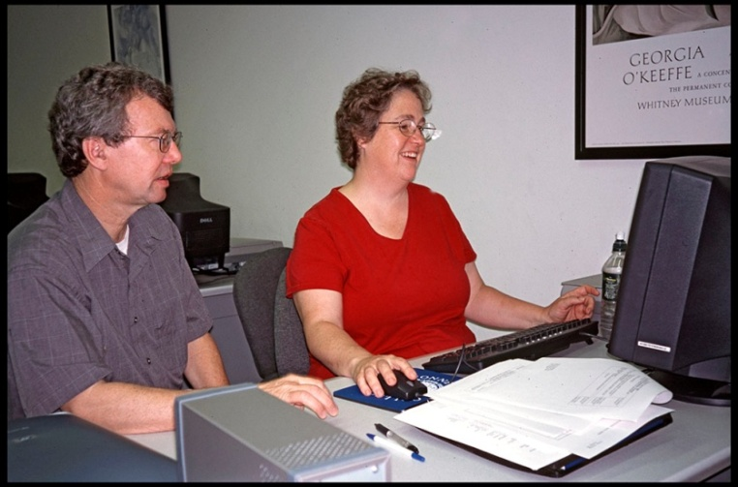
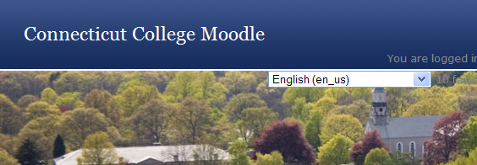
Opportunities cont.
Collaborations
Tempel Summer Institute
  Instructional Technology staff
  Reference librarians
  Center for Teaching and Learning faculty

Slide 42
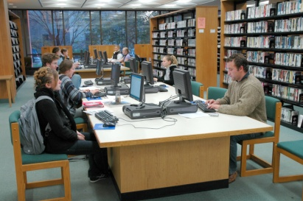
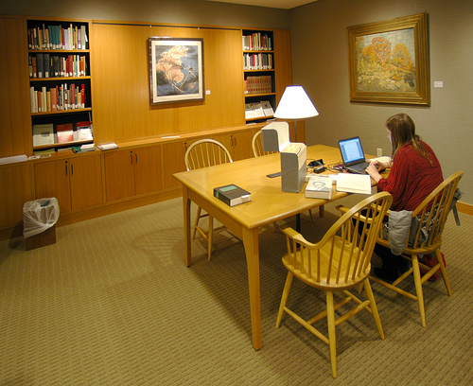
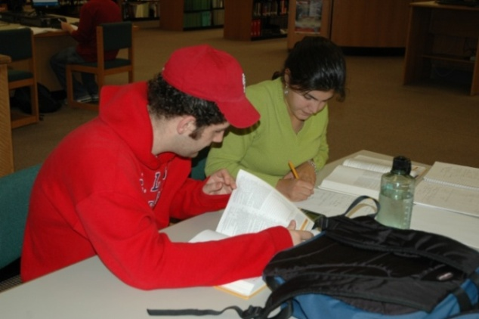
Opportunities cont.
Collaborations
Digital Enhanced Learning Initiative (DELI)
  Instructional Technologists
  Reference Librarians
  Faculty
Applied Anthropology Research:
How Students Study in the Library

Slide 43
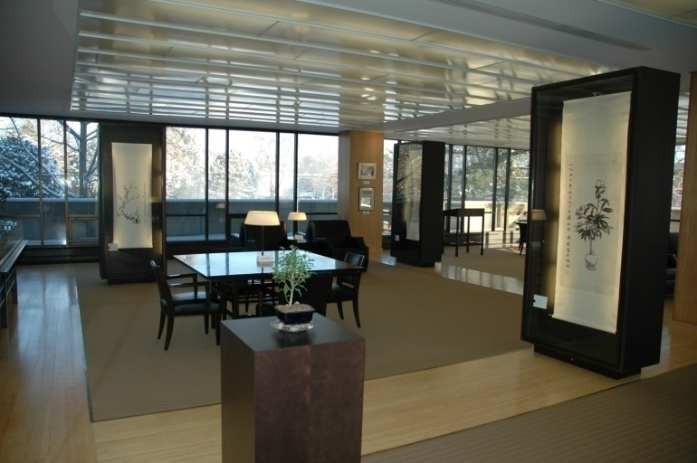
Benefits
Staff have a better understanding of what other IS staff do and how to address campus needs
Easier to bring the right people to projects
Provide improved
services to the
campus community

Slide 44
Information Services Today
Vice President of IS and Librarian of the College
Admin. & Fin. Support
Research Support & Instruction
Information Resources
Technical Support
Visual Resources
Media Services /Cable TV
Computer Labs
Instructional Project Development
Research and Instructional Librarians
Special Projects Coordination
Serials
Bibliographic Info. Management/ Acquisitions
Circulation/ Reserve
Interlibrary Loan / CTW Circulation
Greer Music Libary
CTW Collaborative Collect. Project
Admin. Information Systems
Computer Purchasing & Training
Computer Support Services
Networks, Servers, Telecomm
Web Support
Special Collections and Archives
Special Collections
College Archives
Instructional Technology

Slide 45


Summary
Effective merging requires ongoing planning and allocation of resources
A merged organization provides great flexibility to adjust to the changing needs of the campus
More information at
www.conncoll.edu

