Slide 1

Tearing Down the Silos: Inclusive Faculty Development
Tobi Krutt: System Office, Connecticut Community Colleges
Manager, Technological Tools & Training &
Founding Member of the System Technology Advisory Group.
Bonnie Riedinger: Manchester Community College
Director of Educational Technology & Distance Learning
Co-Chair, System Teaching & Learning Team &
Founding Member of the System Technology Advisory Group.

Slide 2
Abstract
Developing faculty training across 12 community colleges can be a daunting task, given the institutions’ varied resources, demographics, and organizational cultures.
This presentation will describe how our system’s “Teaching and Learning Team” uses a stakeholder driven training approach to create faculty development initiatives and resources in an inclusive, collaborative environment.

Slide 3
Impetus for Action
Migration from WebCT Campus Edition to WebCT Vista Fall 2005
Faculty training brought in-house
700+ faculty who needed to learn to use new CMS
5-month lead time to train faculty

Slide 4
Challenges
Competing and duplicative resources: Lack of communication between councils and committees with overlapping responsibilities and constituencies resulted in duplicate efforts.
Stakeholder-driven training: Faculty training and learning resources needed to be developed with adequate input and ideas from end-users.
Meld technology & pedagogy: Technology training needed to integrate pedagogical considerations.

Slide 5
Challenge # 1
Competing and duplicative resources are often developed without communication between councils and committees that have overlapping responsibilities and constituencies.
12 separate, diverse, self-managed community colleges
Overlapping, duplicative training responsibilities (System Office & Colleges)
One System Office: Manages enterprise systems (Banner, Luminis, Bb)
Countless (and uncounted) System-wide councils, committees & subcommittees ….
Notes:
Colleges have different business practices, no common academic calendar. No reporting to SO

Slide 6
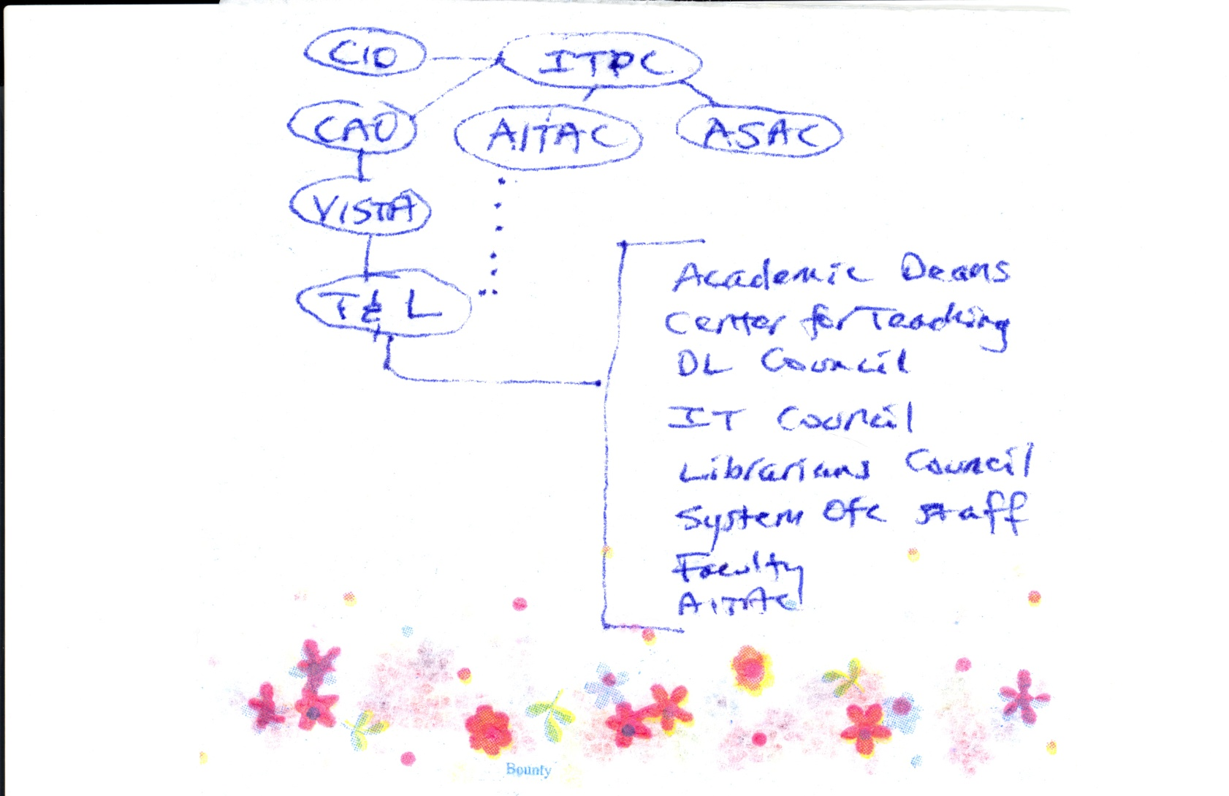
Napkin-based Org Chart…

Slide 7
Challenge #2
Faculty training and learning resources needed to be developed with adequate input and ideas from end-users.
Reconcile competing training philosophies and approaches.
Ensure opportunities for input from different colleges and disciplines
Reconcile different semantics
Address collective bargaining issues (the “E Word”)
Create atmosphere of trust and inclusiveness

Slide 8
Challenge # 3
Technology training needed to integrate pedagogical considerations.
Documentation provided by third-party training vendor and WebCT Vista focused primarily on which buttons to push.
Faculty needed and wanted to learn how technology could advance their learning objectives, but there were no guidelines or agreed upon Best Practices.

Slide 9
Goals
Integration of pedagogy and technology training.
Alignment of resources and curriculum for hands-on training, online self-paced resources, and online facilitated courses for faculty.
Equal access for full-time and adjunct faculty and staff regardless of which college employs them.
Multiple points of entry based on past experience, technological self-efficacy, and learning preferences.

Slide 10
Solutions
Formation of a system-wide team Vista Implementation Team charged with roll out of WebCT Vista.
Creation of sub-teams including the Teaching & Learning Team, which had two initial charges:
  Defining Best Practices in online instruction that align with the System’s mission and strategic goals.
  Determining ways to deploy and support these practices System-wide.

Slide 11
Inclusiveness
Academic Deans
Faculty members (from various disciplines)
Department/Division Chairs
Center for Teaching
Academic Information Technology Advisory Committee
Librarians
System Office staff
Distance Learning Directors
Notes:
The composition of the T&L Team was crucial to its success. Representatives from all relevant stakeholder groups were included.
Membership by invitation. Those who represent councils serve as representatives from those councils. Membership now also includes IT directors , a System Data Center Representative, the System CIO, and a college president. All colleges are represented.

Slide 12
First Steps
Developed effective online teaching guidelines, which were reviewed and endorsed by relevant councils.
Marketed the guidelines and new training plans that would integrate pedagogy and technology.
Formed Training Redesign Team, which reorganized aligned resources, curriculum for hands-on training, online self-paced resources, and online facilitated classes for faculty.

Slide 13
Training Redesign
Create a unified, system-wide faculty training program that melds information about best practices in online pedagogy with technical skills training.
Create an aligned curriculum.
Provide the individual colleges with flexible course delivery methods.
Provide a method by which faculty may obtain validation or certification for training participation
Develop a training program that models our Best Practices

Slide 14
New Training Initiatives
“Best Practices” document
“Effective Online Teaching” Seminars
“60-Second Vista” webpage
“Faculty Orientation and Resources” Course
“Essential Pre-Vista Skills” webpage
iTeach courses
Course Cart online registration for faculty/staff training

Slide 15
Goals Accomplished
Integration of pedagogy and technology training | Best Practices document Redesign of training Effective Online Teaching Seminars
Alignment of resources and curriculum for hands-on training, online self-paced resources, and online facilitated courses for faculty. | Best Practices document Redesign of training 60-second Vista Essential Pre-Vista Skills Self-paced faculty resources course
Ensured equal access for full-time and adjunct faculty and staff regardless of which college employs them. | “Course Cart”—online registration system for faculty & staff Synchronous and Asynchronous Web-based Training
Multiple points of entry based on past experience, technological self-efficacy, and learning preferences. | Full array of choices now offered.
Notes:
60 second Vista: Videos and step by step documentations, web page and resources developed by team subcommittee. Self-paced faculty resources: tech staff developed way to enroll all faculty each term.

Slide 16

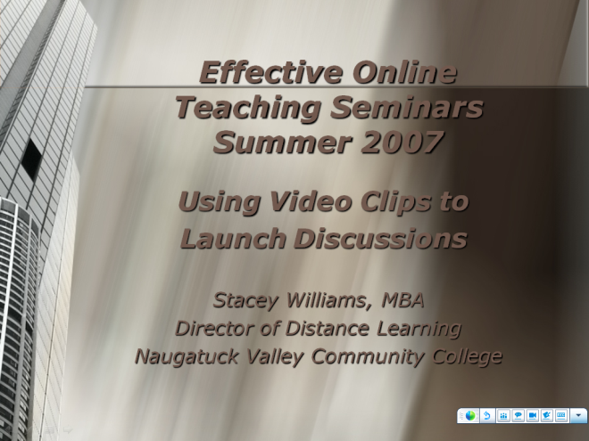
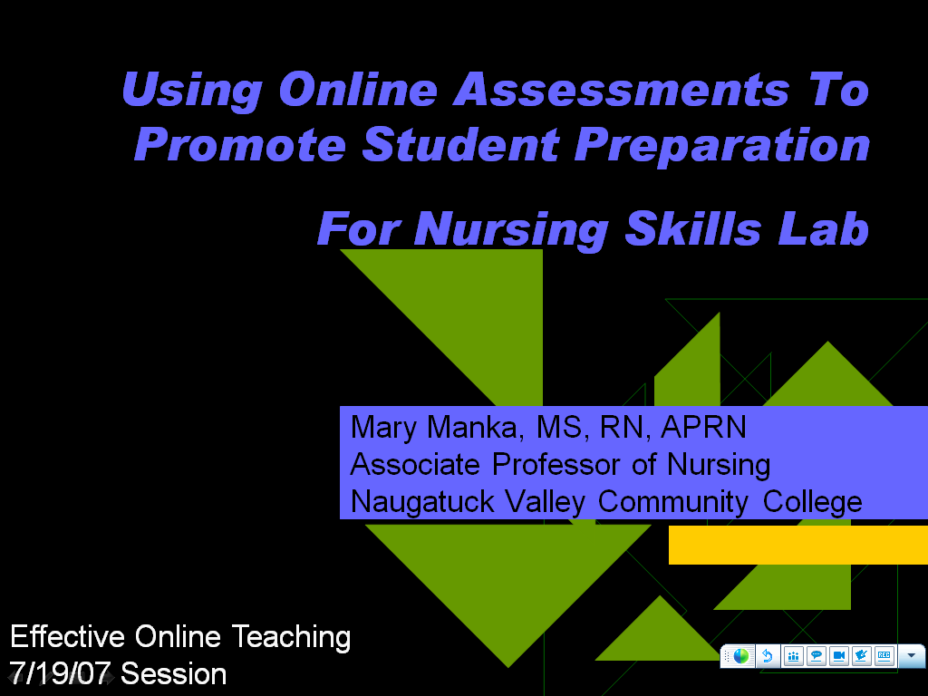

Slide 17
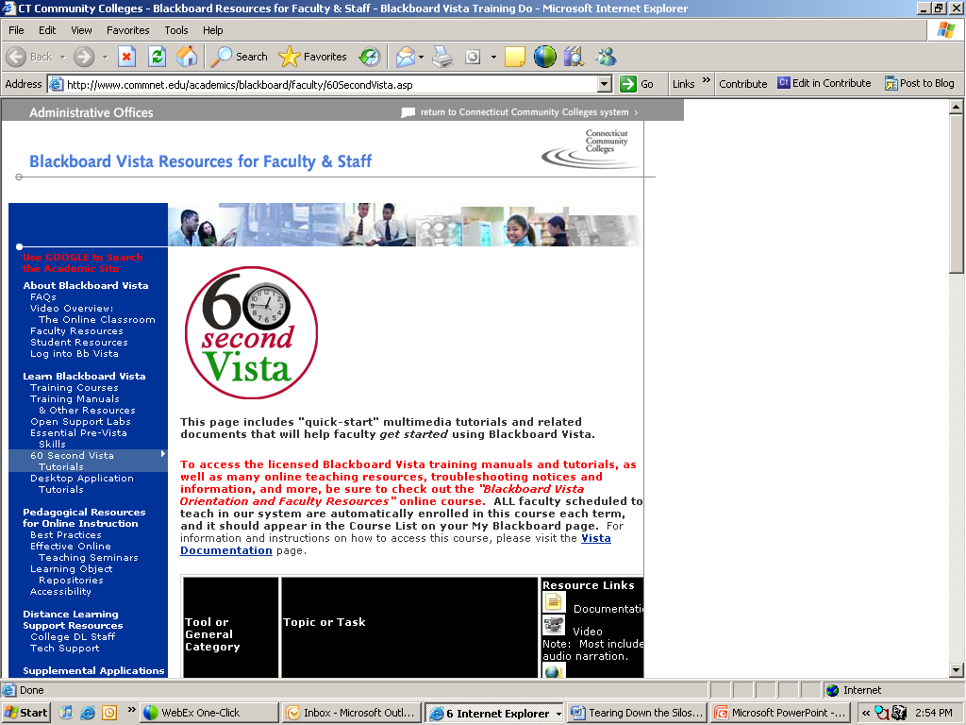

Slide 18
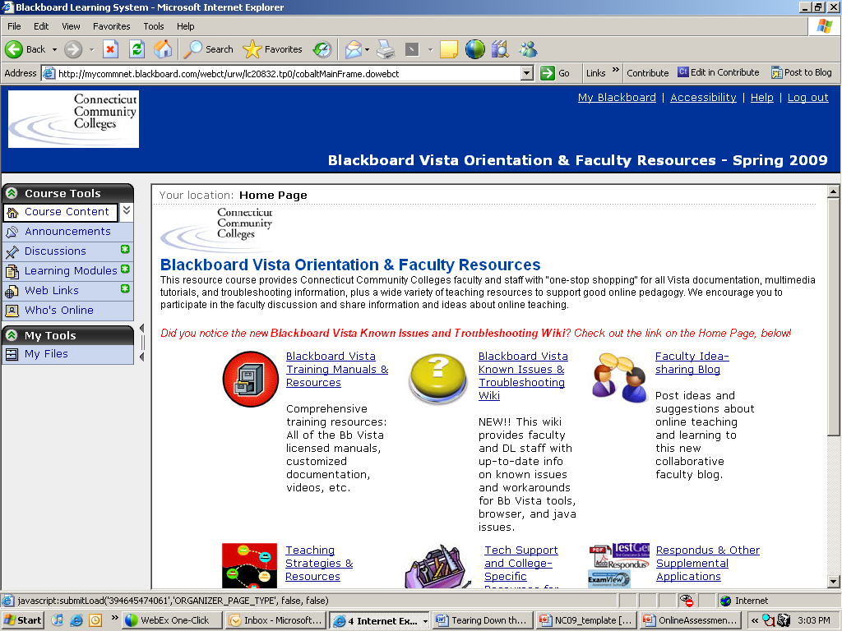

Slide 19
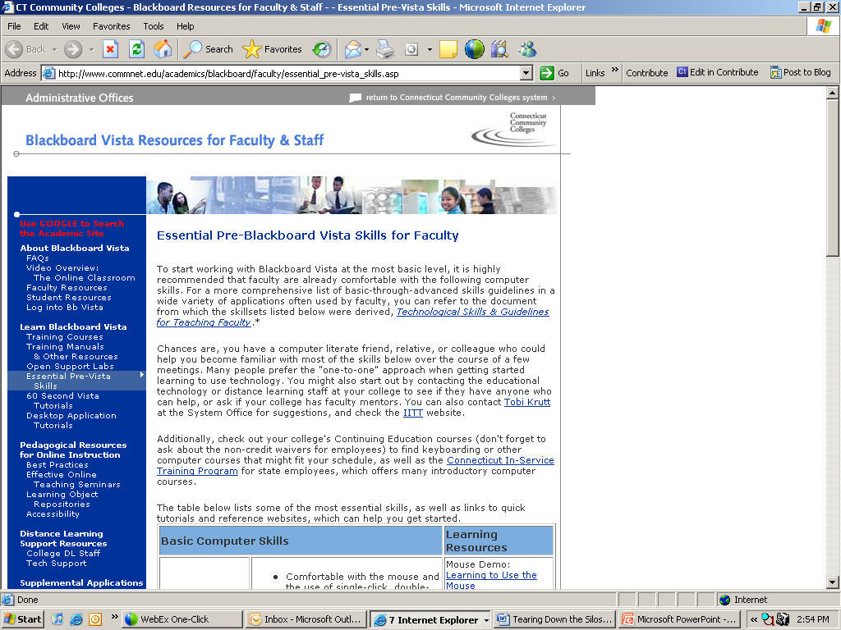

Slide 20

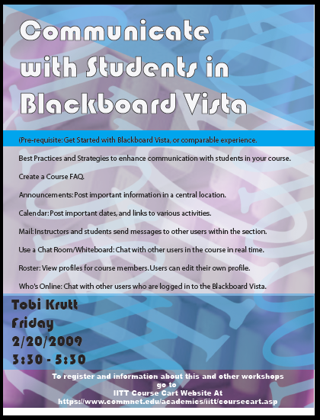
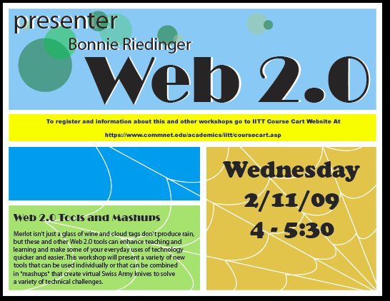
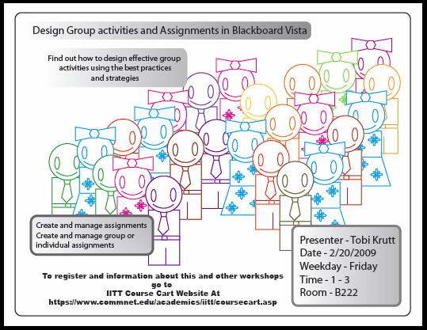
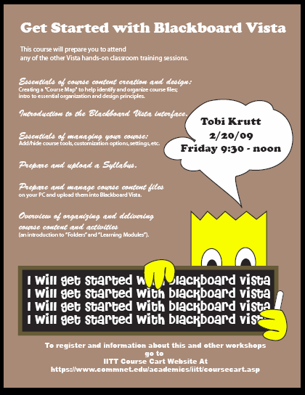

Slide 21
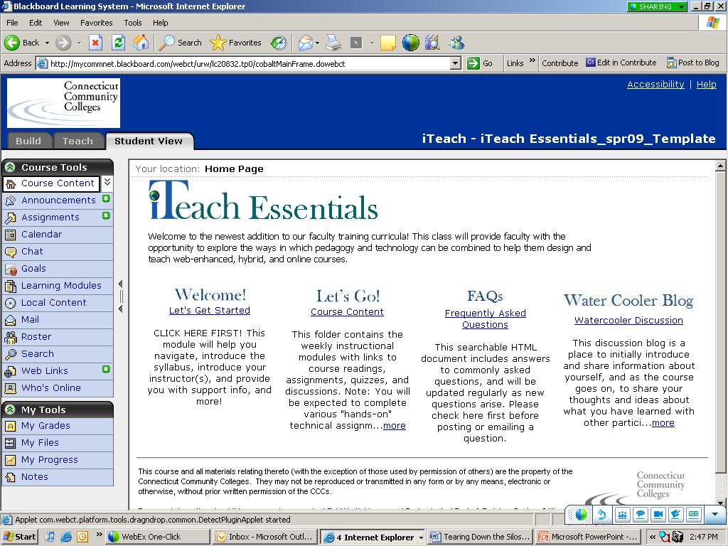

Slide 22
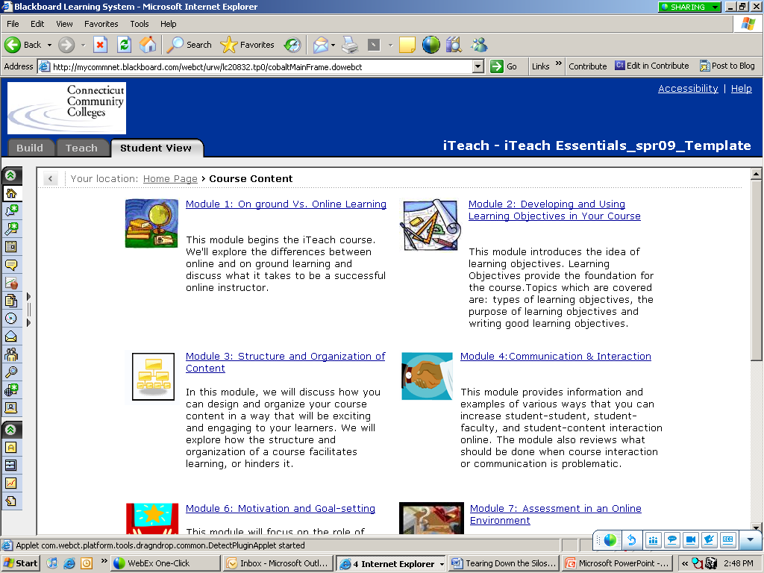

Slide 23
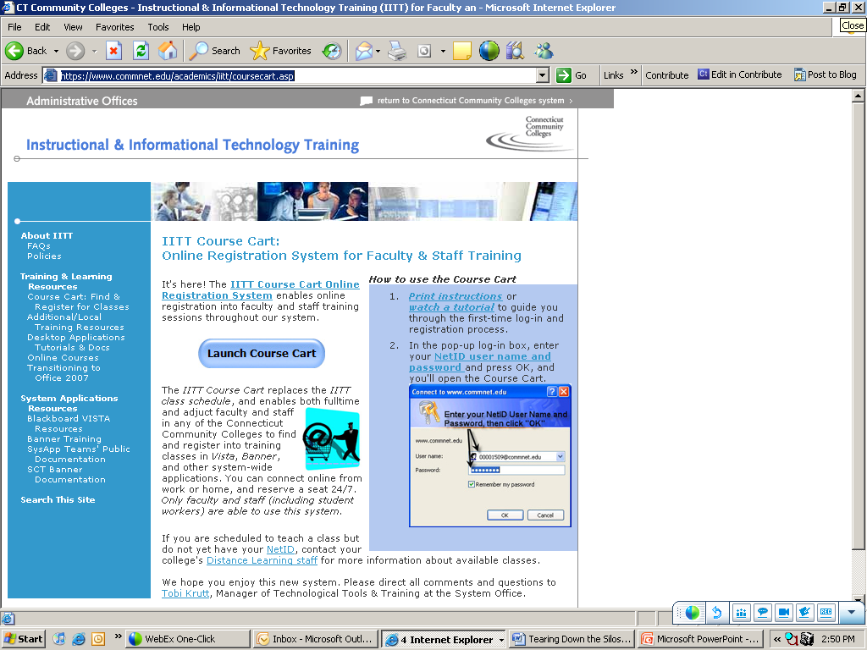

Slide 24
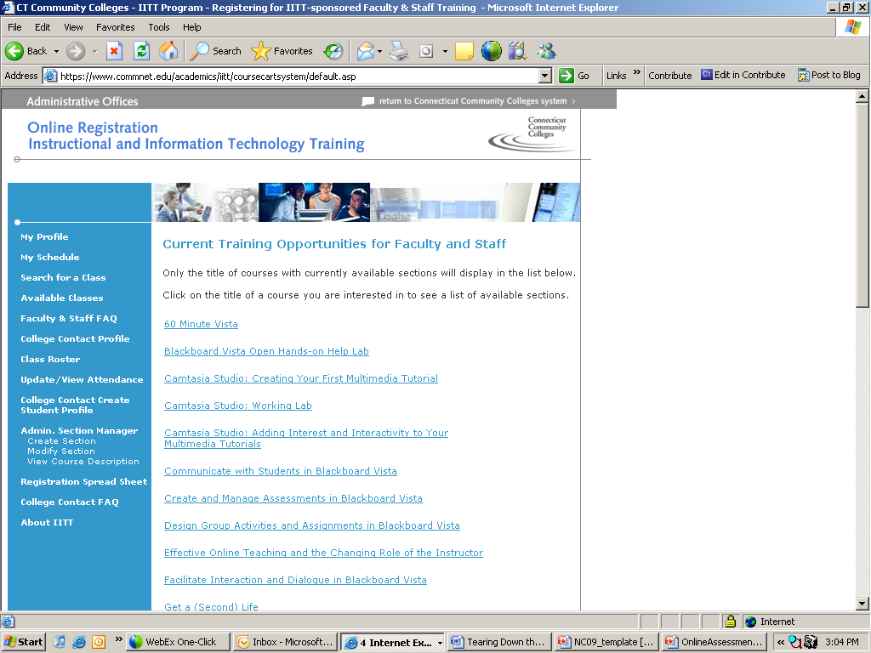

Slide 25
Benefits of T&L
Provides multiple perspectives on problems and solutions, deepening our pool of knowledge and enhancing our ability to provide the right services
Promotes cooperation for future projects and sharing of information among colleges and colleagues
Promotes intentional and well-designed training that is consistent across the System.
Promotes identification of potential training needs for various segments of the faculty
Helps to identify potential “hot button” issues so they can be pro-actively addressed
Enhances communication
Notes:
Last bullet: in which members bring back information about various initiatives and project to their respective councils and committees. This helps ensure buy-in from those who often need to champion these initiatives locally.

Slide 26
What Makes T&L Work?
Focusing on central mission: Quality student learning
Operating outside the formal governance structure
Careful selection of participants
Use of wikis and web conferencing tools.
Creation of subcommittees
Action items for all meetings
Remaining flexible and open to new ideas
Meetings at various locations and online
Staying on track and organized (wikis)
Trust and appreciation for difference perspectives
Planning
Notes:
Wikis: to promote communication, sharing of ideas and asynchronous participation at a distance
Subcommittee: with specific charges and deadlines
Meetings: to accommodate geography and schedules

Slide 27
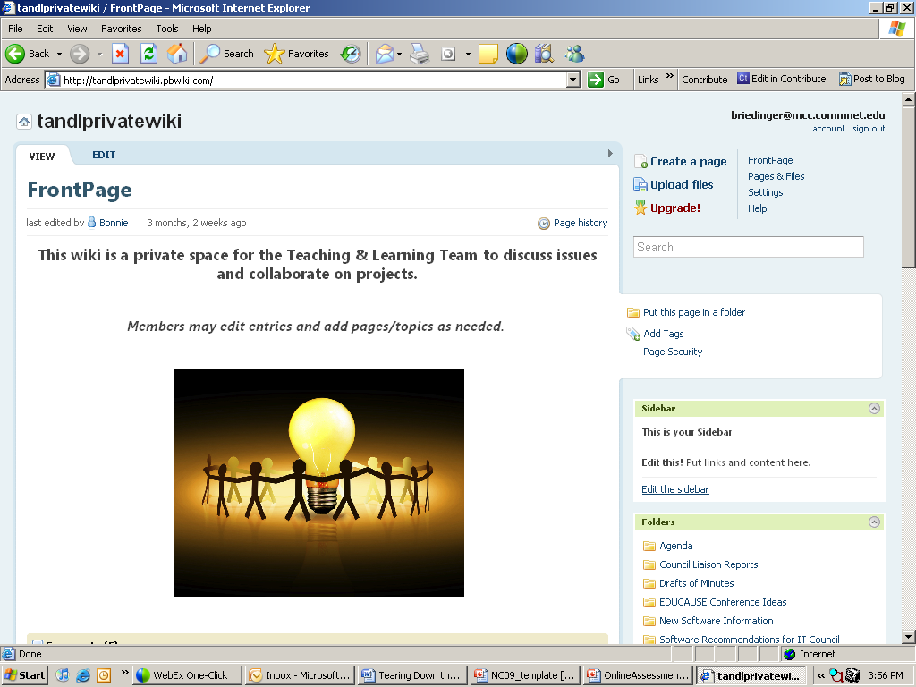

Slide 28
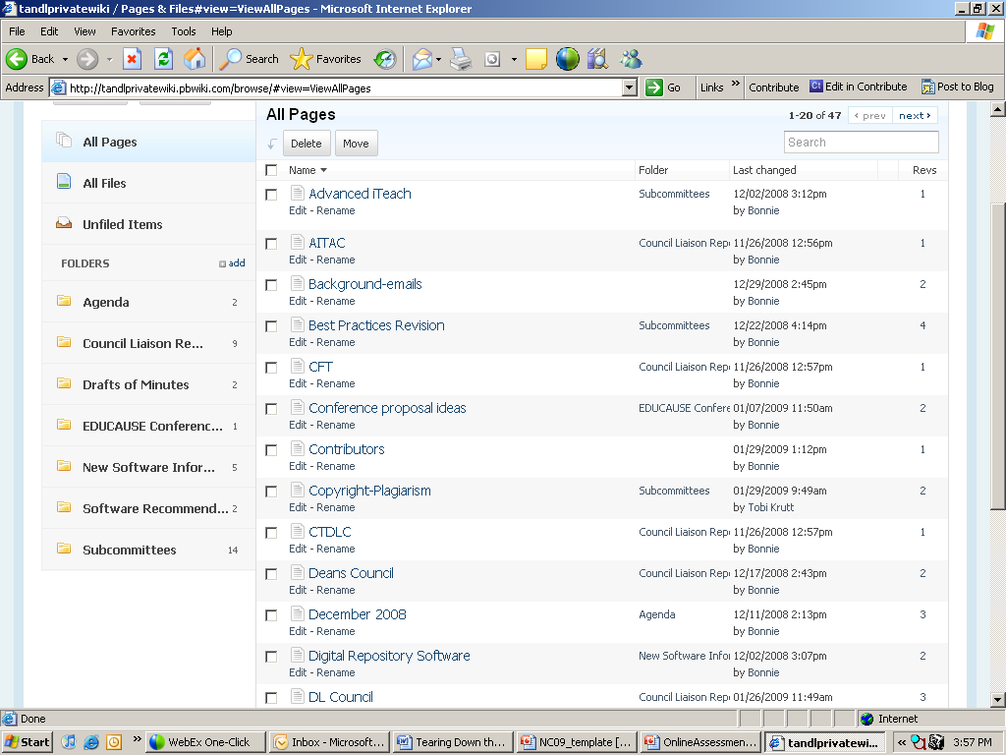

Slide 29
Ongoing Challenges
Changing composition of team
Occasional “bad fits”
Rapid changes in technology and budgets
Working as a team requires time. Projects may take longer than if they were assigned to one person

Slide 30
Current Projects
Formation of TAG
iTeach Next Steps course
Revision of Best Practices document
Formation of guidelines for hiring/scheduling, training and evaluating online faculty
Development of Best Practices for Web 2.0
Fall 2009 conference
Grant proposals to support curriculum development and integration of Web 2.0 tools in teaching and learning
Evaluation of ways to test student readiness for online learning
Copyright training

Slide 31
What did you think?
Your input is important to us!
Click on “Evaluate This Session” on the Mid-Atlantic Regional program page.

Slide 32
Contact Info
Tobi Krutt: tkrutt@commnet.edu
Bonnie Riedinger: briedinger@mcc.commnet.edu

Slide 33
Copyright
Copyright Tobi Krutt and Bonnie Riedinger, 2009.
This work is the intellectual property of the authors. Permission is granted for this material to be shared for non-commercial, educational purposes, provided that this copyright statement appears on the reproduced materials and notice is given that the copying is by permission of the authors. To disseminate otherwise or to republish requires written permission from the authors.

