Slide 1
NERComP09 presentation
What's Your Carbon Footprint? Sustainability and Green IT:
Initiatives That Make a Difference
Dr. Linda Croll Howell
Director, Strategic Planning &
Org Effectiveness
Cornell University
Dr. David Todd
Associate VP & CIO
University of Vermont
Copyright Dr. Linda Croll Howell and Dr. David Todd, 2009. Except for included reference material noted, this work is the intellectual property of the authors. Permission is granted for this material to be shared for non-commercial, educational purposes, provided that this copyright statement appears on the reproduced materials and notice is given that the copying is by permission of the author. To disseminate otherwise or to republish requires written permission from the author.

Slide 2
[format]
Before session starts, run a loop of ppts 3-12 that give questions and answers that engage the audience before the presentation
Introduce ourselves; note EDUCAUSE summit
Review basic concepts of carbon foot print, initiatives
Solicit ideas from audience about what they’re doing, connect to slide we’ve prepared on that topic
Notes:
(Linda) And yes, I did remember correctly! Recycling one 1-gallon plastic milk jug saves enough energy to keep a 100-watt bulb burning for 11 hours! Wow!!
Wouldn't it be "illuminating" if we could come up with a similar set of figures for Green IT efforts in relation to higher ed? Who's up for the challenge? ;)
_______________________________________________________________
* Every ton of recycled paper saves 17 forty-foot Douglas Fir trees.
* Paper takes up as much as 50% of all landfill space.
* Up to 90% of recycled glass can be reused to make new glass items, such as bottles and jars.
* Every glass bottle recycled saves enough energy for a 100-watt light bulb to be lit for 4 hours.
* Americans throw away enough aluminum to rebuild the entire commercial airline fleet every six months.
* Recycling one aluminum can saves enough energy to run your TV for 3 hours.
* Thirty-six recycled bottles can make one square yard of carpet.
* 130 billion beverage containers are sent to US landfills each year.
* Recycling a 1-gallon plastic milk jug will save enough energy to keep a 100-watt bulb burning for 11 hours.
* Increasing materials recycling in the US to 60% (up from the current 30% national recycling rate) could save the equivalent of 315 million barrels of oil per year.

Slide 3
How’s Your Greening IT Knowledge?
1. How much paper does an average office worker use per year?
  A. 500 sheets
  B. 1,000 sheets
  C. 5,000 sheets
  D. 10,000 sheets

Slide 4
How’s Your Greening IT Knowledge?
2. What percent of the heavy metal in landfills is there due to e-waste?
  A. 10%
  B. 50%
  C. 70%
  D. 90%

Slide 5
How’s Your Greening IT Knowledge?
3. On average, what percent of server reduction can an enterprise expect to gain from virtualization?
  A. 15%
  B. 50%
  C. 65%
  D. 80%

Slide 6
How’s Your Greening IT Knowledge?
4. Which produces the most CO₂ emissions:
  A. Data centers
  B. The airline industry
  C. The steel industry

Slide 7
How’s Your Greening IT Knowledge?
5. Which of the following devices have the highest power consumption growth and highest overall power consumption?
  A. Storage devices
  B. High-end servers
  C. Mid-range servers
  D. Networking equipment

Slide 8
How’s Your Greening IT Knowledge?
6. How much money could the federal government save over five years in electricity costs by using Energy Star-rated PCs?
  A. $130 million
  B. $230 million
  C. $330 million
  D. $430 million

Slide 9
How’s Your Greening IT Knowledge?
7. What percent of companies with large data centers will have to add additional power and cooling capacity to them in the in the next two years?
  A. 30 percent
  B. 50 percent
  C. 70 percent
  D. 90 percent

Slide 10
How’s Your Greening IT Knowledge?
8. In a McKinsey study of four production data centers, what percent of servers were found to be zombies, running at or below average and peak utilization of 3%?
  A. 12 percent
  B. 22 percent
  C. 32 percent
  D. 42 percent

Slide 11
How’s Your Greening IT Knowledge?
9. Increasing the temperature of your data center by a single degree can reduce your energy consumption by how much?
  A. 1 to 2 percent
  B. 2 to 3 percent
  C. 3 to 4 percent
  D. 4 to 5 percent

Slide 12
How’s Your Greening IT Knowledge?
10. A PC running a screensaver uses on average more than 100W of power. How much electricity does that same PC use in sleep mode?
  A. 5W
  B. 10W
  C. 20W
  D. 30W

Slide 13

What's Your Carbon Footprint?
Sustainability and Green IT: Initiatives That Make a Difference
Dr. Linda Croll Howell
Director, Strategic Planning & Org Effectiveness
Cornell University
Dr. David Todd
Associate VP & CIO
University of Vermont
Notes:
What's Your Carbon Footprint? Sustainability and Green IT Initiatives That Make a Difference
Supporting our institutions' sustainability efforts and responses to climate change will be a key role for higher education IT in the decades to come. Do you know your carbon footprint? Do you know what it will take to reach climate neutrality? Whose responsibility is it on your campus? What can IT do that has high impact? What best practices are emerging for IT units? Leaders for campus sustainability and green initiatives will provide a framework for your own participation in critical discussions and actions on your campus.

Slide 14
Outline
Concepts
  “Carbon footprint”
Initiatives
  International
  National
  Higher education
Higher ed initiatives
Opportunities for us in IT

Slide 15
How we got here …
EDUCAUSE-sponsored “IT Greening and Sustainability” Summit, UMD, Nov, 2008
~40 participants
Presentations, discussion, small team project work
Joyce Dickerson, Stanford, moderating “Sustain” listserv (see refs)

Slide 16
Carbon footprint – what is it?
A carbon footprint is “the total set of GHG (greenhouse gas) emissions caused directly and indirectly by an individual, organization, event or product” (UK Carbon Trust 2008)
Carbon offsets are the mitigation of carbon emissions through the development of alternative projects such as solar or wind energy or reforestation.

Slide 17


Carbon footprint – why care?
Greenhouse gases

Slide 18
International Agreements
The Kyoto agreement (1997) targets carbon dioxide and five other heat-trapping gases blamed for rising global temperatures and disrupted weather patterns. It calls on the top 35 industrialized nations to cut emissions to 5.2 percent below their 1990 levels between 2008 and 2012. [US didn’t sign but Pres Bush called for 18% reduction in GHG by 2012]

Slide 19
National initiatives
Across the Federal government, partnerships and programs promote opportunities to conserve fossil fuels, improve energy efficiency, recover methane and sequester carbon.
[www.epa.gov/climatechange]

Slide 20
Higher education IT initiatives
EDUCAUSE
  Summit
  Ongoing listserv
  Web resources
ECAR
  “Climate Change, Campus Commitment, and IT” by Suresh Balakrishnan and Donald Z Spicer

Slide 21
American college & University
Presidents’ Climate commitment (June, 07)
“Accordingly, we commit our institutions to taking the following steps in pursuit of climate neutrality:
Initiate the development of a comprehensive plan to achieve climate neutrality as soon as possible
Initiate two or more of the following tangible actions to reduce greenhouse gases while the more comprehensive plan is being developed.”
Notes:
1. Initiate the development of a comprehensive plan to achieve climate neutrality as soon as possible.
a. Within two months of signing this document, create institutional structures to guide the development and implementation of the plan.
b. Within one year of signing this document, complete a comprehensive inventory of all greenhouse gas emissions (including emissions from electricity, heating, commuting, and air travel) and update the inventory every other year thereafter.
c. Within two years of signing this document, develop an institutional action plan for becoming climate neutral, which will include:
i. A target date for achieving climate neutrality as soon as possible.
ii. Interim targets for goals and actions that will lead to climate neutrality.
iii. Actions to make climate neutrality and sustainability a part of the curriculum and other educational experience for all students.
iv. Actions to expand research or other efforts necessary to achieve climate neutrality.
v. Mechanisms for tracking progress on goals and actions.
2. Initiate two or more of the following tangible actions to reduce greenhouse gases while the more comprehensive plan is being developed.
a. Establish a policy that all new campus construction will be built to at least the U.S. Green Building Council’s LEED Silver standard or equivalent.
b. Adopt an energy-efficient appliance purchasing policy requiring purchase of ENERGY STAR certified products in all areas for which such ratings exist.
c. Establish a policy of offsetting all greenhouse gas emissions generated by air travel paid for by our institution.
d. Encourage use of and provide access to public transportation for all faculty, staff, students and visitors at our institution
e. Within one year of signing this document, begin purchasing or producing at least 15% of our institution’s electricity consumption from renewable sources.
f. Establish a policy or a committee that supports climate and sustainability shareholder proposals at companies where our institution's endowment is invested.
g. Participate in the Waste Minimization component of the national RecycleMania competition, and adopt 3 or more associated measures to reduce waste.
3. Make the action plan, inventory, and periodic progress reports publicly available by providing them to the Association for the Advancement of Sustainability in Higher Education (AASHE) for posting and dissemination.

Slide 22
American college & University
Presidents’ Climate commitment (June, 07)
Colby College
Bentley College
Fitchberg State
Northeastern Univ
Worcester State
Mount Wachusett
Middlebury College
Clark University
Southern Conn State
Cornell University
UMass – Dartmouth, Lowell, Boston
Westfield State
Holy Cross
Bowdoin College
Green Mountain College
Univ of Vermont
Univ of Rhode Island
UNH
Smith College
Apologies … 614 signatories
Notes:
1. Initiate the development of a comprehensive plan to achieve climate neutrality as soon as possible.
a. Within two months of signing this document, create institutional structures to guide the development and implementation of the plan.
b. Within one year of signing this document, complete a comprehensive inventory of all greenhouse gas emissions (including emissions from electricity, heating, commuting, and air travel) and update the inventory every other year thereafter.
c. Within two years of signing this document, develop an institutional action plan for becoming climate neutral, which will include:
i. A target date for achieving climate neutrality as soon as possible.
ii. Interim targets for goals and actions that will lead to climate neutrality.
iii. Actions to make climate neutrality and sustainability a part of the curriculum and other educational experience for all students.
iv. Actions to expand research or other efforts necessary to achieve climate neutrality.
v. Mechanisms for tracking progress on goals and actions.
2. Initiate two or more of the following tangible actions to reduce greenhouse gases while the more comprehensive plan is being developed.
a. Establish a policy that all new campus construction will be built to at least the U.S. Green Building Council’s LEED Silver standard or equivalent.
b. Adopt an energy-efficient appliance purchasing policy requiring purchase of ENERGY STAR certified products in all areas for which such ratings exist.
c. Establish a policy of offsetting all greenhouse gas emissions generated by air travel paid for by our institution.
d. Encourage use of and provide access to public transportation for all faculty, staff, students and visitors at our institution
e. Within one year of signing this document, begin purchasing or producing at least 15% of our institution’s electricity consumption from renewable sources.
f. Establish a policy or a committee that supports climate and sustainability shareholder proposals at companies where our institution's endowment is invested.
g. Participate in the Waste Minimization component of the national RecycleMania competition, and adopt 3 or more associated measures to reduce waste.
3. Make the action plan, inventory, and periodic progress reports publicly available by providing them to the Association for the Advancement of Sustainability in Higher Education (AASHE) for posting and dissemination.

Slide 23
What did the acupcc commit us to?
Within one year of signing this document, complete a comprehensive inventory of all greenhouse gas emissions (including emissions from electricity, heating, commuting, and air travel) and update the inventory every other year thereafter.
Within two years of signing this document, develop an institutional action plan for becoming climate neutral.

Slide 24
What did the acupcc commit us to?
Initiate two or more of the following tangible interim actions to reduce GHG’s
  Establish a policy that all new campus construction will be built to at least the U.S. Green Building Council’s LEED Silver standard or equivalent.
  Adopt an energy-efficient appliance purchasing policy requiring purchase of ENERGY STAR certified products in all areas for which such ratings exist.
  Establish a policy of offsetting all greenhouse gas emissions generated by air travel paid for by our institution.
  Encourage use of and provide access to public transportation for all faculty, staff, students and visitors at our institution
  Within one year of signing this document, begin purchasing or producing at least 15% of our institution’s electricity consumption from renewable sources.
  Establish a policy or a committee that supports climate and sustainability shareholder proposals at companies where our institution's endowment is invested.

Slide 25
What is Sustainability?
In 1987, the World Commission on Environment and Development defined sustainability as an approach to economic development that "meets the needs of the present without compromising the ability of future generations to meet their own needs."

Slide 26
How’s IT Doing?
Gartner* estimates that worldwide IT accounts for approximately 2 percent of global carbon dioxide (CO₂) emissions. That's roughly equal to the carbon output of the airline industry.
*Source: Gartner Press Release, STAMFORD, Conn., April 26, 2007

Slide 27
What’s included in Gartner’s* estimate …
The in-use phase of PCs, servers, cooling, fixed and mobile telephony, local area network (LAN), office telecommunications and printers.
An estimate of the embodied (that used in design, manufacture and distribution) energy in large-volume devices, namely PCs and cell phones.
All commercial and governmental IT and telecommunications infrastructure worldwide, but not consumer electronics other than cell phones and PCs.
*Source: Gartner Press Release, STAMFORD, Conn., April 26, 2007

Slide 28
IT Sustainability Considerations
Because IT is a large contributor to the greenhouse gas emission problem, it also has an opportunity to be a big part of the solution.
Green Purchasing
IT Department Initiatives
End User IT Behavior (consumption)
Responsible Disposal

Slide 29





Lifecycle carbon footprint factors
Design/Mfr
Green
Purchasing
Ship
Dispose
Responsible
Disposal
IT Initiatives &
End User Behaviors
Use

Slide 30
Green Purchasing - Product Lifecycle Considerations
Raw materials (i.e., mercury, lead) and where they come from
Production methods (carbon footprint)
Waste products
Packaging (recycled materials, minimal)
Transporting (raw materials, components and finished product)
Consolidate Shipments
Recycling/Take-back Programs?

Slide 31
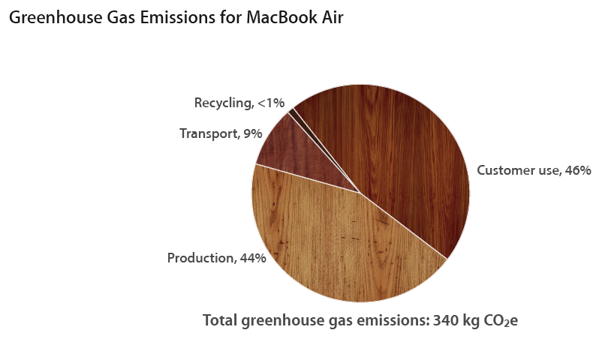
A Lifecycle Example:
Source: http://www.apple.com/environment/resources/environmentalperformance.html

Slide 32
Some Best IT Department Practices
Cloud Computing
Server Virtualization
Air Economizing
HVAC/UPS replacement
Energy Star Equipment
Thin Client Computing

Slide 33
IT Department Initiatives
IT Enabling Initiatives – Dematerialization
IT - Led Department Initiatives

Slide 34
Best IT Enabling Initiatives: Dematerialization
One of IT’s biggest opportunities to reduce the carbon footprint is to help reduce the number of material objects needed to be produced.
Source: SMART 2020: Enabling the low carbon economy in the information age.

Slide 35
Opportunities for Dematerialization
Online Media
E-Commerce
E-Paper
Videoconferencing
Telecommuting
Source: SMART 2020: Enabling the low carbon economy in the information age.

Slide 36
Other IT Enabling Practices
Enabling Power Save Features as Standard on Workstation Configurations
Printer Management (NetPrint, sharing, duplex)
Machine Consulting (laptops, thin clients)
Document Management/Collaboration Tools
IT Systems for Tracking/Measuring

Slide 37
Campus-wide IT Opportunities
Green purchasing/bundles
Machine room redesign / cooling re-engineering
Green solutions via IT
Campus Re-use/Recycle Programs

Slide 38
End User Behavior
Turn off computers at night
Use energy saving modes
Consider if you really need to print
Paperless office (laptops, collaborative tools)
Turn off lights
Recycle - paper, electronics, batteries
Purchase local where possible and green
Run back-ups/updates manually
Think “green”

Slide 39
Responsible Disposal
Every day an estimated 130,000 computers are disposed of in the U.S. alone.
And, over 100 million cell phones are thrown out annually.
Source: Allen Hershkowitz, Natural Resource Defense Council, Following the Trail of Toxic
E-Waste, 60 Minutes. Nov. 9, 2008.

Slide 40
Concerns for E-Waste
E-Waste is toxic and needs to be disposed of properly:
Lead, Cadmium, Chrominum
Mercury
Brominated Flame Retardants
Polyvinyl Chlorides
Dioxins

Slide 41
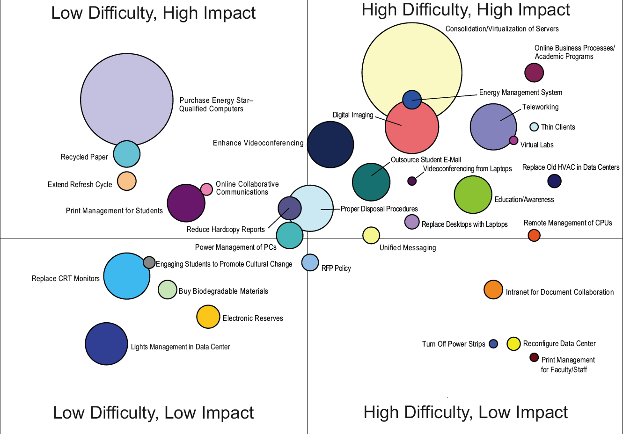
What Can IT do?
Source: Balakrishnan, Suresh, and Donald Z. Spicer. “IT and Campus Climate Change” (Research Bulletin, Issue 20). Boulder, CO: EDUCAUSE Center for Applied Research, 2008, available from http://www.educause.edu/ecar.
Notes:
Balakrishnan, Suresh, and Donald Z. Spicer. “IT and Campus Climate Change” (Research Bulletin, Issue 20). Boulder, CO: EDUCAUSE Center for Applied Research, 2008, available from http://www.educause.edu/ecar.

Slide 42
Other Food For Thought:
Being “green” is very important to Gen X and even more so to Gen Y.
Our students care about the environment.
The new workforce will look for “green” employers.
The new generation of alumni are “affinity” based in their giving. They will look for “green” programs for targeted donating.

Slide 43
Some cool “green” resources
http://www.educause.edu/groups/sustain
http://www.treehugger.com
http://www.epeat.net
http://www.smart2020.org
http://www.e-stewards.org
http://www.greenercomputing.com
http://www.ecofont.eu/downloads_en.html
http://www.climatesaverscomputing.org
Notes:
43

Slide 44
Climate Savers Computing Initiative
  The Initiative is comprised of consumers, businesses, schools and conservation organizations that have come together to cut the energy consumption of PCs in half.
  Together we can make a difference
  By enabling power saving features on their desktop PCs, U.S. college students could collectively make an enormous impact:
    Savings of more than 1.6 billion kilowatt hours per year
    Annual savings of more than $150 million in energy costs
    1 million-ton reduction of CO2 emissions from the operation of computers
    Equivalent to taking more than 200,000 cars off the road¹
  www.ClimateSaversComputing.org
¹ Based on U.S. Census Bureau estimate of the number of college students, Harris Interactive estimate of the percentage of students that own desktop computers, U.S. Department of Energy estimate of average CO2 per KW/hr, U.S. EPA estimate of average tons of CO2 produced per car, and an average energy cost of $0.0885/KW.

Slide 45
Becoming a member
Membership is free
Benefits of participation:
    Recognition on Climate Savers Computing web site and challenge website
    Recognition as thought leader in green IT and sustainability
    Energy/cost saving benefits
    Opportunity to engage campus community in sustainability efforts
    Member universities commit to:
    Align procurement with Climate Savers Computing recommendations
    Begin using computer power management on all university-owned computers
    Encourage students, staff and faculty to adopt green computing practices
Did you know?
A university with 70,000 networked computers can save as much as $3 million per year just by activating power management features on all of its computers. That’s the equivalent of removing 4,500 cars from the road for an entire year.¹
¹ Based on U.S. EPA estimate of average energy saved annually by enabling power management on a desktop computer that is left on at all times, U.S. EPA estimate of average tons of CO2 produced per car, and an average energy cost of $0.10559/kWH.

Slide 46






Power Down for the Planet
  Online Pledge Challenge
    Winner is the university or college with the highest percentage of students, staff and faculty to sign online pledge to use computer power management
    Winning University will receive publicity related to challenge program and bragging rights
  Video Challenge
    Students can create videos that tell the Climate Savers Computing story and post them on YouTube to compete for cash, Specialized bikes, Microsoft software and HP laptops.
  Timeline
    March 2 Viral Video challenge kick-off
    March 23 Pledge challenge kick-off
    March 28 Momentum-building activity for the World Wildlife Fund’s Earth Hour
    April 17 Pledge and video challenges conclude
    April 22 Challenge winners and collective impact will be announced on Earth Day
    www.PowerDownforthePlanet.org

Slide 47
For more information
  Contact:
  Kristin Hampton
  Power Down for the Planet, program manager
  Owen Media
  kristinh@owenmedia.com
  503.222.2545 ext. 223

