Slide 1
Using Web 2.0 Technologies to Develop an Online Presence: How Twitter, Wikis, and Blogs can help Turn Names on the Screen into Real People
Rose Tirotta and Paul Carson
Hofstra University

Slide 2
Community and Collaboration
Staying connected between classes
Option for private and public communications
Class collaboration and beyond

Slide 3
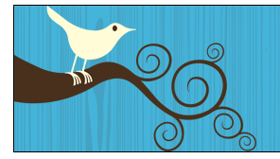
Microblogging
Twitter (http://www.twitter.com)
  Texting one to many
  Cell phone information is kept private
  Connect with others quickly
  Create a Twitter Feed for your class
    Keep students up to date
    Twitter homework, announcements
    Questions/Answers
  Professional
  Follow people as a class!
Notes:
Henry

Slide 4
Blogs
Wikis
Reactions on readings
Reflections on the class
Discussion board replacement
Continue the conversations started in class
Readings
Group projects
FAQs
Collect data
Notes:
Blue, Pace, Mary Ann Allison, Elena, Ludwig

