Slide 1
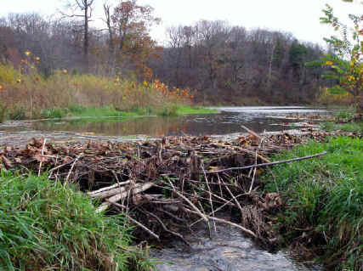
Undamming DAM
NERCOMP – Providence, RI March 11, 2009
Establishing Digital Asset Management (DAM)
Guidelines at Bowdoin College, Brunswick, Maine
Sherrie Bergman, Librarian, sbergman@bowdoin.edu
Rebecca Sandlin, Deputy CIO, rsandlin@bowdoin.edu

Slide 2
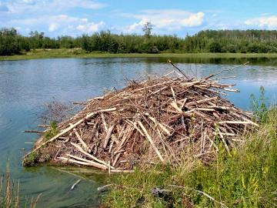
Introduction
Why we formed a working group
Early activities and work plan
The evolution and expansion of our goals
Lessons learned
Current & future projects
Notes:
Rebecca and I are going to describe the process of how staff members from a variety of departments at Bowdoin collaboratively established digital asset management guidelines to encourage and sustain campus-wide supported and self-service digitization projects.
Our project began nearly five years ago as an effort to establish common digital image management guidelines. It has developed into an ongoing effort to define guidelines for all digital formats, by forming short-term work groups to develop specific standards for file format, metadata and workflow.
Our methodology has included adding new members to bring in needed technical expertise in specific formats and to involve stakeholders in additional campus digitization service and facility initiatives.

Slide 3
How and why did we get started?

Slide 4
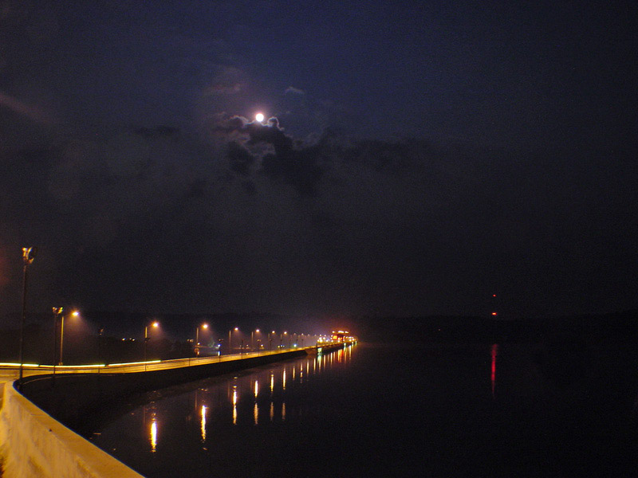
In the beginning…
DAM was DIM
Notes:
Our initial goal was the management of digital images only.
Efforts began in June 2004. The former IT Director of Computing & Research and I invited a dozen Bowdoin administrators:
to attend a meeting to identify the common needs of various campus departments related to the storage, description and presentation of collections of visual images in various formats and to explore whether there are one or more common software products that might meet our shared needs.
Those invited: the curators of the major image collections on campus, i.e., staff from the college Museum of Art, Arctic Museum, Library Department of Special Collections & Archives, Communications, Art History Department, and Classics Department, and several technology professionals in IT and the Library.

Slide 5
Why did we call a meeting at that point in time?
Image digitization had begun
Storage requirements
Need for common tools & compatible solutions
    Metadata
    Crosswalks
    Classrooms
Notes:
There were many reasons we formed our Digital Image Workgroup in 2004:
Many departments had started to digitize all or parts of their considerable photograph and or slide collections, develop new digital content and or puchase commercial digital image collections but without regard to established standards and legal issues.
Centralized storage of disparate digital collections was needed—some lived solely on a faculty member’s laptop.
IT needed to plan storage and support requirements.
Each department needed a system to catalog, organize, view, manage and display their growing digital image collections.
Crosswalks were needed among existing asset management systems to enable collection sharing.
Classroom projection equipment upgrades were needed.

Slide 6
Why did we call a meeting at that point in time?
  - Digital image use in classroom
  - Luna
  - Immediate need to spend $
  - Library/IT cooperation
Notes:
Faculty and students were interested in using digital images or a combination of print and digital images in teaching and course assignments.
Attendance at a Luna demonstration led to broader thinking about inter-departmental needs for better digital image management practices. A solution was needed that enabled security restrictions for copyright adherence.
We realistically realized that legitimate specialized requirements of some departments would make it impossible to select a tool that met everyone’s needs.
One department had budget funds for a digital image management tool that needed to be spent immediately.

Slide 7
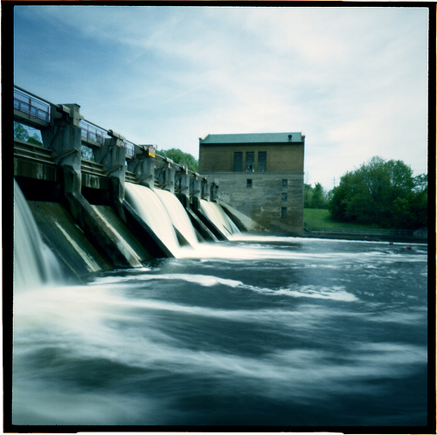
Information Technology and the Library have formed a group to look at the current and potential ways to work together, determine any and all methods of cooperation that would benefit Bowdoin College and create a permanent process for collaboration.
Notes:
The Library and IT were at the beginning of what has evolved into a highly successful model of cooperation, while maintaining separate administrative structures and identities. We were seeking opportunities for joint projects to capitalize on staff expertise in both departments to enhance service delivery to faculty and students.

Slide 8
Why did we call a meeting at that point in time?
Need for faculty and staff support & instruction:
    digitization standards –file format, metadata, workflow
    copyright issues
    project scope
    realistic timelines
    encourage broader thinking about potential uses of digitized collections
Notes:
The final and most pressing need for forming a Digital Image Workgroup: community education:
IT Consultant was inundated with work orders for assistance with digitization projects.
These faculty were uninformed about metadata, file formats, copyright issues or workflow concerns.
Faculty also had unrealistic expectations for reasonable turnaround time for massive image scanning projects.
Faculty didn’t realize metadata would help them search and manage their collections in the future.
It was time to develop a shared strategy for solving our digital image management requirements.

Slide 9
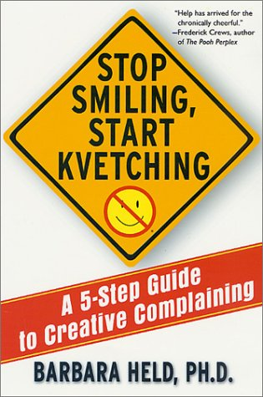
Early activities and work plan
Shared kvetching
Notes:
This is the cover of a book written by a member of our Psychology Department.
We confess we began with the universal desire to share complaints about what wasn’t going right:
faculty with unrealistic expectations, software tools with limited capability, the lack of thesauri of standard metadata descriptors…
In fairness to ourselves, we quickly passed that stage and began to articulate positive steps we could take:
Review current practices
Define unmet needs
Educate each other about current digitization projects and shared challenges.

Slide 10
Early activities and work plan
Defining unmet needs & identifying practices in use: stakeholder survey
  Image management software
  Consistent metadata standards
  Campus digital imaging center
Notes:
We designed a survey instrument to capture information about current digitization projects and practices: hardware and software in use? file formats being created? resolution sought? metadata?
We evaluated image management tools:
Wanted ability to consolidate digital collections
Needed to assist purchase of product for Communications Department.
Portfolio Extensis was selected to meet specialized needs of Communications—easily stores multiple images of same photo shot. Library and Art Department chose Luna which has a better front end.
We discussed the campus need for a high quality imaging center to generate digital images from print or two or three-dimensional sources. Rebecca will discuss current planning to meet that need.

Slide 11
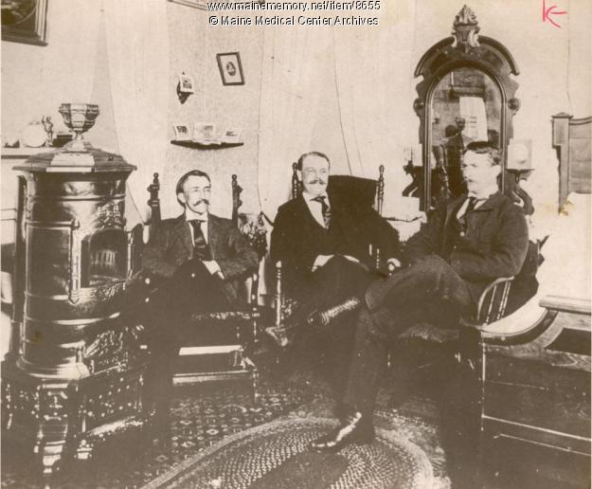
Early activities and work plan
Learning together
Notes:
We wanted to incorporate a digital image from one of our digitized collections into this presentation. We see here that learning together long has been incorporated into pedagogy at Bowdoin. [This image is provided through courtesy of the Bowdoin College Archives.] These distinguished-looking gentlemen were affiliated with the Maine Medical Center, the medical school administered by the College in the 19th century.

Slide 12
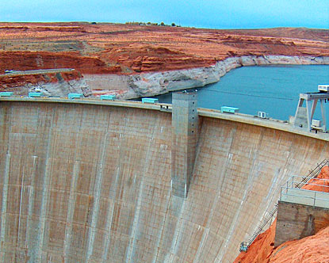
Work Plan
Notes:
Utilizing data collected through the stakeholder survey, we established a work plan which included forming three sub-groups to educate each other.

Slide 13
Work Plan
Writing Digital Image Guidelines
Sub-groups:
- Metadata
- File format
- Workflow/business process
Notes:
Metadata: As mentioned earlier, we needed consistent field assignment of descriptive metadata elements and a shared thesaurus of terms, e.g., the ability to use consistent names for the same campus building. We knew that without metadata, scanned images could never easily be accessed by others and probably wouldn’t even be easily accessed in the future by the image creator! Yet faculty often are impatient to begin the scanning of a carousel of slides and don’t want to bother with metadata.
File formats: IT specialists were concerned that faculty were choosing inappropriate file formats or resolution as they digitized. We wanted to avoid the wasteful need to re-scan for future uses of already scanned images.
Continuing education series workshops for the group:
College Archivist and Curator/Registrar of the Arctic Museum presented on Dublin Core.
Two IT specialists gave a workshop on file formats for digital images.
Two other IT specialists presented on the process and workflow steps involved in digitization projects.
Workflow: faculty and students were confused about whom to call for what service among campus departments--IT, the Library, the Language Media Center--And again, faculty had unrealistic expectations of time requirements or copyright law related to digitization.
We wanted the process to be easy for both IT service providers and their clients. We thus consolidated service provision through inter-departmental cooperation and created a Whom to Call for What page on the Library and IT websites.
The writing of the Guidelines:
Continuing ed workshops were very useful in determining how to write and publish the Guidelines.
Each sub-group was asked to draft individual Guideline sections (metadata, file format, workflow)
Type of online Guideline to publish: some faculty would never read beyond the answer to a pressing question, e.g., which file format do I use? Thus we decided to present the Guidelines in sections; the more patient could read the entire document; others could read just a section and IT staff could print handouts to answer quick questions.
Rebecca now will continue by presenting an overview of our DAM Guidelines, explain some lessons learned, and describe the continuing evolution of our Guidelines into current and future projects.

Slide 14
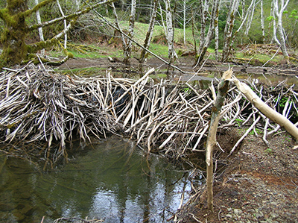
Evolution and Expansion of Our Goals
Created DAM guidelines for Digital Images
  Introduction
  About
  Definition of a Digital Image
  Copyright Standards
  Security and Permissions
  Project Planning
  Collection Selection
  Building the Collection
  Acquiring Digital Images
  Color Management
  Learning Digital Image Skill sets
  Maintaining the Collection
  Standards Review
  Workgroup Membership
  Workflow
  Glossary
Notes:
Thank you, Sherrie!
About 2 years ago, we finally completed and published the DAM guidelines.
This was essential because:
Some people in our community are very independent so we wanted to create self-service documentation – published to the web – with contact information in case they wanted support.
The guidelines would be complex because there are so many aspects to creating digital images, but we worked hard to make them as user-friendly as possible.
If an explanation for a task became too complicated to document in a user-friendly manner, we added a suggestion calling the multi-media support line.
We hope the website prevents our worst fear – that Sherrie described earlier -that some faculty member out there was spending a lot of time digitizing a collection of thousands of images – only to have to do it again in the future.
This is the main menu on the website:

Slide 15
DAM Guidelines
Digital technology has fundamentally altered how we can use and disseminate information for teaching, learning, and research.

Slide 16
DAM Guidelines
Digital collections can eliminate many of the physical, economic, and social barriers that have traditionally confined access to information resources within academia and among the general public.

Slide 17
DAM Guidelines
Digitization is an especially powerful tool in increasing our ability to organize, locate, view, control, and share information.
Notes:
The guidelines took about a year to complete and it was a slow and oftentimes tedious process.
Everyone in the group was already busy with their existing workloads so the DAM website could not be built in a day.
Also, it was very important to have consensus about the format and the content among the group members – which of course added a lot of time.
One lesson that we learned is that impatience has no place in the DAM process.
Another lesson I learned was to free up at least part of an employee’s - who was one of our top DAM experts - workload so she could dedicate more time to this endeavor.
Part of the DAM guidelines explained the importance and impact of digitizing image collections.

Slide 18
DAM Standards
Copyright
Security and Permissions
Budget
Software and Hardware
Metadata
File Storage
File Naming
Scanning
Resolution
File Format
Color Mode
Color Space
Notes:
There were many hours of intense discussion about DAM standards because this group really cared; the standards would reflect our institution.
Workgroups were created to get through the more complicated areas of standards creation: copyright, metadata, file format and workflow.

Slide 19
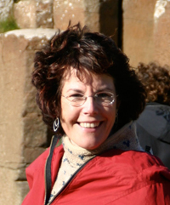
Tribute to Ruth Bartlett
1959 - 2007
The late Ruth Bartlett, our dedicated colleague and generous friend, was a founding member of Bowdoin's Digital Asset Management group. As the editor of our digital image guidelines, Ruth undertook each task guided by her vision to educate people in the use of technology for research and instruction. Here we pay tribute to Ruth's bold sense of humor, her serious understanding of digital workflow and her fine ability to kindle and nurture relationships with students and faculty, librarians, her IT co-workers, many vendors, and colleagues in the larger academic IT community.
Notes:
About 15 months ago, the employee who spent the most time on the DAM guidelines passed away and since she would have surely been one of the presenters here today otherwise, I would like to pay tribute to her.

Slide 20
Evolution and Expansion of Our Goals
DAM Guidelines at
www.bowdoin.edu/it/dam
Notes:
Feel free to use our guidelines as needed. After everything we went through, it would be great if the guidelines could help our fellow NERCOMP institutions (!)

Slide 21
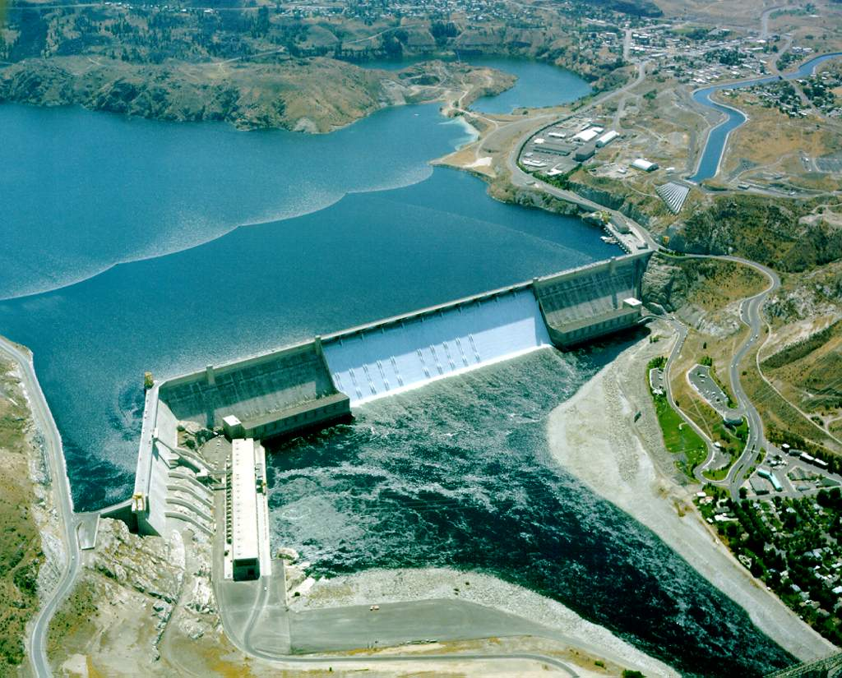
Current & Future Projects
Notes:
Even during the early years, future vision was frequently being discussed and after the DAM guidelines were published, the DAM group was energized and knew that now anything was possible.
The DAM group wanted to move to digitization beyond still images.
We had many of the right players to further develop a college copyright policy to ensure that staff working on digitization projects would be “protected.”
In the future, we envisioned that the DAM groups efforts were laying some of the groundwork for an institutional repository.
As more faculty and staff were digitizing, a digitization center would be needed.

Slide 22
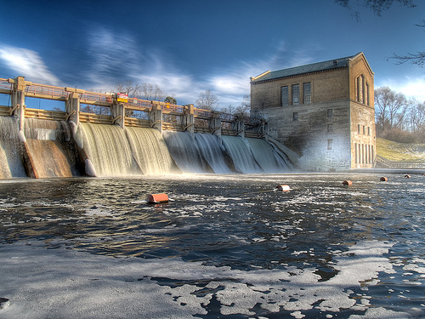
DAM Changes
New subgroups, new initiatives and better communication

Slide 23
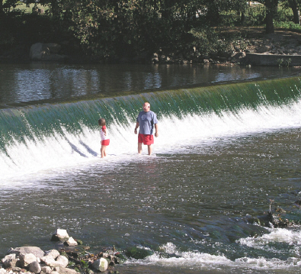
DAM Subgroups
Image
Video
Audio
Notes:
The group decided to quickly start work on writing guidelines for video and audio digitization.
It was decided to incorporate the new guidelines into the existing image guidelines.
Even though it might be harder to write this way, it would definitely be more user-friendly by providing one-stop shopping for digitizing documentation.
------How many DAM guidelines did one small liberal arts college need?!

Slide 24
DAM Sub-Subgroups
Image, Video, Audio Subgroups
  File Format
  Metadata
  Workflow
Notes:
We are now completing standards for video and audio.
We drafted new representatives to the DAM group from IT, the Library and the Music Department to help with this effort.

Slide 25
Shared Audio DAM Vision
Music
Theater & Dance
IT – Database, Systems & AV
Events
Library – Special Collections, Music
Communications
WBOR
Student Activities
Museums
Academic Dean’s Office

Slide 26
Introduction to (not quite ready) website in progress
These guidelines contain a mix of policies, best practices, and procedures. They come from many hours of work by the Digital Image Asset Management Group and by the Digital Video & Audio Asset Management Groups, including extensive testing of hardware, software, and best practices.
Notes:
We determined departments most involved with audio production on campus and assigned representatives as needed to the new Audio subgroups.
One member of the music department was asked to become a permanent member of DAM.
Comfortable relationships among DAM members make it easier to form groups to solve related problems and plan for the future:
Improving the process of tying together signed releases and recordings for visiting entertainers and speakers
With video group, we knew who should start the discussion on BlueRay in the classroom – yes, no or maybe?
Consensus and trust had emerged from †he hard work and cooperation of the DAM group

Slide 27
What is Protected by Copyright?
Notes:
We wanted the DAM website to be helpful to all levels of experience and did not assume any prior knowledge from our clients answering even the basic questions such as:

Slide 28
What is Copyright?
Copyright is a constitutionally protected right that gives authors and artists — creators of original works — the legal right to exclude others from using their works.
Copyright encourages creative efforts by giving creators of works the exclusive right to reproduce their work, prepare derivative works, distribute works, and derive income from them.
Ideas, concepts, and facts are not eligible for copyright protection.
Notes:
Now that we understand copyright a little better:
A Copyright Subgroup was formed to answer the question: (NEXT SLIDE)

Slide 29
What is protected by Copyright?
Almost all works fixed in a tangible medium are covered by some form of copyright protection. This protection is automatic; when a covered work is created, it is protected from the date of creation until the copyright expires.
Notes:
A Copyright Subgroup was comprised of a museum curator, media services librarian, deputy CIO, Librarian and associate librarian, and the assistant treasurer - who is also an attorney.

Slide 30
What is protected by Copyright?
In most cases, to use works created by others, one must obtain permission from the legitimate copyright owner. There are exceptions:
  works for which the copyright has expired, such as works that are in the public domain;
  materials covered by the "fair use" doctrine; and
  other exceptions defined by copyright statutes and related amendments.

Slide 31
What is protected by Copyright?
While most works are covered by copyright law automatically upon creation, registration of the copyright with the U.S. Copyright Office provides added protection for the owner's copyright. Statutory damages up to $150,000, as well as attorney fees, can be awarded if works are promptly registered.
In the case of unpublished works, registration must occur before the unauthorized use. Published works should be registered within three months of publication
Notes:
The Copyright Subgroup drafted copyright guidelines; we are in the process of issuing them as a copyright FAQ to be linked to the DAM Guidelines.

Slide 32
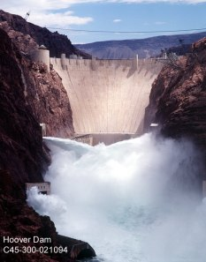
Shared IR Vision

Slide 33
Shared IR Vision
“Research is more valuable when it’s shared.” (www.arl.org/sparc)
Notes:
From early on, we had a shared vision that – through DAM - we may have been laying groundwork for an institutional repository.

Slide 34
Shared IR Vision
“The program, developed by a diverse and expert program committee, delved into four key areas: The Policy Environment, New Horizons, Campus Publishing Strategies, and Value-Added Services.?” (www.arl.org/sparc)
Notes:
Several of us attended the SPARC-IR conference in November 2008 (4 from library and 3 from IT) to learn together so we would communicate better as we work together toward an institutional repository.
Attending the conference as a group had a similar benefit as attending DAM meetings together; our shared experience allowed us to “speak the same language” and benefit from the same lessons learned.
It was encouraging that there was a lot of consensus before the end of the conference about which software and what early pilot projects would make the most sense for Bowdoin.
We have just scheduled the Bowdoin kick-off meeting to discuss the long range goal of establishing an institutional repository.

Slide 35
Campus Digitization Center Revisited
The proposed Digitization Center is to have two purposes:
1. Accommodate the digitization needs of the college.
2. Function as a creative and academic center.
Notes:
A campus digitization center has become a hot topic on campus. There were some integral moments which led up to this:
For two years, our showplace for image digitization was Beam Classroom. We achieved our goal which was to replace the two slide carousels with one computer, one projector and still have easily changeable dual side by side images for Art History classes. The image quality needed to be the best possible in order to win over the faculty who did not have confidence in digital images – this goal was also achieved and there is still a waiting list of image digitization projects as a result.
A year ago, Small Art Department lab with digital scanning and printing funded by IT only met part of an unmet need.
Last summer, a funding request from Art Department to Academic Dean’s Office for a campus digitization center.
New group led by Associate Academic Dean (who is also member of DAM)
Needs for services are coming from a lot of different quarters, individual faculty, departmental requests, etc. The deans office said they want to do something collaborative, affordable is in the best interest of the College.

Slide 36
Campus Digitization Center Revisited
Its space plan will reflect these purposes, with a utility space dedicated to the digitization and conversion of existing media, and a studio space for instruction and creation of new media projects. While initially devoted to the capture, creation, and management of imagery, the facility will evolve to include text, audio, and video.
Notes:
The goal is to bring together a small working group to facilitate development of a facility somewhere on campus, discussions and meetings began in January.
The College has allocated a gift to establish the facility.
Initial discussions will focus on the need to establish a footprint for facilities – they are looking around at a number of spaces that could be used. Probably no facility will satisfy everyone.
Optimistically, they would like to have the facility up and running by this time next year, with a consideration for the short term needs of Art Dept. The group will:
Look at sites
Develop lists of equipment
Look at/understand expenses
Generate implementation plan

Slide 37
Web as College Communications Tool
DAM Guidelines just in time for populating social networking sites…
Notes:
DAM Guidelines are just in time for populating social networking sites which are one of our newest multimedia –related endeavors…this is just one example and we expect the guidelines to continue to be useful and evolve as the community finds more ways to use digital media.

Slide 38
Questions?
DAM lessons learned from your institution that you would like to share?
Notes:
Questions?
DAM lessons learned from your institution that you would like to share?

Slide 39
Thank you!

