Slide 1

Sharing the Wealth:
Creating a University-wide Security Council
Anne Agee (CIO)
Robert Sarao (Security Officer)
University of Massachusetts Boston
Copyright Anne Agee and Robert Sarao 2010. This work is the intellectual property of the authors.
Permission is granted for this material to be shared for non-commercial, educational purposes,
provided that this copyright statement appears on the reproduced materials
and notice is given that the copying is by permission of the author.
To disseminate otherwise or to republish requires written permission from the author.

Slide 2
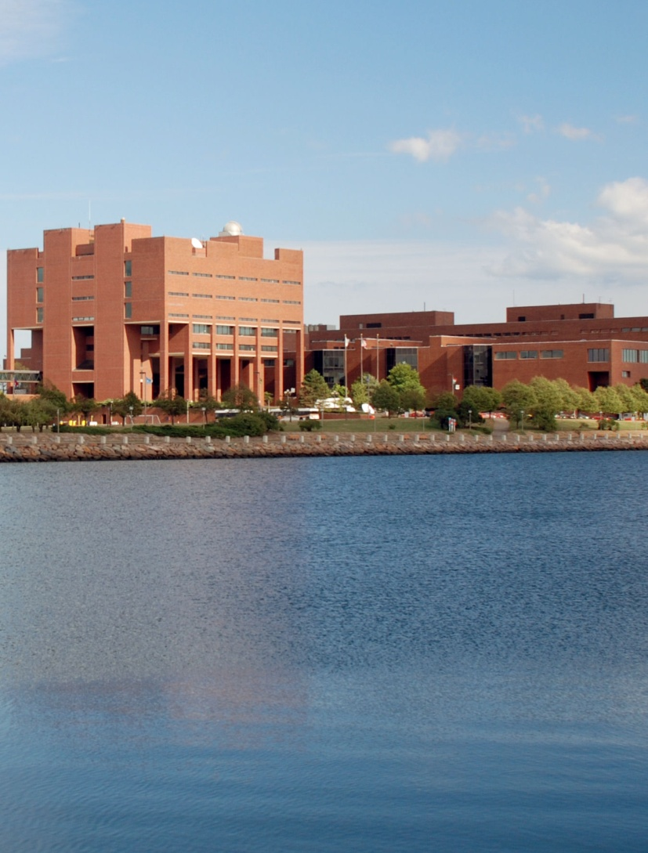
About UMass Boston
Research University with a teaching emphasis
Urban public institution
Non-residential
7 colleges, 30 institutes
Faculty—462 FT 451 PT
Staff—1074 FT 458 PT
Fall 08 Students
  Undergrad—13,560
  Grad and Prof—4996

Slide 3
The Impetus
Increasing attention to data breaches
External regulations
  Massachusetts General Law on PII
  Federal “Red Flags”
  FERPA revisions
  HEOA
University policies
External auditors
Internal auditors

Slide 4
The Impediments
Lack of ownership for data security
  “It’s an IT problem”
Dispersed data ownership
Lack of knowledge
Lack of resources—people and money
Disparity of security solutions
Many silos

Slide 5

The Response
November 2008
  Create a University-wide Information Security Council
  Presented proposal to University Executive Council
  Solicited Members from each business area
March 2009
  Hire a Security Officer

Slide 6
ISC Responsibilities
Help ensure university compliance with state and federal regulations on security and privacy of university data.
Educate the university community about trends in security and privacy that have the potential to affect how the university does business.
Recommend to the Chancellor of the University of Massachusetts Boston remedial actions to identified problems.
Review policies and procedures developed by departments or units within the university to ensure that these units have appropriate security measures that will protect institutional data from compromise or unauthorized access, modification, destruction or disclosure.

Slide 7

Membership in the ISC
Initially, 24 people from 20 departments
Currently, 33 people from 27 departments
No one wants to be left out!

Slide 8

The Results
Information sharing
Improved security awareness
Development of shared guidelines
Better understanding of security issues and tools
Easier rollout of security software

Slide 9
Information Sharing
Server Inventory
Printer security
Tips and advisories

Slide 10
Improved Security Awareness
Review of University security training
Additional security class added
Security Awareness day-long training
Presentation by University policy officer
Presentation by University internal auditor
Shared training opportunities

Slide 11
Development of
Shared Guidelines
Server security
Desktop security
Laptop security
Paper security

Slide 12
Better Understanding of Issues and Tools
What is Personally Identifiable Information (PII)?
Where is PII?
What tools can we use for encryption?
House calls from Dr. Bob

Slide 13
Overall Benefits
Increased level of data security
Security gaps identified
Knowledge base improved
Users know help is available
Improved collaboration b/w IT and business units at the University

Slide 14
Questions/Discussion
Anne.Agee@umb.edu
Robert.Sarao@umb.edu

