Slide 1
LLEK Koha:
One Year After Launch of an Open-Source ILS
Presented by:
Nina Lee, MLS, Head of Technical Services & Automation,
Braddlee, Ph.D., Dean of Libraries, Academic Technology & Online Learning,
and Robert McKenna, B.S., Circulation Manager
March 30, 2011

Slide 2
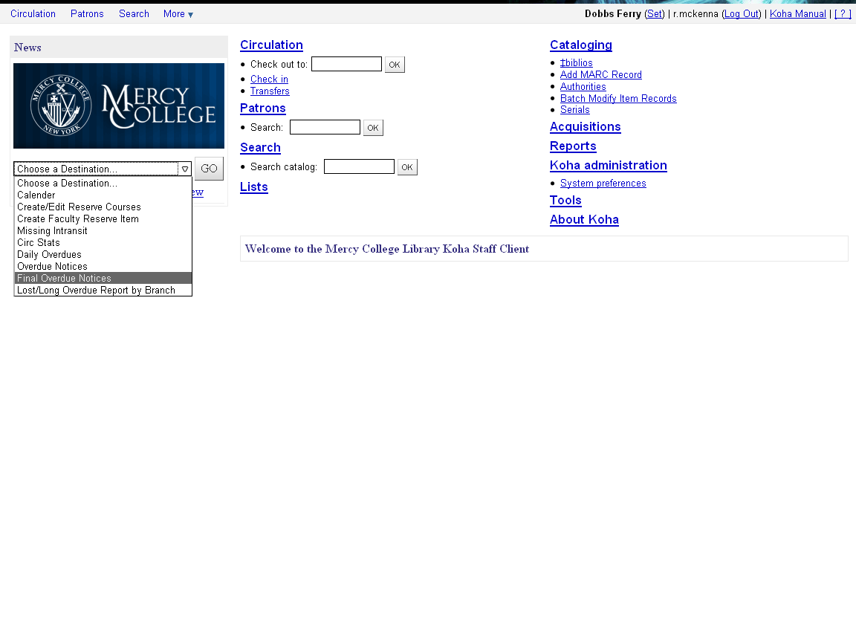
Koha Staff Client

Slide 3
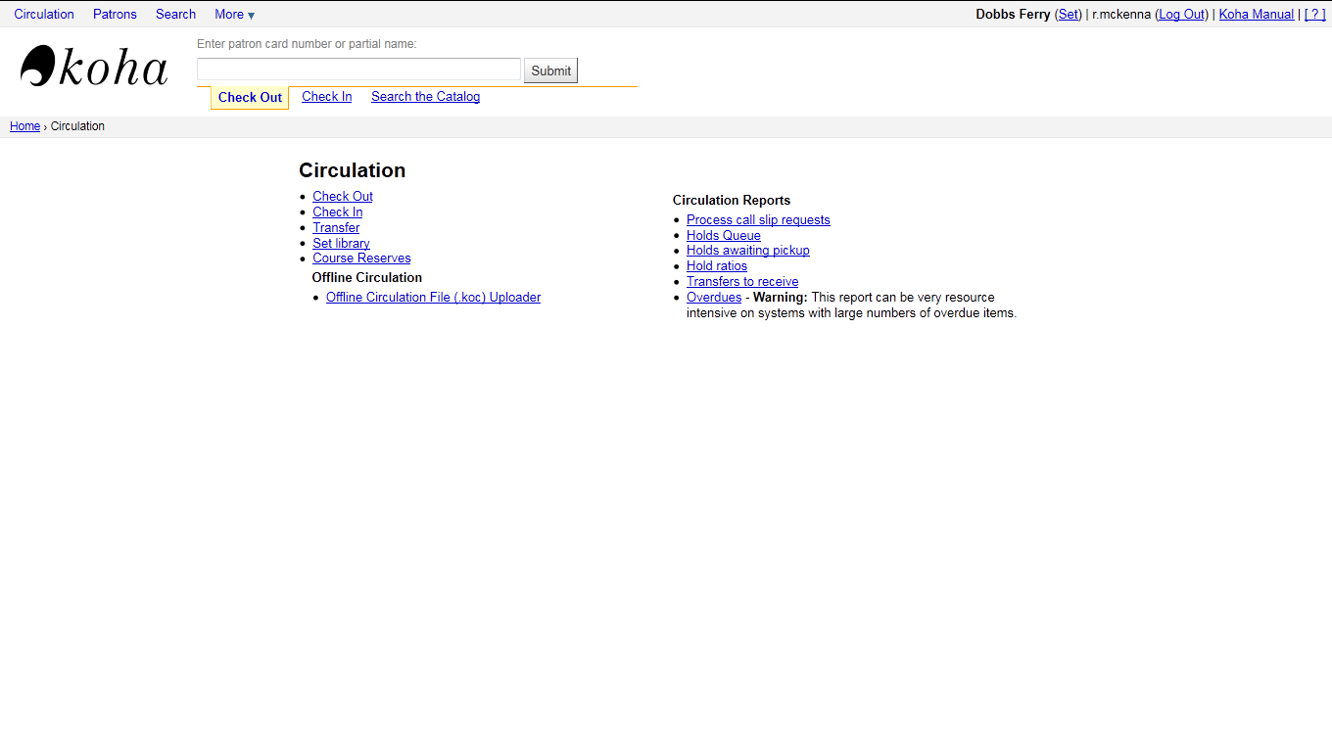
Circulation
Circulation Module home screen

Slide 4
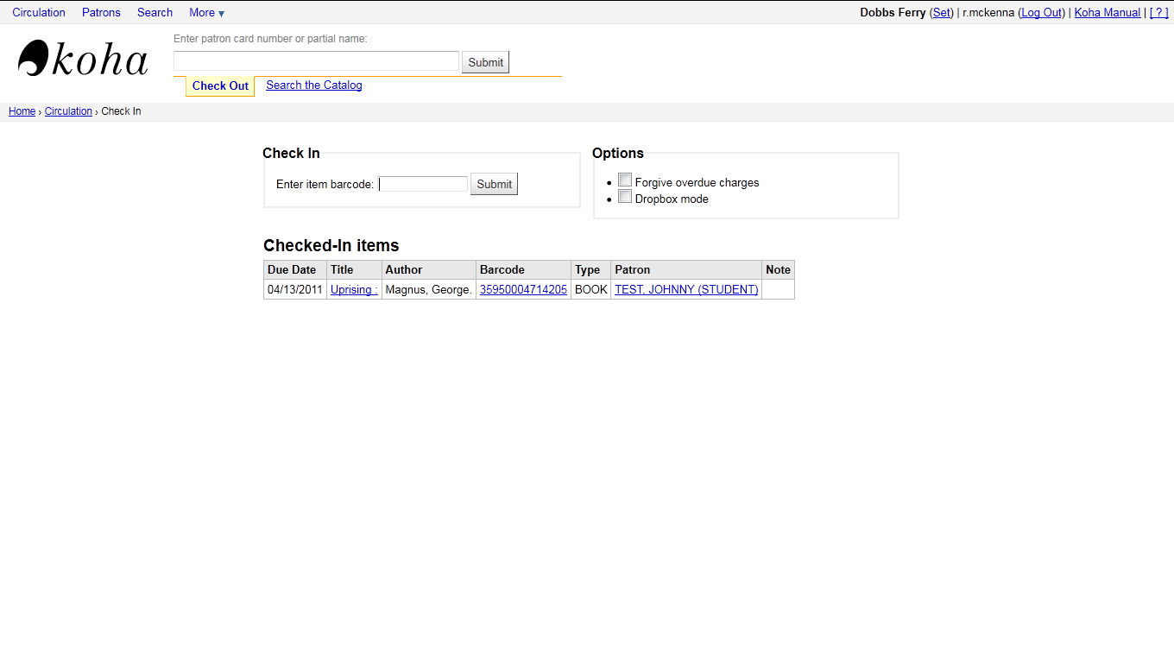
Circulation
Checkin Screen

Slide 5
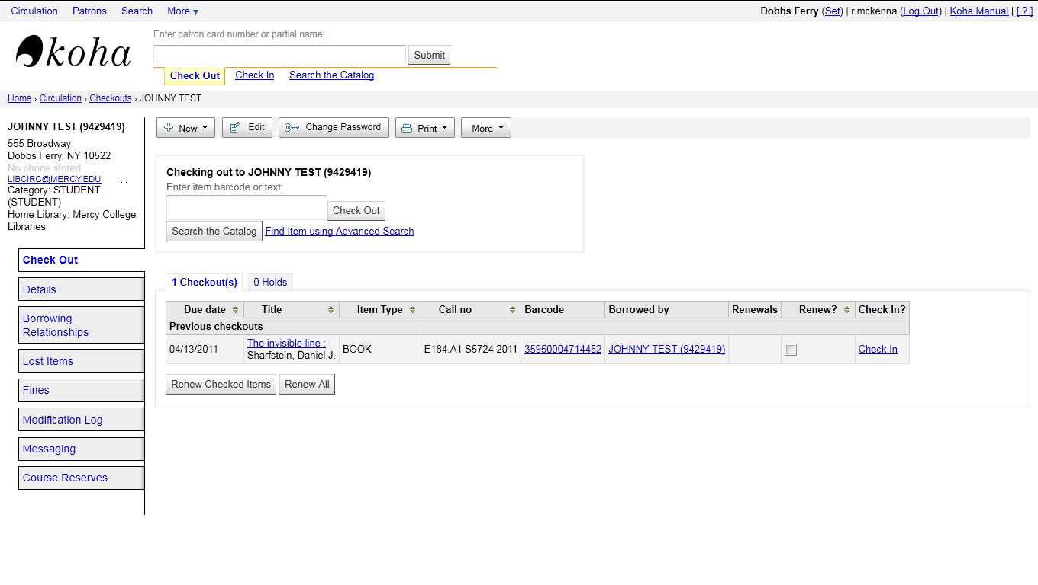
Circulation
Checkout Screen

Slide 6
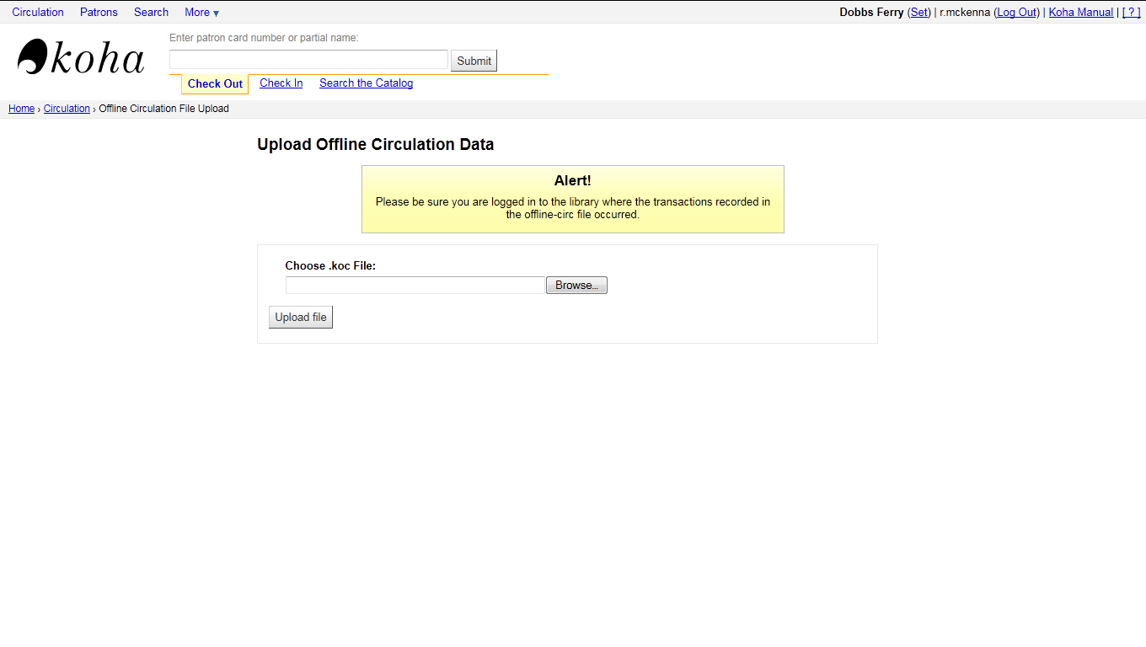
Circulation
Offline Circulation import tool

Slide 7
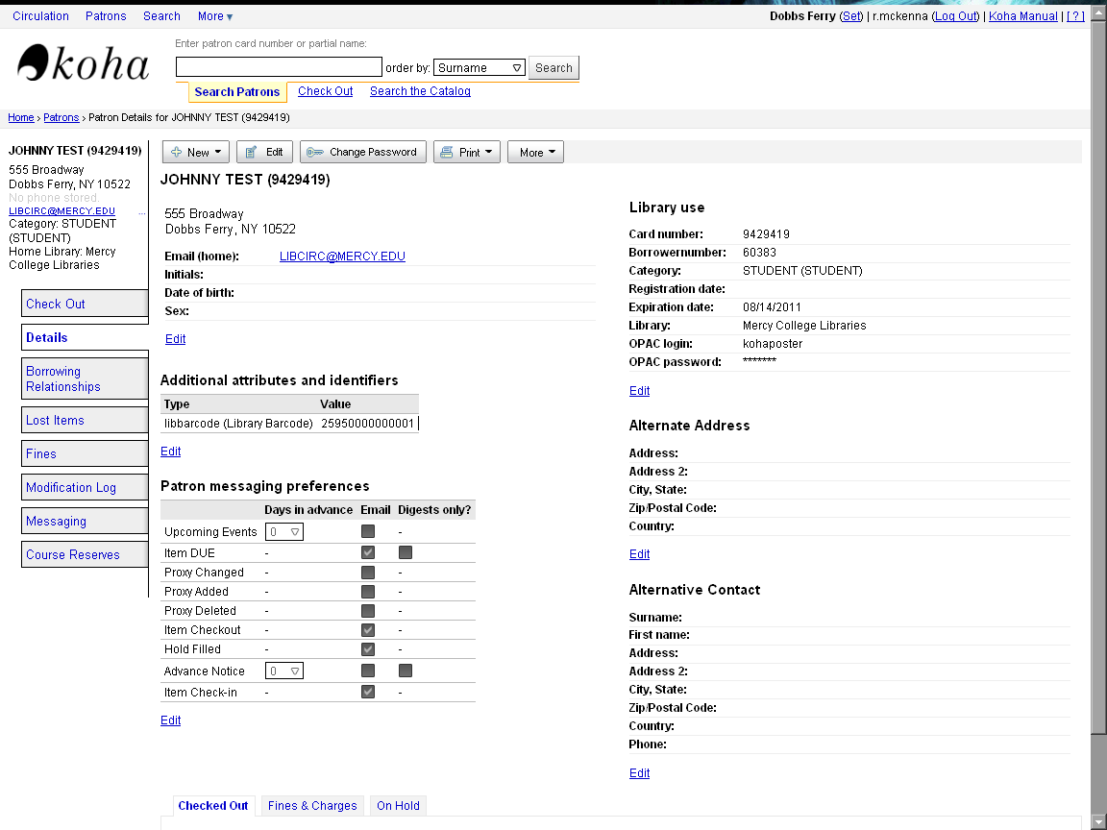
Patron Records
A typical patron record in Koha

Slide 8
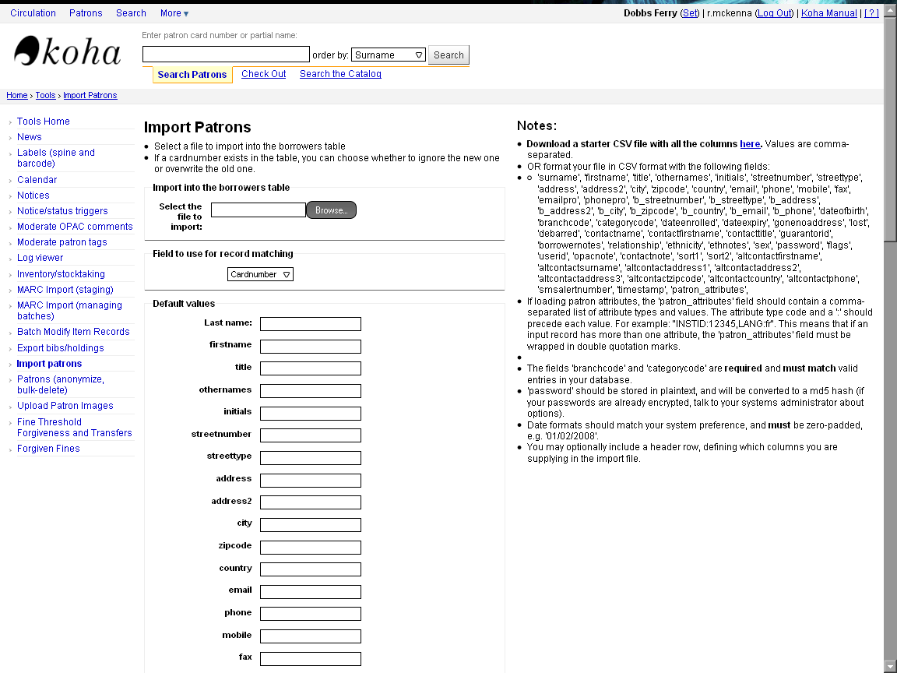
Patron Records
Patron Load importing tool in the staff client

Slide 9
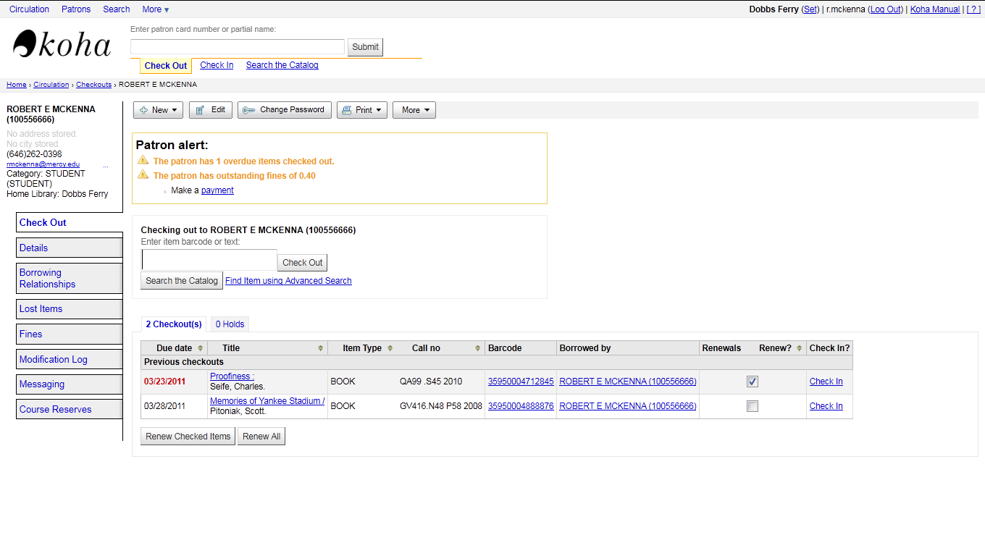
Patron Records
Patron Record with fine and overdue alerts

Slide 10
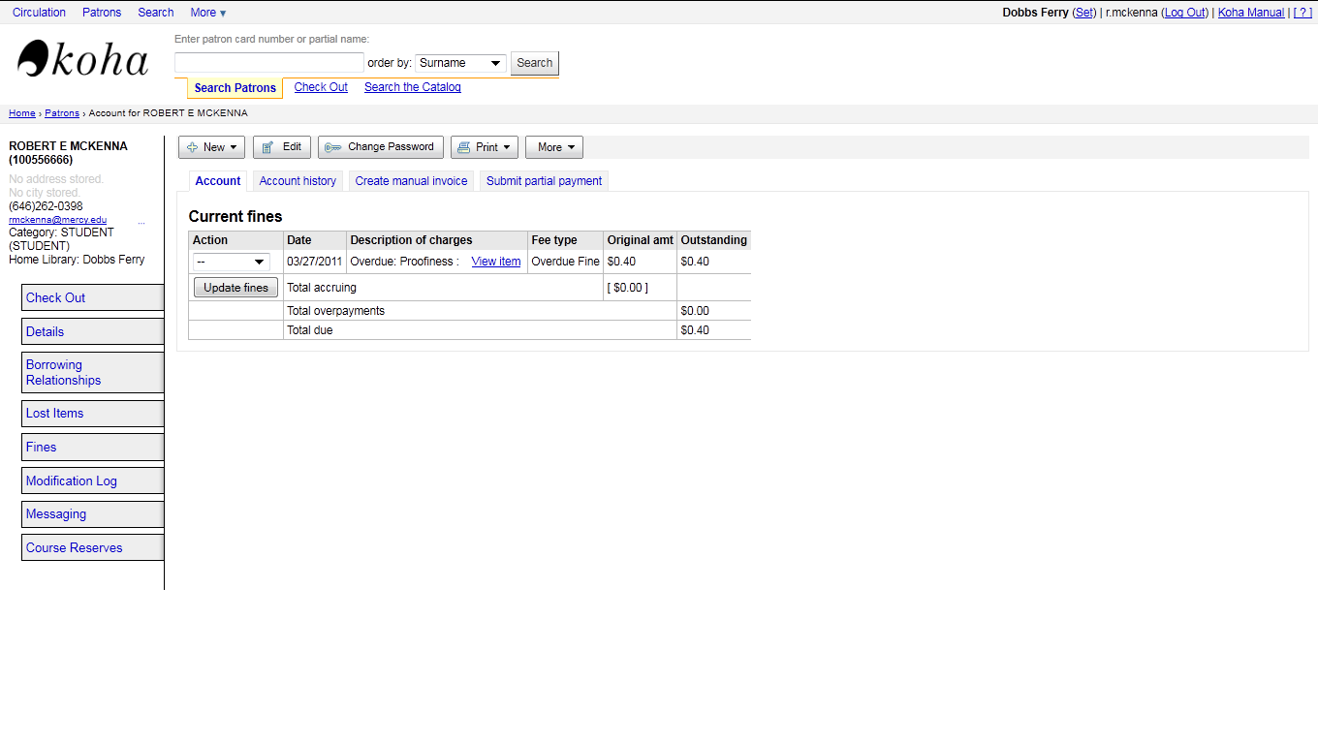
Patron Records
Fine Payment Processing

Slide 11
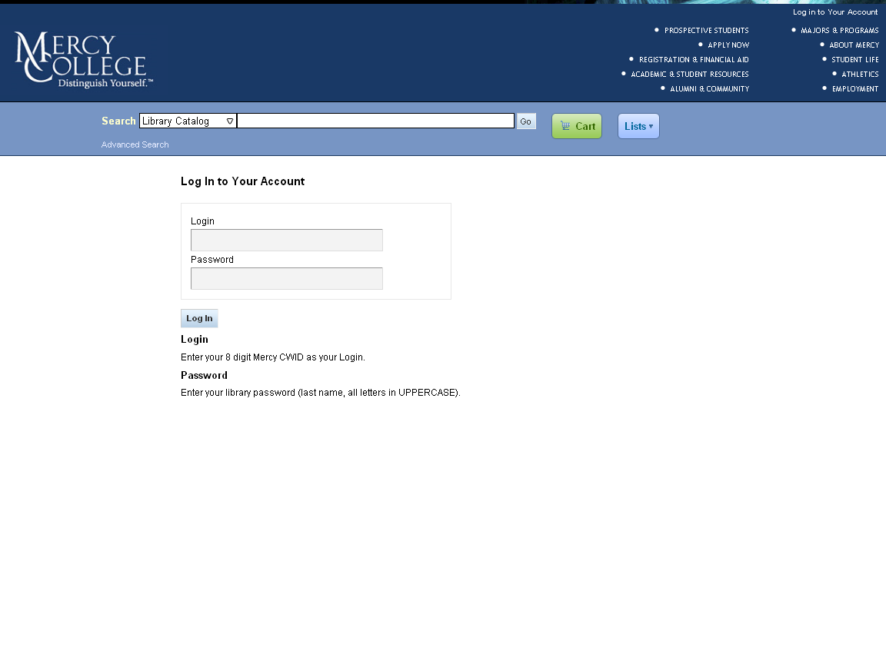
Patron Records
OPAC login screen

Slide 12
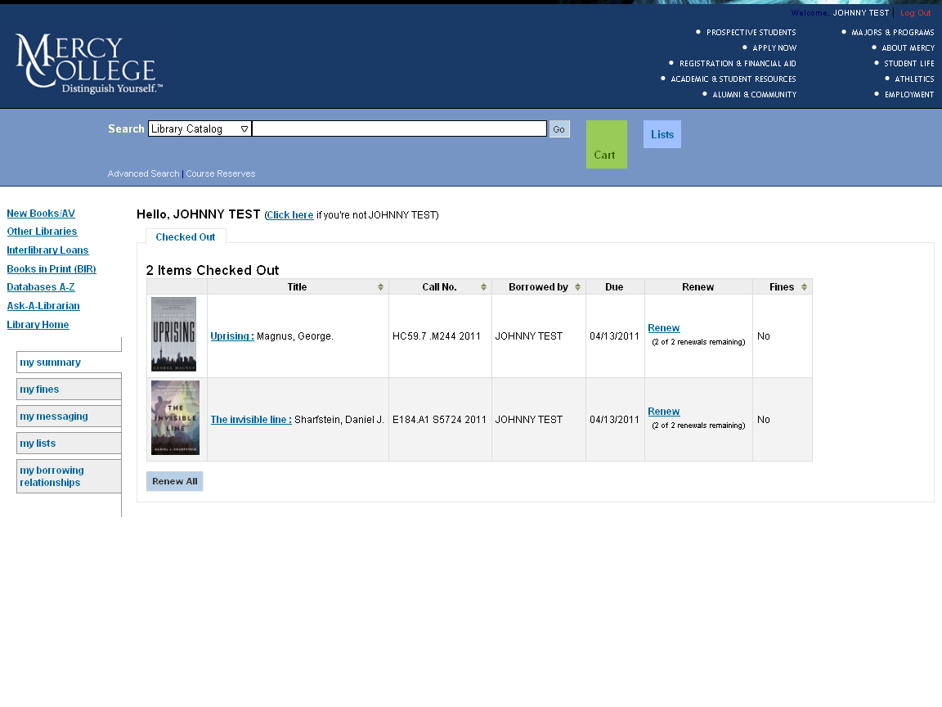
Patron Record
A patron record display in our OPAC after authentication

Slide 13
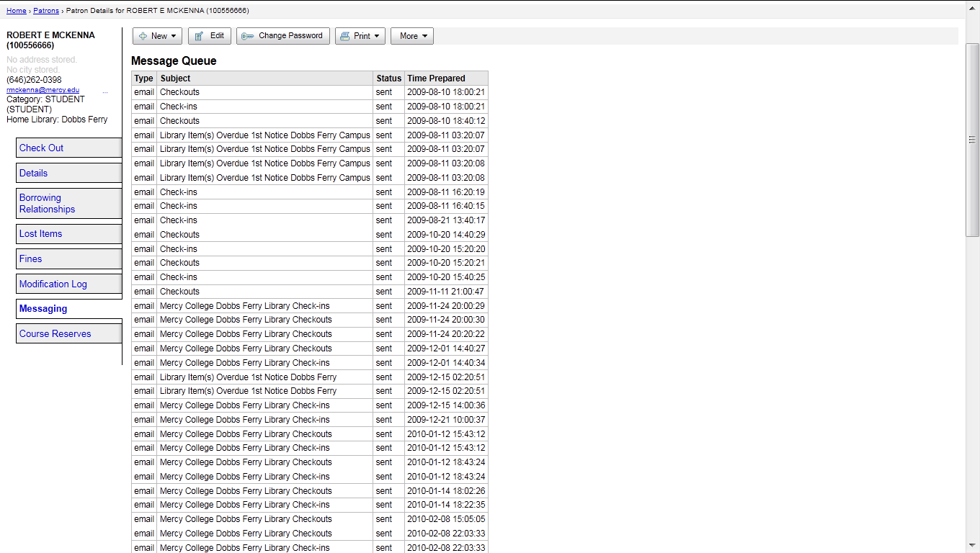
Notices
Patron Notice queue

Slide 14
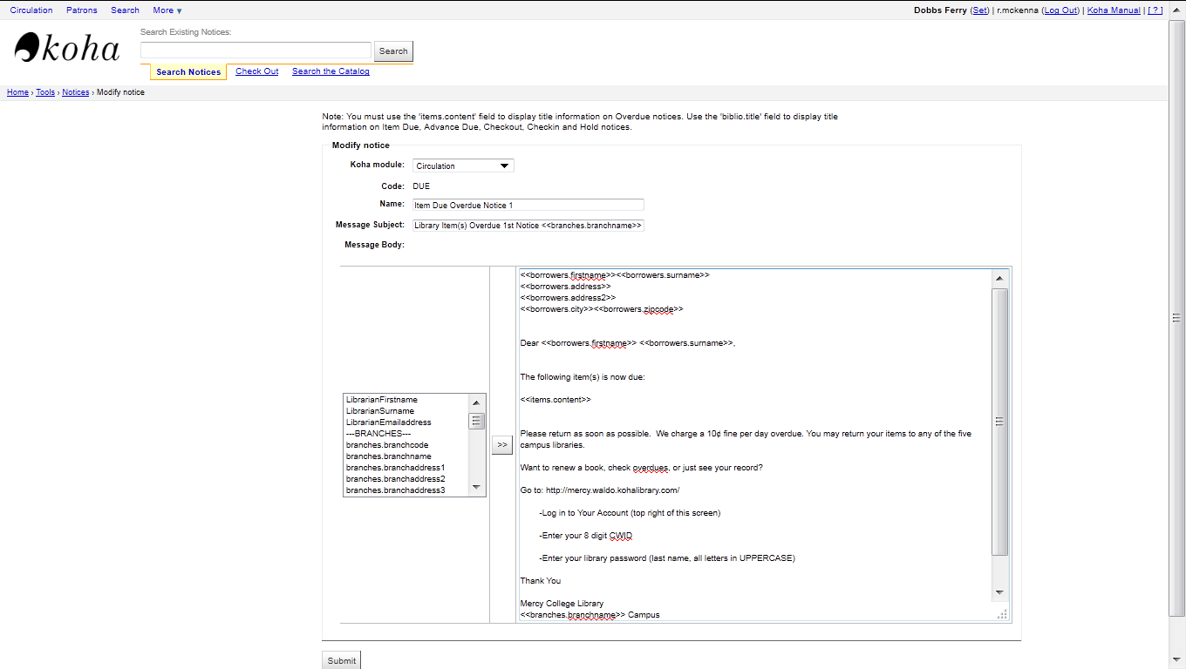
Notices

Slide 15
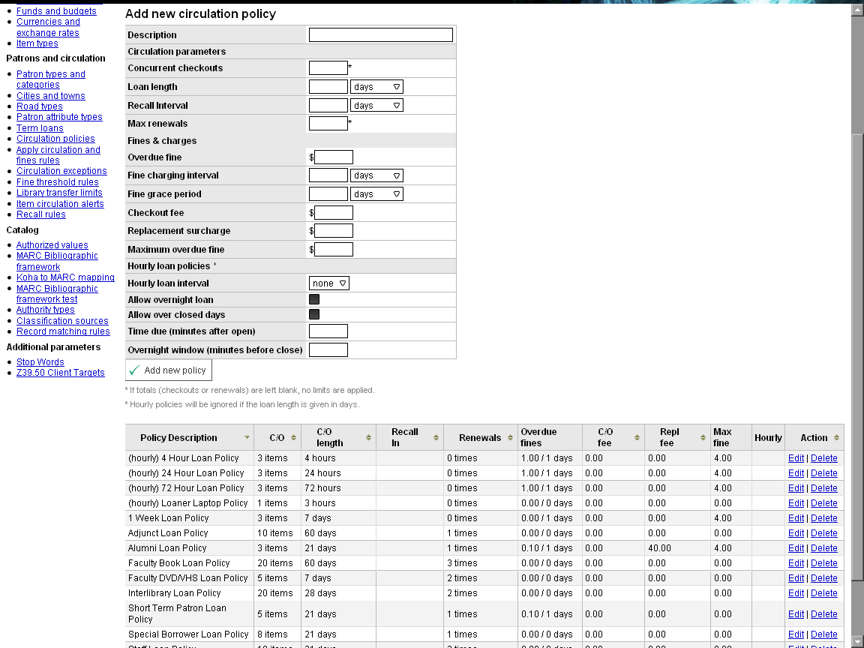
Policy Matrix

Slide 16
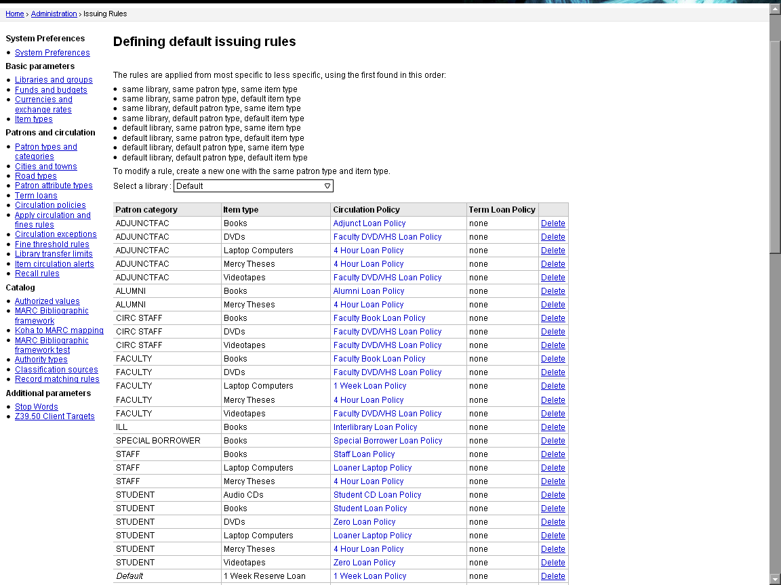
Policy Matrix

Slide 17
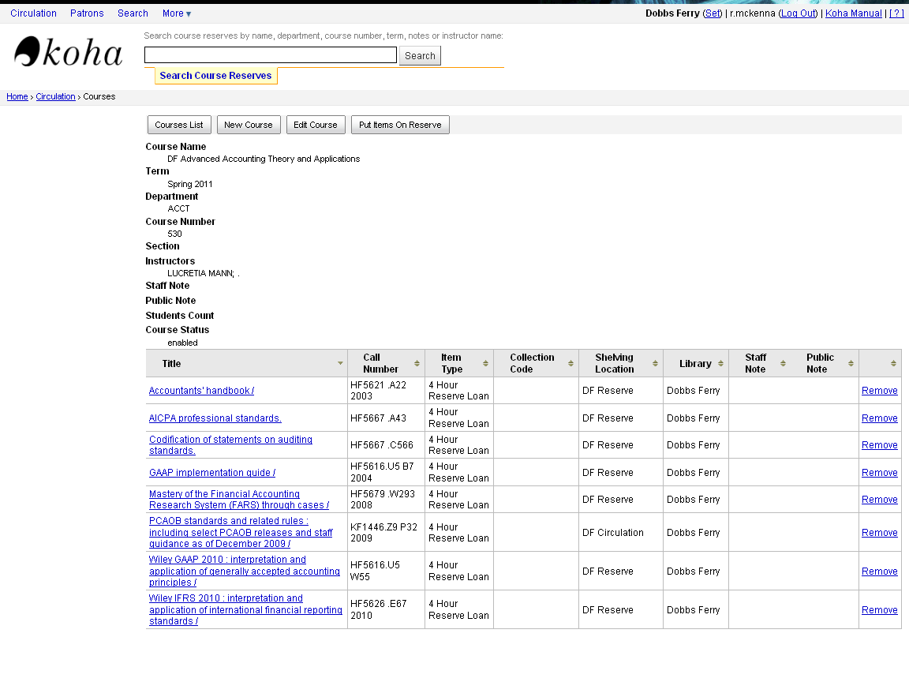
Course Reserves
Course Reserves editing screen in the staff client

Slide 18
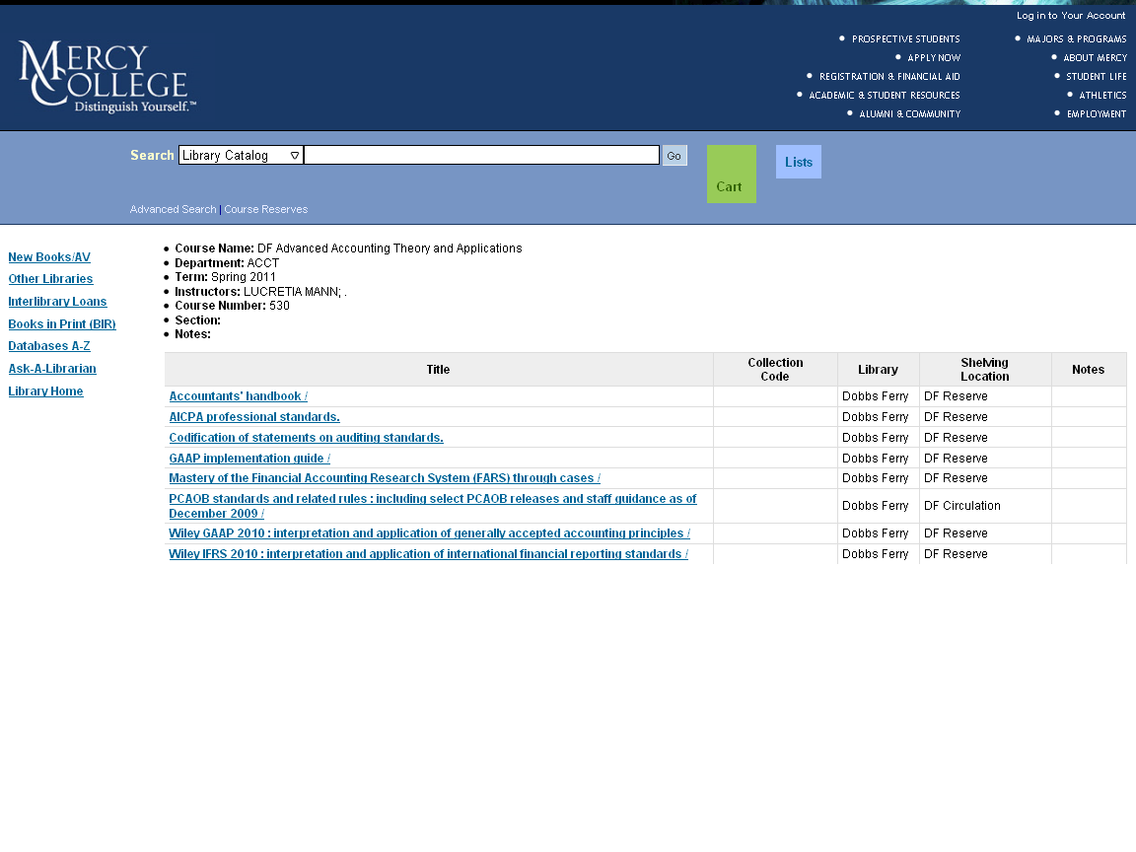
Course Reserves
Course Reserves display in the OPAC

Slide 19
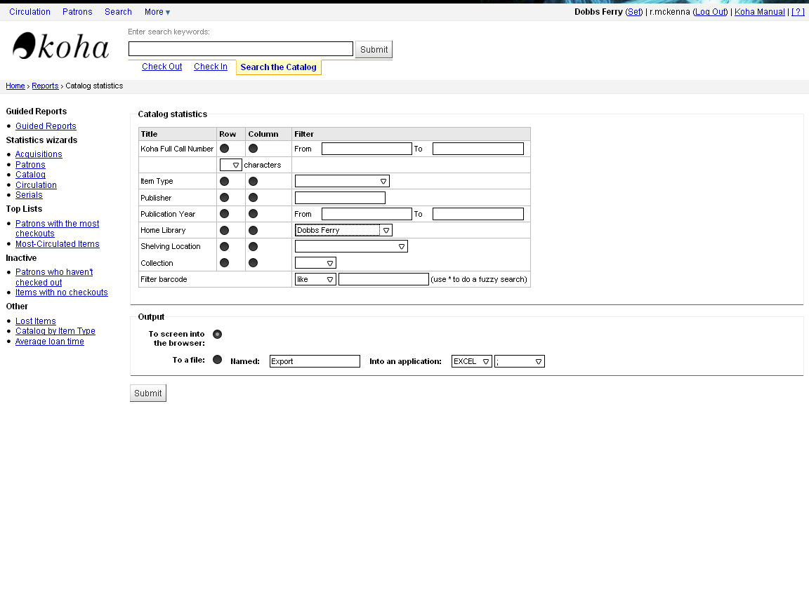
Reports
Cataloging Statistics Wizard

Slide 20
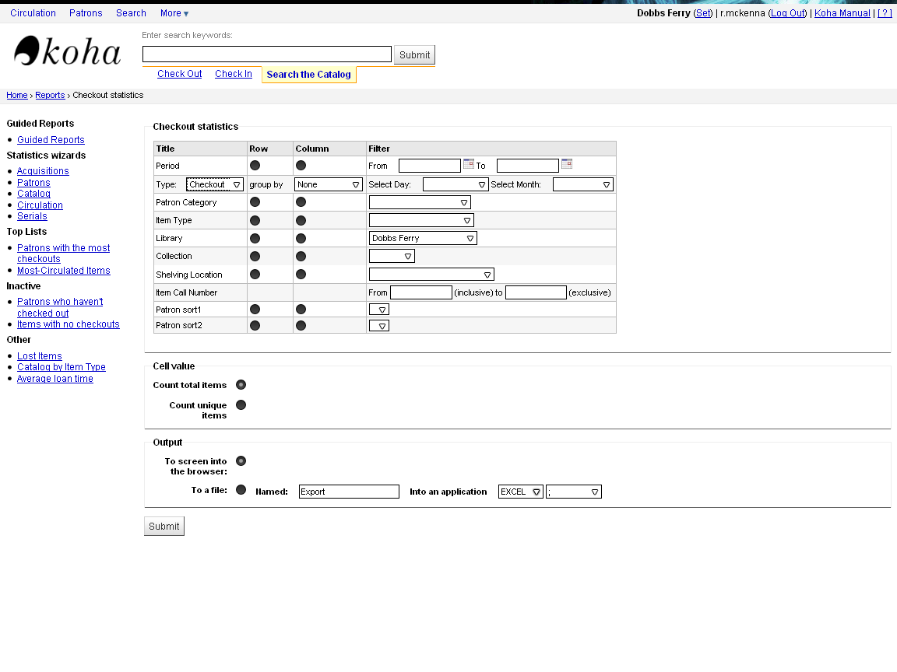
Reports
Circulation Statistics Wizard

Slide 21
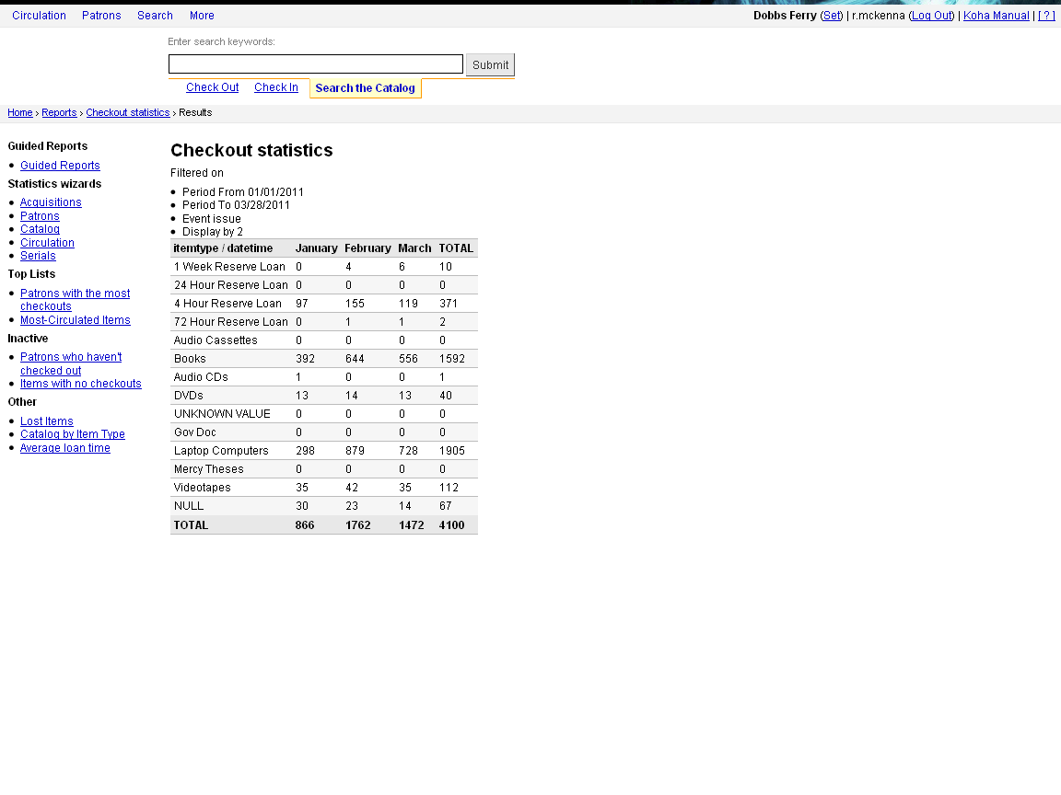
Reports
Circulation Statistics January –March 2011

Slide 22
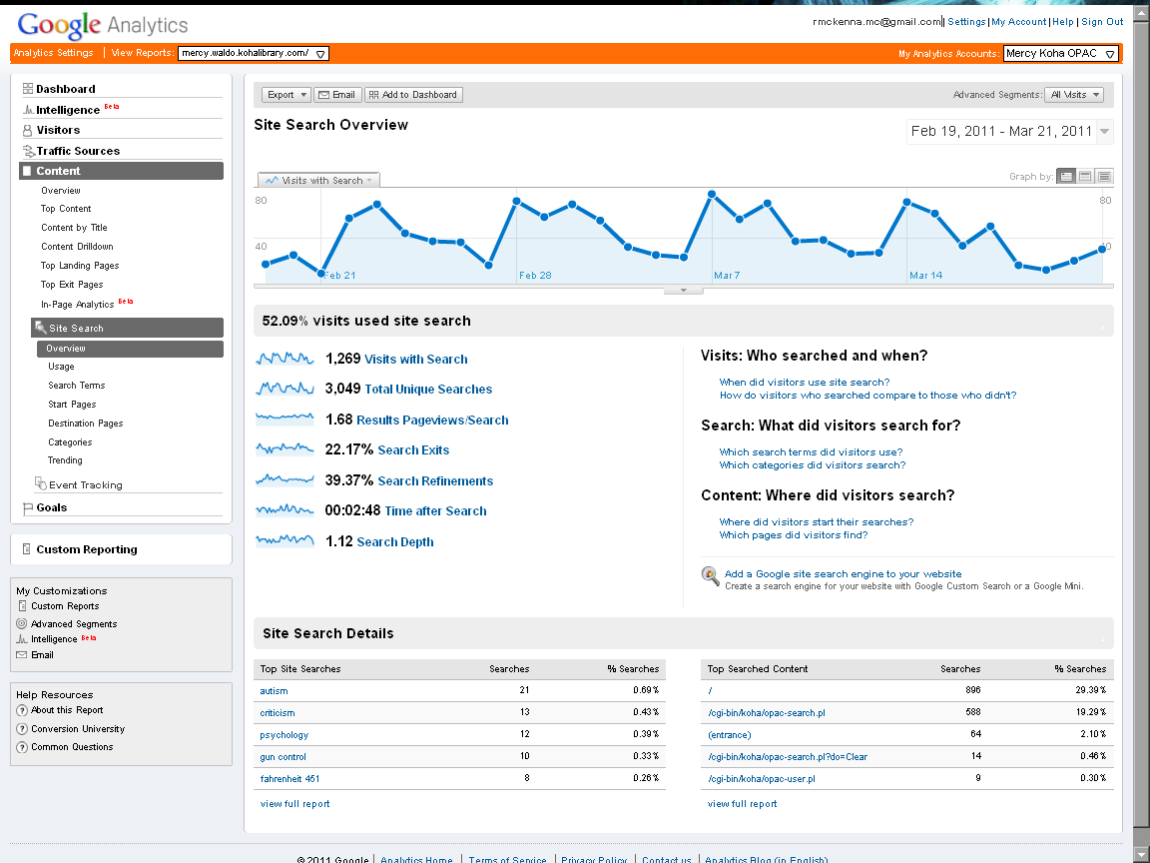
Reports
Google Analytics Report of OPAC searches

Slide 23
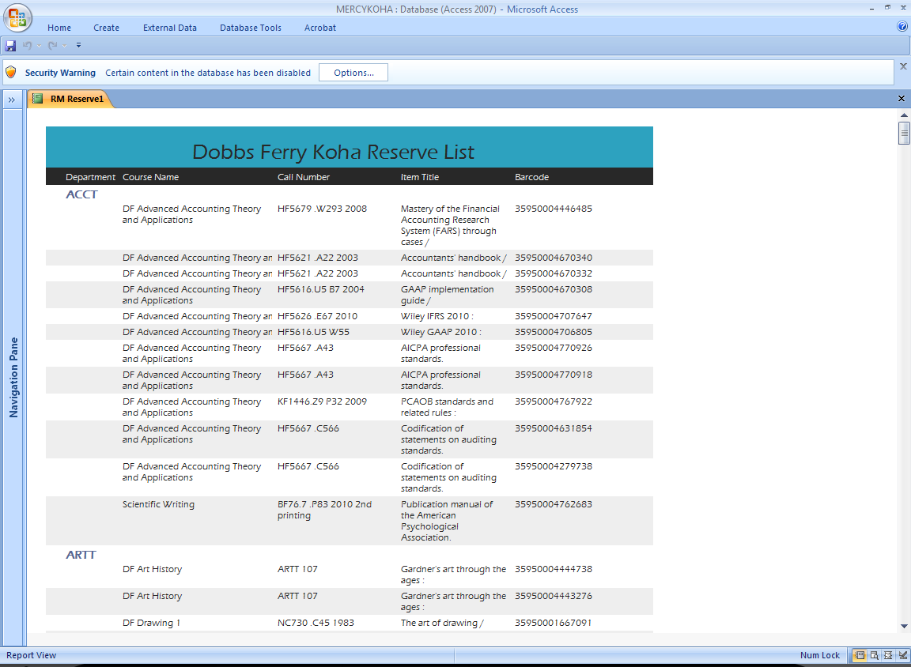
Reports
A Microsoft Access report from Koha displaying library reserves

Slide 24
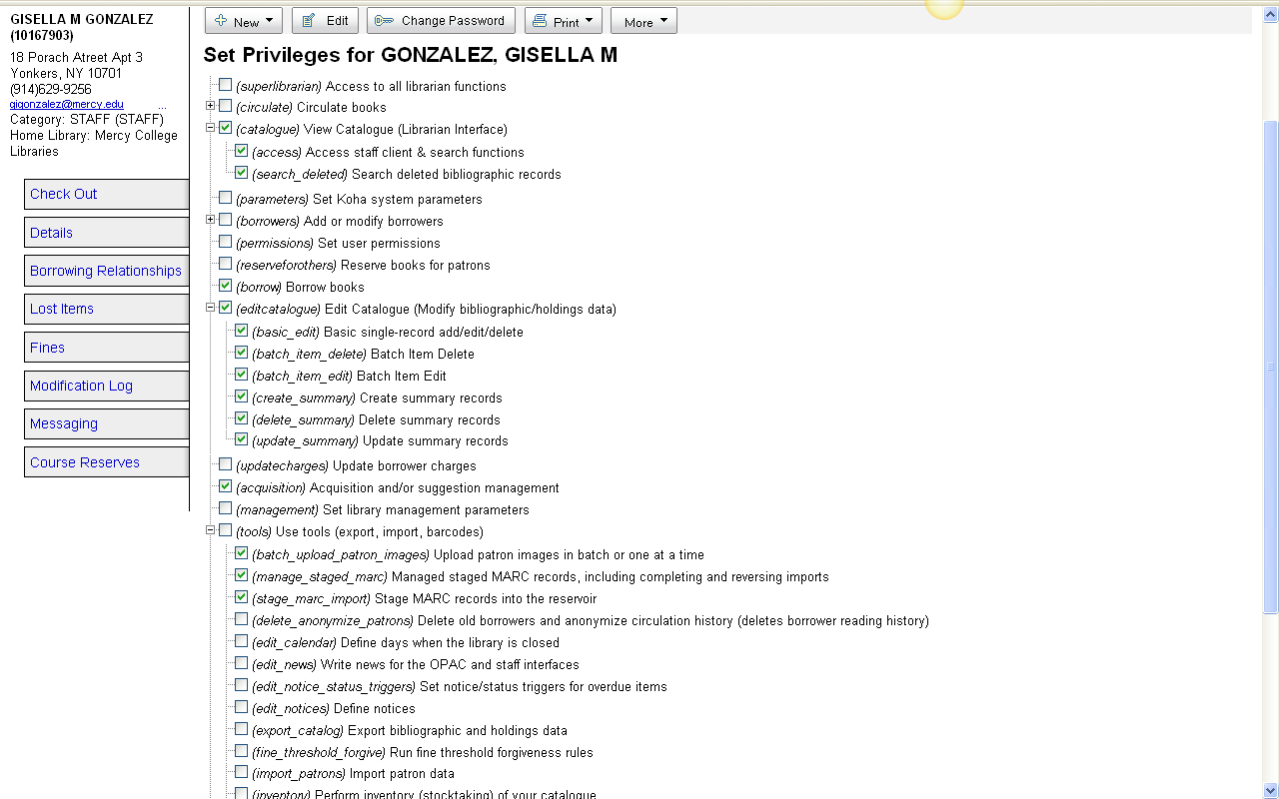
Staff Privileges

Slide 25
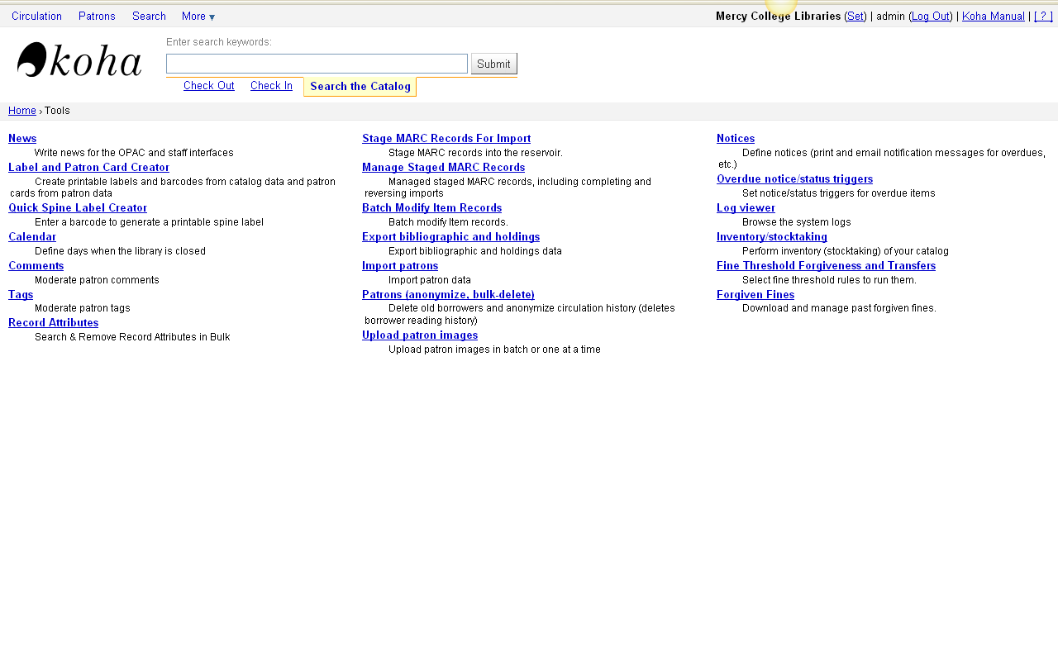
Tools

Slide 26
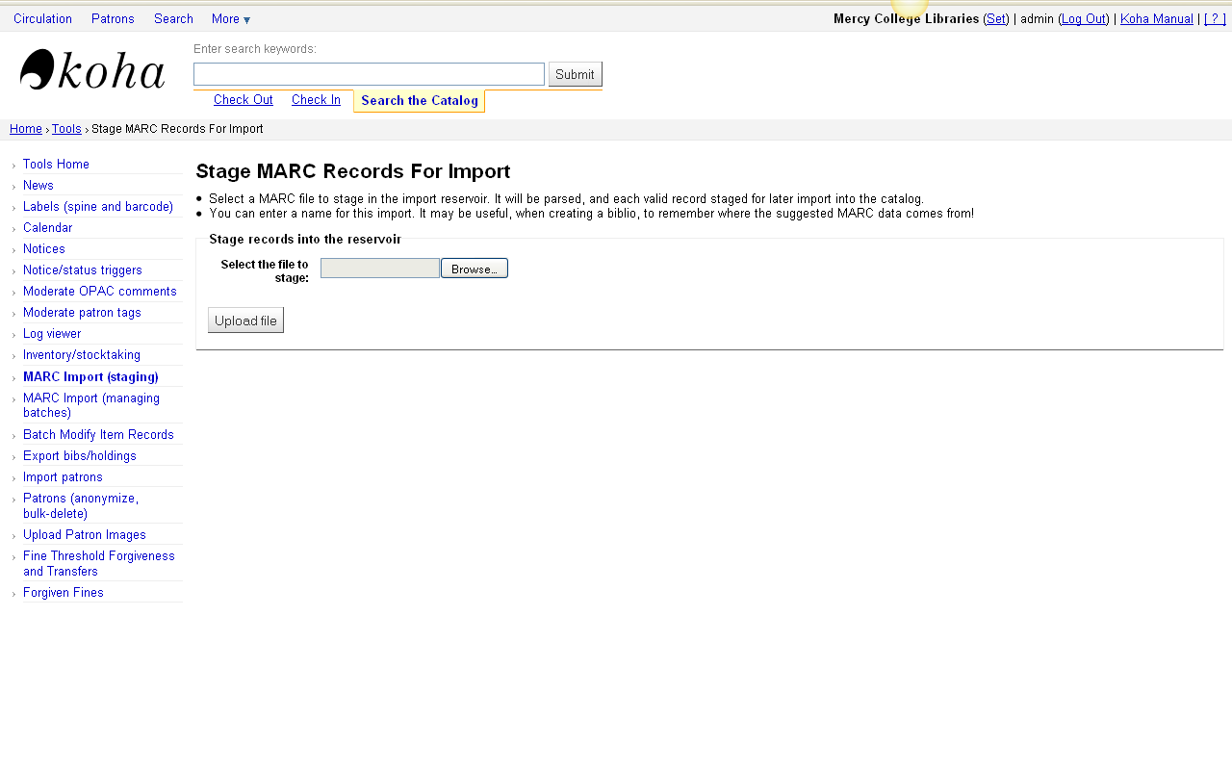
MARC Import

Slide 27
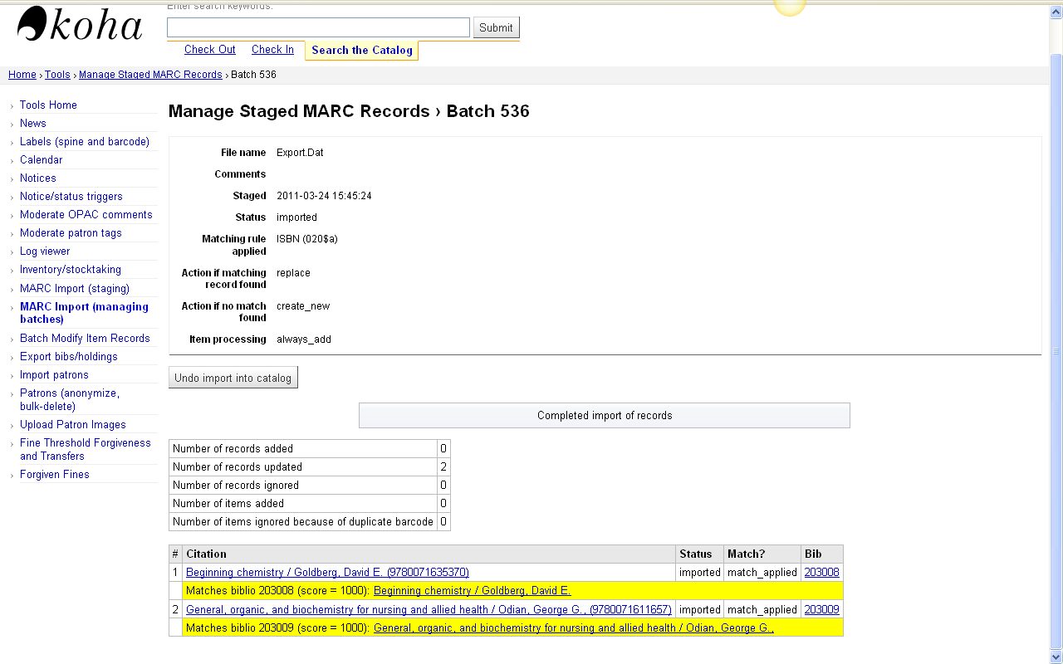
MARC Import

Slide 28
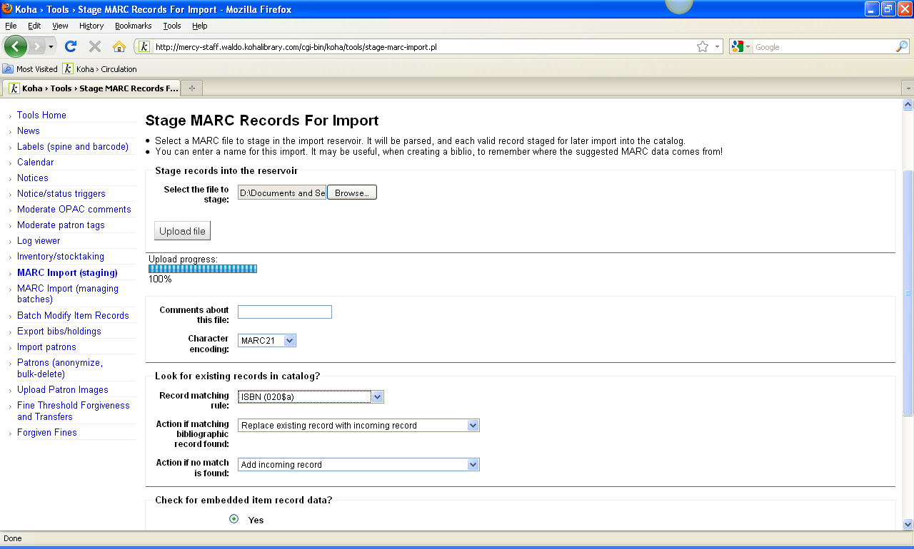
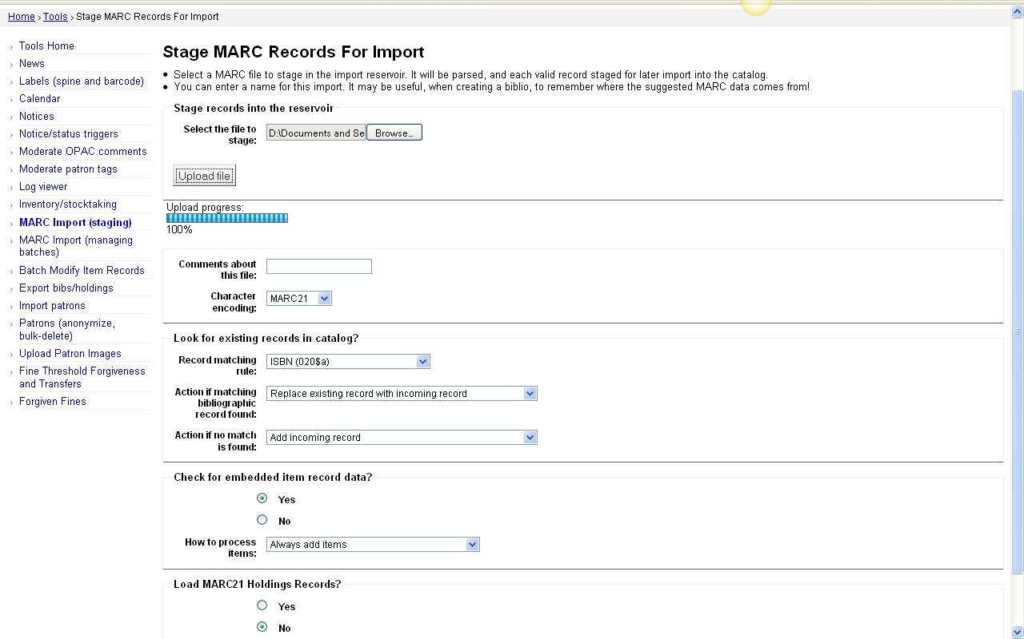
2 MARC Records Staged

Slide 29
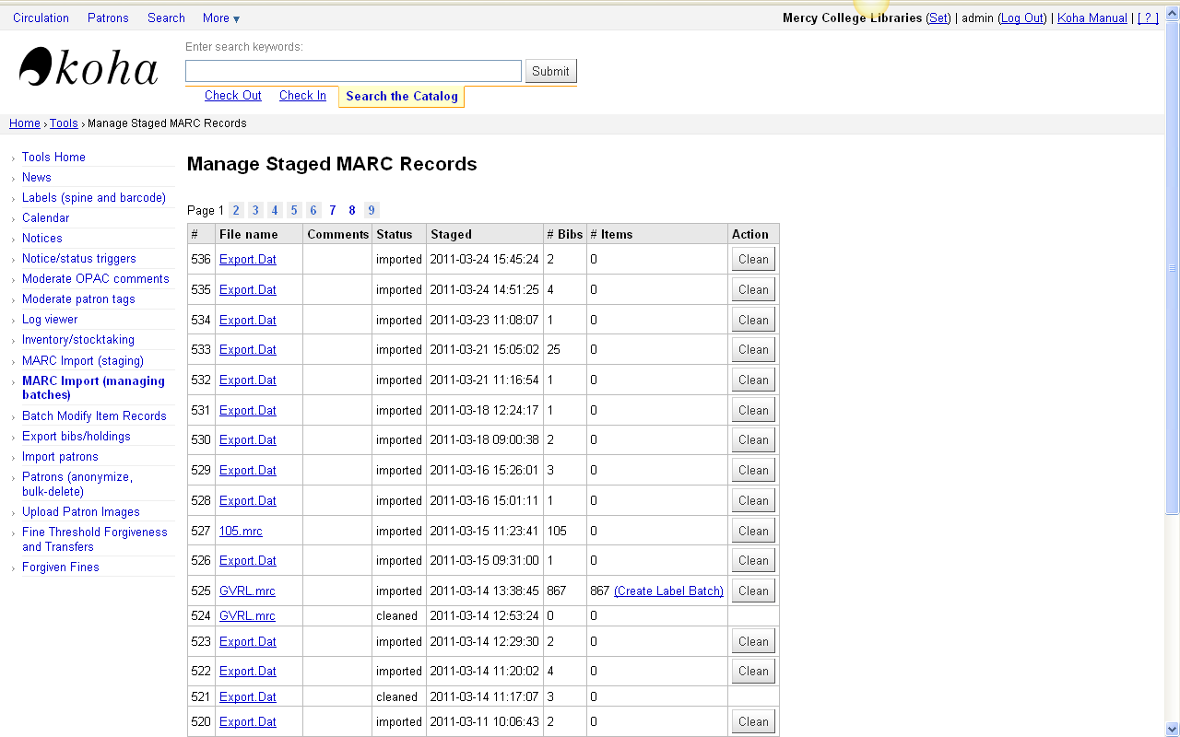
Managing Batches

Slide 30
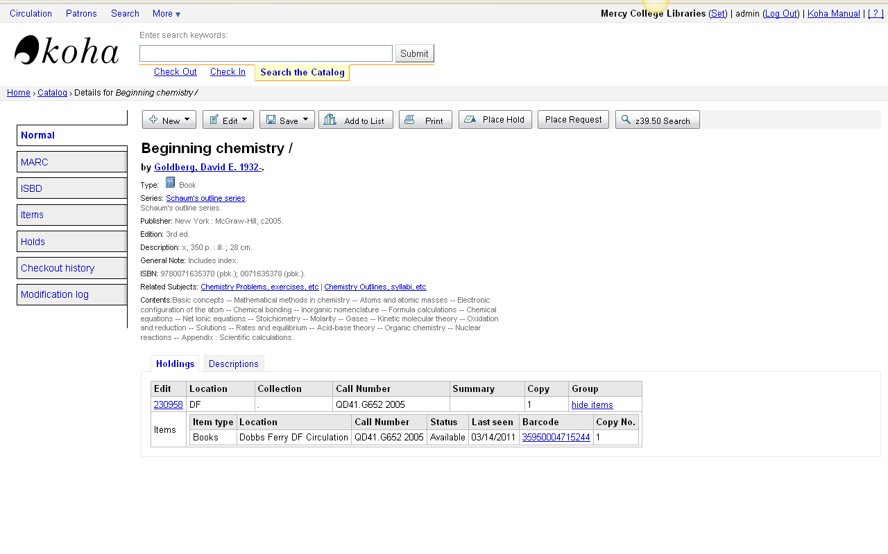
Item Record in Database

Slide 31
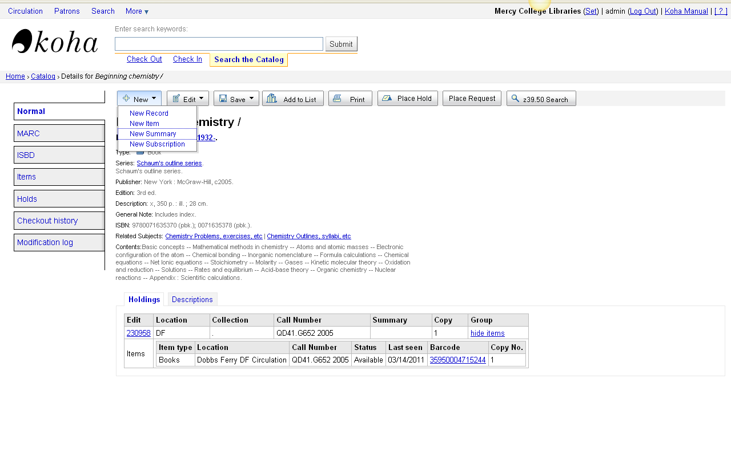
New Item & Summary

Slide 32
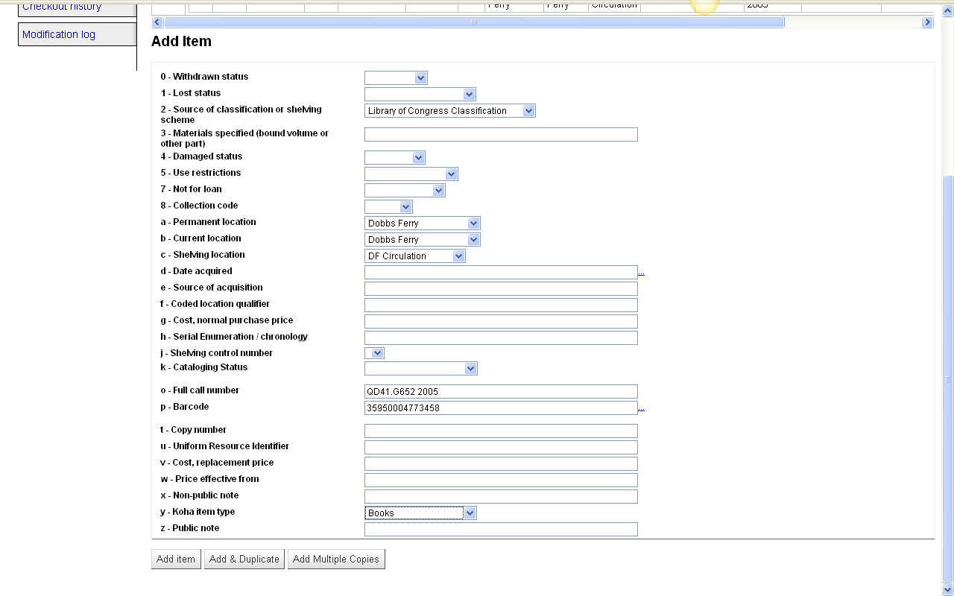
Add Item Record

Slide 33
Script for Item Record Creation
Greenwood (ABC-CLIO)
ǂ2 z ǂ8 ebook ǂa EB ǂb EB ǂc GRWD ǂo E-Book ǂy EB
$2z$8ebook$aEB$bEB$cGRWD$oE-Book$yEB
Ebrary
ǂ2 z ǂ8 ebook ǂa EB ǂb EB ǂc EBRY ǂo E-Book ǂy EB
$2z$8ebook$aEB$bEB$cEBRY$oE-Book$yEB
Gale
ǂ2 z ǂ8 ebook ǂa EB ǂb EB ǂc GVRL ǂo E-Book ǂy EB
$2z$8ebook$aEB$bEB$cGVRL$oE-Book$yEB
NetLibrary
ǂ2 z ǂ8 ebook ǂa EB ǂb EB ǂc NTLB ǂo E-Book ǂy EB
$2z$8ebook$aEB$bEB$cNTLB$oE-Book$yEB
Ovid
ǂ2 z ǂ8 ebook ǂa EB ǂb EB ǂc OVID ǂo E-Book ǂy EB
$2z$8ebook$aEB$bEB$cOVID$oE-Book$yEB

Slide 34
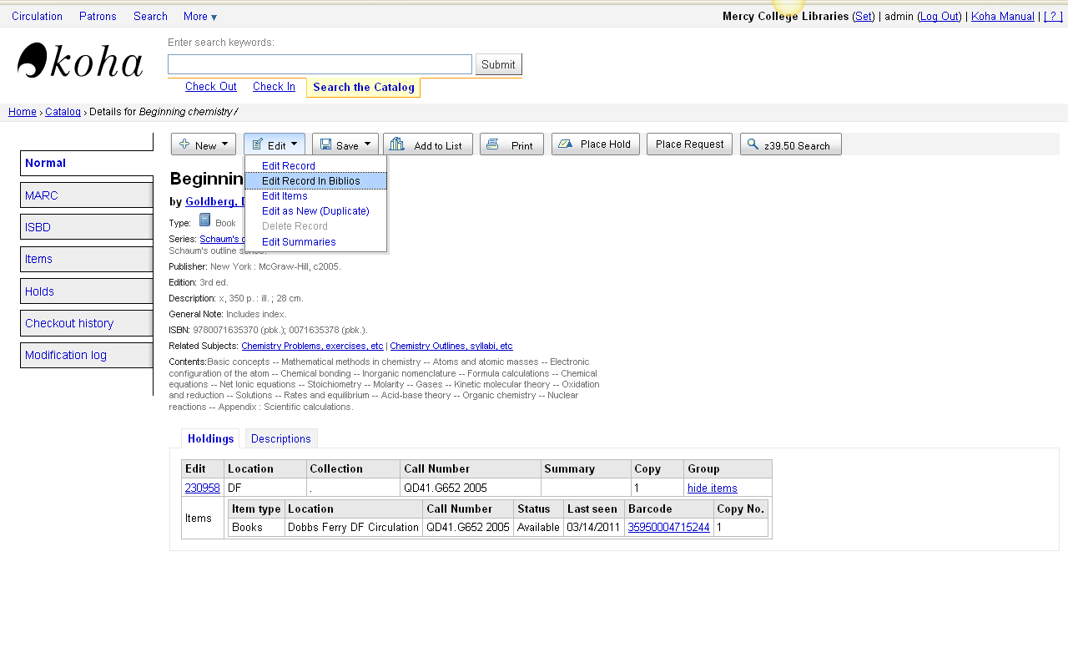
Editing Bibliographic Record

Slide 35
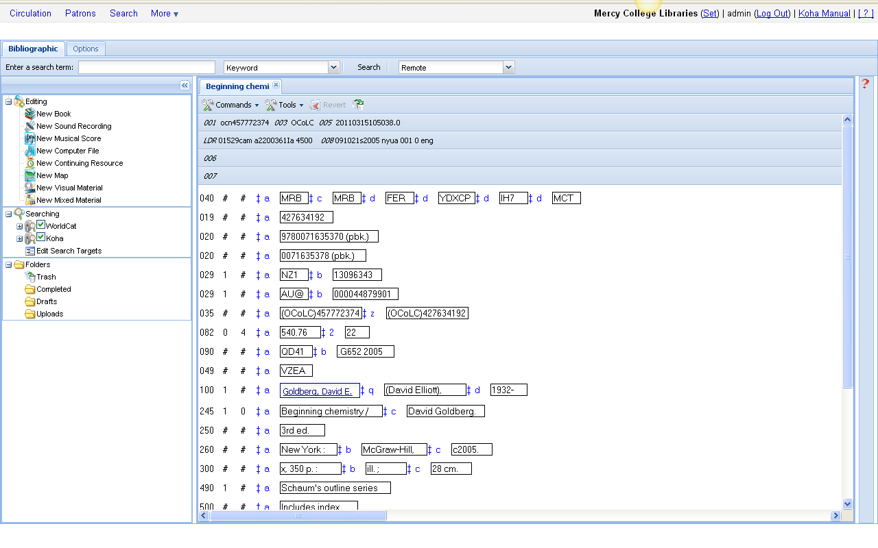
Editing in Biblios

Slide 36
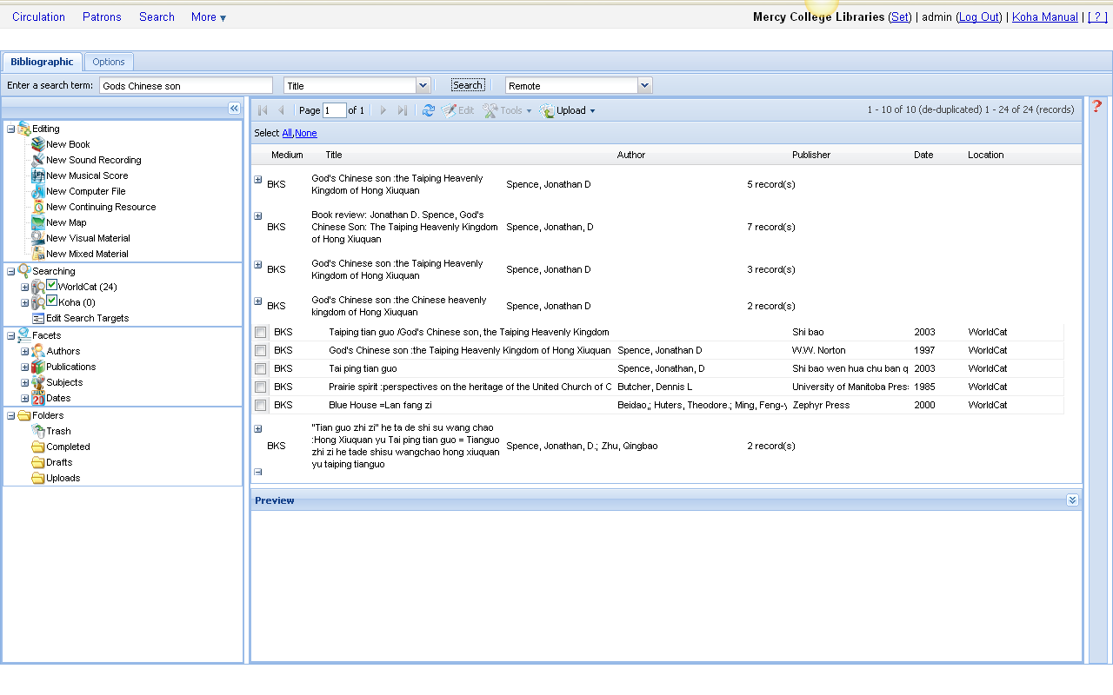
Searching in Biblios

Slide 37
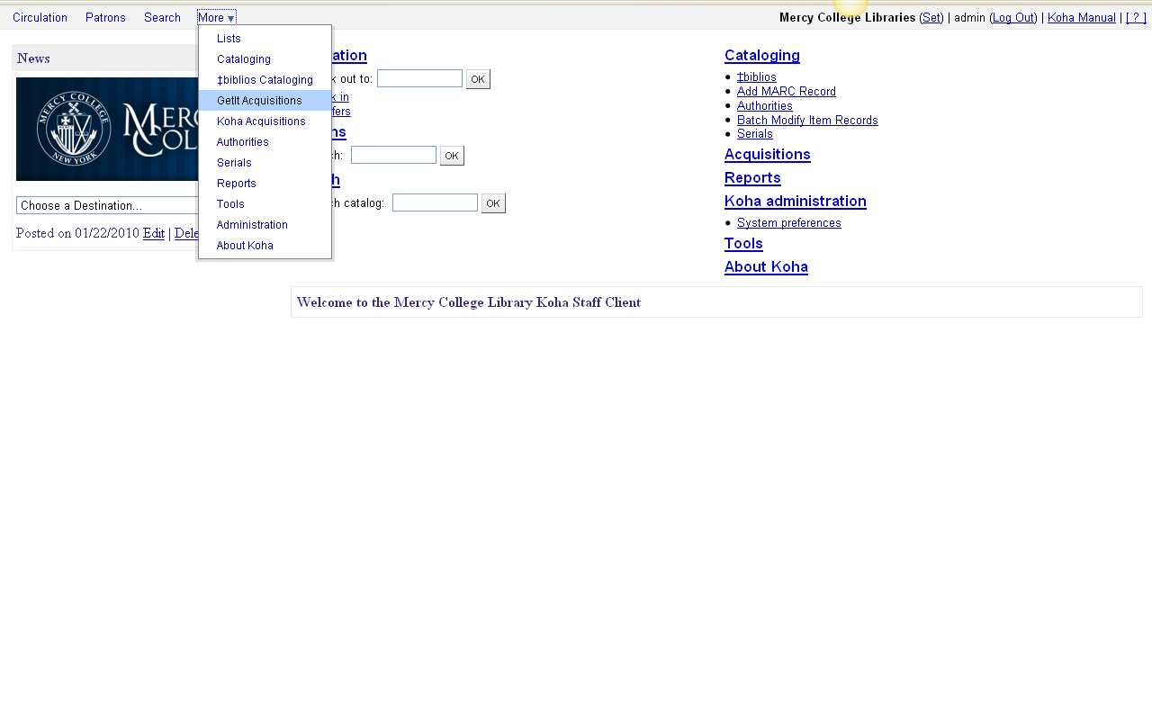
GetIt (Acquisitions)

Slide 38
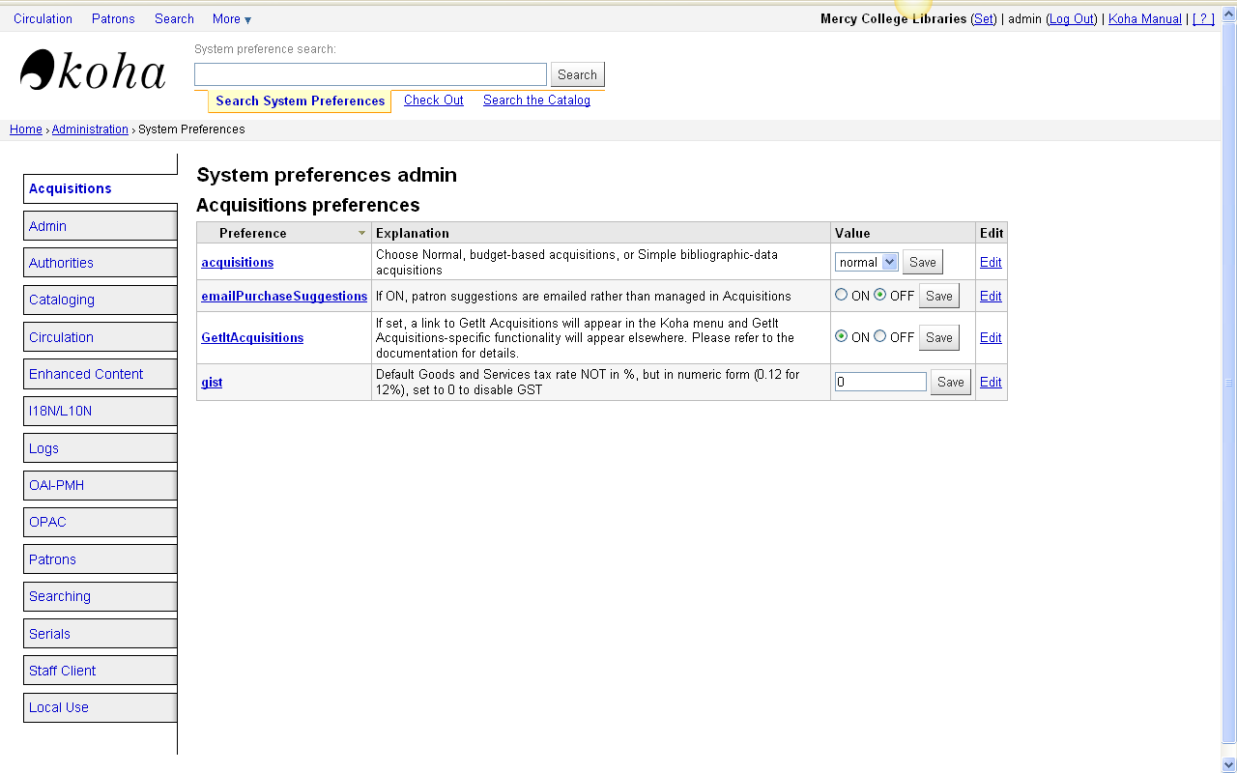
System Preference

Slide 39
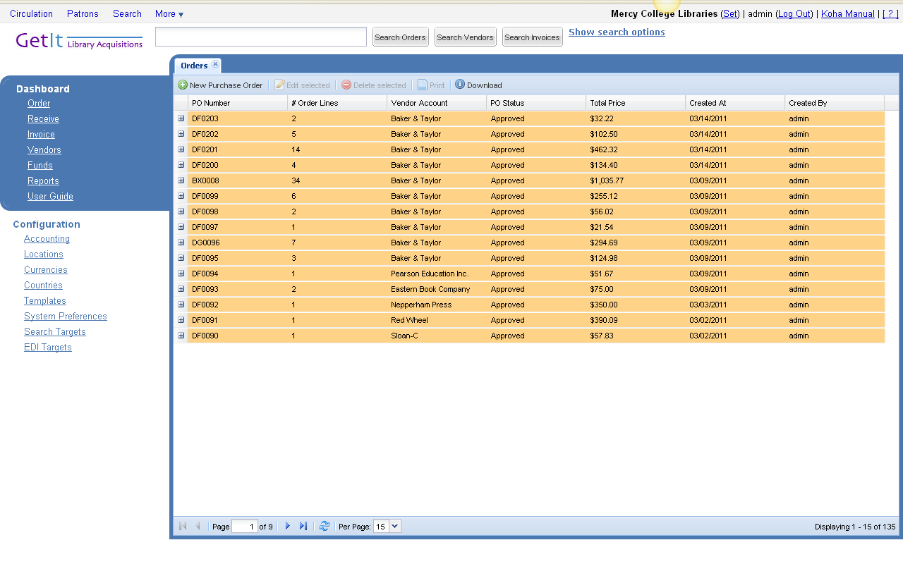
Purchase Orders

Slide 40
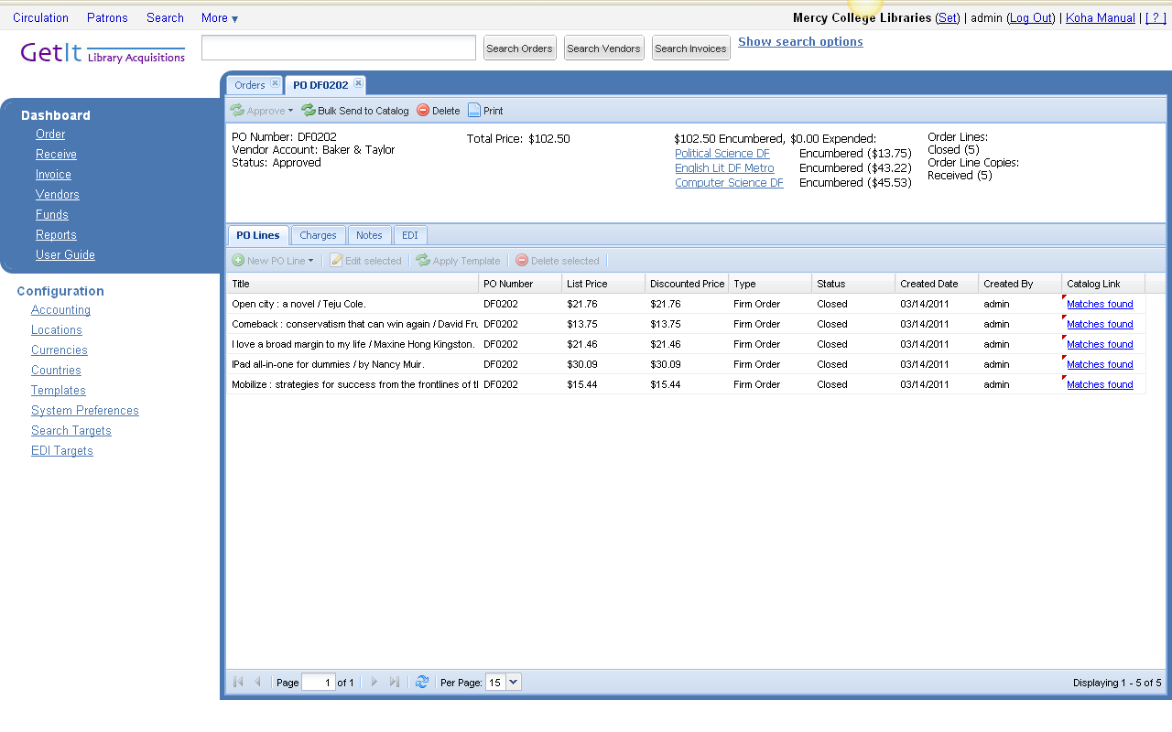
PO# DF0202

Slide 41
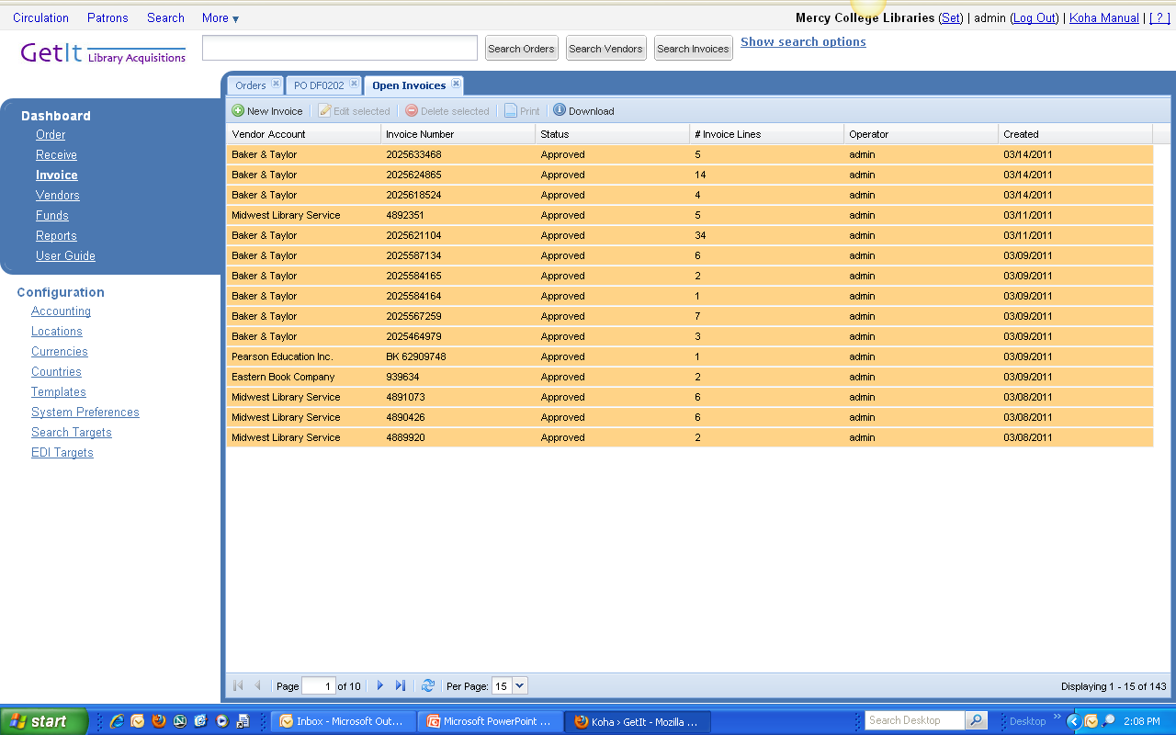
Invoices

Slide 42
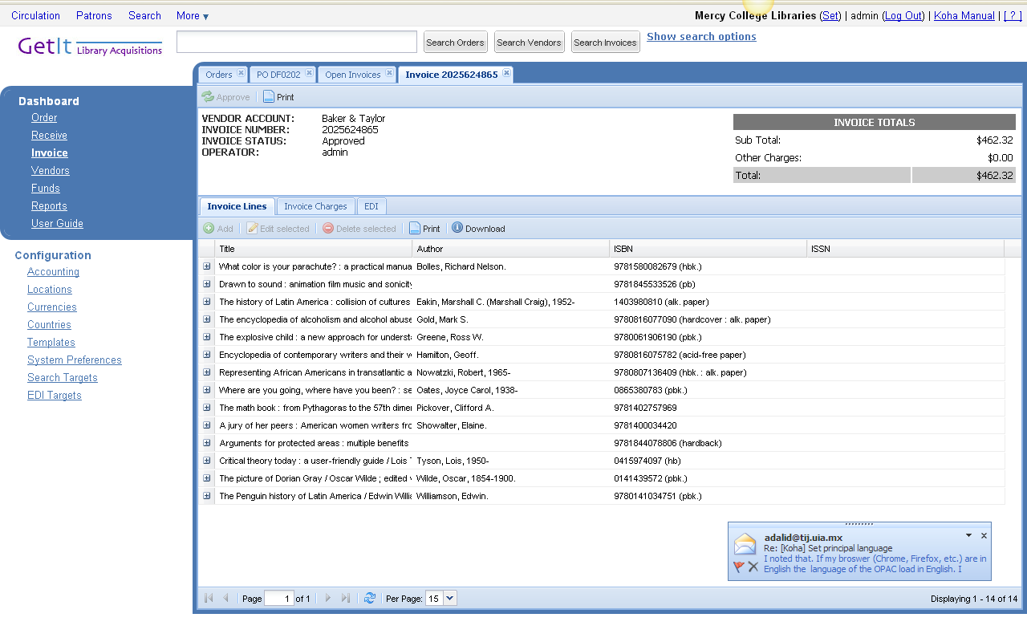
Inv# 2025624865

Slide 43
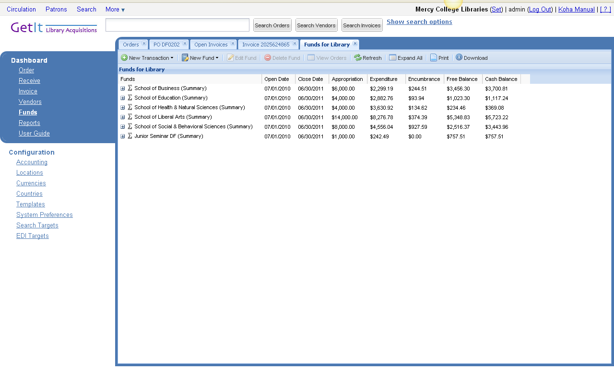
Summary Fund by Schools

Slide 44
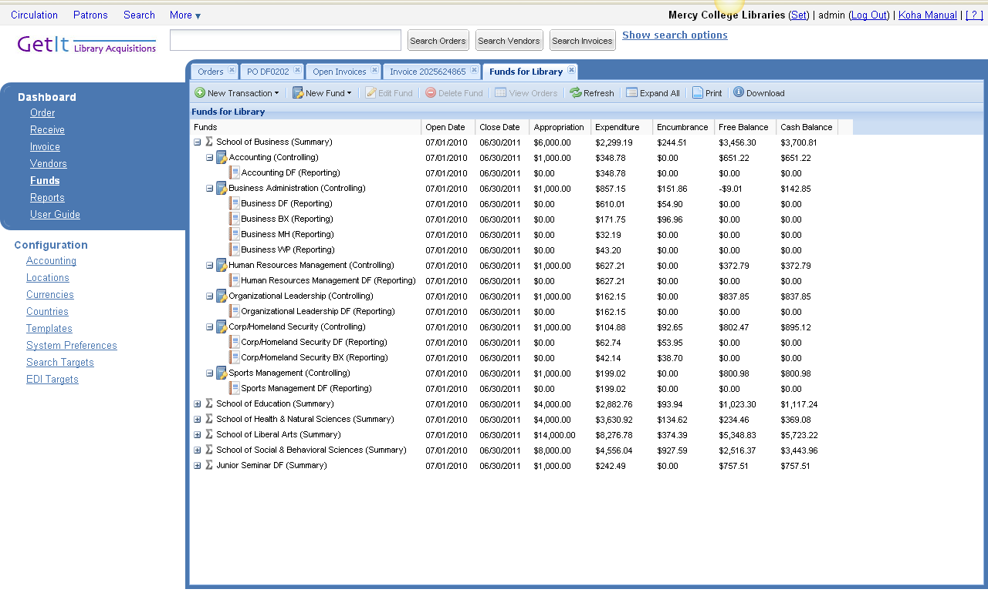
Controlling & Reporting Fund

Slide 45

View Orders

Slide 46
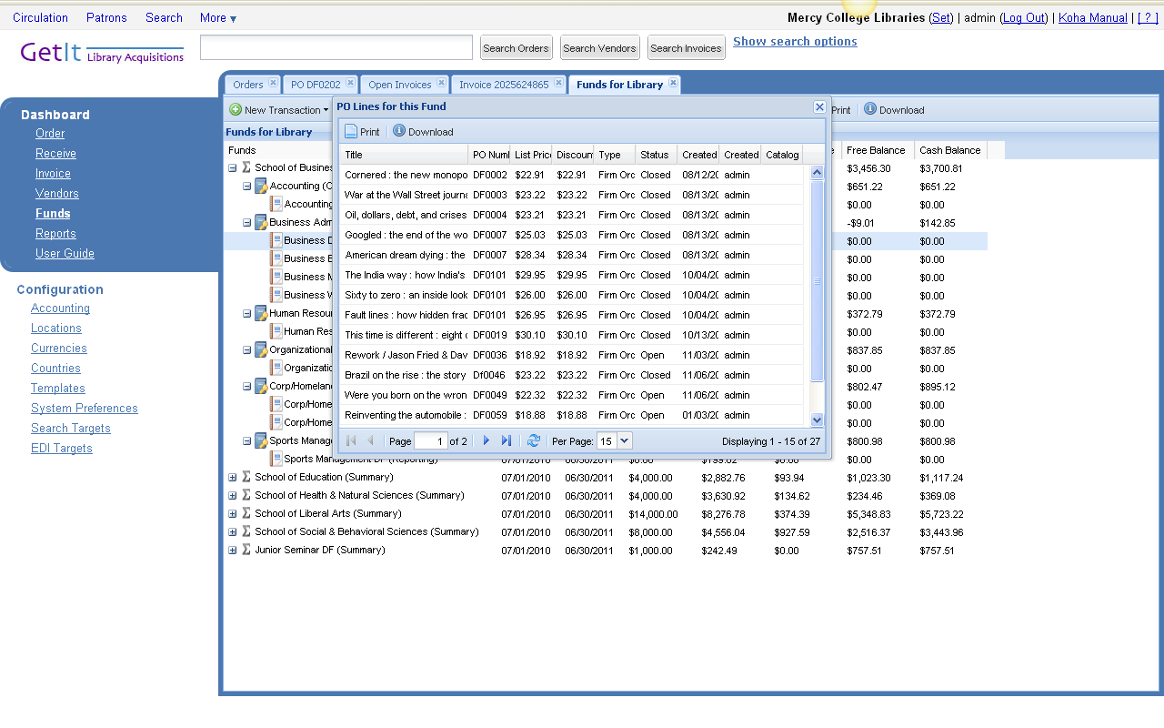
Book Orders for DF Business Program

Slide 47
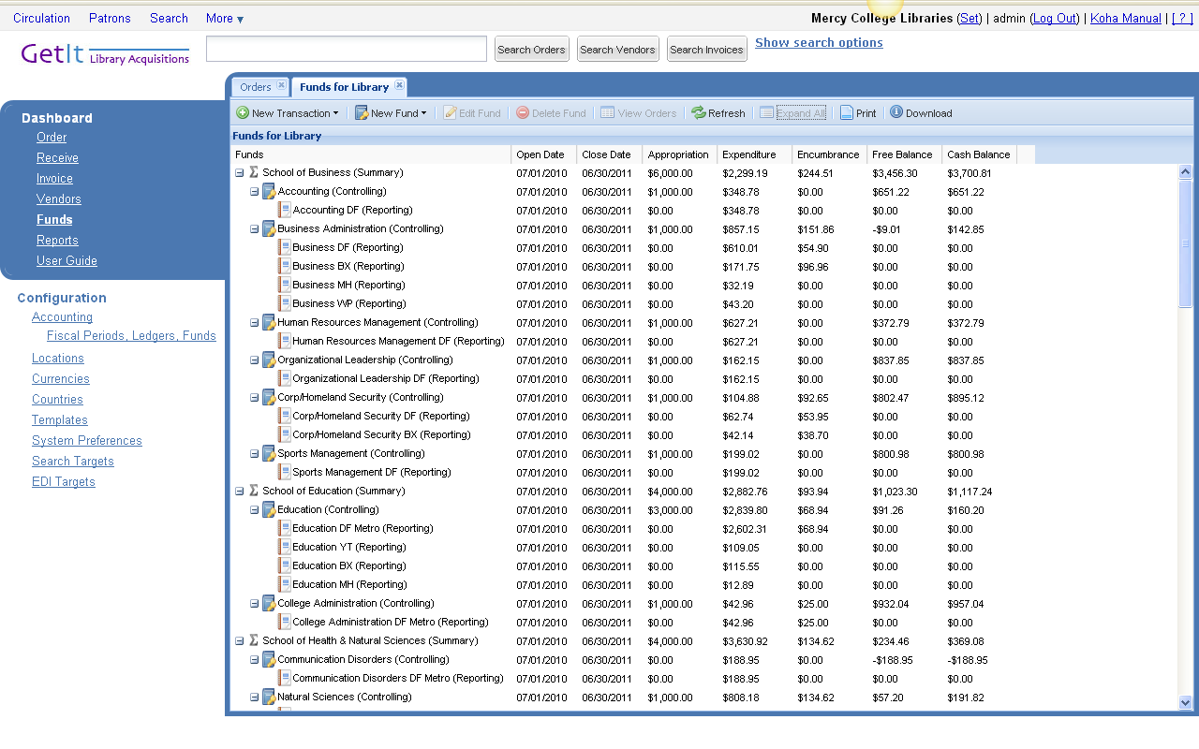
Expand All

Slide 48
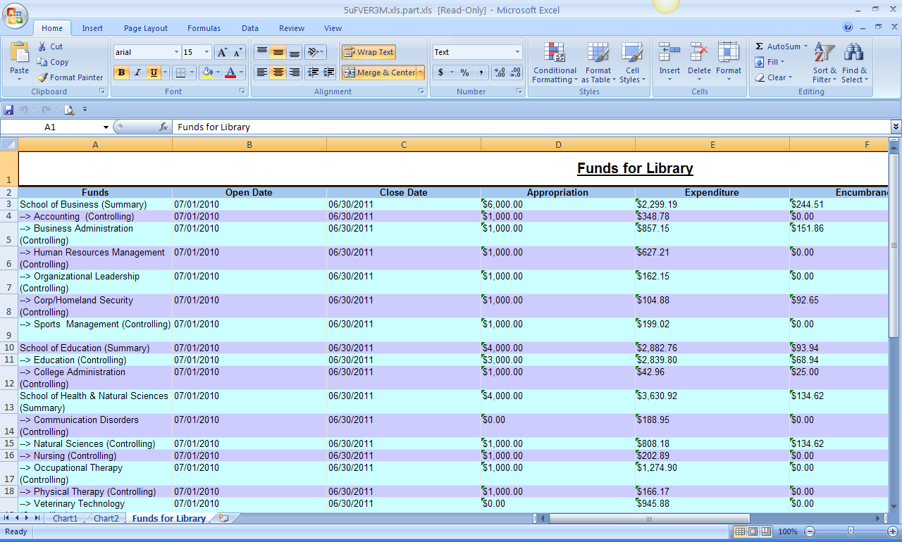
Download to Excel Spreadsheet

Slide 49
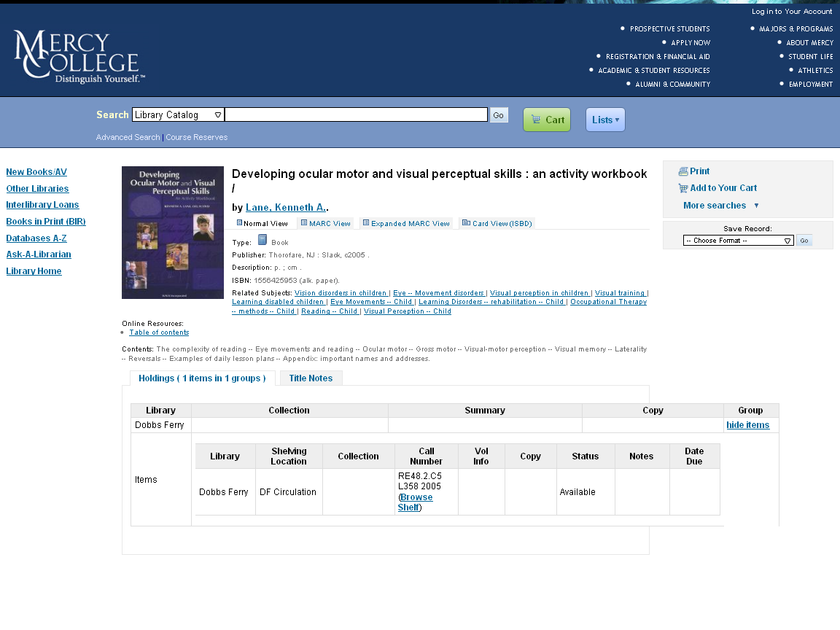
OPAC

Slide 50
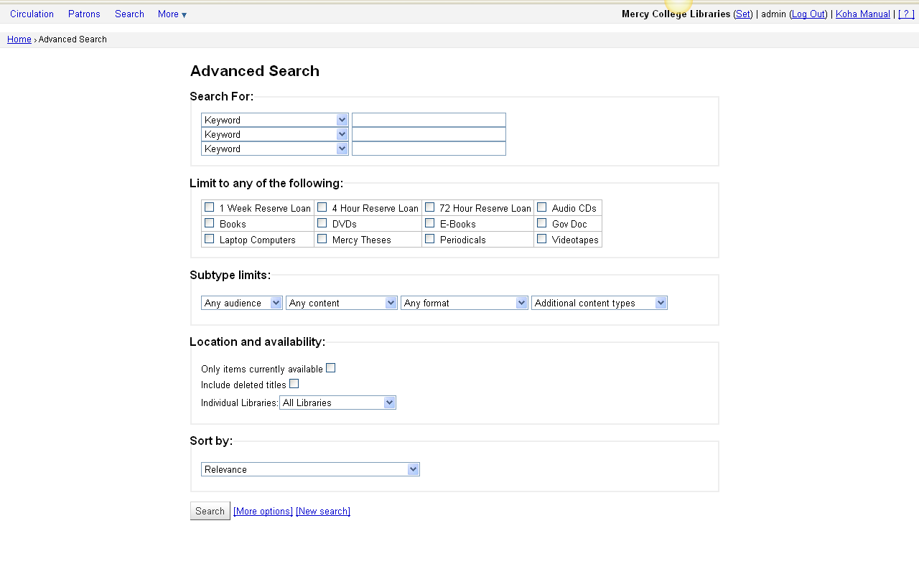
Advanced Search

Slide 51
OPAC Enhanced Content
RSS (Really Simple Syndication)
Tag Cloud
Faceted Navigation
xISBN

Slide 52
Faceted Navigation
Use of facets to narrow the search results
- availability
- authors
- branches
- series
- topics

Slide 53
FRBR in Koha - xISBN
xISBN Web service
Using the OCLC FRBR Work-Set Algorithm
Map book-related identifiers (ISBN, LCCN, OCLC number), based on WorldCat information
Free for non-commercial use (not exceed 500 requests per day)
xISBN in Koha

Slide 54
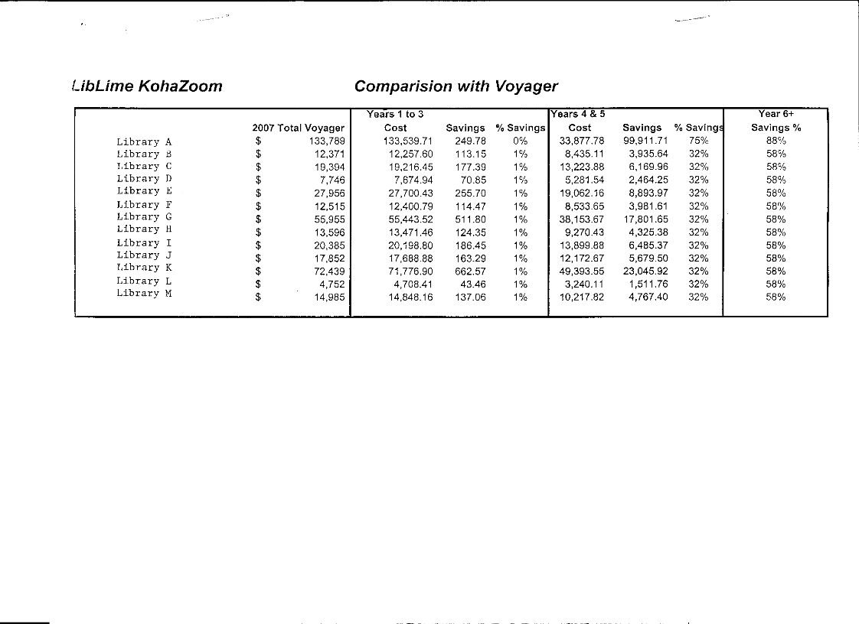
Cost Savings

Slide 55
Contact Us
Nlee@mercy.edu
Rmckenna@mercy.edu
Braddlee@mercy.edu
http://mercy.waldo.kohalibrary.com/

