Slide 1
Doing More with Less: Student Worker Support
2011 Annual NERCOMP Conference
Quinnipiac University
Bill Murphy: Manager of Client Services
Rick Brownell: Director of Client Services
Brooke Eder: STAR Supervisor
Bridget Garrity: STAR Coordinator
Copyright Bill Murphy 2011. This work is the intellectual property of the author. Permission is granted for this material to be shared for non-commercial, educational purposes, provided that this copyright statement appears on the reproduced materials and notice is given that the copying is by permission of the author. To disseminate otherwise or to republish requires written permission from the author

Slide 2
Introductions
Bill Murphy
Rick Brownell
Brooke Eder
Bridget Garrity

Slide 3
Quinnipiac University
Undergraduate enrollment: 5,900
Graduate enrollment: 2,000
School of Law enrollment: 550
Full-time faculty: 308
3 Campuses: Mt. Carmel, North Haven, and York Hill

Slide 4
Client Services
Consists of Technology Center and 2 satellite offices
“One stop shop” for technology support
Help Desk and Media Services
Staff at each of the three campuses
All devices welcome
All calls returned
Three walk-up service centers
Notes:
Rick will explain Client Services

Slide 5
STAR Program – The Beginning
Student Technology Academic Resource
Started in the summer of 2000
58 Students
Part of Academic Technology
Charged with support of faculty
      Classrooms and offices
Run out of Media Services
Strategically located STAR Stations

Slide 6
STAR Program – Through the Years
STAR stations increase to 13
Help Desk Student Workers included
Expanded to include student technology support
eSTARs (2004 – 2010)
Program grew to 140 students

Slide 7
STAR Program – Recent Events
Focus on core operations (HD, MS, ES)
“Founding father” retires
Two new campuses
Merge support organizations
Technology Center(s)

Slide 8
STAR Organization
Richard Brownell
Sharon Angelicola
STAR Coordinator
Bill Murphy
STAR Supervisors
STAR Technical Analysts
STARs

Slide 9
By the Numbers
Telephone Calls – x4357
2010
August
September
October
November
December
Total
Total
1,555
1103
808
704
630
4800
Answered
704
401
385
336
314
2140
Unresolved
13
8
11
3
8
43
January 2011 | 745 | 396 | 7
February 2011 | 593 | 281 | 1

Slide 10
By the Numbers
Work Orders
2010
August
September
October
November
December
Total
New
2144
2638
1893
1894
1220
9789
Closed (24 hours)
1322
1638
1125
1096
798
5979
DSS
922
860
581
579
439
3381
3060
January 2011 | 1551 | 949 | 522
February 2011 | 1167 | 811 | 393
824

Slide 11
By the Numbers
Student Worker vs Full Time Staff
 | Student | Staff
Wage | $10.50 / hr = $10,080 / yr | $42,000 / yr + benefits
Hours per week | 20 | 40

Slide 12
By the Numbers
Tech Center Hours of Operation
Technology Center – Mount Carmel Campus
M-Th: 8a – 10p (Full Time Staff: 8a – 8p)
F: 8a – 5p (Full Time Staff: 8a – 5p)
Sa: 9a – 6p (Full Time Staff: None)
Su: 12p – 6p (Full Time Staff: None)
Technology Desk – York Hill Campus
M – Th: 12p – 8p (Full Time Staff: 12p – 8p)
F: 12p – 4p (Full Time Staff: 12p – 4p)
Technology Desk – North Haven Campus
M – Th: 10a – 8p (Full Time Staff: 10a – 4p)
F: 10a – 5p (Full Time Staff: 10a – 4p)

Slide 13
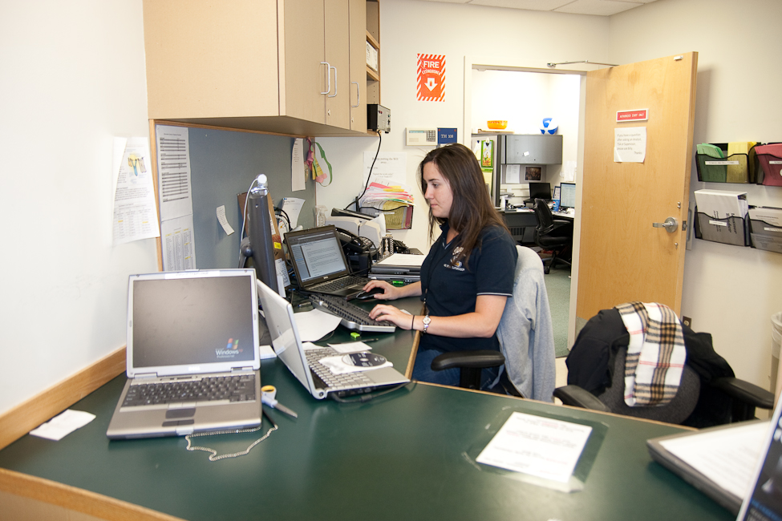
Before Pictures

Slide 14
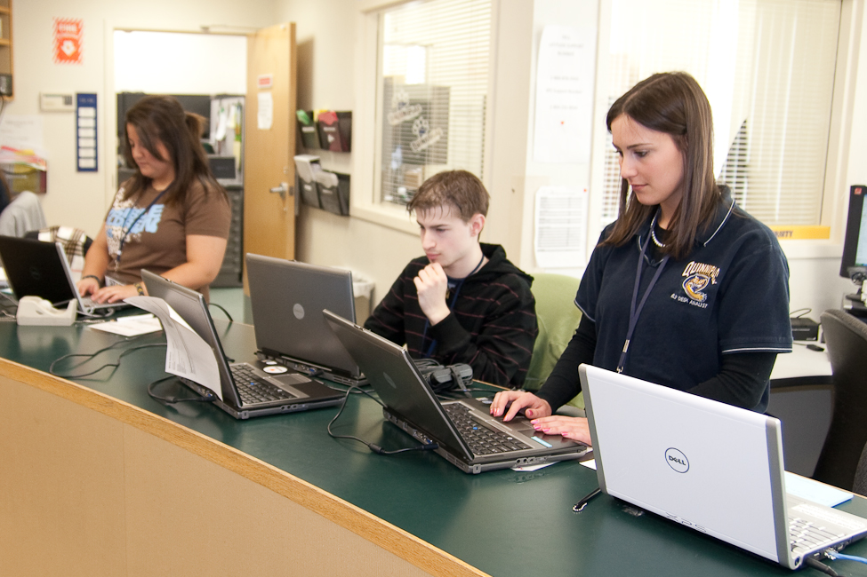
Before Pictures
Notes:
Add a MS picture

Slide 15
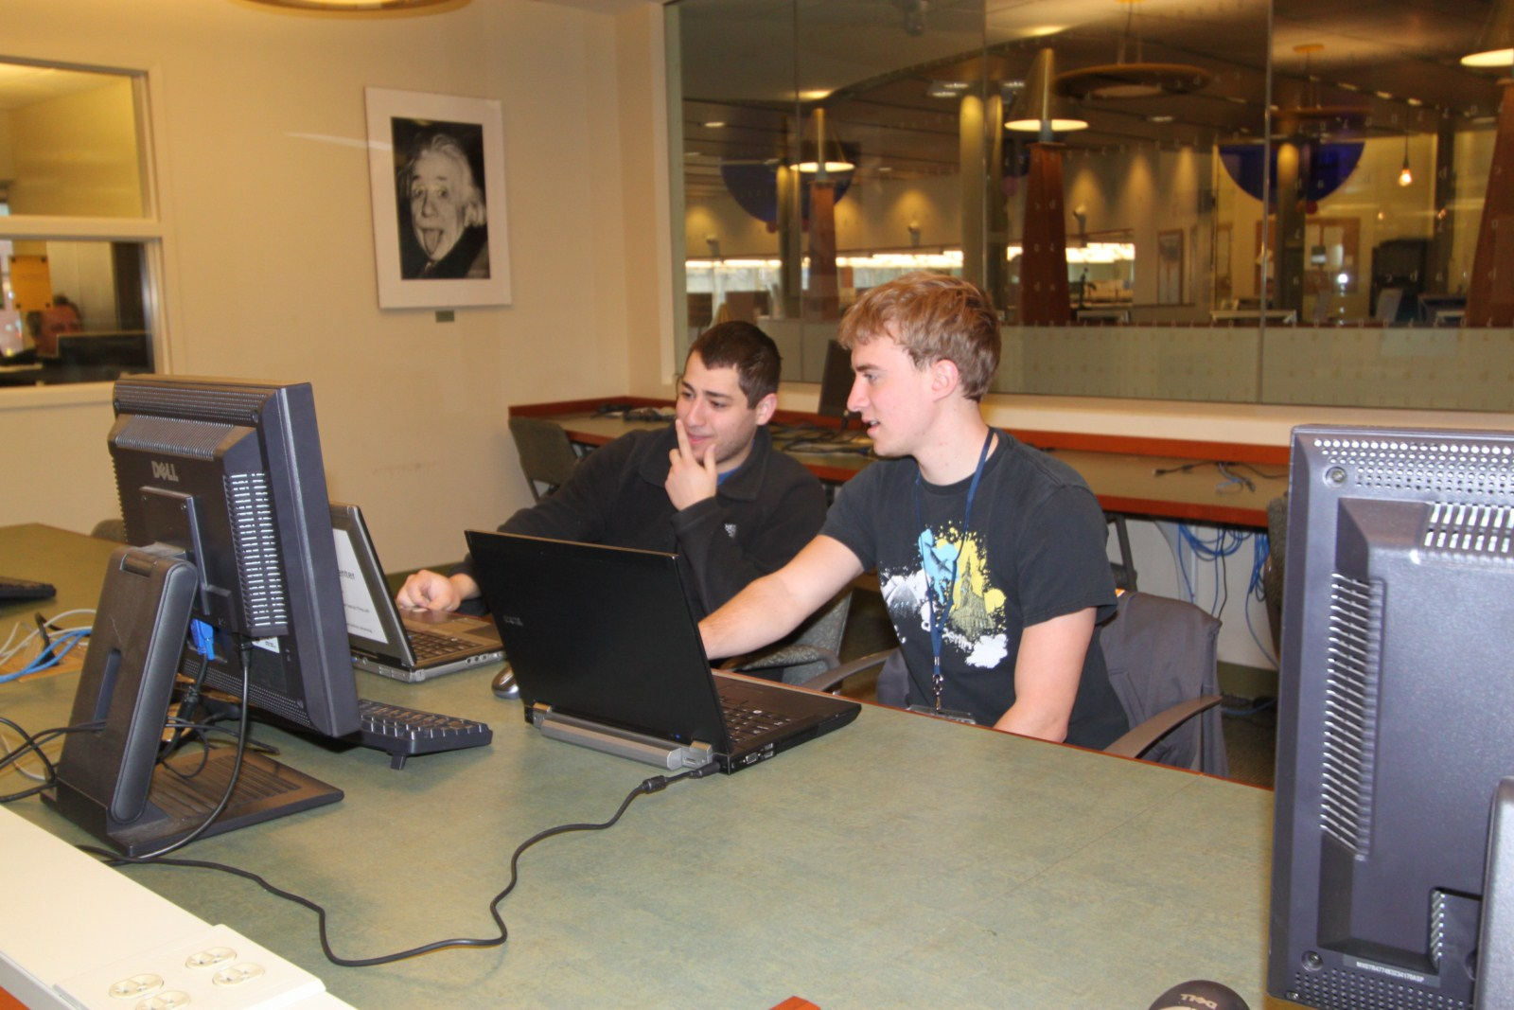
After Pictures

Slide 16
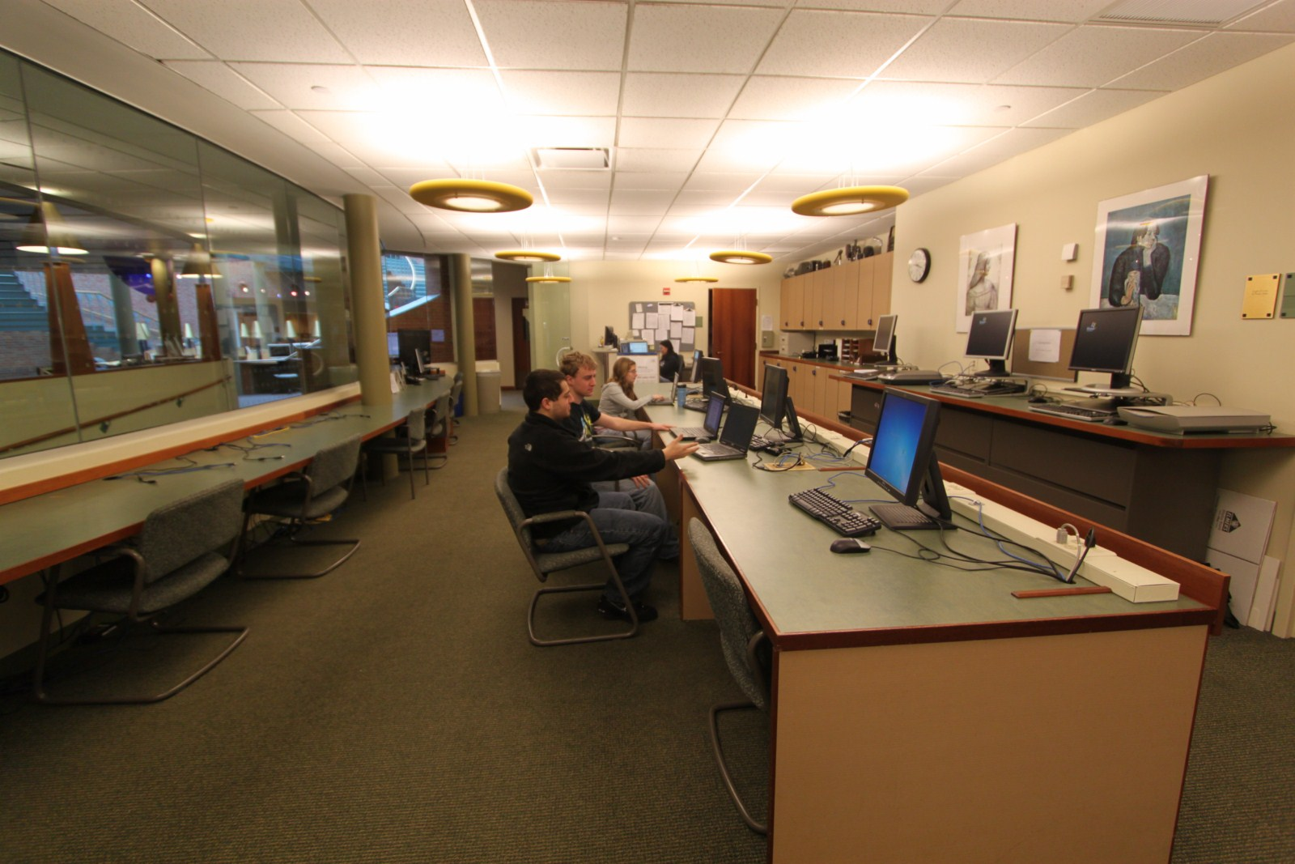
After Pictures

Slide 17
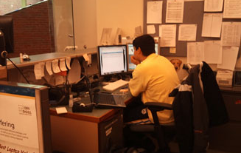
Supervisor Desk

Slide 18
For More Information
Bill Murphy: william.murphy@quinnipiac.edu
Rick Brownell: richard.brownell@quinnipiac.edu

