Slide 1
OCLC Worldshare at Bucknell
Carrie Rampp
Director of Library Services & Instructional Technology
Bucknell University
March 2012

Slide 2
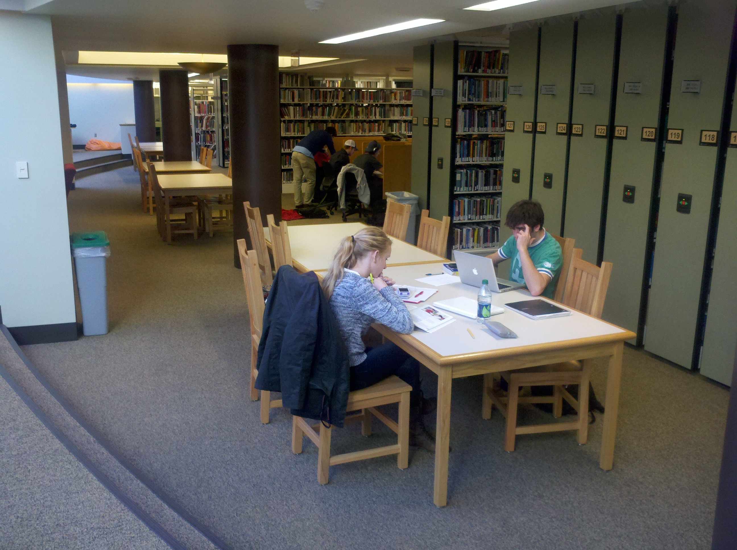
What’s the value?
Savings
A LOT of $$
Staff time (approaching 2 FTEs to date)
Far less duplicated work/effort
MOST IMPORTANT:
Even closer to our goal of one-stop discovery
One stream for patron-driven acquisitions/inter-library loan
What will I cover?
Our path to implementation
Bucknell perspective, a little insight into each major system module
What comes next

Slide 3

Quick overview of Bucknell
Bucknell University
Located in rural Lewisburg, PA
Largest liberal arts university in U.S., founded 1846
3400 undergraduates, 150 graduate students
350 faculty, 50 majors
Elmo creator Kevin Clash, Bucknell Forum
"Creativity: Beyond the Box" speaker series
Organization – Library & IT
Merged with approximately 80 staff, nearly 25 directly related to the library
One University library, approximately 810,000 physical volumes
Approximately $3m materials budget
Receive more than 90% of materials shelf-ready

Slide 4

How did we get here?
3 most commonly asked questions
How did you make this decision?
What is the cloud?
Why not open source?
Positively received by the community
More on costs, legal and the like in a moment…

Slide 5

In the beginning…
July 2010 – Invited by OCLC to participate in the early-adopter program for WMS
Internal discussions focused on…
Privacy and data security
Business plan
Cost/Benefit analysis
What’s the back-up plan?
SLA

Slide 6
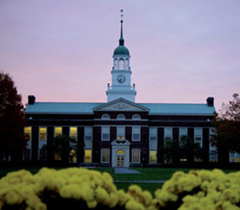
Then, there’s the contract…
Show Stoppers
University counsel and OCLC counsel negotiation
CAS implementation for authentication
Support for Summon feed
Go Live date – prior to June 30th, 2011
Bertrand Library

Slide 7
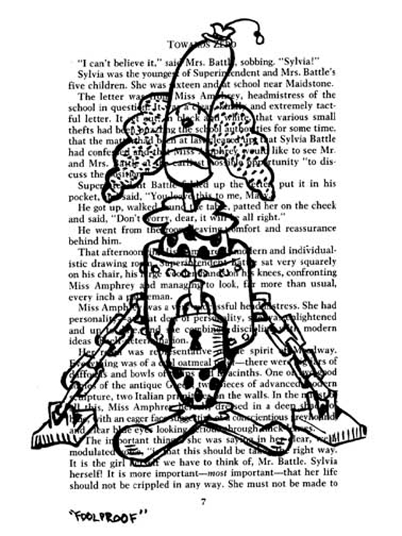
Getting started…
Cohort Group (8 other University libraries)
Weekly online meetings
Assignments
Presentations
Local task-force
weekly meetings
Filled out many, many forms…
Artist John Kovaleski, panel from “Unbound”

Slide 8
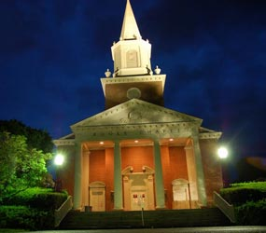
Challenges to work through
Not all Bucknell records had OCLC number
How to preserve our local subject headings
Lack of a reporting module, short term

Slide 9
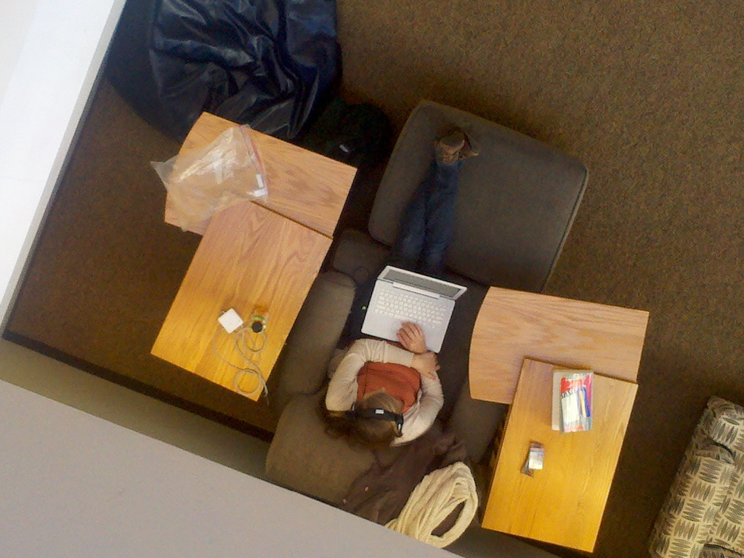
Timeline
March 2011 -- Bibliographic Data
8 files of 90,000 records each
Ceased shipments of all new materials, except for RUSH (created a backlog of several thousand titles)
May 2011 -- Patron Data
Ceased adding new patrons
June 2011 -- Circulation Transaction Data
Manual circulations for a couple of weeks
June 13 – WENT LIVE!!!
Loaded manual circs from spreadsheet

Slide 10
Immediately after go-live
Cataloging and Circulation had exception reports and other migration issues to clean-up – which were mostly done by the middle of August
Verify…
Bib records, patron records, circulation transactions, holdings
CAS Authentication (Single-sign on)-Available in July 2011
On to module by module….

Slide 11
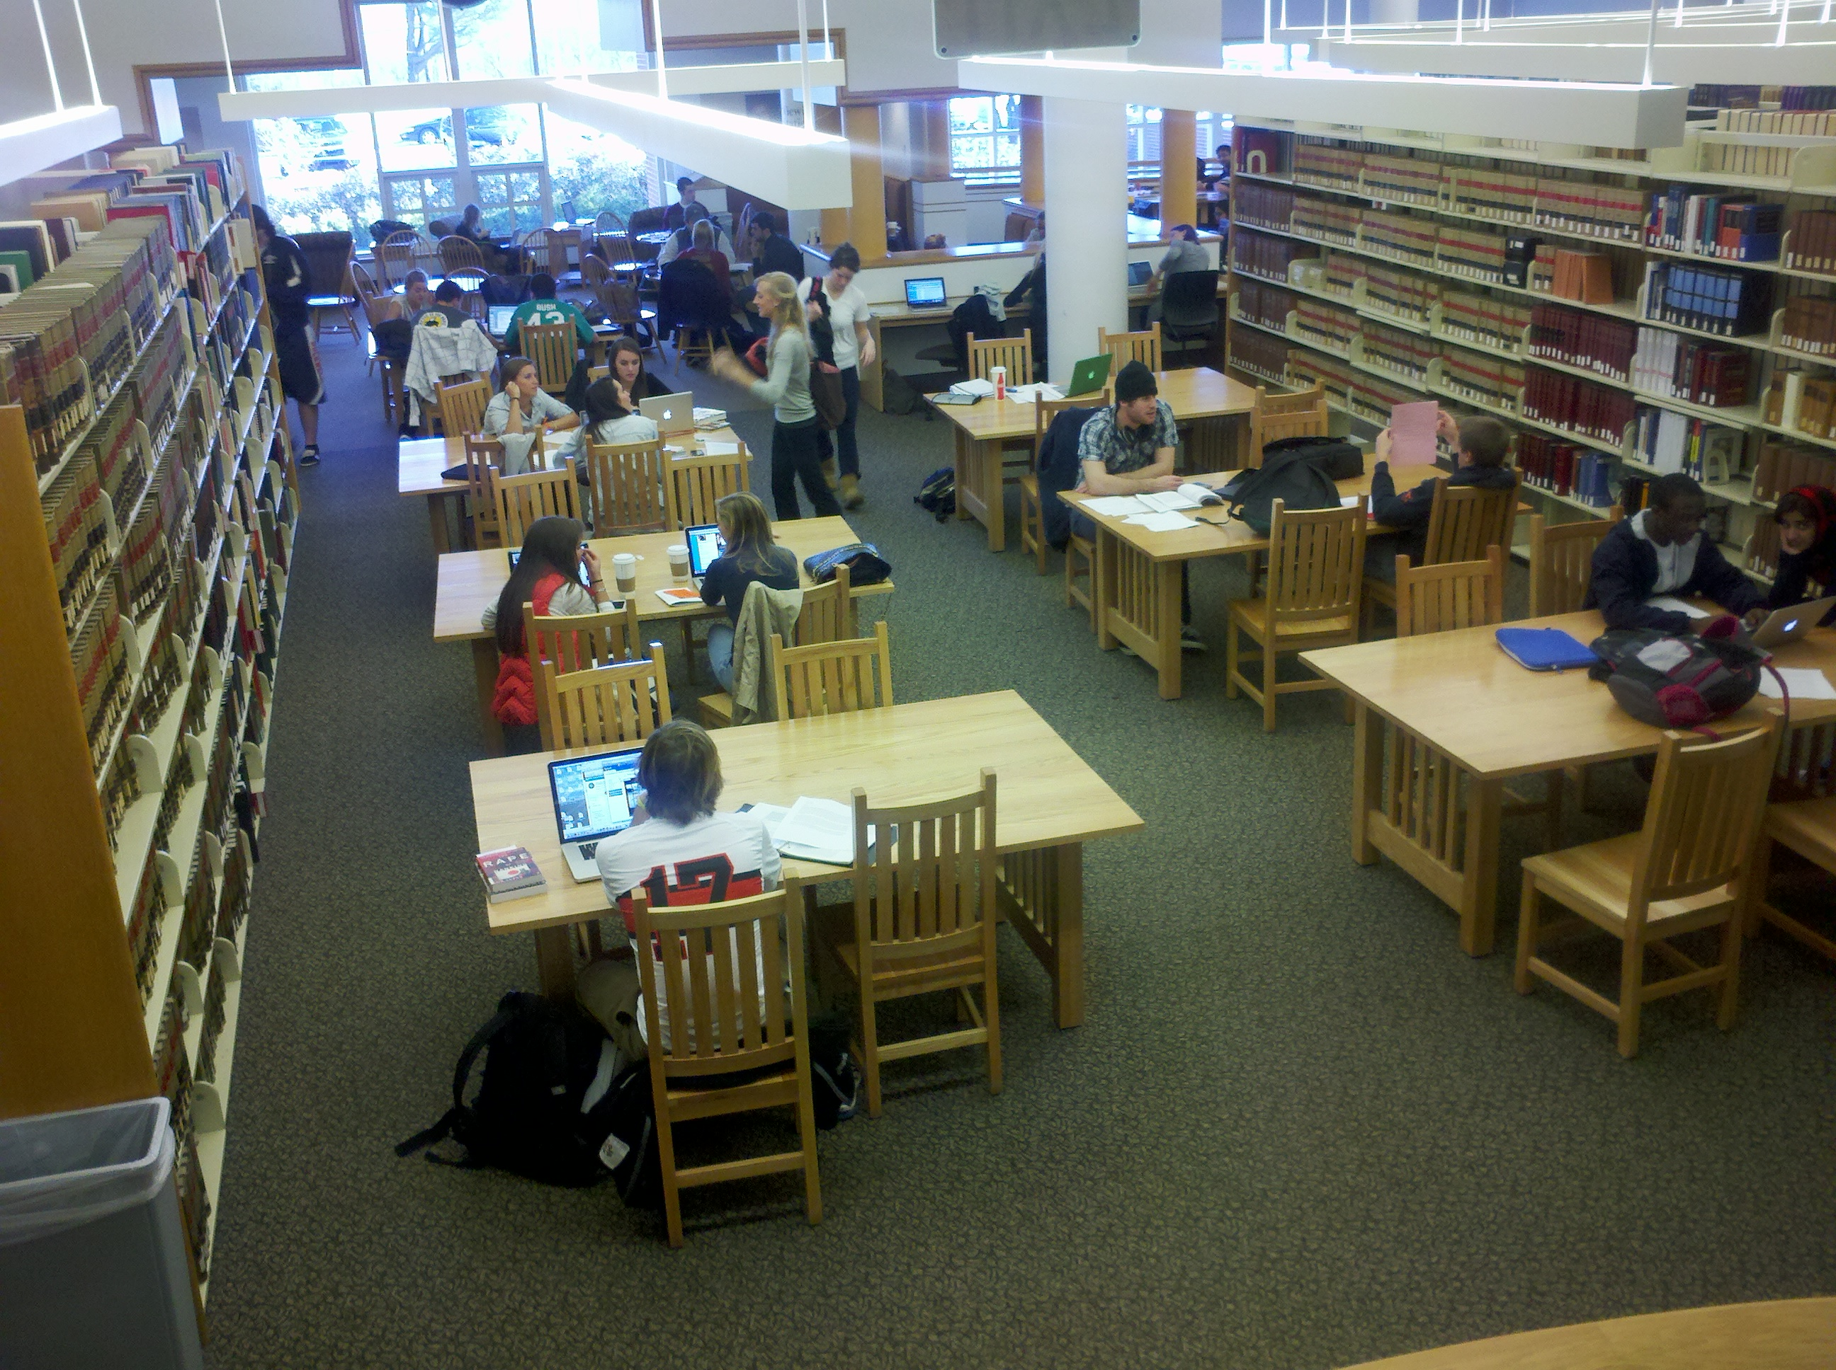
Circulation
Module fairly basic, but evolving
Reserves module very new at time of go-live
Limited reports

Slide 12
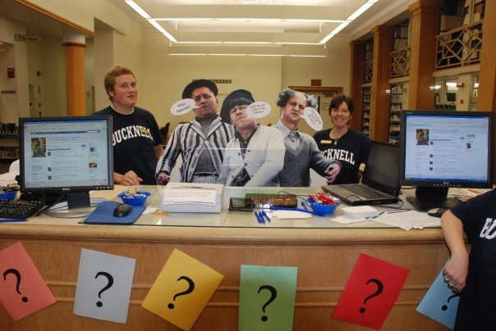
Acquisitions
Use WorldShare acquisitions only for rush orders, items requested through Get-It.
Catalogers need not do anything with items ordered through acquisition module as OCLC local holding record is automatically created.

Slide 13
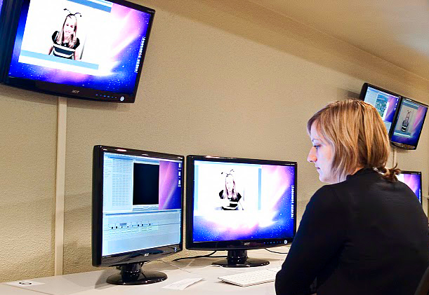
Collection Development
Patron Driven Acquisitions
Get-It button in World-Cat allows us to make buy/borrow decisions immediately
Knowledge Base
Very quick tour through WorldShare/Get-It
12-seat FinalCut/Apple Xsan video editing lab in library

Slide 14
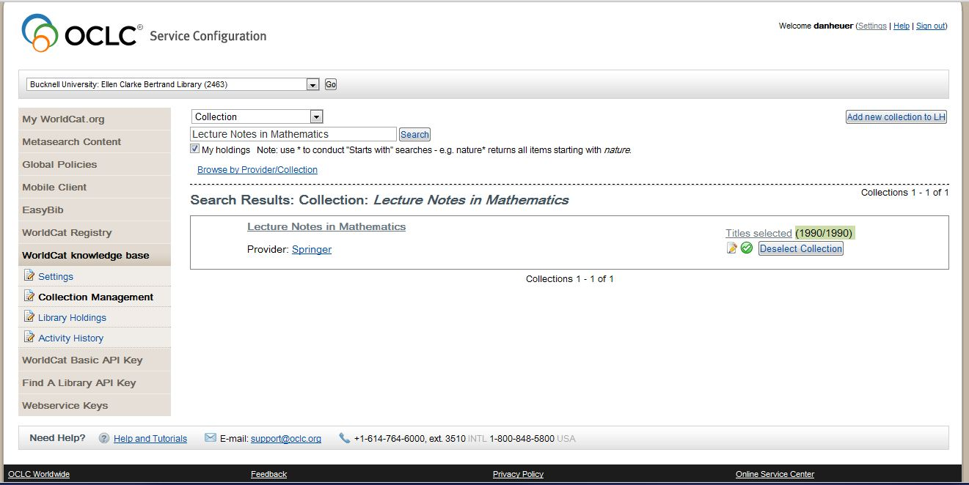
View into OCLC Knowledgebase

Slide 15
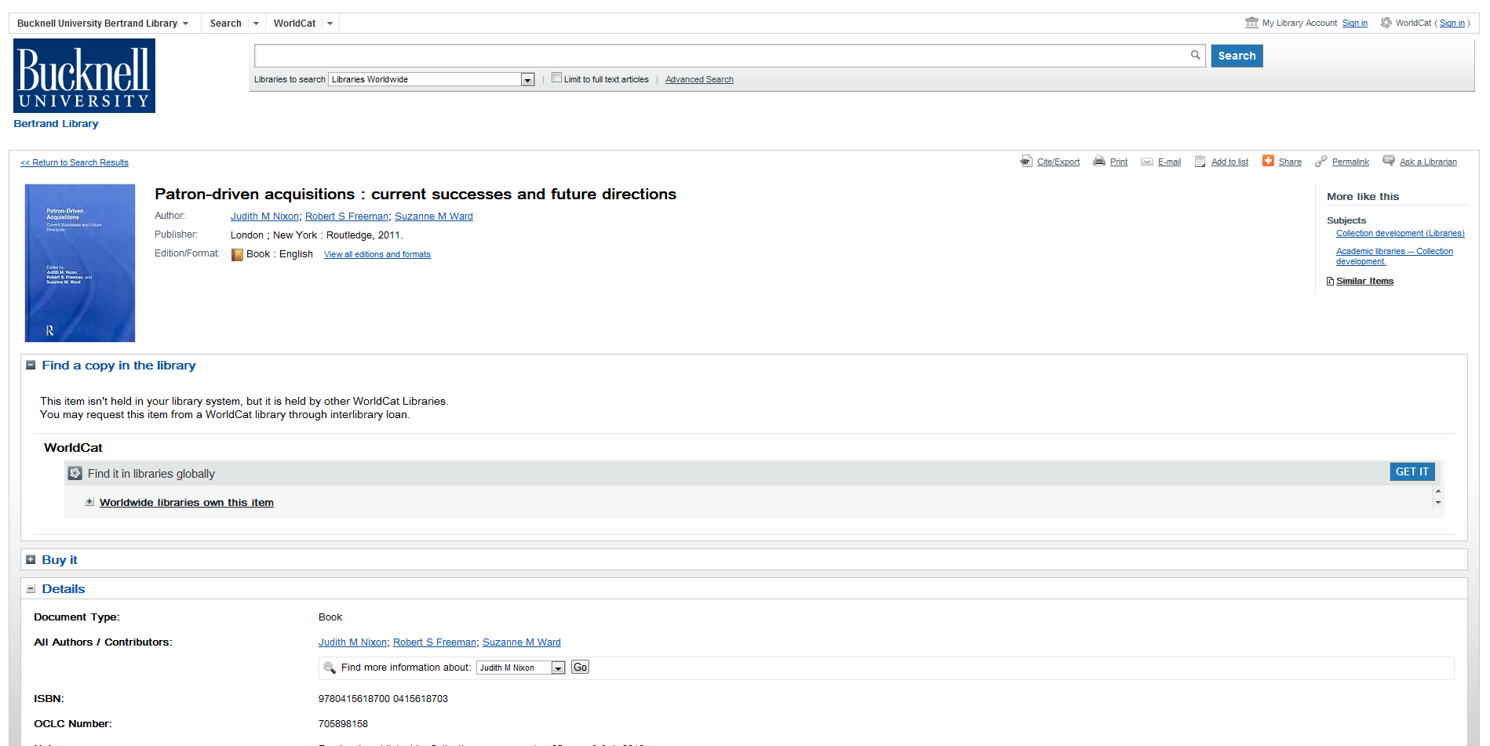

Slide 16
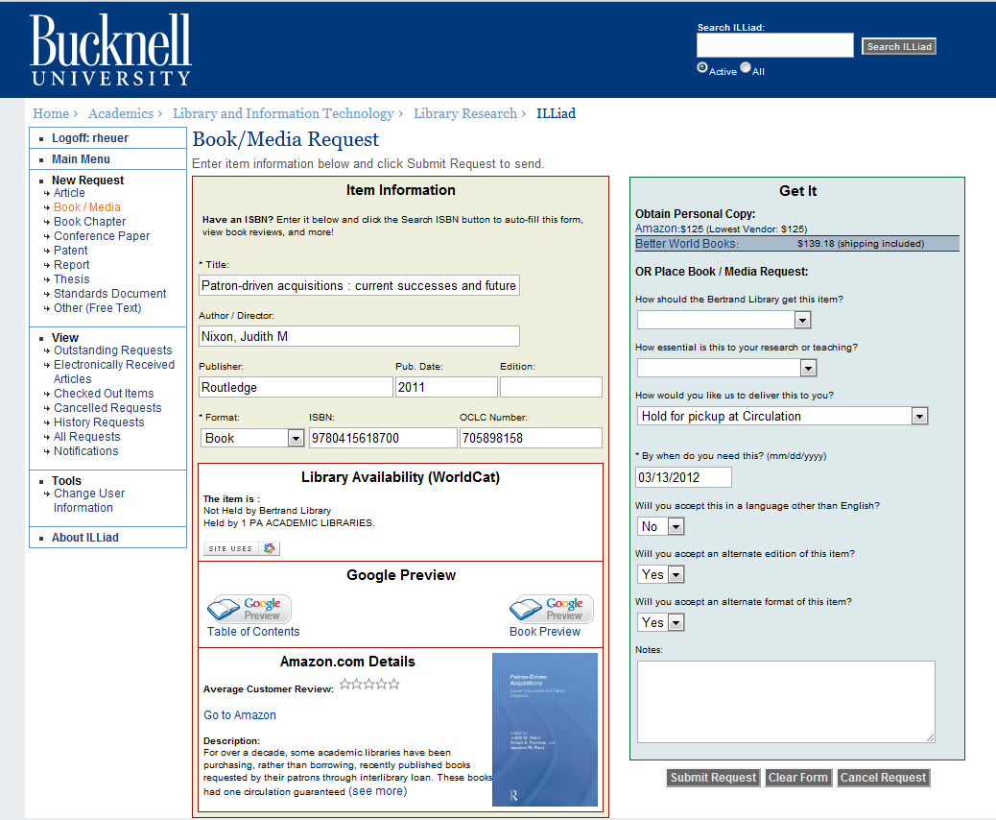

Slide 17
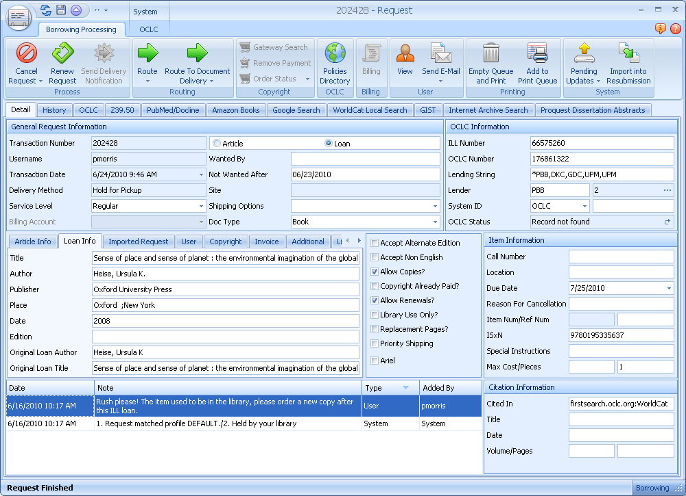

Slide 18
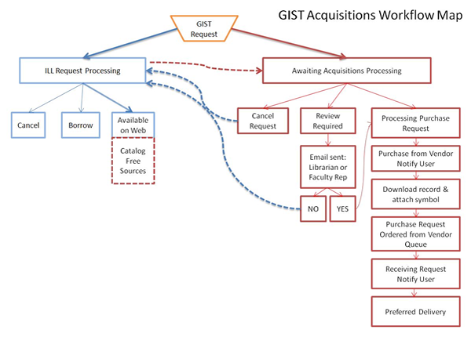

Slide 19
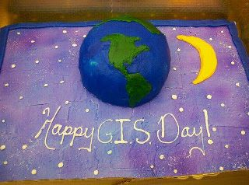
Serials
Do not use Serials module. Had not used it in Sirsi for a long time. All print and electronic holdings reflected in Serials Solutions and now in WorldCat.
Will phase out Serials Solutions A-Z list summer 2012.

Slide 20
Cataloging
Changed from YBP to OCLC WorldCat Cataloging partners
Receive 85-90% of materials shelf-ready
Bucknell symbol and OCLC local holdings record created by WorldCat Cataloging partners—Means most of what we get goes straight to the shelves upon arriving.
Huge savings -- $$$$
Since June, 600 fewer books for original cataloging/cataloging review
Accepting additional levels of cataloging
No more redundant work – however, we can’t slack with brief records any more
No need to maintain local authority work
Cataloging DVDs is a little more cumbersome—short term
No call number browse
Limited information on hit-lists

Slide 21
Costs/ Savings
We have saved A LOT of $$$.
Indirect costs – servers, staff time, new staff opportunities
We expected an increase in ILL activity, but we have not – in fact, it’s gone down

Slide 22
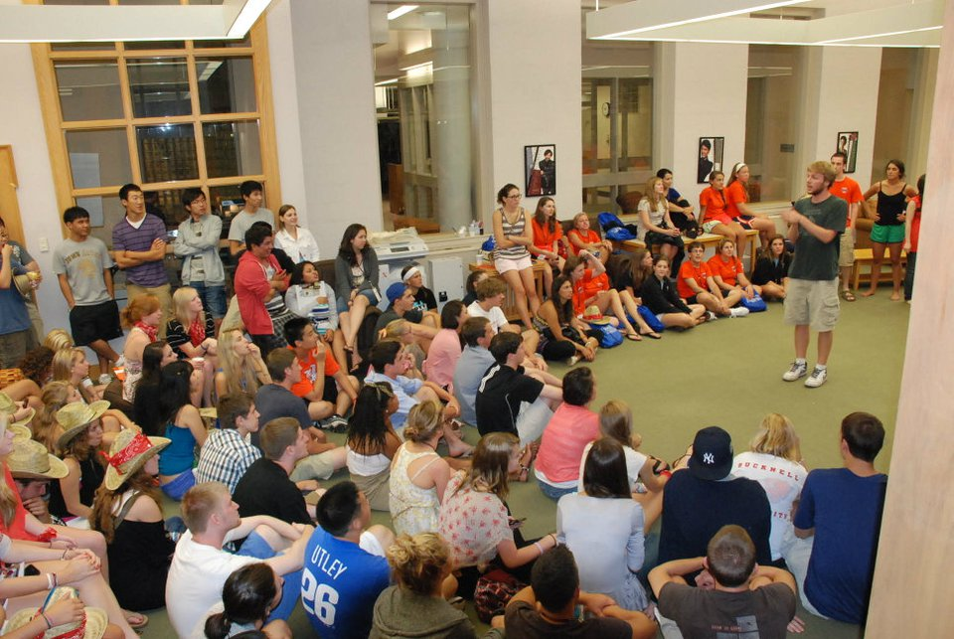
Looking forward to…
Improved and customizable notices (March 2012)
Self-check (March 2012)
Reports
Plan to eliminate:
Serials Solutions, A-Z list
Summon
Maybe, 12 months…Illiad
First year students participate in the library’s late-night orientation program.

Slide 23
Thanks!
Questions?
Carrie Rampp, Director of Library Services & Instructional Technology
cer013@bucknell.edu
Other info:
WebEx playback for WorldShare event http://tinyurl.com/jan2012WorldshareWebEx

Slide 24
Thank you for attending! Please remember to fill out this session’s evaluation by going to the appropriate listing in the conference program on the EDUCAUSE website. Your feedback directly affects future planning.

Slide 25
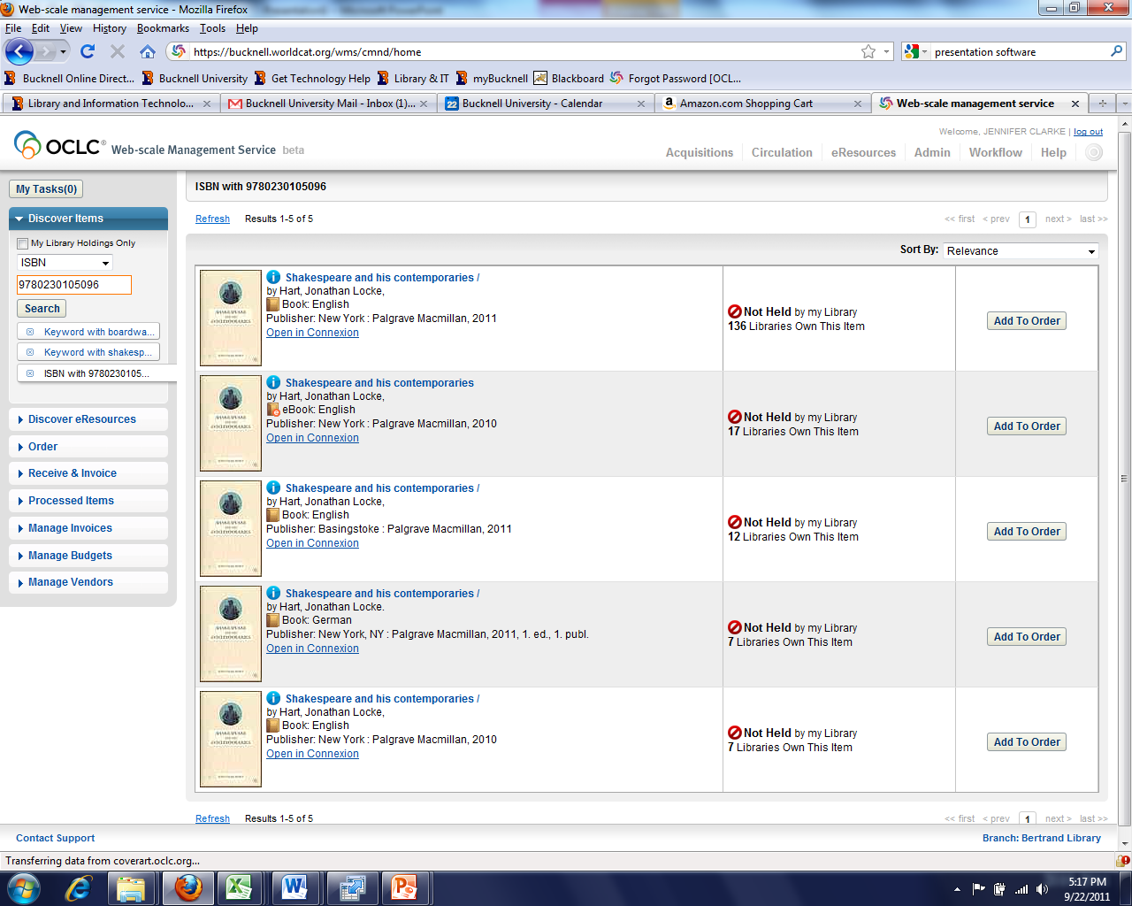
Find the item in WC

Slide 26
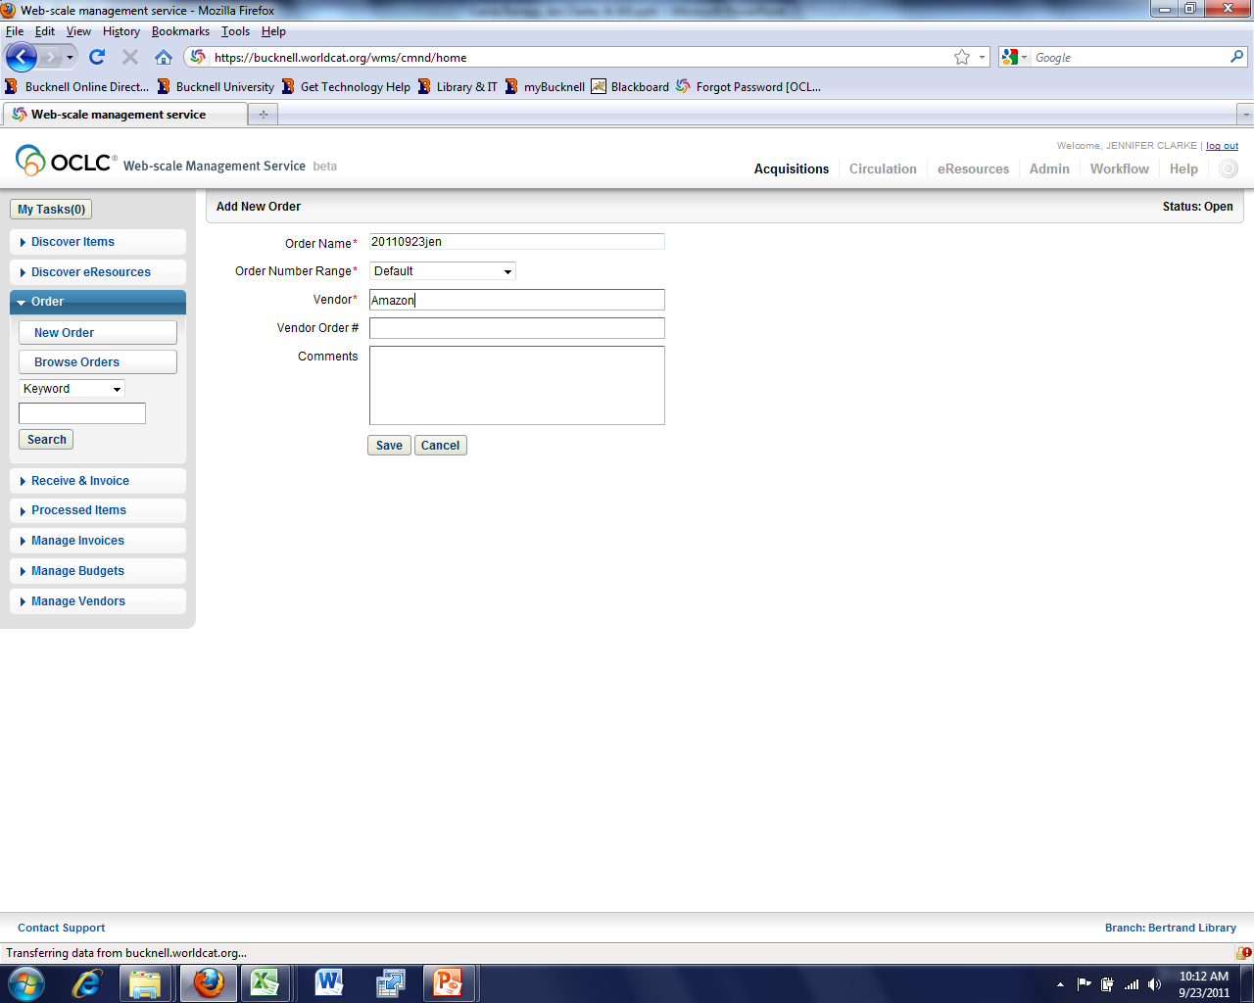
Would like auto-generated po numbers

Slide 27
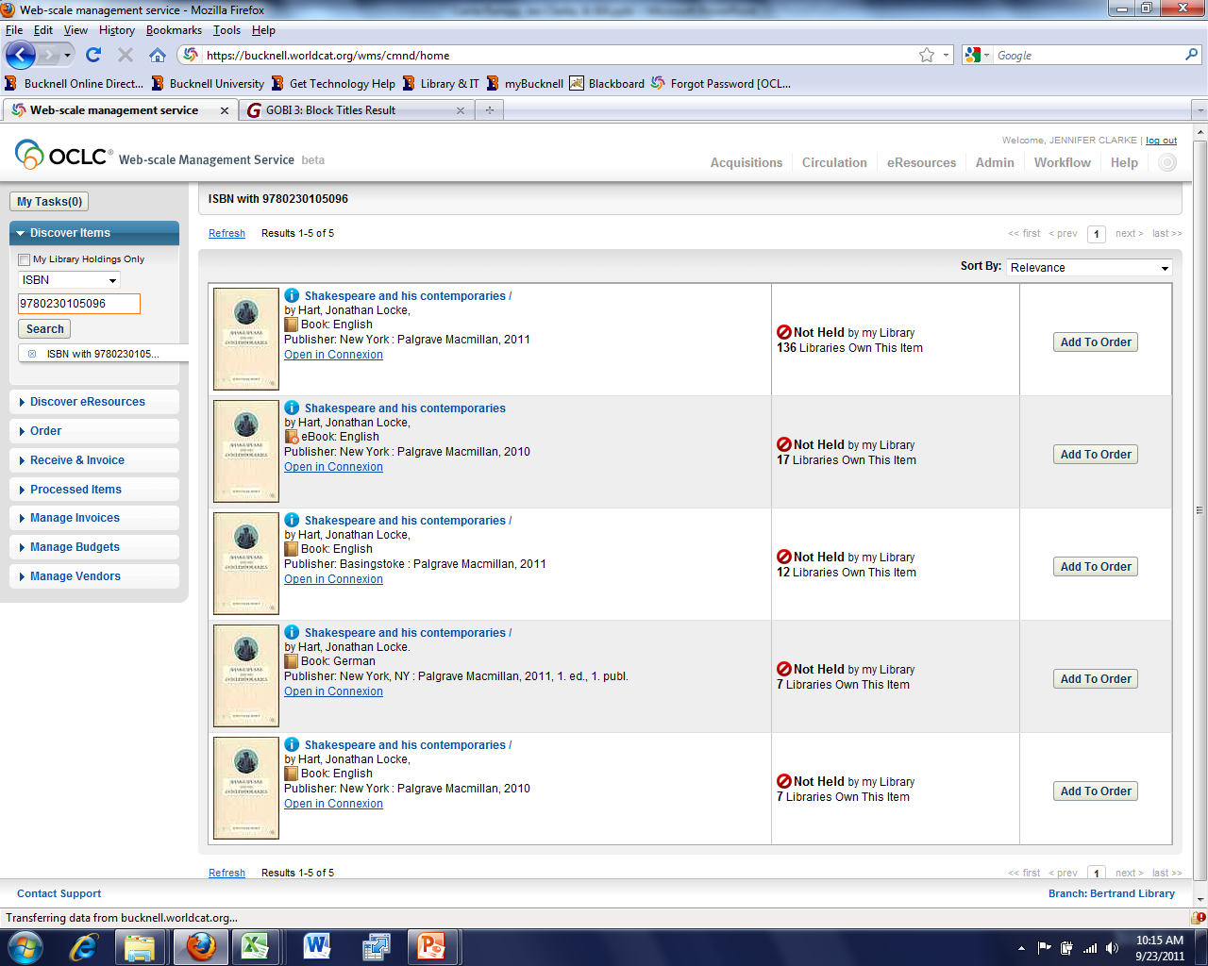
Discover the item
Create a New Order

Slide 28
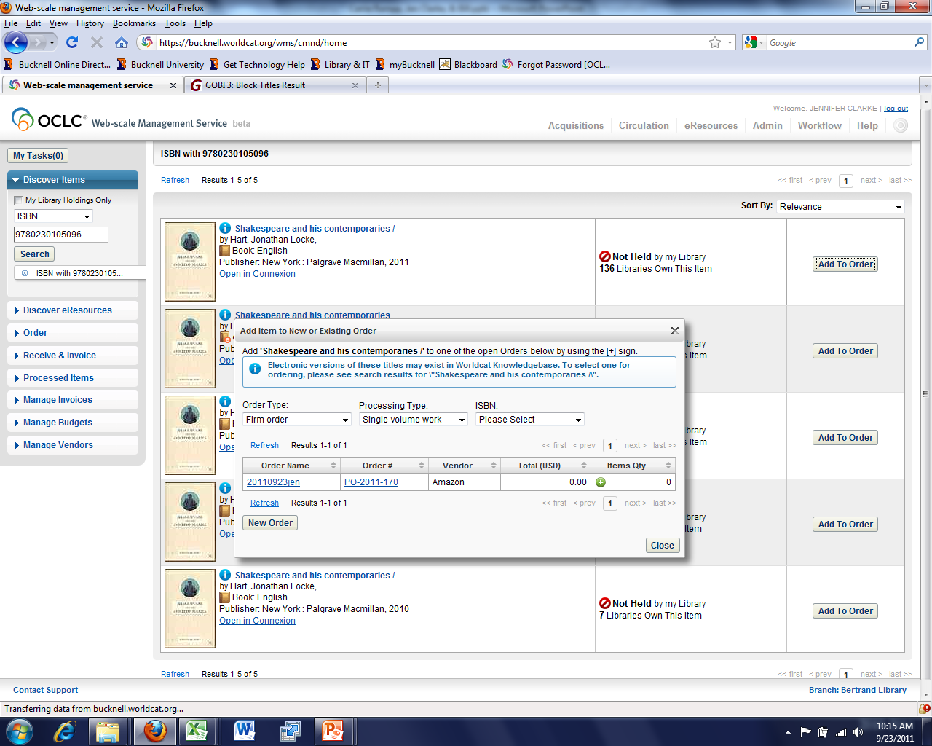
Add the title to the order

Slide 29


Slide 30
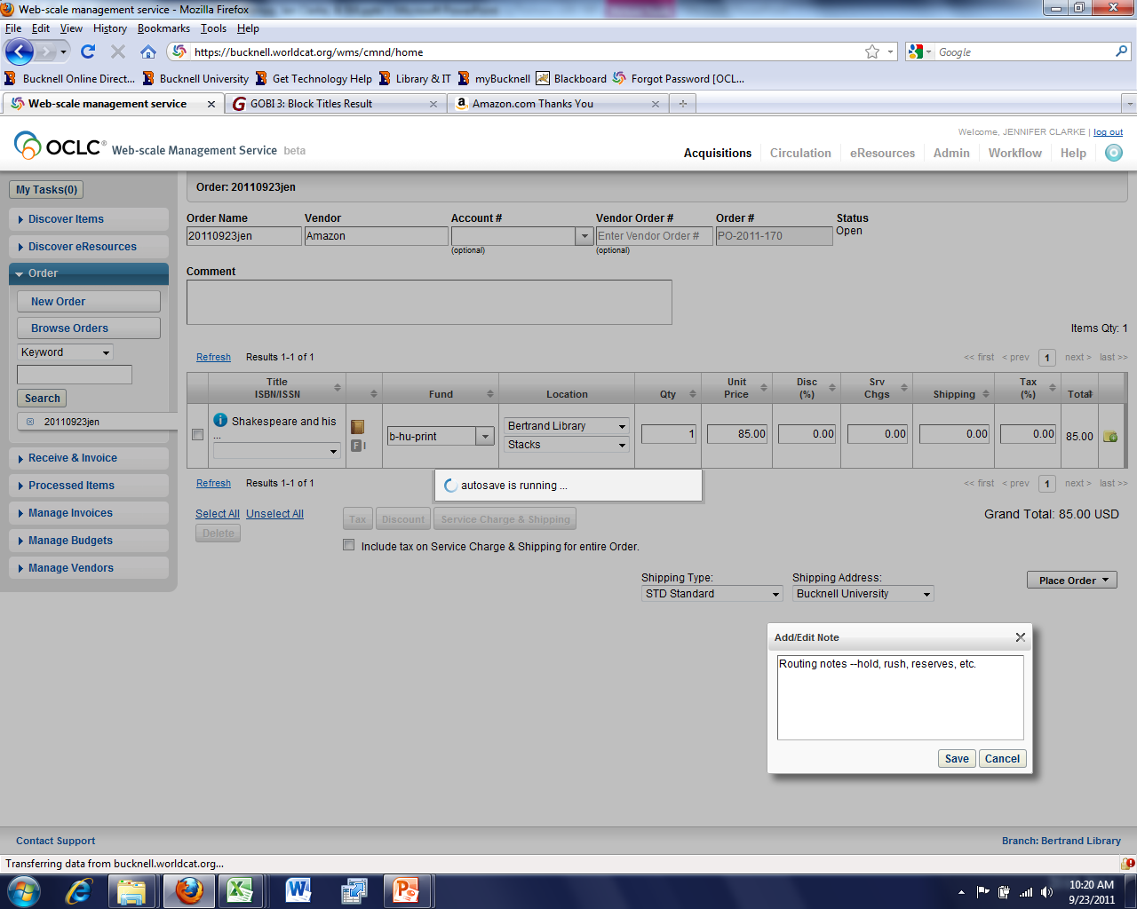
Enter fund, location, price, and notes

Slide 31
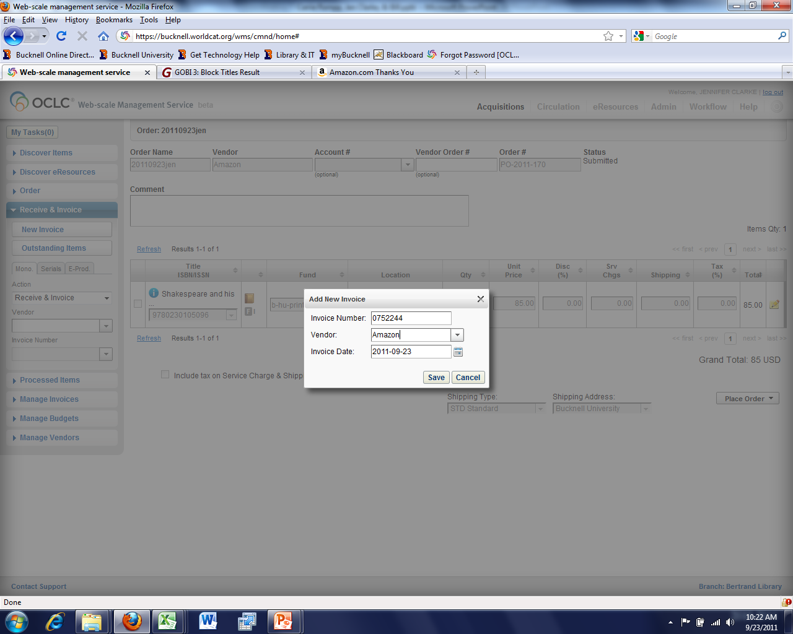
Receive and Invoice

Slide 32
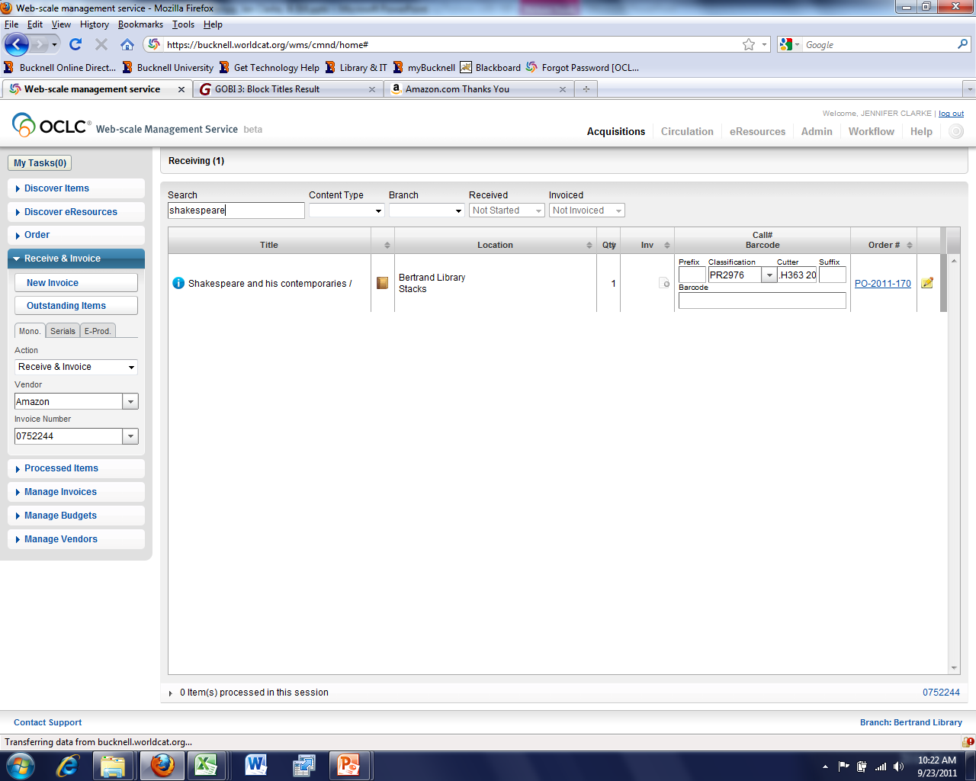

Slide 33
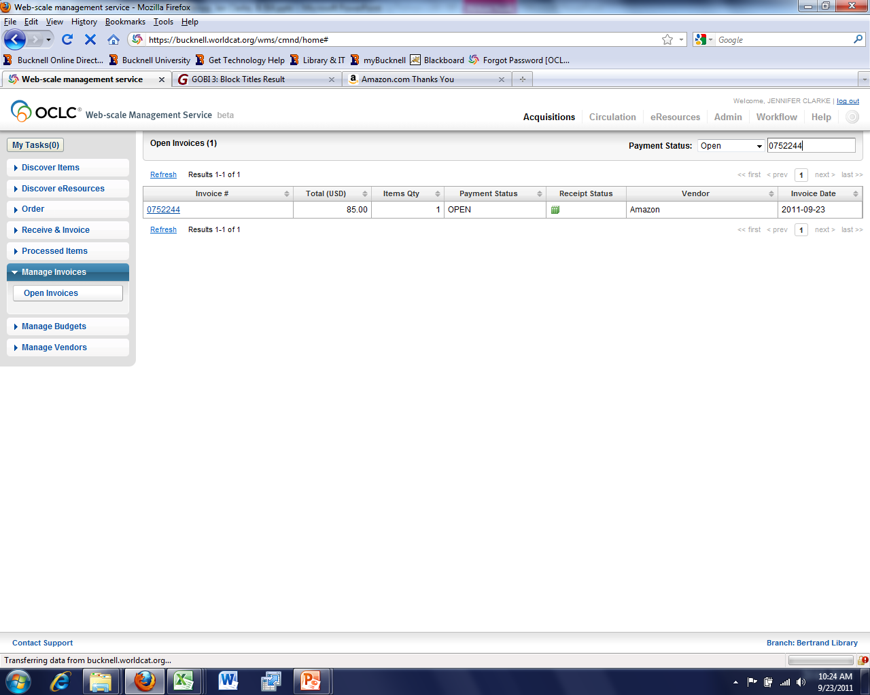
Manage Invoice (pay)

Slide 34
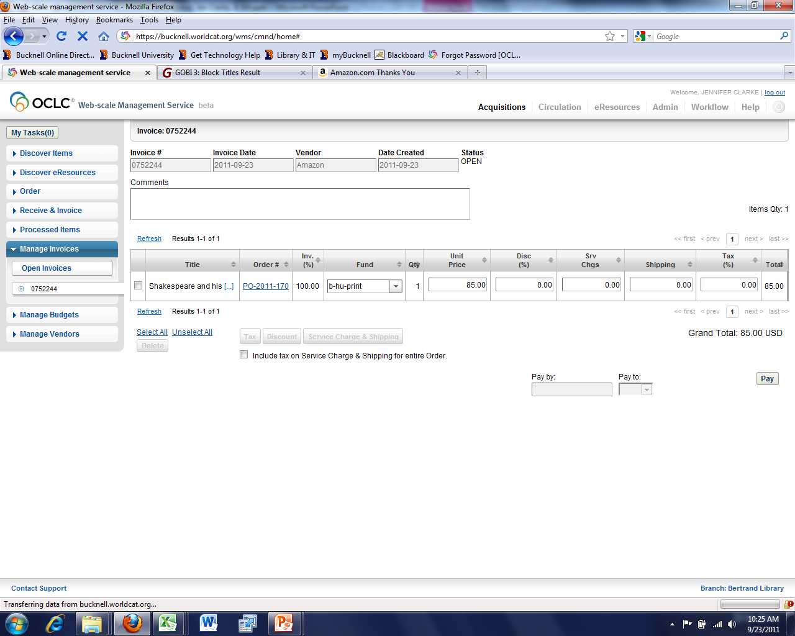
Pay

Slide 35
