Slide 1

March 2012
NERCOMP
Mike Friscia, Carolyn Caizzi, James Terray
Yale University Library

Slide 2

The Problems
Lack of:
standard cataloging tools
cataloging standards
common workflows
common best practices
IT support for some collections

Slide 3
Cataloging Tools
Extensis Portfolio
DB Text
Luna
CONTENTdm
Microsoft Access/Excel
FileMaker Pro
Home grown web apps
Notepad
No metadata at all

Slide 4
Digital Asset Storage
Server Storage (many different servers)
External Hard Drives
Personal Computers
Personal Web Storage
Thumb Drives
CD/DVDs
Floppy Disks
Zip Disks
Jaz Drives

Slide 5
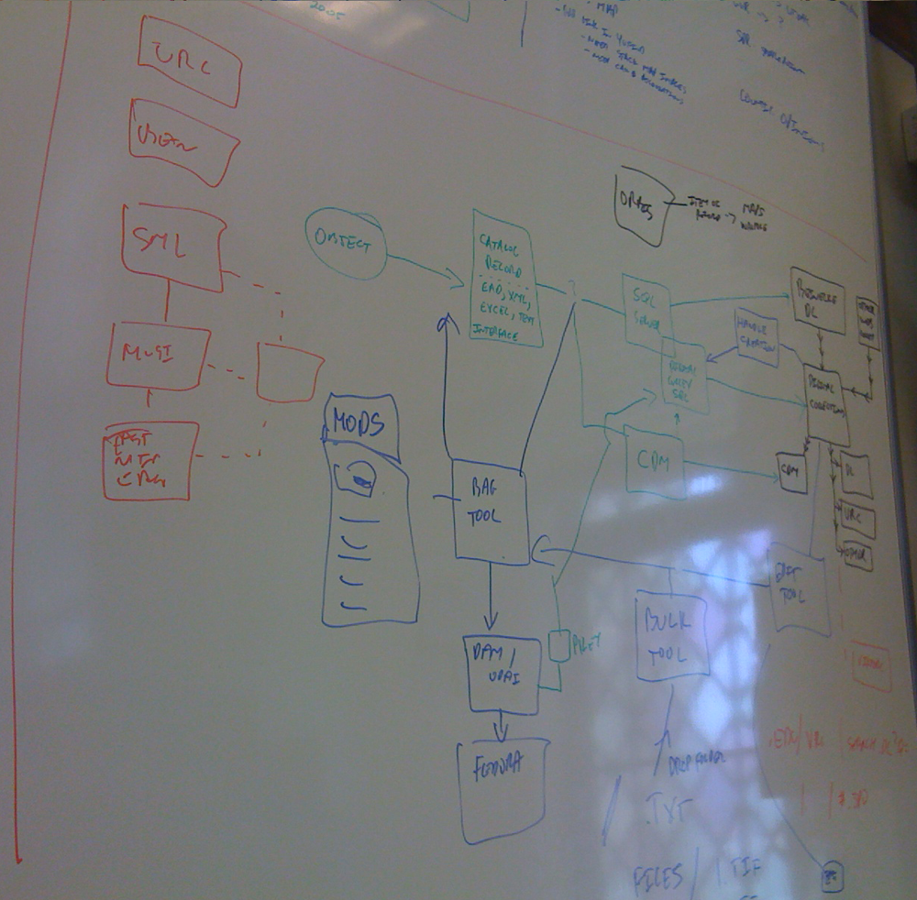

Slide 6
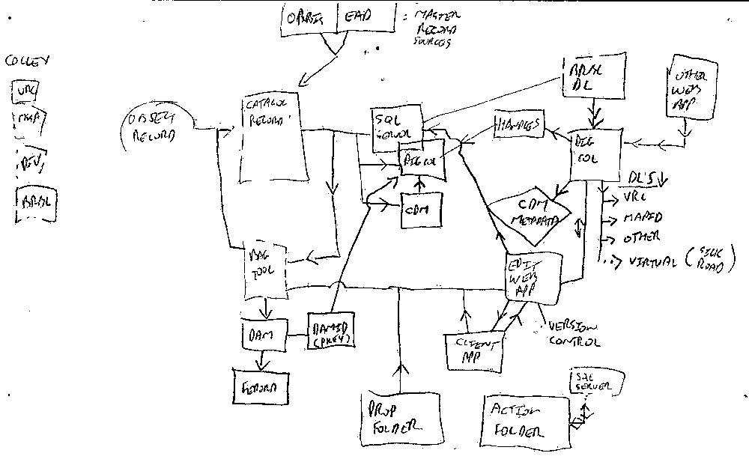

Slide 7
Workflow
Create Digital Stuff
Put it Somewhere

Slide 8
Why Build?
Products Reviewed:
CONTENTdm
Extensis Portfolio
Luna
eXtensible Catalog
Microsoft SharePoint
Fedora/DSpace
many more

Slide 9
Why Build?
What we needed:
Ability to publish digital objects to:
Preservation Repository
Web Presentation
Digital Asset Management Systems
Version control
Ability to manage different workflows
Import metadata from other systems
Manage Authority Control
Manage complex relationships
Bulk processing/editing of metadata
Metadata editing tools

Slide 10
two Workflows
1. Visual Resources Collection @ Yale University Library
2. Beinecke Rare Book and Manuscript Library @ Yale University

Slide 11
1. Visual Resources Collection
Background &
Context
Notes:
Digital Collection of more than 250,000 images originally scanned from slide library; new content added by patron request (usually art reproductions scanned from monographs)
Item (single surrogate image) level cataloging using locally developed content standard (YVRC Core)
ULAN; LCNA; LCSH; AAT; TGN

Slide 12
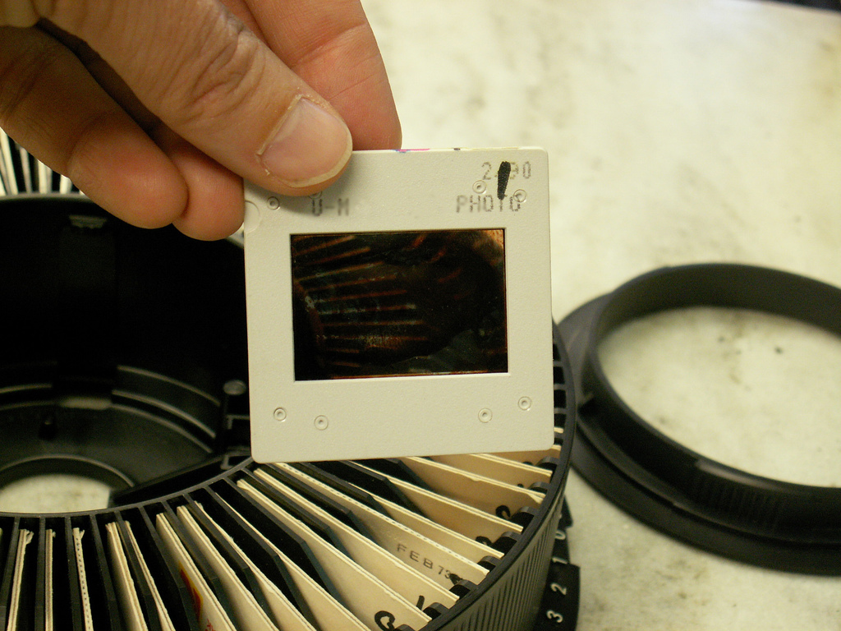
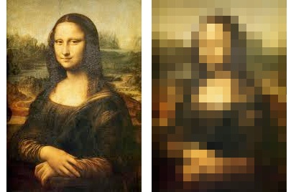
http://www.flickr.com/photos/rosefirerising/556514186/

Slide 13
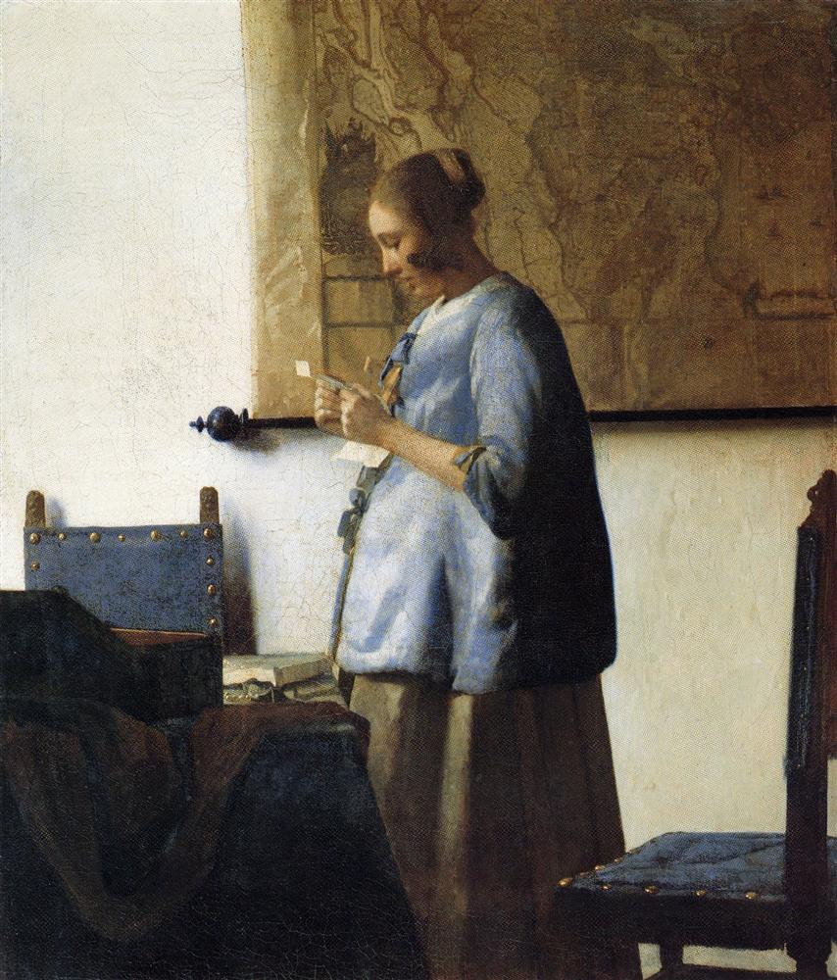

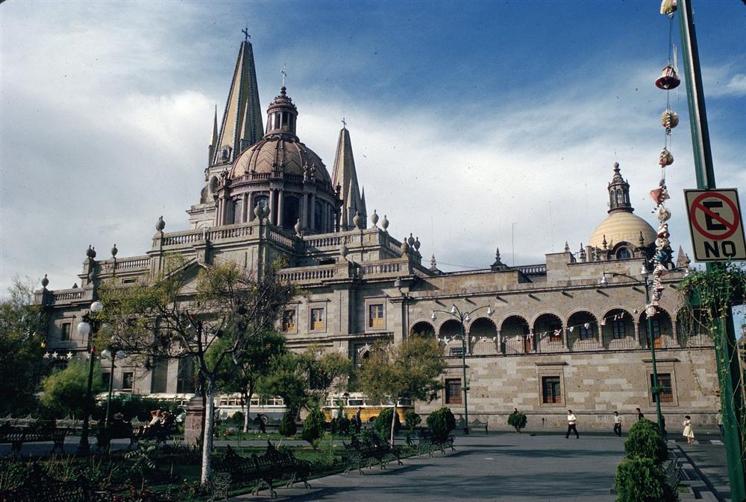
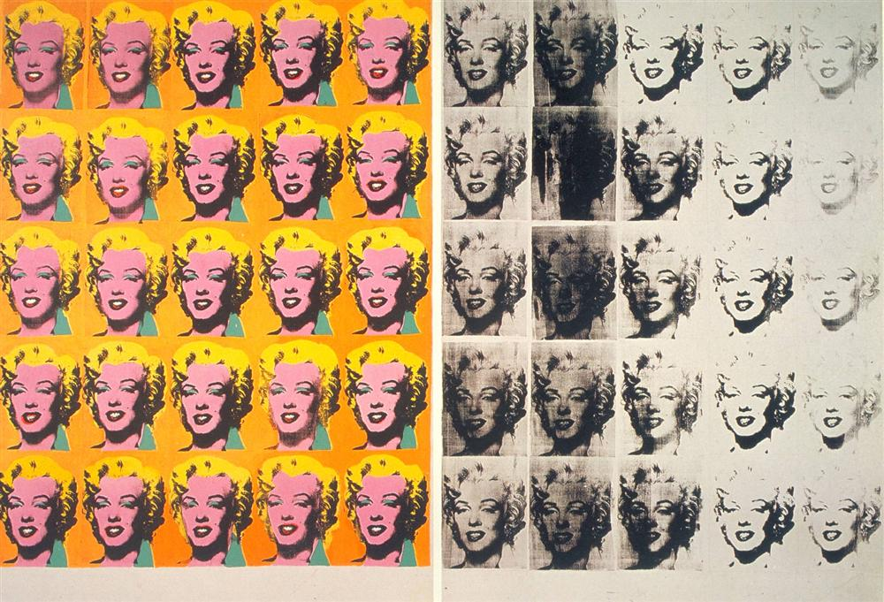
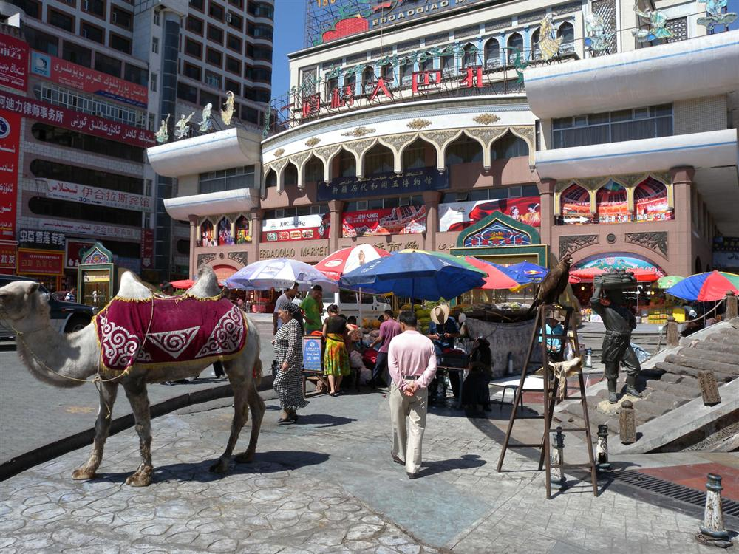
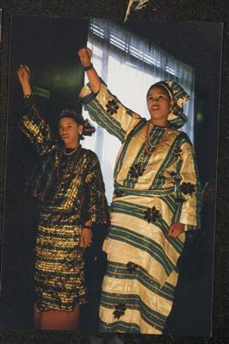
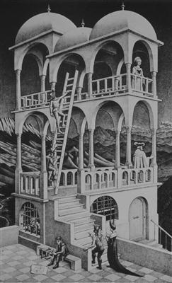
Foxy Brown, 1974.
Vermeer, Jan, “Woman in Blue Reading a Letter,” 1662-65.
Cathedral (Guadalajara, Jalisco): Exterior, 1561-1618.
Oma Oba say Pledge of Allegiance, 1970s-2008
Warhol, Andy, “Marilyn Diptych,” 1962.
Escher, MC, “Belvedere,” 1958.
Newman, Abbey, “Erdaoqiao Market,” 2009.

Slide 14


http://www.flickr.com/photos/mrs_logic/3799729875
http://www.flickr.com/photos/andrec/2893549851/

Slide 15

http://www.flickr.com/photos/ppix/2305078608

Slide 16
Visual Resources
Workflow & Opportunities

Slide 17
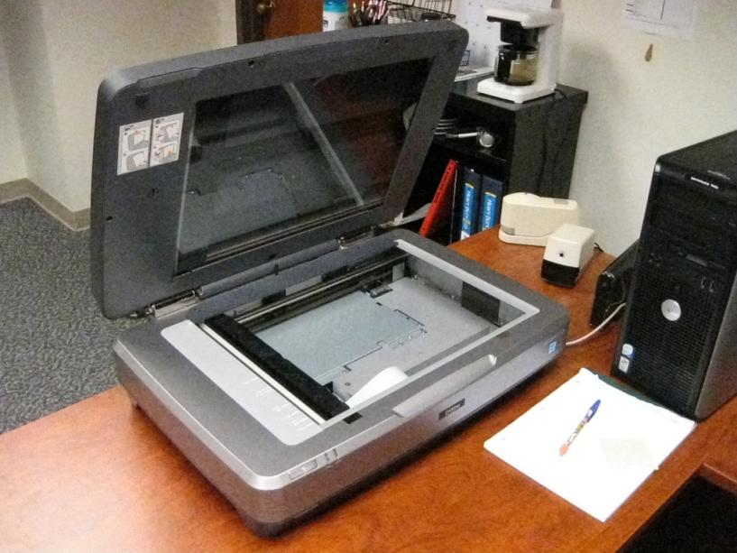
Visual Resources
Digitize
Process Images
Add Metadata
Publish
Archive

Slide 18
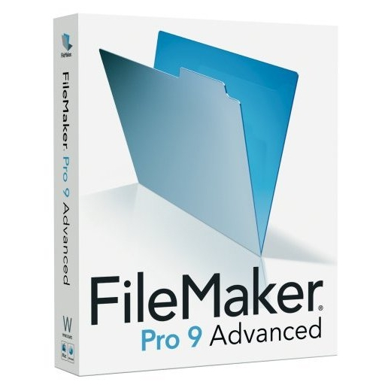
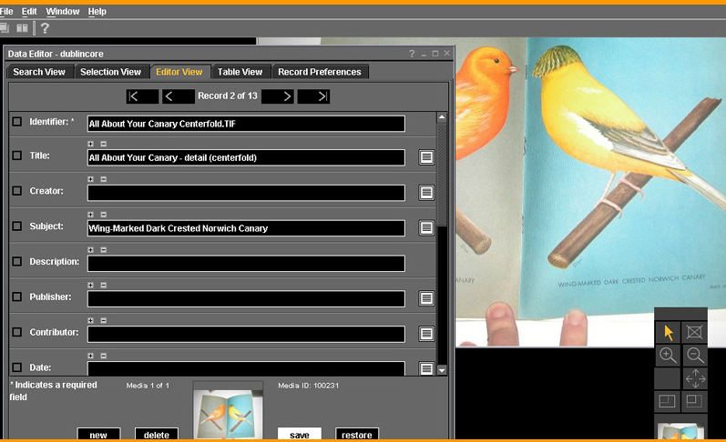
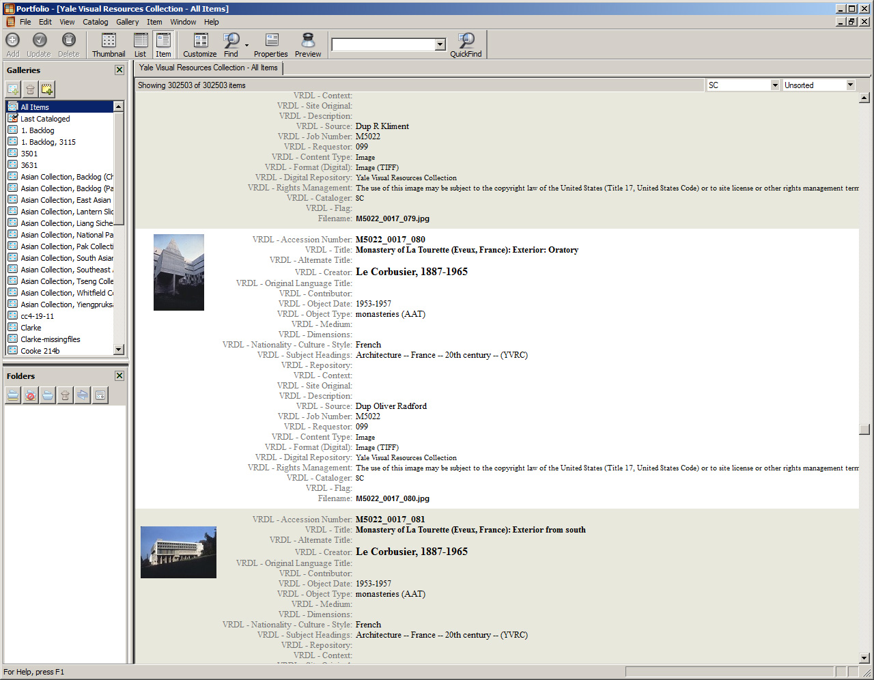
Notes:
Cataloging tools: FileMaker, Luna, Extensis Portfolio (commercial product) “Most popular Image Catalog for SOLO Creatives and Photographers.” Software installed locally. Connect to shared DB on server.
Only a cataloging tool: no control over publishing to interface; moving master images to RR was a separate process; limited in permissions (students); processing masters used different software; was not easy to add/delete from controlled vocab list (separate custom program developed for that). Not designed to manage institutional collections.

Slide 19
Visual Resources
Ladybird as a
Solution
Notes:
Not only the routing problem as Mike described, but also helped with consolidating our tools into one place. Publish controls. Levels of permission and CAS authentication makes it easier to manage staff/student access. Shared controlled vocabulary lists across departments.

Slide 20
Visual Resources
One stop shop: process, metadata, publish and archive in one interface
Metadata editor with shared authority control
Granular permissions
Publish and archive in hands of staff

Slide 21
Visual Resources
One-at-a-Time
Notes:
Not only the routing problem as Mike described, but also helped with consolidating our tools into one place. Publish controls. Levels of permission and CAS authentication makes it easier to manage staff/student access. Shared controlled vocabulary lists across departments.

Slide 22
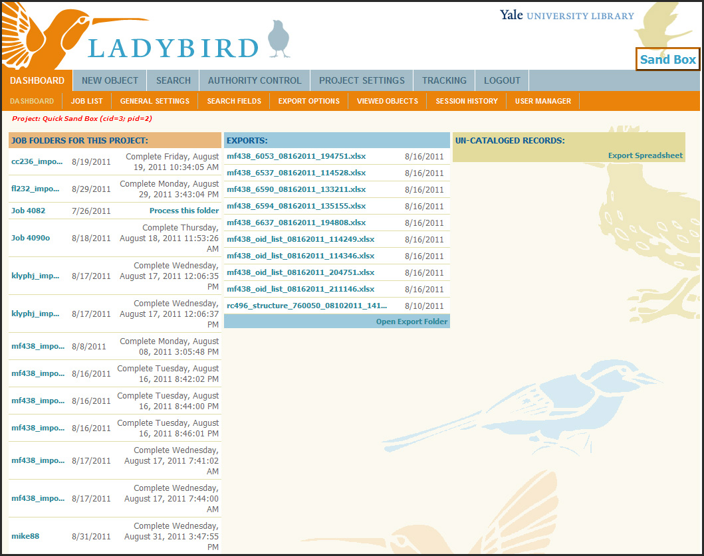

Slide 23
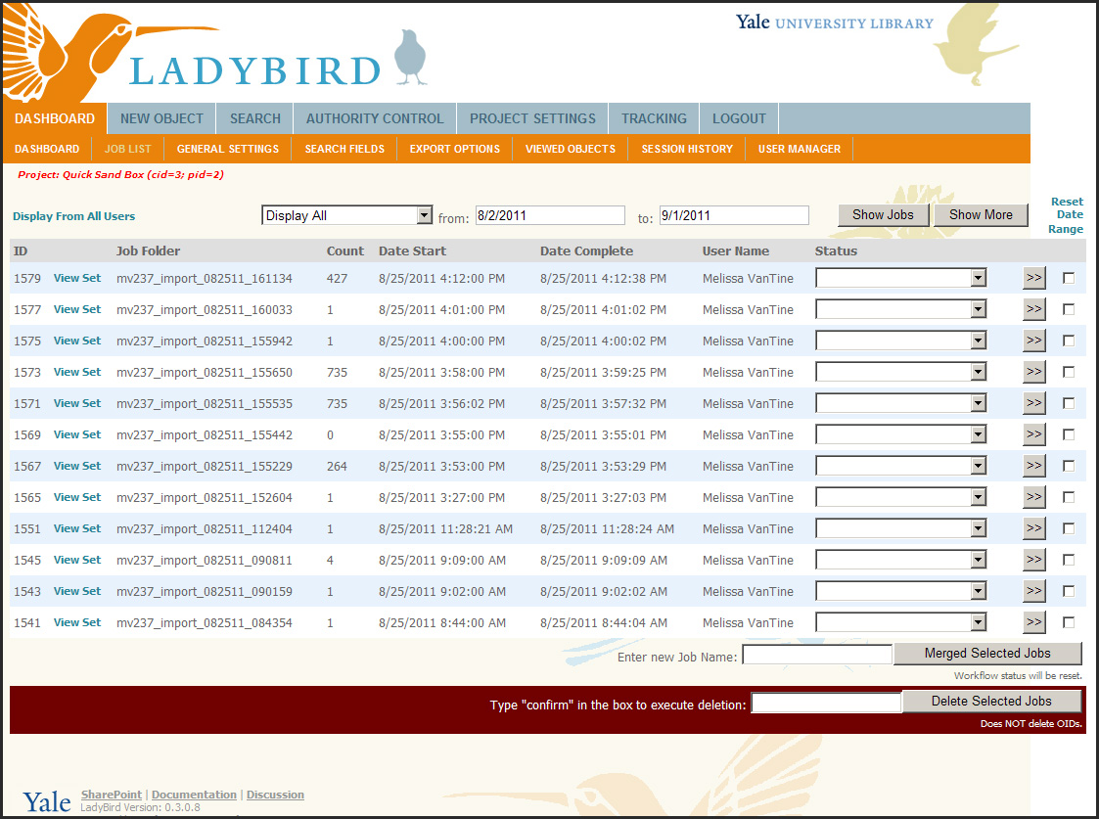

Slide 24
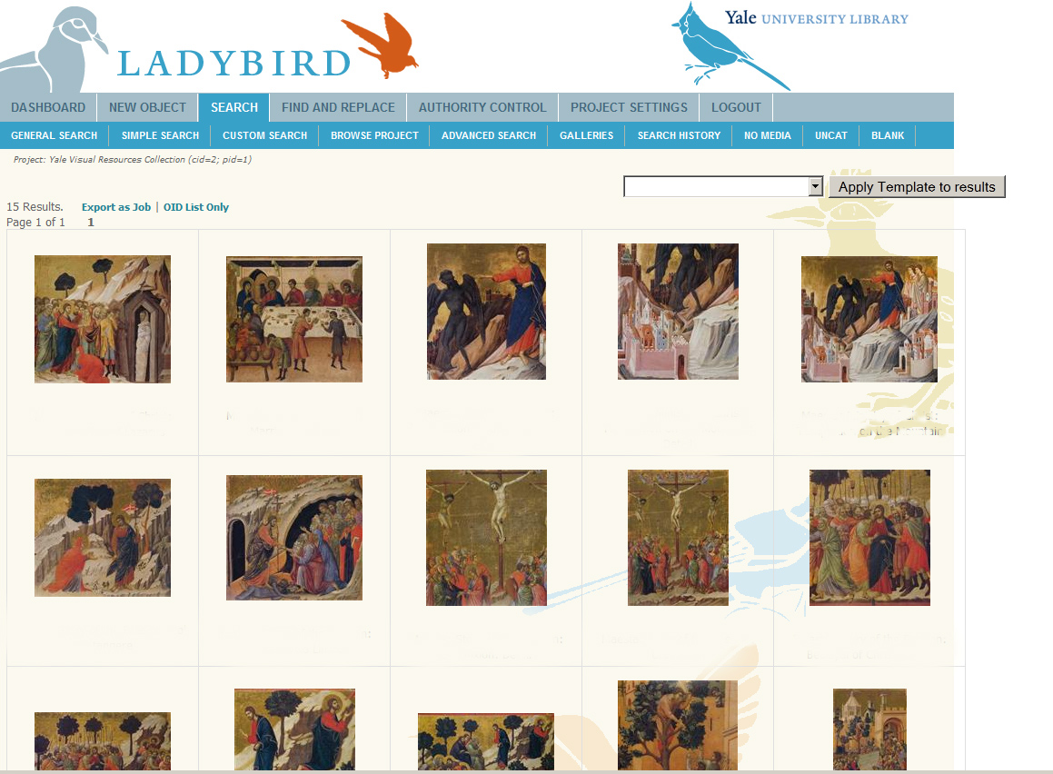

Slide 25
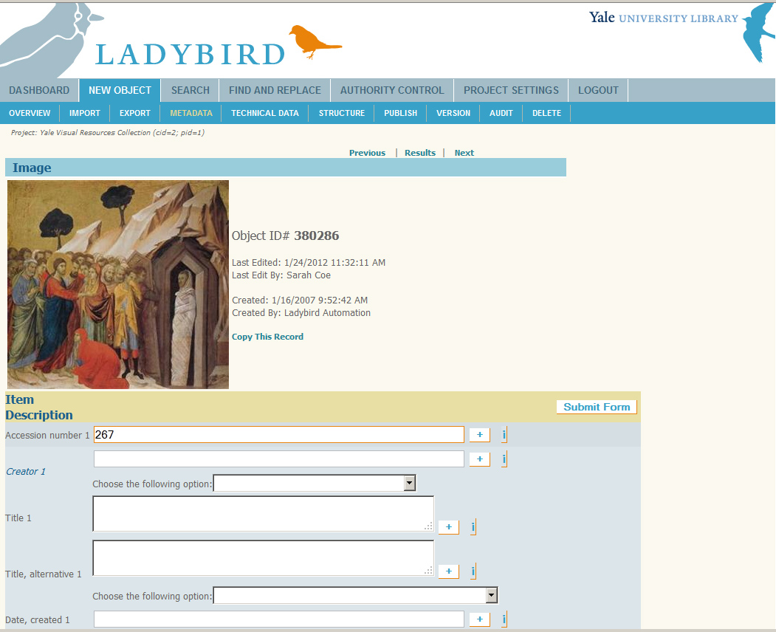

Slide 26
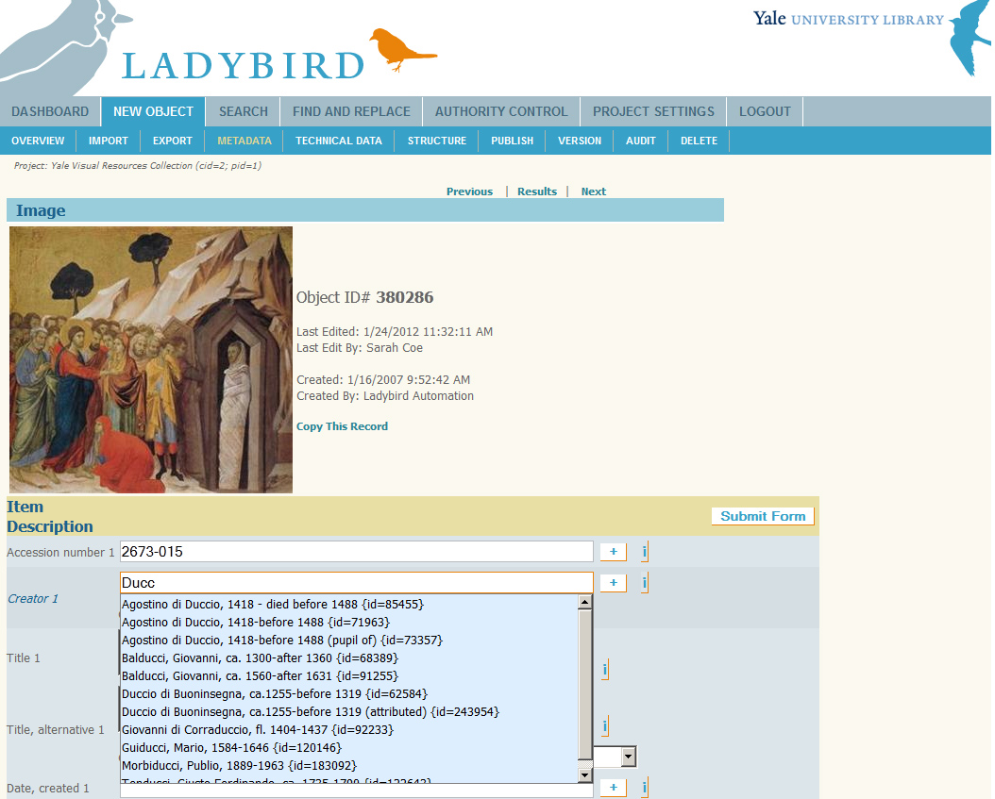

Slide 27
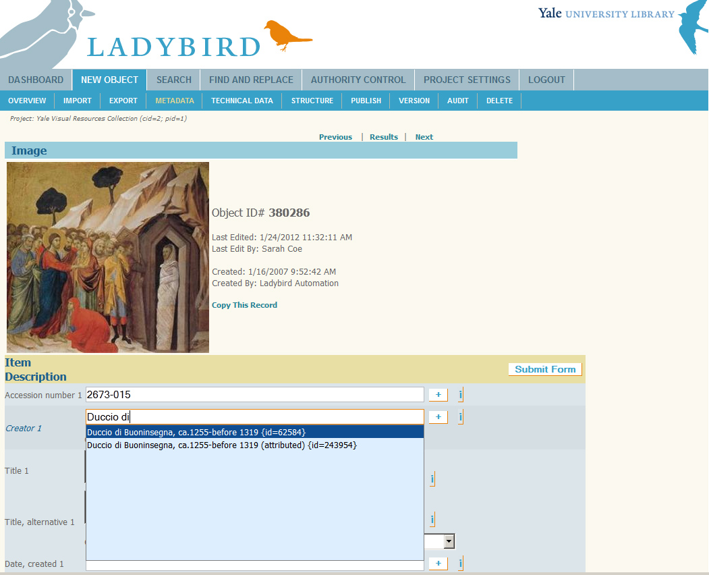

Slide 28
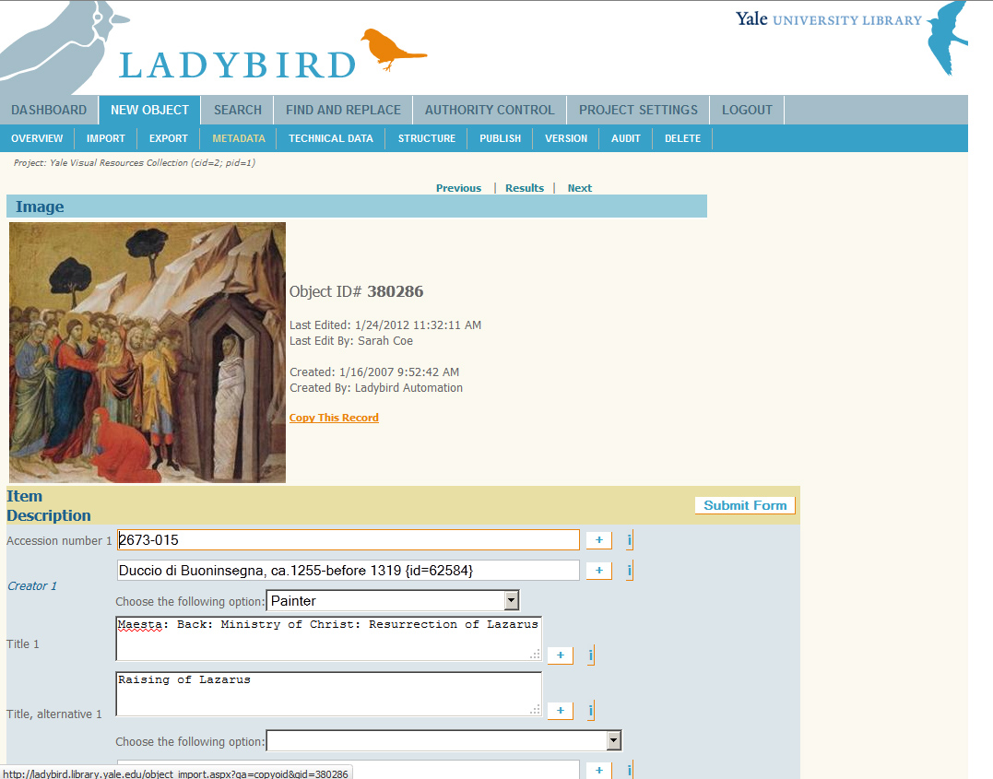

Slide 29
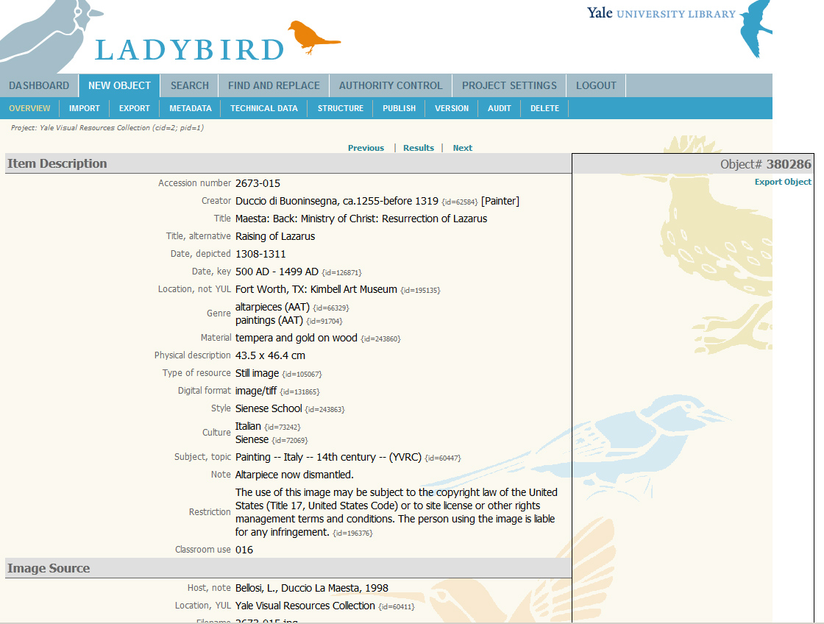

Slide 30
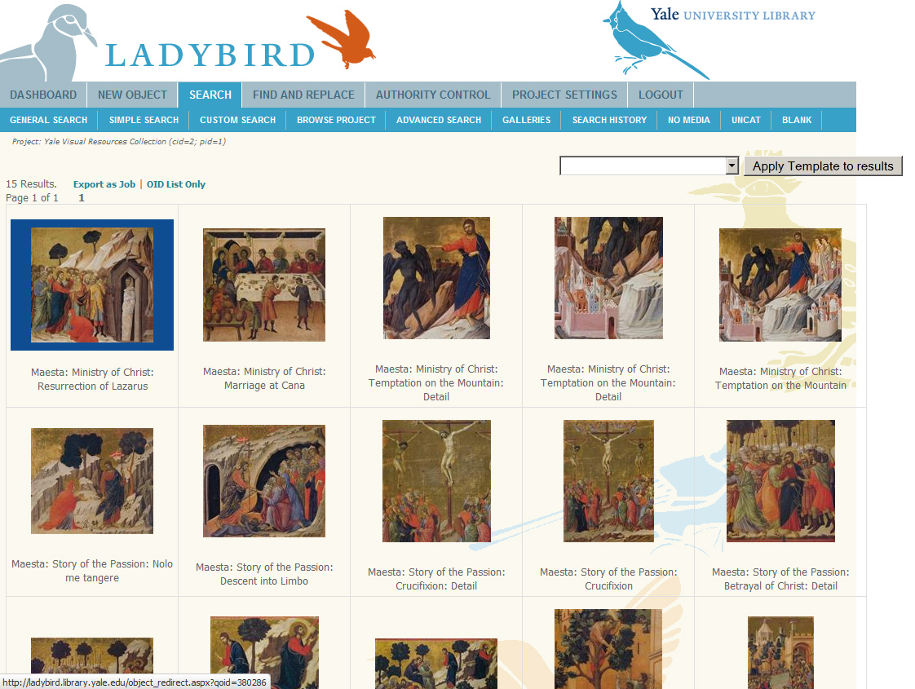

Slide 31
Visual Resources
Batch
Notes:
Not only the routing problem as Mike described, but also helped with consolidating our tools into one place. Publish controls. Levels of permission and CAS authentication makes it easier to manage staff/student access. Shared controlled vocabulary lists across departments.

Slide 32
Notes:
Scan images and drop them in a “hot” folder.
Sign into LadyBird-Dashboard. Process folder.
Wait for e-mail from system that alerts me they are available in LadyBird.
Two options: one-at-a-time cataloging or batch cataloging through a spreadsheet

Slide 35
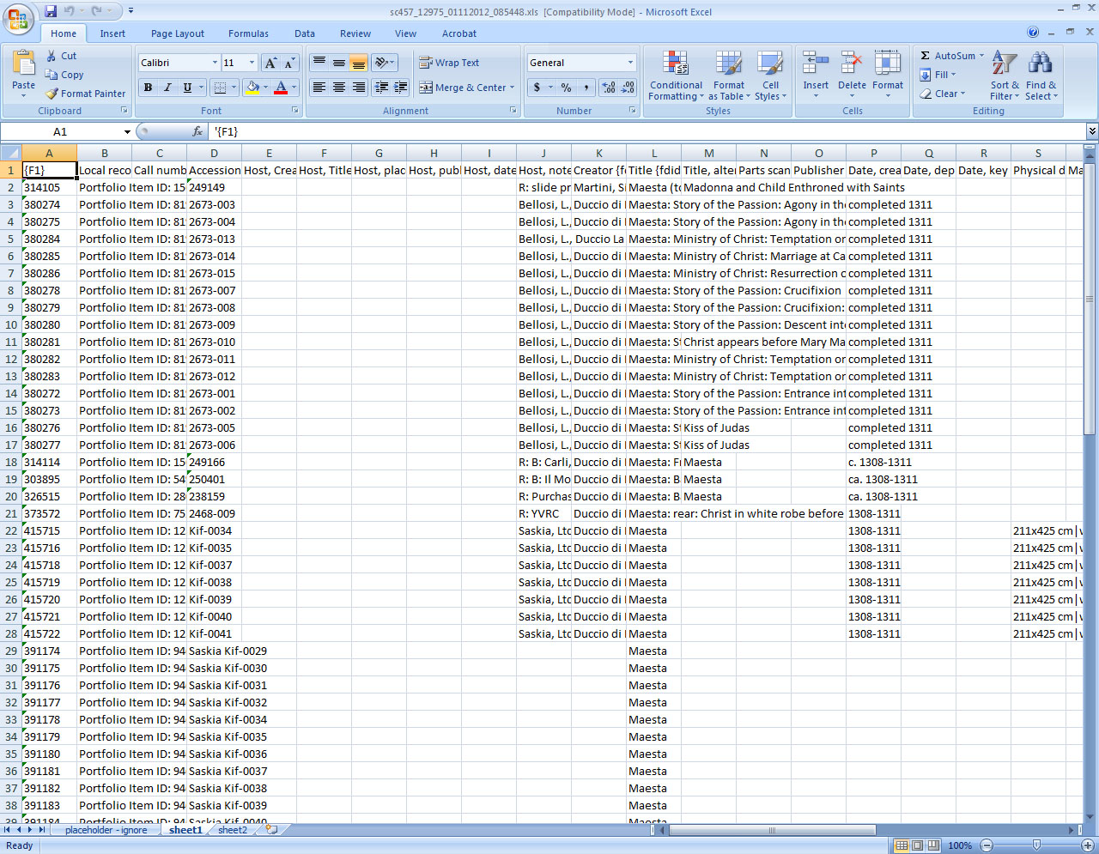

Slide 38
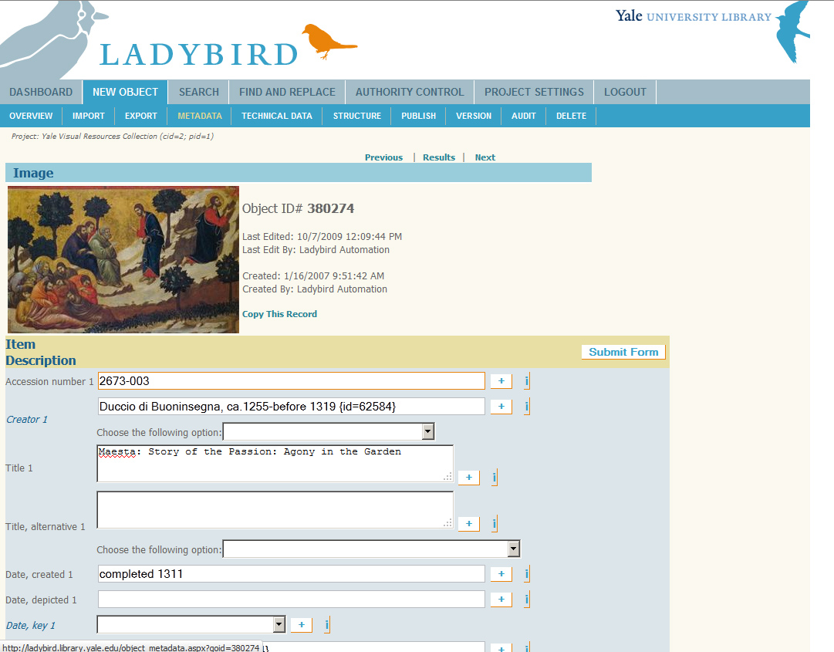

Slide 39
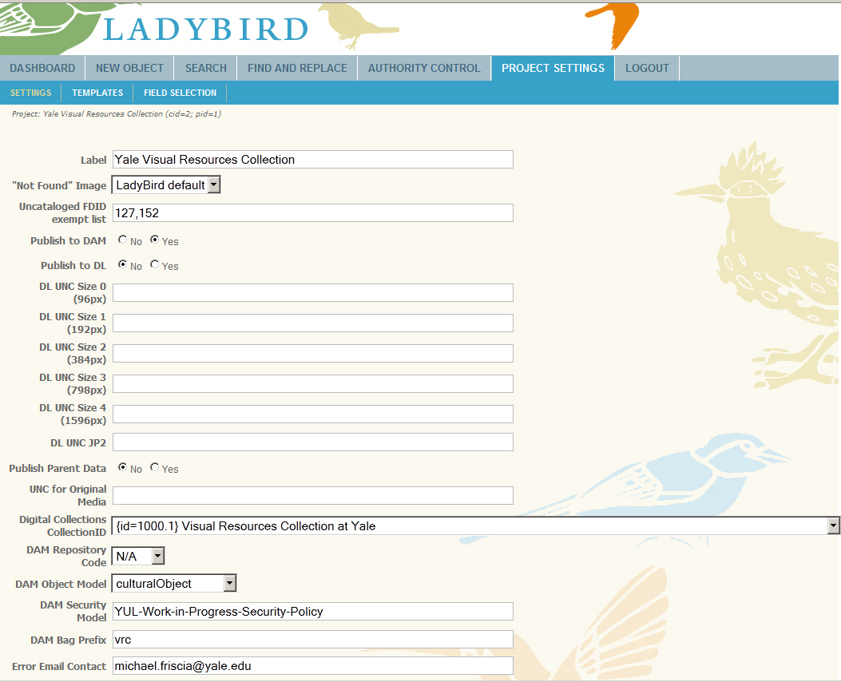

Slide 40
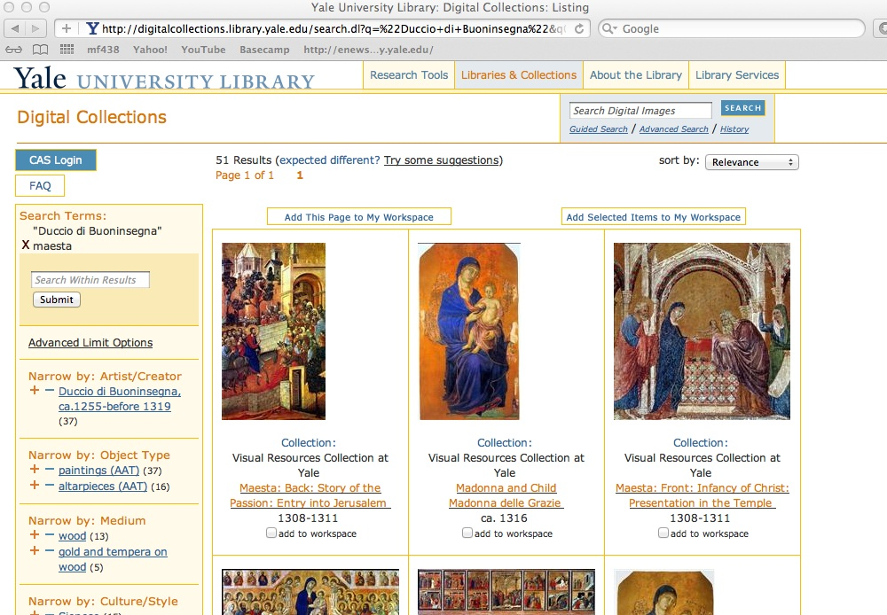

Slide 42
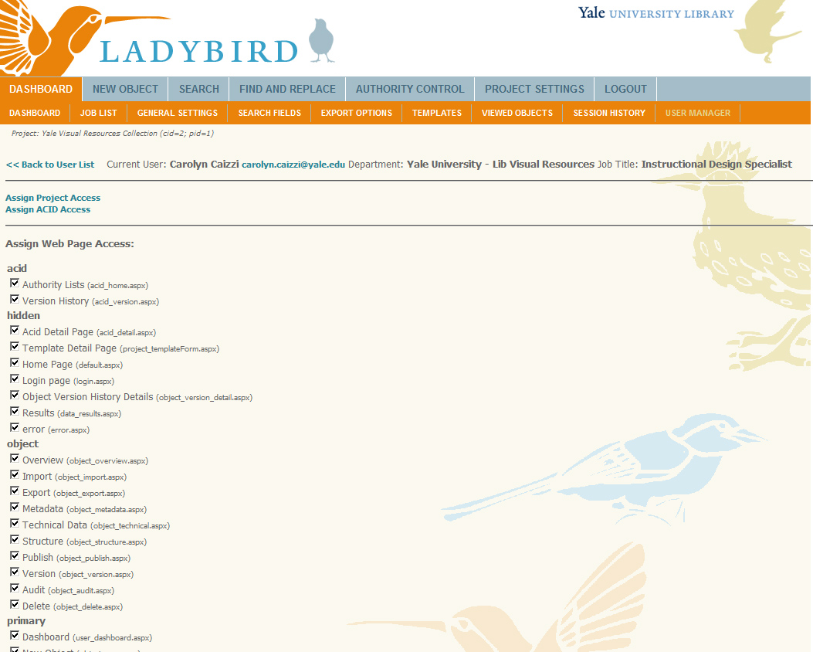

Slide 43
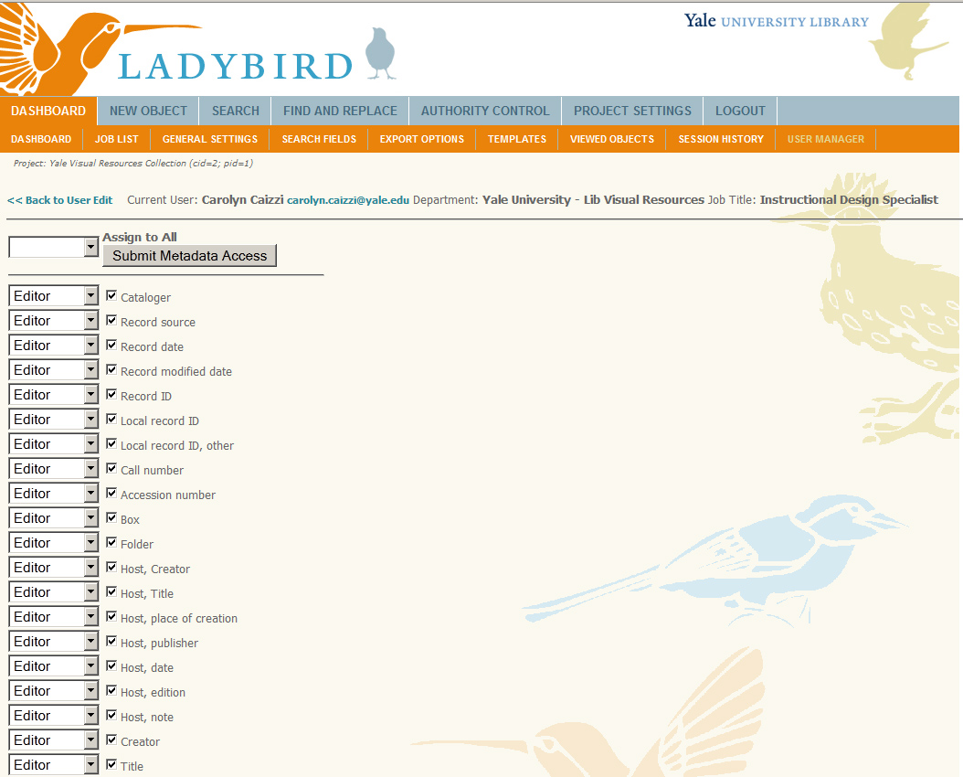

Slide 44
2. Beinecke Rare Book and Manuscript Library

Slide 45
2. Beinecke Library
Background &
Context

Slide 46
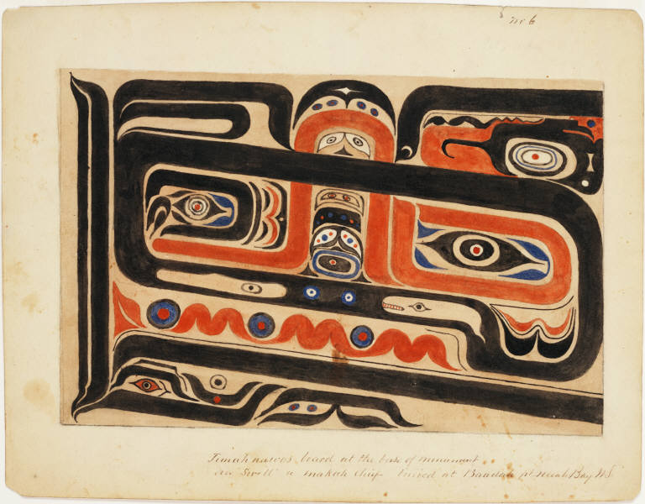
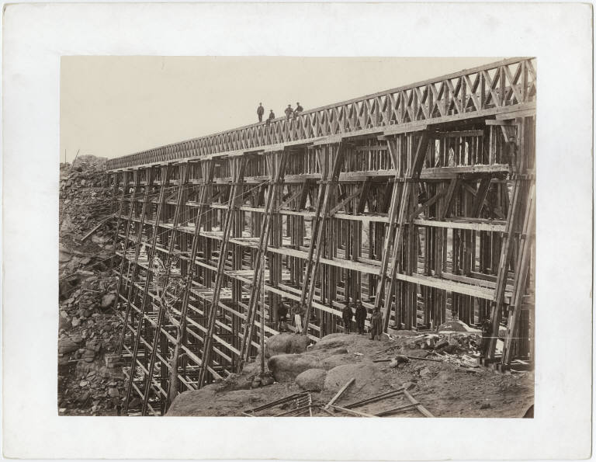
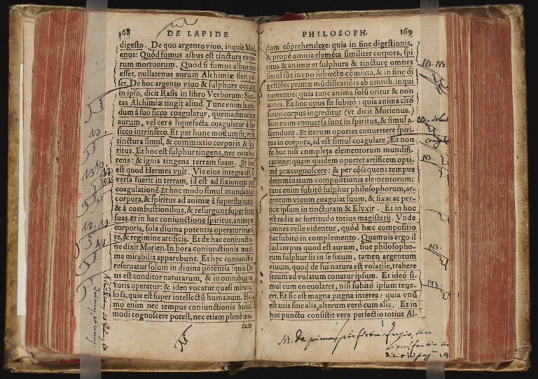
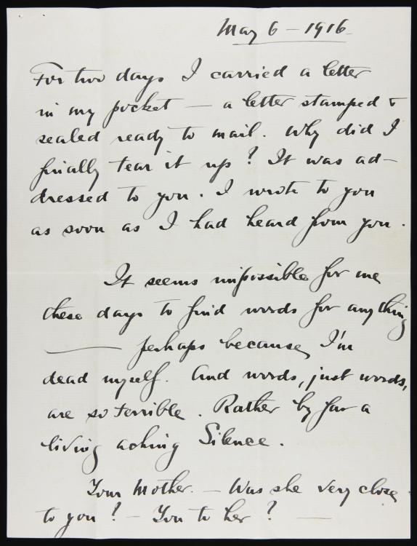
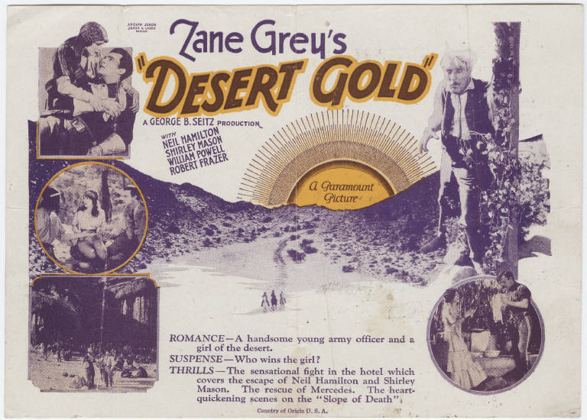
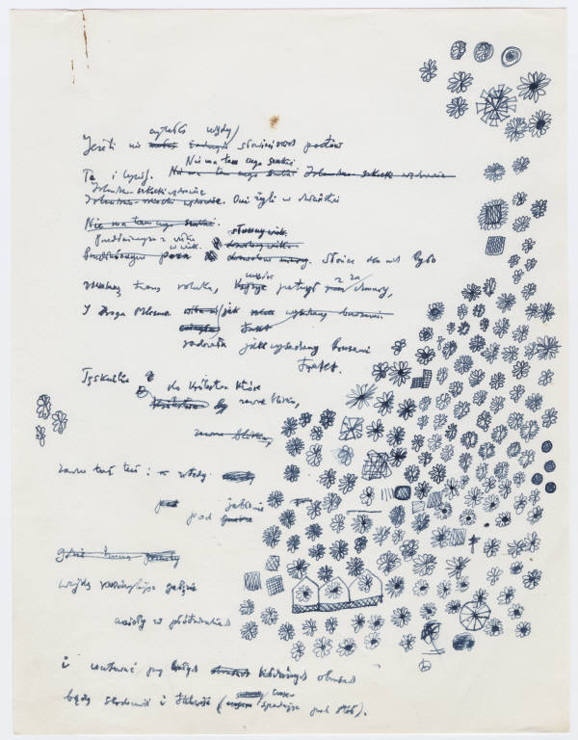
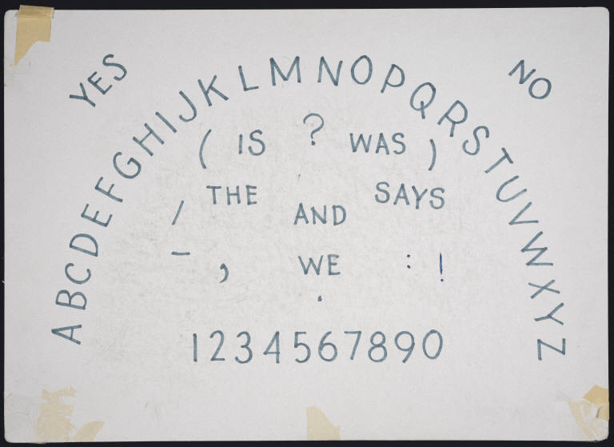
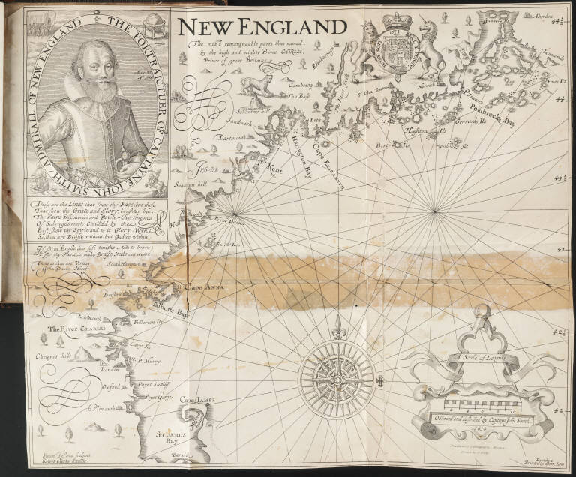
Dale Creek Bridge, Yale Collection of Western Americana
Tomanawos board at the base of monument over 'Swell’ …, Yale Collection of Western Americana
Lavrentii Ventvrae ... De ratione conficiendi lapidis philosophici, liber vnus ..., General Collection
Desert Gold, Yale Collection of Western Americana
Merrill, James Ingram. Ouija board. Yale Collection of American Literature
Letters from Stieglitz to O’Keeffe, 1916 May 6 : p. [1]
Miłosz, Czesław.
Do Robinsona Jeffersa, draft, holograph, corrected, I. [1]
New England: the most remarqueable parts…, General Collection
New England: the most remarqueable parts…, General Collection

Slide 47
Beinecke Library
Workflow & Opportunities

Slide 48
Beinecke Library
Create Metadata
Digitize
Process Images
Publish Metadata and Images
Archive

Slide 49
Beinecke Library
Single Items
One-to-one relationship
Object record Image
Complex Objects
One-to-many relationship
Object record Image
Image
Image

Slide 50
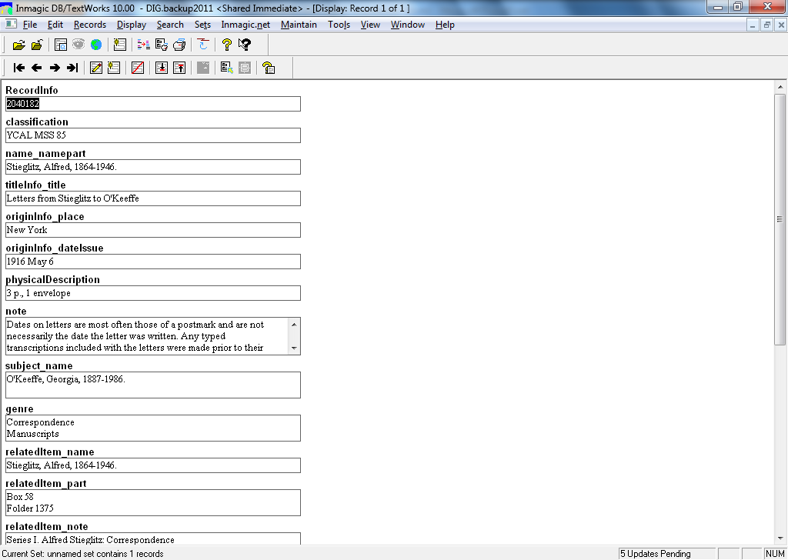

Slide 51
Beinecke Library
Ladybird as a
Solution
Notes:
Not only the routing problem as Mike described, but also helped with consolidating our tools into one place. Publish controls. Levels of permission and CAS authentication makes it easier to manage staff/student access. Shared controlled vocabulary lists across departments.

Slide 52
Beinecke Library
Metadata
Import from MARC and EAD
Shared authority control
Batch updates of multiple fields
Describe and manage complex objects
Workflow
Consolidate into one tool
Automate publishing and archiving

Slide 53
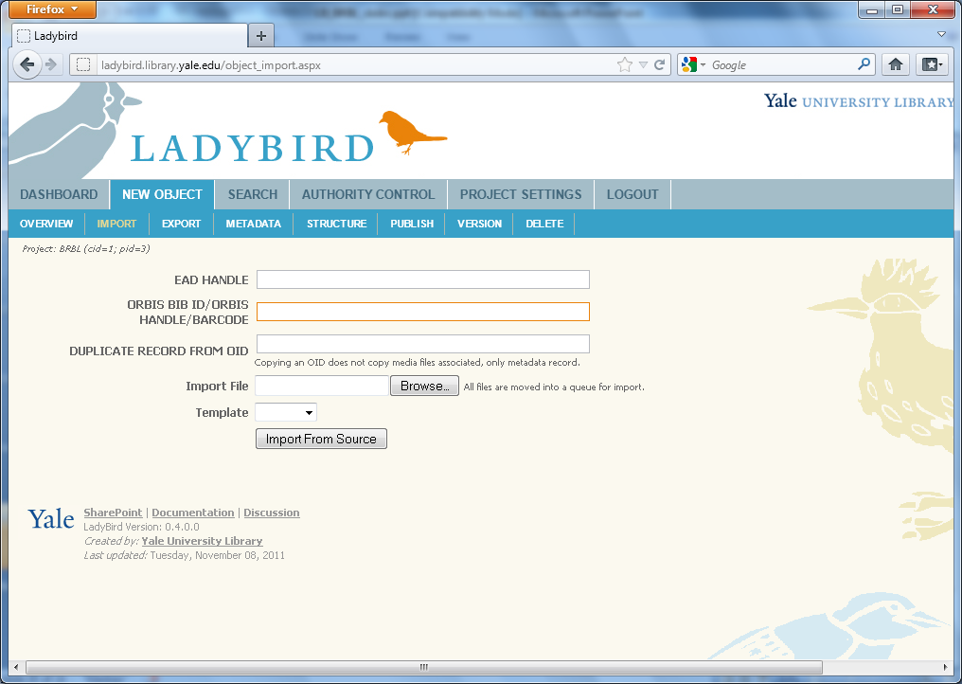

Slide 54
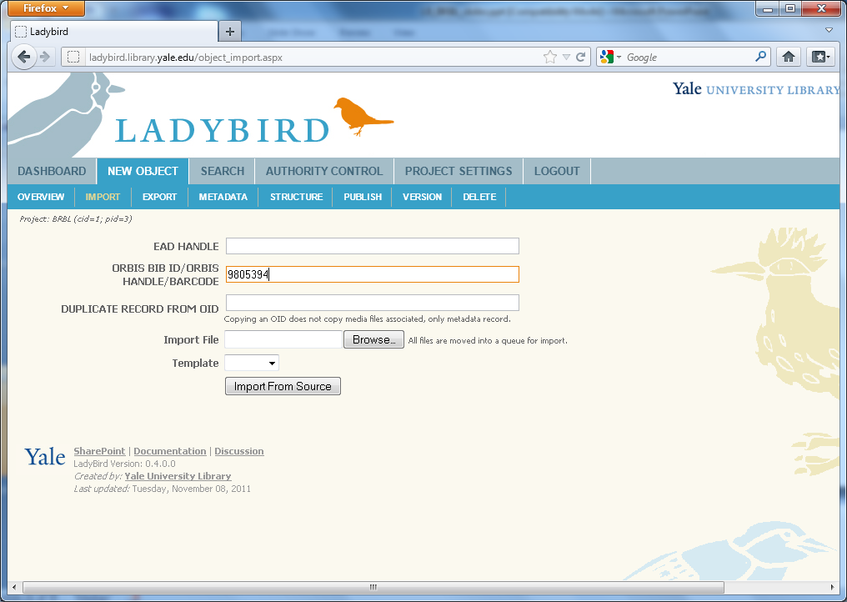

Slide 55
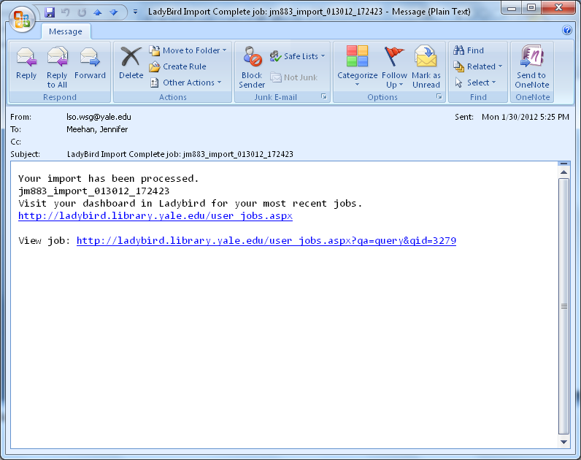

Slide 56
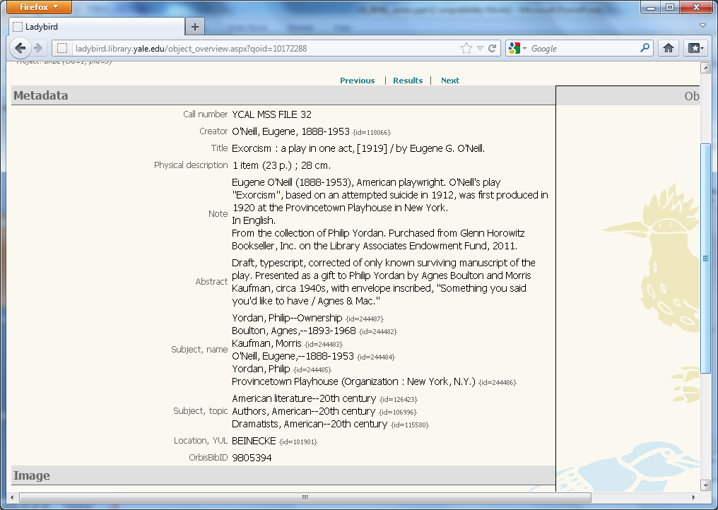

Slide 57
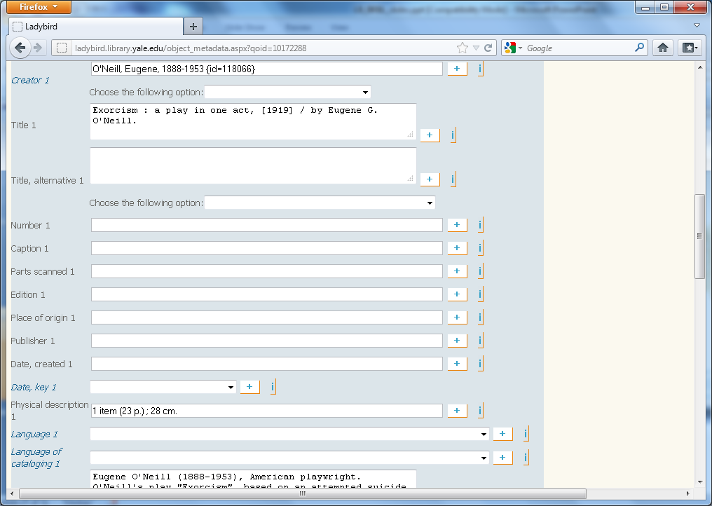

Slide 58
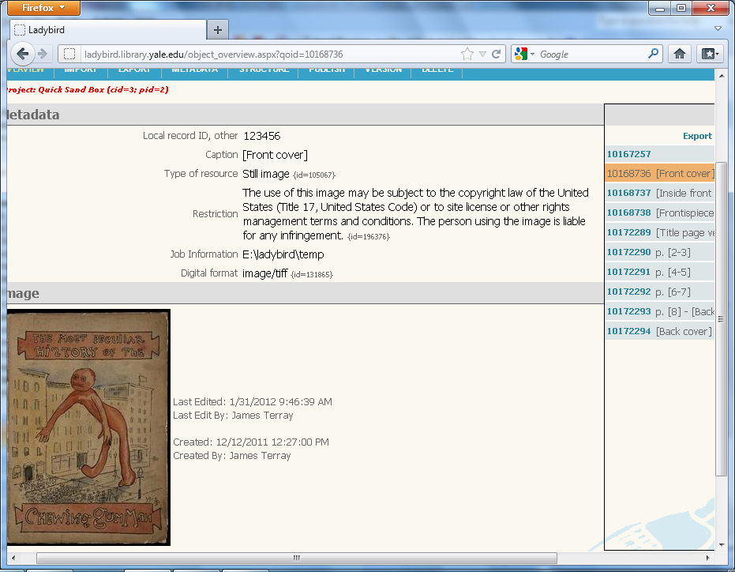

Slide 59
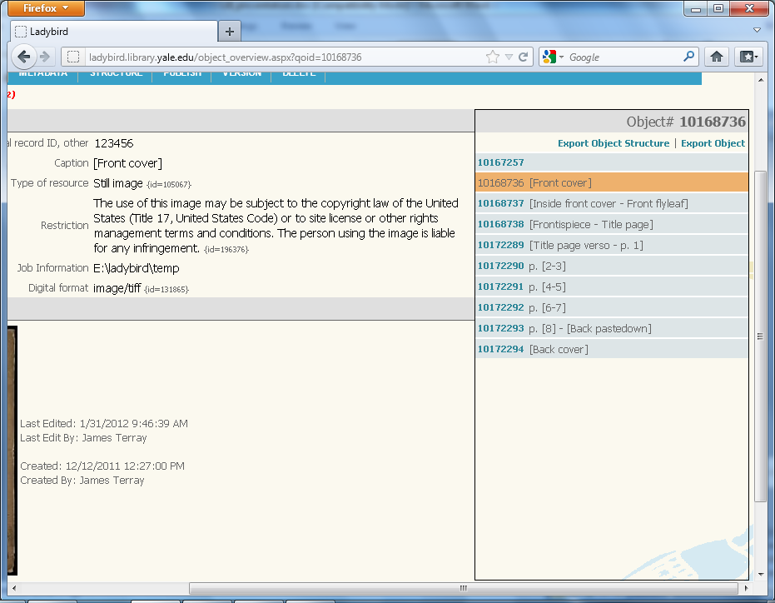

Slide 60
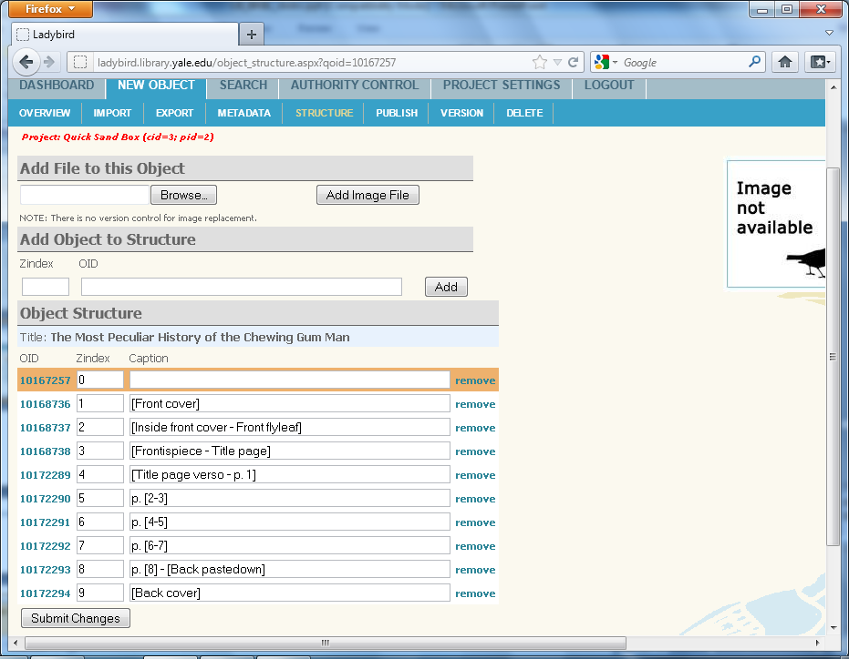

Slide 61
Beinecke Library
Create Metadata (object)
Digitize
Process Images
Publish Metadata (object) and Images
Archive

Slide 62
Flexible
Shared
Sustainable

Slide 63
LadyBird technical overview

Slide 64
Tech stack & approach
Technologies:
ASP.Net (C#)
SQL Server 2008
Approach:
Keep it simple
Develop it rapidly
Build it to handle lots of data (~600k records in it now, projected to double by 2013)

Slide 65
Under the hood
Database Techniques
Processing & Routing

Slide 66
Database Techniques
Versioning / History

Slide 67
Database Techniques
Versioning / History
Main Table
ID | ColumnA | ColumnB
1 | apple | car
History Table
ID | VersionID | ColumnA | ColumnB | Timestamp | UserID
1 | 1 | orange | truck | 5/15/10 2:58pm | 5
1 | 2 | NULL | truck | 6/10/10 9:45am | 15
1 | 3 | apple | car | 3/13/12 10:10am | 5

Slide 68
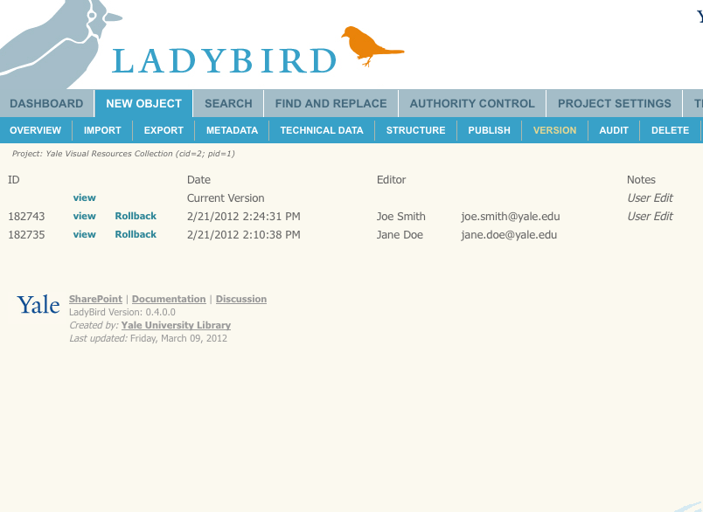

Slide 69
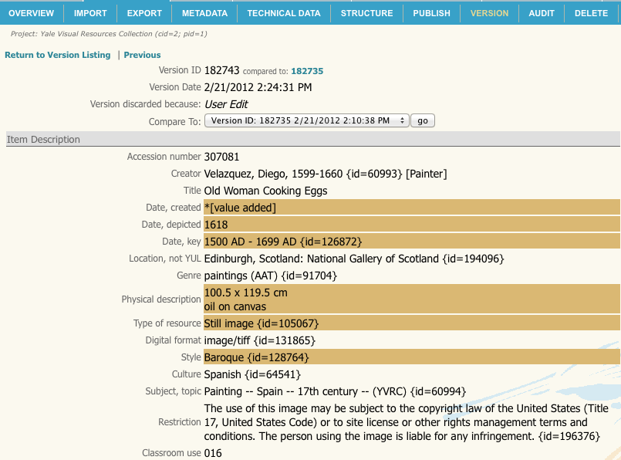

Slide 70
LadyBird data approach
Data model not known up front.
New fields being added as metadata standards change, and new schemas emerge (PBCore, LIDO, etc.).
Many of these fields need to be multi-valued.
Flexibility is crucial.

Slide 71
LadyBird data approach
We started by creating a “Field Definition” table:
Any new fields get added to the table, identified by a unique ID, and given a datatype.
Field Definition
Field ID | Field Name | Datatype
50 | Title | String
51 | Subtitle | String
52 | Author | String
etc. | etc. | etc.
Notes:
No need for an Alt. Title2

Slide 72
LadyBird data approach
Next, we created an “Object” table to keep track of our unique Object IDs for our records:
Object
Object ID
99
1234
etc.
Field Definition
Field ID | Field Name | Datatype
50 | Title | String
51 | Subtitle | String
52 | Author | String
etc. | etc. | etc.
Notes:
No need for an Alt. Title2

Slide 73
LadyBird data approach
Object
Object ID
99
1234
Field Definition
Field ID | Field Name | Datatype
50 | Title | String
51 | Subtitle | String
52 | Author | String
String Metadata
Object ID | Field ID | Value
1234 | 50 | The C Programming Language
1234 | 52 | Kernighan, Brian W.
1234 | 52 | Ritchie, Dennis M.
99 | 50 | Nostromo
99 | 51 | A Tale of the Seaboard
99 | 52 | Conrad, Joseph
Notes:
No need for an Alt. Title2

Slide 74
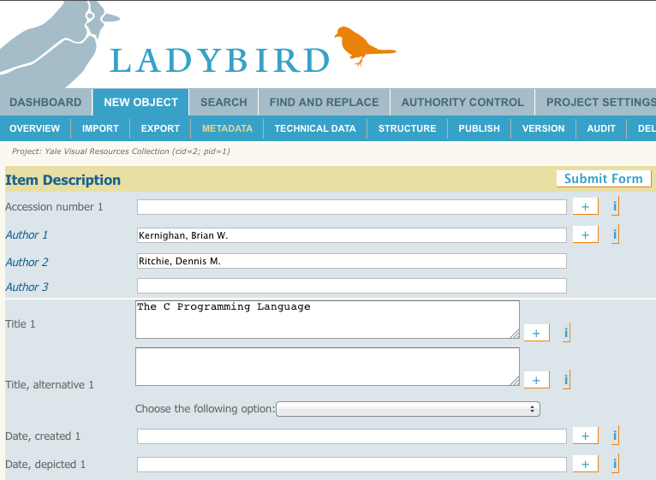

Slide 75
Vertically-stacked data
Benefits of this approach:
Allows for 0..n uses of a particular field in a record.
Adding new metadata fields is trivial.
Easy to associate Field IDs with a Project in a configuration table.
No additional code! No database ALTER statements!
Notes:
Will talk about security in a moment

Slide 76
Processing & Routing
Web application just one way to use the system.
Project Directories == “hotfolders”
Scanned frequently for new files to process.
Design goal: make as much functionality possible through hotfolders as can be accomplished via web

Slide 77
Processing & Routing
What happens in the hotfolders?
Imports/Exports (via spreadsheet)
Digital asset processing (thumbnails, packaging for external systems, etc.)
What can’t be done in hotfolders?
Configuration changes
Searches
Notes:
Exported spreadsheets can be tweaked and immediately re-imported.

Slide 78
Processing & Routing
.Net programs crawl the hotfolders looking for things to do
Run via Scheduled Tasks in Windows
Never more than one instance running at a time
“Heartbeat” monitoring

Slide 79
Summary
Simple design, rapid development, high-performance
Version tracking for errors/mistakes
Vertically-stacked data for extensibility
Hotfolders make bulk operations possible.

Slide 80
Next Steps For LadyBird

Slide 81
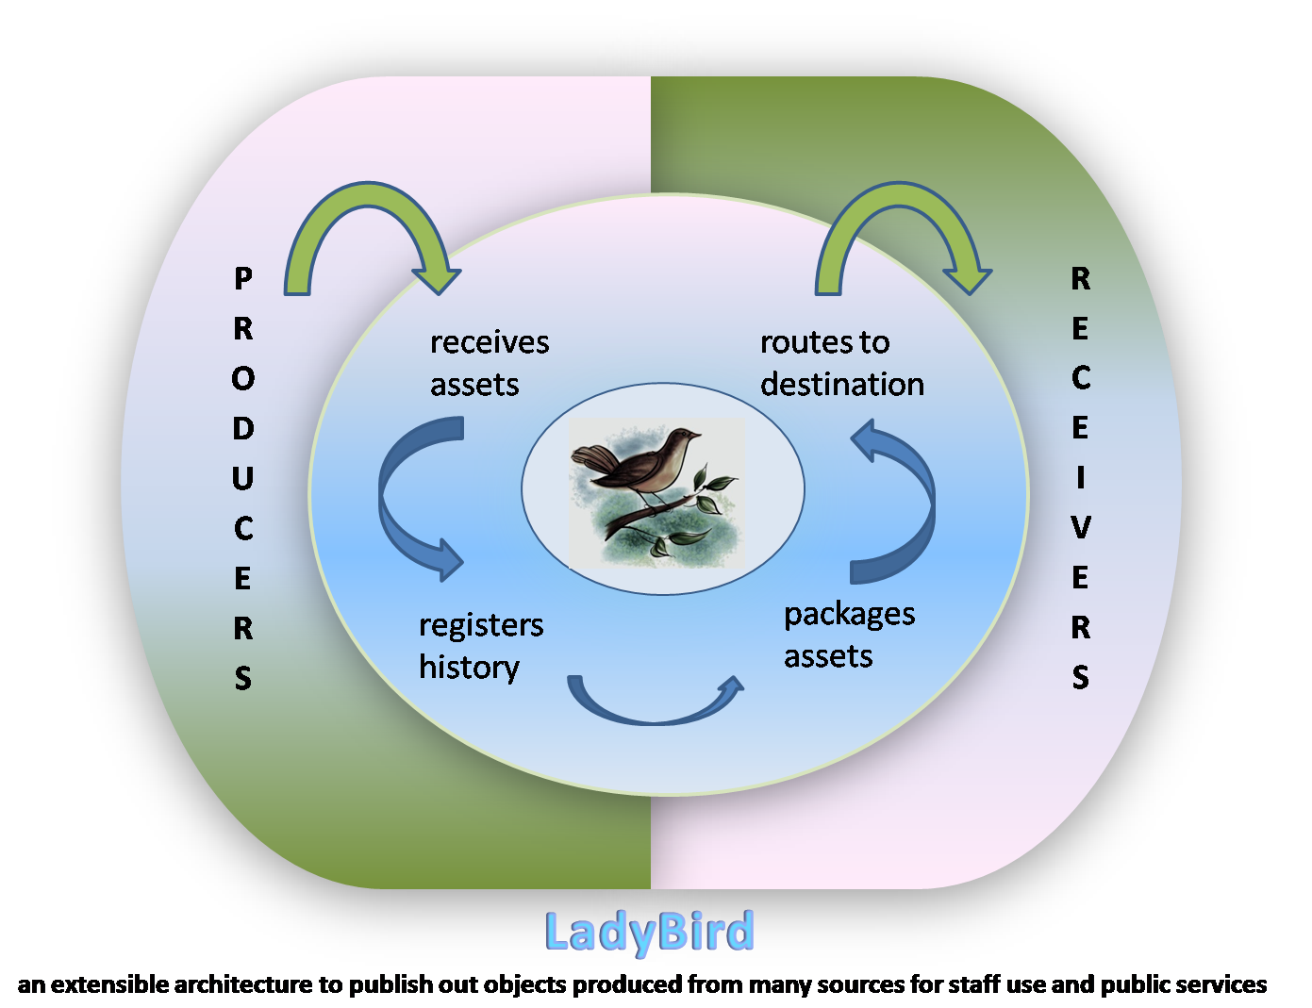
Ecosystem

Slide 82
General Timeline
Version 0.6 – Summer 2012
Enhance: Publishing, importing, complex objects
Version 0.8 – Fall 2012
Build: User managed workflow systems
Version 1.0 – January 2013
Enhance: backend system/application upgrades
Start: planning for open source

Slide 83
Hello, my name is
Lady Bird
A Jazz Song
Composed by Tadd Dameron, 1947

Slide 84
Questions ???
Michael Friscia michael.friscia@yale.edu
Carolyn Caizzi carolyn.caizzi@yale.edu
Jay Terray jay.terray@yale.edu
Visit:
http://Ladybird.Library.Yale.edu

