Slide 1

Confessions of Active Learning Space Committees
George F. Claffey, Jr., Charter Oak State College
Jason Gregg, Bryant University
William Krysinski, Charter Oak State College
Philip Lombardi, Bryant University
Bob Shea, Bryant University
Questions for the Panel:
Respond at PollEv.com/nc15
Text NC15 to 37607
April 1, 2015

Slide 2

Agenda
Charter Oak State College
  Building State of the Art Classrooms in CT
  Process/Goals/Challenges
Bryant University
  Building State of the Art Classrooms @ Bryant University
  Process/Goals/Challenges
Questions for the Panel:
Respond at PollEv.com/nc15
Text NC15 to 37607

Slide 3

4 Year Public Liberal Arts College
Created in 1973
Adult-centric
3,000 Student headcount, 1,000 FTE
100 % Distance Learning Delivery
Charter Oak State College
A dynamic community of online learners advancing the nation's workforce one graduate at a time

Slide 4
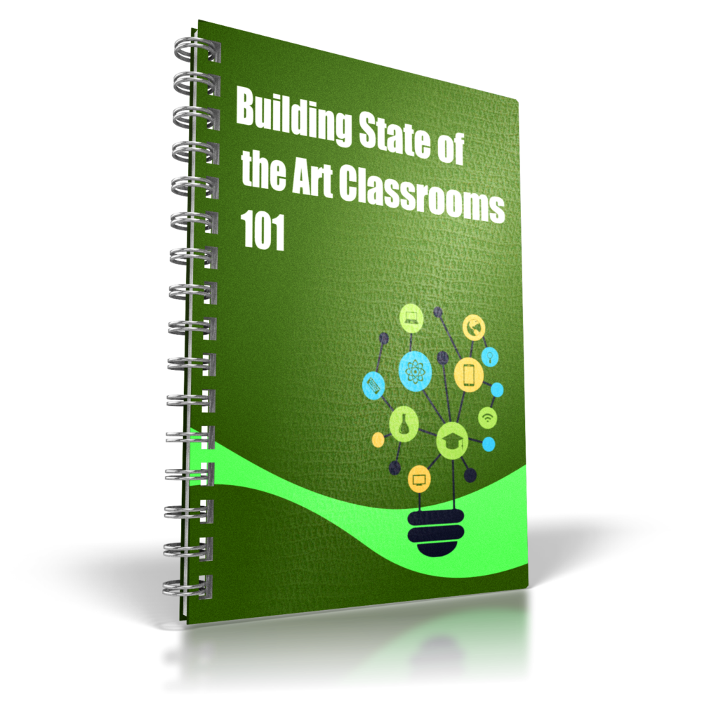

Building State of the Art Classrooms

Slide 5


17 Campuses - ONE GOAL
(4) Four – Year Residential Universities
(12) Community Colleges
(1) Online College

Slide 6

Project Overview & Depth
Multi-year implementation
Multiple vendors (20x) / 17 Campuses
Cloud based (Boundary less)
Institution Based (Specialty)
System/Standards Based
Student based
Dependencies on mid-flight Transform 2020 projects

Slide 7
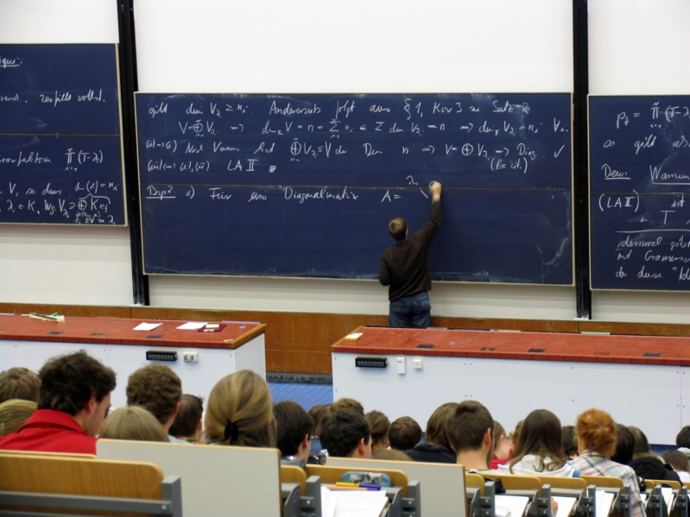
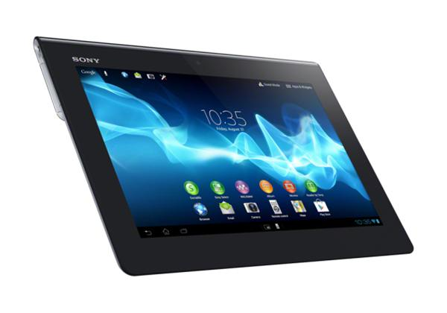
Classroom of the Future
Paradigm shift to a learner-centric model of teaching and learning
Movement away from a physical time and space and into a native digital space
Meeting student in and on their digital platform

Slide 8
Peer Reviewed Research & Partners
EDUCAUSE & NERCOMP
Gartner, Blackboard, & Cisco
Futurists: Christiansen
Peer-reviewed research: Rogers
Technology
Culture
Training
Communication

Slide 9





Current TIME LINE
FULL IMPLEMENTATION
Full implementation scheduled for Fall 2015 allowing for major installation, coordination, and training over the summer
PROTOTYPE Test & Design
Fall ‘14
Plan & Organize
Summer ‘14
Institution based Pilot
Spring ‘15
March
2014
Phase 1
Phase 2
Phase 3

Slide 10

Project Team Charter
Sub-Committee
  A/V, Physical Space, Projection, Student Hardware
Designed to Assist Vendors/Project Team
  Goals
  KPI
  Needs Assessments
  Solution

Slide 11
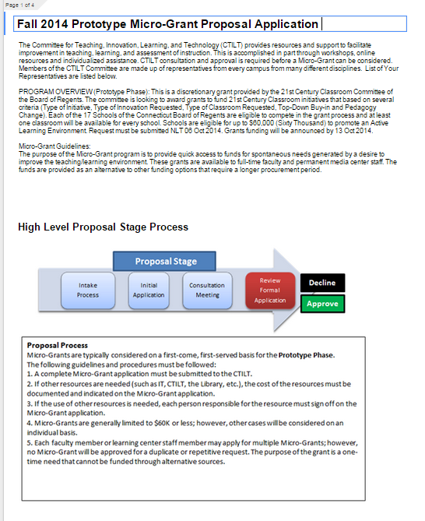

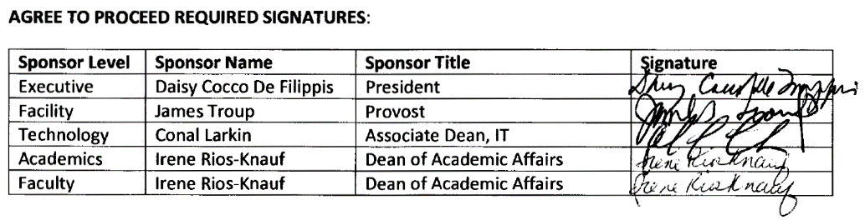
Micro-Grant Process
Collaboration - Google
  Sites, Drive, Forms
Campus Buy-In
  Scope
  Milestones
  Design
    Technology and Furniture
  Agree to Proceed
    Executive, Tech, Facilities, Academics
  Outcomes and Reporting

Slide 12
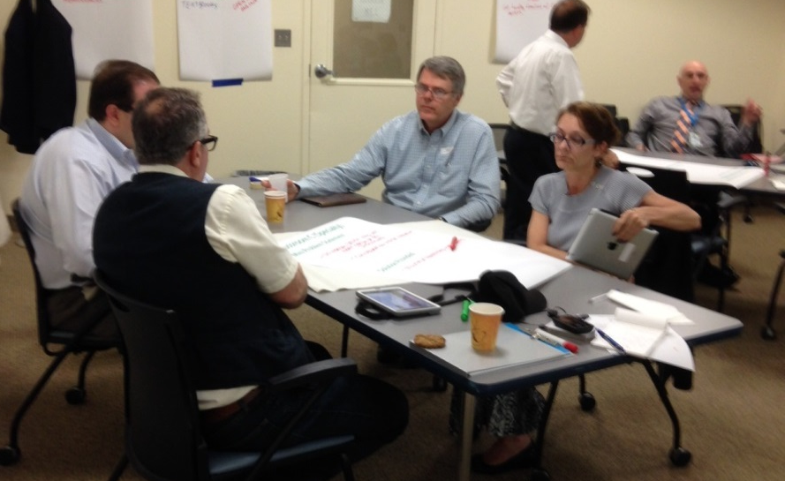
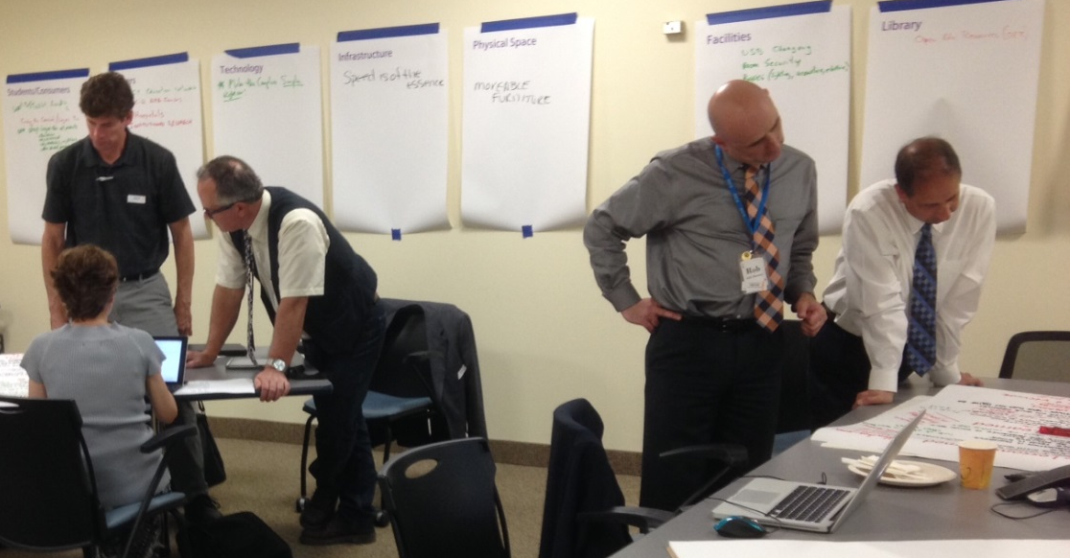
THE TEAM
George Claffey | COSC
Michael Bies | CCC
Bill Krysinski | COSC
Scott Graves | SCSU
Veronica Kenausis | WCSU
Lisa Lavoie | TXCC
Richard Lenoce | MXCC
Nicholas Messina | ECSU
Karen Musmanno | SCSU
Katie O'Connell | ACC
Sherry Pesino | BOR
Amy Kullgren | CCSU
Robert Sheftel | NVCC
Robert Wahl | TXCC
Rebecca Woodard | WCSU
Adrianne Kelly | TXCC

Slide 13
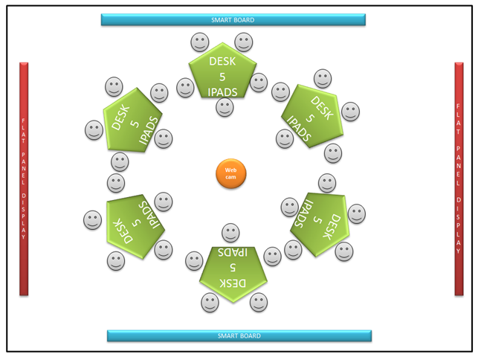
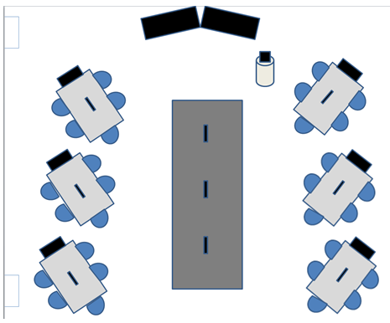
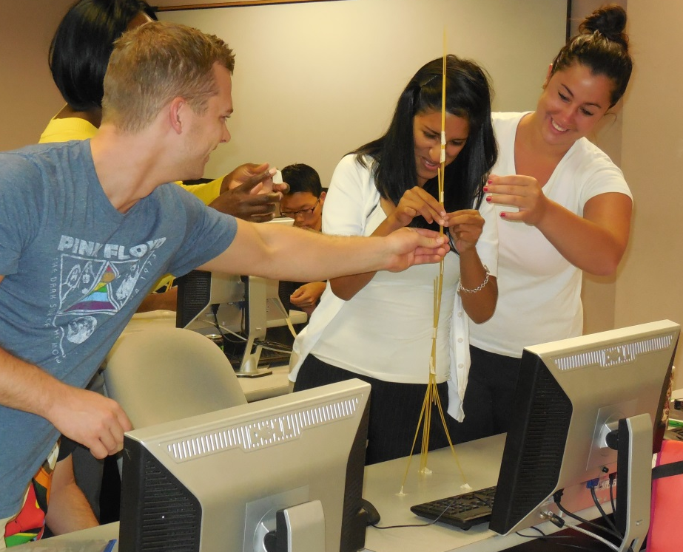
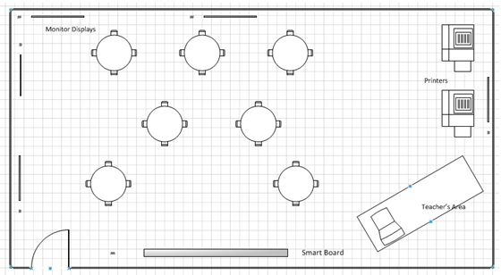
The Team (Students)

Slide 14





Strategic Partners

Slide 15
Prototype
Phase
Questions for the Panel:
Respond at PollEv.com/nc15
Text NC15 to 37607

Slide 16
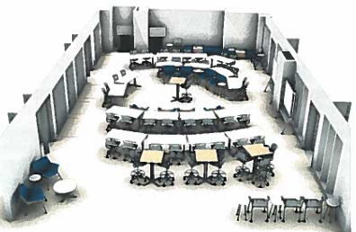
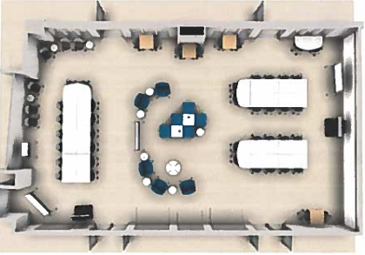
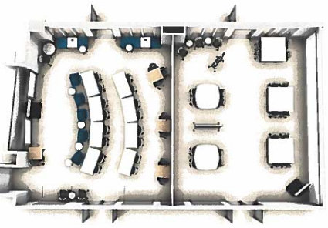
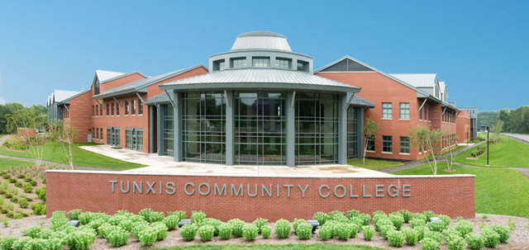
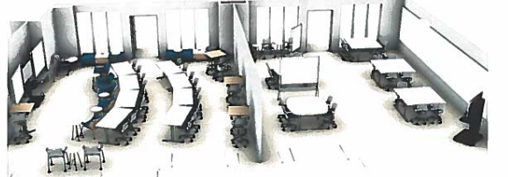
Tunxis Community College
1 Kit of furniture
6 different configurations
Total cost <50K

Slide 17

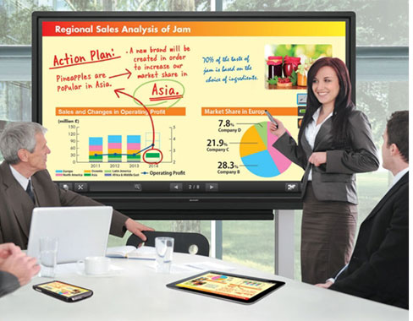
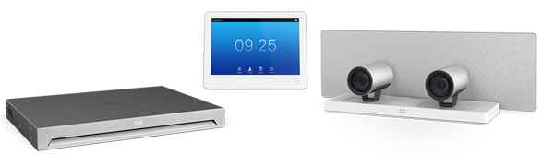
Charter Oak State College
Double Robotics
Cisco TelePresence
Interactive Displays

Slide 18

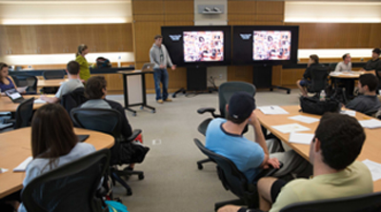
Bryant University:
Building Active Learning Spaces to Support an Outcomes-Based Curriculum
Bryant University
Preparing students to be successful in an age of unlimited global opportunity.
Notes:
Phil

Slide 19
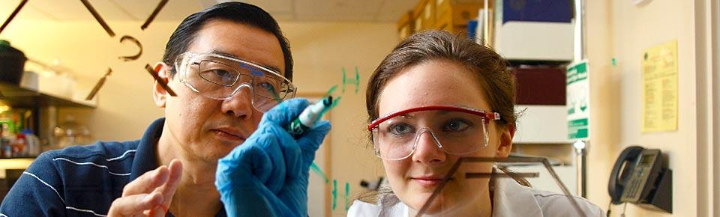
Located in Smithfield, RI
Diverse student population
3,200 undergraduates
  C.O.B.
  C.A.S
  P.A. Program
Small number of M.A. Programs
Bryant University
Preparing students to be successful in an age of unlimited global opportunity.
Notes:
Phil

Slide 20
Bryant University
Preparing for a new Academic Innovation Center
Notes:
Phil

Slide 21
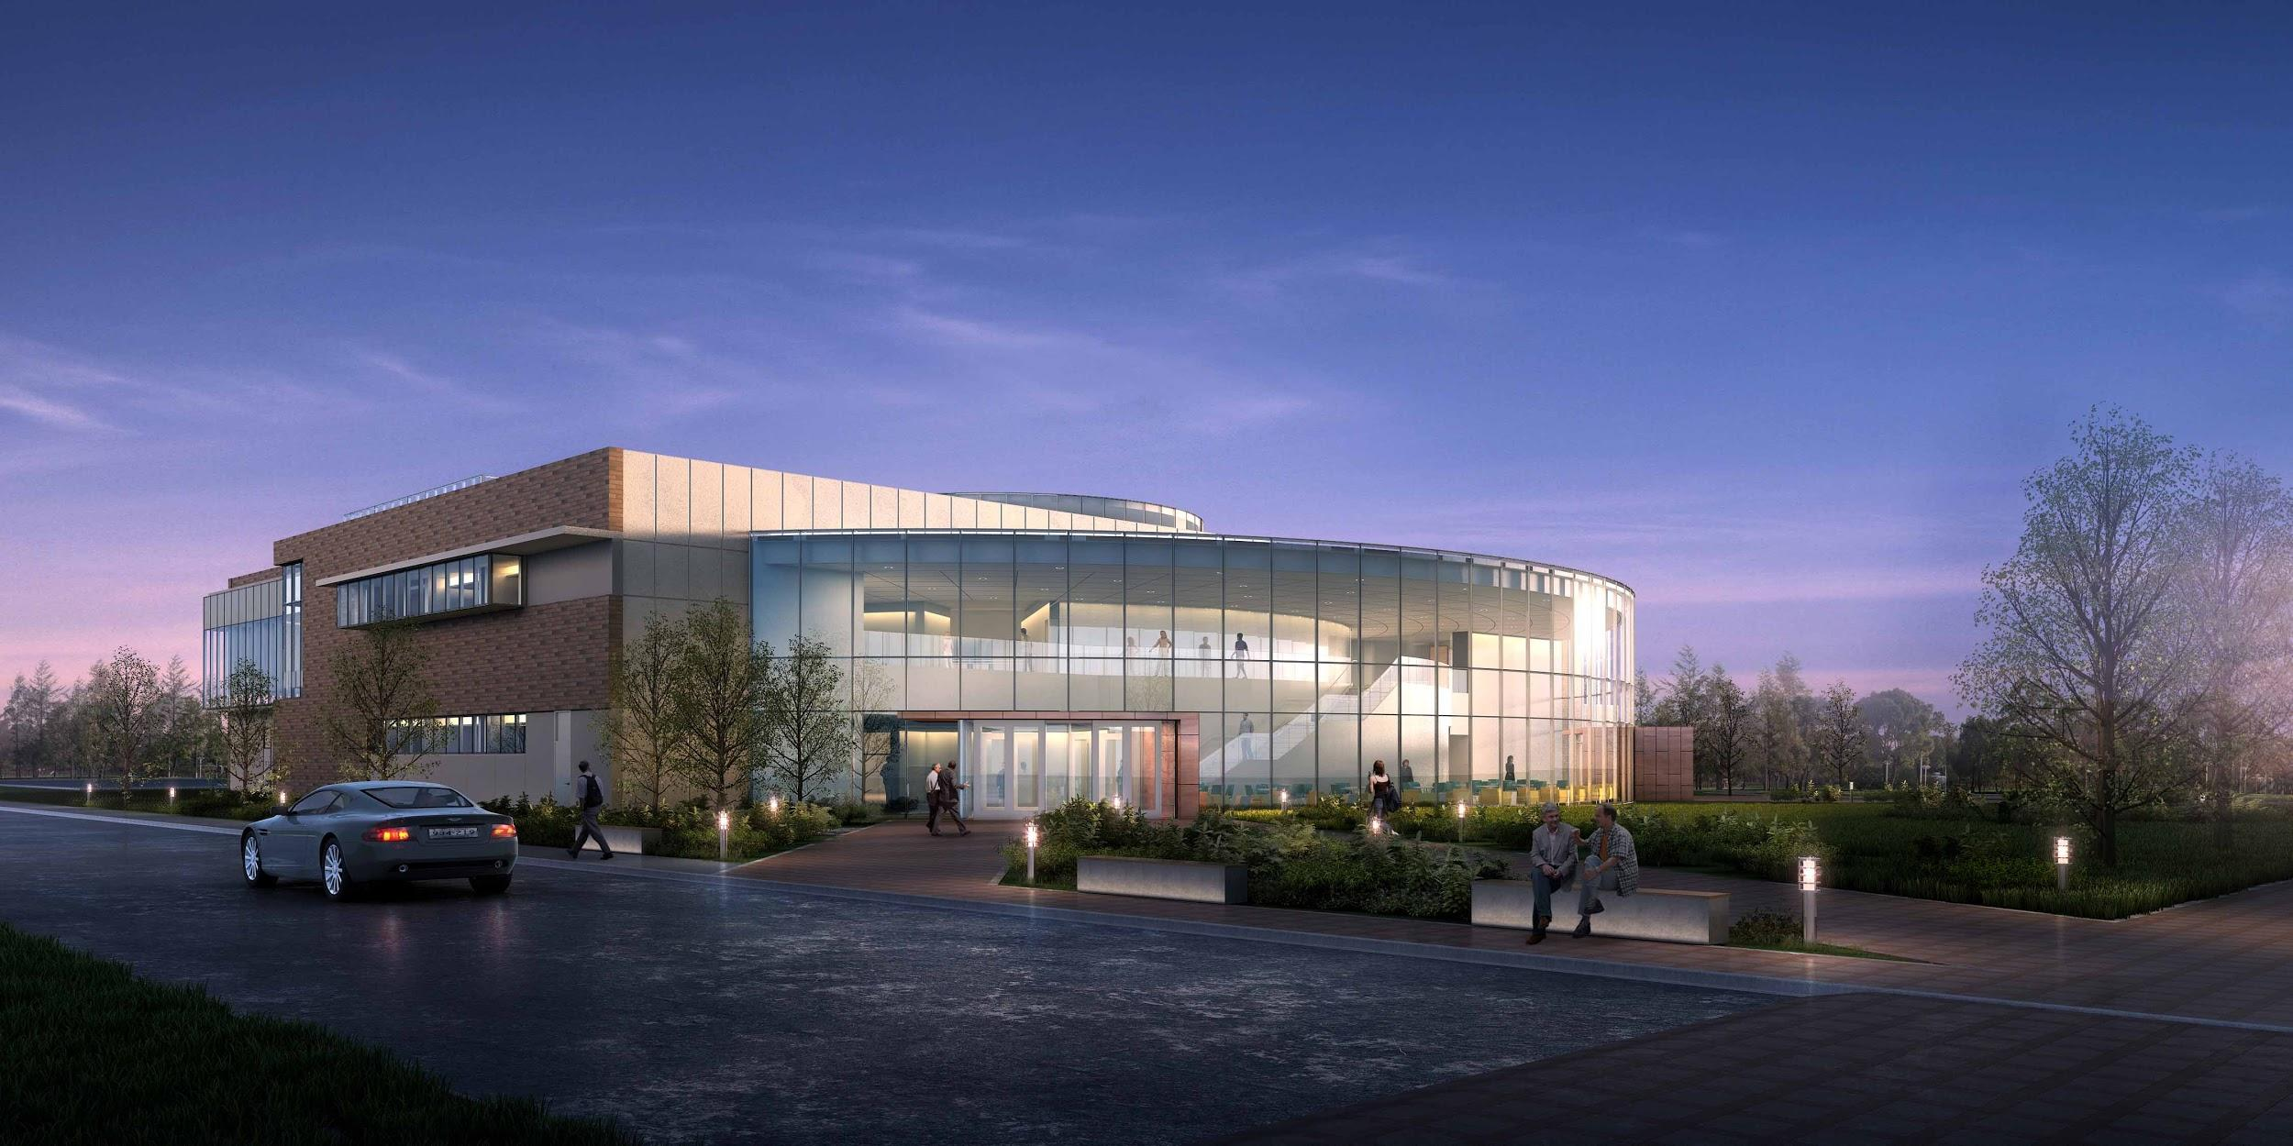
Bryant University
Preparing for a new Academic Innovation Center
Notes:
Phil

Slide 22
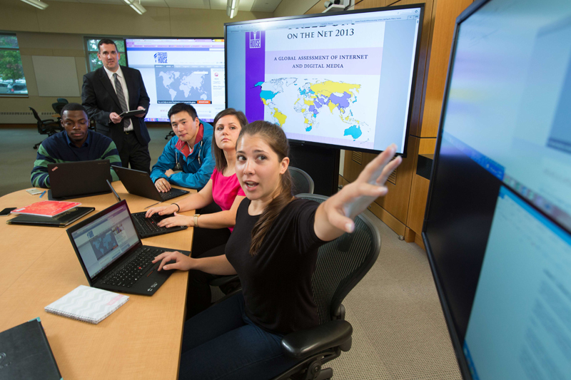
Project Overview & Depth
Ideation Classroom
Donor support
Space Utilization Study
Collaborative approach
  University Relations
  Center for Teaching & Learning
  Academic Computing & Media Services
  Center for Program Innovation
Notes:
Bob

Slide 23
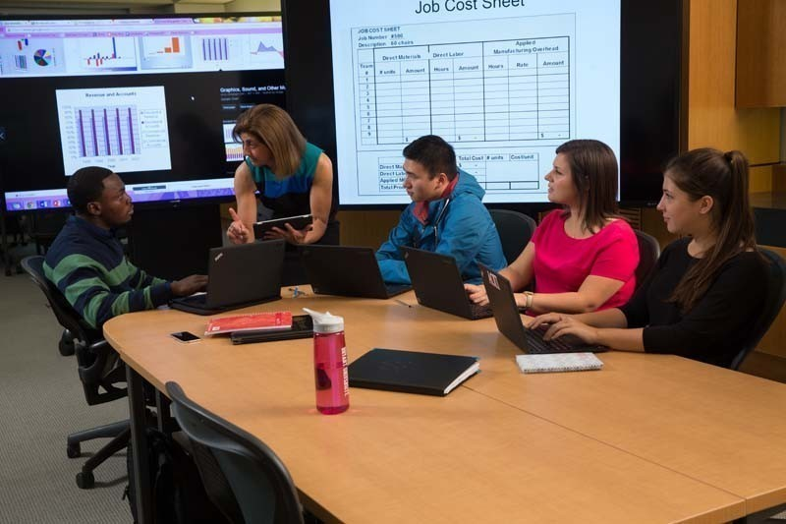
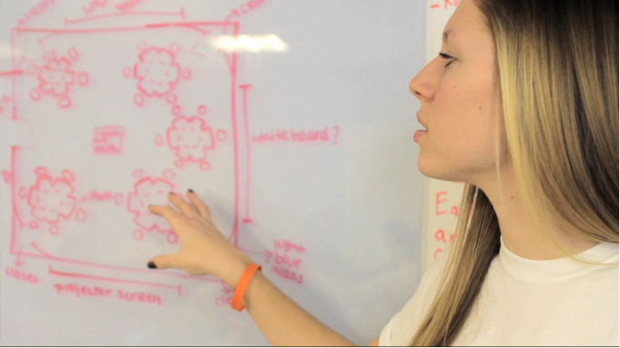
Classroom of the Future
Paradigm shift to a learner-centric model of teaching and learning
Movement to team-based, active learning environment
Allow students to wirelessly project and share work
Notes:
Bob

Slide 24
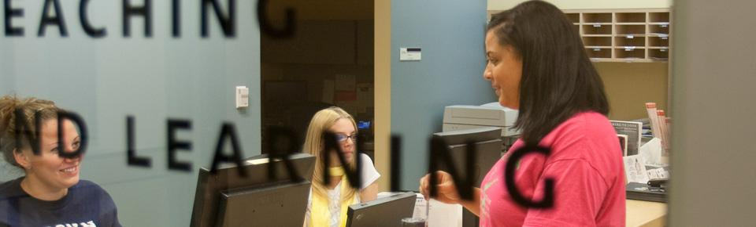
THE TEAM
Center for Teaching & Learning
Academic Computing & Media Services
Facilities
Center for Program Innovation
University Advancement
Notes:
Bob

Slide 25
Prototype
Bryant University
Preparing for a new Academic Innovation Center
Academic Innovation Center
Notes:
Bob

Slide 26
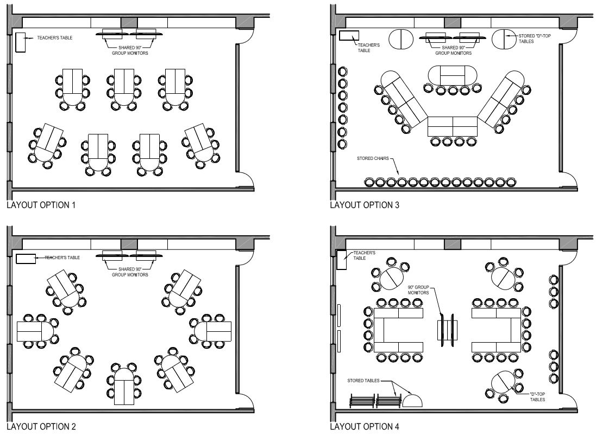
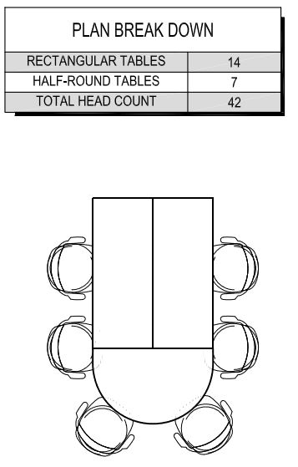
Bryant University
Notes:
Jason

Slide 27
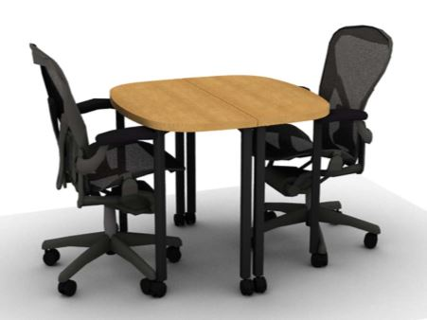
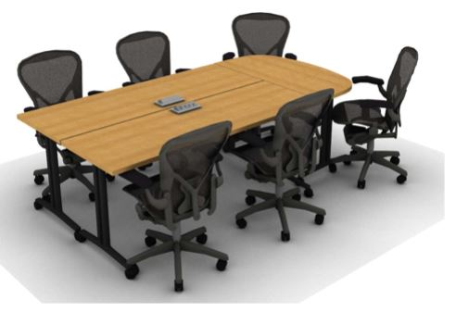
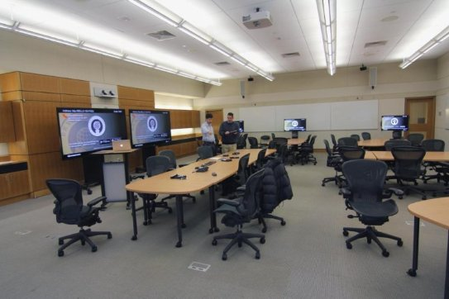
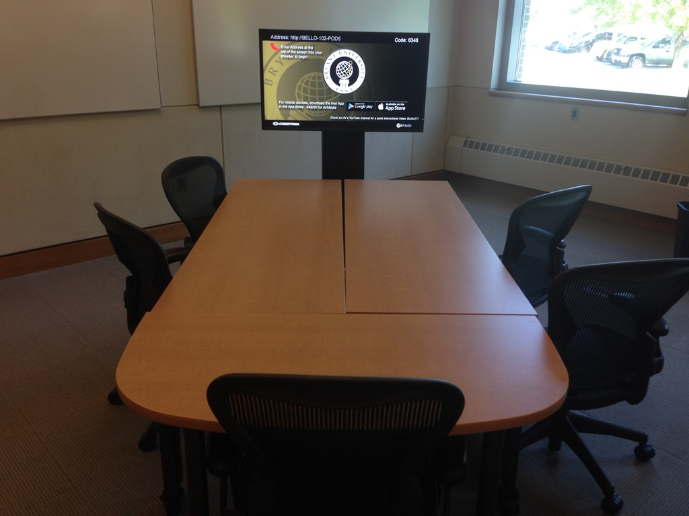
Bryant University
Notes:
Jason

Slide 28
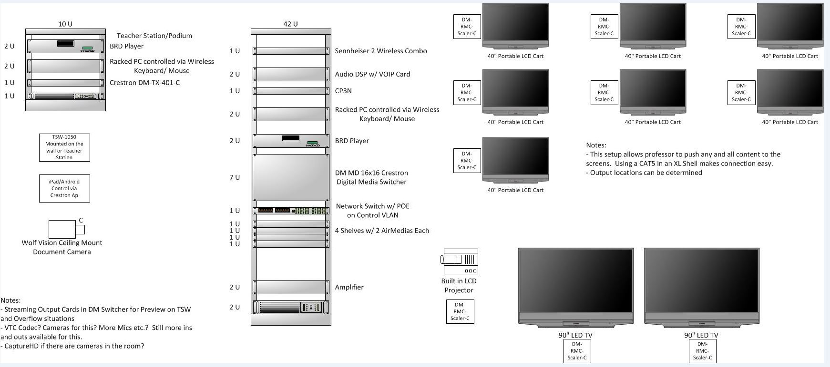
Bryant University
Selecting Equipment to meet the needs of the faculty
Ease of Use
End User experience
Keep it simple
Know your target audience
Notes:
Jason

Slide 29
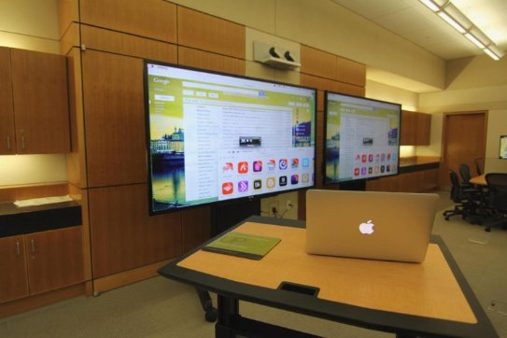
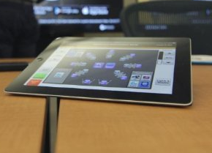
Bryant University
Equipment used in Bello 102
All Wireless
Digital Media to support the future of video
HD Video Conference
Remote control management from the AV office
iPad control
Notes:
Jason

Slide 30
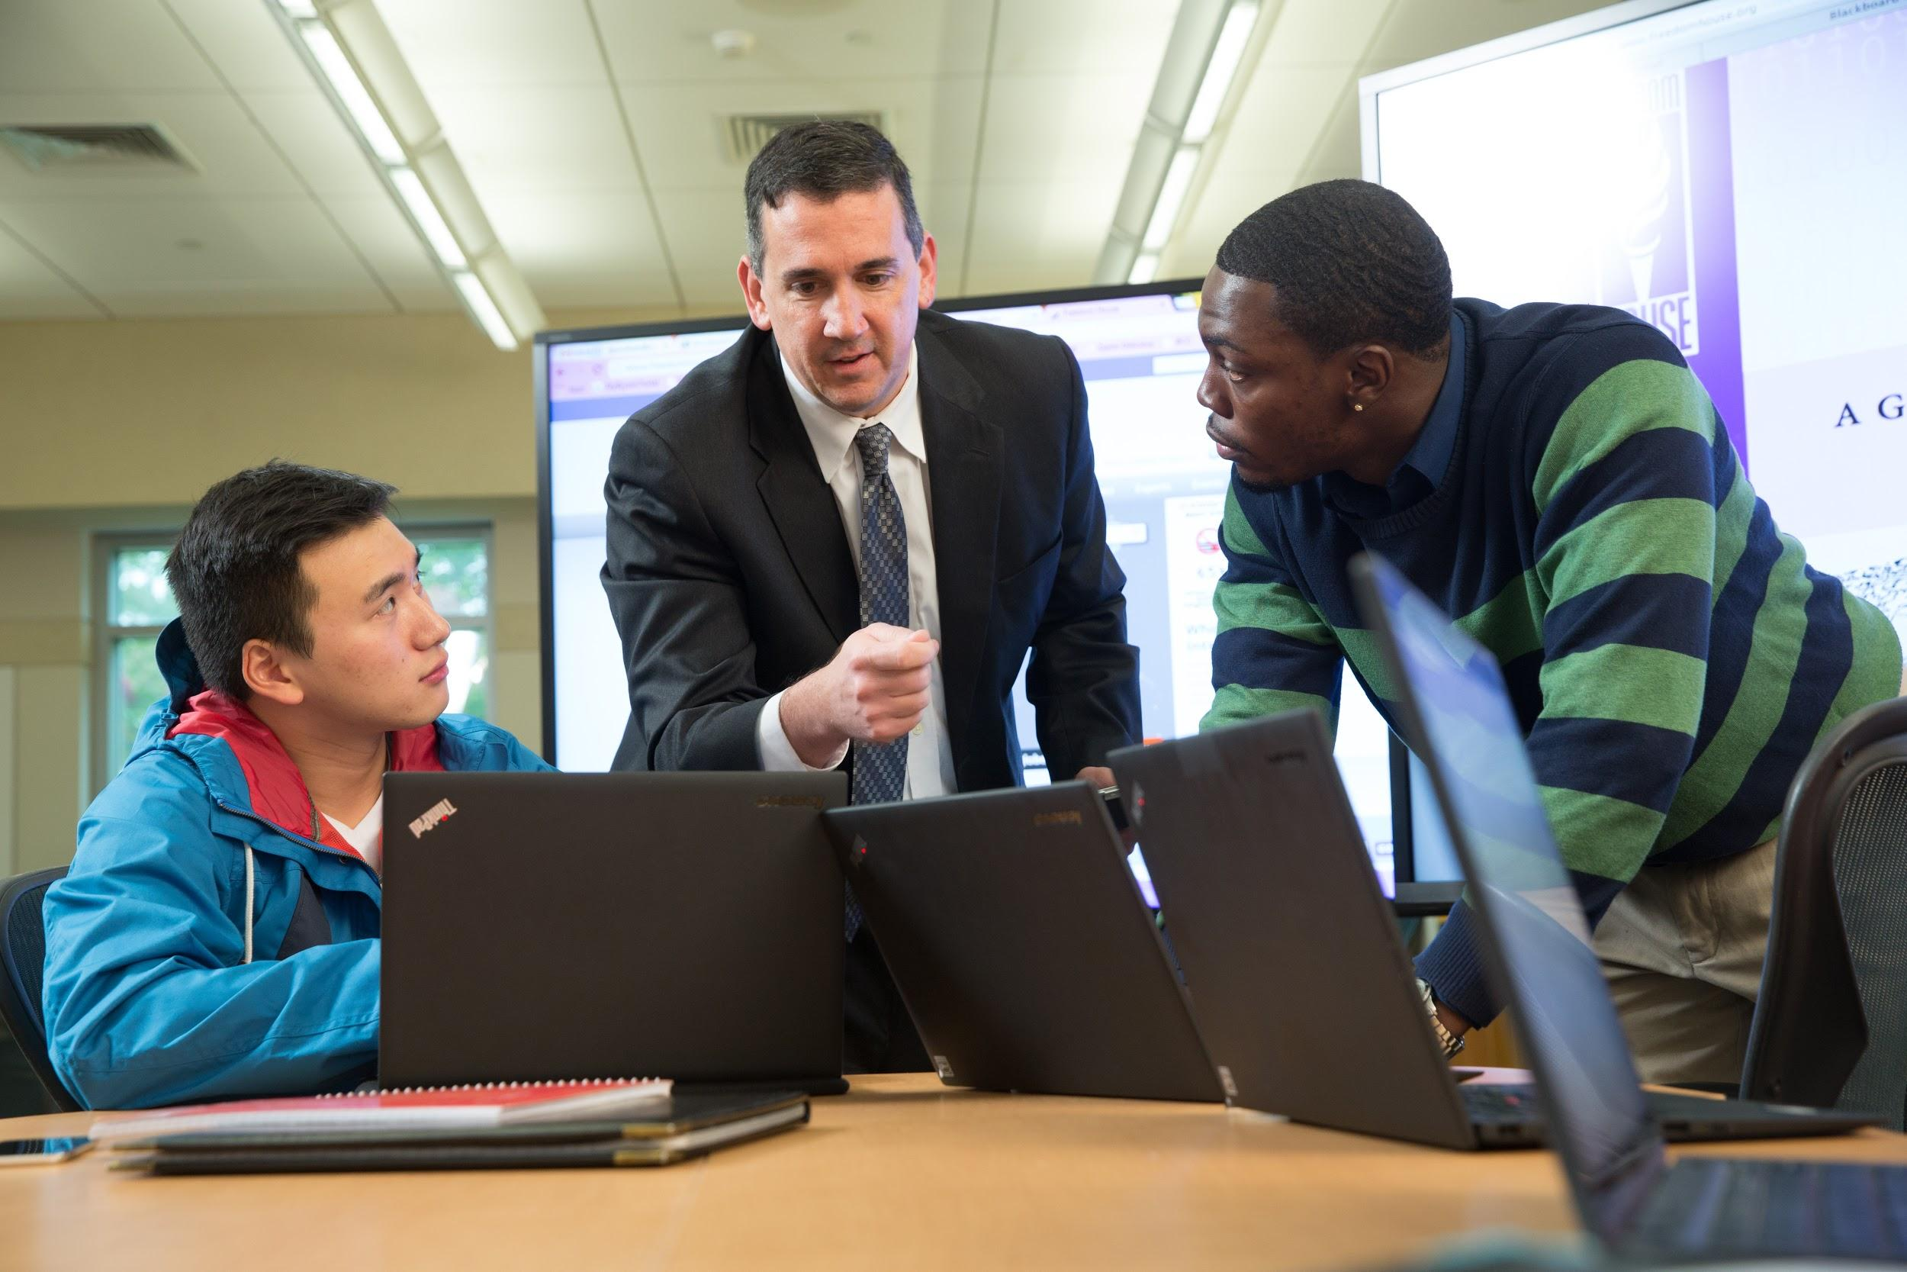

Bryant University

Slide 31
Closing
Charter Oak State College
  Building State of the Art Classrooms in CT
  Process/Goals/Challenges
Bryant University
  Building State of the Art Classrooms @ Bryant University
  Process/Goals/Challenges
Questions for the Panel:
Respond at PollEv.com/nc15
Text NC15 to 37607
Notes:
Phil

Slide 32

Thank You and Good Luck
“A year from now you will wish you had started today.” — Karen Lamb
“By changing nothing, nothing changes.” – Tony Robbins
Thank You for Letting Us Share our Story

