Slide 1
Utah Education Network
A report on UEN and economic hard times in Utah
StateNets Conference, 2009

Slide 2
UEN Funding Model
Funded directly by the state
  2/3rds of revenue are state appropriations
  1/3rd is federal E-Rate & CPB Community Service Grant funds
UEN stakeholders receive UEN services at no cost to them

Slide 3
State revenues have declined by about 10% in the last 8 months
UEN state budget was cut in September by 4%-- $900,000
An additional 4% cut is being finalized this week – another $900,000

Slide 4
Absorbing $1.8 million in cuts this year:
We have reduced our staff by not filling 5 positions
The 1st phase of a major project to improve network connectivity for elementary & charter schools has been revised, but will still be completed

Slide 5
Next year will probably be worse:
The UEN budget could be cut by $3-4 million. That could mean:
  cutting as many as 16 staff positions
  cancelling contracts for some redundant network circuits
  cutting equipment, travel, professional development, supplies

Slide 6
Business as usual will not work for UEN:
We are exploring offering services to state and local government agencies:
  UEN IVC services will be used by new state agencies
  The state court system may replace its network with UEN
  Local governments may use UEN

Slide 7
The key message:
Public and higher education and state and local government must do more with less.
UEN is a solution to do that in tough economic times.

Slide 8
How does UEN leverage mission-critical technology for Utah?

Slide 9
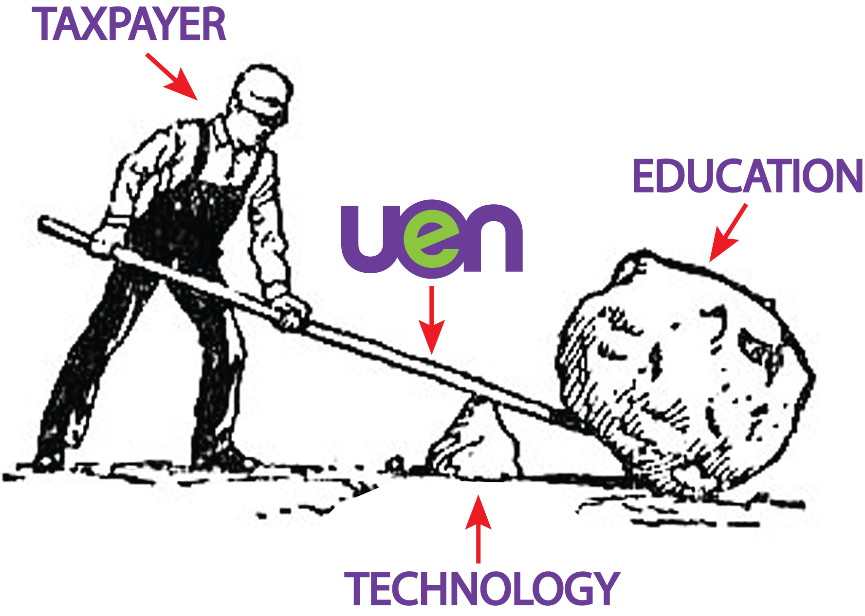

Slide 10
UEN leverages mission-critical technology for education and government.
How will this leverage be maintained without sufficient funding for staff and circuit charges?

