Slide 1

PCI DSS Compliance Assessments
(a proactive approach @ Penn State)
Jenn Stewart, Project Technical Coordinator
Michael Leach, Project Manager
EDUCAUSE Security Professionals Conference 2009

Slide 2
Objectives for Today
Background on Penn State environment
Current threats/vulnerabilities
PCI DSS trends
PCI lifecycle change
Need for assessments
Conducting assessments
Dealing with compromises
Resources

Slide 3
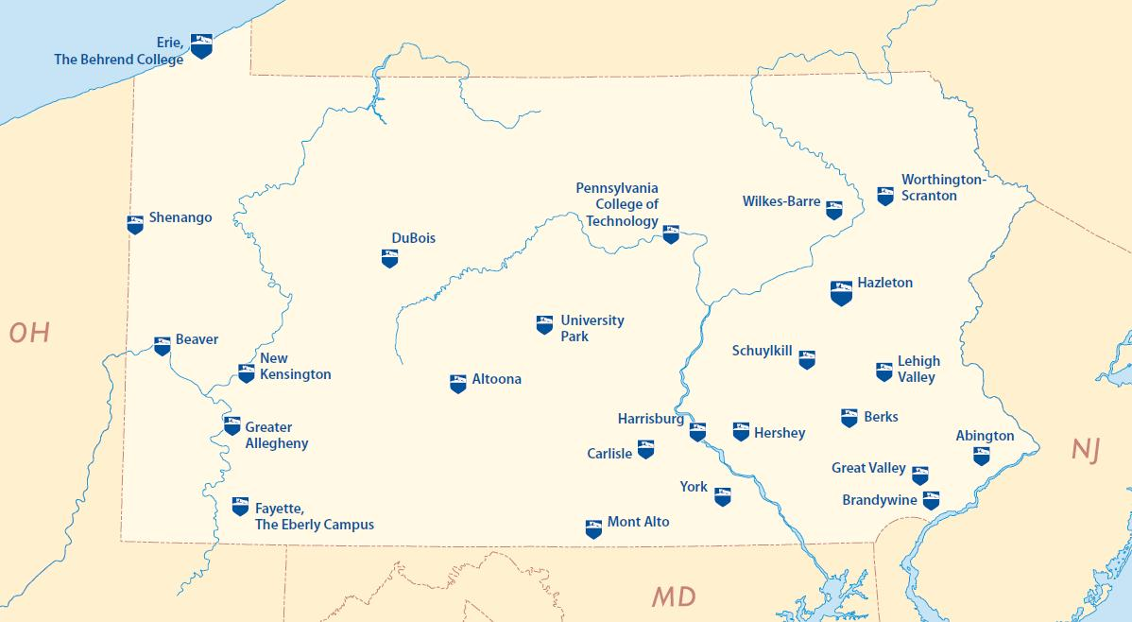
We Are! Penn State!

Slide 4
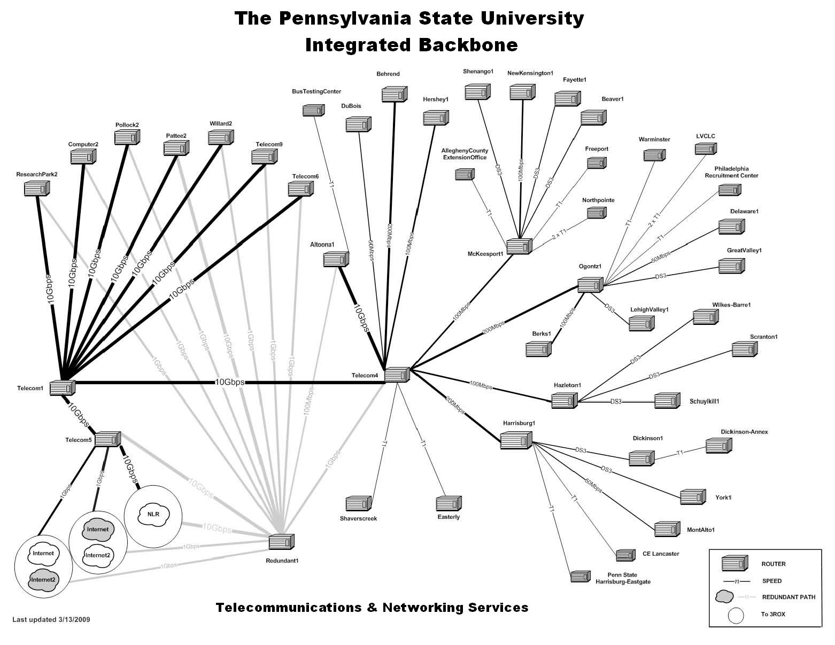

Slide 5
Collaboration Efforts
Compliance team-IPAS
Senior leadership
Corporate Controller
Designated contacts
Budget executives
Merchants
Incident response team

Slide 6
Threats and Vulnerabilities
Older terminals
Residual data of older software programs
Physical intrusion
Network intrusion
Grey market sales

Slide 7
PCI Trends
Introduced in 2005
Merchant Level-Do I have to comply?
New version 1.5 years
  PA DSS
  PCI PED Security Requirements
Self Assessment Questionnaire (SAQ)

Slide 8
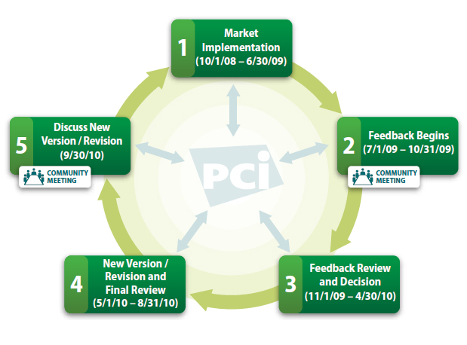
PCI Lifecycle Change

Slide 9
PSU Processing Environments
Dial-up swipe terminals
Network based terminals
Third party providers
Internal applications
Wireless devices -802.11

Slide 10
Need for Assessments
Remember the diverse, statewide network?
  Known areas of deficiency
  Suspected areas of weakness
  Distributed Responsibility
Converging Initiatives
Methods of Intrusion

Slide 11
Question
Does having a new firewall, still in the box, mean I am compliant with PCI DSS requirement 1? After all, it was purchased with good intent.

Slide 12
Conducting Assessments
What we are not
Informational, not a punitive review
Hit the high points we’ve found glossed over
Response requested within two weeks
Escalate to Corporate Controller if needed
Merchant ID may be suspended

Slide 13
Compromise Occurs
Audience--Show of hands – who has an incident response team to deal with PCI incidents?
Overview of PSU Process
Required Reporting Process

Slide 14
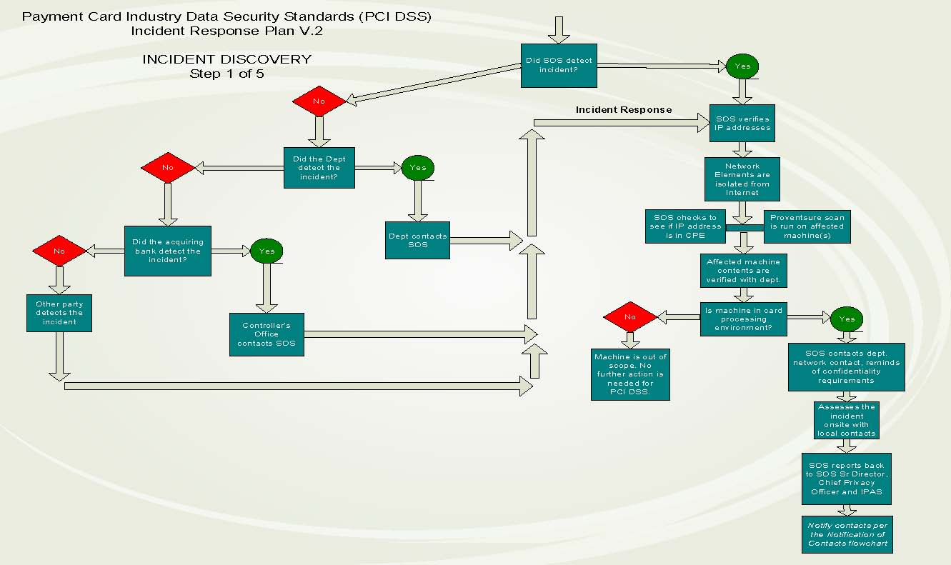

Slide 15
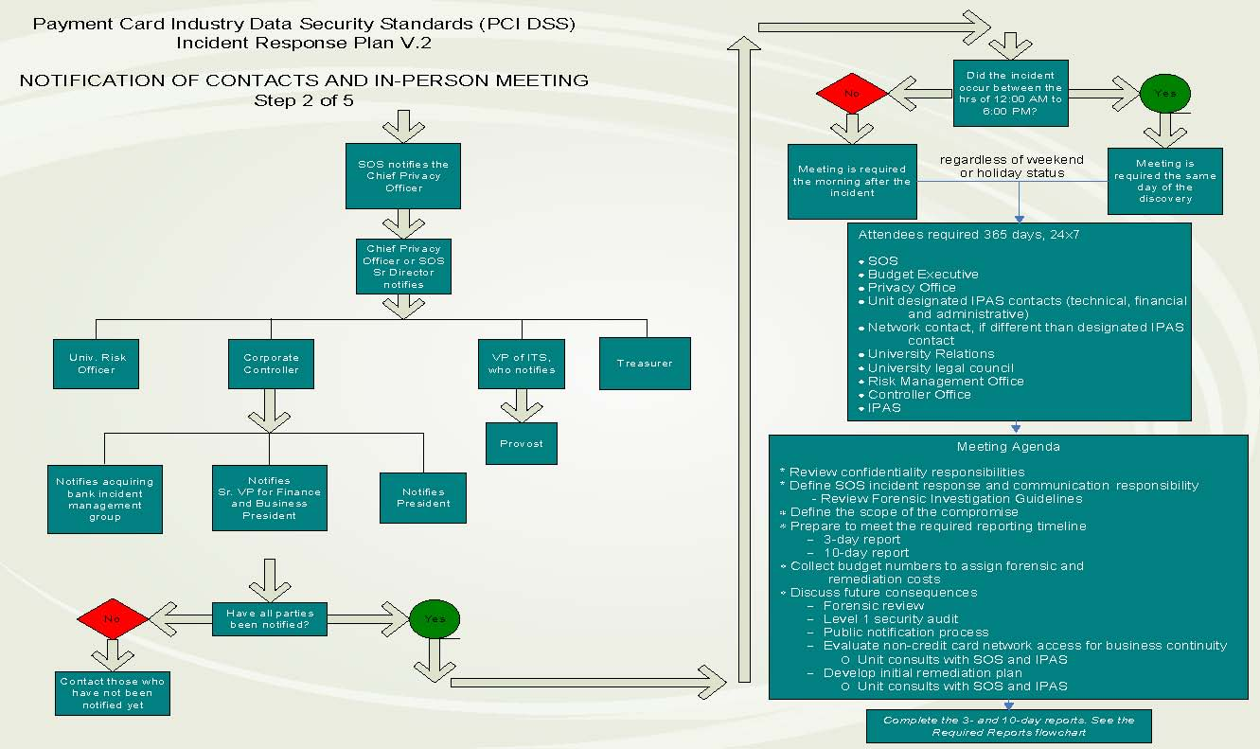

Slide 16
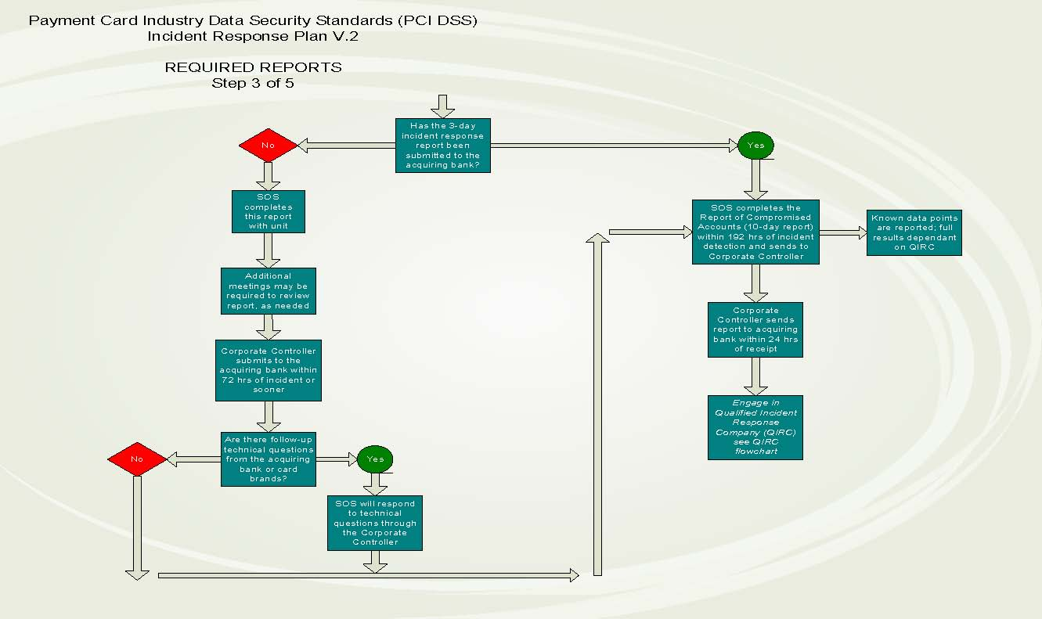

Slide 17
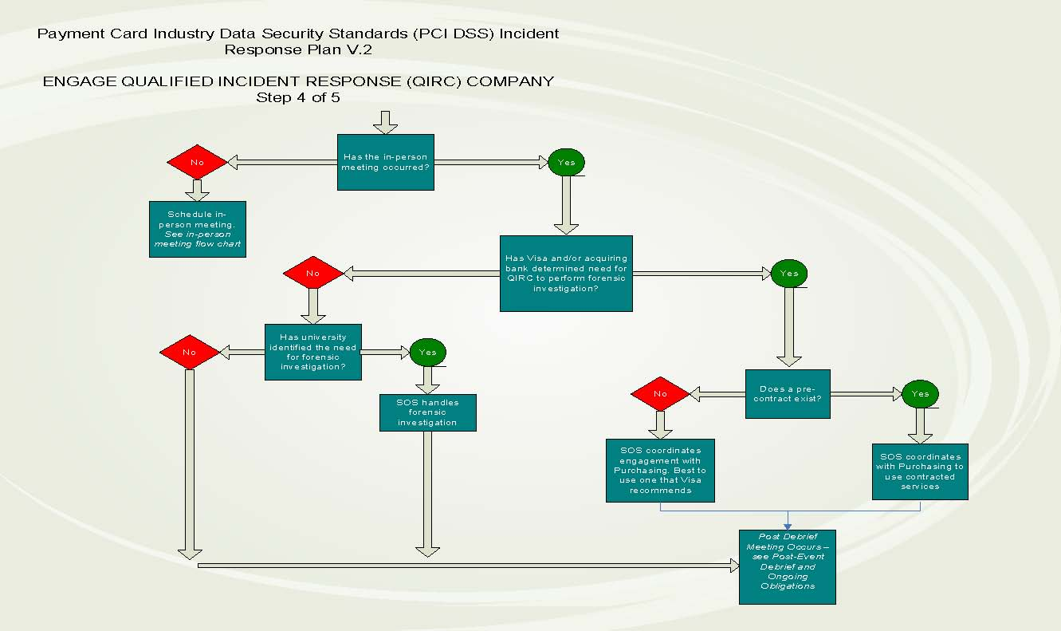

Slide 18
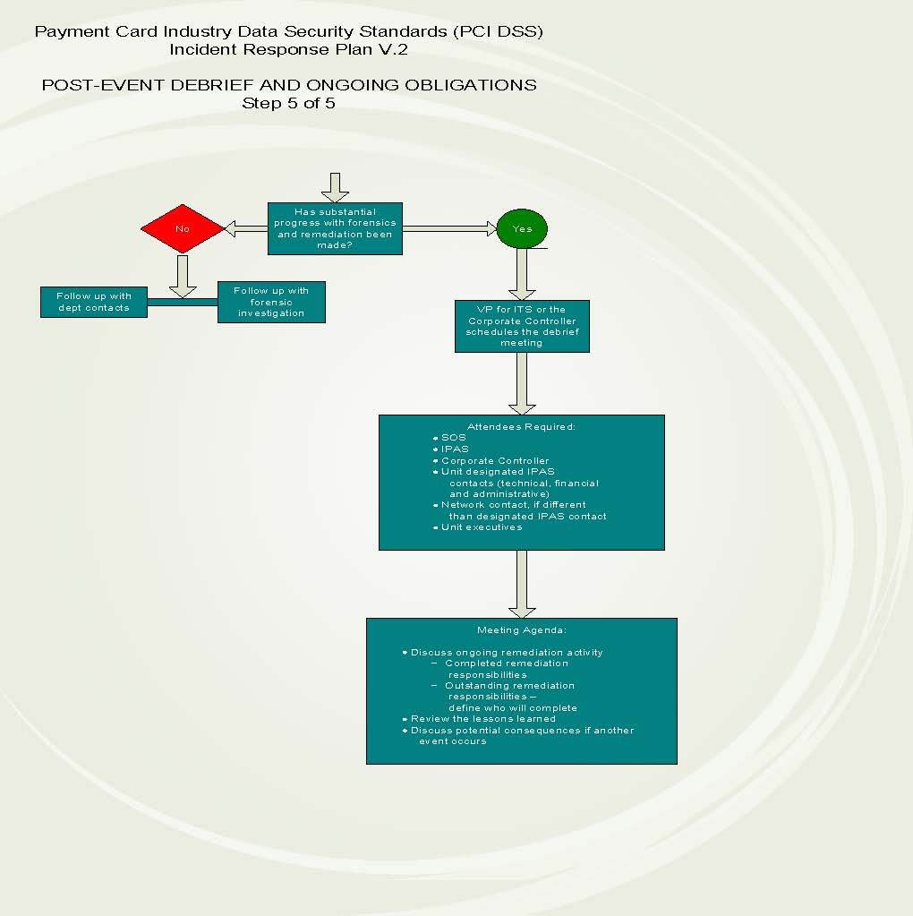

Slide 19
Compromise in a Nutshell
Visa, other brands are similar
  3-day report
  10 day report
Card brands fine the acquiring bank
Acquiring bank passes fines to merchant
Levying fines
  One time
  Monthly

Slide 20
Resources
PCI Security Standards Council
www.pcisecuritystandards.org
Visa
usa.visa.com/merchants/risk_management/
cisp.html
Privacy Rights Clearing House
  http://privacyrights.org
DATALOSSdb
  http://datalossdb.org/

Slide 21
DISCUSSION
Information Privacy and Security
www.ipas.psu.edu | ipas@psu.edu
814-867-1340
Mike Leach, Project Manager
Jenn Stewart, Technical Coordinator

