Slide 1
Provisioning and De-provisioning of Common Credentials and
User Maintenance of Common Credential Attributes in a
Higher Education Setting
Kevin L. McLaughlin, Director Information Security
MS, CISSP, CISM, GSLC, PMP, ITIL Manager Certified
Quinn R. Shamblin, Information Security Officer, Forensics & Special Projects
BA, CISSP, PMP, GCFA
Notes:
We do have a handout that accompanies this presentation, we will be handing it out at the end after you have listened to us yammer for a bit….

Slide 2

Chaos!
Chaos
Notes:
Identities everywhere!

Slide 3
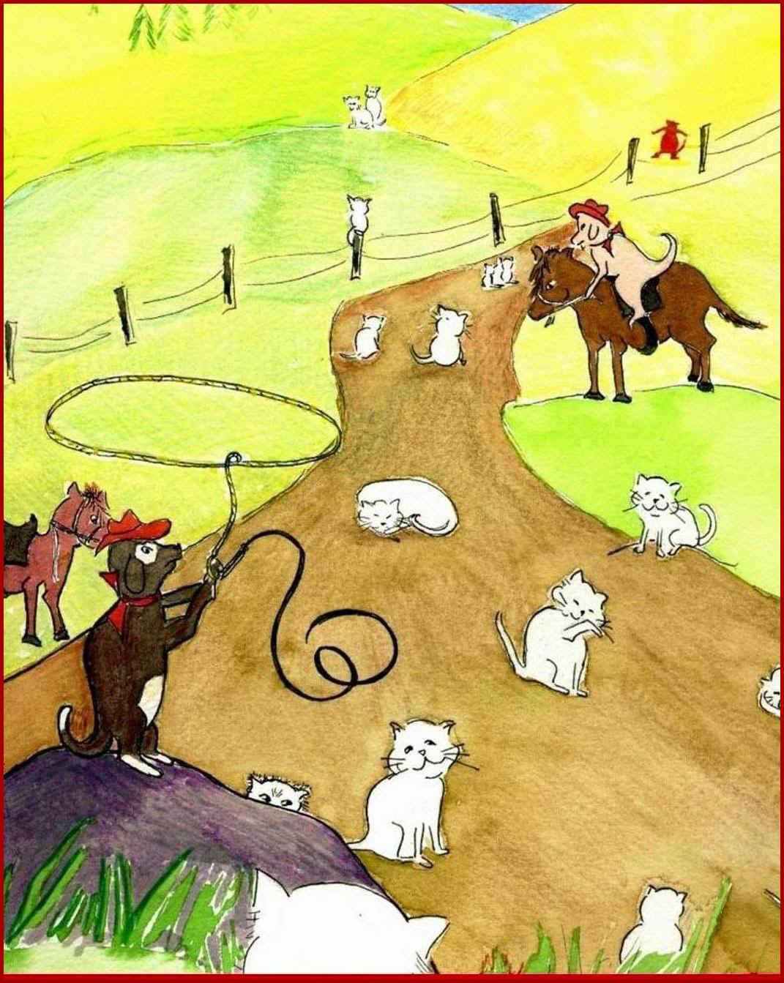
H
H
E
R
D
I
N
G
CATS
Notes:
Herding cats

Slide 4

ORDER
Notes:
Order

Slide 5
Identity Management
IDM helps bring order to chaos by centrally managing the identity life cycle
  Creation
    Auto provision, distribution, role assignment
  Management
    Role-based access, re-assignment
  Deletion
    Auto de-provision
Notes:
Story: When Kevin first became an adjunct professor at UC
Quick overview of IDM system at a high level.
Identities include attributes about the identity.

Slide 6
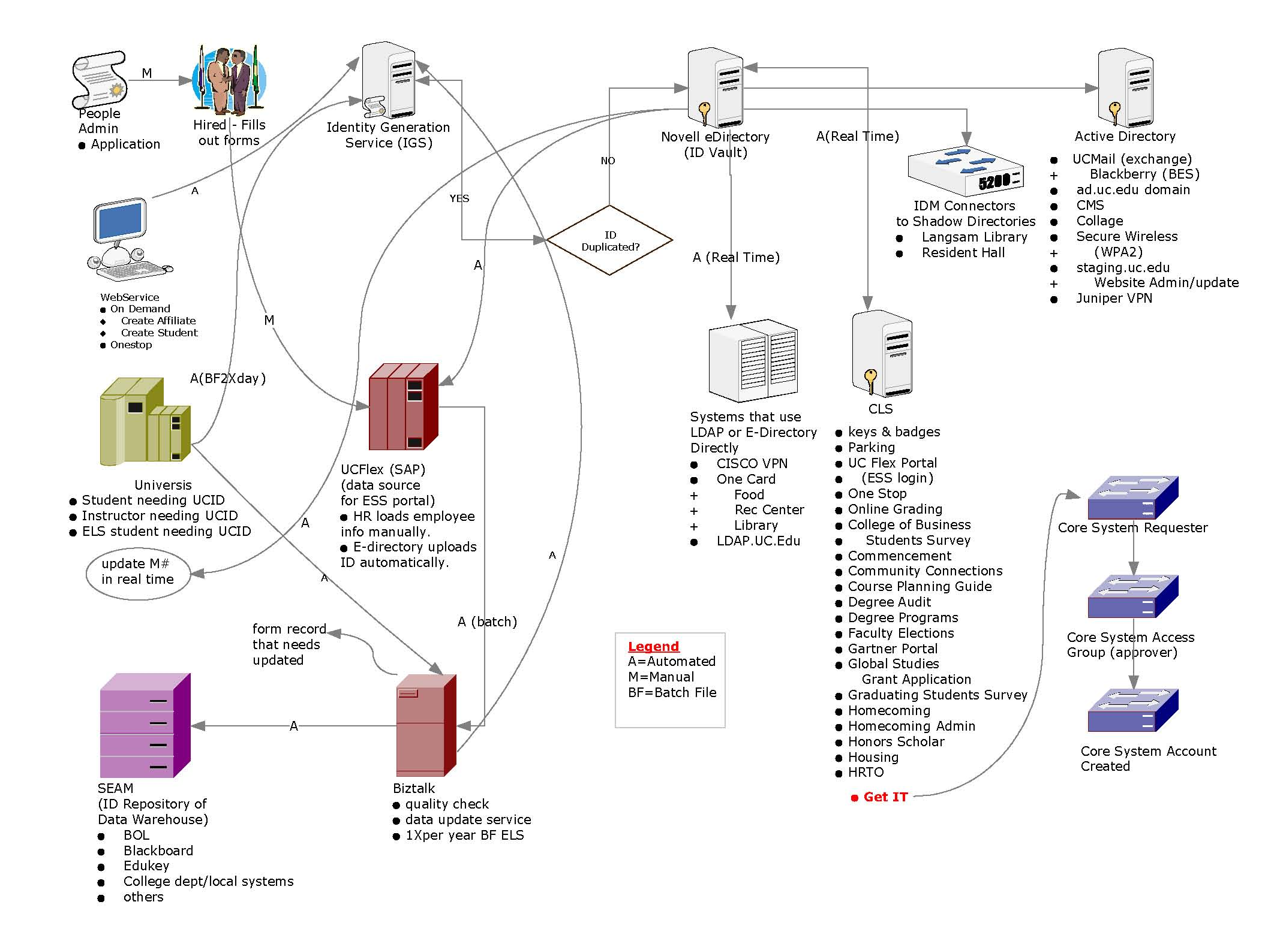
IDM from an IT perspective
Notes:
Quinn rattles off the IT processing of the UC infrastructure in a professorial and geeky way, with lots of technical terms, ending with, “OK, Everyone got that?”
IDM at UC begins the way that most systems do, when a person is hired, an HR rep keys their details into our Enterprise Resource Management system, SAP. SAP is configured to call an Identity Generation Service (IGS) to generate a unique UCID which will be the persons primary account key for the duration of their tenure at the institution. The IGS updates our identity vault. The ID Vault is our central, authoritative source for all identity information to all connected systems in the IDM ring. This feeds our Central Login Service, which uses the Services Oriented Architecture Protocol to exposed selected directory information. Web pages through UC are set up to handshake with the central system via WSDL and SOAP. At the same time, connectors from the ID Vault to our Active Directory are busy keeping information on both systems in synch. This feeds the Exchange server, Blackberry Enterprise Server and our Juniper VPN implementation. The connectors are an event-driven, near-real-time solution designed to keep appropriate attribute information in synch across all connected systems. There are also connectors to other distributed systems like our library and resident halls. The cool thing about all this is that, if you change your contact information or password in the ID Vault, it gets pushed out to all the other systems pretty much instantly. OK, Everyone got that?

Slide 7







Online Grading
Blackboard
Remote User
Who Am I?
Payroll
Student/Faculty
ESS
One Stop
Notes:
“We don’t need to worry about the IT perspective. Let IT services worry about that. Functionally, here is how it works.”

Slide 8
I am One Person
No matter how many systems I use!

Slide 9
IDM from a business perspective
Registrar
Blackboard
Central Directory
Library
College of X
Finance
Mobile Apps

Slide 10











Who Am I?

Slide 11


Slide 12
I am One Organization
…No matter how many business partners or other institutions I connect to
Taking it further
  I am one person… from one organization… no matter where I am trying to connect
Notes:
Federated Bridge (Shibboleth)
Organizations can allow people to authenticate through a remote directory
Organizations may then allow visiting personnel access to specific local resources based on the persons account at another institution.

Slide 13

That’s Common Credentials…
Done
Notes:
What are we going to do for the next half hour?

Slide 14
User Maintenance
of Common Credential Attributes

Slide 15


Slide 16
What is an attribute?
Password
Address
Home Phone
Name
Emergency Contact
Mobile Phone
Notes:
This presentation will focus on passwords, but all attributes may be handled in a similar fashion.

Slide 17
Limited Access
Only the user or a trusted party may change an attribute
Notes:
Story of the new job at Montgomery Wards when Kevin was just out of school and newly married, 1st paycheck didn’t show. The insider threat.

Slide 18
Password Self-Service at UC
Challenges and Key Learnings
  Selecting Questions
  Pushback on the questions
  Pushback on having the system at all
    Safeguards on the requested information
Notes:
“What is your favorite beer?”
“What do you like on your pizza?”

Slide 19
Strong Password
Determining complexity requirements
Implementation and rollout plan
Communication challenges
Pushback
  “Can’t remember”

Slide 20
IDM implementation at UC

Slide 21
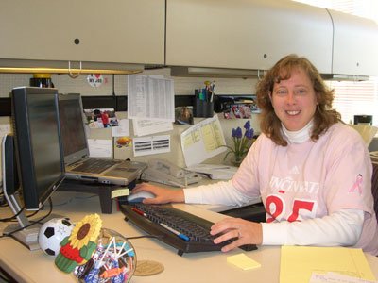

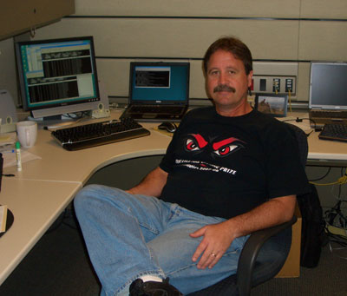
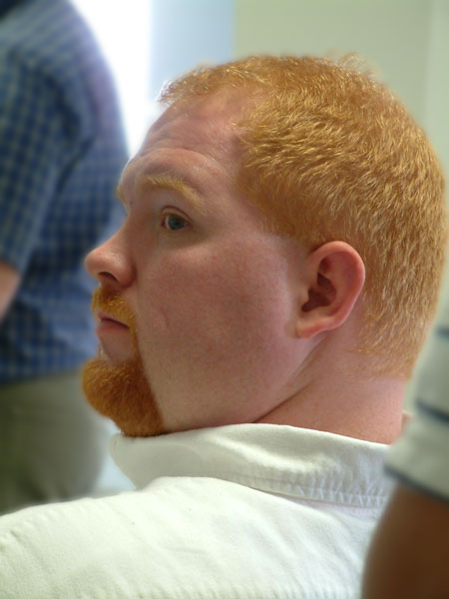
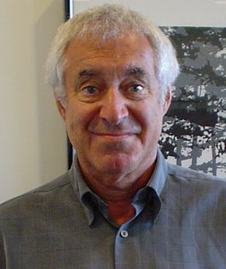
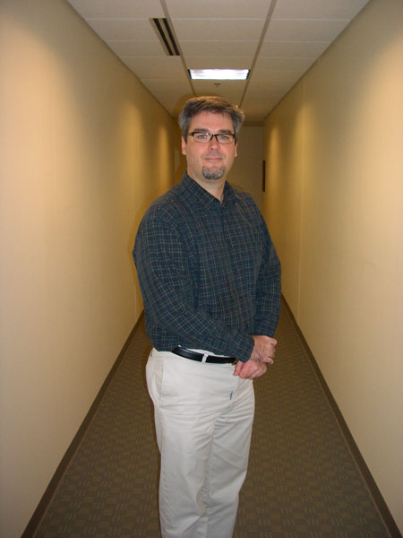
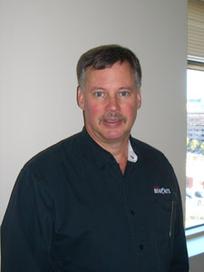
Pick the right team
Notes:
CIO Commitment
Assign the right project manager – must push and be political the same time - build cooperation among diverse groups
Communications will be the most important thing you do. Have the right person on the team to help develop and coordinate
AD guru
Systems guru
Network guru
Support from strategic system owners

Slide 22





Pick the tech
Notes:
There are many very good solutions out there. The direction you go should be based on what is best for your particular situation.
Don’t keep flipping coins for 6 months…

Slide 23
Pick the approach
Incremental change.
Phases
  Synchronization of core systems
  Password self-service
  Strong passwords
  Synchronization of distributed systems
  Shibboleth
   Single sign-on

Slide 24

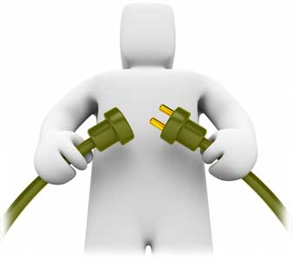

Implement
Notes:
Use good change management
Communicate the change
When you think you have done enough, find ways to double what you did…
Train support staff
Be prepared for push back
Have a response ready
Be consistent throughout management
Conclusion
Change of any type can impact members of your community
Charles Darwin – not the strongest of the species nor the most intelligent – the one most responsive to change
JFK – there are risks and costs to a program of action , but they are less then the long-range risks and costs of comfortable inaction.
IDM is one of the items that move folks from their comfort zones and are often challenged as over-kill – nothing farther from reality. We are world in cyber crisis – data at an almost laughable (if it wasn’t so serious) rate. In order to move forward we need to change the way we are doing things. Change requires action, not inaction.

Slide 25


Notes:
Our journey has just begun, we’ll let you know how it turns out…

Slide 26
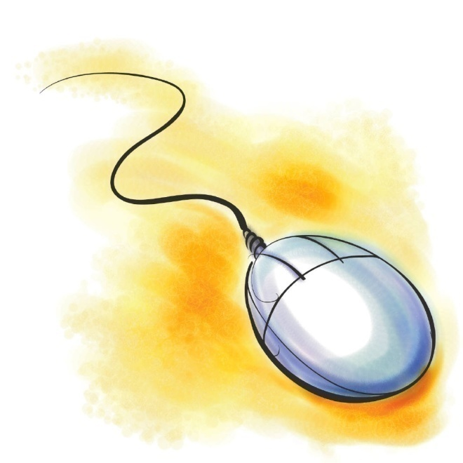
Contact Information
Kevin McLaughlin
Quinn Shamblin
UC InfoSec
  513 558-ISec
  infosec@uc.edu
  www.uc.edu/infosec

