Slide 1
ACHIEVING A SECURE CAMPUS
Sanjay Raja – Director of Application Management

Slide 2
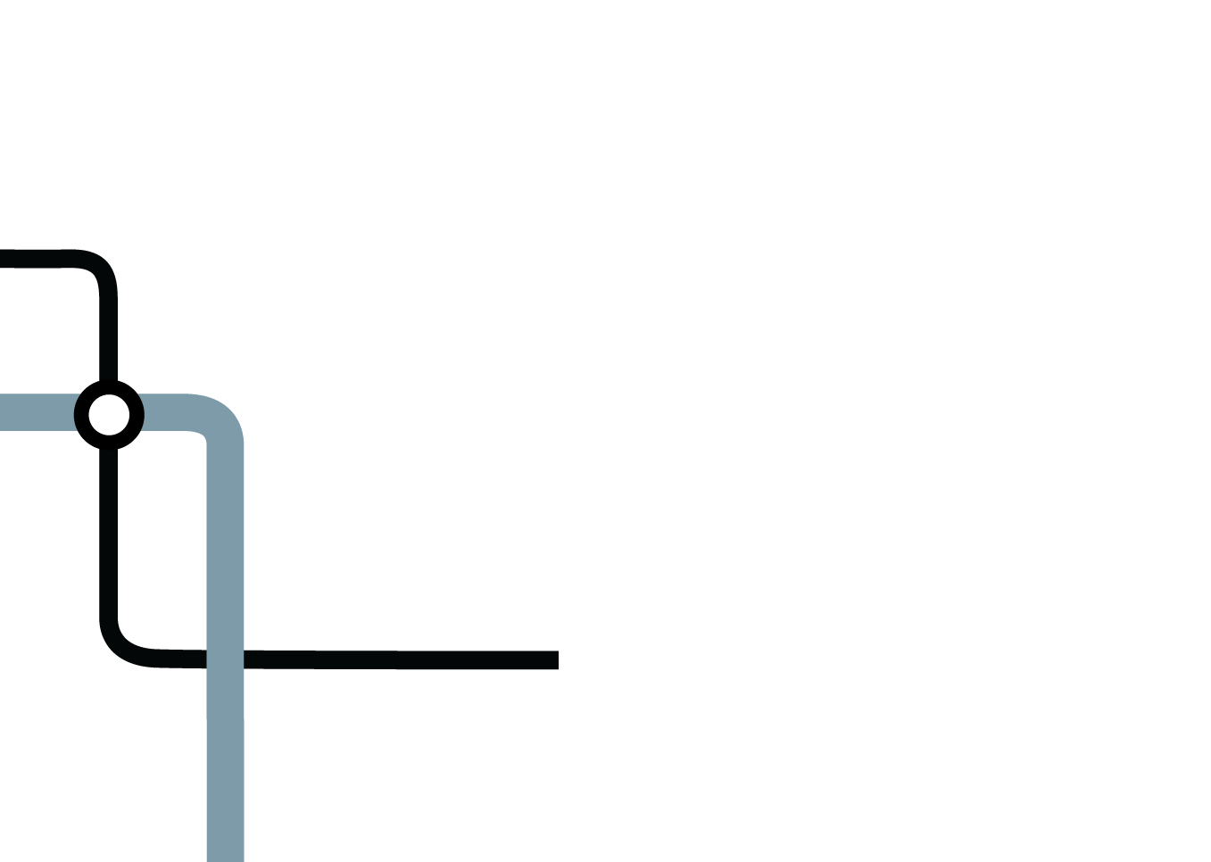

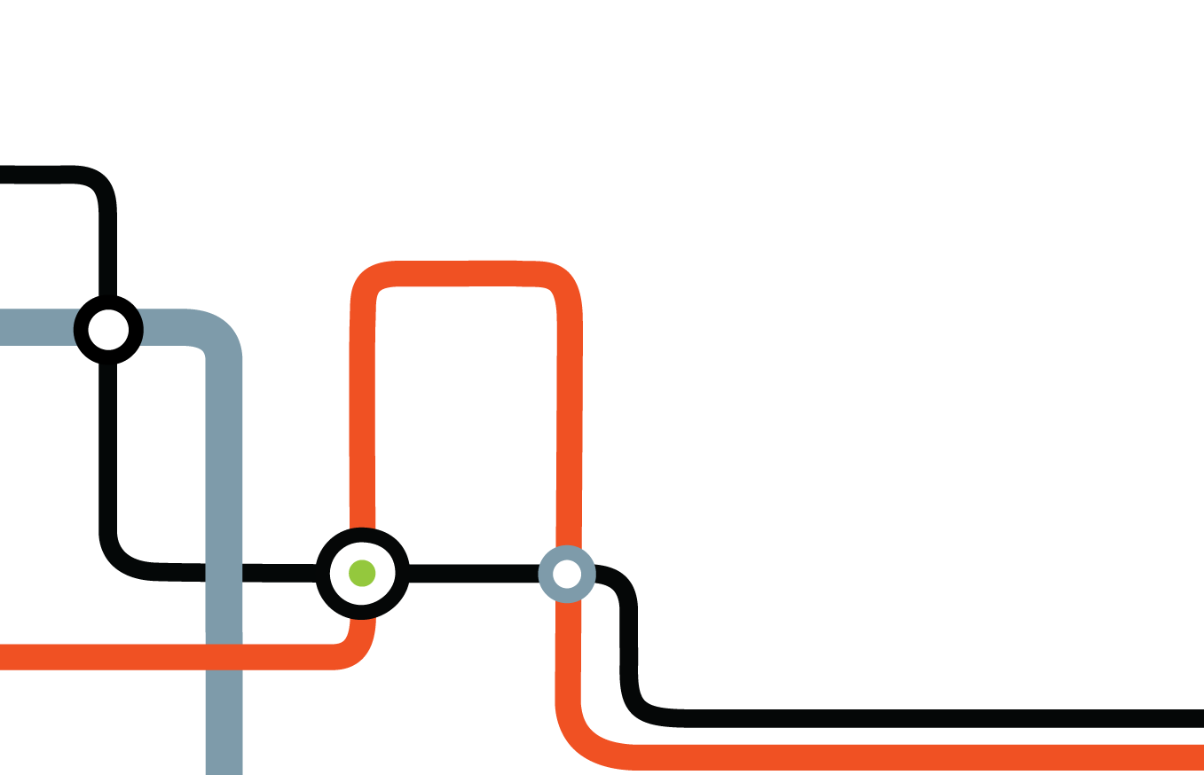
Crossbeam
WHAT DO WE DO
We help the Universities, Colleges, eLearning Service Providers consolidate their security infrastructure
We excel at providing an adaptable platform that can meet and scale with the needs of the learning environment
We help education maximize their security with our open architecture
We help our education customers protect their brands
Notes:
What Crossbeam does is deliver a “security architecture in a box” – one that take the traditional deployment model for security applications, racks of appliances and lots of network gear like switches and load balancers, and consolidates them into a high performance, bladed platform. The world’s largest telecommunications carriers, global 200 companies and government agencies benefit from Crossbeam.
The Crossbeam platform is an exceptionally adaptable platform, allowing customers linearly scale applications as needed and seamlessly add new ones
And because we are an open, secure platform, we allow our customers to choose the best-in-class applications they need to implement their security policies.
The result is our customers critical data, infrastructure and brands are protected.

Slide 3




















We are Proven – In All Industries
Deployed in 10 out of top 11 Service Providers in the world
Deployed in over 900 Global Enterprise Companies
Global operations –
10 Years Strong.
■
■
■
■
■
■
■
■
■
■
■
■
■
■
■
■
■
■
Support & services in over 50 countries
56 Global Integrators
24% y/y growth in X-Series
50% International Business
2009 Private Company of the Year
Notes:
We have over 900 customers and they come from virtually all major industries from financial services (Scottrade, Fiserv, Bank of America ), technology (Intel, RIM & Qualcomm), transportation (United Airlines & FedEx) and government agencies (Library of Congress, US Department of Commerce and The NSA).
Furthermore, 10 of the world’s 11 largest carriers rely on Crossbeam to secure the critical infrastructure. Some of these carriers have 100s of our chassis running in their data centers.
Moreover, these customers come from around the globe reflecting the truly global nature of Crossbeam. Crossbeam is well funded with no debt. We see a good increase in our X-Series business growing 24% year over year.

Slide 4
What Are We Up Against?
Notes:
At Crossbeam, our customers have used Crossbeam to rethink the traditional approach to deploying network security – they rethink the network!

Slide 5
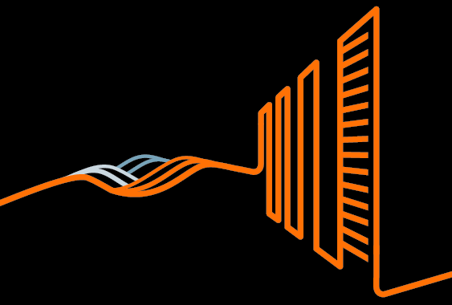
The Appliance Farm
We Think its time to Cut the Crop
Firewalls. IPS. Web Application Firewalls. Secure Web Gateways. Load Balancers. Switches. Routers.
Security in the data center is too complex today
Appliance and network sprawl is increasing capital costs, operational expense & energy consumption
Notes:
Our customers tell is that there are a number of challenges they face in deploying security services. The first is the “appliance sprawl” that characterizes today’s security deployments.
Today’s security deployment model is based on appliances. Racks and racks of firewall appliances to scale a firewall service, plus all of the network gear, like switches, load balancers, etc., needed to connect them. And that’s just the firewall service. Now add intrusion prevention and you have the same architecture of racks of appliances, switches and load balancers. Every security service requires the same “throw more boxes at it” approach.
The appliance based model is extremely complex, expensive to deploy and operate and difficult to maintain.

Slide 6

The Bandwidth Struggle
Goodbye Gigabyte.
Hello Zettabyte.
We need to adjust our thinking from Gigabytes to Zettabytes
Connections between online and offline are growing more pervasive every day.
Network bandwidth is out of control.
Notes:
The next issue our customers consistently face is dealing with the exponential growth in the amount of bandwidth coming into their data center. Appliances that used to have 36-48 months lifecycles are now being replaced every 18th months. Why – because they are running out of gas much more quickly!
Recent analyst estimates are the with the advent of everything mobile, this problem is going to become more daunting.

Slide 7
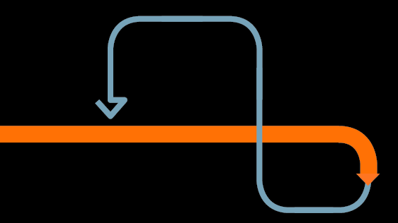
Things are Changing
We need to prepare for the future
Threats are exploding. Vulnerabilities are everywhere. Regulations are increasing.
How we adapt to these changes in the future will dictate our success.
Notes:
The only constant in security is change. That change could mean that existing security services need to be scaled quickly to deal with new threats or exploding bandwidth. Or, change could mean adding a new security application to address increased regulations.
Whatever the change, one thing is clear. The security architecture you deploy must be ready for that change.

Slide 8


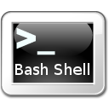



Malware is #1 Problem
Malware
Malicious
Software
Classic malware was about notoriety
New Malware is hidden & silent for financial gain
The Malware Tools
Virus
Trojans
Worms
Rootkits
Adware/Spyware
Cookies
Notes:
The only constant in security is change. That change could mean that existing security services need to be scaled quickly to deal with new threats or exploding bandwidth. Or, change could mean adding a new security application to address increased regulations.
Whatever the change, one thing is clear. The security architecture you deploy must be ready for that change.

Slide 9
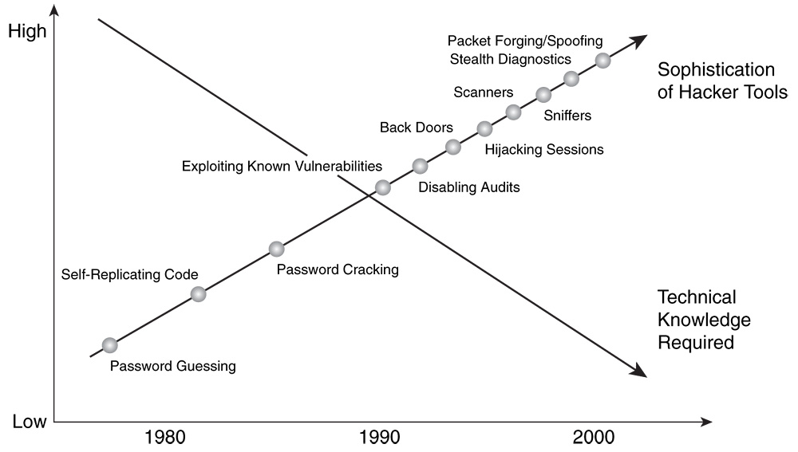
Explosion of Malware Tools
Notes:
The only constant in security is change. That change could mean that existing security services need to be scaled quickly to deal with new threats or exploding bandwidth. Or, change could mean adding a new security application to address increased regulations.
Whatever the change, one thing is clear. The security architecture you deploy must be ready for that change.

Slide 10
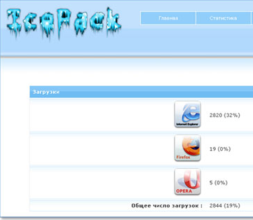
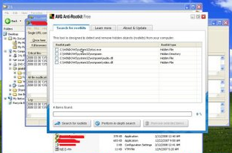
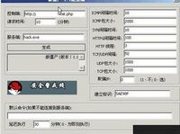
Even Students can afford it
Ice Pack
Neosploit
Black Sun
Exploit Kit Rental (1 hours)
$1
Exploit Kit Rental (5 hours)
$4
Malware Package
$1,000

Slide 11
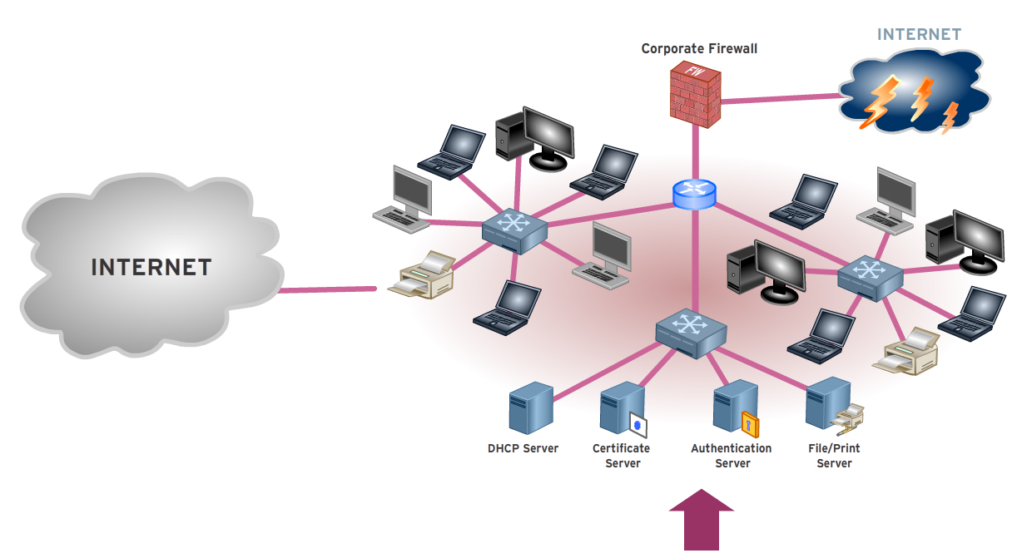
It’s Complex to Catch
15 Million new malware strains detected this year alone
Malware is getting better at evading detection

Slide 12
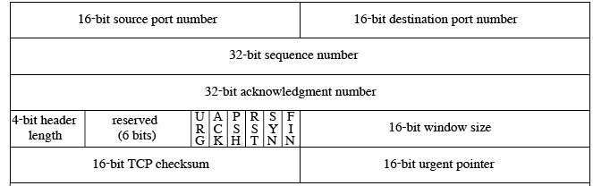
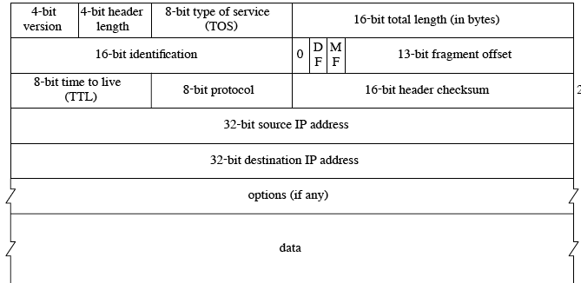
It’s Hard to Catch
Firewall’s are dumb
→ Inspect Src/Dest Ports/IP
IPS’s go a lot deeper
→ Inspect header and specific parts of the content based on signatures
Content based security has to look at everything
→ Up to 9000 bytes in every packet

Slide 13
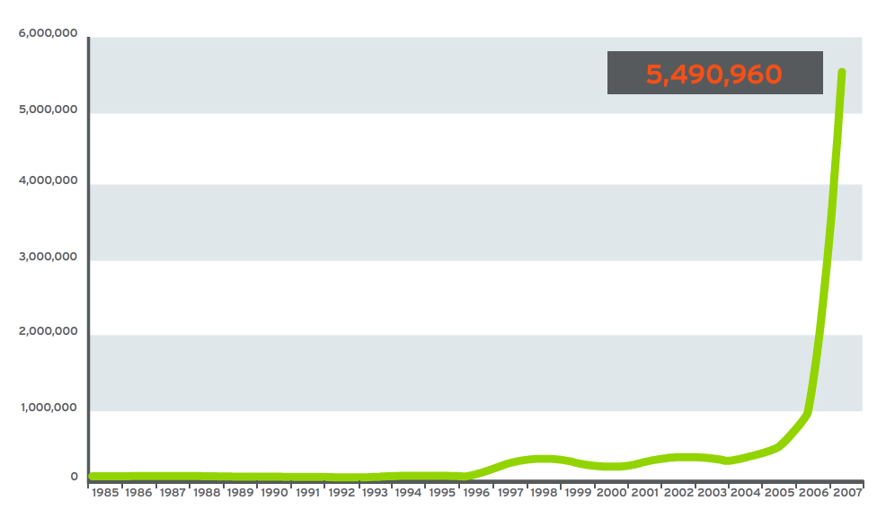
And it’s Growing
Over 5 million unique Malware samples
More than the past 20 years together

Slide 14



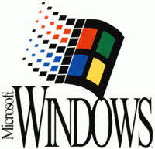
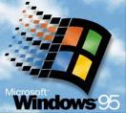


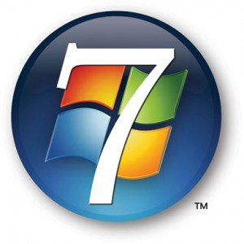
Malware effects everything
Educational Environments are breeding grounds for different Operating Platforms
How do you manage Malware protection for each OS?

Slide 15
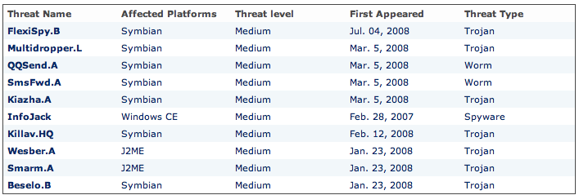
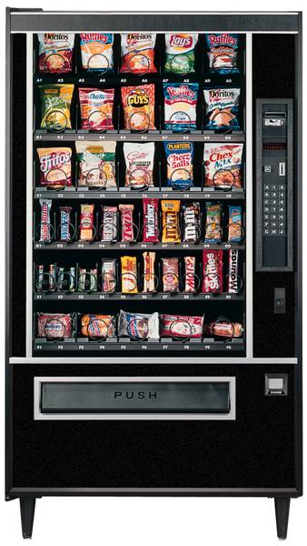
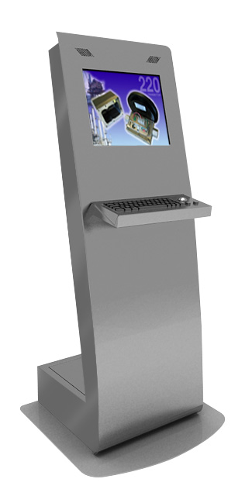
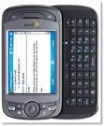


Malware affects every device
WiFi Enabled Phone
Visiting Professor Laptop
iPad
Vending Machines
Kiosks

Slide 16
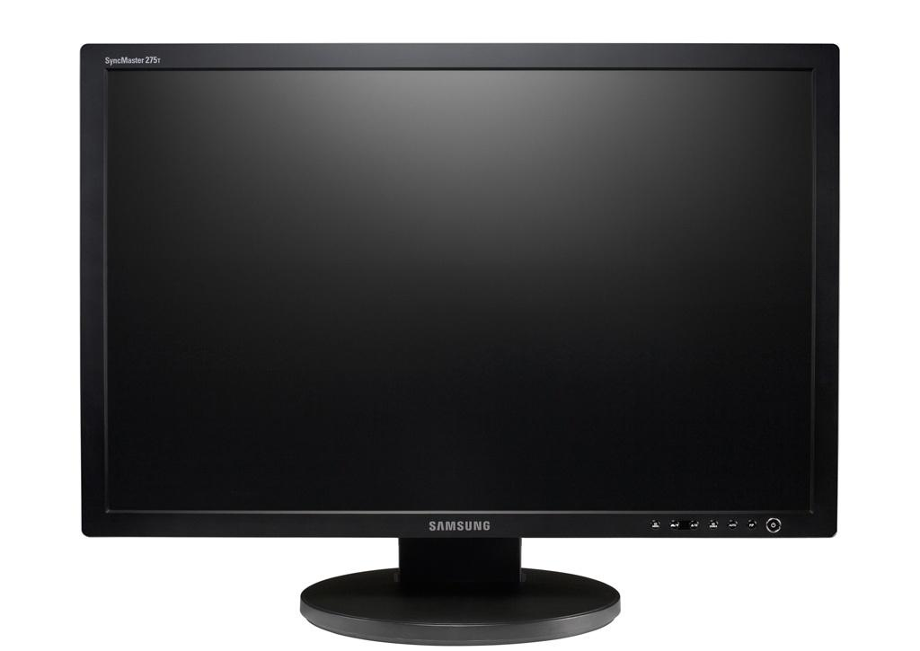
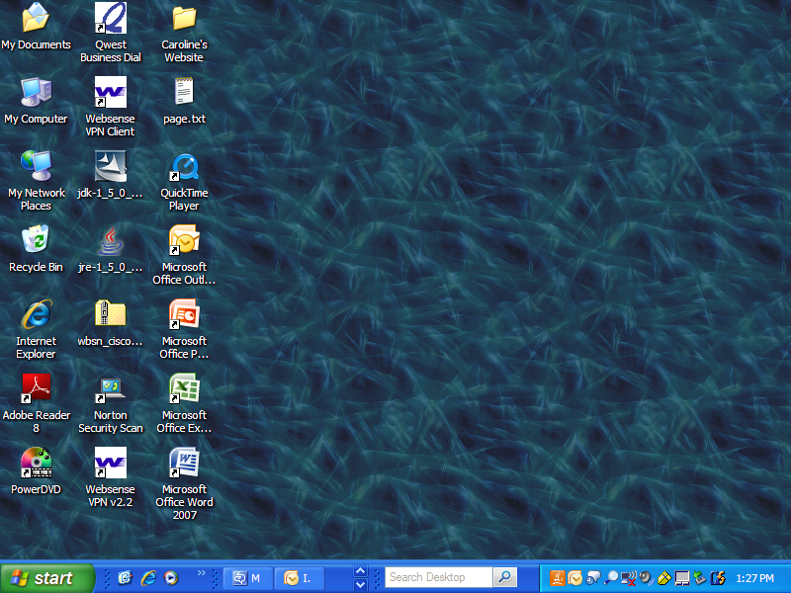
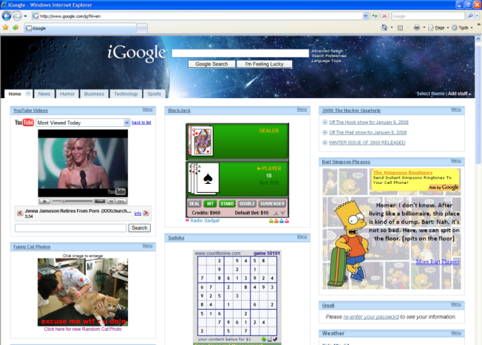


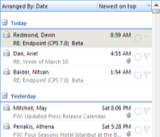
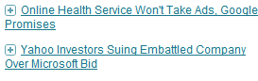



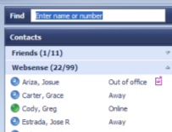



Malware loves the way we now access content
Web-Based Mashup
Hosted Applications and Data
Corporate Webmail
 □ 
Blogs
 □ 
Hosted Applications
 □ 
YouTube Videos
 □ 
User Generated Content
Local applications and data
Hosted Security
 □ 
Instant Messaging
 □ 
Email Security
Hosted Security
Local Weather
 □ 
Networking
 □ 
User Generated Applications
Network applications and data

Slide 17
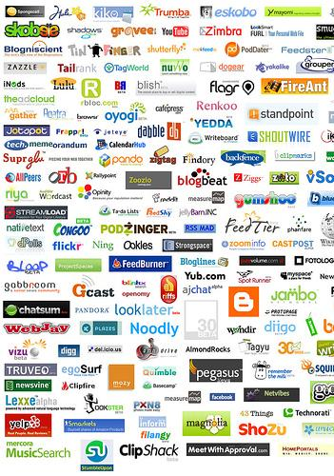








Web 2.0 is a breeding ground for Malware

Slide 18
How do we mitigate the Malware Threats, but still ensure our educational environment remains open?

Slide 19
How we should Rethink the network
Notes:
At Crossbeam, our customers have used Crossbeam to rethink the traditional approach to deploying network security – they rethink the network!

Slide 20



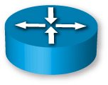
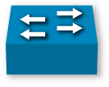
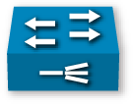




Our Life Today
Typical multi-box architectures have a lot of duplication and inefficiency
FW
IPS
L2
LB
LB
Internet
L2
LB
LB
Security changes require network changes causing slow responses to changing needs
Difficult to add a new security service & scale the network
Notes:
The status quo is that in any network there is duplication, inefficiency and box sprawl. Unfortunately, the status quo yields extraordinarily complex data center architectures, leading to wasted data center space, growing power usage and difficulty in fault diagnosis. Moreover, since these devices require connections to switches & load balancers, and have limited networking & application processing power, they essentially become embedded elements in the network – meaning that when the security services need to be expanded or upgraded so does the network.

Slide 21




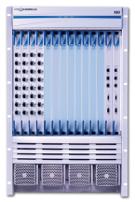
The Crossbeam “Virtual Infrastructure”
Crossbeam creates a “Network in a Box”
Network Processor Modules
Application Processor Modules
Control Processing Modules
The X-Series Platform becomes a “Virtual Infrastructure” integrating both Network Processing & Application Processing
FW
IPS
L2
LB
LB
Internet
L2
LB
LB
Notes:
The X-Series is essentially a “network in a box” that helps solve inefficiencies by optimizing the network & application processing together under one operating system.
The X-Series platform allows enterprises and service providers to consolidate network infrastructure (switches, load balancers, patch cabling & power cords) and appliances supporting security applications, “virtualize” the delivery of security applications and dramatically simplify deployment and on-going management.
More specifically, the our solution has 5 primary components, to wit:
A high performance, fully redundant chassis, that comes in a 7 slot and 14 slot version. Everything in the chassis from Power supplies to fan trays to backplanes is redundant
We have 3 kinds of blades, the first of which is our network processing module which consolidates all of the switching and load balance fabric needed for a multi- application security architecture
Our 2nd blade is our application processor module – this blade replicates the computing power of appliances and is used to run security applications. Each one of our APMs is a high-end dual quad core system
Our 3rd blade in our control processor module that manages the overall health of the chassis and manages failover
The final component is our open secure OS which we will cover next

Slide 22
Crossbeam XOS
Optimizes data flow between the network and application processors
Switched Data Path
Management
Dynamic Resource
Allocation
Provides a responsive system to application processing needs
Optimizes & controls flows between apps
Secure Flow Processing
Virtual Application
Processor / Grouping
Allows application performance to scale independently
Protects & ensures optimum network processing
Chassis Resource
Protection
Self-Healing
Automatic performance capacity restoration
Network
Processing
Environment
Application
Processing
Environment
Provides Superior Network Performance
Ensures Exceptional Application Processing
Open Secure OS
Broad support of best-in-class security applications
Notes:
At Crossbeam, we believe the secret to a successful platform is its Operating System. That’s why we have spent the last 10 years perfecting our creation.
We built an operating system that allowed multiple best-of-breed applications to live on the same platform and work together seamlessly with the ability to centralize control and visibility of the entire system.
Over 500 man-years of effort later, XOS was born and is being used by some of the largest banks, service providers, mobile operators, schools and governments around the world.
What makes XOS so special is the ability to consolidate multiple best-of-breed applications on to a single chassis and in the process, direct networks flows from one security application to another as if physical infrastructure like switches, load balancers, appliances , etc. were in place, except it’s all done with software --- we call this secure flow processing.
More over, our virtual application processing allows for 1, 2 3, up to 10 APMs to act as a single system to bring true linear scalability to security applications.
With XOS, a Virtual Infrastructure was created allowing customers to move, add and change applications onto the same hardware within minutes and to do so without fear to downtime.
In effect, XOS created a new genre of Network Security Platforms.
Bottom line – In order to best leverage your assets and maximize system life, it’s all about control, adaptability and flexibility and that’s what Crossbeam delivers.

Slide 23
The Power Of The Virtual Infrastructure
FW – Policy 1
IPS – Policy 1
Zone 1
FW – Policy 2
IPS – Policy 2
Zone 2
FW – Policy 3
IPS – Policy 3
Zone 3
Collapse hundreds of unique
security policies
Scale, add, remove or change
security policies - virtually
Notes:
The real power of Crossbeam’s X-Series is the ability to create a virtual network infrastructure. In other words the ability to create separate network segments, each with it’s own set of security applications and policies, all done in software virtually. This allows physically separate and distinct network security infrastructure segments (appliances, switches, load balancers, patch panels, patch cables, rack space, etc.) to be implemented via a highly consolidated and virtualized infrastructure, all in software without any compromises to security policies.
This virtual infrastructure provides tremendous flexibility in terms of the ability to scale, add, remove or change security policies for different set of users, all virtually. Thus the duplication and associated expense and difficulty of managing separate physical network segments and appliances for R&D, Finance, Contractors, Partners, etc. is eliminated.

Slide 24
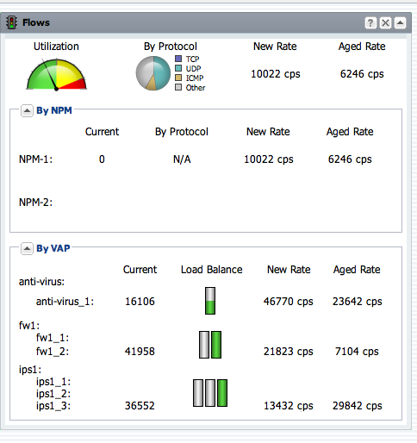
Crossbeam Management
Simplifying the Complex. Always.
Installation – Install new firmware direct from a USB disk
Configuration – Common tasks completed in one command saving operational headaches
Operations – Health, Capacity Planning, Troubleshooting – all provided in one graphical “at-a-glance” interface
Notes:
And a primary focus for Crossbeam over the past year and on a going-forward basis is simplifying how our customers interact with, configure and monitor the performance and health of our products. Consistent with the goal of “simplifying the complex”, Crossbeam has numerous tools to simplify and automate previously-arduous tasks like installation and configuration of our OS.
In addition, our new element management system allows for a graphical “at-a-glace” real-time view of view of what’s happening in our X-Series platform. From understanding utilization and protocol mix to alarms and capacity planning, our new Greenlight Element Management system is a powerful tool.

Slide 25




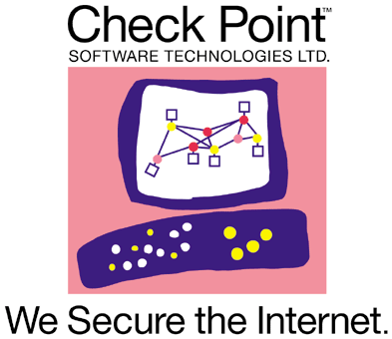


Demand the Best
One Size fits all Actually fits no one
Worms. Bots. Phishing. Trojans. PCI. GLB. HIPAA. SOX
No matter the security jargon - you should demand the best solution that fits your business.
We think the same way. That’s why Crossbeams’ platform allows you to utilize the innovation from best-in-class application vendors in any certified configuration.
Notes:
Also, key to the value we offer customers is ability to choose best-in-class third-party security applications. In this way, out customers are able to respond to new security threats by deploying the security from an independent best-of-breed security vendor as opposed to being forced to take and “all in one” approach from a vendor that bundles all of their own software with their own OS and their own hardware.
Crossbeam works leading firewall, intrusion detection and prevention companies like Sourcefire, IBM and Check Point as well as leaders in the Web applications firewall space like Imperva and secure web gateway leaders like Trend Micro and Websense, with new vendors to come this year.

Slide 26
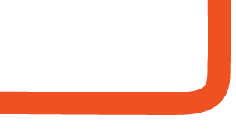
Crossbeam Delivers
Maximized Security
Lower Cost of Ownership
Exceptional Performance
A platform that utilizes innovation from best-in-class security vendors to fit your business
The ability to adapt security performance and scaling needs to fit your business
Cut the security appliance farm and consolidate 50:1 saving time & money
Reduce energy consumption by >50%
Simplify the complex and reduce operational labor expense
Extend hardware capital depreciation cycles to 5+ years
Increase confidence and decrease downtime with Crossbeam’s self-healing technology
Crossbeam provides the worlds most optimized network so you have unwavering confidence in your business
Notes:
Our customer experience is that the flexibility and adaptability of our platform allows them to choose the best-in-class security applications that work best for their environment and their policies.
Moreover the architecture of our solution, allows customers to scale linearly, improve uptime and deploy a solution that is ready for change for the next 5 years and beyond.
This translate into significant consolidation (50:1 or more of physical boxes into one of our chassis), all of which leads to dramatically lower total cost of ownership, in the from of reduced power, cooling, maintenance costs and labor savings.

