Slide 1
IT Audit Response A cross-discipline approach
Stephen C. Gay CISSP
Information Security Officer
Kennesaw State University

Slide 2
Copyright Stephen C. Gay, 2010. This work is the intellectual property of the author. Permission is granted for this material to be shared for non-commercial, educational purposes, provided that this copyright statement appears on the reproduced materials and notice is given that the copying is by permission of the author. To disseminate otherwise or to republish requires written permission from the author.

Slide 3
Presentation Outline
Prologue
The Georgia Department of Audits & Accounts 2008 IT Audit
Summary of Findings
Response
Current Status
Closing Thoughts / Discussion

Slide 4
Presentation Format
For each section…
Narrative of KSU’s experience
In-depth examination of select points
Lessons Learned \ Tools
Discussion!

Slide 5
IT Audit Response A cross-discipline approach Section I: Prologue

Slide 6
Kennesaw State University
Founded in 1963
3rd largest university in Georgia
22,500 undergraduate & graduate students
2,500 faculty & staff
70 bachelor’s, master’s and doctorate degree programs
Information Security Office founded 2006

Slide 7
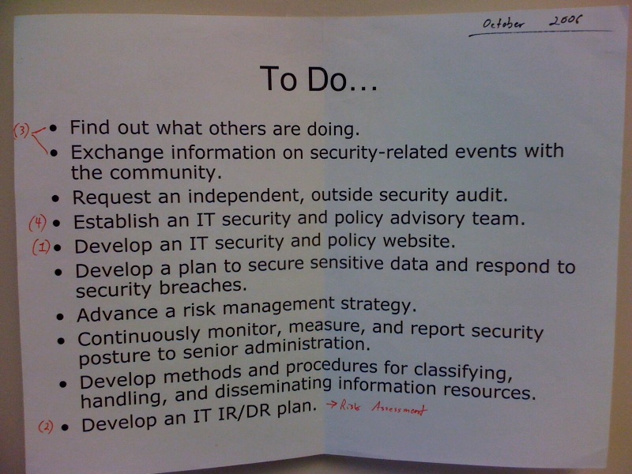
To Do…

Slide 8
Prologue: Lessons Learned
Be careful what you wish for…

Slide 9
IT Audit Response A cross-discipline approach Section II: The Georgia Department of Audits & Accounts 2008 IT Audit

Slide 10
The Georgia Department of Audits & Accounts 2008 IT Audit
April 2008 – December 2008
3-member team
Scope: “The information systems and applications that were publically accessible and those that included or interacted with Kennesaw State University’s Banner Student Information System”

Slide 11
The Georgia Department of Audits & Accounts 2008 IT Audit
April 2008 – December 2008
3-member team
Scope: “The information systems and applications that were publically accessible and those that included or interacted with Kennesaw State University’s Banner Student Information System”

Slide 12
2008 IT Audit - Domains evaluated
Systems Security & Protection
Data & Systems integrity
Change Management
Identification & Authentication
Access Control
Education & Awareness
Contingency Planning
Policy & Procedures
Systems & Services Acquisition
Auditing
Incident Response

Slide 13
2008 IT Audit - Domains evaluated (w/ 27001 mapping)
Systems Security & Protection – Asset management
Data & Systems integrity – Communication & Operations Mgmt
Change Management - Systems development & maintenance
Identification & Authentication – Access Control
Access Control – Access Control
Education & Awareness – Human Resources Security
Contingency Planning – Business Continuity Plan
Policy & Procedures – Security Policy
Systems & Services Acquisition – Asset management
Auditing - Compliance
Incident Response – Information Security & Incident Mgmt

Slide 14
2008 IT Audit - Timeline
May 2008
Initial document request
June 2008
Results from (external) network scan
Audit team arrives at KSU
July 2008
Interviews with KSU IT Staff
Results from (internal) network scan
August 2008
Audit team leaves KSU
November 2008
Final Report DRAFT submitted to KSU
Feedback Meeting
Final Report published to DOAA website

Slide 15
2008 IT Audit - Timeline
Incident Response…
Let’s look at a couple of examples

Slide 16
2008 IT Audit – In-depth examination: Banner numerical login
OwlExpress Login, Pre-October 2008
KSU ID & DOB or
NetID & Password
DOAA Audit team
Collected Student Athlete DOB’s from KSU Athletics website
Collected KSU ID from NetID search page
Result: Account compromise

Slide 17
Lessons Learned In-depth examination: Banner numerical login
OwlExpress Login, Pre-October 2008
KSU ID & DOB or
NetID & Password
DOAA Audit team
Collected Student Athlete DOB’s from KSU Athletics website
Collected KSU ID from NetID search page
Result: Account compromise

Slide 18
2008 IT Audit – In-depth examination: FERPA data in public web space
A pair of data sources
Text file hosted on faculty member’s KSU homepage
KSU ID & Test Score
Oracle Web Cache
KSU ID & SSN matrix
SSN <> KSU ID <> Test Score
Result: Potential FERPA disclosure for 32 students & Audit Finding 1.8

Slide 19
Lessons Learned In-depth examination: FERPA data in public web space
A pair of data sources
Text file hosted on faculty member’s KSU homepage
KSU ID & Test Score
Oracle Web Cache
KSU ID & SSN matrix
SSN <> KSU ID <> Test Score
Result: Potential FERPA disclosure for 32 students & Audit Finding 1.8

Slide 20
IT Audit Response A cross-discipline approach Section III: Summary of Findings

Slide 21
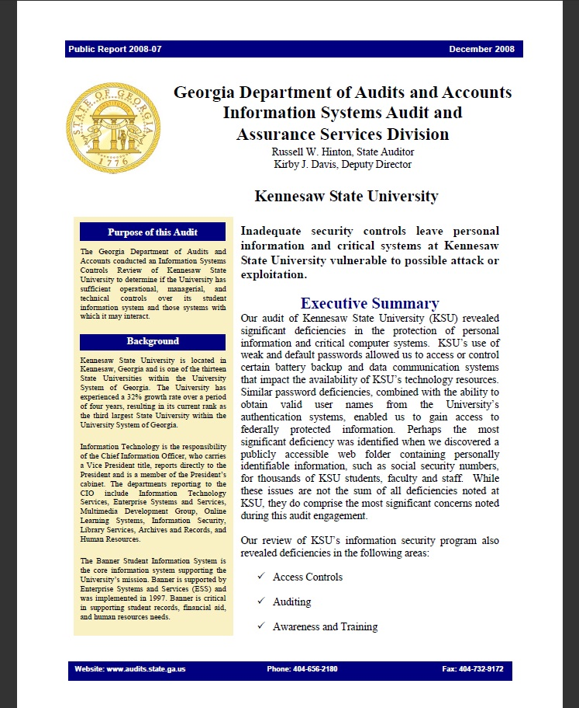
Summary of Findings
“Inadequate security controls leave personal information and critical systems vulnerable to possible attack or exploitation.”

Slide 22
Initial Summary of Findings
Systems Security & Protection – 9
Data & Systems integrity - 1
Change Management - 5
Identification & Authentication -7
Access Control - 5
Education & Awareness - 1
Contingency Planning - 4
Policy & Procedures - 3
Systems & Services Acquisition – 1
Auditing - 4
Incident Response - 0
Total: 40

Slide 23
A closer examination of findings for a single domain
Systems Security & Protection
1.1 – No DMZ
1.2 – No review of firewall rules before implementation
1.3 – No annual review of existing firewall rules
1.4 – FTP & Telnet usage at KSU
1.5 – Application log files found in public directories
1.6 – Web Directory indexing enabled on critical servers
1.7 – Redundant copies of web pages found in public web space
1.8 – Potential FERPA disclosure (as discussed earlier)
1.9 – No scheduled vulnerability scans of KSU servers

Slide 24
IT Audit Response A cross-discipline approach Section IV: Response

Slide 25
Response
November 2008 – CIO & Stakeholder Meeting
ITS Information Security Office assigned coordination responsibilities
Commitment to the security of university data and the closure of all findings.

Slide 26
Response
No findings are to be closed without necessary documentation to support closure & maintenance
A cross-discipline approach
Quarterly update reports to USG, via KSU Internal Audit Department
Balance the mission of the University with the need to resolve audit findings
“It’s not about saying no, it’s about saying how”
David Rowan, Chief Security Officer SunTrust Banks

Slide 27
Response
December 2008
Residual Risk Mitigation Form
Individual assigned primary responsibility for EACH finding
Supporting staff documented
Closure requires primary and one supporting staff sign-off, followed by ITS Information Security Office review

Slide 28
Response: Q3 FY09
14 findings closed, including:
FW rule documentation
Web Directory Indexing
Scheduled Server Scans
Default Passwords
Incident Responses
Policy heading revisions

Slide 29
Response: Q4 FY09
7 findings closed, including:
Annual Firewall review
FTP & Telnet Usage
Redundant web copies
Default files & directories on web servers
SETA for new hires

Slide 30
Response: Q1 FY10
5 findings closed, including:
Inventory of system configurations
SDLC for production servers
Banner Procedures
SDLC usage documentation

Slide 31
Response: Q2 FY10
Zero findings closed…why?
Focus on maintenance tasks
Concentrated efforts in the domains of disaster recovery & auditing
Other responsibilities…

Slide 32
Response: Q3 FY10
4 findings closed, including:
Modular IT DR Plan
IT DR Plan testing
Auditable data definition

Slide 33
IT Audit Response A cross-discipline approach Section V: Current Status

Slide 34
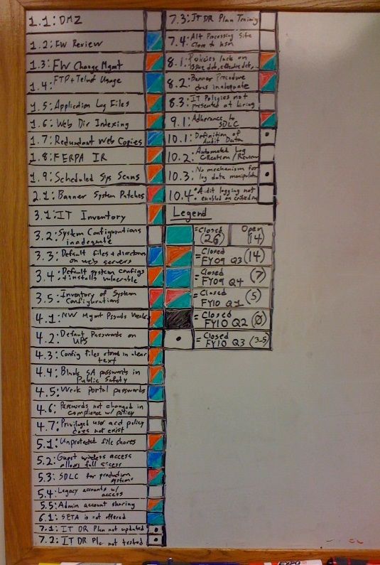
Current Status
30 of 40 findings closed (75%)
Reexamination & maintenance of findings previously closed
Approaching anticipated return of DOAA Audit team

Slide 35
IT Audit Response A cross-discipline approach Section VI: Closing Thoughts & Lessons Learned

Slide 36
Closing Thoughts / Lessons Learned
A formal engagement meeting is a necessity
Audit scope is clearly defined
Procedures for reporting critical findings
Single point of contact, with backup
A formal response meeting is a necessity
Match stakeholders to specific findings
Procedures for reporting responses
Single point for response coordination, with backup
It is critical to develop quantitative measures for all projects or tasks.
Especially maintenance / reoccurring tasks

Slide 37
Closing Thoughts / Lessons Learned (cont)
An information security framework is critical
To better communicate the overarching impact of a finding
To match appropriate safeguards.
A collaborative relationship between the audit team and the university is crucial to reap the most benefit from the audit work performed

Slide 38
Questions or Comments about IT Audit Response?
Feel free to contact me!
Stephen C. Gay
Kennesaw State University
sgay@kennesaw.edu

Slide 39
What did you think?
Your input is important to us!
Click on “Evaluate This Session” on the EDUCAUSE Security program page.

