Slide 1



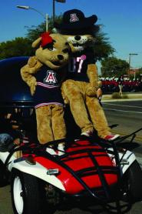
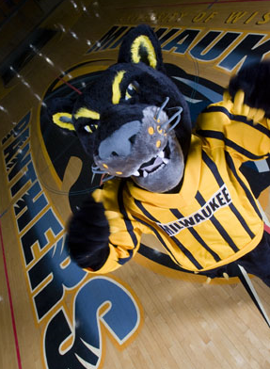
Meeting Information Security Awareness Needs... and the Campus Likes It!

Slide 2
Tanya Choice-Henry
Information Security Liaison
Mick Brickner
Training & Development Coordinator
April 5, 2011
Notes:
We will provide an overview of UWM, our need for information security awareness training, how information security departments are uniquely positioned to assist with this need and the successes and challenges we experienced in implementing this program.

Slide 3
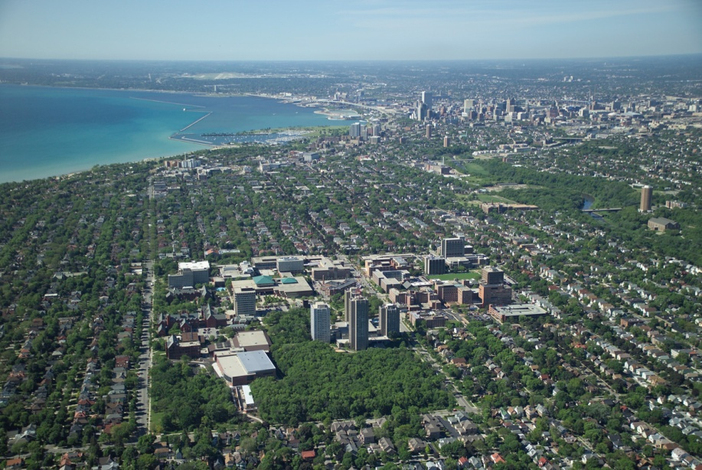
UW–Milwaukee
Enrollment 30,502
Undergraduate 25,271
Masters & Doctoral 5,231
Faculty & Staff 3,637
Central IT staff 150
IT student staff 190
Schools & Colleges 12
Undergraduate 94
Masters 53
Doctoral 32
Notes:
-Enrollment, Undergraduate, Faculty/Staff, IT staff figures…
-One of two public doctoral colleges in state of Wisconsin
-Enrolls more Wisconsin students than any other school in the state
-$68 million in research expenditures in 09-10 biennium (up from $21 million ten years ago)
-Increased our footprint and continuing to expand… more users means more data to protect

Slide 4
The Issue
More complex information security requirements
New federal, state and University mandates
Overall lack of policy existence and awareness
Policies are stored in multiple locations
Inconsistent delivery methods
Lacking comprehension and tracking tools
Notes:
The whole purpose of our training program was to address the following issues on campus:
More and more complex information security requirements
New federal, state and University mandates
Lack of awareness of policy existence and/or personal responsibilities to adhere to policy
Policies are stored in many different places
No consistent way to get the message out about policies and updates/changes
No way to track completion or assess comprehension of responsibilities

Slide 5
The Goal
Provide the UWM campus community with consistent, accurate and auditable training for secure information handling
Notes:
-Our Goal: “Provide the UWM campus community with consistent, accurate and auditable training for secure information handling.”
-Online training -
Maintains consistency of the message - easy to update/change material
Provides delivery to users home or office computer
Available - Online and on-demand (24/7)
Completion of training is tracked and auditable
Comprehension of training is verified via successful completion of the assessments
Alleviates the difficulties of coordinating in-person training

Slide 6

Why Should Information Security Deliver the Message?
Protect data
Mitigate unauthorized access/use
Clean up errors
Inform & educates campus
Coordinate policy requirements
Facilitate compliance with campus partners
Notes:
-Policies:
State, federal, University
HIPAA, FERPA, Acceptable Use, Confidentiality, SSN usage, etc.
-Campus partners: Records Management, Internal Audit, Human Resources, Legal, faculty/staff/students

Slide 7
Getting Started Choosing the Subjects
UWM Acceptable Use Policy
Employee Confidentiality Acknowledgment
FERPA, HIPAA, GLBA
Records Management
Identity Theft Program: FTC Red Flags
Assurance Protocol for SSN’s
Notes:
Focused on policies applying to the entire campus and issues that reach the largest audience…
-UWM’s Acceptable Use Policy for IT Resources
-Identity Theft Program: FTC Red Flags
-Assurance Protocol for SSNs
-Employee Confidentiality Acknowledgment
-Family Educational Rights & Privacy Act (FERPA)
-Health Insurance Portability & Accountability Act (HIPAA)
-Gramm-Leach-Bliley Act (GLBA)
-Records Management
-Compromised Accounts, Password and Phishing
-Information Security Policy
-UWM Information Disclosure Protocol
-Wisconsin State Statute 134.98
-And more…

Slide 8
Getting Started Project Champions
Getting buy-in from CIO
Identify partners
Share the cost
Combine resources
Collaborate on materials
Assist with marketing
Notes:
Mitigating risk
Educated employees have fewer incidents
Proactive-instead of reactive
Meets compliance and auditing requirements for HIPAA and FTC Red Flags
Identify partners
-Share the cost (we are providing this to the campus for free). As such, we were able to work with areas who have an obligation to educate the entire campus.

Slide 9
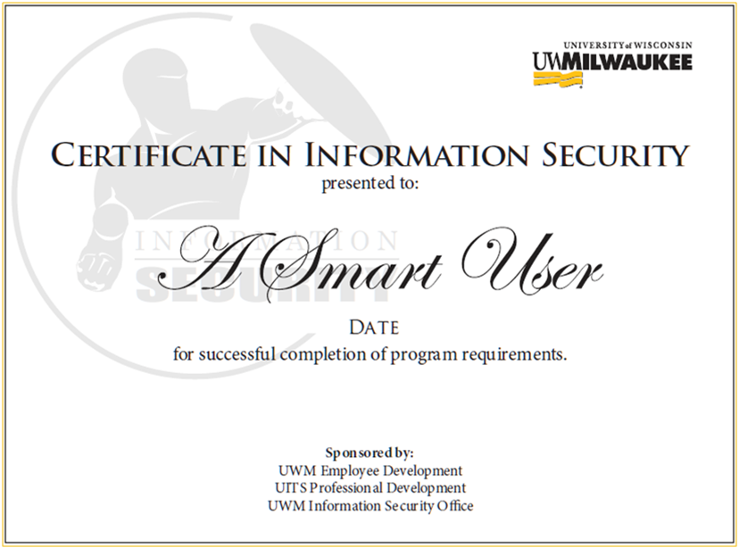
Notes:
Earn a Certificate in Information Security
-Obtain valuable knowledge about their responsibilities
-Learn how to keep confidential and sensitive information from unauthorized access and misuse
-Stay in compliance with University policies and state law
-Bolster their credentials, professional development, on-the-job performance, and resume
-Receive a certificate suitable for framing!
Receive a copy of the applicable policy upon completion
Training completion is tracked in their Training Records
Researchers can use completion of the training as a part of the required “data security plan” for federal grants

Slide 10
Creating the Tutorials
Software Tools
Adobe Captivate
(or Articulate)
Adobe Photoshop
Adobe Flash
Audacity
Camtasia
PowerPoint
Time Commitment
Creating
Verifying
Revising
Testing
Finalizing
(Weekly Meetings w/ SME)
Notes:
Software Tools
Necessary
Captivate (or Articulate) for presentation and quizzing
Optional
Photoshop for editing/creating images and backgrounds
Flash for advanced animations
Audacity for audio recording
Camtasia for screen capture/recording
PowerPoint for presentation
Time Commitments
Creating
Verifying
Revising
Testing
Finalizing
Weekly Meeting with Subject Matter Expert (verify information, content, quiz questions, etc.)

Slide 11

Getting the Word Out
Advertising
Word of Mouth
Notes:
To promote the training we used…
Advertising
-Brochures
-Banners, flyers, gold signs, 8x11
-Weekly emails from Employee Development
-Security, Employee Development and Professional Development websites
Word of Mouth
-IT’s 4 U sessions
-Tech Users
-Governance groups

Slide 12
The Response
“I hope UITS will offer more training opportunities like this!”
“You guys are doing great jobs of informing the campus about security policies.”
“This makes my day. Thanks for all of your help!”
Notes:
We are closing in on 1000 views of the online trainings. The most popular topic has been the Confidentiality Acknowledgment.
We have also seemed a lot of positive feedback!

Slide 13
Successes
Required for permanent centralized IT staff
Required for student centralized IT staff
Recommended for de-centralized IT staff
Required for some existing non-IT personnel
Graduate School, HR, Payroll
Notes:
Some of the unplanned successes we have had since implementation include…
Centralized IT staff will be required to obtain a certificate – rollout 7/11
All new student employees hired for centralized IT are required to take and pass the Confidentiality Acknowledgment tutorial
De-centralized IT staff are being recommended to obtain a certificate
Some tutorials required for some existing non-IT personnel
Department HR Staff
Admin. assistants – who handle confidential data
Payroll staff

Slide 14
Successes
More
Required for access to some confidential data
HR, Payroll, Accounting
Campus partners creating additional training
Internal Audit
Records Management
Safety and Assurances
Used by researchers for Data Security Plans
Notes:
Some of the tutorials must now be completed before receiving access to certain confidential data
HR, Payroll, Accounting
Campus partners creating additional training to be included in (or to supplement) the certificate
-Internal Audit
-Records Management
-Safety and Assurances
Researchers are using some tutorials as part of their Data Security Plans

Slide 15

Challenges
Obtaining resources
Finding time to collaborate
Developing appropriate assessments
Presenting and paraphrasing policies
Automating certificates
Maintaining/updating content
Notes:
Resources
People, time, funding, software, online resources, etc.
Collaboration
-Different departments, projects, schedules
Assessments
-100% completion, deciding on appropriate questions & answers
Presenting and Paraphrasing Policy
-How do you make policy interesting?
-How do you communicate policy in a bullet point?
-How do you paraphrase without changing meaning?
Automating certificates
-Who sets up, maintains and tracks automated certificate creation?
Maintaining and updating content
-When and what to update?
-Finding time to update…

Slide 16
What’s Next?
New topics
DMCA (Illegal File-Sharing)
Technical Subjects
Increased use for access management
Require for centralized IT staff
Review/update for policy changes
Refresh presentation
Notes:
What’s next for our Information Security Awareness Training Program?
New topics
Digital Millennium Copyright Act (DMCA)
Technical subjects – anti-virus, server security, software updates
Increased use for access management
Require viewing for all student and permanent centralized IT staff
Review and update as necessary to reflect policy changes
Refresh look and feel of presentation

Slide 17
Check It Out!
InfoSecurityCertificate.uwm.edu
security.uwm.edu

Slide 18
Tanya Choice-Henry
choice@uwm.edu
Mick Brickner
brickne2@uwm.edu

Slide 19


University of Arizona
Kelley J. Bogart, CISSP
Senior Information Security Specialist
Teresa E. Banks
Senior Program Coordinator

Slide 20


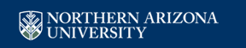
Mandatory – Yippee!
2008 IT Performance Audit
All three state universities MUST provide a security program that includes MANDATORY university-wide security awareness education and training for all users

Slide 21
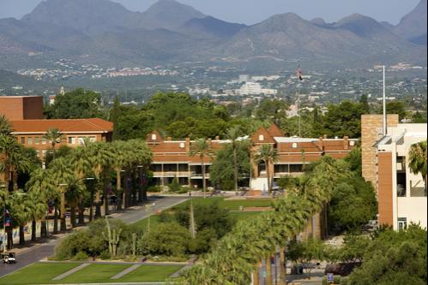
About the UA
29,719 Undergraduates
6,962 Graduates
1,376 Professional/Medical
2,756 Faculty
2,818 Grad Assistants/Associates
8,684 Staff
From UA Fact Book 2009-2010

Slide 22



The Challenge. . . .
How do you roll out MANDATORY Information Security Awareness for ALL EMPLOYEES and. . . .
Make it interesting and relevant?
Get the word out and get buy-in?
Track completion?

Slide 23

Campus-wide understanding of UA policies, requirements, roles and responsibilities
Understanding cyber-threats and best practices for securing computers and data
Incident detection and response procedures
MORE SECURE CAMPUS!

Slide 24
My Only Chance . . . .
Security
Technical
Physical
People
Administrative
Process
To get in front of EVERY employee
To get the message out
Security is everyone’s responsibility
It’s not just about technology
PROTECT
DETECT
REACT

Slide 25
WIIFM
Home Computers/ Personal Use
Why
You are a potential target
Protecting your personal information
It can happen to you!
90/10 Rule
What’s In It For Me?

Slide 26
True Culture Change
KNOWLEDGE
WHY
WHAT
SKILL
HOW
ATTITUDE
WANT

Slide 27
Security Culture
Level 5
CONTINUOUS IMPROVEMENT
Level 4
COMMON PRACTICE
Level 3
INTEGRATION
Level 2
ACKNOWLEDGMENT
Level 1
COMPLACENCY

Slide 28
Identifying Stakeholders
President
Deans, Directors, Department Heads
Governance Organizations
Graduate and Professional Student Council
IT Staff/Net Managers
Information Security Liaisons
Faculty Senate
Appointed Professionals Advisory Council
Staff Advisory Council
Cabinet
All UA Employees

Slide 29


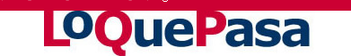
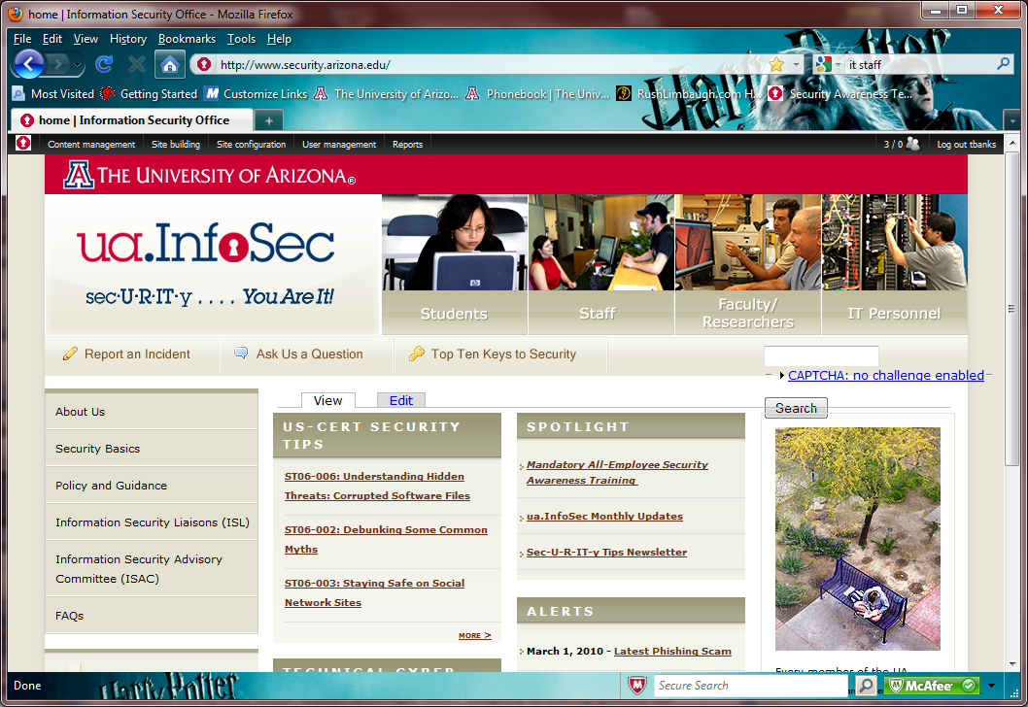
7 Times, 7 Ways
Colleges and Departments
Grad/Professional Students
Faculty Senate
Appointed and Classified Staff
Net Managers
ISLs
ONE
TWO
THREE
FOUR
FIVE
SIX
SEVEN
Net Managers
Deans, Directors, Department Heads
Information Security Liaisons (ISLs)

Slide 30
Challenges
No central method for tracking employee completion , but. . . . .
Has led to effort to develop this
No resources, but hard & fast deadlines, so. . . .
Live & Online
Communication, communication, communication – can’t have too much!

Slide 31
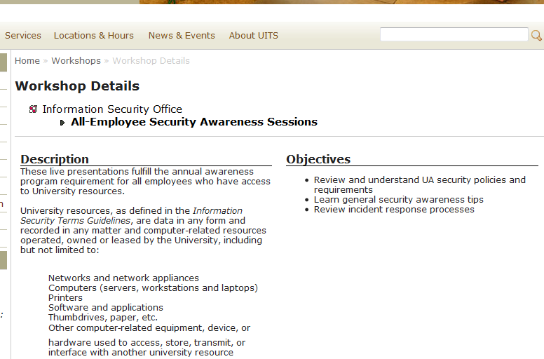
Methodology
Live
General Sessions in high-capacity venues
Departmental Sessions
Performed live and remotely
Kelley presented most, Teresa a few, ISLs helped as well

Slide 32
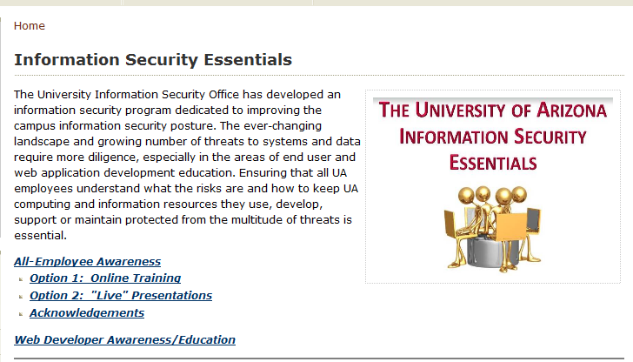
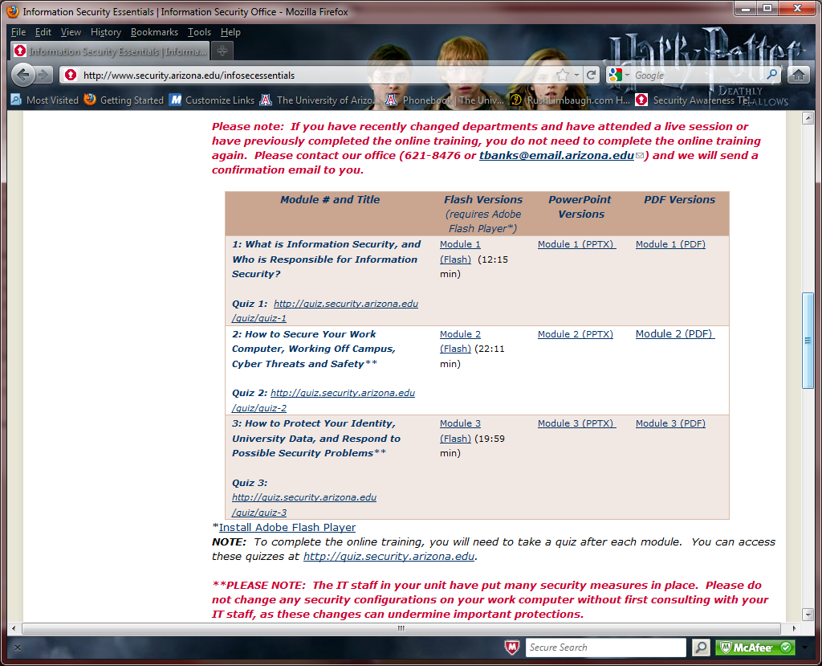
Methodology
Online
Three formats available
Started with PowerPoint
Used Articulate to produce audio version with slides
PDF format for those with special needs

Slide 33
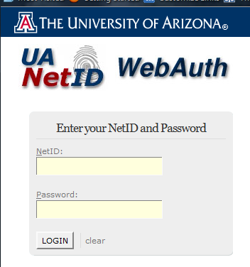
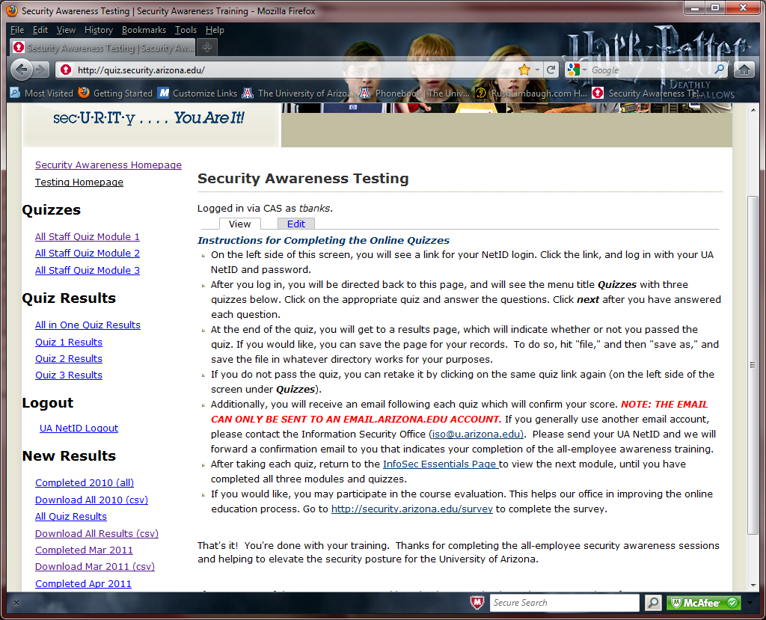
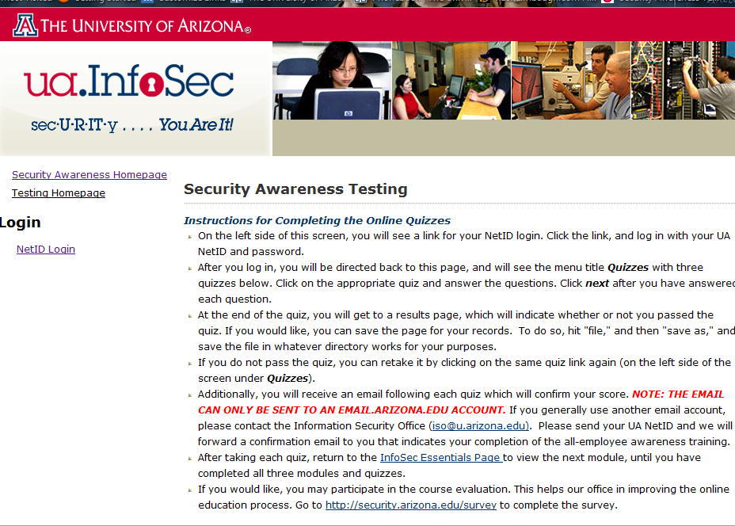
The Dreaded Quizzes. . . .
Separate web page
Log in with using UA NetID and Password (for tracking purposes)
Results downloadable in CSV file for use in database

Slide 34
The Response? 95% Satisfaction!
Excellent explanation, logic and sequence! Great animation. Spoke respectfully to audience.
The course was super easy to understand, easy to navigate and easy to follow.
BTW, thanks for the training. I plan on sharing some of the PowerPoint slides with my wife & teenagers to upgrade their security awareness.
It was a wonderful Information Security training session this morning; I am grateful, as I am sure many, many others are too, to have 'good people' watching out for us.
The online presentations were concise, professional and to the point.

Slide 35

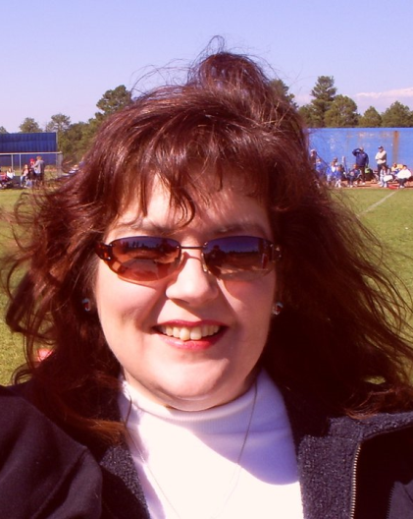
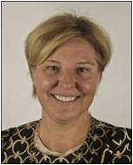
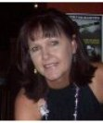
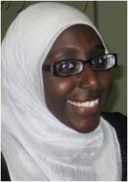
Successes of Program
>10,000 complete!
Increased web page traffic
More phone calls and inquiries to ISO
Greater ISO visibility

Slide 36
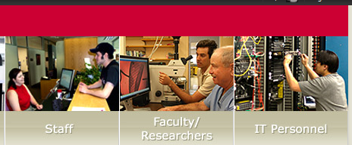
Next Steps
Role-based annual refresher course

Slide 37
University of Arizona
Kelley J. Bogart, CISSP
bogartk@email.arizona.edu
Teresa E. Banks
tbanks@email.arizona.edu
security.arizona.edu /educause2011

Slide 38
Questions?

