Slide 1

Network Segmentation: Virtual Routing Implementation
“Layers, Donkey.”
Jeff Kell jeff-kell@utc.edu
University of Tennessee At Chattanooga

Slide 2
Copyright Jeff Kell, 2011. This work is the intellectual property of the author. Permission is granted for this material to be shared for non-commercial, educational purposes, provided that this copyright statement appears on the reproduced materials and notice is given that the copying is by permission of the author. To disseminate otherwise or to republish requires written permission from the author

Slide 3
Networking by the Numbers
20,084 wired ports
582 switches/routers
342 wireless access points
17,191 registered MAC addresses
4,311 unregistered MAC addresses
6 FTE (2 E&G, 3 Tech Fee, 1 Stimulus)

Slide 4
Agenda
Why virtualize? (What, Me Worry?)
Classic segmentation
VRF Overview
VRF Proof-of-Concept Case Example
Design challenges
Network evolution
Implementation methodology

Slide 5
Virtual Routing? Really?
Isn’t this just one big happy trusting net?

Slide 6
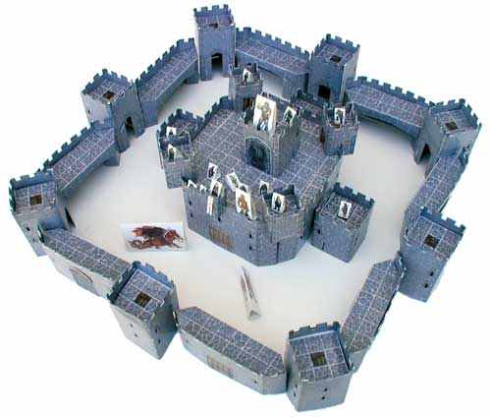
Legacy “closed” systems
Enterprise data center
Testbeds, research
Alarms
Phones
HVAC
Video
Phones
Card swipes
Access controls
Point of sale
Departmental services
“It’s Just for the Office”
Printers
Faxes
Multifunction
File sharing
Data archiving
Hubs/switches/routers

Slide 7

Trendy “open” systems
Web services (and wikis, blogs, photos, social networking)
Email and messaging (PDAs / smart phones)
Application portals
Remote desktop access
Webcams

Slide 8

Dash of “mobile access”
Not Just Laptops
PDAs / smart phones / Steve Jobs imagination / Droids
Wireless (802.11-whatever)
EVDO/3G/4G/etc

Slide 9
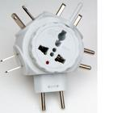
Add “plug and pray”
Windows
NetBIOS / SMB
UPnP
PNRP
Vista / Win7
IPv6 discovery
WPAD
ISATAP
Teredo
LLTD
Apple
Rendezvous/Bonjour
mDNS
Airport autoconfig

Slide 10


Mix well…
Common networks / vlans
Windows ICS / Bridging
Wireless automatic associations
“Found a jack, got a link light”
User hubs/switches/routers/WiFi

Slide 11
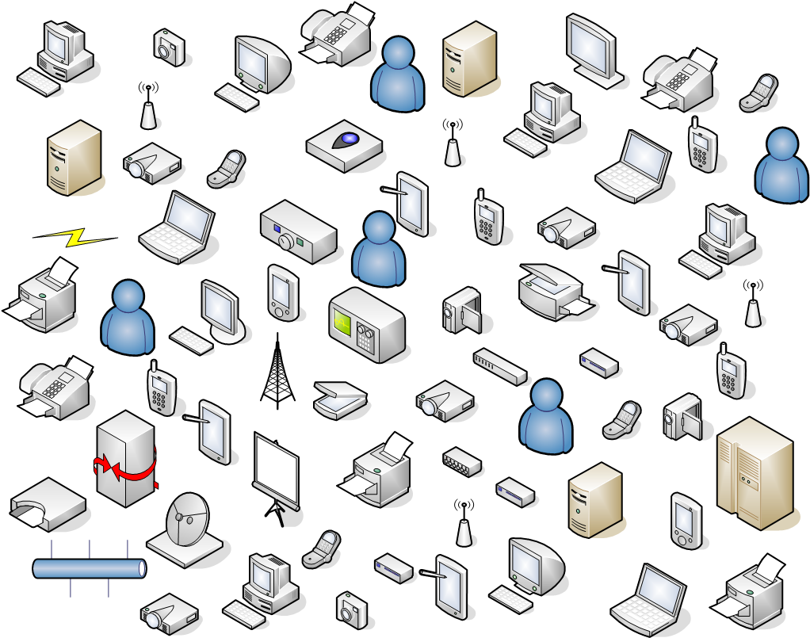
Look Familiar ?
Notes:
University network was growing increasingly “homogeneous”. Despite efforts to maintain original design (student vs faculty/staff) this was not always maintained. Anything that was plugged into the network and initially worked was never mapped or identified. Rapid expansions spread networks originally intended for specific buildings across campus. Only EMCS and UC maintained a building perimeter.
Many “surprise” devices appeared in arbitrary locations on arbitrary networks – vending machines, cameras, point-of-sale terminals, printers (GoPrint, departmental, Xerox then Ikon), video recorders, HVAC controllers, power meters, power switchgear monitoring, digital signage, webcams, door access panels, phones, possibly others we still haven’t identified.
The underlying risk here is the lack of application / security classification boundaries.
Sometimes this is intentional -- we host “orientation overrides” in student labs. That was a security oxymoron. If the “override” areas are identified to Bradford, we can avoid this network access conflict in the future.

Slide 12
“Gems” from the PCI Standards
1.1: HTTP, SSH, SSL, VPN permitted
1.2: Default deny
1.3: Stateful inbound and filter egress
1.5: RFC1918 / IP Masquerading (NAT) is required
2.3: non-console admin access must be encrypted, unencrypted admin channels must be disabled
5.1: Antivirus required (clients and servers)
5.1.1: A/V deployed is capable of detecting, removing and protecting against Spyware and Adware
8.3: Remote access requires two factor authentication

Slide 13
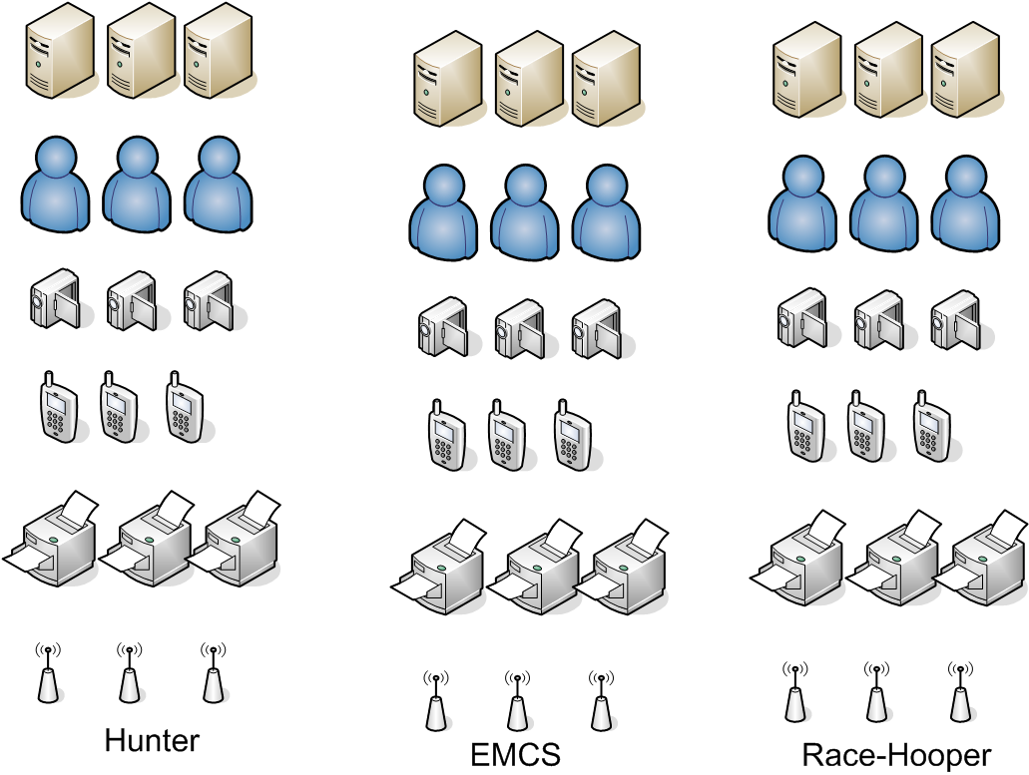
Pie in the sky segmentation?
Notes:
The new network architecture is designed to segregate the network into manageable segments, both from a network and security perspective.
Vertical separation between buildings for network isolation and management.
Horizontal separation by device types, roles, or security classification.
A given port can participate in any valid role (for the building).
A given role can move from one building to another (where permitted).

Slide 14

Recurring theme: Minimize Exposure
Minimize visibility (period)
Private networks, subnets
Minimize exposure
Only required services
Avoid cleartext in public
Minimize advertisements
DNS / SMB / PnP
Scanning (well-known ports)
Web crawlers / google hacking

Slide 15

Original model – “Tootsie Pop”
Perimeter firewall
Border router ACLs
Hard on the outside
Soft and chewy on the inside…

Slide 16

Updated model – “Onion”
Perimeter firewall / IPS
Border router ACLs
Server farm firewall / IPS
Host-based firewall
“Layers”

Slide 17
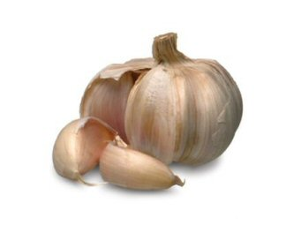
New security model – “Garlic”
Common “root” of public services (web, mail, etc)
Core divided into “cloves” of functionality
Relatively independent groups of users and services
May share a common “stem” of infrastructure (DNS, DHCP)

Slide 18
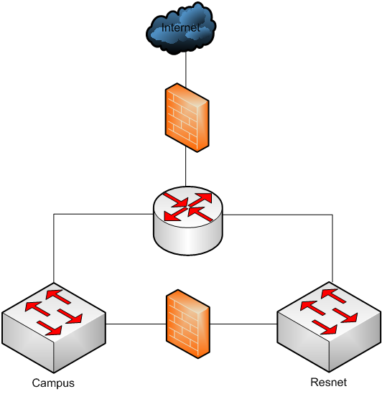
Typical separation: ResNet
Campus / Resnet each have their own infrastructure
May share outside connectivity
May have a direct link
Can be applied to other “customers” with primarily edge connectivity only

Slide 19
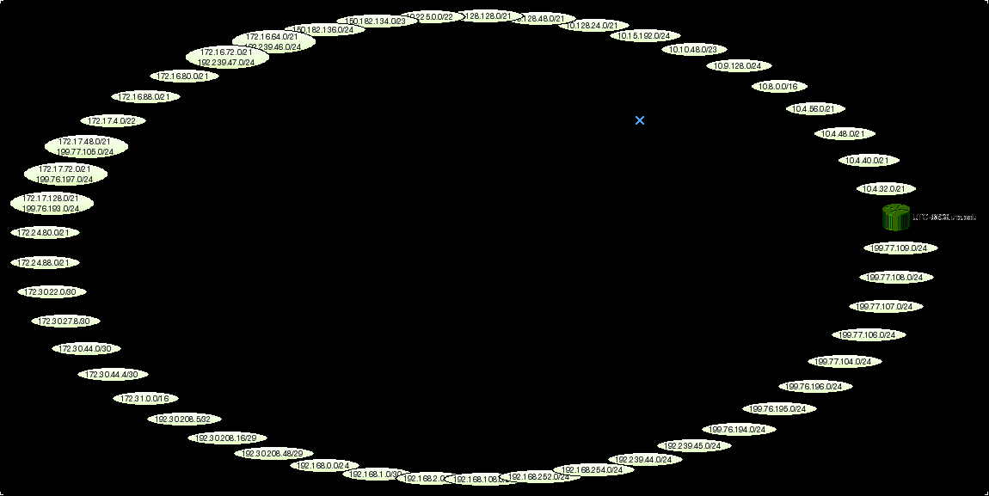
Real World: Campus INTERnet
Isolation is difficult
Campus core often “fully meshed”
Separation by ACLs increases complexity geometrically by number of routed interfaces
No way to easily group or isolate related subnets
Or is there?

Slide 20
VRFs and VRF-Lite
Virtual Routing and Forwarding
In a Nutshell…

Slide 21
Virtual Routing vs Virtual LANs
Layer 2 Virtual LANs
Layer 3 Virtual Routing
Simulates multiple physical switches on single hardware
Unique MAC address tables for each VLAN
Interconnections managed by a router (SVI or external)
Linked by “trunks”
Simulates multiple physical routers on single hardware
Unique routing tables for each VRF
Interconnections managed by a “Provider Edge [PE]” router
Linked by:
Trunks (VRF-lite)
Tunnels (VRF-lite)
MPLS

Slide 22
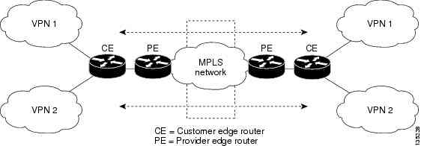
Virtual Private Networks (no, not that little app you use off-campus)

Slide 23
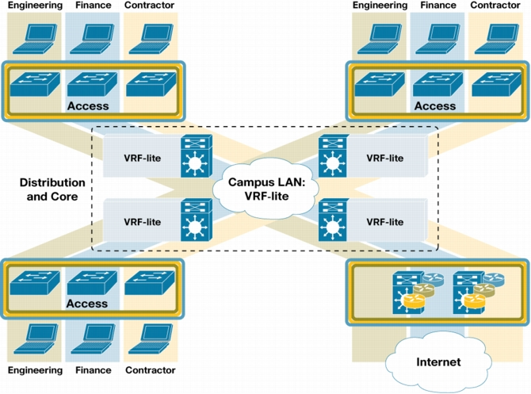
Overview (Plagiarizing Cisco)

Slide 24
Virtualizing Your Network Divide and Conquer (copyright notice as required below) EDUCAUSE & Internet2 Security Professionals Conference April 10-12, 2007
Copyright Robert E. Neale 2007. This work is the intellectual property of the author. Permission is granted for this material to be shared for non-commercial, educational purposes, provided that this copyright statement appears on the reproduced materials and notice is given that the copying is by permission of the author. To disseminate otherwise or to republish requires written permission from the author.

Slide 25
High Level Backbone Logical Design (VCU)
Notes:
Existing mesh of L3 Dist. switches broken and connected to new core of MPLS “P” routers
Dist. switches become MPLS PE routers and dual-homed into diverse P routers (Catalyst 6500)
User Groups separated and organized into segmented VRFs

Slide 26
Distribution/Core Options
VRF-Lite: dedicated P2P vlans on traditional trunk
No [particularly] special hardware required at all
Tunnels: arbitrarily extend VRFs over legacy (or public) internet via GRE or similar tunneling protocol
No “official” Catalyst support (other than 45/65/76xx)
Possible scaling issues (hardware dependent)
True MPLS: encapsulated VRF trunk
Even greater complexity and cost

Slide 27
Hardware Requirements
No special Layer-2 access hardware requirements, anything that normally handles vlans / trunking is fine
Layer-3 switches supporting more than 1 VRF require at least VRF-lite (only have experience with Cisco)
All L-3 Catalyst (IOS) switches except early 45xx/65xx
6500 Supervisor II will not assign SVIs to VRFs, only interfaces
Most router platforms at least back to IOS 11
Quick test: configuration mode
UTC-3640(config)#ip vrf ?
WORD VPN Routing/Forwarding instance name
Does require “EMI” / IP Services license to create VRFs

Slide 28
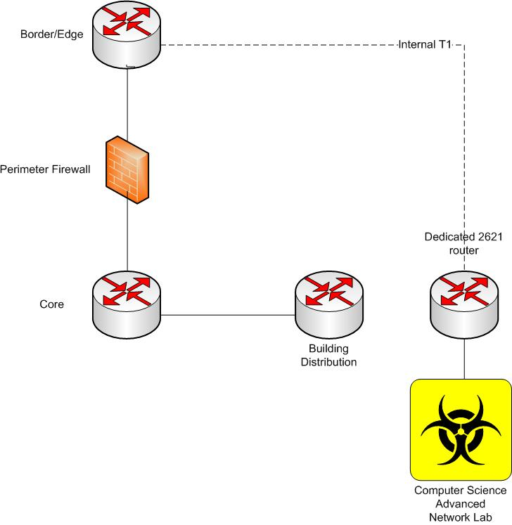
Live, practical example (before)

Slide 29
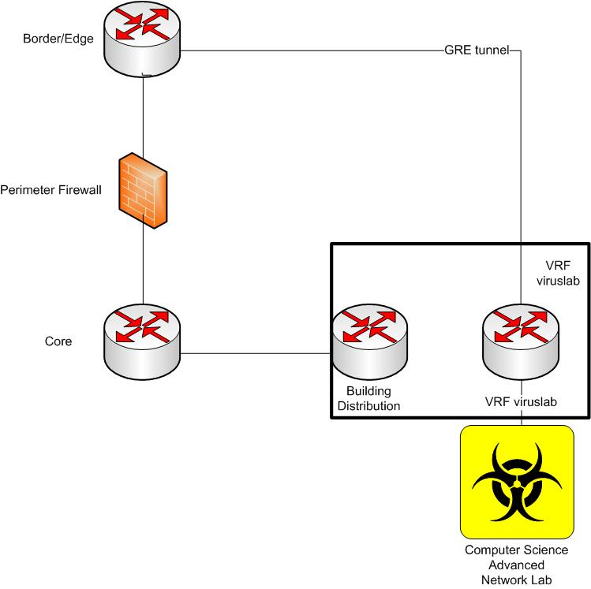
Live, practical example (after)

Slide 30
EMCS Virus lab islation
Lab occupies public internet space
74.yy.xx.xx/26
Must remain hidden from campus
(while on campus)

Slide 31
Legacy view of EMCS router
EMCS-3W-Uplink#sho ip route connected
192.xx.yyy.0/24 is variably subnetted, 21 subnets, 4 masks
C 192.xx.yyy.zz/32 is directly connected, Loopback1
172.30.0.0/16 is variably subnetted, 17 subnets, 2 masks
C 172.30.46.4/30 is directly connected, GigabitEthernet1/2
C 172.30.46.0/30 is directly connected, GigabitEthernet1/1
10.0.0.0/8 is variably subnetted, 63 subnets, 8 masks
C 10.46.32.0/20 is directly connected, Vlan32
C 10.46.48.0/20 is directly connected, Vlan48
C 10.46.4.0/22 is directly connected, Vlan4
C 10.46.0.0/23 is directly connected, Vlan101
C 10.46.2.0/23 is directly connected, Vlan2
C 10.46.8.0/21 is directly connected, Vlan8
C 10.46.16.0/20 is directly connected, Vlan16
EMCS-3W-Uplink#

Slide 32
VRF view of EMCS router
EMCS-3W-Uplink#sho ip route vrf emcs-lab connected
192.xx.yyy.0/24 is variably subnetted, 15 subnets, 3 masks
C 192.xx.yyy.zz/30 is directly connected, Tunnel0
74.0.0.0/8 is variably subnetted, 2 subnets, 2 masks
C 74.yy.xx.xx/26 is directly connected, GigabitEthernet2/47
EMCS-3W-Uplink#sho ip route vrf emcs-lab 0.0.0.0
Routing entry for 0.0.0.0/0, supernet
Known via "static", distance 1, metric 0 (connected), candidate default path
Routing Descriptor Blocks:
* directly connected, via Tunnel0
Route metric is 0, traffic share count is 1
EMCS-3W-Uplink#

Slide 33
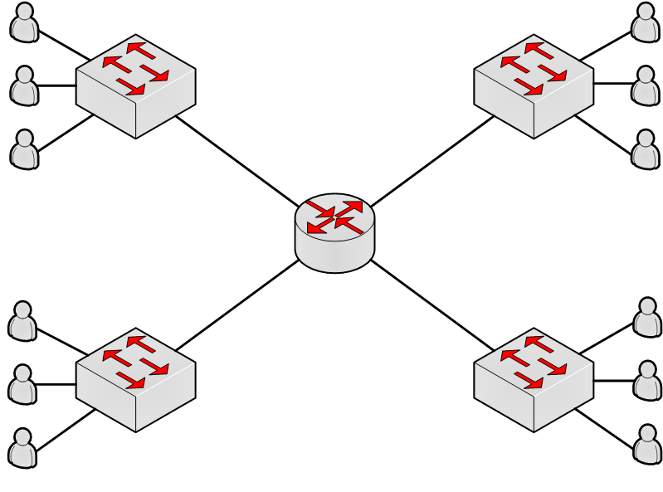
Network evolution (quickly)
Flat network origins (one router!)

Slide 34
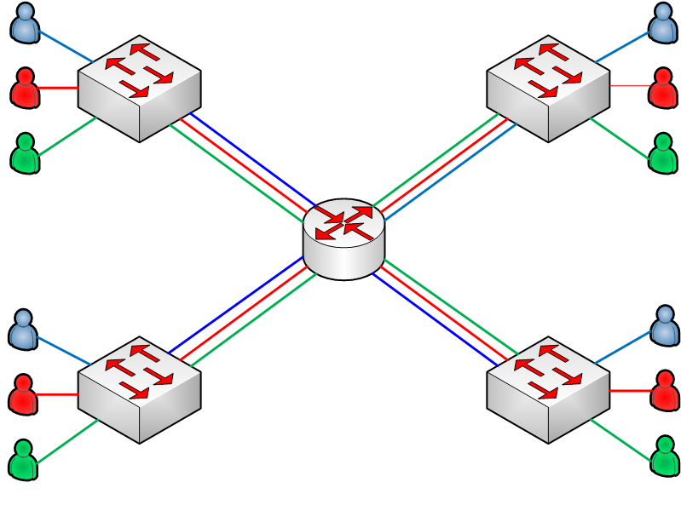
Flat, with vlans + trunks

Slide 35
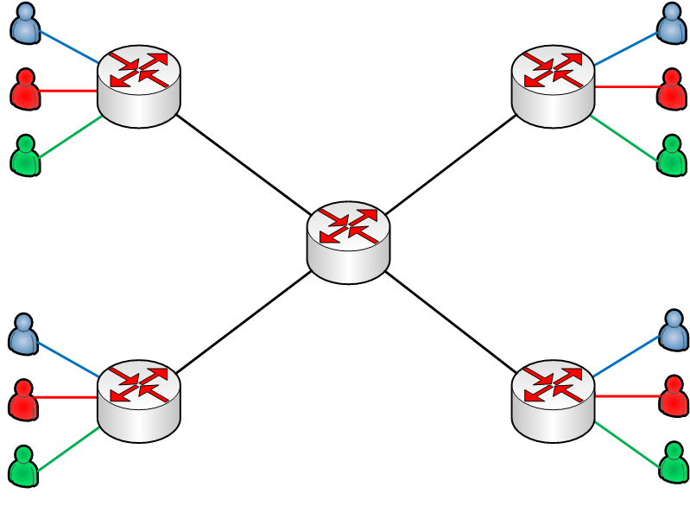
Routed and/or remote distribution

Slide 36
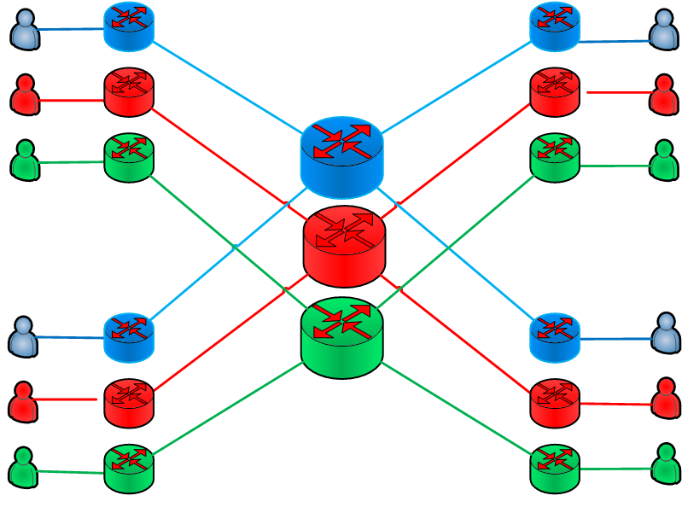
Target VRF (isolated Layer3)

Slide 37
VRF design “challenges”
General VRF template
How to start (from a traditional network)
External connectivity (without backhaul)
Internal connectivity to common services
Specific exceptions for inter-VRF access

Slide 38
Addressing conventions
RFC 1918, non-overlapping
Backbone vlans (one per VRF, per path)
Per building or routed node
Service vlans (grouped per VRF)
End-user vlans (grouped per VRF)
Device vlans (grouped per VRF)

Slide 39
Backbone (P2P or ring?)
Need MPLS or Trunk (MPLS = $$$$)
Routed physical interface only does one VRF/net, routers can do sub-interfaces
Catalyst limitations on sub-interfaces rules out routed physical interfaces
We chose SVIs and 802.1Q trunks
P2P requires one SVI/vlan per remote node and gets very complicated very quickly

Slide 40
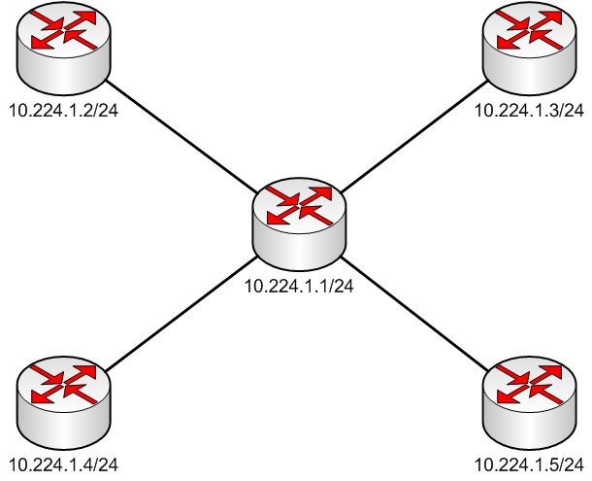
Hub/spoke SVI “ring”

Slide 41
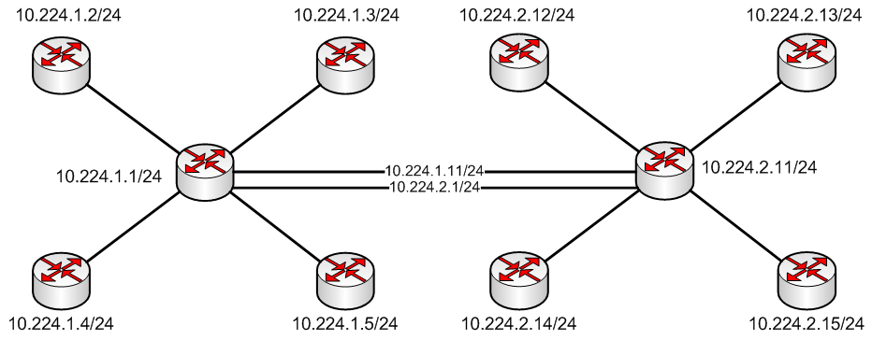
Multiple nodes / Multiple rings

Slide 42
Start: Import legacy as VRF!

Slide 43
VRF “Template”
VRF name and routing identifier (route distinguisher)
16-bit ASN : 16-bit identifier
32-bit IPv4 router IP : 16-bit identifier
UTC uses ASN : VRF-identifier
Vlan number used for the backbone
Used as ASN for internal routing protocol

Slide 44
Bring a trunk over from legacy
ip vrf legacy
rd 14209:810
interface Vlan810
description Legacy network ring 1
ip vrf forwarding legacy
ip address 10.225.1.1 255.255.255.0

Slide 45
Bring IGP routes from legacy
router eigrp [PE-base router ID]
!
address-family ipv4 vrf legacy
autonomous-system 1
network 10.225.0.0 0.0.0.255
no auto-summary
exit-address-family

Slide 46
Migration strategy
All routed P2P nodes converted to trunks
Introduce VRFs into the routed nodes
Trunk VRF backbone vlans over to legacy, or
Introduce new CE into the routed node
Legacy vlans stay routed on the legacy core
New VRF vlans are routed at the uplink/CE

Slide 47
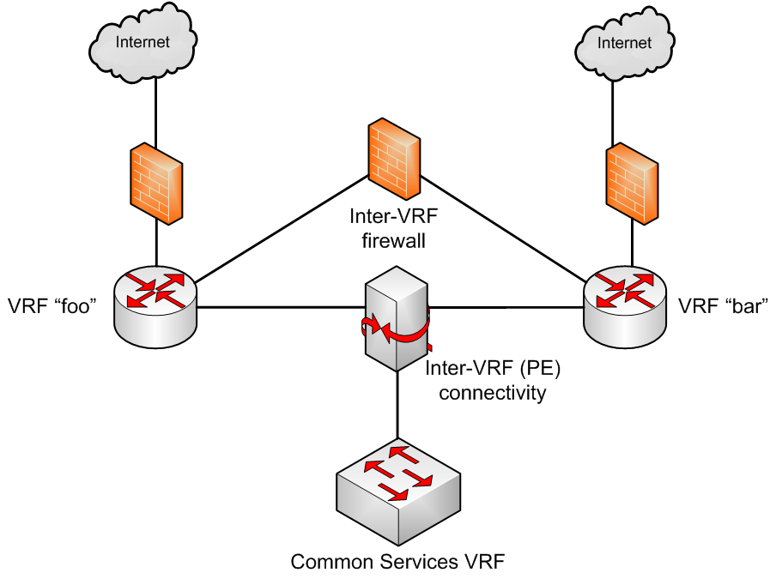
Inter-VRF routing at the PE

Slide 48
Import/Export (BGP implied)
ip vrf utc-services
rd 14209:910
route-target both 14209:910
route-target import 14209:802
ip vrf dorms
rd 14209:802
route-target both 14209:802
route-target import 14209:910

Slide 49
router bgp 14209
address-family ipv4 vrf utc-services
redistribute connected
redistribute eigrp 910
no synchronization
exit-address-family
address-family ipv4 vrf dorms
redistribute connected
redistribute eigrp 802
no synchronization
exit-address-family

Slide 50
Partial Inter-VRF: Import map
ip vrf dorms
rd 14209:802
import map dorm-routes
route-target both 14209:802
route-target import 14209:910

Slide 51
Partial Inter-VRF: redistribute map
router bgp 14209
address-family ipv4 vrf utc-services
redistribute connected
redistribute eigrp 910 route-map
strip-eigrp-defaults
no synchronization
exit-address-family

Slide 52
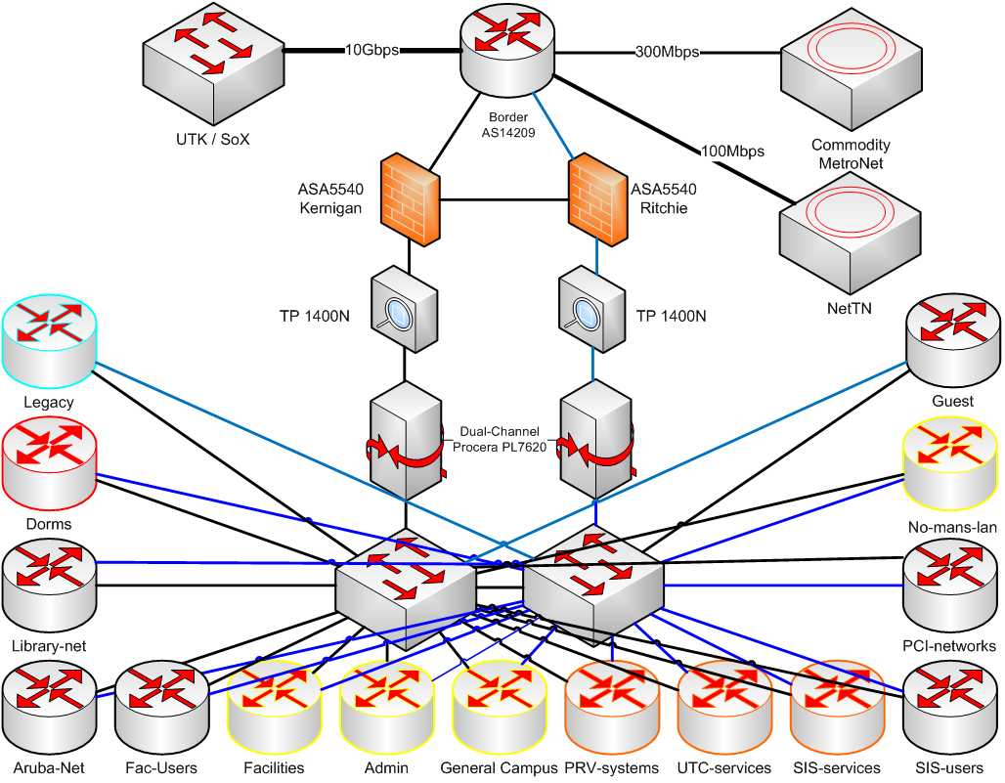
Edge connectivity

Slide 53
Edge implementation
Using Cisco ASAs, active/active failover
One for dorms/wireless, one for campus
ASAs are NOT VRF-aware
VRFs are trunked to the inside interface
One common outside interface for all VRFs
All VRFs set to same security level value
No traffic is allowed by default between same security levels

Slide 54
Edge implementation (2)
You can use a common NAT pool for as many VRFs as you wish (per context)
You can static NAT multiple VRF/hosts into common outside subnets (e.g., web servers) to simplify ACLs
Two primary contexts here (but I have seen examples of a context per VRF)

Slide 55
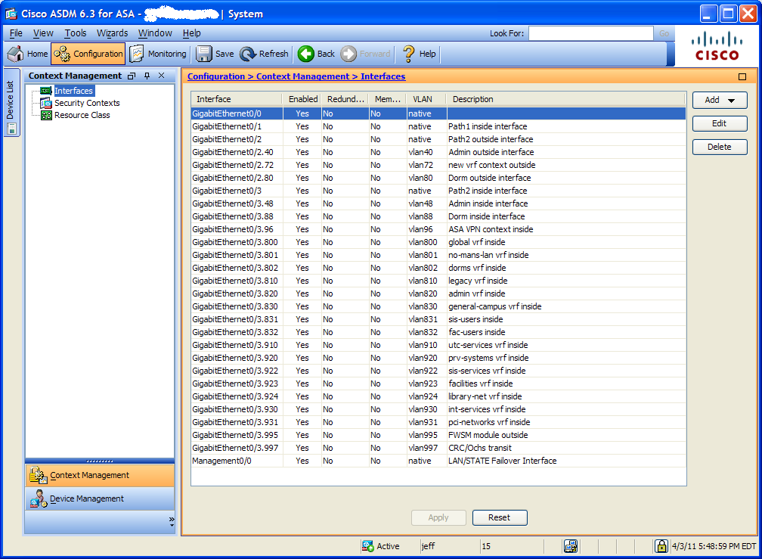

Slide 56
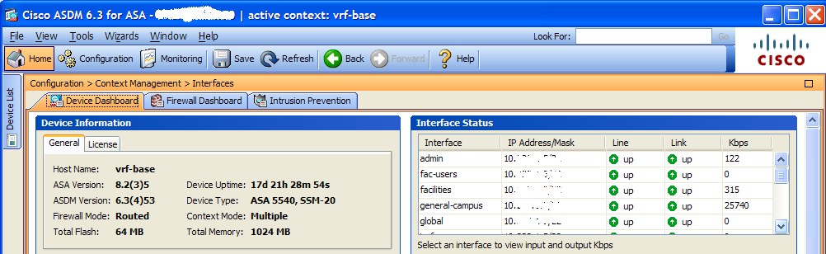
VRF stats maintained at ASA

Slide 57
Other Edge considerations
Trunks pass through Procera Packetlogic
PL handles the trunked traffic just fine
Can classify / shape / etc based on vlan tag
Trunks pass through TippingPoint IPS
TP handles the trunked traffic just fine
Can define “virtual interfaces” based on vlan and apply specific policies and exceptions
Snort/Bro/etc: Span trunk to a non-trunk destination port strips the vlan tags (or define ‘encap dot1q’ and keep tags)

Slide 58
The Fatal “Gotcha”
Pretty much impossible to route VRF to global, or global to VRF
Best to keep global for management/infrastructure only
Some high-end router IOS allows statics to cross global
Catalysts can do statics IF the next hop address is on another device (kludgy)
You will want to mix into your inter-VRF firewall mix (we use FWSM as do most examples)
You could do this with external firewall, or port-to-port cabling (*cough*) [yes, before we got the FWSM]

Slide 59
Currently Active VRFs
Admin
Aruba-net
Dorms
Facilities-users
Facilities
General-campus
Internal-services
Legacy
Library-net
No-mans-LAN
PCI-networks
ITD-Networks
ITD-Systems
Public-services
SIS-services
SIS-users
UTC-services
EMCS-lab

Slide 60
Whew!
Questions?
Comments?
Snarky remarks? ☺
Jeff-Kell@utc.edu

