Slide 1
How Tokenization and Point-to-Point Encryption Can Reduce PCI Scope
EDUCAUSE Security Professionals Conference
Indianapolis
May 15, 2012
Seminar 01-P

Slide 2
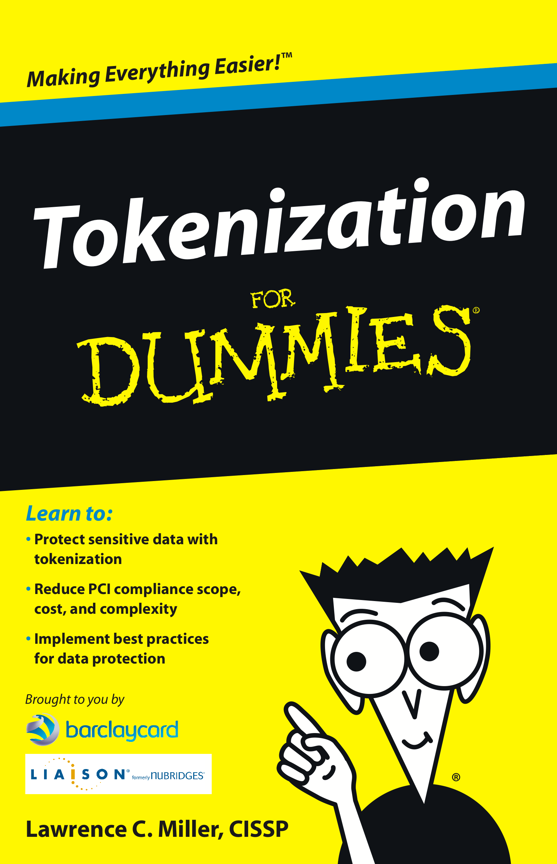
Agenda
1.00 – 2.30: Tokenization
  Tokenization and PCI
  Use cases
  The basics
  A “Buyer’s Guide”
  What is right for your school?
3.00 – 4.00: P2PE
  How P2PE works
  Benefits – P2PE and PCI
  What you need to know
  A P2PE buyer’s guide?
  What is right for your school?
4.00 – 4.30: Q&A

Slide 3
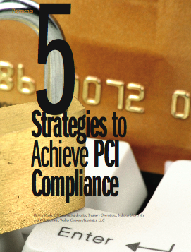

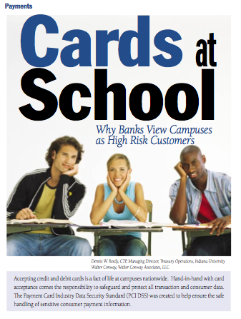
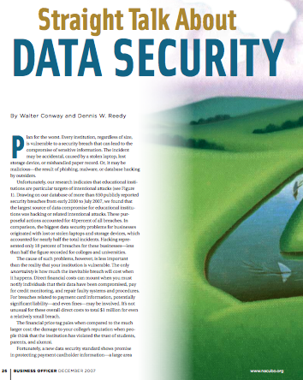

Walt Conway and 403 Labs, LLC
PCI Qualified Security Assessor (QSA), consultant, blogger, trainer, speaker, author
  Former Visa VP
  Help schools become PCI compliant
  Represent NACUBO at PCI Council
403 Labs is a security consulting firm
  All things PCI: QSA, PA-QSA, ASV, PFI

Slide 4
Part 1: Tokenization
Introductions (What do you want to know?)
Tokenization and PCI
Tokenization use cases
Tokenization basics
A tokenization “Buyer’s Guide”
What is right for your school?

Slide 5
Some PCI DSS Basics
Payment Card Industry Data Security Standard
Goal is to protect Cardholder Data
  And to keep you out of the headlines
  PCI does not make you secure
If you take plastic, PCI applies to you
  “Store, process, or transmit” cardholder data
PCI is a program, not a project
Two things you need to accept about PCI
  Your costs have gone up
  You will change the way you do business

Slide 6
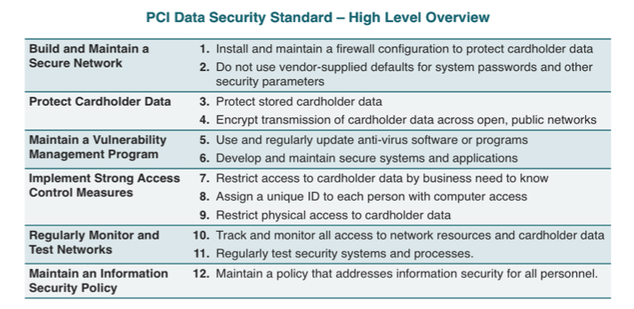
PCI DSS: 6 Goals, 12 Requirements

Slide 7
PCI Ecosystem
P2PE
Manufacturers
PCI PTS
Pin Entry Devices
Software Developers
PCI PA-DSS
Payment Applications
Merchants & Service Providers
PCI DSS
Secure Environments
PCI Security
P2PE
Ecosystem of payment devices, applications, infrastructure and users

Slide 8
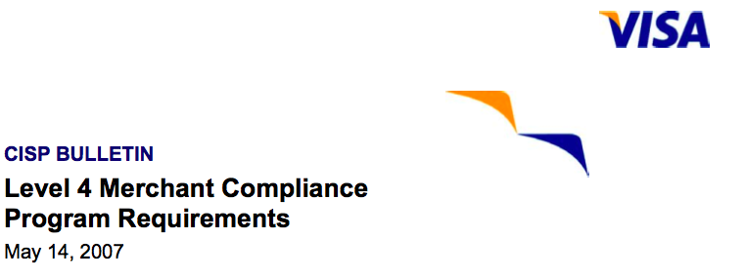
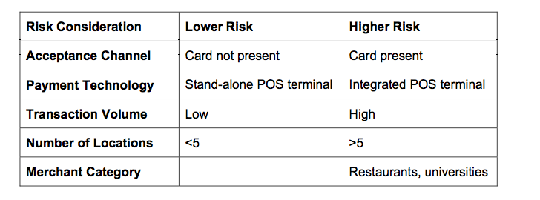
Who are the High Risk Merchants?

Slide 9
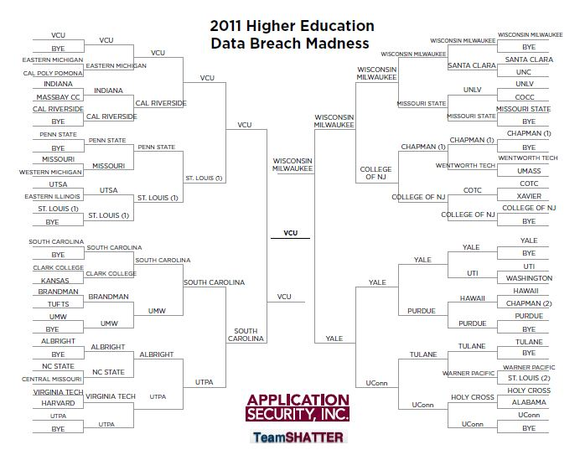
Who are the High Risk Merchants?

Slide 10

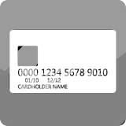




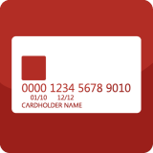
PCI Council Guidance
Mobile
P2PE
Virtualization
Wireless
Tokenization
Telephone-based
Payment Card Data
EMV

Slide 11
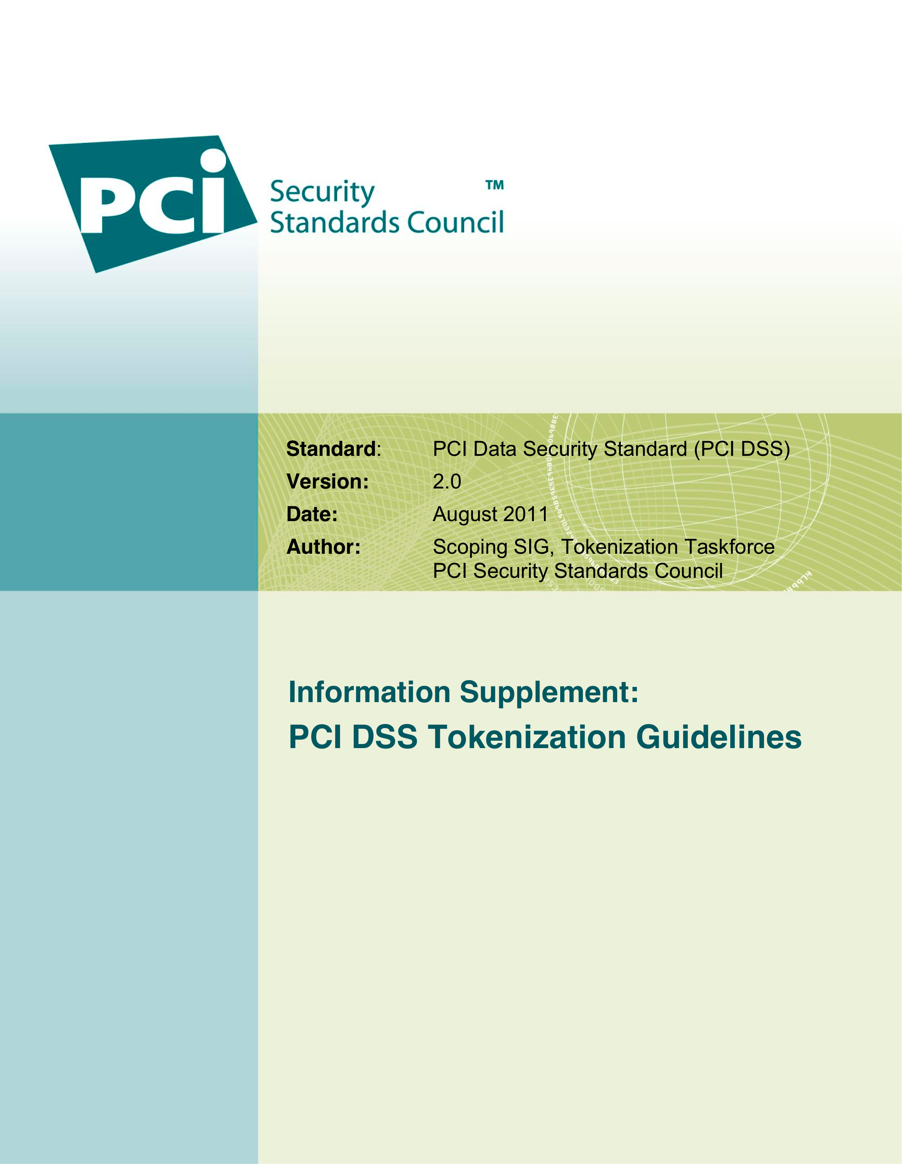
Tokenization and the PCI Council
Tokens can reduce scope
  “The level of PCI DSS scope reduction offered by a tokenization solution will also need to be carefully evaluated for each implementation.”
“High-value” tokens may be in scope
  Used as a payment instrument
  Initiate a transaction

Slide 12
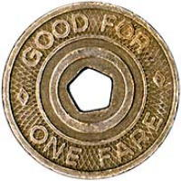
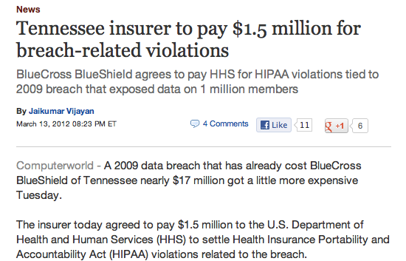
Tokenization
Replacing a valuable piece of information with a surrogate value, or token
  In a PCI context, replacing PAN data with random number strings
Tokenization is not encryption
Why tokens?
  Reduce PCI scope
  Lower cost of PCI compliance
  Increase security
Tokenization for other PII
(e.g., HIPAA)

Slide 13
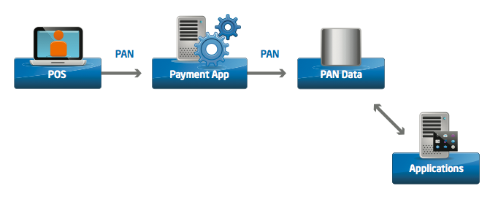
Tokenization Use Cases
PCI scope without tokenization
  Everything is in PCI scope

Slide 14
Tokenization Use Cases
Tokenization: A data security technology in which strings of random characters – tokens – can be used in lieu of other, more valuable data, such as PANs
Tokenization replaces PAN with surrogate value, or “token”
Token engine and vault are in PCI scope, but post-payment applications may be out of scope

Slide 15
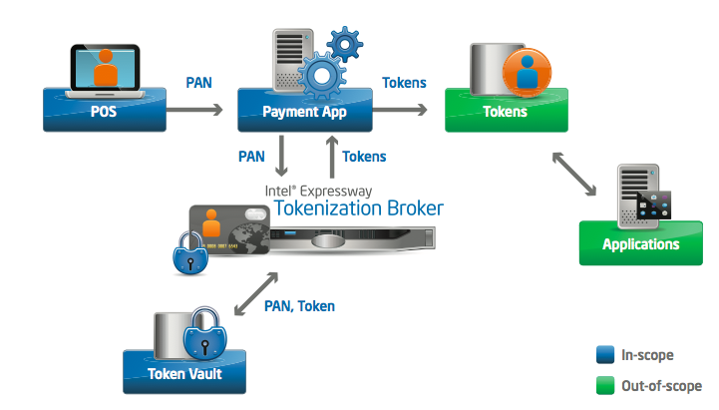
Tokenization Use Cases
Many merchants will host their own token vault
  Home-brewed
  Purchase from third-party provider

Slide 16
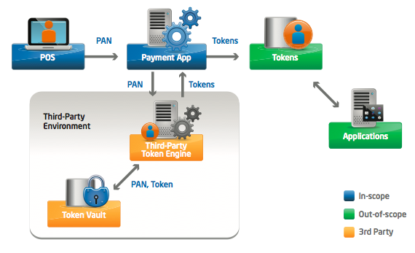
Tokenization Use Cases
Tokenization can be outsourced: processor

Slide 17
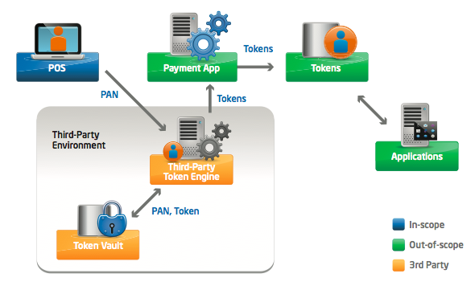
Tokenization Use Cases
Tokenization can be outsourced: 3rd party
  Get as close to POS as possible

Slide 18
Some Details – Construction
Above all, token cannot be reversed
How much to tokenize?
  e.g., keep first six, last four
Random numbers are best
  Replace PAN with string of random numbers
One-way hash
  Non-reversible mathematical function (salt!)
Encryption
  Potentially reversible
Home-grown (sequence numbers), other approaches
  Not recommended

Slide 19
Crypto and Hashes and PANs, Oh My!
Primary Account Number (PAN) | 4111 1234 5678 9012 | In Scope
Truncated PAN (not masking!) | 4111 12XX XXXX 9012 | Out of Scope
Hashed PAN | d41d8cd98f00b204e9800998ecf8427e | Usually Out of Scope (PCI 2.0)
Encrypted PAN | 9Ojr73h3d^&hh#&HFH&##ED*HD#* | Almost always In Scope
Token | 9483 7266 3928 9819 | May be Out of Scope

Slide 20
Some Details – Format
Format preserving tokens
  Same length as PAN
  May pass Luhn/Mod 10 check
  Apps may require PAN format
Issue: token collisions
  Apply “anti-Luhn” process?
  Avoid ISO 7812 range

Slide 21
Some Details – Type
Single-use, or one-time token
  Each token is unique
  Same card, same merchant yields
  different tokens
Multi-use, or one-to-one token
  Same token each time the same card is
  presented at POS
Each has advantages/disadvantages
Decision depends on how you will use tokens

Slide 22
Some Details – Management
Avoid token collisions
  Restricting space may mean you
  run out of tokens
Required: distinguish token from
a live PAN
  Another reason to avoid ISO 7812
Token lifetime
  How long do you need to keep the data?
  How frequently are cards replaced?

Slide 23
Some Details – Encryption
A complicated relationship
  Each is different
  Tokenization depends on encryption
  to protect token vault
Biggest difference: PCI scope
  Encrypted data in scope
  Tokens may be out of scope
Point-to-point encryption (P2PE)
  Different from tokenization
  Alternative to (not a substitute for) tokenization

Slide 24
Some Details – “High-Value” Tokens
Tokens that can be used as payment instruments (sometimes called “high-value tokens”) could potentially be “monetized” or used to generate fraudulent transactions, and may therefore have the same value to an attacker as the data they are intended to replace.
Tokenization solutions which support these types of tokens should have additional controls in place to detect and prevent attempted fraudulent activities.
Additionally, tokens that can be used to initiate a transaction might be in scope for PCI DSS, even if they cannot directly be used to retrieve PAN or other cardholder data; merchants should therefore consult with their acquirer and/or the Payment Brands directly to determine specific requirements for tokens that can be used as payment instruments.

Slide 25
Some Details – “High-Value” Tokens
High-value tokens may be in scope
  Token can be used as a payment instrument
  Token can initiate a transaction
Examples???
  A single-use card (or similar proxy)
  PayPal account tied to payment card
  Others…

Slide 26

Tokens and PCI Council
Tokens must not be reversible
Token only has value in defined, limited environment
Tokenization can reduce – not eliminate – PCI scope
  Tokenization engine and token vault will be in scope
  Token database may be out of PCI scope
  Downstream applications may be out of PCI scope
“High-value” tokens may be in scope

Slide 27
Tokens and PCI Scope
PCI starting point: everything is in scope
If PAN is retrievable, tokens are in scope
Even if you outsource, you are responsible
Guaranteed to be in scope:
  Tokenization engine (and application)
  Token vault
  De-tokenization application(s)
Systems using tokens may be out of scope if:
  Cannot request PAN from token
  Tokens not computationally reversible (random generation)
  Isolated from CDE (means token database not in CDE, either)
  If not isolated, tokenization may reduce compliance effort

Slide 28
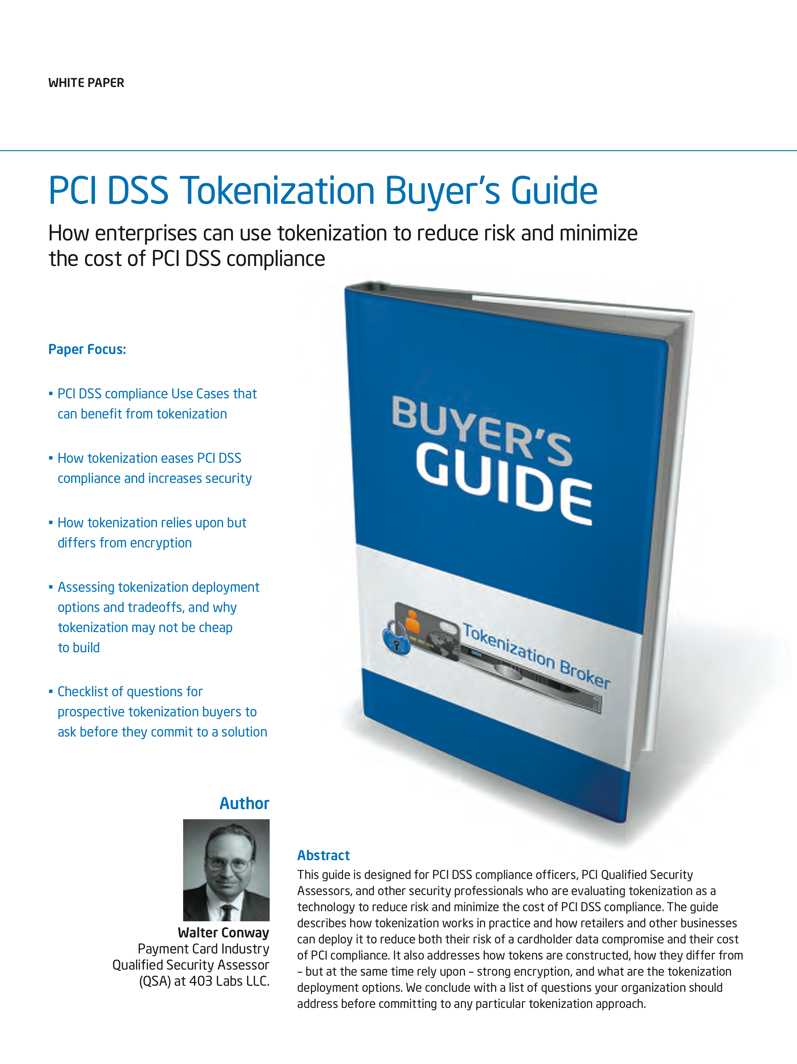
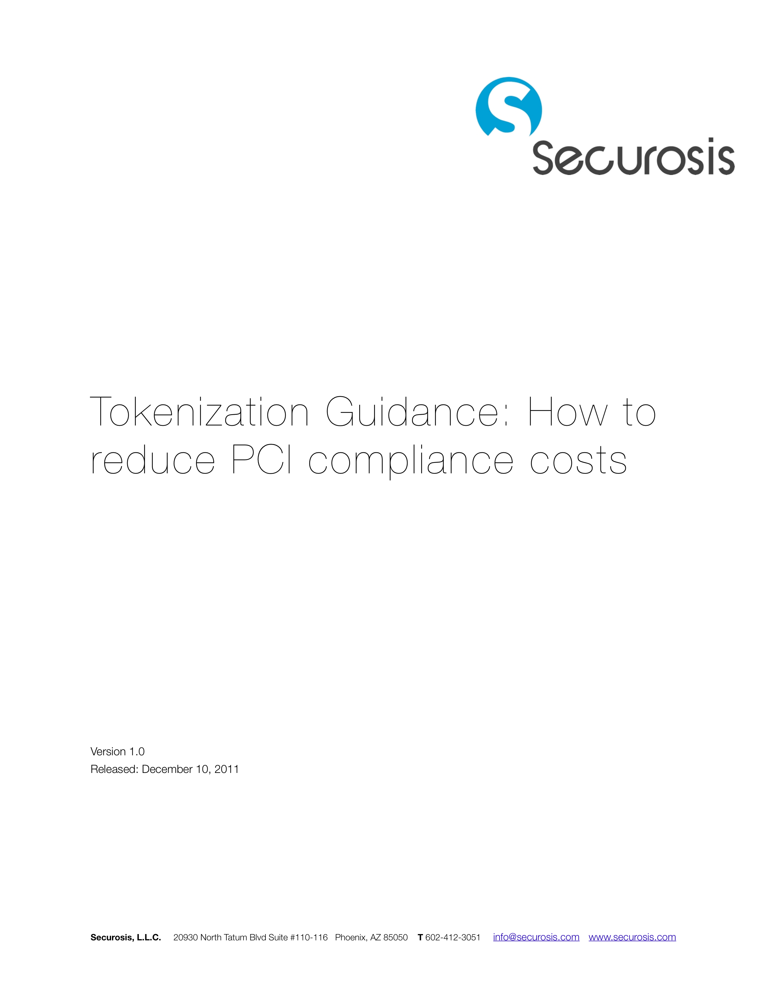
Buyer’s Guides

Slide 29
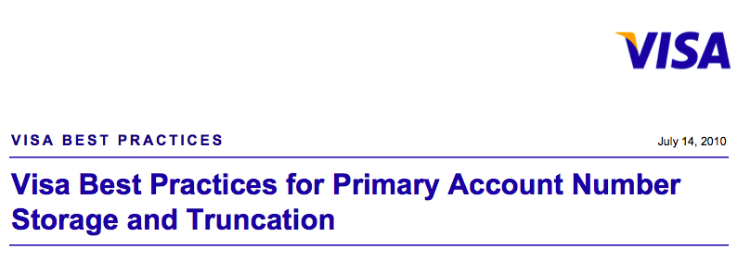
Our Tokenization Kickoff
Who called this meeting?
Why do we need tokenization?
  Do you need the cardholder data?!
    Recurring payments – call your processor
    Chargebacks and refunds – processor can help
    Payment application stores the data – reconfigure?

Slide 30
Our Tokenization Kickoff
Have we found all applications and cardholder data?
  Network diagram
  Cardholder data flow diagram
Have we REALLY found all our apps and data?
  Automated data discovery tool
  Search servers, user endpoints, user-owned devices
  Data leakage to out-of-scope devices (“unknown unknowns”)
Will tokens break any POS applications?

Slide 31
Our Tokenization Kickoff
Which implementation?
Tokenization Option | Advantages | Disadvantages
Internal, Home Grown | Control Cost | Security a core strength? Time to implement
Internal, Package | Control Flexibility Time to implement Expertise/functionality | Cost
3rd Party, Processor | Easy implementation Good PCI scope reduction | Cost Limited flexibility Compatibility with apps Vendor lock-in
3rd Party, Token Vendor | Easy implementation Good PCI scope reduction | Cost Limited flexibility Compatibility with apps Vendor lock-in Business risk (12.8)

Slide 32
Our Tokenization Kickoff
How will we (or partner) generate tokens?
  Random numbers (recommended)
  One-way hash
  Encryption
  Home-grown
What kind of tokens?
  Single-use, or one-time
  Multi-use, or one-to-one
  Format preserving
How will we use tokens?
  Reference values or PAN proxy for transactions

Slide 33
Our Tokenization Kickoff
How will we manage tokenization?
  Security, security, security – tokenizing, de-tokenizing, vault
  Token life, recycling
  Tokenizing legacy data
How will we manage any third party?
  Stickiness vs. flexibility
  Token portability
  Business risk
  Management of segregation of duties, access controls, etc.
  PCI Requirement 12.8 is your friend
How much will we (really) reduce PCI scope?

Slide 34


Where is My Silver Bullet?
Tokenization is exciting technology
  Can reduce PCI scope and increase security
Tokenization requires security expertise
  Constructing and managing tokens
  Encryption, key management
  Physical and logical security of the token vault
PCI Council guidance is just that: guidance

Slide 35
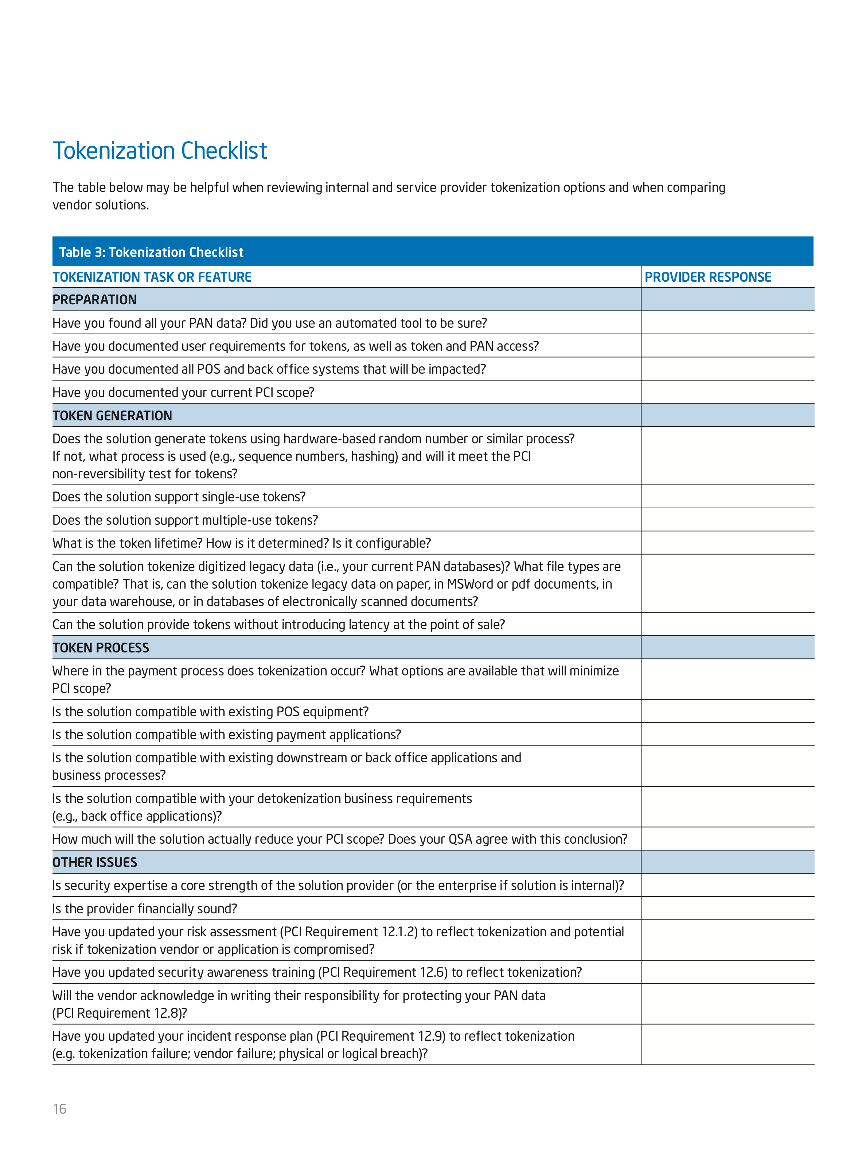
A Tokenization Checklist

Slide 36
Resources
PCI Security Standards Council:
https://www.pcisecuritystandards.org
  Documents Library, FAQ, resources
Tokenization Buyer’s Guides:
http://software.intel.com/en-us/articles/PCI-DSS-Tokenization-Buyers-Guide/
https://securosis.com/research/publication/tokenization-guidance-analysis-jan-2012

Slide 37
Tokenization and P2PE
Thank you!
Questions, comments, thoughts?
Walter Conway
wconway@403labs.com
877.403.5227, ext. 223
www.403labs.com
Find infosec posts at blog.403labs.com
and my PCI column at StorefrontBacktalk.com

Slide 38
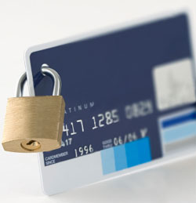
Part 2: P2pe
What do you want to know?
How P2PE works
Benefits – P2PE and PCI
New guidance
A P2PE buyer’s guide?
What is right for your school?

Slide 39
PCI Ecosystem
P2PE
Manufacturers
PCI PTS
Pin Entry Devices
Software Developers
PCI PA-DSS
Payment Applications
Merchants & Service Providers
PCI DSS
Secure Environments
PCI Security
P2PE
Ecosystem of payment devices, applications, infrastructure and users

Slide 40
P2PE Definition
Point-to-point encryption (P2PE):
  People, processes and technology
  That encrypt and decrypt cardholder or sensitive authentication data
“Point” – One designated and independently validated encryption device or location (the source, or encryption point)
“to” – The data are subsequently sent as unreadable ciphertext for decryption to…
“Point” – A second designated and independently validated decryption device or location (the destination, or decryption point)
“Encryption” – the algorithmic process of transforming plaintext into unreadable ciphertext
Note: there is no such thing as “End-to-End” encryption…

Slide 41
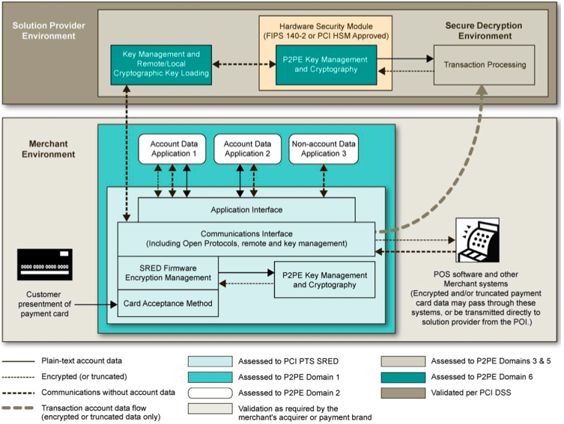
P2PE In Theory
Source: PCI SSC

Slide 42
P2PE In Theory
Ideally, P2PE encrypts data everywhere in merchant environment
  Merchant has no (or limited) access to cleartext card data
  Data remain encrypted between the merchant and the destination (processor)
  No decryption is feasible at any point between the source and the destination

Slide 43
P2PE and PCI
PCI scoping
  Data discovery is part of implementation
  Confirm no leaks from P2PE environment
Identify the encryption point (the first “P”)
  At magnetic reader?
  In firmware in POS device or another device?
  At an application hosted on a server?
Map cardholder dataflow
  Find all cardholder data (and any sensitive authentication data)
  Implement appropriate security and risk management

Slide 44
P2PE and PCI
P2PE has the potential to limit PCI scope to two requirements
  Requirement 9: Restrict physical access to CHD
  Requirement 12: Maintain information security policies
“You must still comply with all applicable PCI DSS requirements in order to be PCI DSS compliant”
  Other PCI requirements may (and possibly do) apply
  Use any shortened SAQ to guide PCI validation

Slide 45
P2PE and PCI – Where We Are Today
PCI SSC documents, announcements
  Initial P2PE Roadmap, October 2010
  Hardware Solution Requirements, September 2011
  Announced PCI PTS will include P2PE MSRs, October 2011
  P2PE QSA requirements released, January 2012
Still to come in 2012 (and beyond?)
  Approval and listing of approved POI devices
  Training of P2PE QSAs and PA-QSAs
  Validation of payment applications (P2PE PA-QSAs)
  Validation of solutions (P2PE QSAs)
  Listing of approved P2PE solutions (PCI SSC)

Slide 46

P2PE and PCI – Where We Are Today
Point-to-Point Encryption (P2PE)
The Council delivered Initial Framework on Point-to-Point Encryption guidance in October 2010
P2PE solutions may help merchants reduce scope of their CDE and their PCI DSS assessment
The Council now has the first set of P2PE validation requirements for hardware-based encryption and decryption solutions
Developed with the Encryption Task Force
Supporting testing procedures, assessor training, and other resources available in 2012

Slide 47
P2PE and PCI – Where We Are Today
There is no validated P2PE solution today
  No standards for technology or validation processes
  Need robust security practices by developers, implementers, and administrators
Require a validated solution to reduce PCI scope
P2PE simplifies but does not eliminate PCI compliance
  Can reduce the number of requirements
Infrastructure and guidance still evolving

Slide 48
P2PE and PCI – Where We Are Today
PCI SSC Initiatives
  Webinars, meetings, speaking events
  Develop and promote standards and testing procedures [√]
  Extend PCI PTS to allow independent lab validation of non-PIN-based POI devices [√]
  Train assessors to evaluate P2PE elements [√]
  List qualified P2PE solutions
  Create new SAQ-P2PE

Slide 49
PCI Council Guidance
Mobile
P2PE
Virtualization
Wireless
Tokenization
Telephone-based
Payment Card Data
EMV

Slide 50
PCI Council Guidance
How merchants will reduce scope
  Use PCI PTS-approved POI device(s)
  Enter all card data always using POI device (no keyboards)
  Solution provider handles all transactions and account data
Additional details
  Use validated solution (coordinate with acquirer/processor)
  All transactions on POI device (“all”?)
  Physical controls, third-party agreements, and policies
  Understand and follow the P2PE Instruction Manual (PIM)
  Segment (isolate) the P2PE environment from any non-P2PE payment channels or confirm that no other channels exist
  Remove or isolate any legacy cardholder data or systems

Slide 51
PCI Council Guidance – SAQ P2PE
New SAQ to include three requirements
  Process all (all?) card transactions processed using an approved solution (POI devices, application)
  Store no electronic cardholder data
  Implement solution per PIM
  Possible: evidence of segmentation (isolation)?
SAQ should include limited set of requirements
  Likely expanded Requirement 9 (more later)
  Still need policies reflecting PIM

Slide 52
PCI Council Guidance – Encryption, Scope
PCI FAQ 10359:
  “However, encrypted data may be deemed out of scope if, and only if, it has been validated that the entity that possesses encrypted cardholder data does not have the means to decrypt it.
  Any technological implementation or vendor solution should be validated to ensure both physical and logical controls are in place in accordance with industry best practices, prohibiting the entity, or malicious users that may gain access to the entity’s environment, from obtaining access to Keys.”
Another reason to consider P2PE?
  “P2PE solutions help reduce merchant PCI DSS scope by eliminating clear-text account data from the merchant’s environment”
  Rewrite FAQ to apply to P2PE approved solutions only?

Slide 53
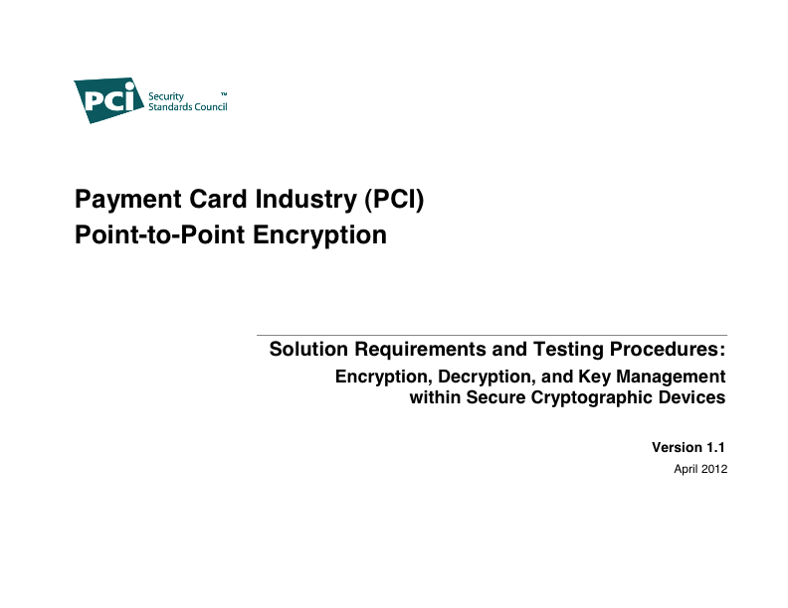
P2PE and PCI – version 1.1 (April 2012)
Assessment scope
Network segmentation
Third parties
PIM specifications
Testing procedures for each Domain
Merchant opt-out
More merchant guidance

Slide 54
P2PE and PCI – version 1.1 (April 2012)
P2PE requires an infrastructure:
  P2PE solution providers (design, implement)
  P2PE assessors (QSAs and PA-QSAs)
  PCI PTS labs (hardware testing)
  POI (hardware) device vendors (terminals)
  Application (software) vendors
  Certification authorities (key distribution)
  Key injection facilities (solution provider, third party)
  New SAQ-P2PE

Slide 55
P2PE “Buyer’s Guide”
Unfortunately, little is in place today
  Some guidance, but the rest is coming
  Therefore…we need a Buyer’s Guide

Slide 56
P2PE “Buyer’s Guide” – Issues, Risks
Issues
  POS device selection
  Encryption details
  Vendor lock-in for merchant
  Compatibility with existing devices and applications (i.e., will P2PE break your payment app?)
Risks
  Device failure
  Legacy PAN data you forgot about
  Software failure (e.g., whitelisting)
  Key entry, e.g., MOTO, Mag strip read failure

Slide 57
P2PE “Buyer’s Guide” – Issues, Risks
Vendor performance
Private Label cards and
key management
vulnerability
key entry at POS, e.g.,
Mag Stripe read failure,
device failure, MOTO
Other stored
CHD (Legacy)
Source: PCI SSC

Slide 58
P2PE “Buyer’s Guide” – Vendor Questions
Has the POI device been evaluated by an approved security laboratory?
  PCI SSC announced details late 2011
  Standards and procedures under development
  “Tamper resistance” vs. “tamper responsive”
If merchant commits now, will vendor commit to provide only approved devices?
  Option to return, or replace with approved devices?
  Include in the contract?
Where is my PIM?
  What merchant/user documentation exists?

Slide 59
P2PE “Buyer’s Guide” – Device Questions
Are cardholder data encrypted at “Point Of Interaction” using a secure, tamper-resistant device?
Are data encrypted immediately upon reading the stripe or key entry?
  If not, exactly where and in which device are data encrypted?
  What are provisions for MOTO, key entry transactions?
Can merchant ever (EVER) access plaintext data, encryption keys, or the decryption function?
  If “yes,” this may be bad news since PCI scope reduction may not be effective
Where are cardholder data decrypted, and by whom?
  Only at a validated decryption point, i.e., processor/acquirer

Slide 60
P2PE “Buyer’s Guide” – Solution Provider Questions
Who is responsible for:
  Devices and device management?
  Secure encryption and key management?
  Decryption (at processor/acquirer)?
  Documentation to help merchants and assessors validate implementation?
Will provider accept responsibility?
  Requirement 12.8 is your friend
Plans for validating solution?
  P2PE PA-QSA assessment, PCI SSC listing

Slide 61
P2PE “Buyer’s Guide” – Merchant Questions
Are P2PE devices secured physically and logically
  Check the vendor/solution provider’s PIM
Is the solution compatible with merchant’s existing devices and payment applications?
  Do application vendors have P2PE-compatible versions?
Will (or can) merchant or reseller/integrator configure the device?
  Who provides change control guidance and training?
  How will merchant validate appropriate deployment?
Remember PCI – all of it – still applies
  Segment network to reduce scope and maintain PCI compliance

Slide 62
P2PE “Buyer’s Guide” – Merchant Questions
P2PE has six domains
  Encryption device management
  Application security
  Encryption environment (merchant responsibilities)
  Segmentation between encryption and decryption environments
  Decryption environment and device management
  Cryptographic key management
Do you understand merchant responsibilities
  3-A Secure POI device throughout it lifecycle
  3-B Secure device management
  3-C Follow P2PE Implementation Manual

Slide 63
P2PE “Buyer’s Guide” – Merchant Questions
3-A: Can you secure the POI devices?
  Implement inventory-control and monitoring procedures to identify and locate all devices, including those deployed, awaiting deployment, or in transit
  For each device track eleven characteristics including model and serial numbers, location, firmware version
  Physically secure any devices in storage
  Secure the devices in transit, e.g., between store locations
  Implement procedures to detect unauthorized or substitute devices
  Implement procedures to detect unauthorized or replacement device prior to installation
  Log all activity and maintain an audit trail

Slide 64
P2PE “Buyer’s Guide” – Merchant Questions
3-B: Can you manage device(s) securely?
  Implement procedures for removing POI devices for maintenance or repair
  Physically inspect the devices on a regular basis
3-B: Do you know opt-out details?
  Merchant request and vendor acknowledgement
  Provisions for returning POI devices
3-C: Do you know PIM contents (for vendors)?

Slide 65
P2PE “Buyer’s Guide” – Hybrid Solution
Hybrid solution combines P2PE and tokenization
  Cardholder data encrypted at POI and transaction authorized using P2PE model
  Now processor returns tokens to the merchant, not encrypted PAN
Merchants use tokens for post-purchase applications or any other purposes
  Same conditions and rules apply (first part of the presentation) as for any other token

Slide 66
P2PE “Buyer’s Guide” – Hybrid Solution
1. Tokens generated
2. Tokens returned
3. Tokens
used?

Slide 67
Where is My Silver Bullet?
P2PE is exciting technology
  Removes merchant systems from PCI scope
  Reduces relevant PCI Requirements
  Cuts cost of compliance
  Increases security
P2PE requires security expertise
  Merchant has security obligations
List of approved devices and solutions in 2012? 2013?
  Until then, merchants are buying based on vendor’s sell sheet
  Get vendor assurances of ultimate compliance
  Get (and follow!) the PIM
  Requirement 12.8 is your friend
Monitor PCI Council guidance and announcements

Slide 68
Resources
PCI Security Standards Council:
https://www.pcisecuritystandards.org
  Documents Library, FAQ, resources
  Initial P2PE Roadmap and
  P2PE Hardware Solution Requirements Initial Release:
  https://www.pcisecuritystandards.org/security_standards/documents.php

Slide 69
Tokenization and P2PE
Thank you!
Questions, comments, thoughts?
Walter Conway
wconway@403labs.com
877.403.5227, ext. 223
www.403labs.com
Find infosec posts at blog.403labs.com
and my PCI column at StorefrontBacktalk.com

