Slide 1
Practical Application Of The Information Security Guide:
Mobile and Cloud Technologies
EDUCAUSE Security Professionals Conference
May 16, 2012
Carol Myers, Paradise Valley Community College

Slide 2
Copyright Statement
This work is the intellectual property of Mary Dunker, Virginia Tech and Cathy Bates, American University. Permission is granted for this material to be shared for non-commercial, educational purposes, provided that this copyright statement appears on the reproduced materials and notice is given that the copying is by permission of the author. To disseminate otherwise or to republish requires written permission from the authors.

Slide 3
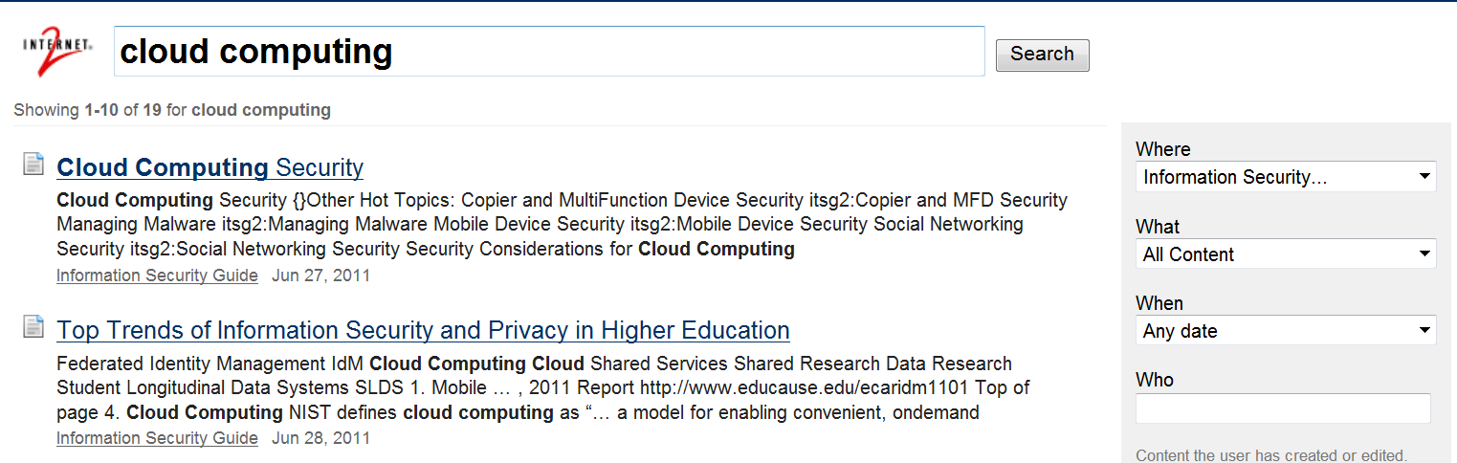
Cloud Computing Security www.educause.edu/security/guide
The university has formed a working group to consider the pros and cons of outsourcing e-mail. One aspect that needs to be considered is security, and I have been tasked with enlightening the group regarding cloud computing security.
I start by searching the Information Security Guide, and I find what looks like just the resource I need: Cloud Computing Security https://wiki.internet2.edu/confluence/display/itsg2/Cloud+Computing+Security

Slide 4
Cloud Computing Security
The Cloud Computing Security page is one of the guide’s Hot Topics. In addition to general security considerations included on that page, we’ll need to assess the risk involved in moving applications to the cloud. Evaluating Cloud Risk for the Enterprise: A Shared Assessments Guide can help.
Once the decision is made to pursue a cloud service, the University of Florida’s SaaS Security Assessment Questionnaire for Hosting Service Provider can help evaluate various offerings from a security standpoint.
Security requirements will need to be built into the contracts for cloud services. Data Protection Contractual Language: Common Themes and Examples refers to Legal and Quasi-Legal Issues in Cloud Computing Contracts which should contain suggestions on the contractual and issues we’ll need to address specific to cloud computing.
Now let’s see what these resources from the Security Guide have to say...
Notes:
Contains links to lots of other resources.

Slide 5
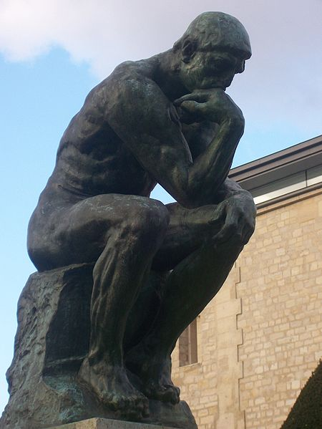
Cloud Computing Security https://wiki.internet2.edu/confluence/display/itsg2/Cloud+Computing+Security
What should I think about to get started?
Rodin’s “The Thinker” – photo by CJ, licensed for reuse under the GNU Free Documentation License

Slide 6
Cloud Computing Security
Confidentiality and privacy – placing records in the cloud introduces new risk
FERPA – Education records are those that are (1) directly related to a student; and (2) maintained by an educational agency or institution or by a party acting for the agency or institution
Export controls – How is the data kept private? Who has access?
Notes:
Security considerations for cloud can be put into 6 categories. The first consideration involves confidentiality and privacy.

Slide 7
Cloud Computing Security
Data breach responsibilities and security – data in the cloud amplifies concerns about data breaches, but reduces the institution’s ability to control security.
Obligation to notify if a breach occurs – who does this?
Risks to intellectual property – institution may not be able to assert “work for hire” for creations developed “without use of institutional resources.”
Export controls – can the data legally reside outside the U.S.?

Slide 8
Cloud Computing Security
E-discovery
Institutions and their legal counsel may be obligated to keep records for legal discovery. How can you “discover” what you don’t have?

Slide 9
Cloud Computing Security
Risk evaluation – consider
Indemnification
Warranties (and lack thereof)
Responsibility for End users
Patent infringement
Choice of Law and Jurisdiction
Risk transfer
Procurement policies & practices (e.g., procurement policies should require a risk evaluation for products that store records with confidential data.)
University of Florida’s cloud assessment template
Notes:
Indemnification – what, if any, compensation will be given for loss?
Warranties – What types of assurances and remedies are needed?
End users – who should support them?
Patent infringement – are patent infringement risks present?
Choice of Law and Jurisdiction – which state law will apply? Will the courts in one jurisdiction need to apply the law of a different jurisdiction?
Risk transfer – will the cloud service assume risks, or will the institution retain them?

Slide 10
Cloud Computing Security
Business continuity
Suspension/Termination and their aftermath
Service level agreements
Notes:
Suspension – what happens if the cloud company folds? Can you recover your data?
SLA – what level of service is provided, both in terms of availability and customer support?

Slide 11
Cloud Computing Security
Legal issues and third-party obligations in cloud computing contracts
Grants with stipulations
Course management
Risk transfer
Incorporated website terms that are modifiable at will
Legal and Quasi-Legal Issues in Cloud Computing Contracts
Data Protection Contractual Language: Common Themes and Examples
Notes:
Will stipulations in certain research grants be impacted if our e-mail is in the cloud?
Is there a link between the cloud service (email) and a course management system?
Are there course management considerations that will require contractual language?
Risk transfer (again) – specifics will need to be written into the contract.
Incorporated terms – Terms of some contracts are tied to URLs that are modifiable at will. Will new risk be introduced, inadvertently, if an underlying definition changes?

Slide 12

Evaluating Cloud Risk for the Enterprise: A Shared Assessments Guide http://sharedassessments.org/media/pdf-EnterpriseCloud-SA.pdf
“Placing records in the cloud introduces new risk.”
Photo by a sailor or employee of the U.S. Navy, in the public domain, Wikimedia Commons collection
Notes:
The first consideration noted on the Cloud Computing Security page indicates we should perform a risk analysis before making a decision on moving our e-mail to the cloud.
Santa Fe Group
The Shared Assessments AUP (formal audit procedures) and SIG (risk questionnaire) offer
detailed standards for cloud use related to security, privacy and business continuity. The goal of the Shared Assessments Guide is to help individuals understand cloud from the perspective of the entire enterprise, with the goal of enabling successful deployment across departments and lines of business.

Slide 13
Evaluating Cloud Risk for the Enterprise: A Shared Assessments Guide
Shared Assessments Guide covers:
Introduction
Cloud computing overview
Risk Management Approach: Common and Delta Controls
Case study
Glossary and Appendix

Slide 14
Evaluating Cloud Risk for the Enterprise: A Shared Assessments Guide
Common Controls: Mature control areas associated with traditional IT services environments that are also applicable to cloud-based services, and whose audit mechanisms are considered mature.
Delta Controls: Higher-risk control areas that have particular relevance to cloud environments, and whose cloud audit mechanisms are less mature.
Notes:
We will focus on the risk management approach, consisting of cloud computing controls, with detailed practical recommendations for each control area. Common controls have been used in outsourcing, and are also present for cloud services. Distinction between cloud and hosted apps: cloud often bundles software product with a service. Hosted is often a pure service where the customer provides the application. Hosted: vendor and customer share responsibility for security. Cloud: vendor is responsible for most security controls and incident response. Cloud infrastructure may be shared among unrelated customers. Multiple customers use one cloud solution.

Slide 15
Evaluating Cloud Risk for the Enterprise: A Shared Assessments Guide
Common cloud controls
Frequently used controls such as ISACA COBIT 4, ISO 27001:2005, NIST 800-53A Rev 1, PCI DSS
Environment type – private vs. public cloud, on-shore vs. off-shore
What will be changing with service in the cloud?
Physical location, facilities
Personnel
Business processes, IT management processes – stability, availability, recoverability
Technology - application, middleware, data, servers, storage, networking
Notes:
Standard audit controls
Understand the differences in the cloud environments. Which applies to the service we are evaluating?

Slide 16
Evaluating Cloud Risk for the Enterprise: A Shared Assessments Guide
Common cloud controls
Mature Relationship, Procurement, Vendor Mgt.
Existing procurement process starts the evaluation
Evaluation – vendor management, process improvement, risk management, quality control, business continuity, project management, security, compliance, internal control, audit)
Non-functional requirements
Information sensitivity and security requirements
Terms and conditions allow organization to conduct periodic assessments
Add key policies the cloud provider must implement

Slide 17
Evaluating Cloud Risk for the Enterprise: A Shared Assessments Guide
Delta cloud controls
Multi-tenant platforms
Multi-client prioritization
Agile delivery
Virtualization
Data location, cloud layers, cloud providers
Cloud management: roles and division of responsibilities
Contracts, data privacy, jurisdictional issues
Notes:
Shared infrastructure creates concerns over data leakage. Evaluate data segmentation and separation controls used by cloud service. Network, physical, system, application. Use of encryption. Penetration testing should be allowed.
One client’s changes can impact another client sharing the same infrastructure. Can our requests for changes be satisfied in a timely fashion? Feature changes, bug fixes. Additional costs?
The rapid (agile) delivery cycles of cloud products make it more difficult to implement security programs that examine long cycles in evaluating operational stability, availability, and recovery. Mass feature changes demand thorough risk evaluation, which takes more resources to keep up. Consider the impact and plan to adjust accordingly.
Virtualization, while allowing many more operating systems and applications to run on the same physical server, increases the difficulty in tracking and protecting the data. The availability of snapshots of a customer’s environment can present a security issue since images and snapshots may contain sensitive data such as PII and passwords. Controls need to be in place to prevent copying of snapshots to insecure locations such as administrator desktops.
Cloud providers should be able to identify the exact location of a customer’s data, and which of the provider’s vendors have access to it. If the provider cannot answer that question, we must decide whether or not that is an acceptable risk.
Will moving assents into the cloud require a realignment of institutional resources? What skill sets and people will be affected? Who is responsible for legal, vendor management, change management, security, problem management? How are communications going to be handled with a cloud vendor in the mix?
A rigorous legal analysis should be conducted, particularly if data will be stored or transmitted in a foreign country. Contractual relationships must be well defined.

Slide 18
Evaluating Cloud Risk for the Enterprise: A Shared Assessments Guide
Delta cloud controls
Identity and log management
Web application security
Cloud vendor interdependence and governance
Data retention, management, recovery, destruction cycles
E-discovery and forensics
Notes:
Ideally, additional user names and passwords should not be required to access the cloud service or its data. A single, unified identity management model with a single authentication data base should be utilized. Will you need to integrate your existing identity management solution with that of the could provider? Solutions employing open, federated standards such as SAML and OpenID should permit transparent user single sign-on. Who will provision/deprovision and manage the identities?
Log management: Who has access to the logs? Are one client’s logs separated from those of another?
9. We all know web applications are prime targets for security hackers. Since cloud providers must serve multiple customers, they typically expose APIs to the Internet, and may use agile software development techniques which result in a new release every two weeks. Both of these practices mean cloud providers need more experienced developers with application security built into their development cycle from beginning to end. Application firewalls, penetration testing, code reviews, and other security hardening measures are essential in a cloud environment.
10. Cloud providers may use multiple vendors for their hardware, software, backups, and disaster recovery. The difference in multi-vendor environments for in-house services vs. cloud services is the lack of clarity in where the client data resides, and who is legally responsible for protecting it. Address this with a single contract for the cloud service that includes a single point of contact and the ability to track the data’s physical location.
11. Data protection controls need to apply to all phases of the data cycle, from copying data to the cloud provider, to day-to-day management, data retention, service level agreements, incident response, and removing or destroying the data at the end of the contract.
12. Responding to an E-discovery subpoena is challenging enough when data is stored in-house. Make sure the cloud provider can comply with procedures required by your legal department. One point to note is whether the “original data on the original hard disk” is required or whether a copy is sufficient. It is likely to be difficult to isolate one client’s data from another’s in a cloud environment.

Slide 19
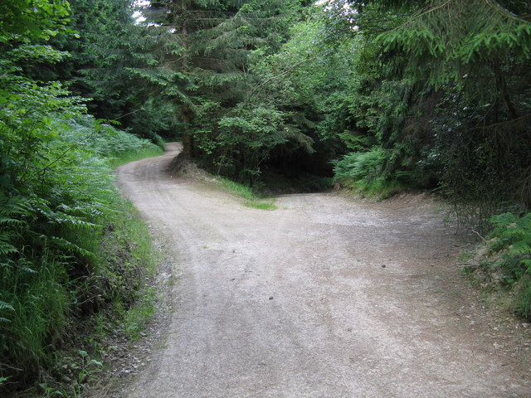
UFL SaaS Security Assessment Questionnaire UFL Security Assessment Questionnaire for Hosting Service Provider
We need a vendor. How do we pick?
“Choose wisely!”
© Copyright Whatlep and licensed for reuse under this Creative Commons License
Notes:
The decision has been made to move our e-mail system to the cloud. Now how do we decide on a vendor?

Slide 20
UFL SaaS Security Assessment Questionnaire
RFP process, vendor evaluation
Requirements: what features are important?
Selection criteria: which vendors meet our needs?
University of Florida has a template – a questionnaire that can be given to each vendor
Notes:
Now how do we decide on a vendor? We’ll need to do an RFP, so what are our requirements and selection criteria? These are standard processes for selecting software to run in-house, but it would help to be able to compare different cloud vendors from a security standpoint.

Slide 21
UFL SaaS Security Assessment Questionnaire
Header/Contact information
1.0 High level description of service
2.0 Authentication
3.0 Authorization – Logical Access Control
4.0 Data security
5.0 Recoverability
6.0 Operational controls
7.0 Incident response
8.0 Application security
9.0 Testing and validation

Slide 22
UFL SaaS Security Assessment Questionnaire
Authentication Questions
2.0 AUTHENTICATION |  |  | YES | NO
2.1 | Will users of the hosted service be authenticated by UF systems?
2.2 | Will users be authenticated by the hosting service provider?
 | 2.2.1 | Will userids assigned by the service provider match UF Gatorlink userids?
 | 2.2.2 | Will each user have a unique userid?
 | 2.2.3 | Can the service provider's system be configured to require strong passwords?
 | 2.2.4 | Can UF dictate password criteria as needed to ensure compliance with UF security standards?
 | 2.2.5 | Can the service provider's system be configured to expire user passwords periodically in accordance with UF security standards?
 | 2.2.6 | Does the service provider provide a function to enable users to change their own password securely?
1.0 HIGH LEVEL DESCRIPTION
1.1 | Please provide a brief description of the purpose of the system, including how the information will be used. If possible, include a simple diagram of the dataflow and where Restricted Data will be stored.

Slide 23
The Cloud Contract
From a presentation by Joe Storch and Patrick Feehan at EDUCAUSE Security Professionals Conference 2010…
If we are going to venture into the cloud, we give something away…control.
The way we exert control in the cloud is through the contract with the cloud provider.

Slide 24
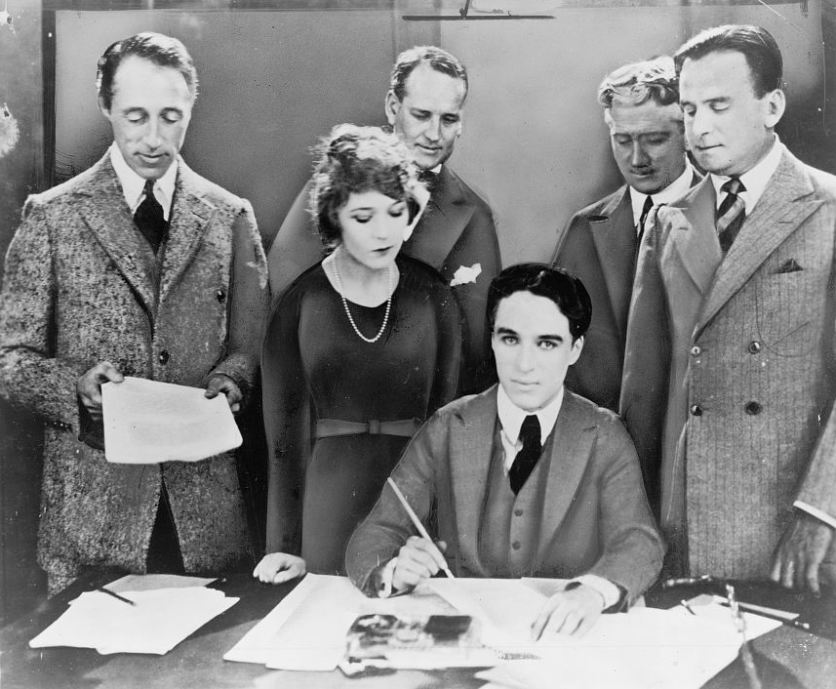
The Cloud Contract Legal and Quasi-Legal Issues in Cloud Computing Contracts
This photograph is a work for hire created prior to 1968 by a staff photographer at New York World-Telegram & Sun. It is part of a collection donated to the Library of Congress. Per the deed of gift, New York World-Telegram & Sun dedicated to the public all rights it held for the photographs in this collection upon its donation to the Library. Thus, there are no known restrictions on the usage of this photograph.
D.W. Griffith, Mary Pickford, Charlie Chaplin (seated) and Douglas Fairbanks at the signing of the contract establishing United Artists motion picture studio in 1919. Lawyers Albert Banzhaf (left) and Dennis F. O'Brien (right) stand in the background.

Slide 25
Legal and Quasi-Legal Issues in Cloud Computing Contracts
FERPA – Faculty and staff e-mail can contain “education records” and may be outsourced only to vendors that we have designated and are willing to accept designation as “School officials” with “legitimate educational interests” in the data.
Data security – Contract should provide specific security practices, not just “reasonable” or “industry standard.” Ideally include SAS 70 type II audit. Include security breach and data breach notification responsibilities.
E-discovery – Contract not likely to specify in what format data is kept, but you should ask and understand. What tools are available to mine the data?
Notes:
Steve McDonald, former associate counsel at Ohio State and currently at the Rhode Island School of Design, is well known and respected for his FERPA knowledge. We are grateful to him for sharing “Legal and Quasi-Legal Issues in Cloud Computing Contracts.” The issues he cites should be dealt with in the contract to ensure the vendor is accountable for its actions.
FERPA – we must ensure that our definitions of those two terms in our FERPA annual notices are broad enough to cover outsourcing and that the vendor will not use the data for any purpose other than providing the outsourced service. Privacy and confidentiality of the data must be protected. Encryption capabilities can help.

Slide 26
Legal and Quasi-Legal Issues in Cloud Computing Contracts
Location of data – what countries have your data? May need to prohibit “extraterritorial” storage for research data.
Responsibility for end users – Vendor may want compliance with their AUP. Provision in contract enforceable for faculty/staff; better for students to agree directly with vendor.
Unauthorized or inappropriate use – Institution has little control to prevent unauthorized or inappropriate use of cloud resource, but will not “knowingly allow” abuse.
Suspension of end-user accounts – Limit vendor’s ability to suspend accounts to violations that “significantly” threaten system security.
Notes:
Acceptable use Policy – contract may be different for faculty/staff and students. We can enforce faculty/staff, but prefer to “inform” students.

Slide 27
Legal and Quasi-Legal Issues in Cloud Computing Contracts
Emergency security issues – Contract should include clear definition of emergency. Limit vendor flexibility.
Suspension and termination of service – Giving vendor right to suspend service is not unreasonable, but should be spelled out and limited to only truly significant matters. For e-mail, it could take >6 months to transition to another service. Make sure data is returned to institution or destroyed at termination of contract.
Ownership of data – Expressly make it clear that all data belongs to the institution (and/or its users) and the vendor has no rights to use.
Publicity – Use of names, logos, trademarks. Either strike or require approval.

Slide 28
Legal and Quasi-Legal Issues in Cloud Computing Contracts
Service Level Agreements – Uptime, Downtime. Time zone differences may impact maintenance windows.
Disclaimer of warranty – Contract should warrant that service conforms to (detailed) specs, and does not infringe upon 3rd party intellectual property rights.
Indemnification by customer – Public institutions may have significant state-law restrictions on their ability to indemnify.
Indemnification by vendor – Require vendor to protect against infringement of IP rights and against data breach or disclosure.

Slide 29
Legal and Quasi-Legal Issues in Cloud Computing Contracts
Modifications to the contract – “Vendor may make commercially reasonable modifications to the Service, provided that they do not materially diminish the nature, scope, or quality of the Service.”
Incorporation of URL terms – URLs can point to non-legal technical standards and guidelines, but include all contractual terms in the contract itself. Try to require notification in advance of any amendments, with right to terminate.
Automatic renewal – Contract may renew automatically, but should allow for termination.

Slide 30
Legal and Quasi-Legal Issues in Cloud Computing Contracts
Governing law and jurisdiction – governance by the law of the vendor’s home state. For cloud, either
Specify the law and jurisdiction of your own state;
Specify that disputes must be brought in the defendant’s jurisdiction; or
Delete the provision and leave the question open.

Slide 31
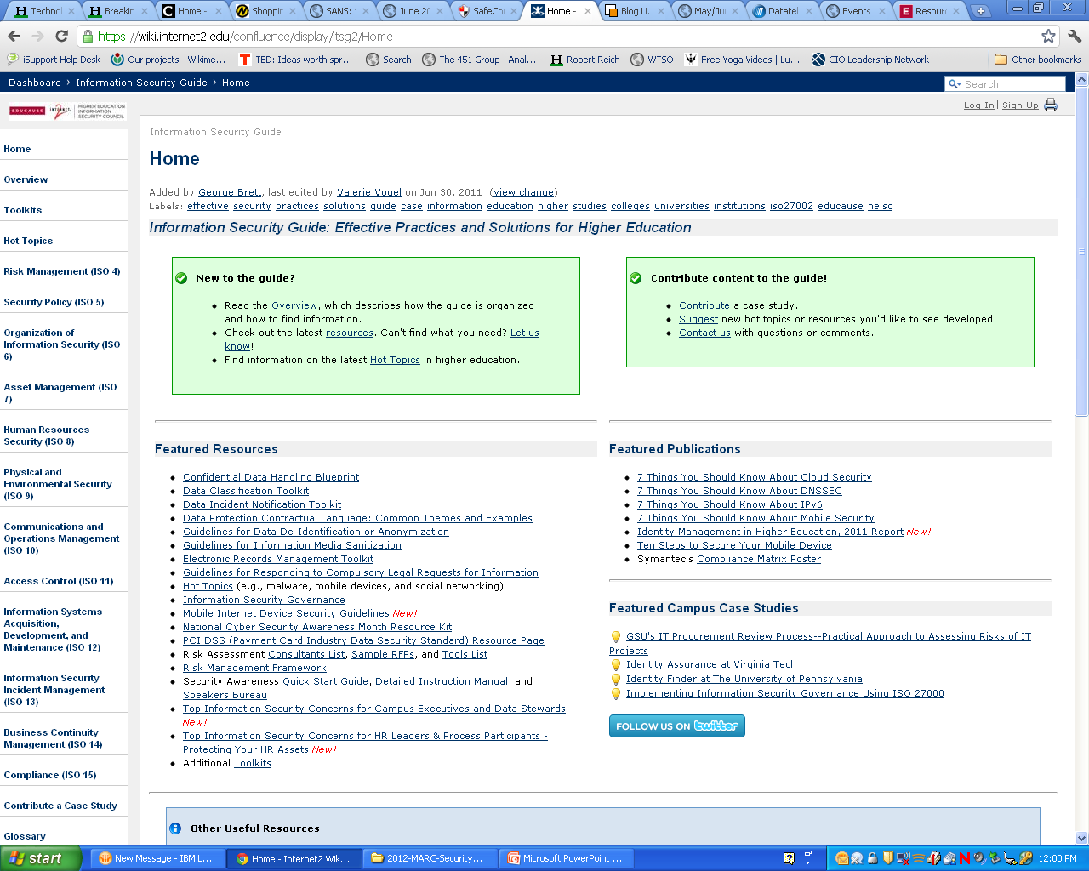
Mobile Security
The university has formed a working group to document a strategy for Mobile. As the ISO I have been asked to develop a list of potential risks and solutions related to Mobile technologies.
This is a new area for me so I’m going to begin on the home page of the Security Guide https://wiki.internet2.edu/confluence/display/itsg2/Home
Immediately my eye catches Featured Publications and I see the title 7 Things You Should Know About Mobile Security.
Let’s take a look. It might be a terrific handout for the working group members.

Slide 32
Not Just Portable but Mobile
Overlapping Insecurities
Risk Ampliﬁcation and Divergence
The Other Side of the Security Coin Is Privacy
Mobile Floodgates Are Open
Special Concerns for Higher Education
People: The Security Wild Card
Notes:
Smaller even more portable, multiple platforms, Operating Systems, Scaled Down Browsers, Apps (introduces news risks), combined with phoned. Personal and University owned.
Inherent risks remain for wireless data transfer, encryption goes along way, however at least one instance of breach of Cellular Service has been recorded.
Compared to PC-based operating systems, mobile operating systems are less mature—hackers have spent less time trying to poke holes in them, but by the same token, developers have spent less time protecting them. largely uncharted territory. Application security is an area that needs to be carefully reviewed.
Mobile devices diverge from laptops in terms of location awareness. Consider implications on Privacy. Knowing where individuals are—or where they are not—can be powerful information in the hands of stalkers, burglars, advertisers, and others.
mobile devices use is expanding to include conducting ﬁnancial transactions and exchanging other sensitive information. On campus, mobile devices are becoming common tools for teaching and learning and for administrative functions, as well as for personal activities. One result of this widespread adoption and the gold-rush expansion of apps is that mobile devices become a honey pot for the unscrupulous and the criminals. Unlike most laptops or desktops, mobile de vices often do not have password protection enabled by default.
Blended ownership, differing platforms, make it difficult for IT depts to apply controls needed for Regulatory compliance.
Mobile devices can securely store private data and conduct sensitive transactions, but only if those devices are conﬁgured and used appropriately. Users need to understand the trade-offs between security and functionality in order to make informed decisions about the things they do with mobile devices and the risks those activities incur.

Slide 33
Mobile Security
That helped with identifying some of the risks. Let’s see if we can find some solutions. Looking at the Navigation menu I decide to follow the Hot Topics link.
Near the top of the list is Ten Steps to Secure Your Mobile Devices. This looks good for serving as a practical set of steps to share with the IT department.
Configure mobile devices securely
Connect to secure Wi-Fi networks and disable Wi-Fi when not in use
Update mobile devices frequently
Utilize AV programs and configure automatic updates if possible
Use an encryption solution to secure data in transit
Notes:
Detailed steps under each of the 10 steps is provided.

Slide 34
Ten Steps To Secure Mobile Devices
Use digital certificates
University of Virginia has set up Digital Certificates (link available)
Take appropriate physical security measures to prevent theft
Use appropriate sanitization and disposal procedures
Develop appropriate policies, procedures, and guidelines
Educate students, faculty, and staff about mobile device security
At the bottom of the page, under Additional Resources, there are contributions from my peer institutes. I see a couple that may help when we begin our awareness efforts and begin to develop policies and guidelines.

Slide 35

Mobile Security
Now I have a great handout and some action steps for securing the devices!
Educational Awareness Tips
Brown University:
Secure IT! Newsletter Article - Focus on Mobile Security: Smart Phones
Guidelines
Carnegie Mellon University:
Mobile Device Security and Usage Guideline
University of Florida:
Supporting Mobile Computing Devices Used With Restricted Data
I would like something that helps the working group think more holistically about Mobile Security issues. Looking at the Navigation Menu, I decide to look under Toolkits.
Mobile Internet Device Security Guidelines
I think this is it!
Image from vascularultrasound.net
Notes:
This is what I want to bring back to the Working Group. A set of steps that the Working Group can talk through and begin to build requirements and a plan.

Slide 36

Mobile Security
The document is designed to help develop mobile Internet device security policy, standards, guidelines or procedures. It is organized into steps you can follow to define your objectives and develop a plan to move forward.
Step 1: What are you trying to accomplish?
Is your goal: Establishing rules people must follow (i.e., policies, standards, procedures) or non-binding recommendations (i.e., guidelines)? Both?
Do you have a clear definition of what a “mobile Internet device” is for your institution?
What is a mobile Internet device?
What Mobile Internet Devices Should You Support?
Will you have different standards for staff, faculty, student-owned, and guests?
Image from vascularultrasound.net
Notes:
These are questions and considerations the Mobile Strategy Working group should address. However, a few of the questions, particularly those in bold are areas Security professionals like myself would want to weigh in on.

Slide 37

Mobile Security
Step 1 continued
What about Enterprise Device Management?
What about mobile device App choices, web site readiness and support of new features?
What spam and malware management is available?
What hardware encryption and remote wipe capabilities are there?
What position should you take regarding Jail breaking or Rooting?
Think about contact with user’s Mobile Devices. Is your goal:
Protection of personal privacy?
Protection of physical university assets?
Defining acceptable use in general?
Setting requirements for classroom or other pedagogical settings?
Image from hollywoodconnect.com
Notes:
As Security Professionals we want to weigh in on at least the questions that are bold.

Slide 38

Mobile Security
Step 2: Does existing physical asset, technology or data-specific policy cover all or part of your defined scope?
Step 3: Communicate what you are trying to accomplish and a high-level implementation plan with your constituents.
Step 4: Begin implementation.
Step 5: Monitor progress, evaluate feedback, make modifications to steps 1 through 3 as necessary and continue with implementation.
Step 6: Regularly report progress to management.
Image from guystuffcounseling.com
Notes:
After talking through this list I will have answered many of the questions with help from the Working Group.

Slide 39
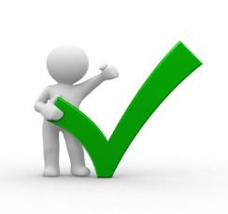
Mobile Security
My initial task was to develop a list of potential risks and solutions related to Mobile technologies.
Have I accomplished that using resources from the Security Guide?
Risks
Under Featured Publications
7 Things You Should Know About Mobile Security
Handout to distribute to the Working Group
Solutions
Under Hot Topics
Ten Steps to Secure Your Mobile Devices
Additional resources from Brown and Carnegie Mellon universities
Under Toolkits an extensive set of considerations
Mobile Internet Device Security Guidelines
Image from marcwayshak.com
Notes:
So thinking about my initial task, I’m feeling pretty good about what I found.
I think the group will come together around these areas of risk and we can work together to address the questions that are raised.
Looking ahead…

Slide 40
Mobile Security
Looking into the future…
Risk Management ISO 4
Assessment Objective: Analyze and evaluate risk.
Treatment Objective: Develop a plan that identifies the controls necessary to reduce, retain, avoid, or transfer identified risks.
Asset Management ISO 7
Objective: To ensure adequate protection of organizational resources, all assets should be accounted for and each should have a designated responsible party.
Image from themesview.com
Notes:
I will be visiting the Security Guide regularly as the Mobile Strategy develops and after it is defined.
It is likely we will want to asses the risk of the approach we take with Applications (in-house development, outsourced, hybrid)
Should we re-examine our Asset Management policies and procedures to ensure they encompass Mobile Devices?
What about Incident Response? There will be many opportunities to visit THE GUIDE
For now…

Slide 41

For now, I can go play!
Image from very-bored.com
Notes:
Thank you Security Guide.

Slide 42
Visit the EDUCAUSE Security Guide
Located at:
www.educause.edu/security/guide
Carol Myers, Paradise Valley Community College
carol.myers@pvmail.maricopa.edu
Notes:
It is contributions and feedback from you that helps to build the guide.
Raising awareness about the Guide as a resource
Encourage you and your peers to contribute – a living dynamic resource
Content
Case Studies
Constructive feedback
Evangelists – you should use the guide too – Legal? Auditors? Risk Managers? Human Resources? CIO?

