Slide 1
Phishing Ourselves to Raise Awareness
Derek Spransy
Senior Information Security Specialist
May 16th 2012

Slide 2
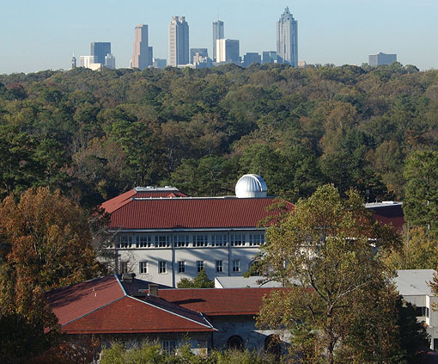


About Emory
University & Healthcare System
Private Methodist University in Atlanta
Carnegie class. RU/VH
Approx. 13,000 students
Largest healthcare provider in Georgia
Five major hospitals

Slide 3

Motivations and decision
Compromised accounts were a steady source of security problems (spamming, VPN logins, etc)
300 accounts in 12 months
Compromised accounts utilized for:
Sending SPAM (LOTS of it!)
Nigerian Scams
More Phishing
Accessing Emory IT resources

Slide 4
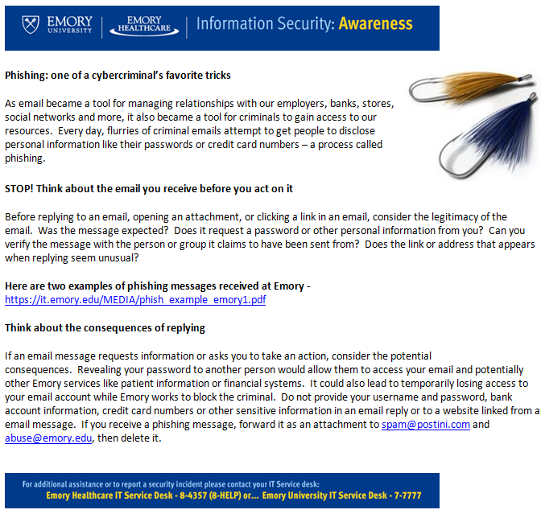
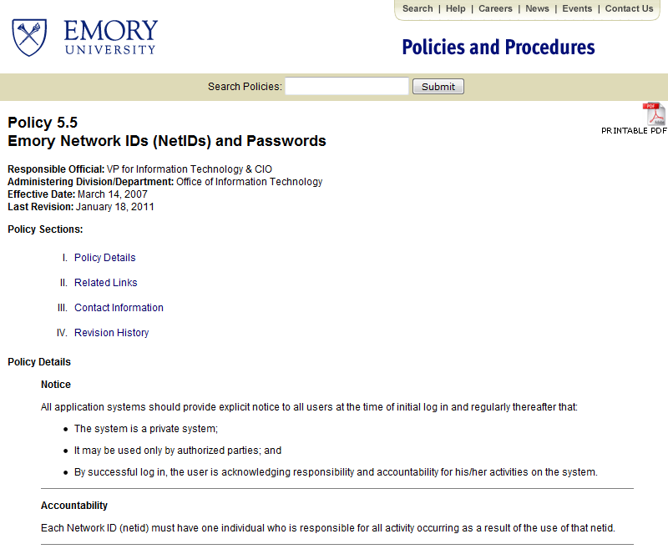
Unsuccessful Traditional Remediation Attempts
Security Policies
Traditional Awareness Messages
Posters

Slide 5

A New Approach
Phishme.com
Cloud Service
Phishing Susceptibility Testing
Real-Time Targeted Awareness Training
Actionable Metrics
Affordable, ~ $1 per user

Slide 6

Building support
Ranked new phishing awareness program high in strategic planning process and received funding
Reviewed approach with Enterprise Risk Management and IT governance groups and integrated their feedback
Presented approach to IT support community and IT help desks and integrated their feedback
Decided to be non-punitive – would not provide lists of names to departments, only stats

Slide 7

Planning for minimal impact
Sent mass email to community informing them about what we were doing
Worked with Phishme to throttle messages to one per minute
Created four different “scenarios” based on real phishing messages
and tuned spam filters to pass them
Created an awareness landing page that walked through which elements from those messages were clues
Gave help desk and e-mail teams heads-up on timing and message content

Slide 8
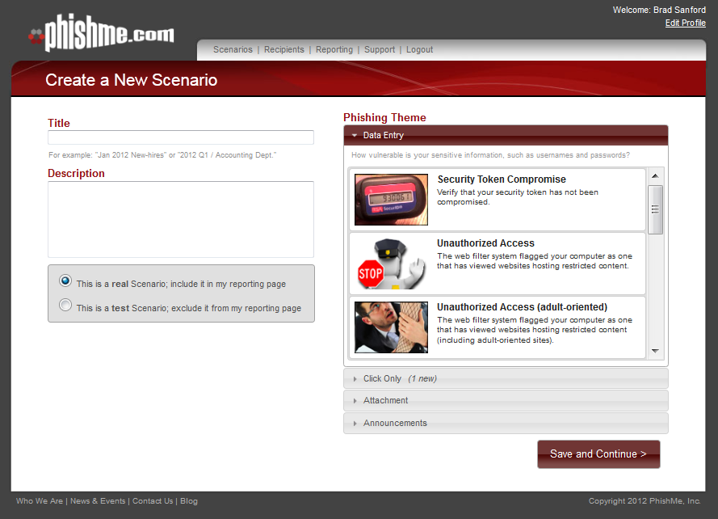
Mechanics of Phishme
Create a “scenario” that has
an email message, list of
recipients, phishing web form,
awareness page, start date
and end date.
They provide canned content –
we only used their web form templates
Each email message has a URL with a unique key that ties it to a user, so the result is keyed to them regardless of the username they supply
Form collects username, but discards the supplied password

Slide 9
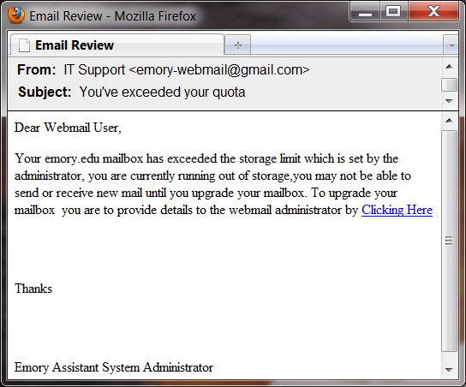
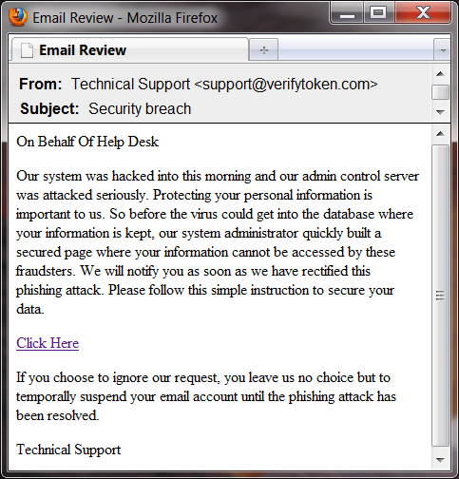
The User’s Perspective
Stage 1 - User receives a phishing email and clicks on hyperlink

Slide 10
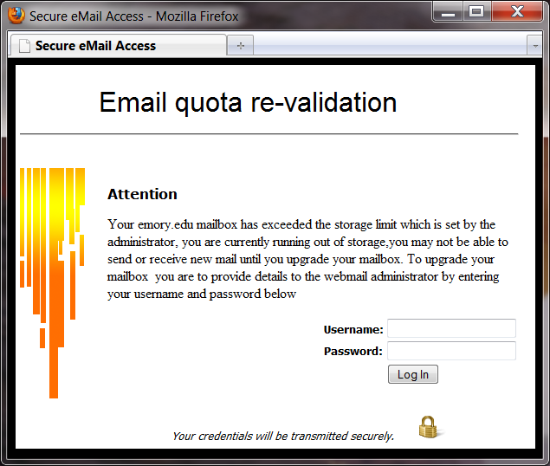
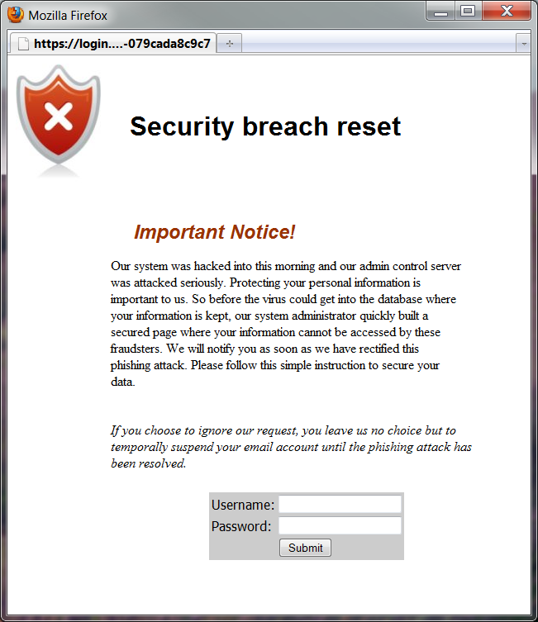
The User’s Perspective
Stage 2 – User redirected to phishing site
Username logged, password never submitted

Slide 11
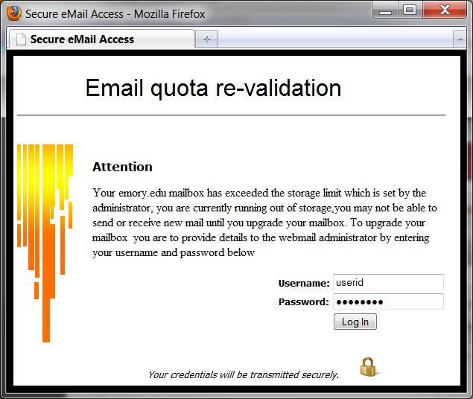
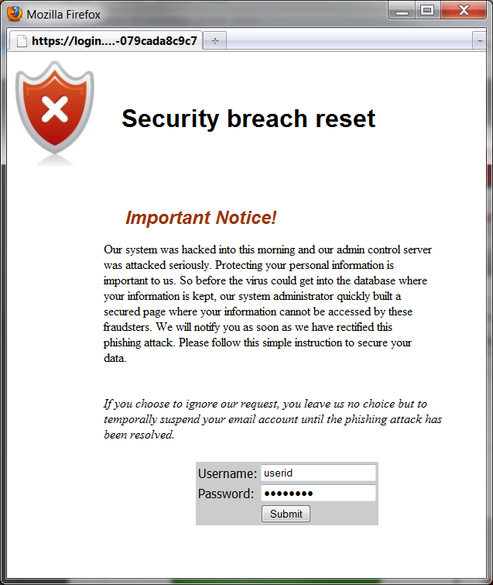
The User’s Perspective
Stage 3 – User provides their credentials

Slide 12
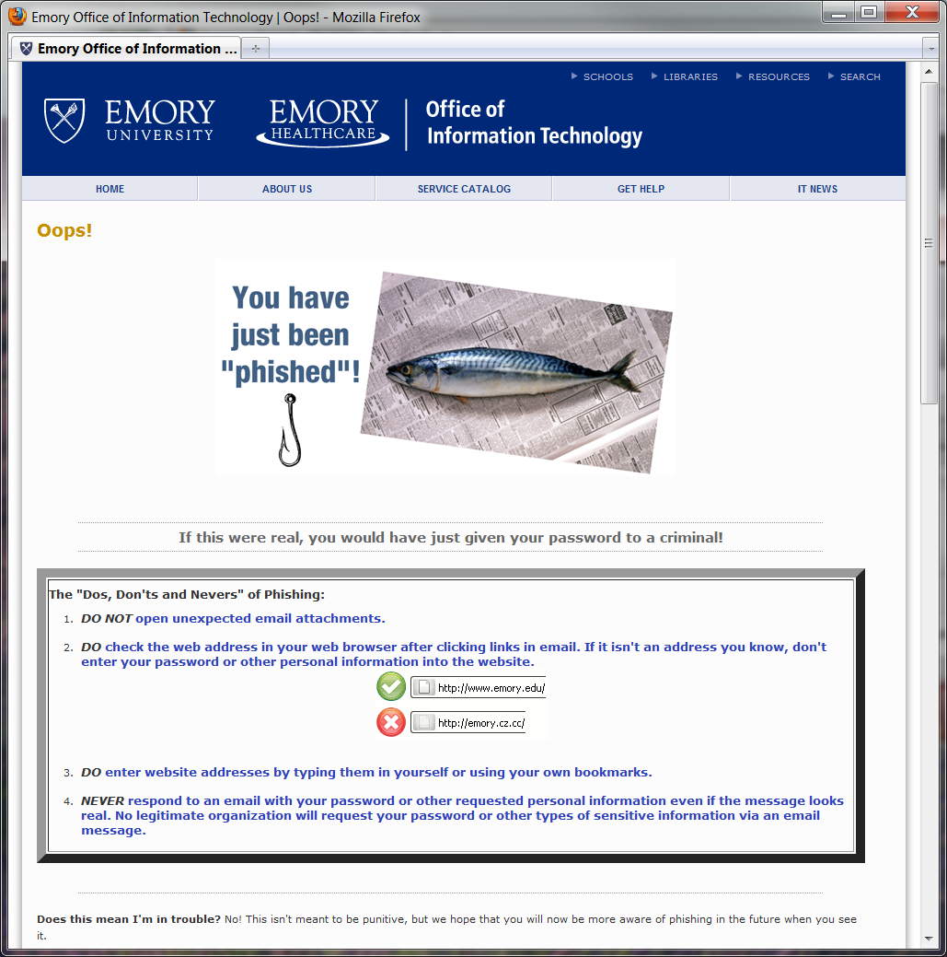
The User’s Perspective
Stage 4 – User redirected to awareness site
http://it.emory.edu/security/phish/

Slide 13
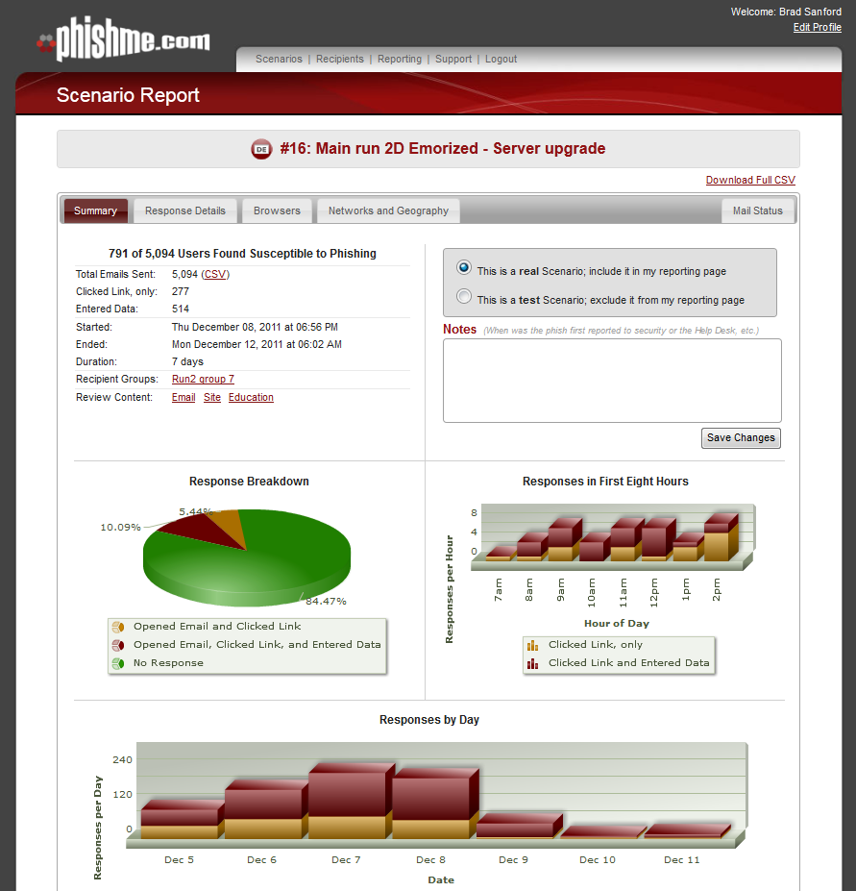
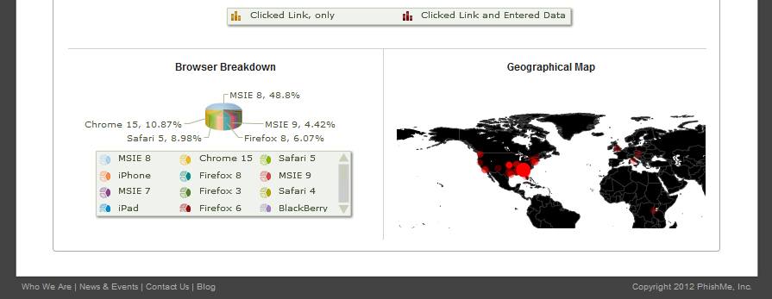
Tracking results
Basic statistics provided by Phishme
Created an in-house tool to track results by demographic information (dept, division, major, class year, job title, etc)
Allows drill down to view combinations (e.g. results by class year for a particular school)
Helped to obfuscate names
Allowed for flagging of false positives (bogus usernames provided)

Slide 14
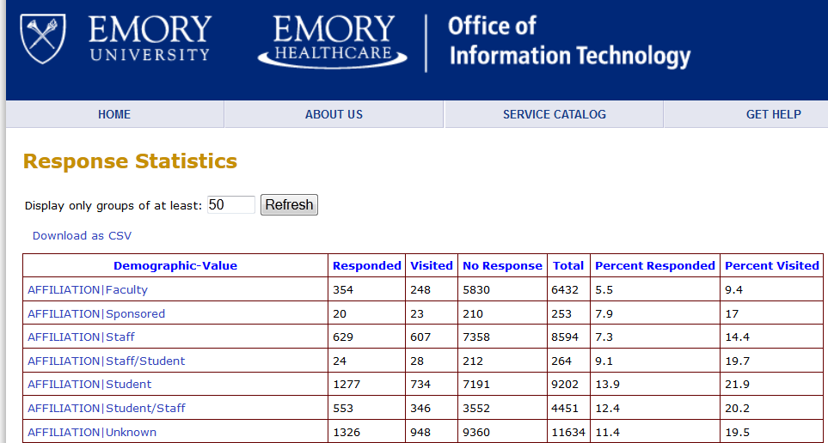

Slide 15
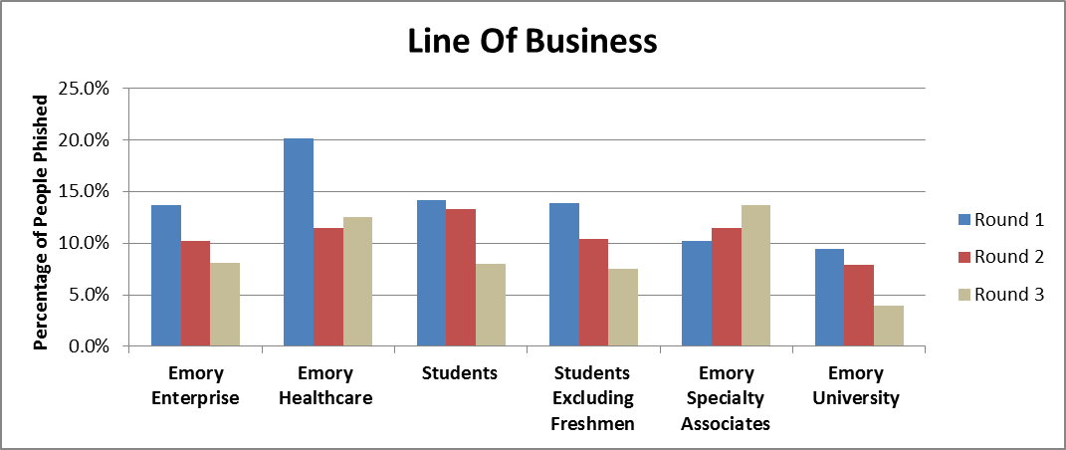
Results by Demographic

Slide 16
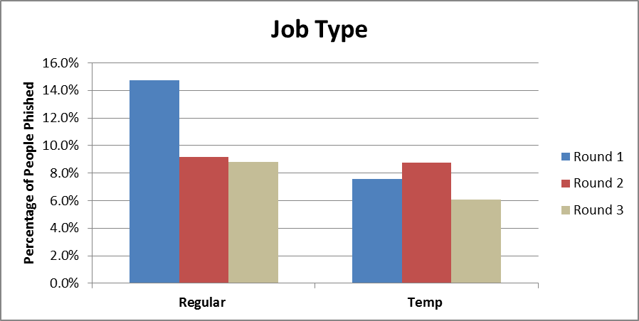
Results by Demographic

Slide 17
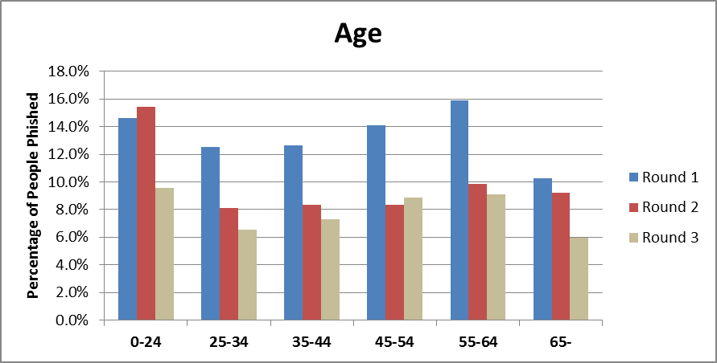
Results by Demographic

Slide 18
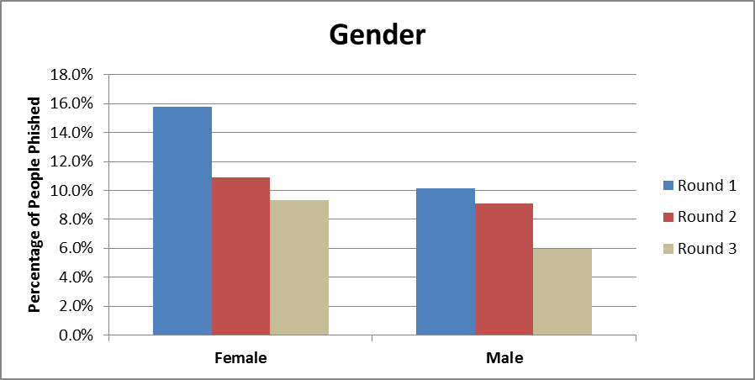
Results by Demographic

Slide 19
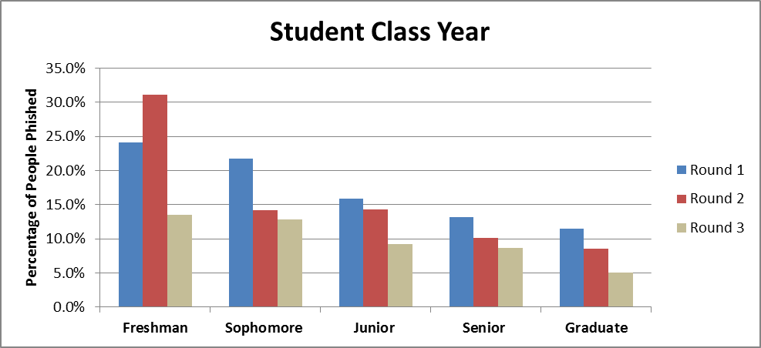
Results by Demographic

Slide 20
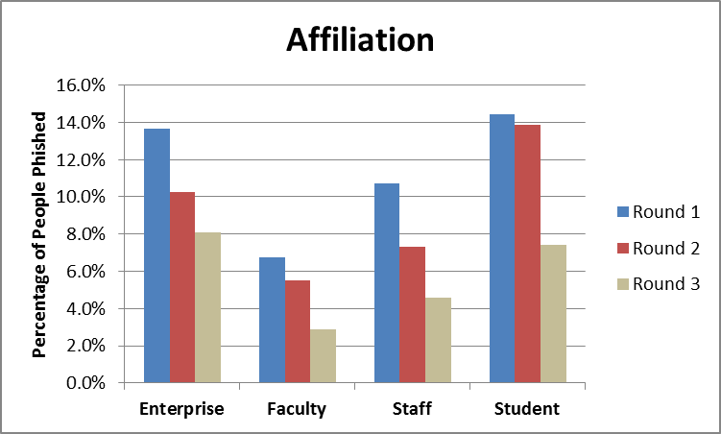
Results by Demographic

Slide 21



First round
Emails sent
39,258
Users clicking
8,395 (21.4%)
Users providing password
5,360 (13.7%)

Slide 22
Second round
Emails sent
40,858
Users clicking
7,118 (17.4%)
Users providing password
4,183 (10.2%)

Slide 23
Third Round
Emails sent
42,872
Users clicking
7,174 (16.7%)
Users providing password
3,489 (8.1%)

Slide 24
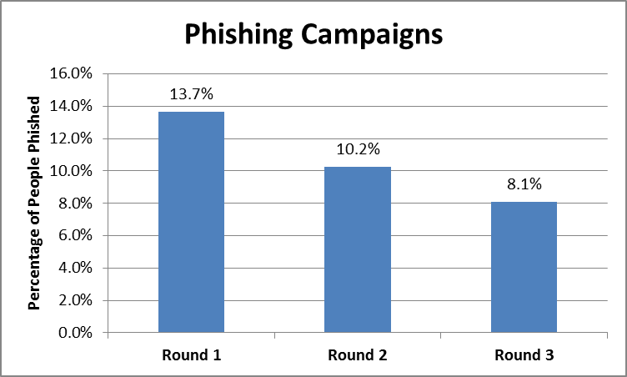
Improvement
Round 1 – 13.7% response rate
Round 2 – 10.2% response rate
26% Improvement over Round 1
Round 3 – 8.1%
20.6% Improvement over Round 2
40.9% Improvement over Round 1

Slide 25
Out of our entire population, what percentage do you think have either clicked or provided credentials during at least one of the three campaigns?

Slide 26
Out of our entire population, what percentage do you think have either clicked or provided credentials during at least one of the three campaigns?
36%
23% provided credentials
13% just clicked the link

Slide 27

Community Reaction
No angry complaints
More questions like: “Is this one of Emory’s sneaky e-mails?”
Many more reports of phishing messages coming in.

Slide 28
Someone has been paying attention…
“I can state from what I noted about the email that it claimed to be from Emory attempting to determine where/how a virus was being introduced into the system. The email return address was suspicious as it was something “emory” but at gmail.com NOT emory.edu or emoryhealthcare.org. Also, it of course stated that I needed to enter my user name and password to log in to a link within 48 hours to avoid having my email shut down entirely.
That is all the information I can recall. I believed it immediately to be suspicious and fraudulent so as I noted above, I deleted it without clicking any links.”

Slide 29

Leadership Reaction
No angry complaints
Understanding of the scope of the risk in quantitative terms
Desire for more aggressive approach to remediating the risk
Increased interest in the expansion of two-factor authentication for sensitive systems

Slide 30
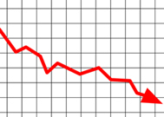

Next Steps
Continuous utilization of phishme.com
Analyze trends over time
Provide targeted education for “hot spots”
Create online training and automatically enroll repeat offenders
One-on-one supervisor counseling

Slide 31


Slide 32
Copyright Statement
Copyright Emory University 2012. This work is the intellectual property of the author. Permission is granted for this material to be shared for non-commercial, educational purposes, provided that this copyright statement appears on the reproduced materials and notice is given that the copying is by permission of the author. To disseminate otherwise or to republish requires written permission from the author.

