Slide 1
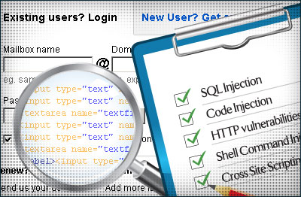
University Wide Vulnerability Scanning Program
Partnering with the campus
to secure the campus
Gil Salazar | May 16th, 2012
University of Arizona

Slide 2
State of the Internet
Recent studies show that websites are exposed to serious vulnerabilities every day.
The University of Arizona has numerous webpages that serve as the face of its academic programs, research centers, and the University at large.
Many of these have web applications that are embedded in the web pages and are exposed to the internet.

Slide 3
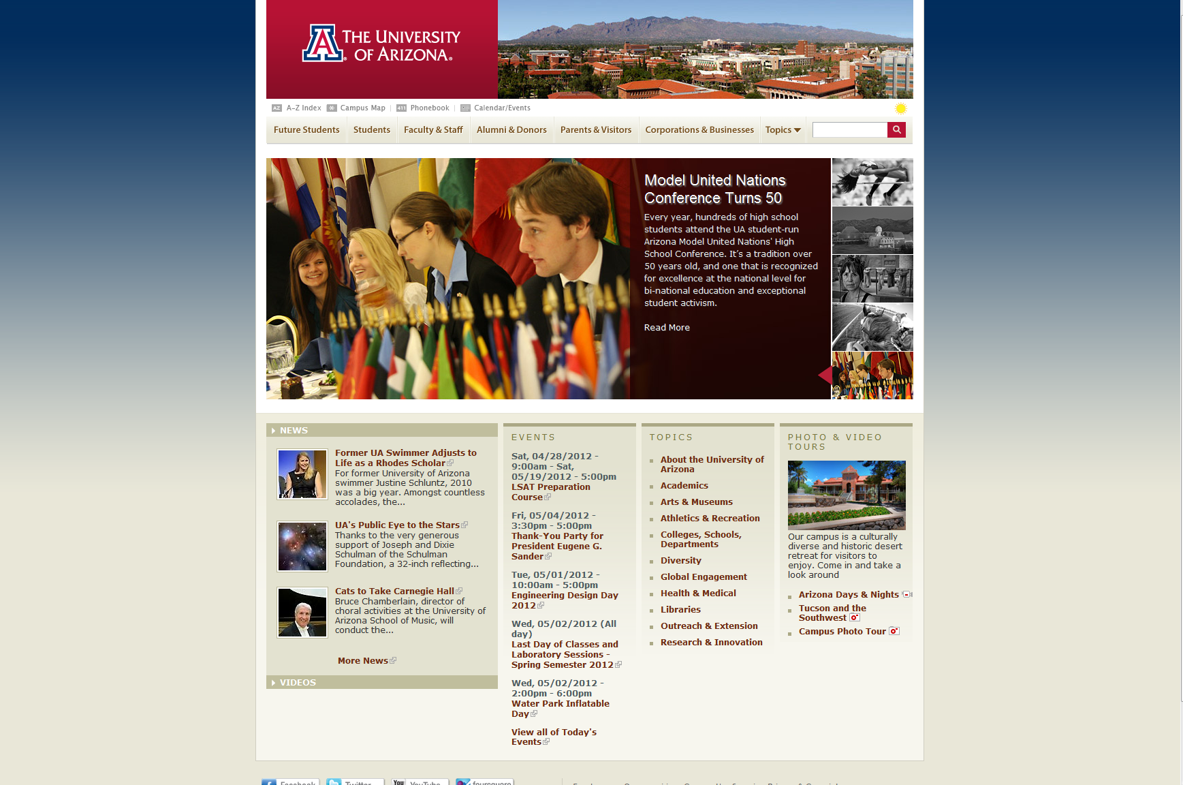
State of the UA Web space
As the result of a state audit, the Arizona Board of Regents mandated that the three state universities perform annual scans of all internet-facing applications and servers.

Slide 4
WebSite Security Concerns
Websites and applications are developed by a wide variety of campus members
Often, web development is not their primary job or area of expertise.
Many of the vulnerabilities are contained within custom website code.
Notes:
Websites and applications are developed by a wide variety of campus members:
professional staff, faculty, researchers and various levels of graduate and undergraduate students.
Many of the vulnerabilities are contained within custom website code.
OWASP recognized vulnerabilities are often a result of poor coding.

Slide 5
Challenges
The Information Security Office consists of a small staff that is not positioned to take on operational work on behalf of the campus.
UA campus is highly distributed in tech support and purpose
UA’s recent economic environment has put additional pressures at the department level, resulting in a decrease in technical staff members
Finding the right scanning tools was/is a challenge.

Slide 6
Challenges
To ensure success, we needed to organize and streamline the processes as much as possible for the campus IT support groups.
Funding for licenses for servers and applications scanners.
The UA needed to find a creative, efficient way of fulfilling the scanning requirements.

Slide 7
Teamwork
The Information Security Office created a project approach to developing and implementing a university-wide scanning program
We recruited a working group of 12 IT staff members chosen strategically across the campus.
Working together, the campus selected QualysGuard and IBM AppScan tools and recently Qualys Web Application Scanner
Notes:
We recruited a working group of 12 IT staff members chosen strategically across the campus. This group received a free two-day training and certification on IBM AppScan in exchange for assisting in creating a train-the-trainer program. The group met for several months to distill the training program down to four hours and tailor it for a UA-specific scanning program.

Slide 8
Logistics
The Information Security Office set up a Communication Plan in order to get buy-in from campus leadership and stakeholders university-wide.
Setup Scheduling system to manage licenses for each developer for a specific timeframe.
Specific instructions were developed to educate campus IT support and developers on use of scanners
Needed to create an application and server inventory database.
Notes:
The Information Security Office set up a Communication Plan in order to get buy-in from campus leadership and stakeholders university-wide. This helped to ensure a level of support and understanding of the effort required by server administrators and developers in colleges and administrative units.
Licenses needed to be managed for each developer for a specific timeframe. This led to an online request form and ticket tracking to schedule and prep licenses.
Specific instructions were developed on the process of scheduling licenses, how to proceed with the scans, remediate issues, create action plans and send in final scan reports.
We utilized Graduate Assistants to create an application and server inventory database. The system serves as an initial critical inventory of servers and applications, assists in tracking the annual scanning requirement and provides a process for transparent reporting on the scanning program.
Future plans to link the inventory and scanning databases with other central databases, device owners who manage IP address ranges and the SSL Certificate program.

Slide 9
Outcomes
Created an online information security awareness program session that is mandatory for all UA web developers
Created an online training video so that appropriate IT staff from across campus can easily access training and information as required
Created scanner support group as a resource for campus
Notes:
Creating an online information security awareness program session that is mandatory for all UA web developers. The training is based on OWASP’s Top Ten. A number of staff with good security expertise assisted with reviewing and validating the training content.
The workgroup conducted initial sessions and then worked together to create an online training version so that appropriate IT staff from across campus can easily access training and information as required.

Slide 10
Impact to Campus
Taking the web development training is a mandatory prerequisite and ensures that both training and scanning work together to create a consistent OWASP Top Ten approach to development of security best practices.
The AppScan Train the Trainer Program has been very successful in getting a large cross-section of campus IT staff members trained in using the Application Scan tool.
Security has become an integral process in web application development.
Notes:
The communication plan provided a robust and comprehensive way of spreading the word to campus stakeholders of their obligation to ensure that their internet-facing devices and applications are scanned with security tools.

Slide 11
Impact to Campus
The Information Security Liaisons are responsive to the program and campus buy-in to security is on the rise.
Campus web server code is being cleaned up and security vulnerabilities are reduced.
The UA has begun to collect metrics on scanning and remediation of vulnerabilities.
ABOR’s scanning initiative is being met.
Notes:
The Information Security Liaisons are responsive to the program because we have provided support for their efforts with stakeholders and provided much needed organization and streamlining to make the process as efficient as possible for them.

Slide 12
Scans Completed

Slide 13
Questions???
Gil Salazar
Information Security Analyst, Senior
gsalazar@email.arizona.edu

