Slide 1
Governance, Risk, and Compliance Systems in Higher Education
Sarah D. Morrow, Moderator
Chief Privacy Officer, The Pennsylvania State University
Merri Beth Lavagnino
Chief Privacy Officer and Compliance Coordinator, Indiana University
Jennifer A. Stewart
Privacy Coordinator, The Pennsylvania State University
Cheryl Washington
Chief Information Security and Privacy Officer, University of California Office of the President

Slide 2
What is a Governance, Risk, and Compliance (GRC) system?
An integrated application that helps automate:
managing the policy development, dissemination and attestation process;
tracking requirements of law, regulations, standards, and frameworks such as ISO and NIST;
monitoring and ensuring compliance obligations are met, such as those required by PCI DSS, GLBA, and HIPAA;
issuing surveys to business units to check themselves against those requirements to find gaps;
doing risk assessment exercises and treating risk factors, especially against the gaps found;
tracking mitigation activities taken to reduce those risks;
automating incident or issue tracking to ensure each is logged, tracked, routed to the right person, completed, etc.;
and often much, much more!

Slide 3
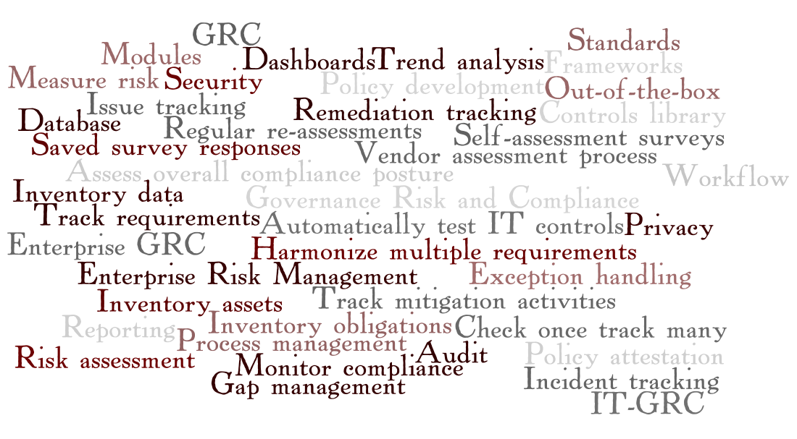

Slide 4
Panel Discussion
Institutional Sponsor
Vendor Search Process
Pre-purchase Considerations
Functionality Essentials
Planning Phase
Production Roll-out

Slide 5
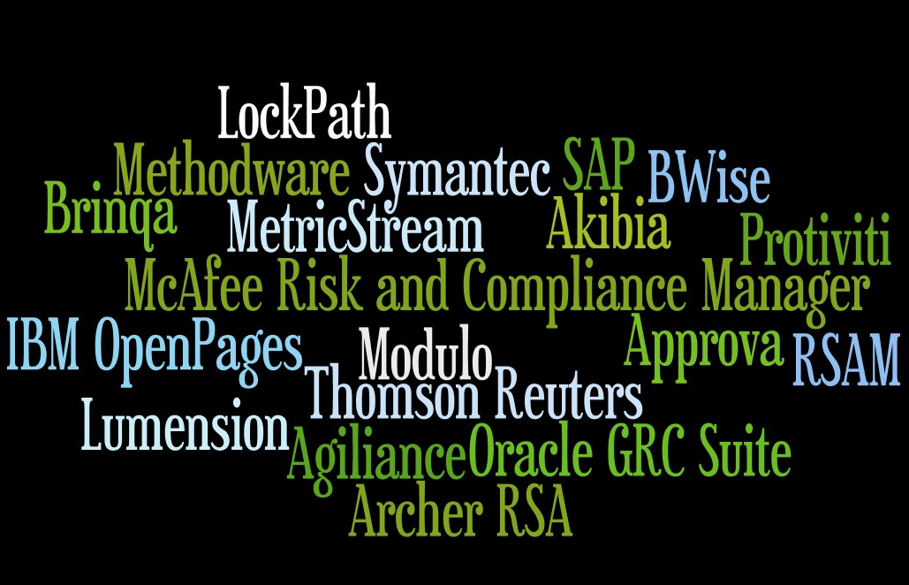
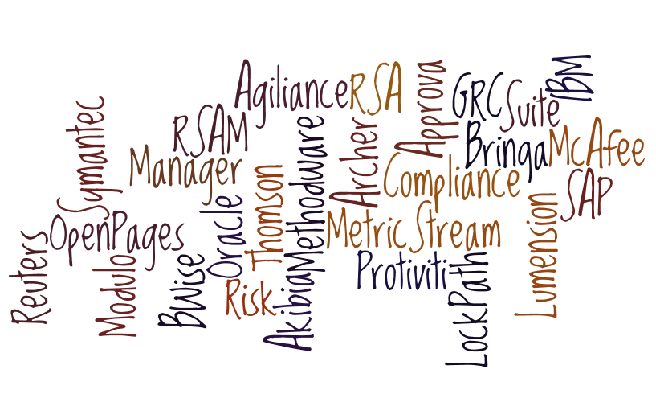

Slide 6
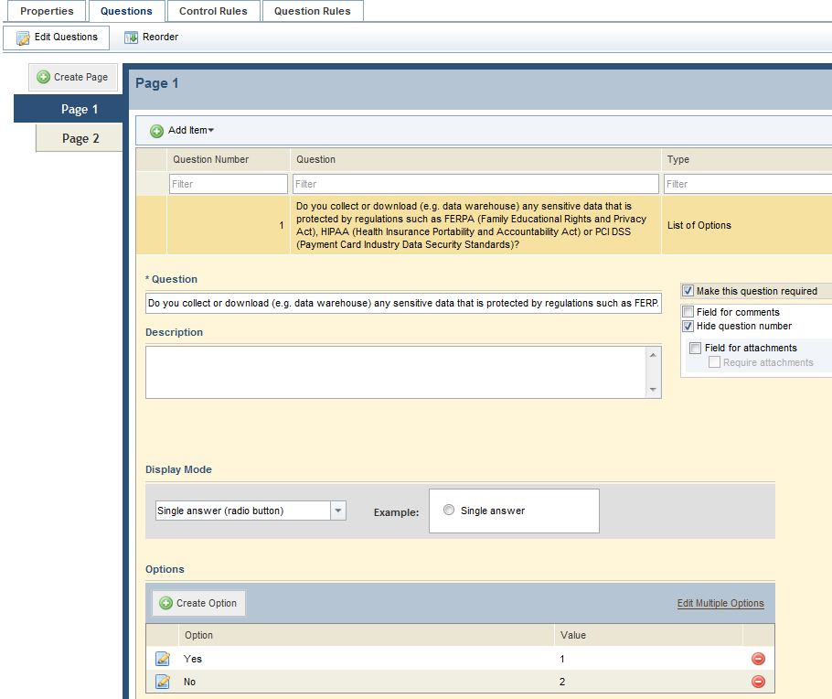

Slide 7
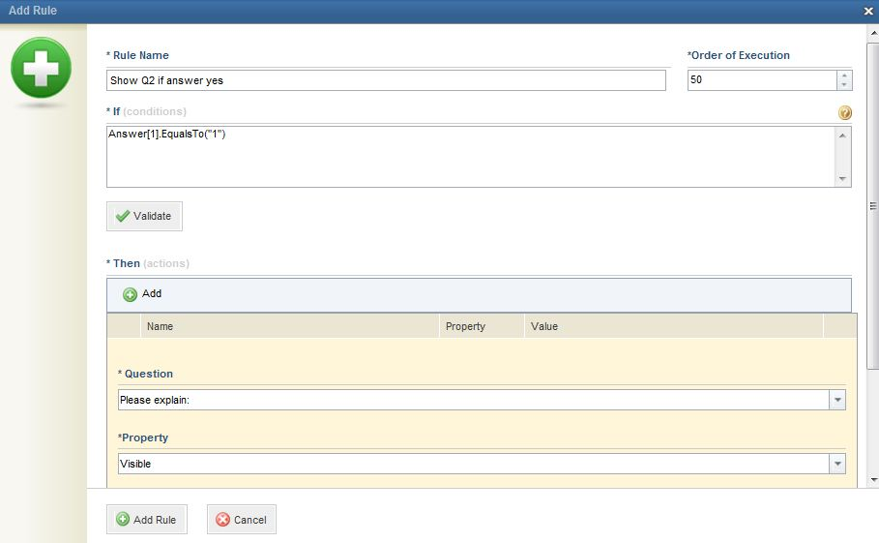

Slide 8
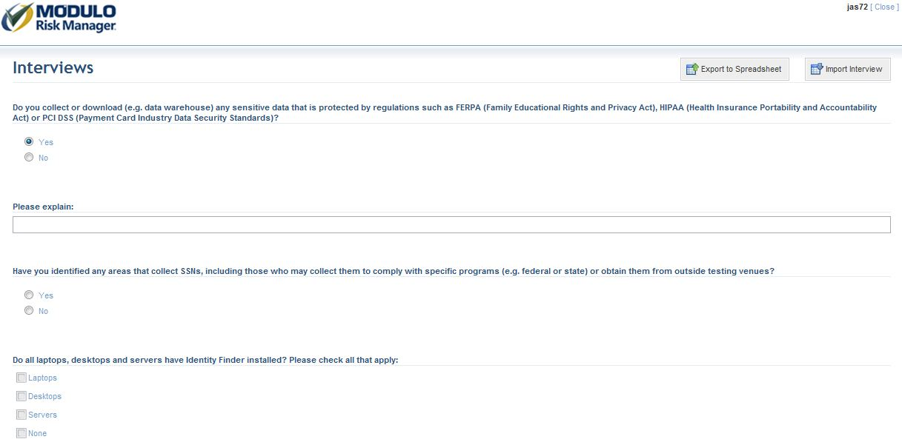

Slide 9
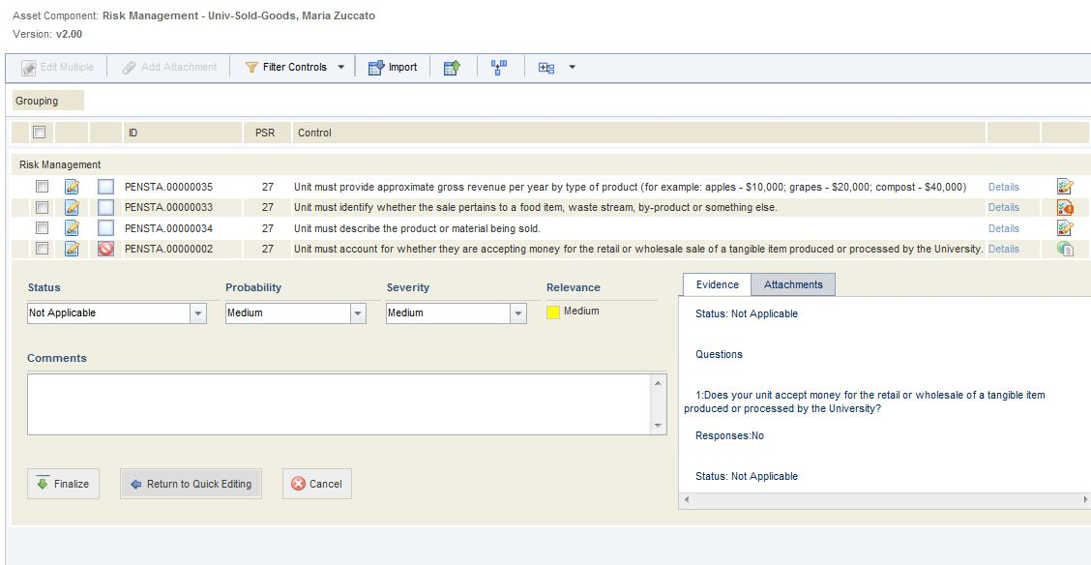

Slide 10
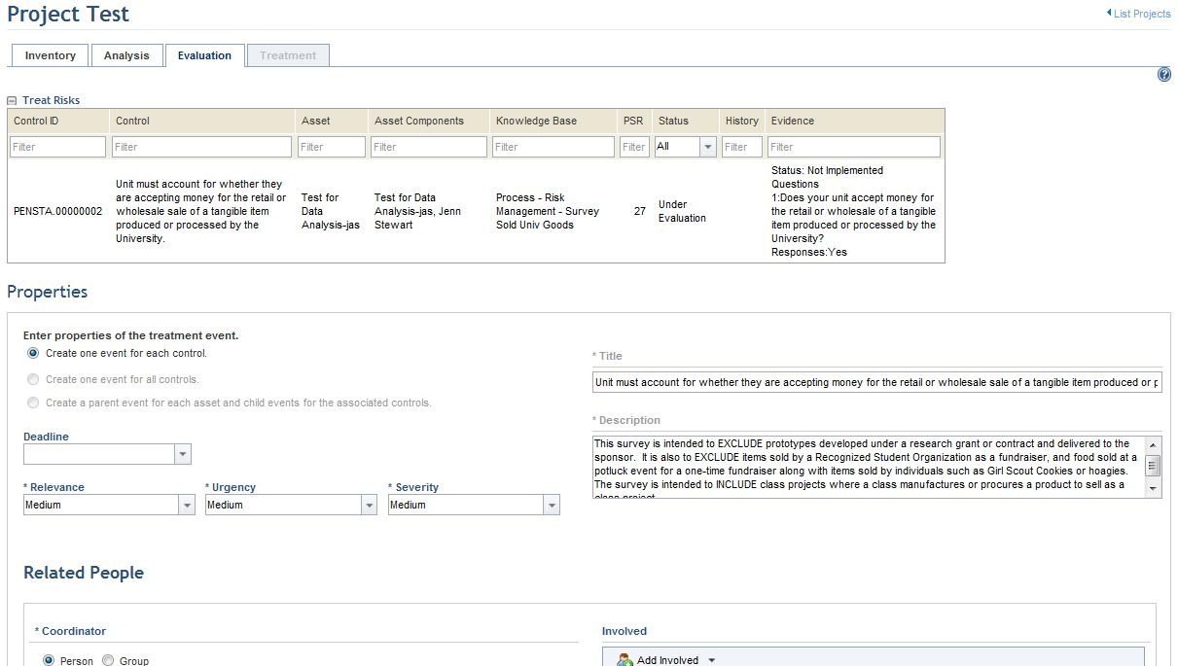

Slide 11
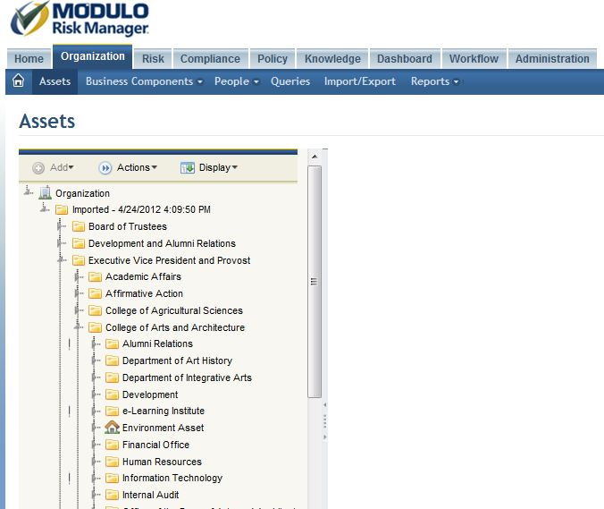

Slide 12
Contact Information
Sarah D. Morrow
sdm24@psu.edu | 814-863-3049
……………………………………
Merri Beth Lavagnino
mbl@iu.edu | 317-274-3739
……………………………………
Jennifer A. Stewart
jas72@psu.edu | 814-863-7820
……………………………………
Cheryl Washington
cheryl.washington@ucop.edu

Slide 13
THANK YOU

