Slide 1
Tools and Methods for Managing Snort Sensors in Distributed Environments
Scott Pack, Ed Carter | May 16, 2012

Slide 2
Ohio University
Students | 36,142
Faculty/Staff | 4,631
Routed Subnets | ~256
Buildings | 163
Unique MAC Addresses (DHCP) last year | 176,412

Slide 3
Information Security Office
Three teams
Assessments, Awareness, and Business Continuity
Identity and Access Management
Architecture and Response
Security Monitoring, Forensics, Vulnerability Management, Architecture Reviews, IR, etc.
Notes:
Architecture and Response – 3.5 analysts

Slide 4
Problem
How can we monitor the network for the ‘Bad Traffic’ given analyst time and financial constraints?

Slide 5
Hardware
Notes:
Leavings from the Student Computing Environment project (Project placed computer & printer in each of ~8000 resident hall rooms).
Pentium 2.4GHz class – Free!
-- newest models are non-dual core NetBurst
Using on-board NIC for management and additional PCI card for monitoring.
Intel PRO/1000 GT Desktop Adapter (Intel PWLA8391GTL) -- ~$35
Monitoring feed comes from span/analyzer/mirror ports on building switches.

Slide 6
Software
RedHat Enterprise Linux
Snort
Cobbler
Puppet
Daemonlogger
PulledPork
Notes:
Cobbler – Kickstart based provisioning system built on programmable system templates.
Puppet – Client/server Linux system configuration tool using a declarative configuration language.
Daemonlogger – Ringbuffer style tcpdump tool. Written by Martin Roesch of Sourcefire.
PulledPork – Rule download/management tool. Written by JJ Cummings of Sourcefire.

Slide 7
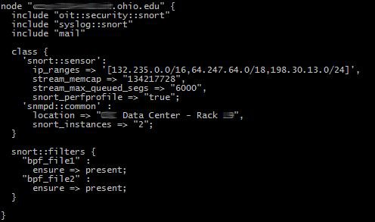
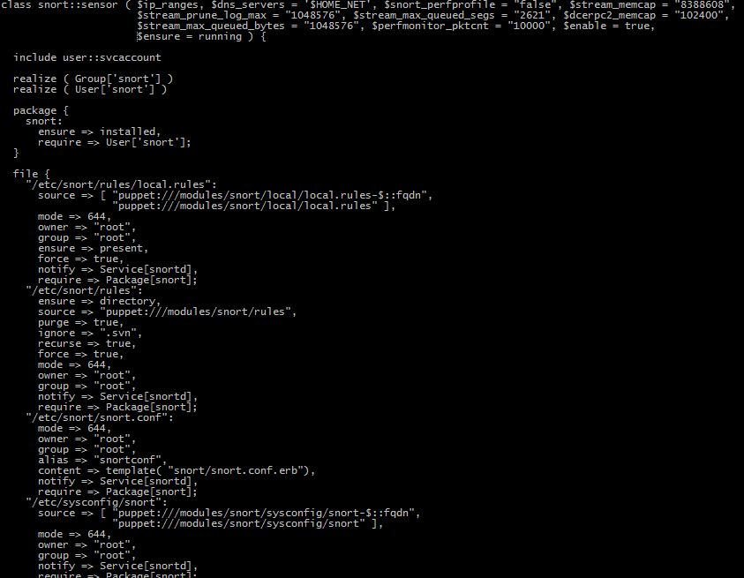
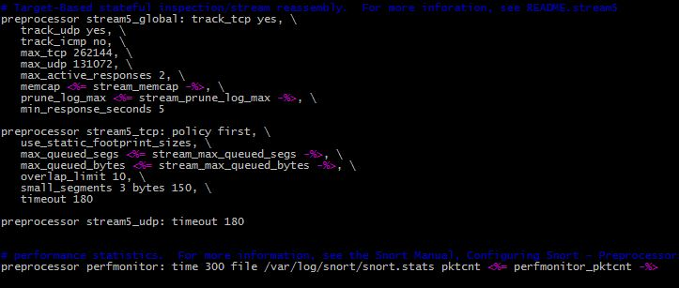
Notes:
Using BPF files for splitting up traffic to multiple instances of snortd on HT or multi-core sensors.
Using class parameterization for per-sensor customization.
Currently same VRT/ET rules are pushed out to every sensor. Some sensors have custom local.rules, distributed by FQDN.

Slide 8
Environment
29 sensors
~1.5Gbps daily average
~5000 alerts/day
9840 Rules in Use
Notes:
Average throughput is sum of the sensor daily averages over last 6 months.
Alerts per day is sum of all sensors for last month / 30.
Number of rules is from 5/15/2012.

Slide 9
Monitoring
Spectrum
Cacti
Puppet-Dashboard

Slide 10
Notes:
Spectrum (not pictured) monitors system state for current health. System up/down, memory/cpu thresholds, etc.
Puppet Dashboard gives centralized view of system configuration changes (whether changes happened, if the check-in failed, etc), how long each system takes to process changes, if systems have stopped checking in.
Net-snmpd is using local OID to present snortd application data from perfmonitor preprocessor. Data is collected and graphed using Cacti.

Slide 11
Lessons
Tuning is a nightmarish necessity.
Data output requires in-depth analysis to be most useful.
Sensor location is complicated.
Large up-front time investment in research/development.
Unintended network troubleshooting tool.
Notes:
A business process, and possibly SIEM depending on size of institution, for processing alerts is a must!
Risk based approach to placing sensors. Also requires consultation with networks for location of mirror/span/monitor ports or taps. Physical data paths are sometimes surprising.
Time Spent – Hard to estimate, development occurred over a couple of years as partial job duty.
Deploying a sensors requires ~1-2 hours per device.
Since sensors are present on many networks they have also been useful as on-site diagnostic probes performing packet captures, local connection tests, ARP lookups, etc.

Slide 12
Future Growth
Expand out to all buildings/networks.
Trigger sanctions based on IDS alerts.
Notes:
Plan on triggering events from SIEM – NitroView.

Slide 13
Resources
Snort - http://snort.org/
Puppet - http://puppetlabs.com/
Cobbler - http://cobbler.github.com/
Cacti - http://www.cacti.net/
Daemonlogger - http://www.snort.org/snort-downloads/additional-downloads#daemonlogger
PulledPork - http://code.google.com/p/pulledpork/

Slide 14
THANK YOU

