Slide 1

Congratulations! You’ve Just Been Named Your Institutions ISO, So What Do You Do Now?
Neal Fisch
Information Security Officer
Director, Enterprise Services and Security
April 16, 2013
10:30am – 11:15am
EDUCAUSE Security Professionals - 2013

Slide 2
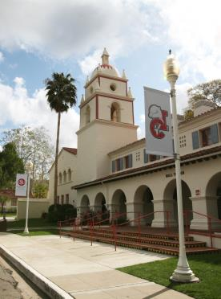

About California State University Channel Islands
California State University Channel Islands (CI), located in Camarillo, California, is a student-centered, four-year, public university known for its interdisciplinary, multicultural, and international perspectives and its emphasis on experiential and service learning.
Founded in 2002 as the 23rd and newest campus of the CSU system, California State University Channel Islands (CI) offers an unparalleled student-centered learning experience in one of Southern California’s most scenic settings.
Students: 4700 Staff: 700
We’re currently celebrating our 10th anniversary.

Slide 3
Some personal backstory …
ERP Application Programmer for 22 years
Mainframe/Client Server
Various Security Responsibilities
Administrator for the last 4 years
Input onto University Security Practices
In ISO role about 8 months
Covering Security, Compliance and Risk
Payroll/HR/Finance
Private Sector, Public Sector, and Consulting
Notes:
About my IT career:
Various responsibilities including information security (identify payroll and consulting background and associated security responsibilities).

Slide 4



Why was this session proposed?
Where can I learn what I need to know?
EDUCAUSE
Security Conference
SANS Institute
Web
Conferences
Workshops
Notes:
Once I started looking for direction as to what tasks I needed to identify, complete, document, etc.. I started with the most logical place… this conference (2012).
The timing was just right after I was given my new responsibilities.
I had been to other EDUCAUSE conferences and felt I could find everything I needed to know at this conference to be able to toddle off and start doing all that I needed …
Well… Even though everyone I encountered was extremely helpful and willing to help me find my way, there didn’t seem to be any single opportunity available to be able to sit with others in my situation and have comprehensive discussions about direction, roles, responsibilities and such. And this wasn’t unique to the EDUCAUSE conference either. I saw this same pattern in many of the other meetings, conferences and workshops I attended.
I did learn new things each time, but still didn’t get an entire picture, so this session was born…. ☺

Slide 5
Survey Time!
How many of you are new to information security?
Notes:
Survey question and discussion with group.

Slide 6
Survey Discussion
Did you have a clear picture of the role you were stepping into and the tasks that would be required of you?
What steps did you take to try and fill in that picture and gain the information you needed?
Where did you turn to for “experienced” advice?
What resources were made available to you?
Notes:
If there are positive answers… group discussion
If not… group discussion on these items:
What steps did you take to try and fill in that picture and gain the information you needed?
Where did you turn to for “experienced” advice?
What resources were made available to you?

Slide 7
Survey Discussion
Did you have a mentor?
Was it someone in your organization (campus/university) or an outside colleague?
How did your mentor work with you to help you?
Notes:
If so….
Did your mentor assign tasks for you to work on relevant to your universities security needs?
Did your mentor collaborate with you on existing tasks assigned to or by your mentor?
What worked well for you?

Slide 8
Survey Time!
How many of you that are ISO’s are new to the ISO position (within the last 1-3 years)?
Notes:
Another survey question and discussion.

Slide 9
Survey Discussion
What had you done previously to that prepared you for the ISO role?
Had you been working in information security previously, and if so, how long?
Had you been preparing for this role previously or were you previously responsible for these tasks?
Notes:
If so,
What had you done previously that prepared you for the new role?
Had you been working in information security previously, and if so, how long?
Had you been preparing for this role previously or were you previously responsible for these tasks?

Slide 10
Some next steps….
Needed to identify current levels of security already in place.
Needed to identify policies and practices currently in place… and documented.
Needed to identify if security awareness training was in place.
Needed to discover if there were any system-wide compliancy items that required addressing.
Needed to identify my system-wide colleagues.
Notes:
I participate as my campus ISO in the CSU’s system-wide ISAC (Information Security Advisory Council).
The ISAC creates standards and guidelines related to information security on all campuses to help abide by security policy set forth by the system-wide CISO.
These are some of the items I felt needed to be identified. We’ll talk a little about each of these items next

Slide 11
Some next steps….
Needed to identify current levels of security already in place.
Initiated discussions with Networking and Infrastructure groups.
Initiated discussions with User Services groups related to desktop security.
Initiated discussions with Enterprise Applications groups.
Initiating discussions with various vendors supporting SaaS applications.
Notes:
Network/Infrastructure discussions surrounded scanning, logging, vulnerability management, and server patching practices including email scanning (phishing).
User Services discussions included client anti-virus usage, desktop patch management, and user access rights to their machines.
Enterprise Applications discussions focused on specific application security, integration security, data ownership, access management, and enterprise database security practices.
Vendor discussions focused on access and compliance, vulnerability, scanning, and server patch management.

Slide 12
Some next steps….
Needed to identify policies, practices, standards and guidelines currently in place and documented.
Reviewed current inventory of IT policies, practices and standards and compared to current system-wide requirements.
Compared these with NIST 800-53 standard as well as SANS 20 Critical Security Controls.
Notes:
The CSU maintains a central advisory body comprised of ISO’s from each of the 23 campuses called the Information Security Advisory Council (ISAC). This body is tasked with identifying and providing policy, standards and guidelines for the 23 campus system.
NIST Special Publication 53 (current revision, revision 4, is under final draft) – Security and Privacy Controls for Federal Information Systems and Organizations (link to NIST special publications is included on another slide).
The link to SANS 20 Critical Security Controls is included on another slide.

Slide 13
Some next steps….
Needed to identify if security awareness training was in place.
Contacted our HR’s training department to see what training was available.
Discovered that security awareness training was sponsored at the system level and not the campus.
Was granted access to the training program and the training records and completed research.

Slide 14
Some next steps….
Needed to discover if there were any system-wide compliance items that required addressing.
Reviewed the system-wide policies, standards and guidelines.
Determined additional documentation was needed to be compliant at the system level.
Began mapping out the documents and respective completion timelines.
Notes:
Ideally, I would have had a nicely defined amount of time to map out the timeline against the identified tasks, but lucky for me the system sent me an auditor to help me “identify, prioritize, and provide deadlines” for this task.

Slide 15
Some next steps….
Needed to identify my system-wide colleagues.
Being part of a 23 campus system does have its advantages!
I have 22 other seasoned ISO’s to look to for advice and direction and it didn’t take very long to find my new friends!
Notes:
I participate as our campus ISO in the system-wide ISAC (Information Security Advisory Council). The ISAC creates standards and guidelines related to information security on all campuses to help abide by security policy set forth by the system-wide CISO.

Slide 16
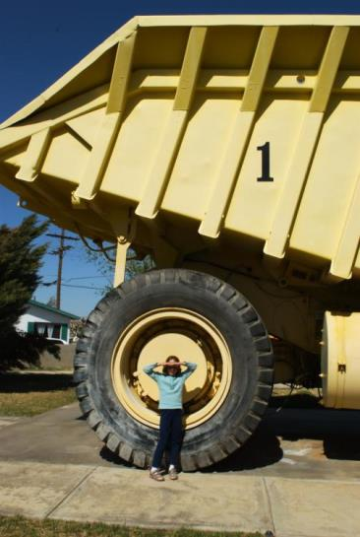
Notes:
During my evaluations of these items, I sometimes felt like this person compared to the tasks at hand …

Slide 17

A Security Program is Born!
Flickr/ CyberHades

Slide 18
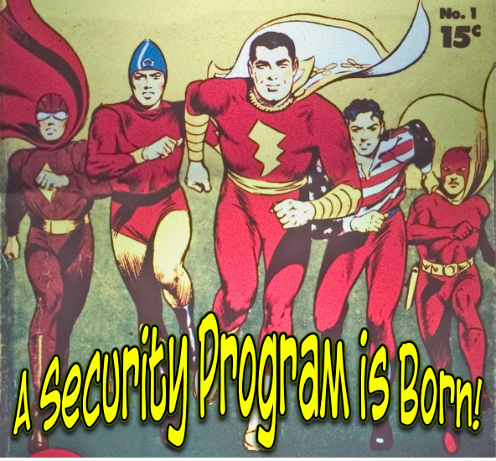
Notes:
This is how I really felt!

Slide 19
Information Security Program
Notes:
So.. Here I was, after completing my initial research and after completing discussions with my CSU colleagues, I had a fair amount of information gathered to begin structuring an information security program. Keeping things simplistic, here’s what we came up with:
There are four areas of focus (or pillars) within our current (and still under construction) security program with each one area supporting the program equally.
< next slide >

Slide 20
Information Security Program
Awareness Program
Notes:
Awareness Program
It’s my opinion that an Awareness Program is incredibly important to a successful information security program. You can have all the policies and standards you could possibly need or want, and have all the tools available on the market, but all of that can become meaningless if you have un-aware technology consumers who make bad choices.
For those staying for the Enterprise IT Leadership Conference, Lance Spitzer Director, SANS Securing the Human, will be presenting a short talk tomorrow at 11:15am “Mitigating the Top Human Risks to EDU’s” to identify the top human risks to institutions, and what can be done to effectively mitigate them.

Slide 21
Information Security Program
Awareness Program
Policies, Risk and Compliance
Notes:
Policy, Risk and Compliance Program
Having policies and standards are an important part to any security program. These define rules and guidelines, draws the lines around what is and is not acceptable, and legal….
Managing your institutions risk and level of compliance helps the members of the university community better perform their tasks.
Are policies, risk and compliance part of your job duties or do you have separate areas responsible for all or parts of this?
Please share with the group.

Slide 22
Information Security Program
Awareness Program
Policies, Risk and Compliance
Vulnerability and Incident Management
Notes:
Vulnerability and Incident Management
Vulnerability management is the ever vigilant traffic cop protecting your borders. Always watching… always reporting

Slide 23
Information Security Program
Awareness Program
Policies, Risk and Compliance
Vulnerability and Incident Management
Audit
Notes:
Audit and Assessment
Audit keeps you honest! Audit makes you accountable to not only Federal, State and Local regulation, but also accountable to your own institutional policies and standards.
Is audit part of your ISO role?
Do any of you have an internal audit group?
How are audits performed at your University?

Slide 24
Information Security Program
Awareness Program
Policies, Risk and Compliance
Vulnerability and Incident Management
Audit
Notes:
The Program!

Slide 25
Leverage Available Resources
EDUCAUSE
Higher Education Information Security Council(HEISC)
Information Security Guide and Toolkits
https://wiki.internet2.edu/confluence/display/itsg2/Home
EDUCAUSE Policy
http://www.educause.edu/focus-areas-and-initiatives/policy-and-security/educause-policy
SANS Institute
http://www.sans.org/
NIST
National Institute of Standards and Technology
Special Publications (800 Series) for computer Security
http://csrc.nist.gov/publications/PubsSPs.html
Notes:
There are a number of available free resources that you can take advantage of as a new ISO.
The EDUCAUSE HEISC (Higher Education Information Security Council) Information Security Guide is an excellent resource to help you build your security programs. The guide includes templates, links, toolkits and other informative resources to help you understand, build, and maintain your information security program.
SANS.org is another great resource. SANS also offers a number of free resources such as the Security Awareness Tip of the Day, OUCH! Monthly Security Awareness Newsletter, 20 Critical Security Controls for Effective Cyber Defense, as well as a number of resources and training for purchase.
NIST – National Institute for Standards and Technology offers national standards, guidelines and publications for computer security.

Slide 26
Leverage Available Resources
ISO 27001 and 27002 Standards
ISO (International Organization for Standardization)
http://www.iso.org
Threatpost
Kaspersky Lab Security News
Current news about security issues around the world
http://threatpost.com/en_us
ZDNet Security News
Current Security News from ZDNet
http://www.zdnet.com/topic-security/
Notes:
There are a number of available free resources that you can take advantage of as a new ISO.
Threatpost, a security news site from Kaspersky Labs provides daily current security news from around the world.
ZDNet Security, a security news site from ZDNet provides daily current security news, advice and opinions.

Slide 27
EDUCAUSE Mentor/Mentee Program 2013
New this year for SEC13
Information is available on the conference website off the Program and Agenda tab
Open to new security managers, directors, ISO’s, and CISO’s
For additional information contact security-council@educause.edu or Valerie Vogel at EDUCUASE.
Notes:
Please stop by the registration desk and leave your name and contact information if you’re interested in being a mentee or a mentor!

Slide 28
Questions?
Notes:
Questions?
At this time I’d like to solicit any recommendations or suggestions from the audience to those of us starting down this winding road…..

Slide 29
Thank You!
Neal Fisch
CSU Channel Islands
(805) 437-3278
neal.fisch@csuci.edu
Notes:
Thank you all very much for participating! I hope you were able to find something to take away with you from this presentation.
Feel free to contact me with any questions any time!
Have a great conference everyone.

