Slide 1
Ben Marsden, Information Security Director, Smith College
A Pragmatic Information Security Program for Small Institutions
EDUCause Security Professionals Conference, April 2013

Slide 2
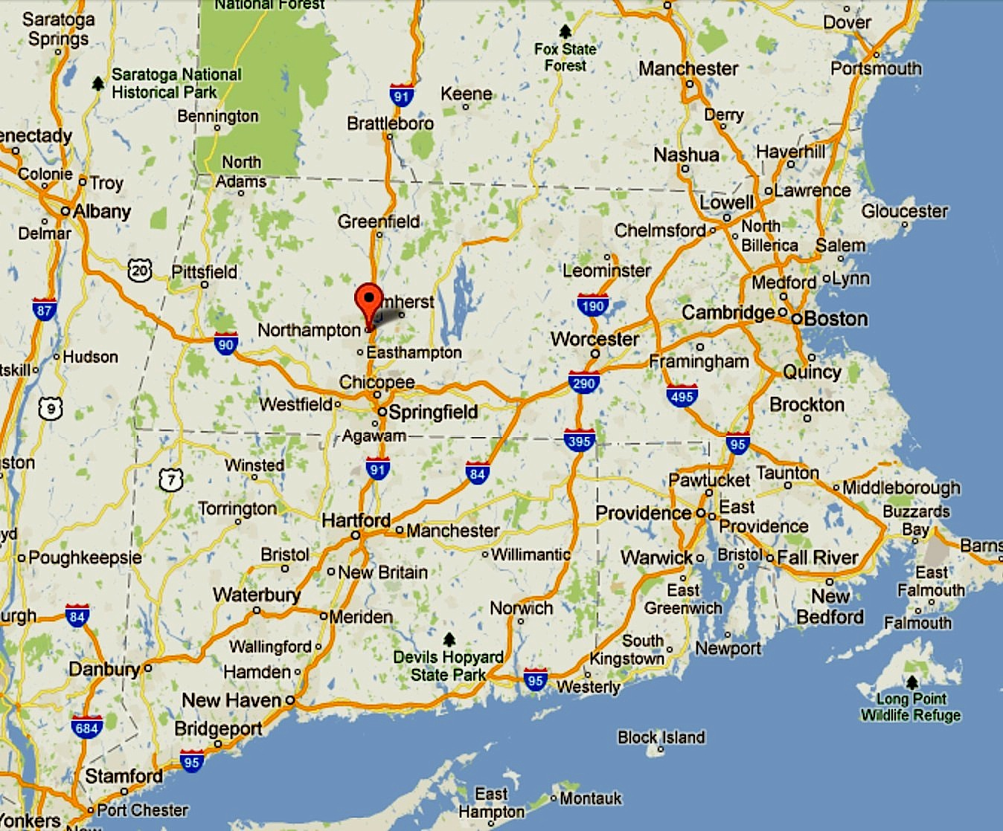
Where in the world is Smith College?

Slide 3
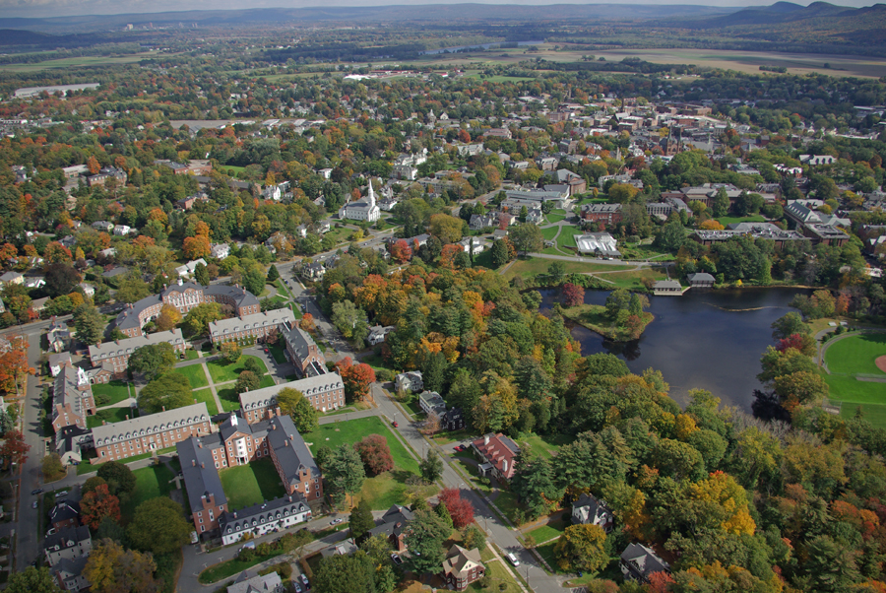
Located in the Connecticut River valley, CT river in the back ground, Umass / Amherst 9 miles east (upper left)
Notes:
Nestled in the bucolic farming lands of glacial lake Hitchcock and the Connecticut River valley

Slide 4
Smith College quick stats:
Undergrad residential women’s college
~2700 students, 513 faculty, 841 staff
~4000 community members
One of the “Seven Sisters”
~120 buildings, geographically contiguous
“new” (15 months?) VP of IT
updated ITS Strategic Plan
Notes:
About 80% of students are living on campus, another 10% study abroad, and 5% live off campus
Of the 120 buildings, about 45 are residences, intermixed geographically within the Smith College campus
An ITS strategic plan was developed by Phil Goldstein at the behest of the Board of Trustees, it was adpoted in 2011, and revised in 2012

Slide 5
me…
At Umass / Amherst about forever:
Umass / Amherst : BS, MS geology
Ugrad –> grad –> staff
VMS & unix sysadmin
Assistant director, Engineering Computer Svcs
Moved to Smith College :
1999 : Director, SNS
2012 : Director, Information Security

Slide 6
WISP – the early years
Original WISP adopted in 2010
MA data breach law compliance
When all you have is a hammer, everything looks like ….

Slide 7
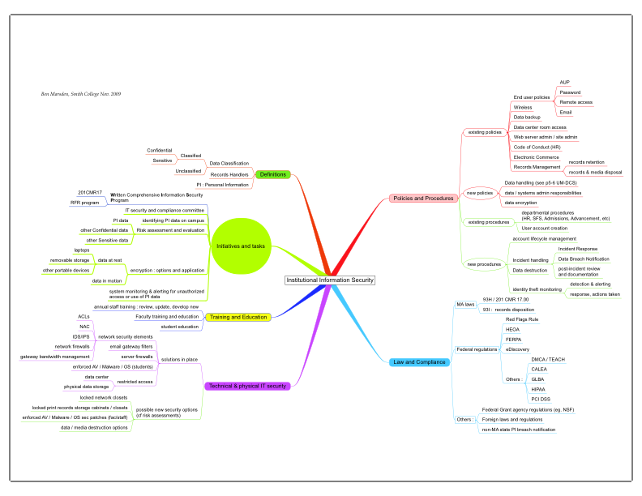
Notes:
When you have two hammers, everything still looks like nails (?)
Policy, procedure & compliance PLUS infrastructure technical controls
with a few definitions and user awareness bits thrown in for glue

Slide 8
An Info Security Program…
New position = new security program !
But, a security program is NOT …
an overview of the current security profile
Help! What should a “real” security program look like?
Attend a bunch of sessions… like this one…

Slide 9
Other sessions I’ve attended in the past….
{imagine picture of jigsaw puzzle with missing pieces here}
Don’t fit me : institution size, available resources
Strategically incomplete, not comprehensive in breadth
Focus on technical controls, not on strategic models
Don’t lay out a helpful path for implementation
So… ….back to baseline fundamentals…
what is an Information Security Program? Why have one?

Slide 10
Info Sec overarching Program Goals :
I hold these truths to be self evident…
General Info Sec goals : promote CIA
Confidentiality, Integrity, Availability
Institutional Info Sec goals : protect IIP
Information, Infrastructure, and our Peeps
Reduce the overall risk profile of the institution
* Keep Info Sec Simple
Not simple = not done (or at least not sustainable)
Notes:
Re : “Peeps” – People :
anecdote : when generally asking people what do you think an IS Director does, what's my main goal? One person answered "protect the girls."
This surprised me, because I had been thinking protect the data, protect the infrastructure, protect the institution; and I was all about the three pillars of security : Confidentiality, Integrity, Availability
-- client machines were on my radar. But students themselves… I hadn't given it much thought.
"Yeah, mommy and daddy are expecting you to help keep them safe." From themselves, or their ex-boyfriends, or their feuding roommate, or random stalkers, or whoever. Not to mention some high profile students who really may be targets and need some extra protection. So, just keeping that on your radar too...

Slide 11
An Info Sec Program is … (conceptually)
It is the manifestation of the Institution's Security Profile design goals
Or, the framework through which governance directives (strategic) are transmitted to management for actions (tactical)
Notes:
These are both GOOD CONCEPT statements of what an Info Sec Program is:
Nice but vague
For example, a control directive might be “implement role-based access controls for records in Banner”, which the Sec Program uber-controller delegates to Sarah to implement (or report back why it may not be implementable)

Slide 12
An Info Sec Program is … (actually)
It articulates complementary control domains that meld a variety of security control initiatives so as to most effectively enhance the overall security comportment of the institution.
-- Ben the Pedantic
It defines information security control domains to most effectively select, implement and manage security control initiatives.
It’s an umbrella against the constant downpour of threats
Notes:
This is what the ISP actually contains :
These both say functionally the same thing, so let’s go with “B” !
My starting baseline : I hold this truth to be self evident.

Slide 13
Security Domain Standard Framework models :
Generally created by gov and commercial entities; are auditable and certifiable.
ISO 27001/27002
27001 specifies 12 domains, ~135 controls ; 27002 specifies lots more
COBIT : 4.1, 5.0
NIST SP800-53
framework of controls recommendations for FIPS compliance which enacts FISMA 2002
20 Critical Controls
CSIS - Center for Strategic and International Studies; consortial effort
actually, 20 control domains
Notes:
Umass uses ISO framework for their security program;
I believe the EduCause Security Guide also uses ISO framework as a reference model for the resources they make available.
27001 represents the assessment or audit tools to use in evaluating implementation of the controls in 27002

Slide 14
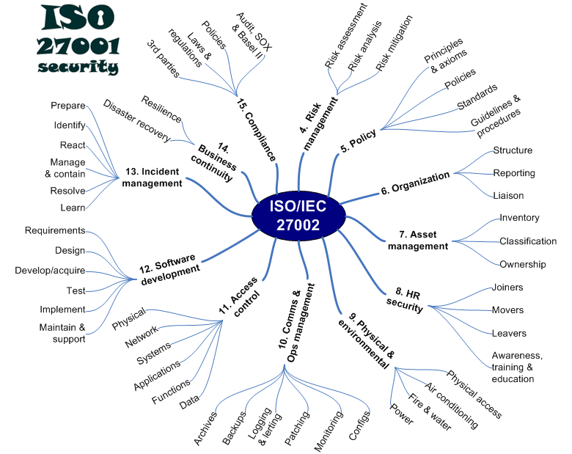
ISO 27001 framework - 12 Domains

Slide 15
ISO 2700n in education:
"[The Educause Information Security Guide] fundamental organization is based upon the ISO/IEC 27002: 2005 standard, Information technology - Security techniques - Code of practice for information security management. […] the Guide is organized into topics which parallel the major clauses of ISO 27002.”
Umass / Amherst has based their Security Program on ISO 2700n

Slide 16
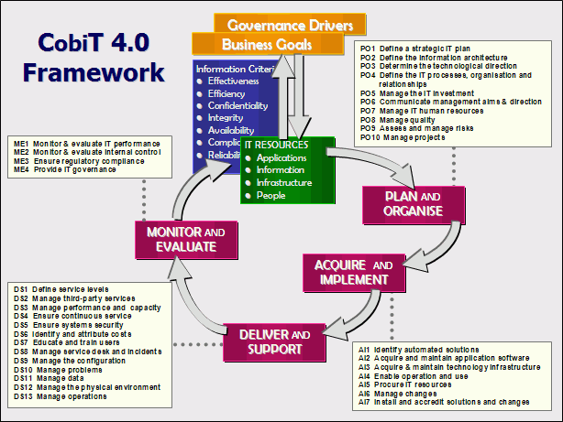
COBIT Framework :
Notes:
Note the strong PROCESS driven focus of this framework !

Slide 17
PROCESS
Note the strong PROCESS driven focus of this framework !
PLAN
IMPLEMENT
DELIVER & Support
EVALUATE (* security metrics)
Consort with stakeholders;
identify resources
…repeat
Notes:
IT is this ongoing process that gives any security program sustainability and vitality over time
Re: EVALUATE : find and use security metrics wherever possible, or find ways to get them when you need them
Metrics are what will best translate into “C”-language

Slide 18
Good Practice…
From COBIT 5, appendix G :
Simplicity :
The enterprise architecture should be designed and maintained to be as simple as possible while still meeting enterprise requirements.
Agility :
The enterprise architecture should incorporate agility to meet changing business needs in an effective and efficient manner.
* I’d place “security agility” as a particular strength that a small institution can use to its advantage!
Notes:
I agree with both of these

Slide 19
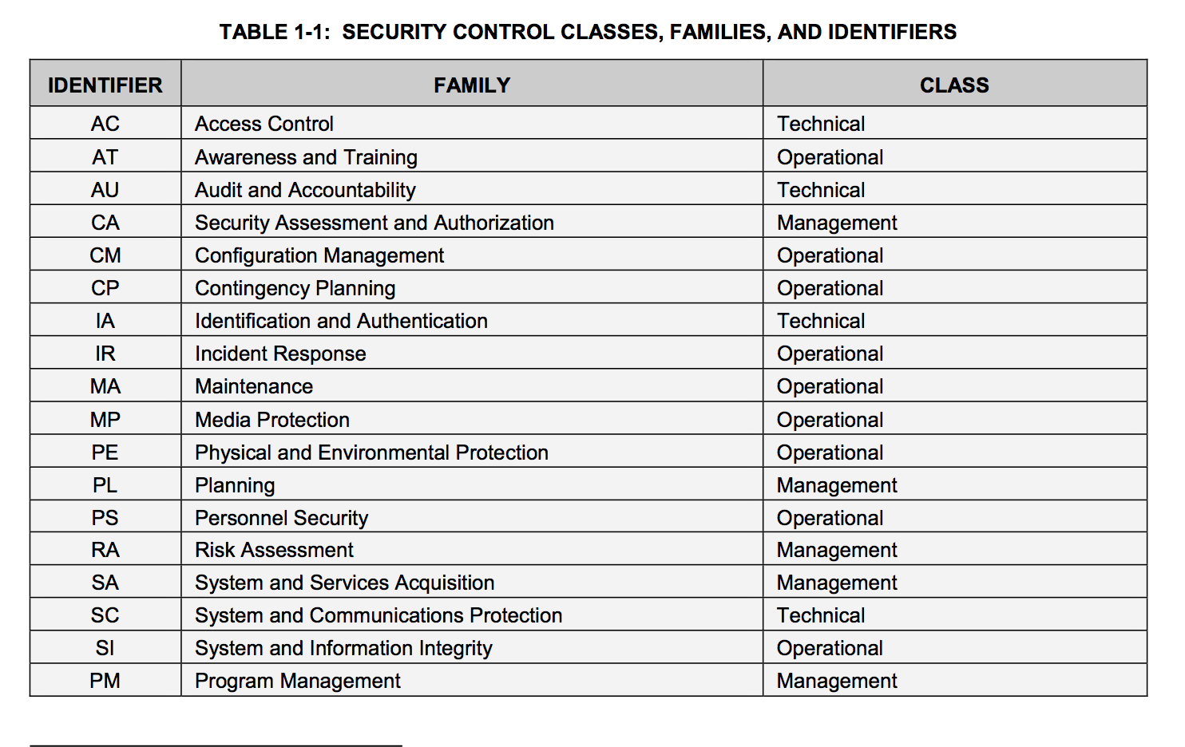
NIST 800-53 Security Control Family table
Defines 17 “families” grouped into 3 “classes”
Notes:
17 “Families” which I’ll tag as “Domains”
3 “Classes” : I also tend to put domains and controls into one of two general “classes”
Strategic - high level, conceptual, longer view (lectures in the class room)
Tactical - low level, hands-on, shorter view (field work, boots on the ground)

Slide 20
SIIS “classes”
Strategic -
high level, conceptual, longer view (lectures in the class room)
Tactical -
low level, hands-on, shorter view (field work, boots on the ground)
(“You don’t learn geology in the classroom, you learn it through the soles of you boots.”)

Slide 21
20 Critical Controls (1/2)
(Rearranged to impose my own logic on how these control domains are grouped)
1: Inventory of Authorized and Unauthorized Devices
2: Inventory of Authorized and Unauthorized Software
3: Secure Configurations for Hardware and Software on Mobile Devices, Laptops, Workstations, and Servers
10: Secure Configurations for Network Devices such as Firewalls, Routers, and Switches
19: Secure Network Engineering
11: Limitation and Control of Network Ports, Protocols, and Services
7: Wireless Device Control
13: Boundary Defense
17: Data Loss Prevention
5: Malware Defenses
Notes:
Rearranged to impose my own logic on how these control domains are grouped

Slide 22
20 Critical Controls (2/2)
12: Controlled Use of Administrative Privileges
14: Maintenance, Monitoring, and Analysis of Audit Logs
15: Controlled Access Based on the Need to Know
16: Account Monitoring and Control
6: Application Software Security
18: Incident Response and Management
8: Data Recovery Capability
4: Continuous Vulnerability Assessment and Remediation
20: Penetration Tests and Red Team Exercises
9: Security Skills Assessment and Appropriate Training to Fill Gaps
Notes:
Authorization
Log analysis
Role-based authorization
User account management
programming security
Incident response
Disaster recovery
Vulnerability and pen testing
Awareness and training

Slide 23
Randy Marchany’s sessions description, earlier today :
The 20 Critical Controls are quick wins that allow you to rapidly improve your cyber security without major procedural or technical change. International cyber security experts developed the 20 Critical Controls to be the most effective and specific set of technical measures to counter the most common and damaging computer attacks. The controls address the root causes of these attacks to ensure your security measures are effective.

Slide 24
My domain goals :
Pare away controls that weren’t relevant to a smaller institution of higher ed
Provide a small, simple yet comprehensive body of domains that :
you can ramp up “easily”
build on as needs and resources permit.
Lends itself to generating projects that can be managed and / or completed by someone not in a security role.
My starting design goal : 5 domains, 10 control groups
ie. Something pragmatically manageable
Notes:
Recall that Risk is the combination of threat, vulnerability, and impact.
When you examine these controls, and the risks that they are trying to mitigate, they distill to nothing when you apply them to a small institution.
For example, it is meaningless to try and implement a “separation of duties” or a “rotation of duties” control when you only have one sys admin and one programmer -- and I’m not going to try and get an FTE just to mitigate that risk!
-----
Also, these frameworks are designed to give you a variety of control options that you pick from and tailor to your need, like planning a dinner party from a menu of options.
My goal is to start simple, with a basic core, that I can then build up as needs demand and resources allow.
-----
anecdote : small institution security practitioners don't want to know what they don't know When I proposed instituting a consortial Info Sec group for our Five Colleges community, one question -- honestly asked -- was : am I going to tell the group about regulatory and compliance requirements that they don't already know about. They don't want to hear about it, because they don't have the time or resources to deal with it. I feel their pain.

Slide 25
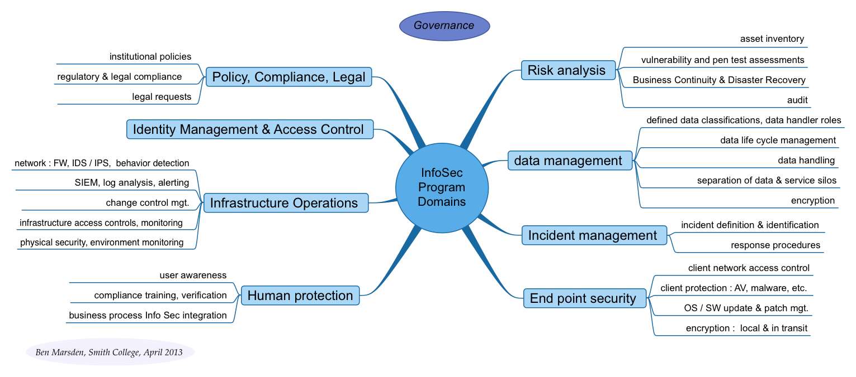
Proposed small institution domains framework
Did not quite hit my goal : 8 domains with 26 “control groups”
Notes:
OK, so I have 8 domains and 26 “control groups”
So I’m back picking controls and projects from a menu of options, but at least now I’m making choices that more directly reflect the security environment I’m working in.
NB: Presented as a “Mind Map” to reaffirm and keep “In Mind” that these domains are all interrelated, and not highly silo-ed.
NB: also that GOVERNANCE is both not explicitly included within the domains, but is prominently important as a component of the institutional security profile

Slide 26
Proposed Security Program Domains :
* In very roughly a “top down”, Strategic --> Tactical, or center -> edge order
1) Risk analysis
2) Policy, Compliance, Legal
3) Identity Management & Access Control
4) Information (data) management
5) Infrastructure Operations
6) Incident management
7) End point security
8) Human protection

Slide 27
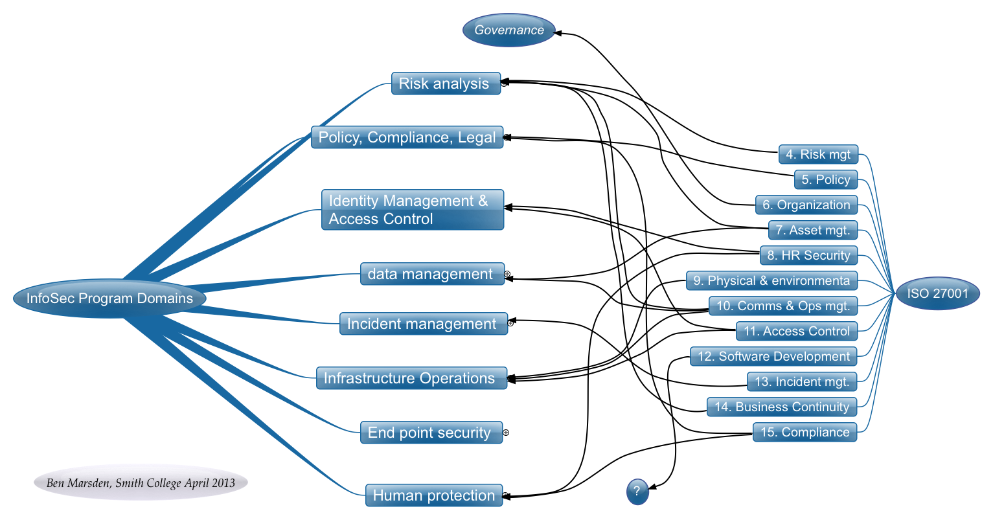
SIIS – ISO27001 Domains mapping

Slide 28
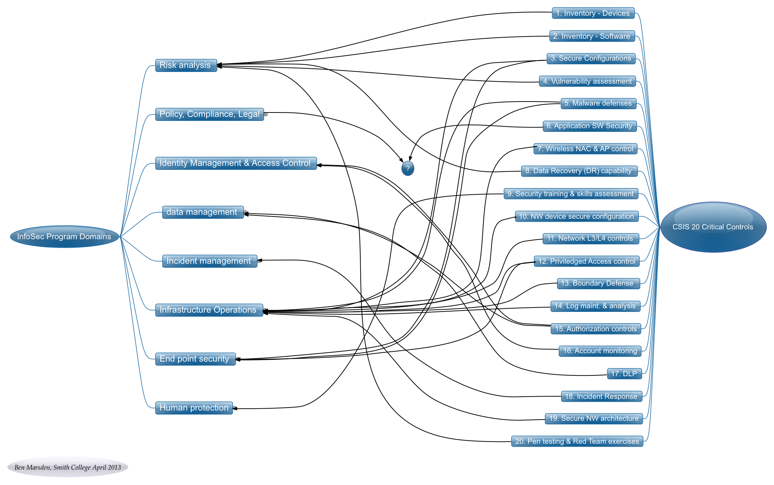
SIIS – 20 Cntls Domains mapping

Slide 29
Proposed Security Program Domains :
* In a possible “implementation order” (I can’t manage 8 major projects at once)
Easiest to Hardest, or “Quick Wins” to maybe not so much with the “Wins”
Also : consideration of prerequisite needs and relative “criticality”
---< 1st pass >---
Infrastructure Operations
End point security
Risk analysis
Information management
---< 2nd pass >---
Human protection
Policy, Compliance, Legal
IdM & Access Control
Incident management
Notes:
This ordered very subjectively in what I personally see as
a) Easiest to Hardest,
or “Quick Wins” – to not so quick wins
– or maybe not so much with the “Wins” but more the “Compromises” or Collaborations
And (b) Necessary prerequisites, or relative “criticality” to implement
goal here is to incorporate whatever currently exists into the Sec Program, check for gaps or omissions that should be addressed, and look for new controls that either supersede or supplement what you already have.
Controls in the upper domains are "easy" because you most likely already have admins and staff who already implement controls in those domains;

Slide 30
1) Risk analysis [collaborators, potential practitioners]
Asset inventory : [Admin supervisors, sys admins]
1st : administrative systems, storage and devices
2nd : protected research systems, storage and devices
Qualitative risk analysis : [me]
MAD options & costs analysis, governance acceptance
BC & DR : [staff from all levels]
data recovery capability (fka data backups )
service recovery capability (fka server backups)
DR procedures, response team, DR testing
vulnerability & pen testing assessments :
[me (bwahaha), 3rd party]
Audit : [external consultant]
Notes:
MAD = Maximum Allowable Downtime – from a business needs perspective
side note : remove the term "backups” to remove ambiguity between DR capability and archived data retention;
create generic policy that states the general DR and compliance needs, and requires service type and data type dependent procedures that can be modified and updated as needs require.

Slide 31
2) Policy, Compliance, Legal
establishes strategic directive controls mandated by internal governance and external regulatory entities
[ me, governance entities, legal office ]
development and promotion of institutional policies and procedures
Possible common policies include : Acceptable Use, Classified data handling, Records management & Retention, Account management, Authentication (password) security requirements
adherence to applicable regulatory and legal compliance requirements
procedures for handling of legal requests
includes : eDiscovery, DMCA notices, Law enforcement info requests
Notes:
-----
anecdote : small institution security practitioners don't want to know what they don't know.
When I proposed instituting a consortial Info Sec group for our Five Colleges community, one question -- honestly asked -- was : am I going to tell the group about regulatory and compliance requirements that they don't already know about. They don't want to hear about it, because they don't have the time or resources to deal with it. I feel their pain.

Slide 32
3) Identity Management & Access Control
this domain sets the electronic identity and functional roles for individual users
[ IT (systems), HR, Dean's office, registrar's office ]
has major impact on engrained business practices
requires assiduous planning, high level buy-in, and political dexterity
functional design :
authoritative Identity info resources ->
Identity Vault -> auth services (LDAP, AD, Shib)
<- services and information resources w/ restricted access

Slide 33
4) Information (data) management (1/2) :
This domain defines and locates the information assets that need protecting
[requires face-to-face engagement with various department heads, dept. staff]
Two basic data classifications :
"Classified" data refers to data that has been identified as either "Confidential" or "Sensitive". Institutional data shall be identified as to its classification regardless of its medium or form.
Confidential information is data whose loss, corruption or unauthorized disclosure would be a violation of federal or state laws and regulations or institutional contracts (i.e., protected data); Personal Information (PII) data; Personal Health Information (PHI) data; data that involves issues of personal privacy; or data whose loss, corruption or unauthorized disclosure may impair the academic, research or business functions of the college, or result in any business, financial, or legal loss.
Sensitive information is data whose unauthorized disclosure is not a violation of law, does not impair business or result in a financial loss but may be damaging to our students, employees, or alumnae or to the college’s reputation and thus require a higher degree of security than other information.
Personal Information (PII) is a specific subset of confidential information; PII is defined by MA General Law 93H, and has specific data handling requirements.
Two basic records handler classifications:
Data Custodians : { Owner / Steward } : responsible for integrity, classification, authorized access and use, storage locations, life cycle
authorized users : anyone required to have access to perform their job, academic assignment, or fulfill a contractual obligation
Notes:
OBJECTIVE here is KISS
Data classifications : functionally are :
Regulatory protected information
Institutionally sensitive information
More granular classifications can be implemented as needed by Data owners and business for specific info security protection needs.

Slide 34
Information (data) management (2/2) :
data life cycle management
storage, tracking who offloads it, useful life span, archive methods and procedures, legal records retention requirements, EOL removal & destruction procedures
!! PII data location assessment :
document all devices & locations, eliminate where ever possible
data handling :
procedures and business processes,
data handling policy compliance
separation of data & service silos
examples : test vs. production systems, single service "appliance" servers, tailored authentication / authorization
Encryption
encrypt where feasible (backup media, on servers, within DBs)
encrypt where compliance mandates (e.g. PII in transit over public networks, classified data locally stored on laptops)

Slide 35
5) Infrastructure Operations
Common technical tactical controls are in this domain
[ mostly systems & network admins ]
network : FW, IDS / IPS, suspicious/malicious behavior detection
SIEM, log analysis, alerting
change control management
system & service patch mgt / security updates
network device control & management (L1-4)
including unauthorized network expansion, such as hubs and rogue Aps
infrastructure access controls, monitoring
physical security, environment monitoring

Slide 36
6) Incident management
defines breadth of incidents, sets procedures for minimizing the impact of incidents; crosses into every other domain in some way
[response team members from various departments ]
incident definition and identification
"Generally, an Incident is any unexpected or unauthorized change, interruption, disclosure of, or access to the institution's information resources that could be damaging to our students, staff, faculty, alumnae, donors, parents, prospective students and / or our reputation."
includes everything from a misaddressed spreadsheet to regional natural disaster
response procedures
triage, escalation, containment, eradication, restoration
Post-event reporting, lessons learned
response teams
Teams dependent on type of incident
Table top, training exercises, forensic tools needs
Notes:
NOTE regarding definition of an Incident :
- want users to report the potential for loss of classified information
- want response team to assess the criticality of the event, and whether to escalate, or declare a non-reportable incident
I do not want the user trying to make that assessment!
This is where documenting all locations for PII data is really helpful!

Slide 37
7) End point security
this domain address all aspects of network edge device security
[ user support, client technical services, departmental IT support staff ]
client network access control
client protection :
AV, malware, host-based FW, app whitelisting, etc.
OS and SW update & patch management
encryption : both local and in transit
* stricter controls for classified data handlers
Notes:
Yeah BYOD goes here….

Slide 38
8) Human protection
This domain addresses all aspects of keeping users safe, promoting safe use of information resources, and proselytizing Info Security awareness.
[ User support, student affairs, College Relations office, HR ]
user awareness :
communicating IS awareness at the user layer
identity protection, security threat awareness, personal info care, managing privacy, preventing misuse, personal security compromise response, client management best practices
policy compliance training & verification
business process Info Sec integration :
communicating IS awareness at the business process layer
opening lines of communication to promote security best practices
integration into project management
NB: the human is invariably the weakest link in security!
Notes:
anecdote : when generally asking people what do you think an IS Director does, what's my main goal? One person answered "protect the girls."
This surprised me, because I had been thinking protect the data, protect the infrastructure, protect the institution; and I was all about the three pillars of security : Confidentiality, Integrity, Availability
-- client machines were on my radar. But students themselves… I hadn't given it much thought.
"Yeah, mommy and daddy are expecting you to help keep them safe." From themselves, or their ex-boyfriends, or their feuding roommate, or random stalkers, or whoever. Not to mention some high profile students who really may be targets and need some extra protection. So, just keeping that on your radar too...

Slide 39
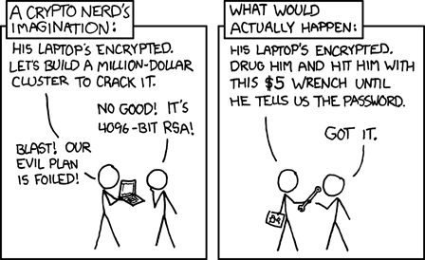
…yes : people are still your weakest link
-- Randall Munroe, xkcd

Slide 40
Proposed small institution domains framework
Notes:
OK, those are my 8 domains.
Now, Let’s take a look at that floating bubble of “Governance”

Slide 41
A look at Governance:
what is it, and what is its role in the Info Security program?
Conceptually, it is making sure that the right questions get asked in the right forum
vets sec program initiatives to confirm they are in line with the mission of the institution and the direction of senior leadership
It might be a committee, but for agility, best to also have a designated point of authority
(or a heirarchy)
Notes:
authoritative decisions can be made at the right point in the general business process.
Governance is then a "standardized" business process that allows for issues to be addressed in a timely manor by the correct decision-making entity -- senior staff group, senior staff individual, governance committee, etc.
It is NOT simply “oversight”, nor is it necessarily a committee! Could be a verbal recommendation from a single cabinet level individual with the authority to make that decision.

Slide 42
Where does governance come into play?
Security program content & priorities
Risk
confirming qualitative risk analysis
MAD (max allowable downtime) risk / cost acceptance
DR options : governance accepts the risks, and controls the purse strings
Policy
Audit

Slide 43
Governance and Incident Response :
When a potential incident occurs, local staff must have the authority to take actions “above their pay grade” to effectively respond.
- has to be formally conveyed, local responder must be able to act without fear of reprimand
From The Checklist Manifesto :
“…in the face of an extraordinarily complex problem, power needs to be pushed out of the center as far as possible.”
(on Katrina response, Walmart CEO Lee Scott) “ ‘A lot of you are going to have to make decisions above your level. Make the best decision that you can with the information that’s available to you at the time, and, above all, do the right thing.’”
Notes:
anecdote : governance, authorization, designated temporary escalation of authority
while in meeting with Cisco and VAR reps, Unix sys admin barges in stating that our main Oracle / ERP server is actively being hacked. But because this was "mission critical" personnel / payroll / business intelligence / HR / student enrollment / everything else, we did not have the authority to either take the system down or take it off line, as this would cause an unscheduled disruption of service.

Slide 44
Incident Response II
P(i) = O, for Ad < i < AG
Or, Chance favors the prepared [security practitioner]
(when function “Preparation” is applied to the variable “incident” the result is “Opportunity”, for any “i” that involves more than a system or network “Administrator” and less than an “Attourney General” )
Notes:
Prepare for the bigger, harder, more costly or disruptive to enact controls that you think will be big security gains or risk reducers
for a set of similar threats, have some preliminary control options with cost estimates and rollout time frames in your pocket

Slide 45
Directive Controls :
Strategic (high level) | Tactical (low level) | Optional
Policies | Procedures
Standards | Baselines | Guidelines
Policy components :
Purpose, Scope, Responsibilities, &
Compliance (a) how to judge effectiveness of the policy, &
(b) what happens when the policy is violated (sanctions)
High level (institution wide) policies: require governance acceptance,
procedures do not
keep procedures out of policies – unless it really is part of the policy!
Remember :
Policy is institutional LAW, not end user documentation!
Also :
a poorly or unevenly enforced policy has no legal standing as a policy
Notes:
Policies : Mandatory : Hi Level (strategic); Senior Management directive : address who, what, why
•Purpose : describes the need
•Scope : describes what systems, people, facilities & organizations are covered by the policy
•Responsibilities : of info security staff, policy & mgt teams, all members of an organization
•Compliance : (a) how to judge effectiveness of the policy, & (b) what happens when the policy is violated (sanctions)

Slide 46
Next Steps …
assign select controls to subdomains
start with controls you already have in place
add controls you'd like to implement that fill gaps in your domain profile
Translate targeted controls into initiatives or projects
tap a staff member to take ownership of a subdomain
usurp a staff member to lead a project based on initiatives

Slide 47
Next next steps…. “quick wins”
Look at what you already have in place that fits the program,
identify who's already managing some of these controls
quick "self audit" on these areas for small deficiencies to address
Look for controls that :
don't require lengthy formalized governance vetting,
don't cost big $$,
don't disrupt established business processes
… but tweaking business processes != disrupting them,
! Staff generally want to "do the right thing" if they're just made aware of what that is!

Slide 48
Random additional thoughts:
Be The Face of Security :
visit / survey key departments & staff members
find out : what info, where info, who owns data, who classifies data, who uses data, business processes, account and authorization management, etc. (if at least to get them thinking about these things themselves)
Inform : key current security issues, regulatory compliance requirements, policies, incident response procedures, etc.
ask : what concerns do they have?

Slide 49
More (platitudinous) thoughts…
“Just say…” anything but “no”
(errr, except when it’s a policy violation)
Just thinking…
when security isn't in anyone's job description, it *can* be part of everyone's job; BUT if there *is* someone with "security" as a substantial part of their job description, does that relieve others from taking ownership of IT Sec concerns ("Not my problem")?
Fear the threat more than the regulation
Don't tailor your security program design to meet the needs of a compliance directive, or audit comment response

Slide 50
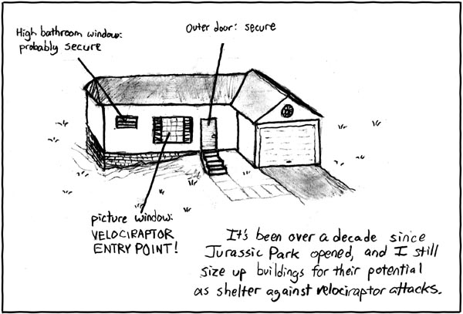
remember : security means being ever vigilant
-- Randall Munroe, xkcd

Slide 51
Contact info :
My .sig
=========================================
Ben Marsden : Information Security Director, CISSP/GISP
ITS, Stoddard Hall, Smith College, Northampton, MA 01063
bmarsden@smith.edu (413) 585-4479
----------------------------------------------------------------

