Slide 1
Rapid Windows Analysis Tell Tale Signs You’ve Been Compromised
Warren Raquel
Sr. IT Security Analyst
CITES Security
Notes:
Time is often precious for IT Pros. Being able to determine if a system is compromised is often a lengthy process. A proper examination usually involves determining things like compromise vector, determination of data loss, sensitive data, determination of scope. Sometimes it can be pretty obvious that a system is compromised but more often than not most organizations won’t know until they get an email from a friendly outside organization telling you one of your systems is acting “funny”.
This presentation is about making a quick determination of certain compromise using a few built in tools. The idea is being able to determine right away that a system is compromised, not that a system is clean. In most cases it’s faster to be determine if a system is compromised than determining that a system is not. Definitively compromised systems or at least highly suspicious systems can more quickly move into your incident response plan whereas non-suspicious systems you may wish to slate for more extensive analysis later.
The type of scenario we’re looking at is maybe:
Walking back from lunch and an administrative assistance saying his/her computer is acting “funny”.
You‘re the ‘dedicated IT person’ for your family and you’re asked to look at a system while at a family function.
Any situation where you don’t have direct access to your normal tools, the system is unfamiliar and so on.
This talk is targeted for people new to the IT Security field but hopefully there is also something for those of us who have been in the field for a while.

Slide 2
What we’re not covering
Locking down systems
Cleaning up compromises
Hardcore forensics
Notes:
Today we won’t be talking about intricate incident response plans. We won’t be talking about third party tools we can use, websites for testing malware, so on and so forth.

Slide 3
What we’re covering
Tools already built into the OS
Rapid determination of compromise
Notes:
We’ll be talking about Windows systems and using tools already on the operating system to check a few key places for strong indications of compromise.
This is not intended to be a panacea of compromise determination. It’s just a quiver in your bow. Maybe think of it like your paperclip and bubble gum if you’re playing MacGyver the IT Pro. This is not a fool-proof method. In fact some viruses can mask themselves enough to not be seen by some of these methods.
Keep in mind, even if you don’t find anything don’t make the assumption that the system is clean.

Slide 4
Rapid Windows Analysis
Check running tasks
Check network connections
Check startup locations
Strange File Activity
Strange User accounts
Check event logs
Notes:
The quick methods I describe here are the following.
Check running tasks
Check active network connections
Check the different startup locations for suspicious files
Check for strange file activity
Look at the current user accounts on the system
Look at your event logs
It is actually quite possible to do all of these things in less than 10 minutes. Maybe not as thoroughly as you would like but remember we’re not trying to determine that the system is perfectly clean, just that it’s certainly compromised.

Slide 5
Windows Tasks
Task Manager (taskmgr.exe/ctrl-shift-esc)
CLI only:
tasklist [/svc]
wmic process <pid> list full
Notes:
Many of us are familiar with the task manager. The easiest way to bring it up is to hit ctrl-shft-esc. There are also some command line utilities you can use to pull up tasks. My favorite being wmic (Windows Management Instrumentation Command-Line). You can also run wmic commands remotely.
Let’s take a look at a few examples.

Slide 6
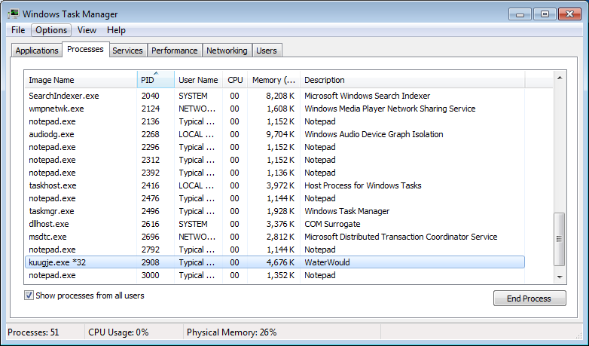
taskmgr.exe example
Notes:
Here I’m looking at a standard standalone install of windows. I got an email with an attachment that said I had a DHL package waiting for me so I double click on it. Nothing happens and actually, there really aren’t any end-user indications of compromise. A few days later I actually did get notification that this system was connected to the Zeus P2P botnet.
So what do we see? I’ve selected the option to look at processes for all users and lo-and-behold there’s something that looks just slightly out of place. The filename looks random and look at the description.

Slide 7
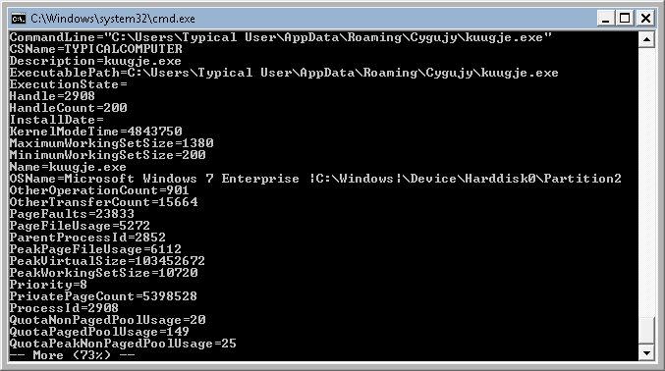
wmic process <pid> list full
Notes:
Let’s take a look a the wmic output. You can use this command to output all active processes to a file using an output redirect to file (a.k.a. greater than sign). I’ve scrolled down to the specific process and you can see lots of useful information especially the exact run location of the file. It’s sitting in a folder under my user’s application data profile.
Adding the specific PID, like in this case, 2908, will output just this specific process.
So, examining the running tasks is one thing you can do. Let’s move on to network activity.

Slide 8
Network Activity
ipconfig /displaydns
/all (check settings like DNS)
netstat -afob
netsh firewall show config
%SYSTEMROOT%/system32/drivers/etc/hosts
Notes:
We want to check the DNS cache, active network connections, the firewall configuration and also the hosts file for changes.

Slide 9
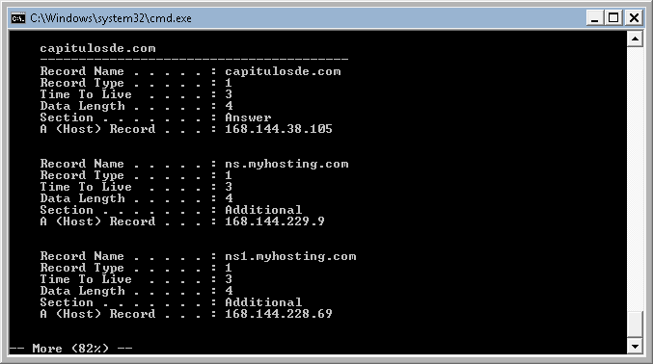
ipconfig /displaydns
Notes:
The first thing we want to do is check the dns cache. You can also output this to a file for review in a text file. You should note, it’s good to actually run this command a few times as some viruses may clear out the dns cache, although, more likely dns names for fast-flux hosts will disappear very quickly.
Here you can see a dns cache for ‘capitulosde.com’, also references for a ns servers for a hosting provider. None of these names nor the address range seem familiar to me and could likely be an indicator of a compromise. I do want to take note of these though and use it in conjunction with looking at currently open network connections.

Slide 10
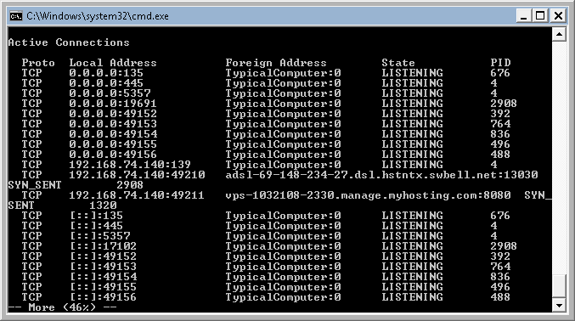
netstat –afo
Notes:
Netstat shows me all active connections. –a means show me all open connections. –f tells netstat to use the fully qualified domain name. –o tells netstat to give me the process id associated with the network connection.
Make note that using the –f option will force your system to do a DNS lookup potentially compromising your dnscache so make sure to collect the dnscache first.
We see here high port to high port TCP traffic on unfamiliar ports, reminiscent of P2P software. There’s the vps address appears to be using port 8080, a common web proxy port. In this case the vps fqdn resolves to the same IP as the fqdn we saw in the DNS cache earlier. And look at the PID, 2908, same as the strange software that’s running.
Next lets look at the firewall settings.

Slide 11
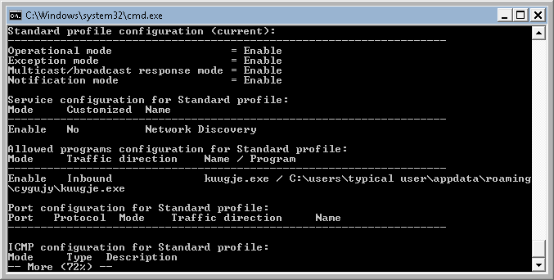
netsh firewall show config
Notes:
The easiest way to look at the firewall settings is to use the netsh command. Here you can see that the file kuugje.exe is allowed to accept incoming traffic.

Slide 12
Startup Locations
Startup folders
%USERPROFILE%\AppData\Roaming\Microsoft\Windows\Start Menu\Programs\Startup
msconfig (gui)
wmic startup list
services (sc query/wmic service list)
Multiple Registry Locations
Notes:
Right off the bat just looking at processes and network traffic we can immediately see a compromise. Some other things you can look into are startup locations for services and other programs.

Slide 13
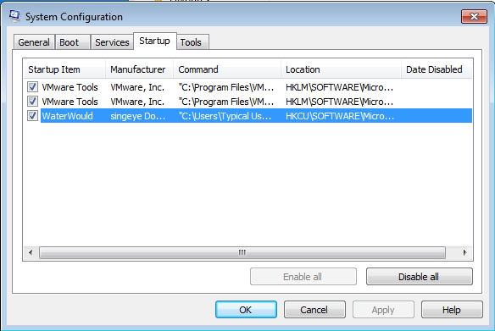
msconfig
Notes:
Msconfig is a very nifty built-in windows tool. Right away you can see the Waterwould program has a startup registry key under the ‘startup’ tab in msconfig. This is neat because it not only shows you the local user Run keys, but it also shows you the system run keys.

Slide 14
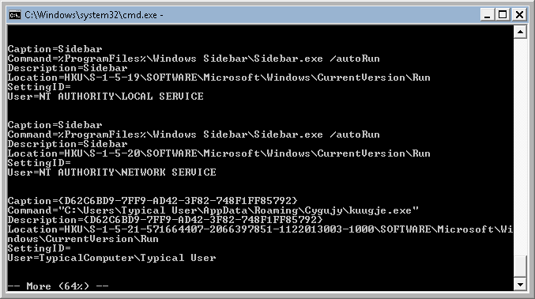
wmic startup
Notes:
Wmic once again offers tons of information. Locations, the security identifier and associated user, command, etc.

Slide 15
Windows Registry
HK[LM/CU]\Software\Microsoft\Windows\CurrentVersion\
Run, Runonce, RunonceEx
Policies\System\Shell
HKEY[CR/LM/CU]\.....\shell\open\command
HKCR\.exe\...
*HKCR\exefile\...
HKLM\SOFTWARE\Clients\StartMenuInternet\IEXPLORE.EXE\...
*HKLM\SOFTWARE\Classes\exefile\...
HKCU\Software\Classes\.exe\...
*HKCU\Software\Classes\exefile\...
<malicious_file> “%1” %*
Notes:
There are lots of different locations to place items in the registry. The location can often determine if the file is run once, run every time the system is restarted or a person logs in and so on. You can replace the windows shell, you can tell windows to open specific filetypes using the malicious file as a sort of ‘shell’ to execute the program under.
HKCR\.exe\shell\open\command
HKCR\exefile\shell\open\command
HKLM\SOFTWARE\Clients\StartMenuInternet\IEXPLORE.EXE\shell\open\command
HKCU\Software\Classes\.exe\shell\open\command
HKCU\Software\Classes\exefile\shell\open\command

Slide 16
File Activity
forfiles /P c:\windows\system32 /D +11/10/2012 /S
dir /od /tw
/od – order by date
/tw – use ‘last written’ time
Notes:
File activity can sometimes be fruitful but you really do have to be familiar with your system. Forfiles will let you search for files akin to the linux to ‘find’ although not exactly the same. If you suspect a recent compromise and the system is relatively quiet or unused this can sometimes show you a newly installed file that could be suspicious.
You can use dir to organize files by date. More often than not, though checking for file activity is a needle in a haystack. If you know exactly where to look it can be fruitful, but if not, you’ll just be looking through lines and lines of filenames.

Slide 17
User accounts
lusrmgr.msc (gui)
wmic useraccount list full
C:\Users
C:\Documents and Settings
Notes:
You can look at user accounts. The gui user manager is an option but I prefer wmic once again. A quick and dirty thing you can do is to look at the users (or pre vista, documents and settings) folder. If there’s a folder for an unfamiliar username, it’s possible someone created a backdoor account to access the system, whether local or remotely.

Slide 18
Event Logs
eventvwr.exe
CLI
Eventquery.vbs (<= 2003 )
Powershell (> 2003)
Login events (Event ID 528, 540)
Stopped/Started services
Notes:
Event logs are an exercise in patience. Most of you have attempted to tackle windows event logs and they can be very useful. The default logging in windows isn’t ideal but sometimes it can prove helpful. You’ll want to look for things like eventID 528 “Successful Logon” and 540 “Successful Network Logon”. You can also look for services that have been stopped either manually or through an application fault (e.g. AV crashing)

Slide 19
Misc things to look for
Misspelings
Bad Grammar
Randomized filenames
Notes:
In general though, that things that will jump out are things like misspellings and bad grammar.
Although randomized filename are a great indicator you may have situations where the virus names itself after things like java update, or cmd.exe and so on. That’s where a keen eye on the open processes and associated network connections can really make a difference.

