Slide 1
We shall meet the enemy, and not only may he be ours, he may be us.
- The Pogo Papers, Walt Kelly, 1953

Slide 2
The Enemy Is Us!
Doing the Work of Information Security Better
Phillip Deneault
Information Security Officer
WPI

Slide 3
Obligatory Introductory Slide
ISO@WPI (We Prefer Initials)
Chair of Internet2 Computer Security Incident SALSA Working Group
REN-ISAC Technical Advisory Group member
CISSP
But moreover….
An Army of One…

Slide 4
Responsibilities
Technical Work
Information Security
Intrusion Detection
Firewalls
Network Diagnostics
Bandwidth Management
AUP enforcement
Vulnerability Scanning
Virus Cleanup
System Administration
Management of 1 FTE + 2 Workstudies
Contract Reviews
Consultation of IS issues
Lead Compliance Initiatives
Develop Policy
Manage InfoSec Program
Governance Participation
Reporting

Slide 5
AND….
Occasionally, I do presentation that don’t involve IPv6
Last Year – “A State of the Union” with Dave@BC and Brian@NYU
Major Points
  Where we are as a sector regarding security
  Highlighting ‘Hip’ Topics
  Trying to get folk to refocus on priorities
  “Don’t be distracted by the Shiny Objects”

Slide 6
Feedback
“In general, I think the speakers were somewhat arrogant in their approach…”
“SOMEWHAT arrogant?! Obviously I need to do better…”
We always fall for shiny objects!
We are our own worst enemy!

Slide 7
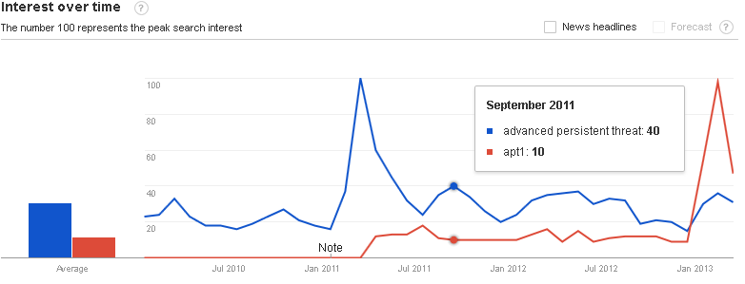
APT!

Slide 8
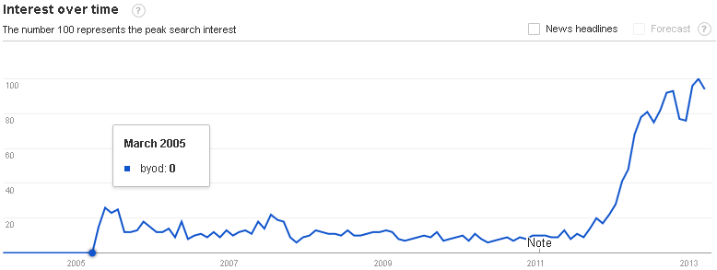
BYOD!

Slide 9
Distractions
Distractions – Pure and Simple
Poorly interpreting shiny objects as special, new, and disruptive tasks
  Stress
  One-Off systems and processes
  Time Sinks
  Constant re-implementation of existing systems
    Not real improvement

Slide 10
STOP!
(just stop)

Slide 11
Stop Making Things Worse
Think about how new requirements are usually retreads on old requirements
Improve what you have already have to meet both old requirements and new
Improve those aspect of your job you already have clearance to improve

Slide 12
“Improvement?”
“I have no money!”
  Focus on the pieces you have, and not what you don’t have
“I have no extra people!”
  Improve efficiency
  Use other people
  Focus on yourself
“I have no power!”
  Develop something people want
  Reach out, don’t hide
“I have no time!”
  Focus on what you should already be doing
  Prioritize improvements which give you time

Slide 13
“Improvement?”
Asked CSI2 group “How Can Information Security Groups Do Their Jobs Better?”
  Tooling
  Personal Improvement Processes
  InfoSec Group Improvement Processes
  Institutional Technology Processes
  Institutional Maturity Processes

Slide 14
Improvements - Tooling
Automation of Tasks
More Logging (alerting on lack of logs)
Correlation of Information (users/machines)
Managing complex cases
  Timelines
  Stickyboards (The paper kind)
  Casefile
  Maltego

Slide 15
Improvements - Personal
Obvious?
  “Attend Conference and Tech Training”
Be honest as security professionals
  Sometimes you can say ‘So What?’
Keep a history of the incidents you deal with
  Learn from your mistakes
Improve ways for your community to give you feedback

Slide 16
Improvements -InfoSec Group
Define and use workflow for common problems
  Use a ticketing system
  Track events by users and machines
Metrics
  Determine how to establish success or failure
  Collect data to measure risks or operations
Processes
  Move from reactive to proactive to integrated
  Aggregate audit data

Slide 17
Improvements - Inst. Technology
Strong Information Security Policies
  If you write ‘em, enforce ‘em
Data Identification and Classification
Fully manage devices with sensitive data
Use standard errors
  Goes back to metrics

Slide 18
Improvements – Inst. Maturity
Accept control by others
  Hand off tasks to other groups (Helpdesk, Governance)
  Be part of policy development even if you can’t drive it
Understand risk
  Look at standard risk management methodologies
  Understand what it means to accept risk
  Get more people to understand risk
Understand requirements of academia and researchers

Slide 19
New Plan!
The Plan ™
  Determine Improvement Goals and Prioritize Them
  Look at new (to you) techniques
  Work with formal processes and methods
  Get Help

Slide 20
Goals

Slide 21
Determine Goals
Places to find Improvement Goals
  Your Job Description
Do Not Look for Goals Here
  Your Unofficial Job Description
  Your Boss’s Job Description
  Your Boss’s Boss’s Job Description
  What Your Job Description Should Be
  What Your Next Job Description Should Be
  What Makes Sense
  What is the Right Thing To Do

Slide 22
POSITION DESCRIPTION
TITLE: Network Security Analyst
BASIC FUNCTION:
To assist the Assistant Vice President for Information Security and Networking to ensure the satisfactory operation of the WPI network and facilitate its use by members of the WPI community.
PRINCIPAL DUTIES AND RESPONSIBILITIES:
Monitor network traffic for and proactively investigate anomalies.
Identify and contain security breaches, threats, and vulnerabilities to the WPI network.
Vulnerability and Malware analysis, reporting and removal of connected campus systems.
Enforce the WPI Network Security Policy (NSP) and Acceptable Use Policy (AUP).
Coordinate with internal and external organizations to resolve network security issues.
System administration and backup of all Network Operation and Information Security servers.
Author and maintain Information Security and Network documentation.
Other related duties as assigned.

Slide 23
Determining Goals
Red bullets have a theme
  Identifying compromised machines and handling them
    Identification
    Notification
    Remediation
Ticket systems can do this if
  Integrated with Network Registration system
  Integrated with email
  Help keep counts of issues we have
  Creates repeatable workflow
  Maintains documentation

Slide 24
Is that Improvement?
1 project, 6 improvement areas
  Tooling – “Automation of Tasks”
  Tooling – “Correlation of Information”
  Personal – “Keep history of Incidents”
  Infosec Group – “Develop Workflow”
  Infosec Group – “Metrics”
  Institutional Technology – “Strong Information Security Policies”

Slide 25
Ticket system for Incidents
@WPI – Implemented in RT
  Repeatable process anyone can be trained on
  Doesn’t require special rights in NetReg
  Doesn’t require years of technical experience reading logs
  Scales well for a multitude of incidents
  Stores all forms and documentation
  Graphing is easy
  1+ hours back per day

Slide 26
Prioritizing Goals
Ridding Yourself of Work
Improving how you or your group (team, department, division) does work
Measuring and Reporting the Work you do
Measuring and Reporting the Work happening TO you
Doing New Work

Slide 27
Using Your New Goals
Write Them Down
Argue for their completion with your boss
Prioritize them
When you encounter new requirements or issues:
  Think them through
  Determine if you can integrate the new issue to your goals

Slide 28
New (To you) Tools

Slide 29
New Techniques
  Automation
    Making machines do the work
  Measuring*
    Keeping quantitative records of stuff
  Aggregation Tools
    Multiple information sets into single more useful set
  Documentation*
    Reporting and Recording
  Be Creative!

Slide 30
Measuring
What are we measuring?
  Circumstances which create work
  How much work needs to be done
  How much work has been completed
  Anything else you want
Y axis is almost always ‘what’ and ‘how much’
X axis is almost always ‘time’

Slide 31
Graphite
Flexibly recording time series information
One-time setup
All points are inserted the same way
  “metric_name value timestamp\n”
  If I can script a connection to Graphite, I can measure it
Dynamically generate graphs
  Graph development workbench

Slide 32
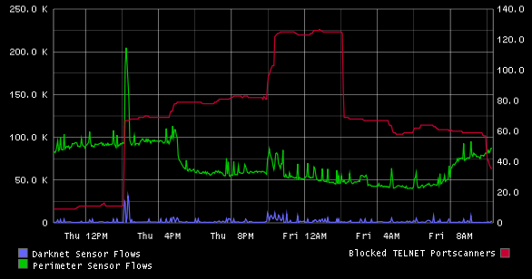
Graphite
DDOS?
Nope! Stupid portscanner tricks…
“Circumstances which create work”

Slide 33
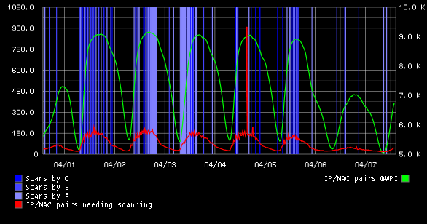
Graphite
Operation of vulnerability scanners
“How much work needs to be done” AND “How much work is done”

Slide 34
Documentation
What you do is NOT a Secret!
  The data you do it with MIGHT be best kept private according to best practices, regulations, and policy
Obvious – Write Down What You Do!
  Wiki
Encourage meetings with your Management
  Write reports (not emails) for them
  Write about things summarizing what you do
  Write about things they should know about
  Length doesn’t matter, Content does

Slide 35
Documentation
Process Mapping
  Building flowcharts of activities
  Tracking handoffs between groups
  Tracks information required to complete a task
  Highlights loops, useless intermediaries, political garbage, places needing more automation
  Blueprint

Slide 36
Formal Processes and Methods

Slide 37
“Formal?”
Identifying missing controls according to some set of best practices, control framework, etc
  ISO 27001:5
  NIST 800-53
  COBIT
Relate new issues to that framework
  It will not be perfect
  Provides some consistency

Slide 38
ISO 27001:5
Organized by Domains
Security policy
Organization of information security
Asset management
Human resources security
Physical and environmental security
Communications and operations management
Access control
Information systems acquisition, development and maintenance
Information security incident management
Business continuity management
Regulatory compliance

Slide 39
COBIT
COBIT 5 for Information Security
“Enablers”
  Principles, Policy, and Frameworks
Processes
Organizational Structures
Culture, Ethics and Behaviors
Information
Services, Infrastructure and Applications
People, Skills, and Competencies

Slide 40
NIST
NIST 800-53 (v4)
Made up of ‘Control Families’
Access Control | Media Protection
Awareness and Training | Physical and Environmental Protection
Audit and Accountability | Planning
Security Assessment and Authorization | Personnel Security
Configuration Management | Risk Assessment
Contingency Planning | System and Services Acquisition
Identification and Authentication | System and Communication Protection
Incident Response | System and Information Integrity
Maintenance | Information Security Program Management

Slide 41
A Game!
Google ‘Information Security Predictions for 2013’ and hit ‘I’m Feeling Lucky’ (Punk)
Websense! HOORAY!
  “7 for 13”
Related all 7 to the NIST standard
“What domains will help my incident handling process related to this issue?”

Slide 42
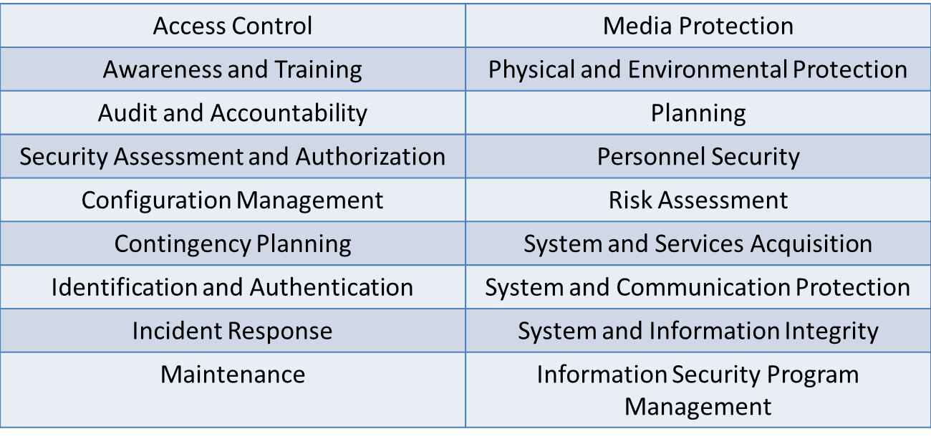
  Prediction #1. Mobile devices will be the new target for cross-platform threats.

Slide 43
Prediction #2: Legitimate mobile app stores will host more malware in 2013.

Slide 44
  Prediction #3: Government-sponsored attacks will increase as new players enter.

Slide 45
  Prediction #4: Cybercriminals will use bypass methods to avoid traditional sandbox detection.

Slide 46
  Prediction #5: Expect hacktivists to move to the next level as simplistic opportunities dwindle.

Slide 47
  Prediction #6: Malicious emails are making a comeback.

Slide 48
  Prediction #7: Cybercriminals will follow the crowds to legitimate content management systems and web platforms

Slide 49
WHO WINS?!
5
2
2
1
1
1
1
4
4
4
1
ALL THE USUAL SUSPECTS!

Slide 50
Get Help

Slide 51
Get Help
Boss
Peers
Subordinates

Slide 52
Boss
Besides reporting and “Other Duties as Assigned”… (getting dry cleaning, waxing cars, etc)
Do things which help them help you
  Work on Budget Cycles
  Establish predictable upgrade cycles
  Give them reasons why you need things

Slide 53
Peers
Not just fellow group members, but other groups as well
Remember, its not just about doing work, sometimes its about doing it right
  Develop Standard Operating Procedure
  Hold each other to methods you agree upon

Slide 54
Subordinates
“But, I don’t have any subordinates”
  Get a Workstudy! Better yet, TWO!
  Quality over Quantity
  Keep them busy!
  You are giving yourself time
“I already give my subordinates things to do”
  Challenge them on how they can improve
  Give them projects which aren’t about improving security, but improving the act of improving security

Slide 55
In Conclusion…

Slide 56
Some Thoughts
You are playing a long game…
  Plan for your future, or someone elses…
You need to stay positive
  You should not assume answers to questions you have not asked
  You should not assume failure
You should not be Machiavellian…
  You are not ‘social engineering’ your co-workers
  You are not planning a coup
  You are trying to do your job better and break bad habits of other people as well as yourself

Slide 57
In Short
Make goals
Focus on what you have
Find new tools
Write documentation
Use formal methods
Get help
Stop focusing on Shiny Objects!

Slide 58
Its Over Now
Questions?

