Slide 1
Bring Your Own Cloud:
Data Management Challenges in a
Click-Through World
Sherry Michael Weller
4-17-2013

Slide 2
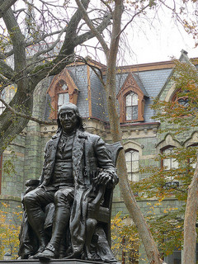

University of Pennsylvania
Ivy League university located in Philadelphia
Founded by Benjamin Franklin in 1740
Ranked in the top five research universities in the United States.
10,000 Undergraduate students
There are twelve schools at the University.
The School of Arts and Sciences is the home of the humanities, social sciences natural sciences with 27 departments and 500 faculty.
Notes:
WHERE
AGE
RESEARCH
SIZE

Slide 3
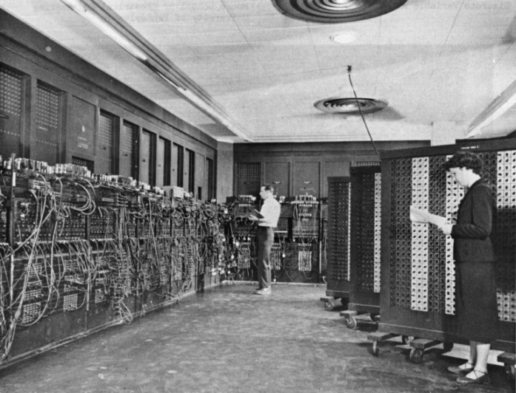
School of Arts and Sciences Computing
Supports the effective use of information technology by the faculty, students and staff of the School.
Five Main Divisions:
Desktop Computing and Network Services
Institutional Research and Application Development
Instructional Technology
Social Sciences Computing
Information Security and Unix Systems
Notes:
So large, schools have their own IT
ENIAC created by the Moore School come visit

Slide 4
Overview
Explore a complex case study to examine a university group that turned to free cloud services to share sensitive data
The value of security assessments
Share stories
Notes:
Why they did it, what are the risks, and what we are doing to resolve

Slide 5

Case Study: Introduction
The University Civic Center (pseudonym)
  Provides charitable services as well as conducts research
  Dozens of outreach programs
  Located off and on campus
Notes:
Outreach programs: plant trees and study the effects and survey the benefits of tree planting

Slide 6
Case Study: Challenges
Many office locations off and on campus
Decentralized management and supervision
Non-university participants and volunteers
Employs student workers
Does not fit in a standard computing support model

Slide 7
Case Study: The Cloud Temptation
Free! Do-Gooders don't have a lot of cash
Easy to use. Familiarity with consumer cloud storage services
Portable. Important when offices are off-campus
Low overhead, especially when IT support path is not clear

Slide 8

Case Study: Irresistible Pull
Click-through services seem to be a clear choice for a group with legitimate needs, little money, murky support channels, distributed locations and varied staff members.
Cloud is agile, familiar and available on demand!

Slide 9
Case Study: The Data
The Civic Center, unfortunately collects, stores and shares sensitive data:
  FERPA protected student data (grades, performance evaluations, attendance)
  Contact information for human research subjects
  Job applicant information and background checks
  Social Security Numbers
Notes:
So far, wouldn’t be so bad…but

Slide 10

Click-Through Cloud Dangers
So…what’s the problem?
Notes:
Ask them to yell them out

Slide 11
Particular Click-through Concerns
No terms protecting regulated data
Intellectual property
No storage management- where is the data? Who opened what free account?
Lack of centralized access control with frequently changing staff

Slide 12
Penn Cloud Guidelines
Consider availability of mission critical resources
Must maintain access to Penn data for regulatory and legal purposes
Weigh security risks storing confidential, contracted and regulated data
Limited support

Slide 13
Penn Cloud Services
Move beyond click-through
Negotiate Penn specific contracts: AWS, Google, Nasuni
Leverage collaborations like Internet2: Box
Explore new tools
Develop in-house solutions when necessary
Foster awareness
Notes:
ISC Cloud group
In house: Secure share- secure web-based replacement for FTP and file attachments

Slide 14
Case Study: Analysis
So what did we do to help the Civic Center better manage their confidential information?
  Allocated IT staff time
  Performed a full assessment
  Developed a plan to address critical concerns

Slide 15

Case Study: Finding Help
SAS Computing supports one of the many Civic Center offices
Discovery began when the Center requested help developing an application
It was determined that a general assessment of data management was in order
Notes:
Because the Center falls between several departments, someone needed to decide who was going to be responsible

Slide 16
Security and Privacy Impact Assessment- SPIA
To determine how sensitive information is handled and stored
Process for vendors, applications and departments
Identify risk factors
To protect the university community, patients and research subjects
Notes:
From the Office Of Privacy and Compliance

Slide 17
SPIA: Discovery
We can’t fix what we don’t know!
The SPIA tool:
  Conduct detailed interviews
  Create an inventory
  Determine risk
  Follow up with an executive summary
" Data! Data! Data! I can't make bricks without clay."
-Sherlock Holmes
The Adventure of the Copper Beeches
Notes:
Not software
Interviews preferably done by technologists aware of tech solutions

Slide 18
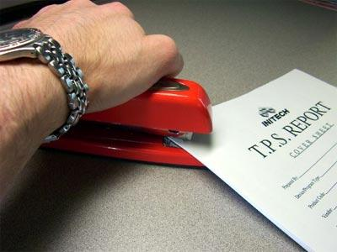
SPIA: Developing Solutions
Not a paperwork exercise
Redact, eliminate or move the most sensitive data at the greatest risk
Explore more secure options
Identify workflow problems

Slide 19
Case Study: Our Solutions
Where possible, move to contracted cloud services
Limit click-throughs in the future
Securely delete unnecessary sensitive information
Review access controls and accounts
Security awareness training

Slide 20
Case Study: Our Challenges
File ownerships and turnovers
Migrating and mitigating from all the click-through providers
User education
IT staff resources and responsibilities
Reviewing contracts for cloud services is time consuming

Slide 21
What Have We Learned?
There is understandable temptation to use click-throughs
When assistance is not provided, clients go for ease, not security
Have a cloud policy and promote it
Offer contracted solutions as alternatives
Security assessments are a tool for problem solving

Slide 22

Security as Relationship Building
Assessments can build relationships
Security creates solutions and not just barriers
Chance to advocate for our clients
Prevents future problems

Slide 23

Summary
We support dynamic environments that often adopt free and easy to use cloud services for collaboration.
Clients need to be aware of security risks when choosing to use such services. Guidelines and contracted alternatives should be provided.
Schools should consider using audit tools like SPIA as a way to identify and mitigate sensitive information exposure and foster partnerships.

Slide 24
Further Information
Penn Cloud:
www.upenn.edu/computing/isc/cloud
Security and Privacy Impact Assessment:
www.upenn.edu/computing/security/spia
Contact:
sherrym@sas.upenn.edu

