Slide 1
Lessons Learned in Managing IT Risk
EDUCAUSE Security Professionals Conference 2013
Jane Drews, CISO
The University of Iowa

Slide 2
Topics
Understanding IT Risk
Key Areas and Lessons Learned
  Information Risk
  Endpoint Risk
  System/Server Risk

Slide 3
Understanding IT Risk

Slide 4
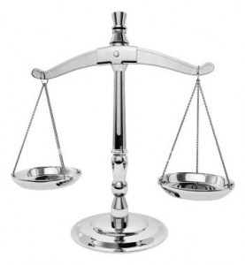
An “Economic” aspect

Slide 5

A “Safety” aspect

Slide 6

A “Probability” perspective

Slide 7

An “Impact” perspective

Slide 8
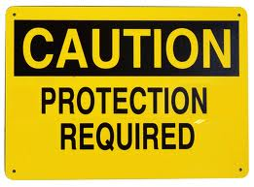
IT Risk Sources
Information (CIA)
Physical failures
Software errors
Non-Compliance
Human elements
Environmental

Slide 9
An IT Risk Management Model
Impact
Transfer
Avoid
Probability
Accept
Reduce

Slide 10
Information Risk

Slide 11
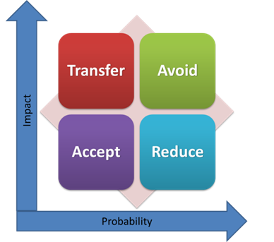

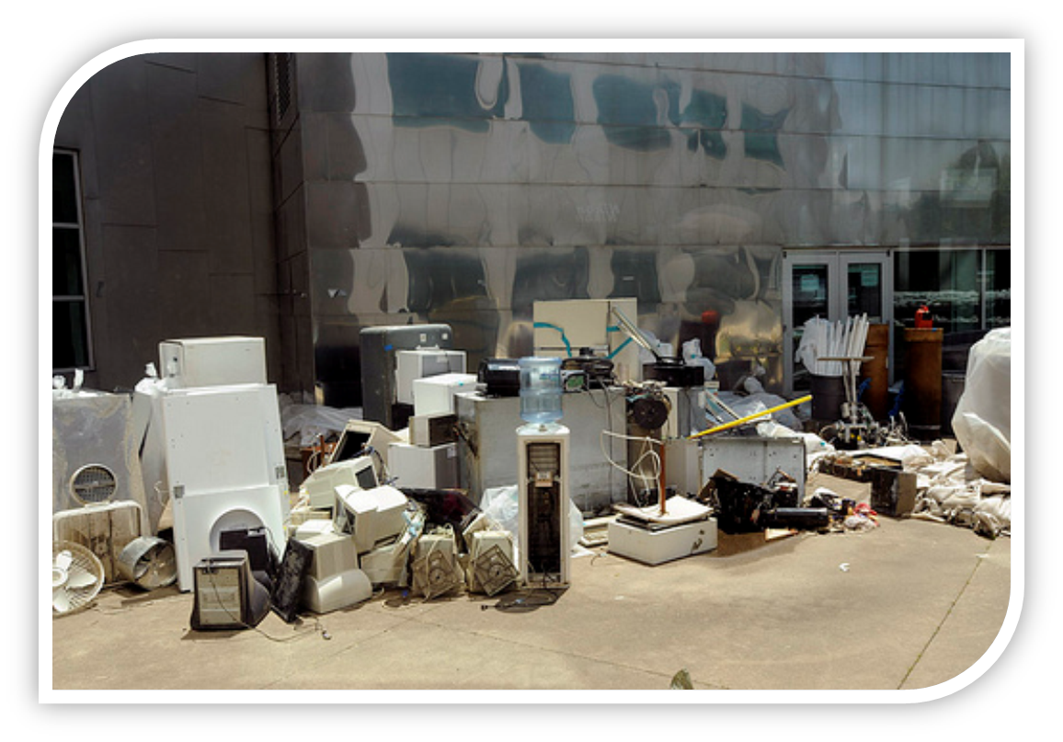
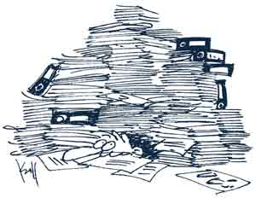
Preservation

Slide 12


Litigation

Slide 13
Lessons about Information Risk
Preserve important information
  Resources, methods/formats, and instructions
Discard what you don’t need
  Controls cost, information sprawl
Automate records management if possible
  Controls errors and omissions
Be prepared for litigation

Slide 14
Endpoint Risk

Slide 15

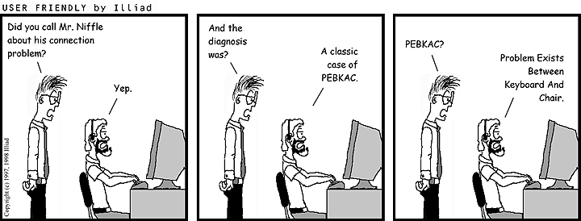
User as the Endpoint

Slide 16


Client Devices
Websense reports only 5 percent of actively used browser installations have the most up-to-date version of the Java plug-in…
Organizations face malware-related events that bypass traditional defense technologies on their networks every three minutes, according to a new report released Wednesday by security vendor FireEye.

Slide 17
Lessons about Endpoints
Threats are constantly evolving
  A-V model is no longer very effective
Standardize and automate client security
  Professionally manage all devices
  Lockdown as much as possible
User Training and Awareness
  Learn safe computing practices and policies
  Recognize and avoid risks
Stronger authentication should be considered

Slide 18
System (Server) Risk

Slide 19

System Compromises
Credentials, Keys, SSO
Patching
Configuration and trusts
System Monitoring

Slide 20
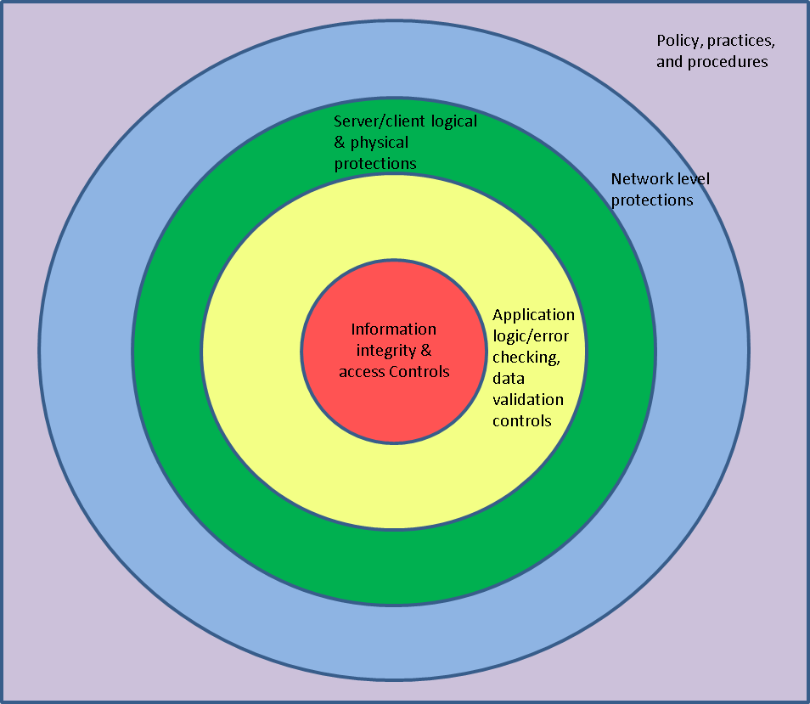
Defense in Depth

Slide 21
Lessons about systems
We are an interconnected IT ecosystem
  Common good, general protections for all
  Small system changes can reap large benefits
  Strong authentication for all accounts
  Don’t be the weak link!
Enforcement is tricky
  Educate on guidelines and policy
  Utilize assessment methods and tools to check

Slide 22
Specific Lessons Recap:
Implement a records management program
Address normal preservation and litigation, as they are equally important
Automate management of all clients
Expand user security awareness training
Employ stronger authentication
Isolate systems or services from Internet
Improve system-level monitoring
Provide more training for IT staffs
Perform more system checks/assessments

Slide 23
For more information:
  jane-drews@uiowa.edu
  http://itsecurity.uiowa.edu
  http://www.educause.edu/security/guide

