Slide 1
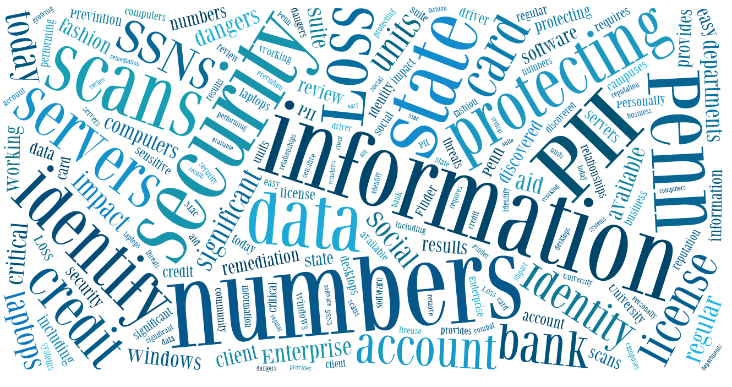
ADMINISTRATION OF DATA LOSS PREVENTION SERVICES IN HIGHER EDUCATION
Mike Thompson Systems and Network Security Analyst The Pennsylvania State University
mot1@psu.edu
Kyle Crain Systems and Network Security Analyst The Pennsylvania State University
kdc12@psu.edu
Notes:
Brief introduction about ourselves
- What we do with the project
- How long we have worked on the project and in what units
- From a unit perspective as well as now from a project management perspective

Slide 2
Overview
General Information
Glossary
Compromise Information
After A Compromise
Summary
Lessons Learned
Key Points
Planning Your Deployment
Governance and Compliance
Training and Documentation
PSU Overview
Who's Responsible
How DLP Comes Into Play
DLP Effect on Compromised Machines
Historical Information
Where we Started
Balancing The Needs
Define Your Scans
Dealing With Difficult Areas
Notes:
Highlight 4 different general categories covered

Slide 3
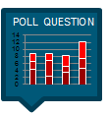
General Information
Notes:
Talk about were going to look at how PSU’s deployment works
Discuss how DLP at PSU got started

Slide 4
Do you currently have a data loss prevention solution in place?
Yes, we are actively scanning/implementing a DLP solution
No, but we plan on implementing one
No, and we have no plans to implement

Slide 5
Glossary
Client
Software that is installed on a computer; either the client for Windows or Mac
Endpoint
A computer on which the DLP client has been installed
Policy
A collection of settings that defines the way scanning is performed
Unit
Used generically to mean a campus, college, administrative area, department, or work unit
Notes:
Run though the glossary terms with a general description, not necessary reading from slide

Slide 6
PSU Deployment Details
Item | Total
Penn State | ~23,000
Commonwealth Campuses | 24 (Includes a Hospital and Law School)
DLP Unit Contacts | 300+
Administrative Roles | 131
Registered Endpoints | 21,000+
Centrally Managed Installations | 1
Independent Installations | 5
Highly Skilled Individuals Responsible for Running Project | 2 (0, and 2 Imposters?)
Notes:
Distributed main campus model
24 campuses all over the state
- Most have a single IT group for entire campus
Define a DLP unit contact and Admistrative role
Talk about independent installations
- Why: hospital data, defense data

Slide 7
Deployment And Support
Manage Project
Maintain Infrastructure
Unit IT Staff
Review Results
End User
Remediation of Data
Train & Support Unit IT Staff
Define Scan Schedules
Maintain Policy Settings
Create Documentation
Train End Users
Deploy Client Software
Security Operations and Services
Generate Install Packages
Notes:
Relationship between SOS, IT Staff and End users
Talk about what we don’t do
- Direct training
Bullet points on notes, break it down further
Details about documentation we provide
- Why we write our own
- PSU Specific
- Not supplied by vendor
- More concise

Slide 8
Historical
Initial DLP Product Rollout Late 2008
Current Product Licensed January 2010
Initial Product Discontinued Use June 2010
Current Product Deployed April 2010
Chose not to Renew Late 2009
Why the Initial Product was Replaced
IT Staff Requested Reports; Parsed Data; Then Sent to End User For Remediation
No Ability to Track Progress of Remediation
No Mac Client
Cumbersome to Define Exclusion Areas for False Positives
IT Staff Wanted Control in the Process
Notes:
Breakdown the timeline
Overlap between last 3 blocks
- Gradual change to allow time to adopt software
- Get the word out, no central list.
More detailed description of Initial process and why it was cumbersome

Slide 9


Needs Assessment
Delegate Control of Process to Units
Mac Client
Direct remediation to Fall to the Data Owner
Centrally Hosted Web Based Application
Scheduled Scan Frequency
Picture an Apple logo so we don’t get sued.
Sizable Subset of Computers that Were Not Being Scanned
Provides Visibility to Remediation Actions Taken (If Any)
Notes:
Talk about what delegate control means
- What the units actually are able to do
- More flexability in terms of policy and scan schedule
Mac client
End users doing the remediation
- Makes sense to do from client right after scan
- Don’t have to go back and dig through data

Slide 10
Planning your deployment
Notes:
Governance and compliance
- Why its important
Striking a balance
Planning for pushback

Slide 11
IF YOU HAVE DLP DEPLOYED, IS IT PART OF AN OFFICIAL POLICY?
Yes
No

Slide 12
Governance and Compliance
DLP Policy
Model
Awareness
Balance
Training
Resistance
Central DLP Policy
Lives At Top Level of Organization
Integrated And Respects Existing Policies
Defines How to Scan and What To Scan Per State and Federal Laws
Outlines Remediation Process and Consequences for Inaction
College or Unit Level If Top Level is Not Feasible
Notes:
We don’t have one
- In the works
- 5 years in
- Point us to the policy that says we have to do this
- Both sides
Optimal to have a policy from the start
Difficult to enforce anything without it
Define what the “top level” is
- Why its better than college or unit
- Consistent
Take laws and regulations into mind

Slide 13
Define A Model
DLP Policy
Model
Awareness
Balance
Training
Resistance
Level of Involvement
Central vs. Distributed
Support Model
Infrastructure
Central Model
Central IT Group
Campus A
Campus B
Campus C
Campus A
Campus C
Campus B
Distributed Model
Notes:
What is your deployment model look like
Support model
- Coordinated centrally
- Every unit on their own including infrastructure
PSU is a central model in terms of support and infrastructure
- Distributed in terms of the units are responsible for actual scanning

Slide 14

Define A Model
DLP Policy
Model
Awareness
Balance
Training
Resistance
Auditing and Review
Reporting Structure
Who is Responsible For Remediation
End User
IT Staff
Other
Notes:
Audit and review twice a year
Why we do this
- Some level of accountability for everyone including us
- Gets them invested in process
Opportunity to make people aware of the project again
Determine who remediation should fall to

Slide 15
Define A Model
DLP Policy
Model
Awareness
Balance
Training
Resistance
Week 1
Unit Contacts
Week 2
Enterprise Security Manager
Week 3
VP – IT
Week 4
Week 5
CISO
Risk Management
Unit FO
Dean, Chancellor or Administrator
Internal Audit
CFO
Provost
PSU Reporting Structure
Notes:
Run through the chain

Slide 16
In your environment, who is best suited TO PERFORM PII remediation?
End User
IT Staff
Other (Privacy Group, etc.)

Slide 17
Define A Model
DLP Policy
Model
Awareness
Balance
Training
Resistance
What Do You Want to Scan?
Scan
End User Machines
Don’t Scan
Domain Controllers
Machines Without Profiles
File Servers
E-Mail
Lab Equipment
Common Areas of Filesystem
System File Areas Within OS
Notes:
Not a good idea to scan everything
Make determinations about what you don’t need to scan
- Don’t make it harder than it needs to be

Slide 18
Generate Awareness
DLP Policy
Model
Awareness
Balance
Training
Resistance
Outreach and Awareness
Make the Project Known…
Personally Identifiable Number Chart
Document Shredder Program
What’s the Virus On My Computer
“
”
Notes:
Make sure everyone is aware of the project/product
Communication channels
What we did
Not perfect, still received emails
Above blocks, within last few months

Slide 19
Balance The Needs
DLP Policy
Model
Awareness
Balance
Training
Resistance
Business
Privacy
Security
Due Diligence
A Routine, Not a Burden
Notes:
Usability
Scan every 2 weeks to once every 30 days
- To often, hassle, quit program
Getting users into a routine
- Virus scanning is now expected, DLP should be expected

Slide 20
Balance The Needs
DLP Policy
Model
Awareness
Balance
Training
Resistance
Faculty
Staff
Executives
Everyone's Responsibility

Slide 21
Training and Documentation
DLP Policy
Model
Awareness
Balance
Training
Resistance
Wiki Articles
End User Training Videos
Unit IT Staff Training
PSU Specific Processes
3 Hour Basic
Win Client
Mac Client
3 Hour Advanced
Technical Articles
Web Based Q&A
Provided Support Resources
Notes:
Talk about wiki
- Constantly changing
- Important to keep up to date and add to
- Cuts back on helpdesk type work, able to point questions to an article
Videos
- Collaborate with training services
- Covers the client and remediation process from start to finish
Unit IT staff training
- Important piece
- Ongoing

Slide 22
DO YOU PLAN ON HAVING STRUCTURED USER TRAINING?
IT staff only
End users only
IT staff and end users
No

Slide 23
User Privacy Concerns
DLP Policy
Model
Awareness
Balance
Training
Resistance
Dealing with Pushback
Isolated Pockets of Acceptance vs. Resistance
Self Assessment Program: Data
Category | Count
Total Downloads | 350
Unique Downloads (Users) | 205
Users on Latest Version | 18
Number of Completed Registrations | 6
Notes:
Why the need for self assessment
- History
- Process
- Look at the data
- Doesn't work
- Self Scan LOL
Last resort in your implementation
Small percentage of overall community

Slide 24
DO YOU FORESEE OR HAVE EXPERIENCED POCKETS OF RESISTANCE?
Yes, we anticipate from a few areas
Yes, widespread
No, our users will comply

Slide 25
Compromise information
Notes:
What happens after a compromise and how DLP comes into play

Slide 26
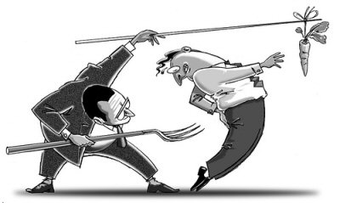
Compromised Computer Process
Compromise
Detected
Scan Host
For PII
(30 Day Rule)
Preserve Data & Rebuild
Report Findings
30 Day Rule
Carrot v Stick
piedtype.com
Notes:
Run through the process
- 30 day rule
Self Assessment still scans

Slide 27
DO YOU SCAN AS PART OF YOUR COMPROMISED COMPUTER PROCESS?
Yes
No, LOL
No, but that is a good idea

Slide 28
Notification Costs
Costs Associated with Each Compromise
Staff Resources To Perform Notifications
“Damage To Reputation”
Third Party Costs
Loss of Funding
Notes:
Breakdown the costs
Funding
- Research
- Grants
- Tuition
- Donors
Damage to rep
- In the news for data loss
- LOL

Slide 29
Compromised Computer Statistics
Previous Tool
Notes:
Not all the fault of previous tool
- Processes were not in place
- Learning experience
- Helped us determine what direction we needed to go
Outcome of all that is now seeing results in decreasing percentages

Slide 30
Summary

Slide 31
Lessons Learned
Assess Your Needs and Find the Right Product
Know Your Environment
Policies Need to be In Place Prior to Production
Hard to “Force” (proper) Remediation
Generate Awareness for Project
Otherwise, People Have No Idea What's Running

Slide 32
Lessons Learned
Define A Model
Support
Remediation
Support for IT Staff Is Ongoing
Takes Up 2 FTE’s Time and Then Some
Training and Documentation Are Not a Replacement
Need to Strike a Balance Between Business Needs and Usability
If it’s a Hassle, Users Wont Comply

Slide 33
Lessons Learned
Plan For Resistance
Separate Process Should Be Last Resort
Integrate DLP Into Compromised Computer Process

Slide 34
Thank You!
Questions?
Notes:
Thanks for having us, hope you are able to take something away.
Fill out a card, tip your server.

