Slide 1

Ribbons in the Sky
A Customer-Focused Approach to Implementing Change
Julie Leary
Manager, Distributed Support & Services
Amy Chase Martin
Manager, Teaching and Learning Support
Copyright Martin, Leary (2009). This work is the intellectual property of the author. Permission is granted for this material to be shared for non-commercial, educational purposes, provided that this copyright statement appears on the reproduced materials and notice is given that the copying is by permission of the author. To disseminate otherwise or to republish requires written permission from the author.
Notes:
Fonts – Title Rotisserie sans serif
Paragraph - Sabon

Slide 2

Towson University
Founded in 1866
Second-largest public university in Maryland
A metropolitan university located in suburban Towson, eight miles north of Baltimore
Offers over 100 bachelor’s, master’s, and doctoral degrees and certificate programs
    Over 21,000 students
    1,456 faculty / 3,123 staff (Fall 2008)

Slide 3
History
Upgrade plan did not consider the client’s perspective or scheduling needs
Communications were limited to university wide announcements and alerts; a warning
Upgrade was pushed out remotely building by building
No visibility unless there were problems
Limited training options; clients responsible to find and attend a scheduled session or use self-help resources

Slide 4
Past Environment
Strained relationships; at times broken relationships
Bad impressions
Negative perception of all support and services offered
Distrust
Defensive mechanisms towards IT
Individual department and colleges relying on their own IT resources

Slide 5
Goals
Focus on the customer
Minimize stress and frustration
Provide clients with choices and flexibility regarding timing
Help people quickly and easily become productive users
Enhance and build strong relationships
Leverage Microsoft SharePoint as a project management tool

Slide 6
Primary Points of the
Action Plan
Communication
Designated Office 2007 upgrade coordinator
Assist with planning and preparation
Options for previewing software prior to upgrade
Flexibility – let the client decide when
Training options, including specialized and custom training
Visibility before, during, and after upgrade

Slide 7
Behind the Scenes
Collaboration; Teaching and Learning Support, Faculty Staff Help Center,
Distributed Support, and Collaboration Services
Centralized tracking of communications,
progress, scheduling, problems, and resolutions
Check lists and scripts for calling and meeting with the clients
Documentation; self-help and handouts

Slide 8
Lessons Learned
OTS standard practices for testing
  Test on computers used for day to day operations
Deal with memory upgrades from the beginning
  Clear recommendations
  Provide memory upgrade through OTS for older computers
Provide Office 2007 upgrade coordinator a marketing packet
  Template e-mails
  Handouts

Slide 9
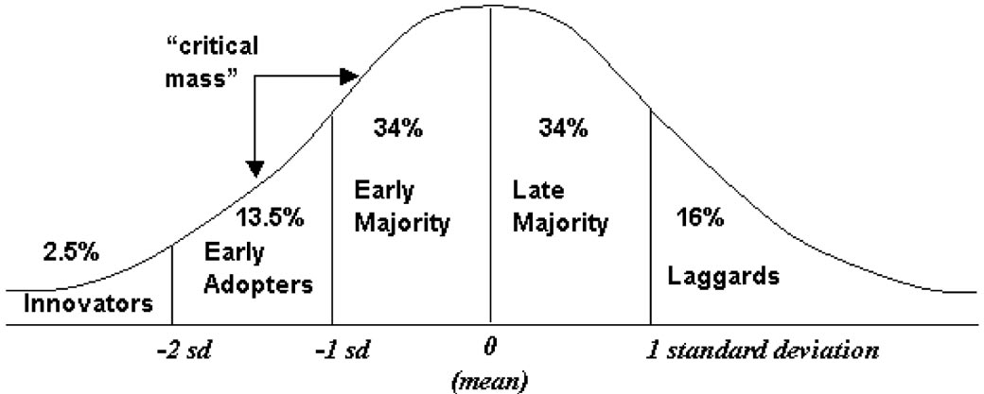
Adopter categories based relative time of
adoption in the normal distribution of adoption times
(innovativeness) (Rogers 1995, p. 262).
Rogers, Everett M. 1962. Diffusion of innovations. 1st ed.
New York, NY: Free Press.

Slide 10
Training Plan
Investigate, try, learn software
Create a script for demos
Create documentation to support demos
Create/revise online self-help documents
  Investigated repurposing other Higher Ed support docs for Office 2007

Slide 11
Training Concerns
Identifying critical training topics
Creating supporting documentation
Creating variety of training options
  Different constituencies at Towson
  Pro 2003 users versus novice software users
  Time constraints
  Learner preferences
  Various platforms
Communicating/Promoting Training to Users
  Securing “buy-in” from stakeholders/gatekeepers

Slide 12
Road Show Concerns
Equipment availability and reliability
Event confirmations
Communications – has audience been informed?
Scheduling mix-ups
CONFIRM – CONFIRM -CONFIRM

Slide 13
User Questions
  Just how different is it?
  Do I really need training?
  Why did you switch?
  Do I have to switch?
  When are we switching?
  What will you do if I won’t switch?

Slide 14
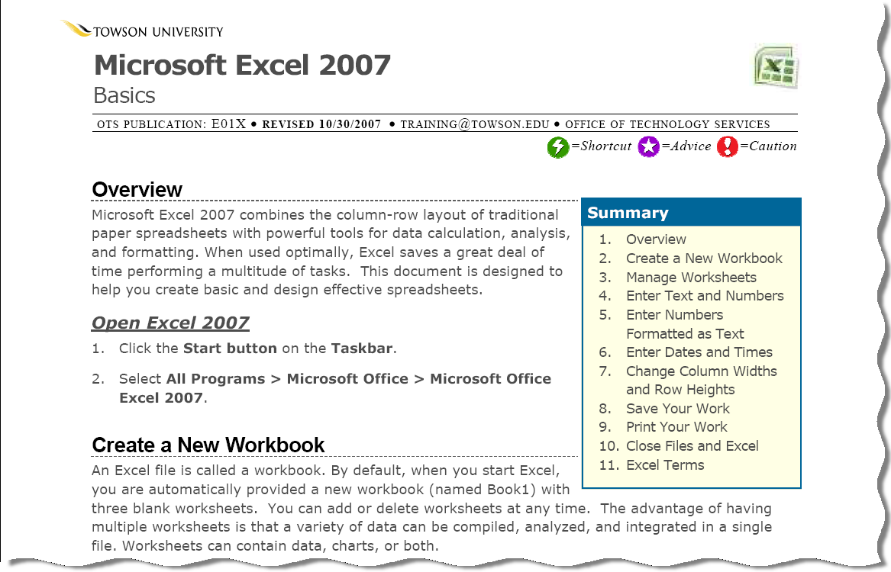
Self-Help Documents
Sample Online Resources
Microsoft Excel
Outlook
Ribbon – Movie Tutorial

Slide 15
Lessons Learned
Essential for field support and training to work together
Training = Sales Pitch
Log attendance numbers for all demos and training events
Provide online recordings of demo topics
Ensure appropriate number of training personnel attached to task
More comprehensive marketing efforts

Slide 16
Our Report Card
Users reported their experience was:

Slide 17
Questions?
A copy of the presentation and additional resources are available at http://net.educause.edu/SERC09/1020826
        Amy Chase Martin
        Manager, Teaching and Learning Support
        aemartin@towson.edu / 410-704-6035
        Julie Leary
        Manager, Distributed Support & Services
        jleary@towson.edu / 410-704-4561

Slide 18
Credits
Music
  "Hear Us Now (poptastic mix)"
  by scottaltham
  2009 - Licensed under
  Creative Commons
  Attribution Noncommercial (3.0)

