Slide 1
Professional Learning Community In Action
Instructional Technology
Eastern Kentucky University
Chris Daniel
Cindy Judd
Beverly Miller

Slide 2
Overview
Definition
EKU and PLCs
Our charge and process
Implementation of ideas
Recommendations
Notes:
Professional Learning Community in Action: Instructional Technology > Outline
History of PLCs
EKU Background on PLCs
Formation of IT PLC for Instructional Technology
Areas Represented
IT
Libraries
Arts and Science
Art and Design
Chemistry
Biology
Business (Had to abscond a quarter of the way through)
Curriculum and instruction
Charge:
Understand current state of classroom technology at EKU
Make discoveries about current and future trends
Literature review
ECAR Report
Article 1 we read
Article 2 we read
Book we read
Information gathering regarding other institutions
Implementation Local K-12 institutions
Madison County Board of Education
Whitehall elementary
Model Laboratory school
Make recommendations about implementation of instructional technology
Findings
Challenges
Faculty involvement?
pedagogy drives the technology
How does EKU measure up?
Recommendations

Slide 3
What is a Professional Learning Community?
Shared learning
Philosophical
Research based
Pragmatic
Notes:
In our PLC we had not just multiple perspectives, but also division of labor, diverse interests, multiple dialogs about a lot of different things.
These qualities brought about quite a bit of thought. Thank goodness the folks on our PLC were a convivial
We used several published works within the context of our community
Pragmatic- toward a purpose, application

Slide 4
PLCs at EKU
EKU Teaching and Learning Center
Began 2001 at Lilly Conference
Currently five active PLCs through EKU TLC
College of Education: 20 under way!
Notes:
EKU Teaching and Learning Center
Leadership of Blythe and Sweet
Began 2001 at Lilly Conference
Milton Cox
Dee Fink
Currently eight active PLCs through EKU TLC
College of Education: 15 under way!
Lilly Conference is University of Miami at Ohio
COE Dean Bill Philips is putting a lot of effort and resources into fostering these- using these toward shared governance

Slide 5
General Qualities of EKU PLCs
Usually cross-disciplinary
8-12 members or fewer
Active, collaborative learning experience
Regular structured scholarly activities
Notes:
Usually cross-disciplinary
often combining faculty and professional staff
8-12 members or less
Less is sometimes more
Blythe and Sweet say that more than 12 is impossible, 8 is ideal
Two facilitators for division of tasks and collaboration in the development of the PLC
Active, collaborative learning experience
Regular structured scholarly activities (with a scholarly text as focus)

Slide 6
General Qualities of EKU PLCs
(continued)
Semester-length
Participants are valued
Creates an end product
Moving into enhanced PLCs
Notes:
Semester-length (though some run a year)
Participants are valued
Payment of a stipend (plus allowance for food and sources)
Creates an end product
Scholarship
Conference
Presentation
Syllabus revision
Enhanced PLCs
Creates renewed internal interest in the work
Serves to communicate or deliver this work to others
Generates communication to others about PLCs and the work of the TLC
Better serves the community at large

Slide 7
Instructional Technology PLC Charge
Become familiar with Inst. Tech issues
Make recommendations about EKU Inst. Tech
Notes:
Here the IT stands for Instructional Technology
Become familiar with instructional technology issues
Make recommendations about EKU instructional technology

Slide 8
Steps Taken
Understand Current Status
Discover Trends
Survey Area Technology
Notes:
Understand current state of classroom technology at EKU
Discover current and future trends
Survey technology in use in the area

Slide 9
Current state of EKU Inst. Tech:
Centralized Technology Management
Notes:
Centralized management of technology
92% have projection system (fixed or mobile)
During past 2 years:
>150 new projectors added
>100 carts and docks added
40 projectors to be replaced by Spring 2009

Slide 10
Cornerstones of Success by 2010
Secure Wireless Access
Computers < 4 Years Old
>= 80% satisfaction
Appropriate
Tech in Every Class

Slide 11
Centralized Technology Initiatives
Classroom Technology
ITV upgrades (HD)
Madison County dual credit program (ITV)
D-Labs
Faculty laptop program
Staff desktop program
Notes:
Departmental Labs (D-Labs) Program
Labs meeting specified criteria may enroll
IT trains and assists lab manager
Computers upgraded and placed on 3 year rotation

Slide 12
Classroom IT Service Model
Proactive maintenance
Replace aging equipment
Staffing
Notes:
Routine check of lamp hours and filter cleaning
1 FTE and Two student workers

Slide 13
ECAR Report
Bates and Pool text
Journal articles
Trends

Slide 14

ECAR Undergrad IT Study
The research arm of Educause
  Over 27,000 at over 90 institutions
  Focus groups
  Qualitative data
  Literature review

Slide 15
ECAR Undergrad IT Study
  Technology Ownership
Laptops: 80%
Computer < 2 Years Old: 68.9%
Net capable phone: 66.1%
  25% access at least monthly

Slide 16
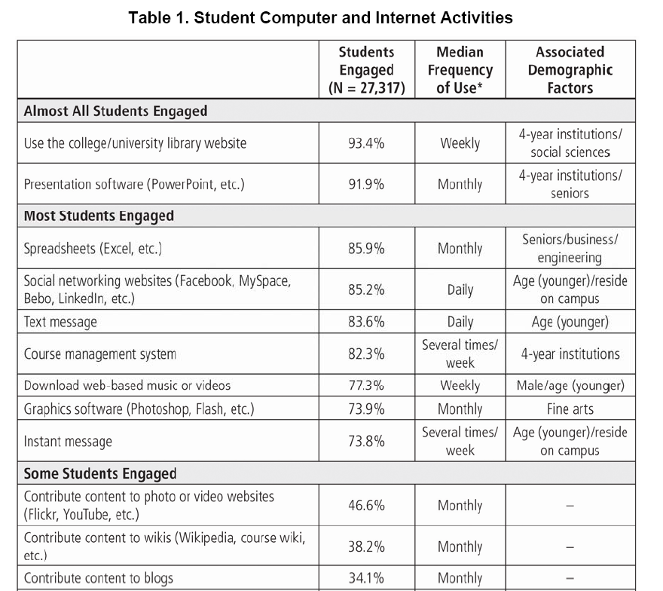
ECAR Undergrad IT Study
  Technology Ownership

Slide 17

Text
Defines the role of media
Framework for selecting appropriate technology
  SECTIONS
How technology integration is organized
Design approaches
Notes:
Media Broadcast Communication
Face-to-face
Text
Audio
Video
Digital Multimedia – Webcasting, CD-DVD
Students- What known information about students will help you make decisions
Ease of use and reliability
Costs- Cost structure of technology- unit cost per learner- time demands on teachers and staff?
Teaching and learning – what kinds of learning are needed and what kinds of teaching best help the learning
Interactivity- what kind is needed?
Organizational issues- What are the organizational requirements and the barriers to be removed first?
Novelty- How new is the technology and what advantages/disadvantages does this bring?
Speed- How quickly can the technology be implemented? How quickly can materials be changed?

Slide 18
K-12 Implementation Discovery
Cindy Judd
Librarian
EKU Libraries

Slide 19
  Local K-12 Implementation
Madison County Board of Education
Whitehall Elementary
Model Laboratory School
Notes:
Need to describe the BoE facility and get specifics about whitehall and Model

Slide 20
K-12 Findings
County K-12s had the same technology as EKU
Technology was more consistently integrated:
  Smaller, more cohesive
  Ability to issue mandates
  Discipline-specific nature of Universities

Slide 21
EKU Implementation from PLC:
Beverly Miller
Assistant Professor
Interior Design

Slide 22
Steps Taken
Technology and DESIGN
Understand current state of classroom technology at EKU
Discover current and future trends
Survey technology in use in the area
Notes:
What I am saying – I wasn’t even on this page
EKU had technology that I didn’t know how to use or wasn’t aware of
I learned a tremendous amount from the other members

Slide 23
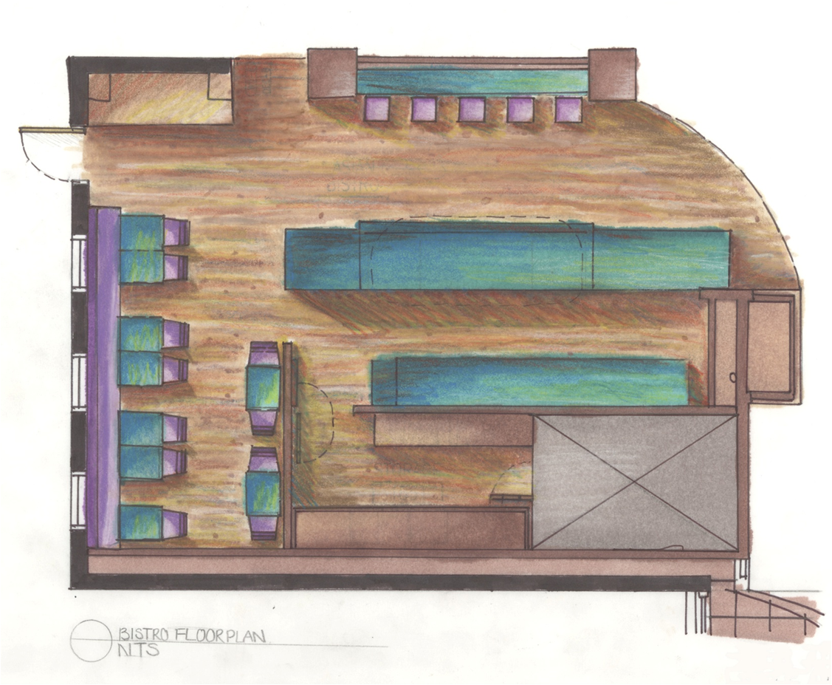
Problem
Technology and DESIGN
Students need to learn techniques and processes
Will learning be enhanced by students seeing technology in use?
Incorporating document camera into design studio

Slide 24
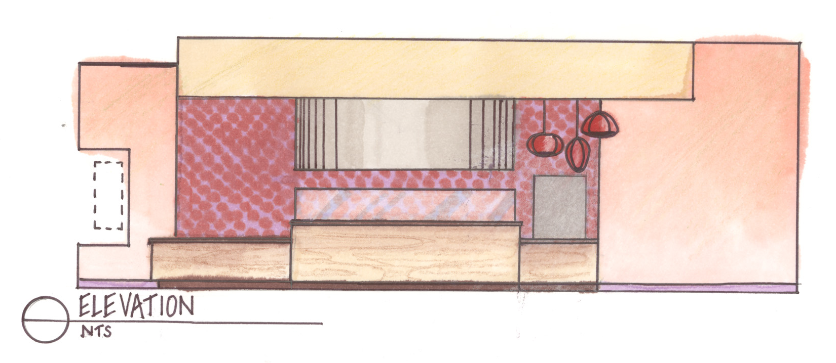
Technology and DESIGN
IT provided document camera
Design studio met in the technology lab of the new Tech Commons on EKU’s campus

Slide 25
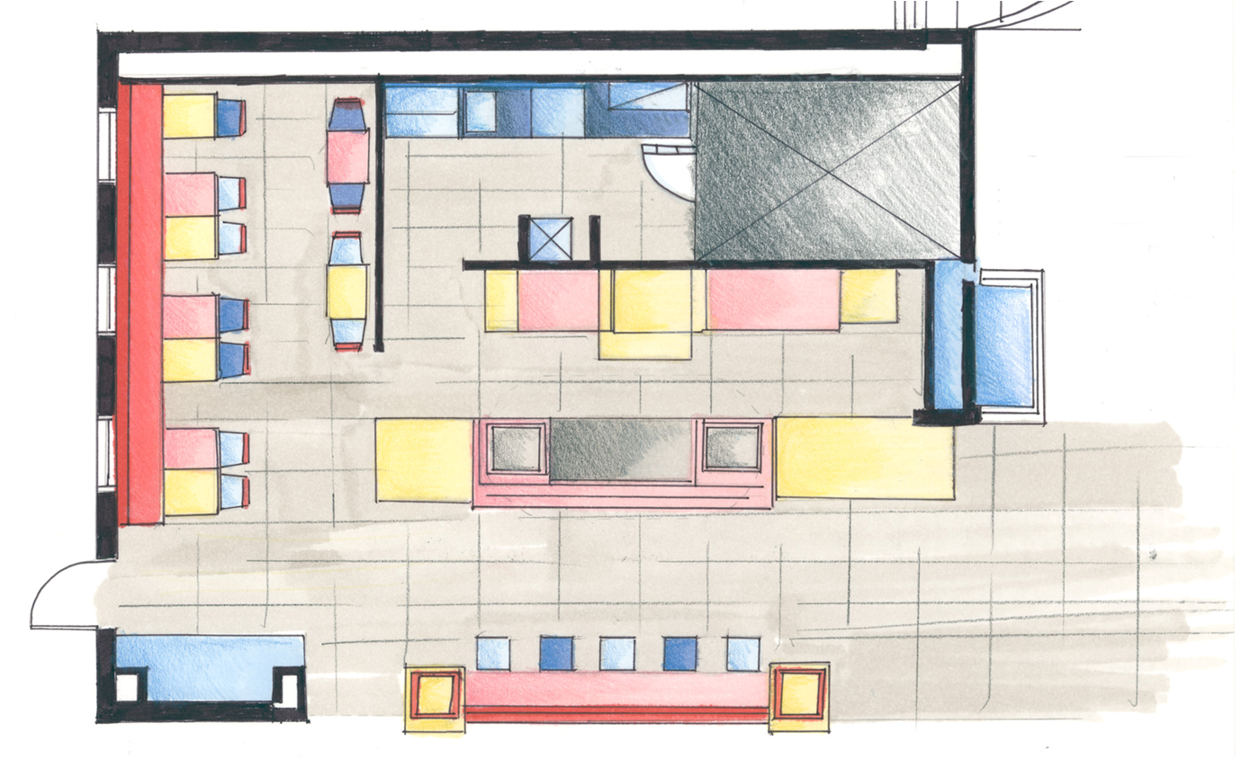
Student Enthusiasm!!
Technology and DESIGN
What happened?
Notes:
mystery of how to draw and blend colors had begun to unfold as they watched and participated.
The key – participation
Learning both technique and process

Slide 26
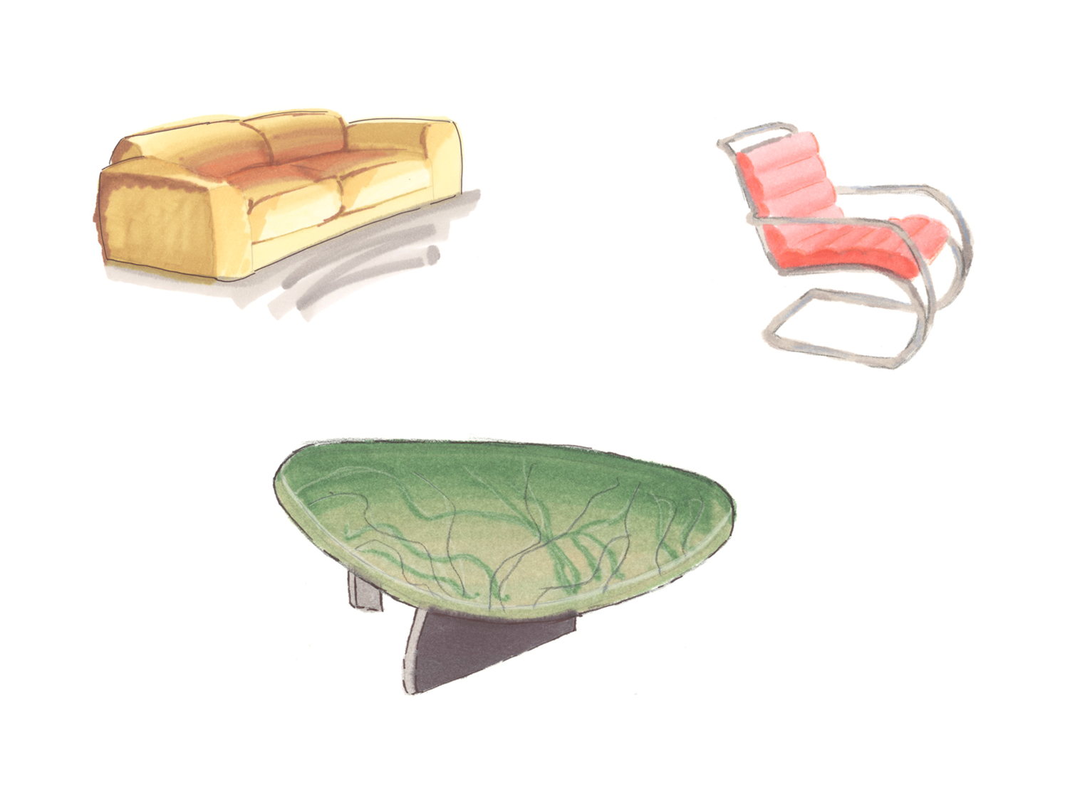
Teaching color theory and rendering
Technology and DESIGN
Can watch as color is applied to a drawing
Can view images without having to scan and download
Notes:
Students see how multiple colors and layers contribute to a finished drawing

Slide 27
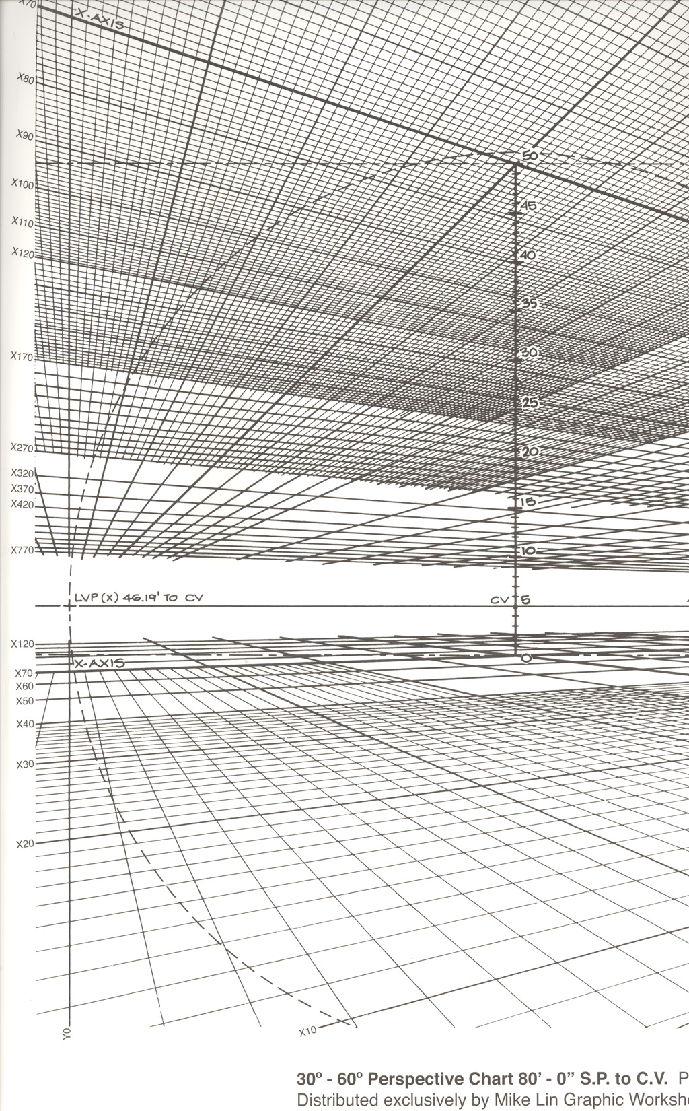
Teaching perspective drawing using a chart
Technology and DESIGN
Notes:
Have perspective chart
Very overwhelming – lines going every which way
Students can see my chart and watch the procedure and do the same
Upside down?

Slide 28
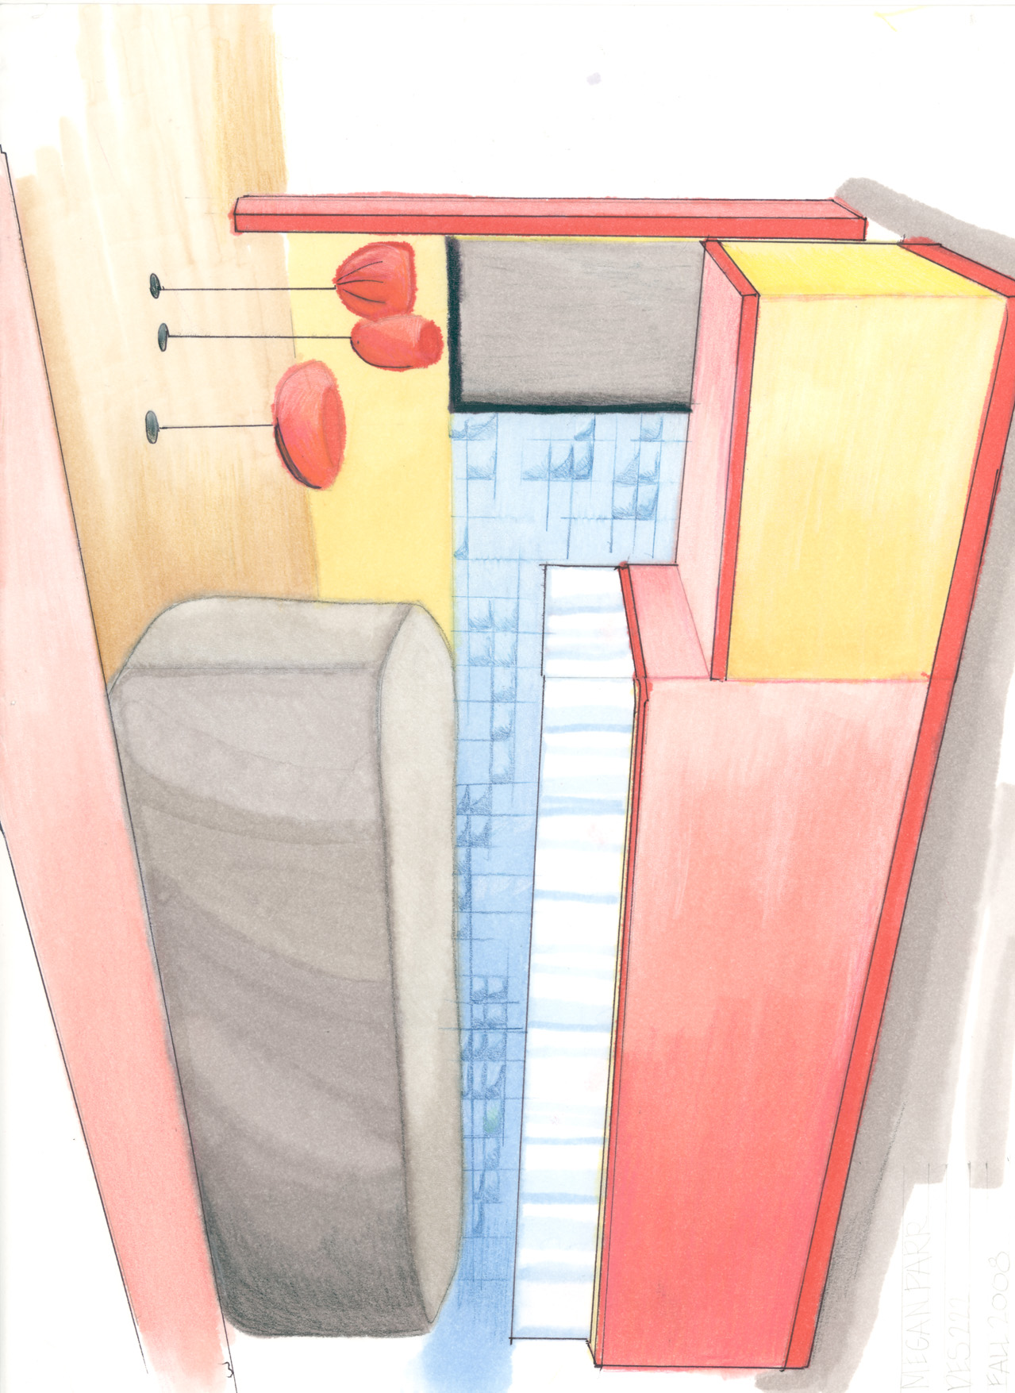
Results:
Technology and DESIGN
Can apply techniques and processes to a new situation
Producing quality rendered drawings and perspectives by midterm
Accomplishing more in one semester
Notes:
After watching and following process one time
Students can repeat and apply to new situation
Why – have learned the technique and process – have tools in their tool box
At mid-term – producing quality rendered drawings and perspectives
Have been able to accomplish more

Slide 29
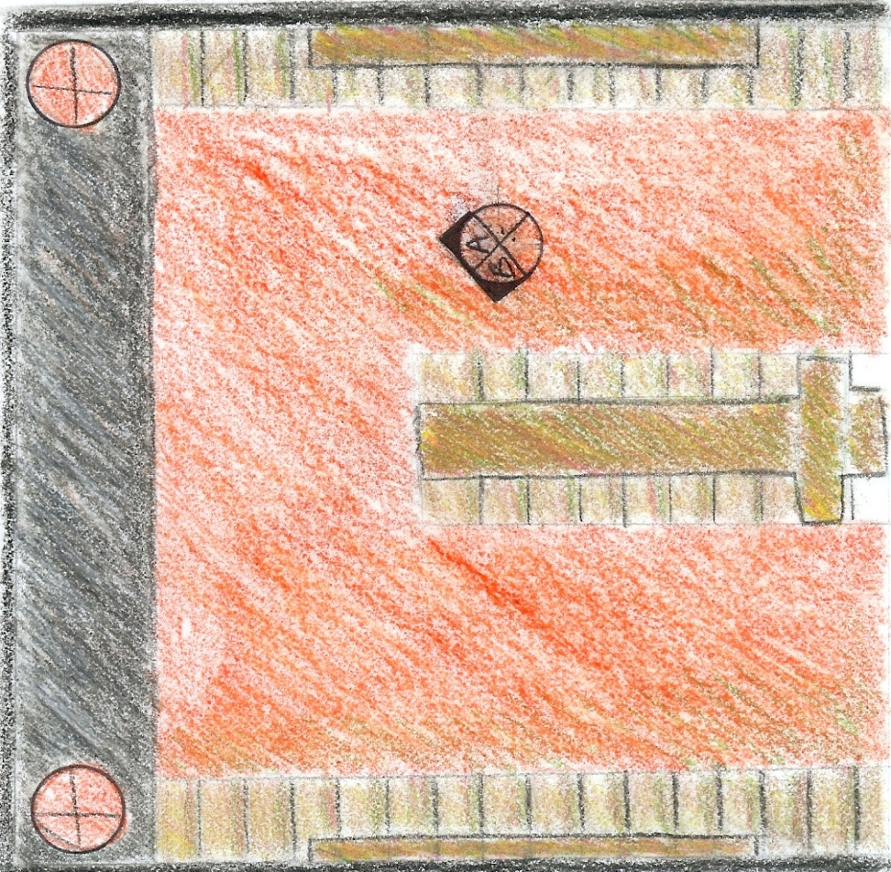
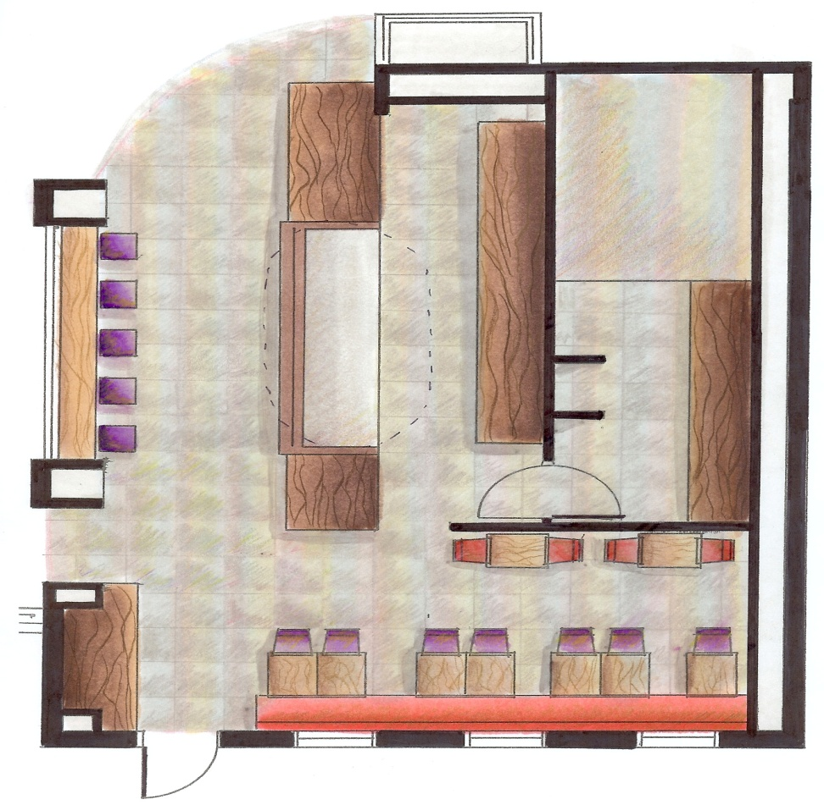
Technology and DESIGN
Beginning of semester
Mid-semester

Slide 30
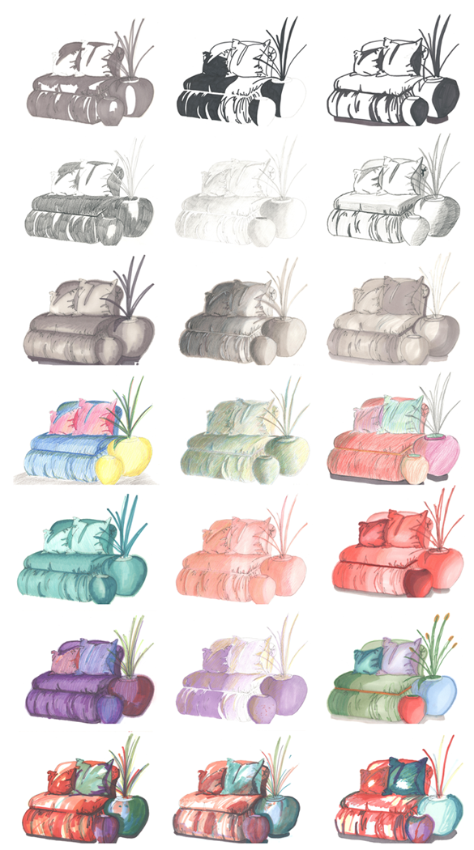
Technology and DESIGN
Applying techniques and types:
High contrast
Pencil
Grayscale marker
Monochromatic
Colored pencil
Marker and colored pencil
Loose!
Notes:
Series assignment to apply knowledge and skills acquired during semester
Prototype used for Loose drawing

Slide 31
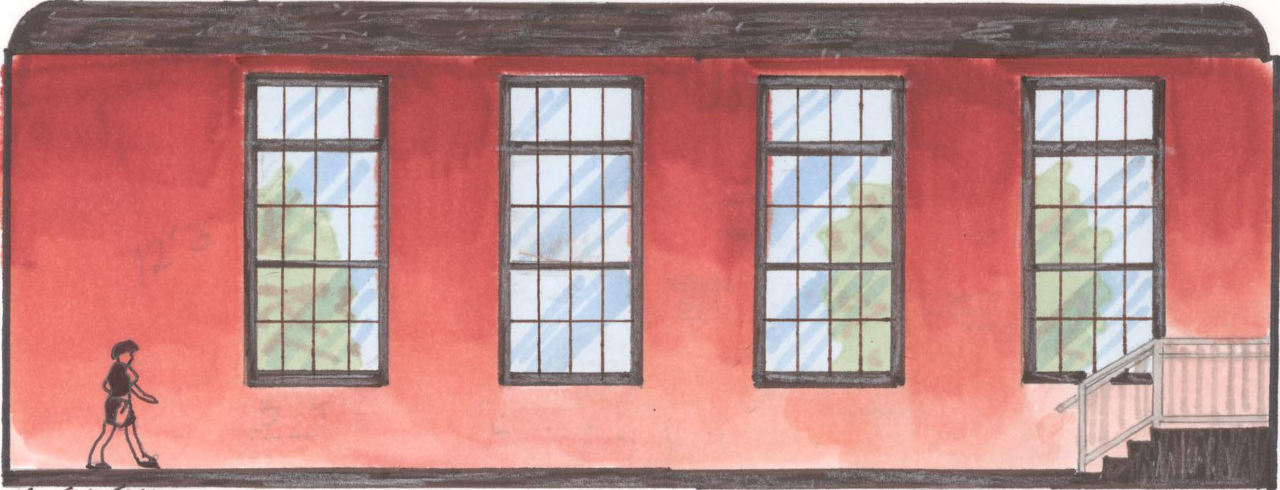
Technology and DESIGN
Notes:
Final Project: Elevation
Students were given elevation and floor plan of actual building

Slide 32
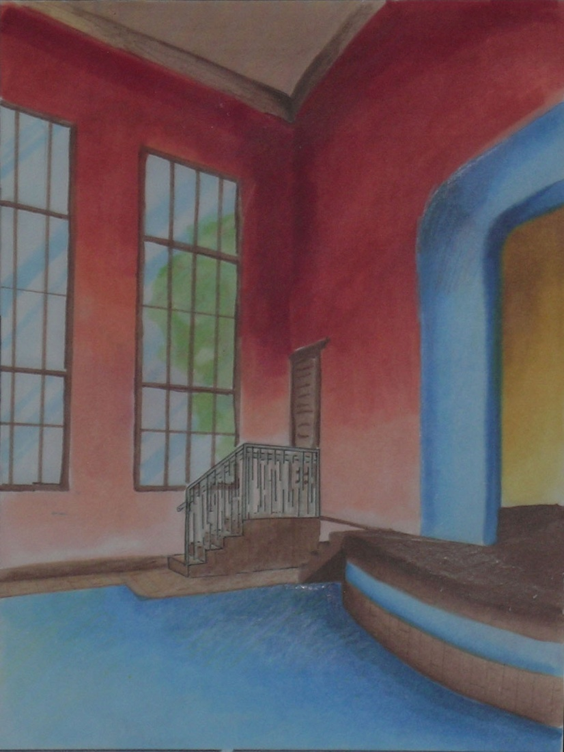
Technology and DESIGN
Notes:
Final Project: Perspective
Students were required to construct perspective of space based on drawings provided.

Slide 33
Recommendations
Baseline appropriate technology
Technology innovation award for faculty
Sponsor faculty to national conference
On campus faculty technology expo
Continuance of PLCs related to other IT issues
Notes:
Sponsor faculty to national conference
IT sponsors (pays) for 5-6 faculty to attend national conference
Meet with faculty at conference to discuss new and innovative ideas

Slide 34
Questions?

