Slide 1

A Second Life Training Course for Faculty and Staff
Edward Howell
Instructional Design Specialist

Slide 2
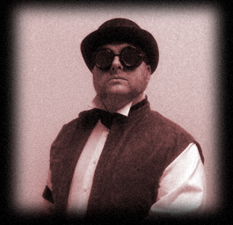
A Bit About Me
Instructional Design Specialist, OIT
Valencia Community College
Orlando, Florida
ehowell@valenciacc.edu
Notes:
Background in special effects, animation and interactive design
Taught computer graphics before Valencia

Slide 3
What I Do
Support faculty and staff
Training
Keep up to date
Notes:
Create and provide training on software that faculty use
Provide assistance for content creation
Design and create content
Investigate and evaluate new and innovative technologies

Slide 4
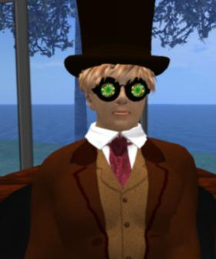
Exosius Woolley
Avatar since January 2007
Create avatars, virtual objects and buildings
Taught Photoshop in-world 2007/2008
Artist in Residence, Kelly Yap Art Gallery
My Flickr stream

Slide 5
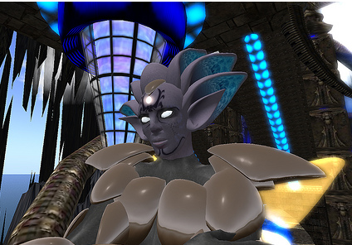
Exosius Mistwalker
Avatar since February 2009
Member of many educational groups

Slide 6
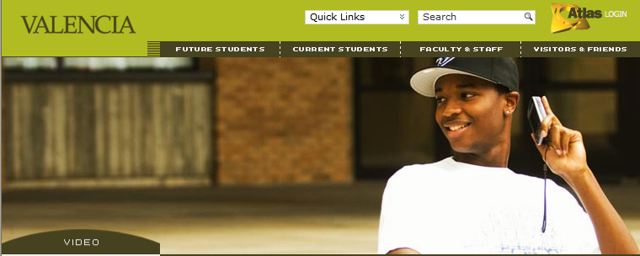
Valencia Community College
Friends and Visitors: Link
More Information: Valencia Institutional Research
Notes:
Orlando, Florida
Founded in 1967, expanded to 4 campuses.
East, West, Osceola, Winter Park
Criminal Justice Institute
Downtown Center
Corporate, Professional & Continuing Education at Sand Lake Center, Valencia Enterprises
About 24,000 full time students and 35,000 college wide
425 Full time faculty, 1500 adjuncts

Slide 7
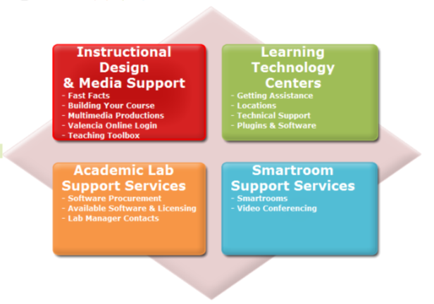
Learning Technology and Alternative Delivery
LTAD: Link
Notes:
Instructional Design, Media Support, Learning Technology Centers, Academic Lab Support, Smartroom
Support Services
Valencia Productions: Audio and Video studio production services
A department of the Office of Information Technology
14 staff, including 4 Instructional Designers

Slide 8
Current Supported Software and Faculty Development
Respondus
Respondus Lock Down Browser
StudyMate
Turn-it-in
Skills Tutor
SoftChalk Lesson Builder
Podcasting
HTML and Web Design
Blackboard
Basic Computer Graphics
Notes:
Also
MS Office
MS Windows
Deepfreeze
AutoCad
Micrograde
Accutrack

Slide 9
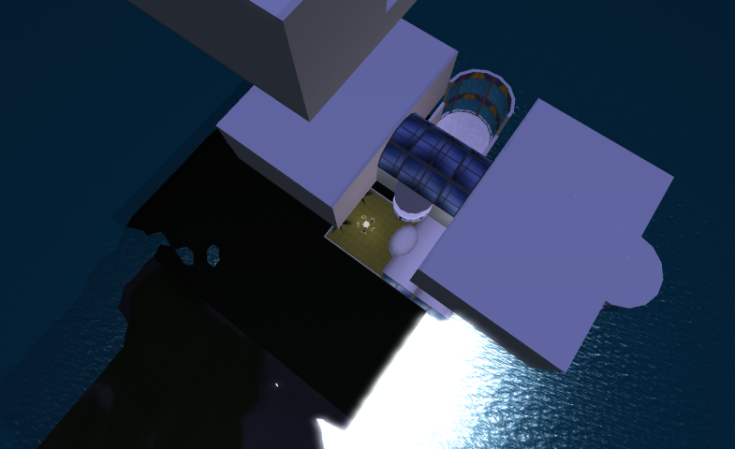
Tour of the Valencia Virtual Campus in EduIsland 4
Teleport

Slide 10
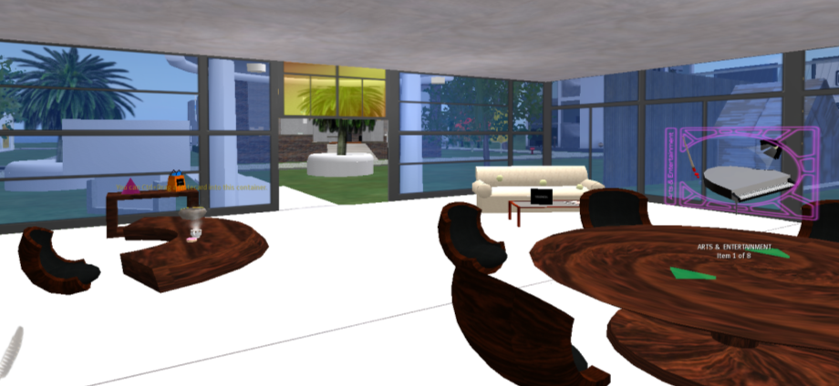
Welcome Center

Slide 11
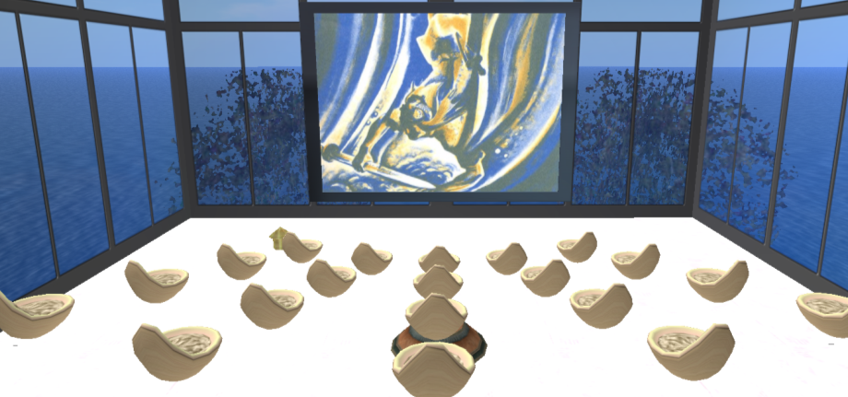
Classroom 1

Slide 12
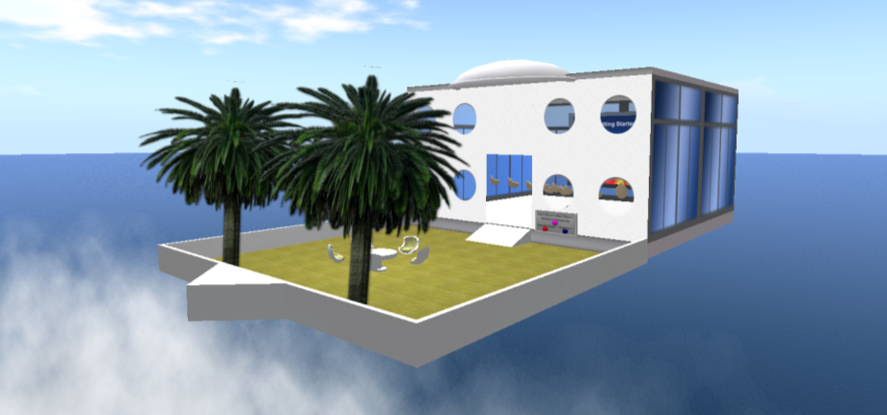
Classroom 2

Slide 13
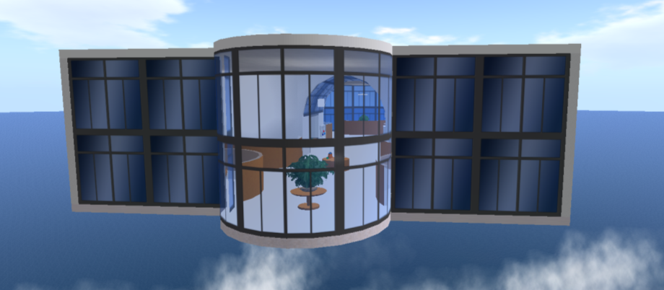
Faculty Offices / Workshop

Slide 14
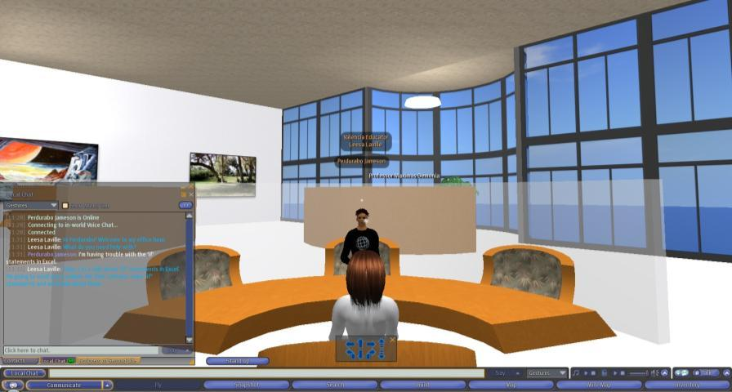
Student Assistance in Second Life

Slide 15
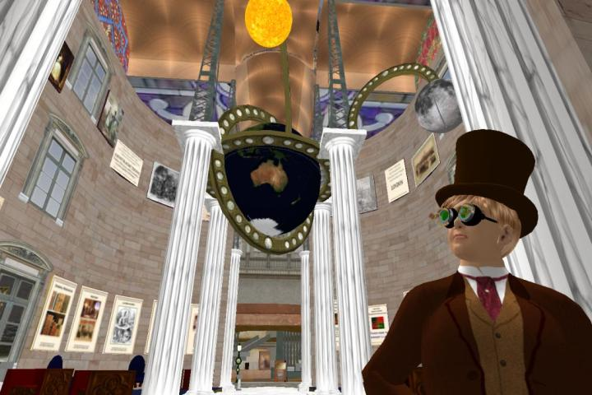
Objective: Introduce Second Life to the faculty and teach them how to use it
Notes:
Informational seminars were given at Learning Day; Second Life campus news sites were added to the monthly newsletter to spark interest, and presentations were given to the Academic Affairs Leadership Committee and other groups. Each was followed by a survey.

Slide 16
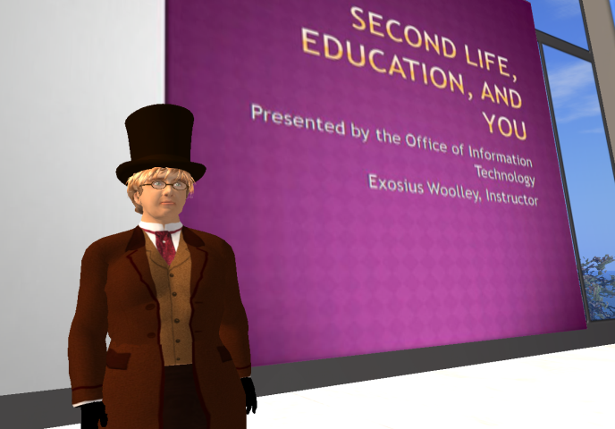
“Virtual Worlds in Education”
Notes:
Through verbal feedback on the presentations, and the surveys, I was able to roughly analyze the current state of faculty and staff information on the subject. The results were, most people who saw the presentations were convinced of the power and utility of the software; but were also very apprehensive about the technology requirements and the learning curve. After discussing the problems to be overcome with the Director of LTAD, we agreed that the software was within the capabilities of the faculty and most of the existing lab computer equipment.
The result was the creation of a new Training Course: Virtual Worlds in Education.

Slide 17
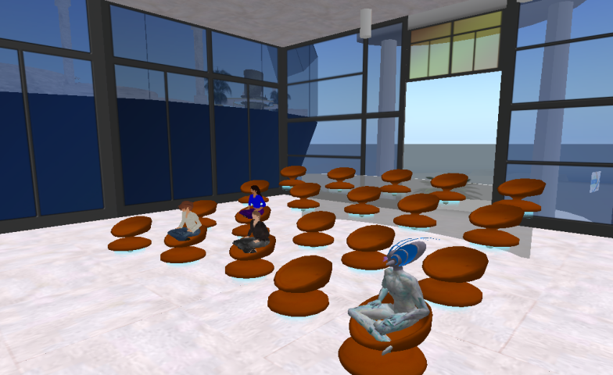
Choosing an approach to the course design
Notes:
Low Threshold Elements – both short and simple
Thorough and complete introduction to the main tools
Connect new ideas to old ones
Chronicle the history of MMORPG’s
Active Learning – Watch, then Do
Leverage existing SL content
Lots of sharing and communication among the students

Slide 18
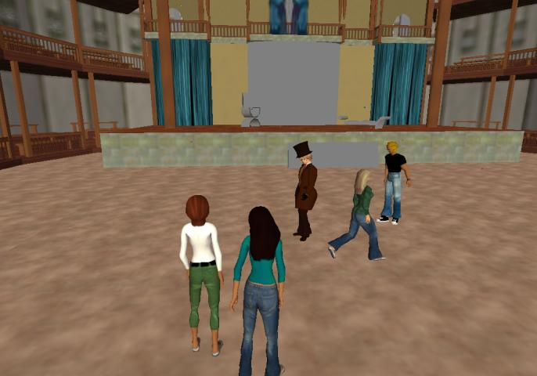
Planning for assessment of outcomes
Notes:
Assessment was a primary concern. I needed to be able to provide concrete evidence of learning. I decided to use project-based assignments with “tangible” results. Each week, the students were asked to complete a project designed to reinforce the learning objective. The results were treated as a summative assessment.

Slide 19
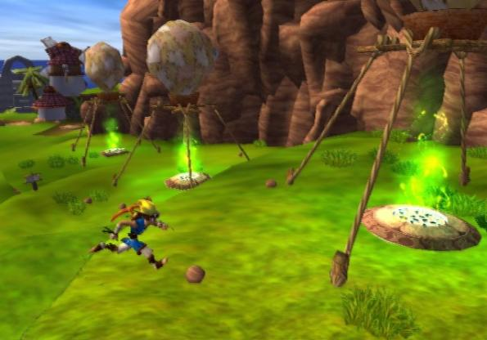
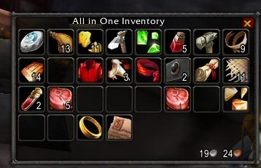
Course Learning Objectives
Introduce basic 3D, gaming, and MMORPG concepts to faculty
Notes:
Since the ideas involved had come from previously existing conventions of RPG’s and game engines, I spent some time at the start of the course talking about the history of computer games. I introduced the concepts of a storage bag or book; explorable 3D environments, live interactions with other players and modern game engine technology.

Slide 20
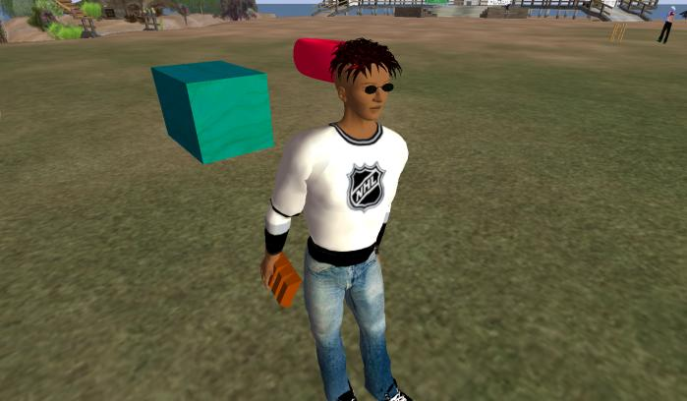
Course Learning Objectives
Prepare the participants to use Second Life not only as users, but content creators
Notes:
Since one of the goals was to enable the students to create their own course materials and environments, I needed to make sure they could not only move around and interact with the environment, but manipulate and create it.
Learn how to build 3D virtual objects and store them in Inventory
Achieve a basic understanding of scripting using Linden Scripting Language

Slide 21
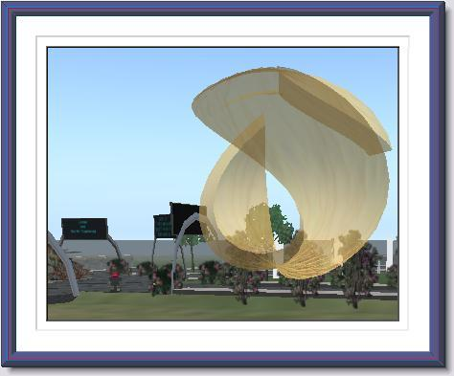
Course Learning Objectives
Equip the participants with a set of resources and tools to develop their own SL enhanced courses
Notes:
In addition to teaching, I had a large store of websites, landmarks, videos and pre-made objects.
Gain an understanding of the economy of Second Life, competitors and other virtual worlds

Slide 22
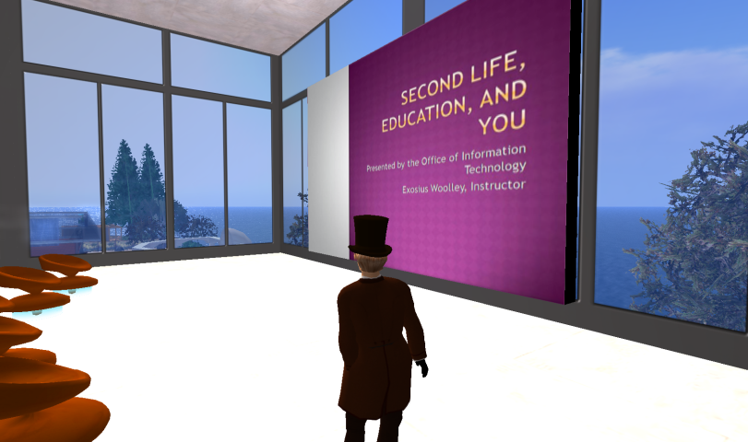
Problems to Solve: Course Management
Notes:
The management of the course would require student tracking, communication tools, assignment controls and delivery of materials

Slide 23

Problems to Solve: SL parts of the course
Notes:
The SL portion of the course required a place to meet weekly, many different locations to visit, and a way to deliver teaching materials in-world
Plan for live weekly interactions with the students while also making it possible for someone to participate completely asynchronously

Slide 24
  Part 1: Second Life, Education and You
Notes:
Result: A three-part faculty development course delivered in Blackboard and Second Life.
Part 1: Second Life, Education and You
6 weeks
Basic introductions to the ideas and concepts
Learning to use SL – Moving, Flying, Teleporting, Communicating, Inventory, Snapshots, Building, Texturing, Scripting
SL in Education, Businesses and Organizations

Slide 25
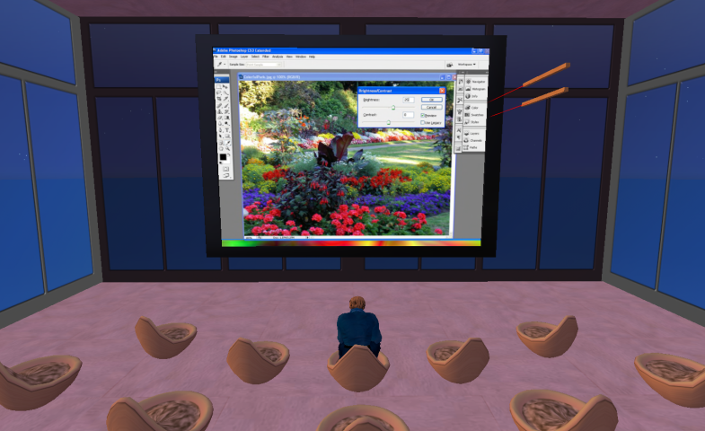
Part 2: Photoshop for Second Life
Notes:
Photoshop via Second Life in live sessions
Attendance at Part 1 was strongly recommended for new SL users – a few who attended were veteran SL users, who came to learn the pedagogical techniques
Avatar skin and clothing creation, creating transparent and animated textures
Modeling how to teach in Second Life

Slide 26
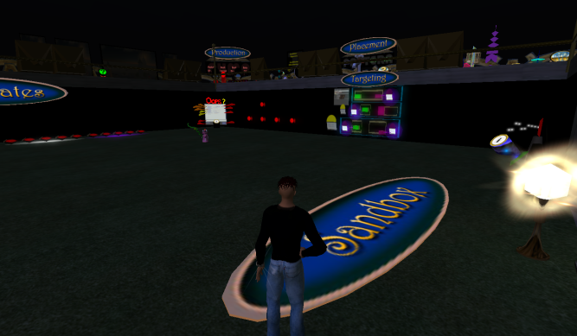
Part 3: Building, Scripting and Interacting with Second Life
Notes:
Advanced course, covering the building and scripting tools in far greater detail than the introductory course
Designed to be taken as a standalone – Started with the same beginner information, but at a faster pace and with greater emphasis on the content creation tools
Assessment included evaluation of completed built and scripted items

Slide 27
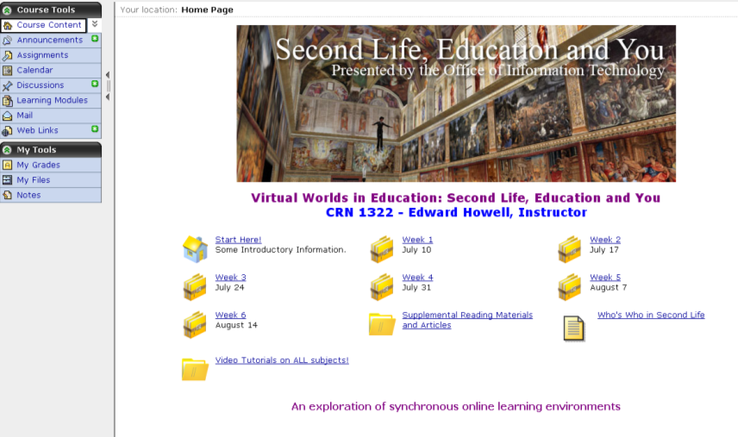
Second Life, Education and You
Notes:
Course Outline
Week 1: What is Second Life?
Week 2: Interacting with the World
Week 3: Interacting & Communicating
Week 4: Building
Week 5: Scripting for behaviors, interactivity
Week 6: Economy, Education and Accessibility

Slide 28
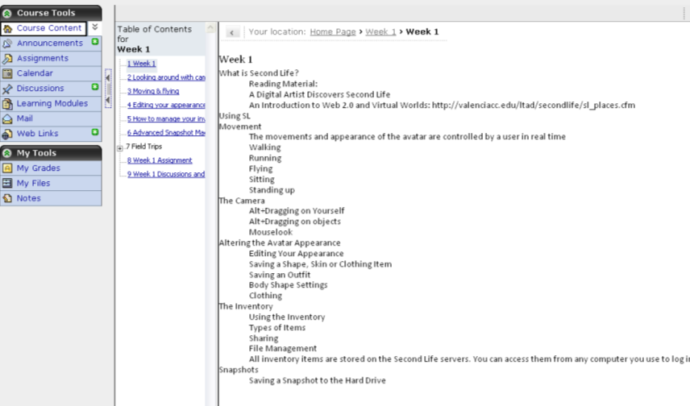
How the course was built
Notes:
Course management for the class was completed in Blackboard CE6.
Weekly presentations were created in PowerPoint and uploaded to SL as textures, then loaded into a presentation board.
Weekly outlines were posted to CE6. Also, linked to Linden Lab’s wiki for videos on the week’s topics, when available.

Slide 29
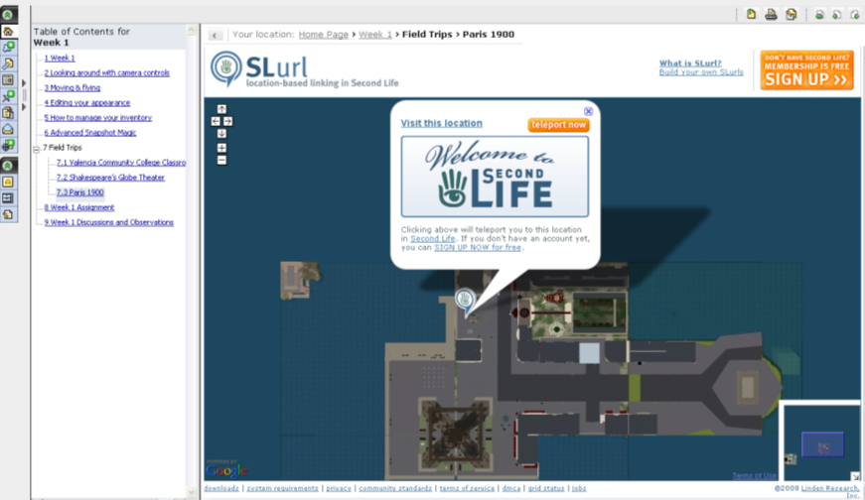
How the course was built
Notes:
1st 30 mins: getting logged in, attending the presentation and answering questions
45 mins: Field Trip 1 - walk or teleport to the first location. A link was provided in the WebCT course to teleport directly there.
45 mins: Field Trip 2 - walk or teleport to the second location. A link was provided in the WebCT course to teleport directly there.
Teleport links (SLURLs) directly in the course, using the Web Links tool.
Assignments each week
Discussion boards for help, observations and fraternization

Slide 30
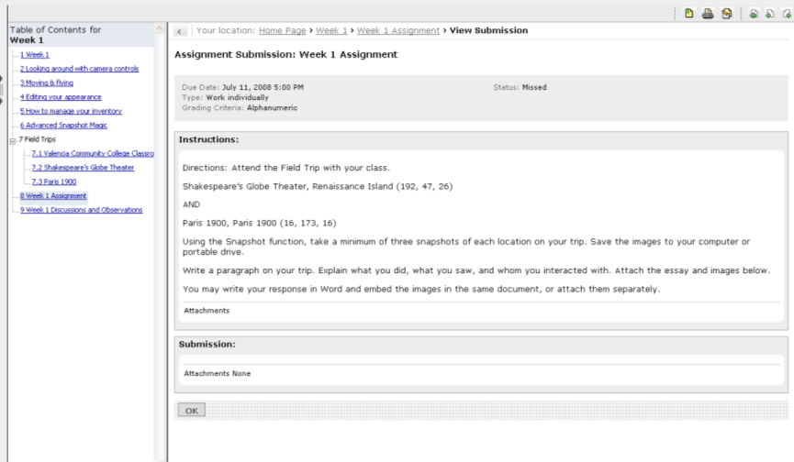
How the course was built

Slide 31
Photoshop for Second Life
Notes:
Photoshop via Second Life in live sessions
Avatar skin and clothing creation, creating transparent and animated textures
Modeling how to teach in Second Life

Slide 32
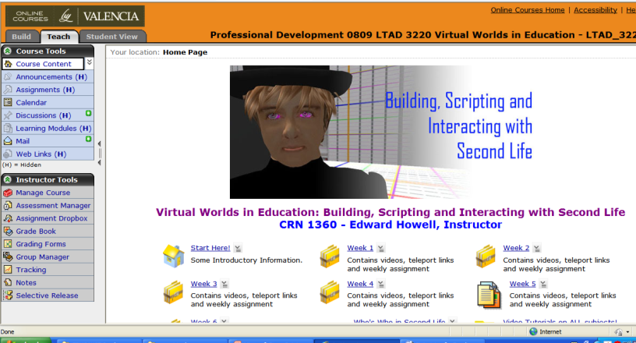
  Building, Scripting and Interacting with Second Life
Notes:
Advanced course, covering the building and scripting tools in far greater detail than the introductory course
Designed to be taken as a standalone – Started with the same beginner information, but at a faster pace and with greater emphasis on the content creation tools
Assessment included evaluation of completed built and scripted items

Slide 33
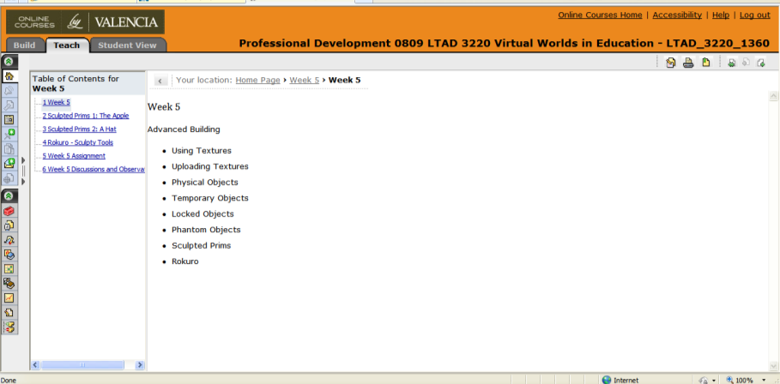
  Building, Scripting and Interacting with Second Life
Notes:
Advanced course, covering the building and scripting tools in far greater detail than the introductory course
Designed to be taken as a standalone – Started with the same beginner information, but at a faster pace and with greater emphasis on the content creation tools
Assessment included evaluation of completed built and scripted items

Slide 34
Outcomes: Agree with this Statement?
Met Expectations: 96%
Contained Applicable Ideas and Information: 92%
Presenter was Effective in Communication and Conveying Knowledge: 96%
Kept Interest Engaged: 96%
N=35

Slide 35
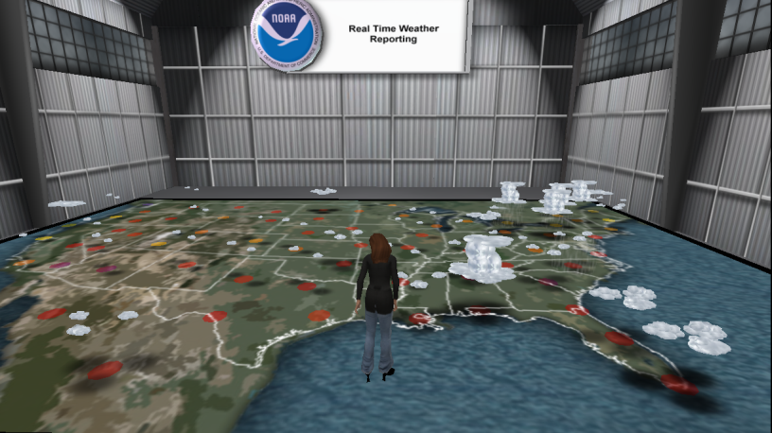
Outcomes
Notes:
After completing the last field trip, I have upgraded my basic membership to premium membership. I am planning to invest more time to further explore the Second Life – a virtual world platform. I believe it could serve as an educational platform for my future digital generation students. – Agatha Shaw

Slide 36
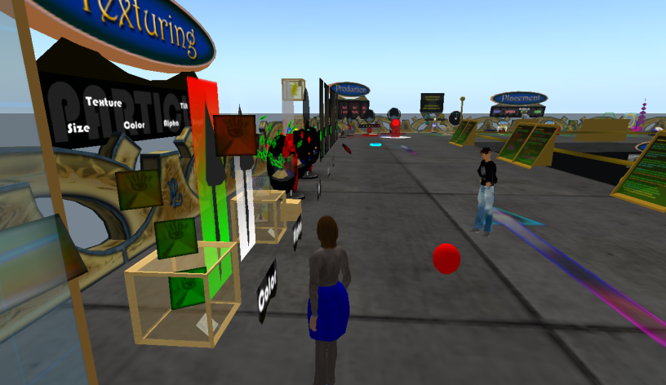
Outcomes
Notes:
Use of the Second Life in personal life can be to relax and use it as a get away from the real world to meet and react with others on a playful level. Also, it could be used to purchase and sell products. Another way to use Second Life personally would be as a family activity. Having all family members create an avatar, prims, and purchase land. Maybe have a competition with the family members.
On a professional level in education it could be used for lectures in an auditorium setting or classroom setting with a powerpoint presentation as used in this online workshop. Also, videos have be shown as needed for better understanding of a subject.
- Betty Waneliesta

Slide 37
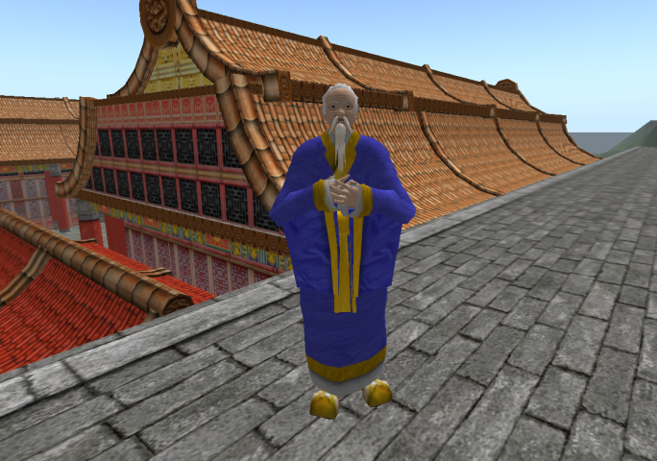
Ed Frame (Maximas Demonia)
Notes:
Honors Mythology: 2008/2009, Summer B 2009, and 2009/2010

Slide 38
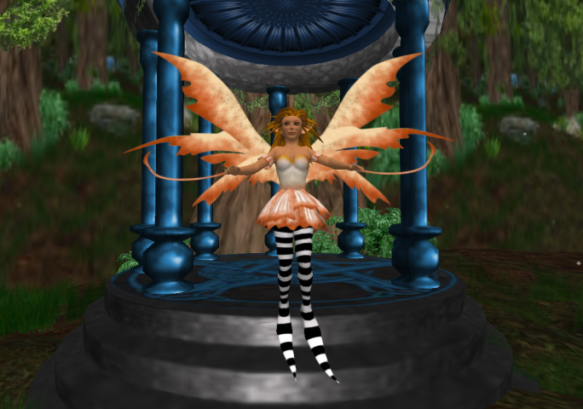
Jean Marie Fuhrman (Petal Littlething)
Notes:
Plans: Comp II with Science Fiction: Do a Research paper on Alternate Realities (Role play, mental states, radically different ideologies)

Slide 39
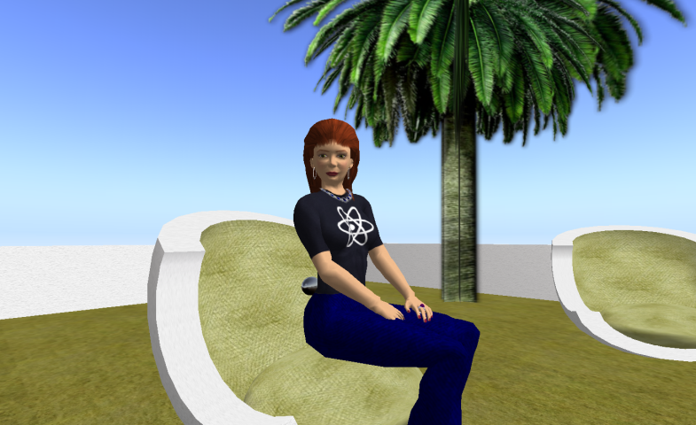
Diane Dalrymple (Nola Darwin)
Notes:
Librarian, Winter Park Campus, plans to use Second Life’s resources and many virtual libraries in the coming year.

Slide 40
Thank you for coming!
Here are some resources you can link to for more information.
Second Life Teleport Links and Web Tutorials
Second Life course materials

Slide 41
Appendix: Second Life, Education and You Week 1 Lesson Plan
Presentation Outline
Shakespeare’s Globe Theater
Paris 1900

Slide 42
Appendix: Week 2 Lesson Plan
Presentation Outline
Svarga
Spaceport Alpha

Slide 43
Appendix: Week 3 Lesson Plan
Presentation Outline
English Village
NOAA Virtual Island

Slide 44
Appendix: Week 4 Lesson Plan
Presentation Outline
The Ivory Tower Library of Primi
EdTech Island Sandbox

Slide 45
Appendix: Week 5 Lesson Plan
Presentation Outline
The Particle Laboratory
ICT Library on Info Island

Slide 46
Appendix: Week 6 Lesson Plan
Presentation Outline
IBM Innovations
Ohio University Without Boundaries

