Slide 1
Going
Mobile
Pooja Saxena
Robby Seitz
Frank Mathew
Ole Miss IT

Slide 2
The University of Mississippi
Located in Oxford, Mississippi, Ole Miss opened its doors in 1848 as the state's first public institution of higher learning.
Over 16,000 students attend classes across three campuses, with support from 1,976 faculty and 1,806 staff.

Slide 3
Mobility
With the proliferation of mobile devices, the way users consume our services is changing.
Student expectations are changing. So how best can we serve them?

Slide 4
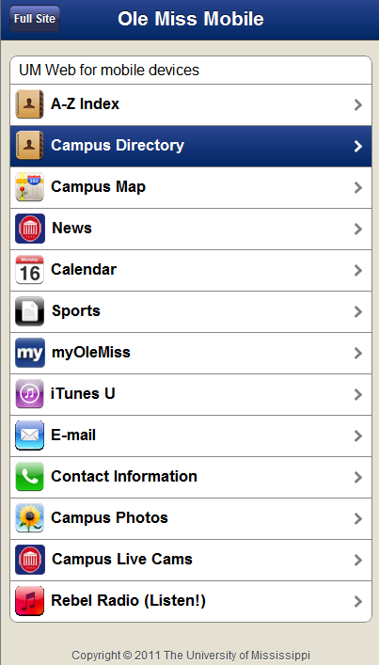
m.olemiss.edu
Mobile implementation supports the WebKit technology incorporated into most mobile browsers.
The particular theme is iWebKit with minor branding.
Javascript redirects mobile users to the mobile site, but they may also opt for the full site.

Slide 5
m.olemiss.edu
UM Home: custom page
News, blogs, calendar: mobility support in the product used (WordPress, Helios)
E-mail: a webmail interface with mobility support
myOleMiss Mobile: custom built on top of the SAP Enterprise Portal Platform
Directories and Campus Map: custom

Slide 6
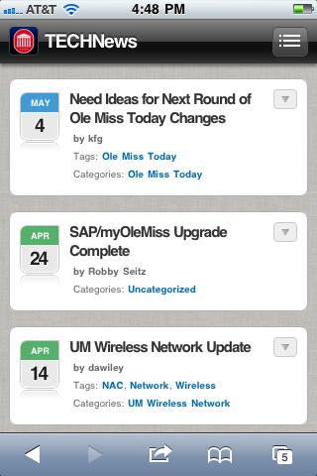
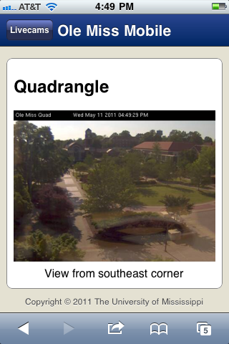
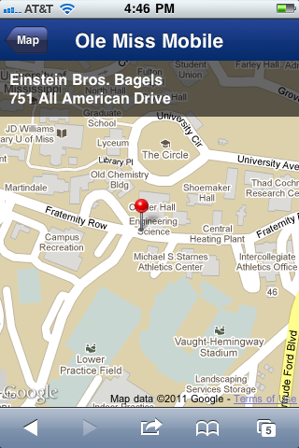
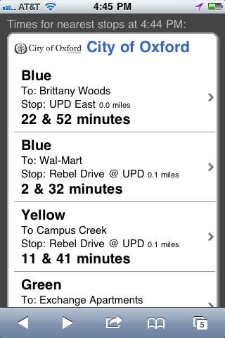
m.olemiss.edu
Blog
(WordPress)
Web Cam
(HTML)
JSP, Google Maps API, SAP
External Link

Slide 7
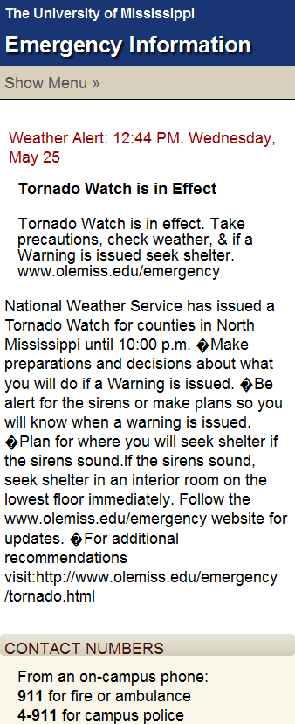
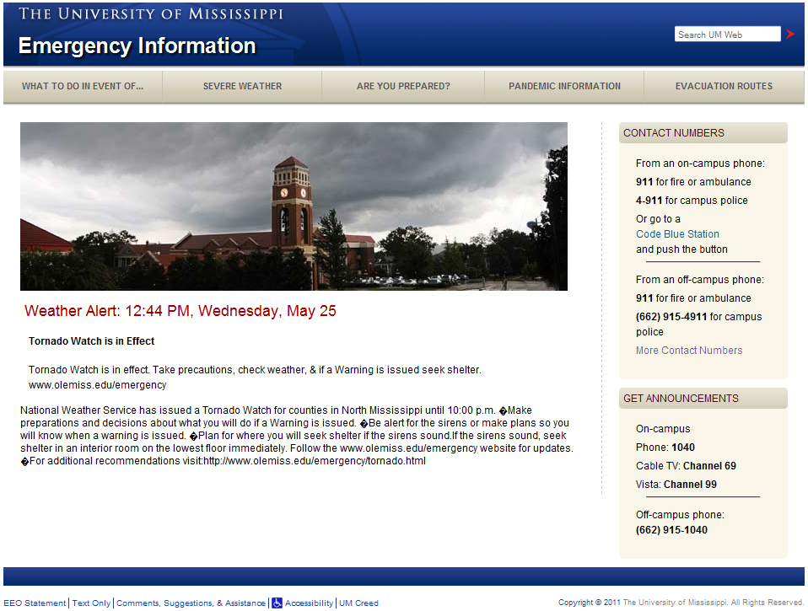
m.olemiss.edu
Alternate mobile conversion concept:
Use custom mobile CSS for windows 480 pixels wide or less.
(@media query)

Slide 8
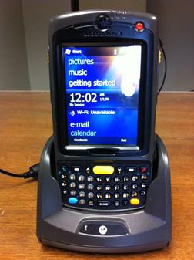
Upcoming: Mobile Asset Management
A mobile solution to enable the auditing process in asset management.
Mobile application is being developed for a Motorola device to:
  Pull info on devices to reconcile and populate local database.
  Scan bar codes on devices to audit and reconcile.
  Upload results of audit back into asset
  management in our ERP system.

Slide 9


Motivation
Presently
Paper-based process
Tedious and time consuming
Error prone
Inefficient Audit

Slide 10
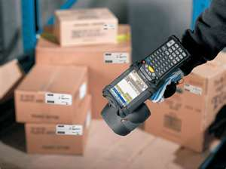
Aim
In-house solution:
  Native application development for mobile device.
  Barcode reader functionality
  Web service communication with SAP backend
  Distribution process for mobile application
Notes:
SAP and other vendors offer solutions for such applications, but the rapidly changing mobile technology landscape can lead to an expensive and possibly premature relationship for maintenance and enhancements. One alternative is to invest in a set of in-house solutions with existing infrastructure so as to have a mobile offering and delay investment in off-the-shelf solutions until more is known about how the mobile technology landscape will evolve. The project takes this approach in coming up with a mobile asset management solution prototype.
The prototype will involve following key features:
Bar code reader functionality
Native application development and distribution process for the same
Web service communication with SAP backend
Once the proof of concept has been validated, the project will then be completed by IT resources based upon the specifications contained in this document. However, this strategy may need refinement based upon any technical issues encountered during the proof of concept phase.

Slide 11
Scanning Process
Download
Scan
Validate
Edit (if needed)
Approve/OK
Update
Asset Number
Description
Personnel Number
Location
Room
Notes:
The process the auditors will use while on-site will be: Scan => Validate => Edit (if needed) => Approve/OK => Update.
The property auditor will need to load all of the assets for a particular department that the auditor plans to visit. The auditor needs the ability to filter assets by attributes: department, location, last scan date and value of the asset, to build the dataset to be loaded onto the mobile device.
The Auditor will walk through each location scanning items one by one. After a scan, the following information shall be pulled up on screen for validation by the auditor:
Asset number
Description
Personnel Number
Location (Building Code)
Room
Long Text (General Comment)
Based on what the auditor sees, one of the following actions could take place:
If the asset was found in the location and the auditor finds no inconsistencies, (i.e. in the right room, description accurately describes the object, and correct personnel number), the auditor needs to be able to ok the scan and have the information ready to be saved to Asset Management in SAP.
If the asset has a room number or a personnel number change, the auditor can do the edits and have the information ready to be saved to Asset Management in SAP.
Any other inconsistencies besides these (such as description of the asset not being accurate) need to have holding status - to be reviewed after the audit.
If the asset does not belong to the location, it will need to be kept in a holding area to be dealt with after the audit.
The auditor also needs the ability to make notes on an asset that could be retrieved later. Currently this is accomplished by using the long text field on the asset master record in SAP.
Steps 3 and 4 would repeat for each asset that is being scanned. At any point of time, the auditor needs the ability to push scanned items to SAP. The ‘good’ scans (those not requiring any additional review/intervention) will have a value of ‘CORRECT’ in the ‘Inventory Note’ field, whereas the items requiring further attention/review/validation will have a value of ‘HOLD’. The scan date would be recorded in the ‘Last inventory on’ field. All items would be stored in a customer table in SAP.
The auditor will need the ability to find out the total number of assets scanned/remaining to be scanned for a particular department while in the field.
Once all items have been scanned (e.g. – the auditor and the department have exhausted their search for outstanding items), the auditor will need the ability to pull up a list of remaining items for the department and mark them as ‘NO SCAN’. Items marked as this should also be uploaded to the customer table in SAP to facilitate the creation of affidavits to properly remove the asset from the property inventory.

Slide 12
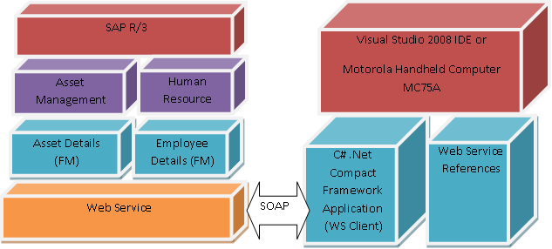
System Architecture
Notes:
The Web Services are created from selected function modules (One to download assets data and one to upload assets data) within the SAP system by using SAP’s Web Service creation wizard and a tool called SOAMANAGER. Once this process is completed, the corresponding WSDL URLs can be used to create clients from the Visual Studio 2008 mobile client project. SAP acts as the server or Web Service provider system while the mobile application acts as the client or consumer system.
Figure 2 shows a conceptual model for the application design using SAP Web Services. The function modules under different SAP modules are exposed as Web Services, which are consumed via Web Service (WS) client or consumer from the Motorola Hand Held Computer MC75A.

Slide 13
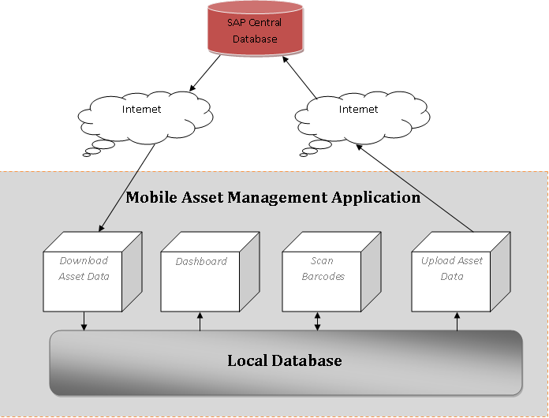
Data Flow
Notes:
Based on the requirements outlined in the section “Scanning Process”, we can roughly summarize the data flow of Mobile Asset Management application in Figure 3. The application comprises of four separate and distinct forms that tap into the same central data source.

Slide 14
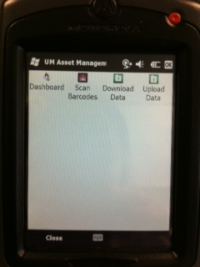
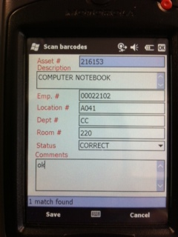
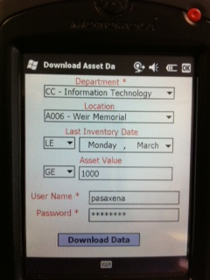
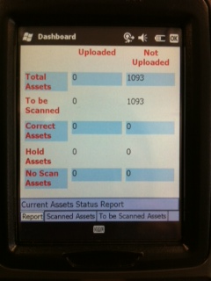
Results

Slide 15
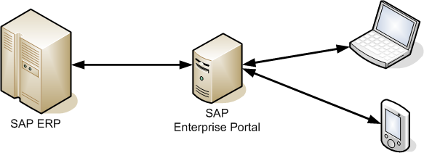
myOleMiss Mobile
Customized the campus portal (SAP Enterprise Portal) to also render a mobile friendly version based on the user’s device.

Slide 16
myOleMiss Mobile
Additionally, portal java applications are built using the model view controller approach and they are made mobile-friendly by adjusting the view and content depending on the user's browser and preference.

Slide 17
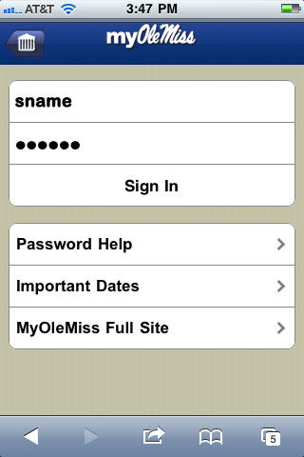
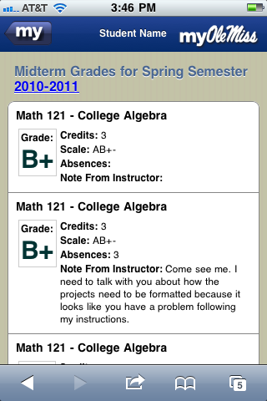
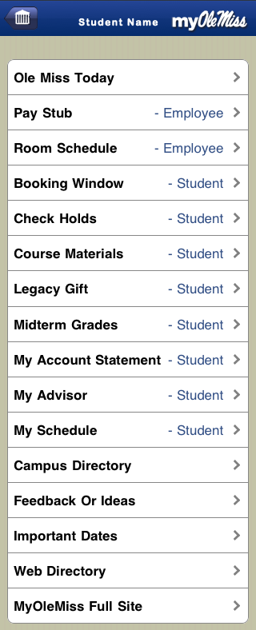
myOleMiss Mobile

Slide 18
The Native Apps Pilot
Ole Miss runs the SLCM module along with the other ERP modules from SAP.
SAP is interested in leveraging its recently acquired Sybase mobility platform to create mobile business content for the Higher Education Market.
Ole Miss and SAP are collaborating this summer on a project to generate native applications on mobile devices for higher education.

Slide 19
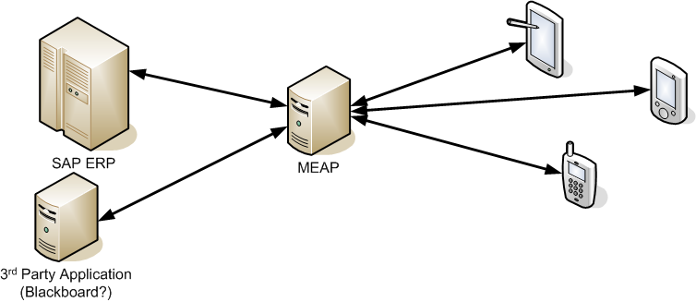
Evaluate a MEAP
Install and configure a MEAP (Mobile Enterprise Application Platform).
Deploy a few key mobile applications using the MEAP to evaluate its value across several perspectives.

Slide 20
Things To Consider
Devices we intend to support.
Native apps versus HTML5 hybrid container apps.
Ease of use and intuitiveness of navigation.
System features we intend to use.
Use cases we intend to deploy.

Slide 21
Thank you
Questions?
Feedback / Thoughts?
Ideas?

