Slide 1



Campus Portal and Email in the Cloud
MyCampus Portal from CampusEAI and Microsoft Live @ Edu
Bill English, Asst Director, IT Services
Chip Matson, Director of IT Services/CIO
Augusta State University
Copyright Bill English 2011. This work is the intellectual property of the author. Permission is granted for this material to be shared for non-commercial, educational purposes, provided that this copyright statement appears on the reproduced materials and notice is given that the copying is by permission of the author. To disseminate otherwise or to republish requires written permission from the author.
Contact Us
2500 Walton Way Augusta, GA 30904
(706) 737-1484 | www.aug.edu

Slide 2
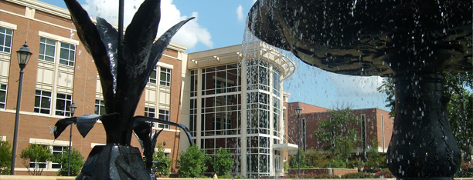





www.aug.edu
ABOUT ASU
Augusta State University
Located in Augusta, Georgia
University System of Georgia
Strong, nationally recognized, undergraduate programs in arts and sciences and professional fields, and selected graduate programs below the doctoral level.
Largest feeder institution to Georgia Health Sciences University
Over 7000 students
2010 Division I Golf Champions
For more information please visit our website:
www.aug.edu
2
of
13
Contact Us
2500 Walton Way Augusta, GA 30904
(706) 737-1484 | www.aug.edu

Slide 3
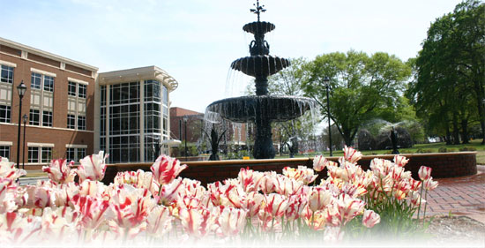
www.aug.edu
In the Cloud
What do we have in the cloud?
Career Center System (Symplicity)
Internet Compass Testing (ACT)
E-portfolio System (LiveText)
Campus Commerce – TouchNet Marketplace and Payment Gateway
Emergency Notifications – Blackboard
Organizations/Groups (OrgSync)
Financial Aid Needs Analysis
Email – Microsoft Live @ Edu
Portal – myCampus (CampusEAI)
Georgia System Cloud:
Human Resources and Payroll – ADP
Financial System – PeopleSoft
LMS – Blackboard Vista
Future Systems:
Housing Management – Realpage OneSite
Bookstore – Missouri Bookstore System (MBS)
University Tickets
3
of
13
Contact Us
2500 Walton Way Augusta, GA 30904
(706) 737-1484 | www.aug.edu

Slide 4

www.aug.edu
To the Cloud
Project to replace Luminis Portal and Email System
Email Considerations
Email reliance on portal
Storage Allocations
User Interface
Integration with local directory
Hardware replacement costs
Zimbra, Google considered
Over 22,000 accounts
4
of
13
Contact Us
2500 Walton Way Augusta, GA 30904
(706) 737-1484 | www.aug.edu

Slide 5
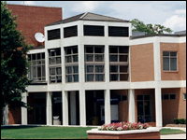
www.aug.edu
To the Cloud
Project to replace Luminis Portal and Email System
Portal Considerations
Luminis integration with Banner
Luminis Upgrade
Portal reliance on Banner and Oracle
Integration with local directory
Hardware Replacement costs
Liferay Portal
5
of
13
Contact Us
2500 Walton Way Augusta, GA 30904
(706) 737-1484 | www.aug.edu

Slide 6
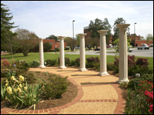

www.aug.edu
Email Project
10GB mail / calendar / contacts for each mail user
Enterprise messaging email based on Exchange 2010 – web access
Secure, encrypted service
Outlook, OWA, Pop, IMAP
Mobile access
Integration with portal and local active directory
6
of
13
Contact Us
2500 Walton Way Augusta, GA 30904
(706) 737-1484 | www.aug.edu

Slide 7
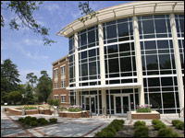
www.aug.edu
Email Project
Services Engagement with Microsoft to Implement Forefront Identity Manager 2010
Contracted for Premier support to carry through the implementation phase.
Developed strategy for provisioning portal and email access via AD account creation process
Password Synchronization set up for one-way sync
Set up “in house” mail server for utility and mail merge usage
Co-branding established
Developed Communication and Marketing Plan
7
of
13
Contact Us
2500 Walton Way Augusta, GA 30904
(706) 737-1484 | www.aug.edu

Slide 8
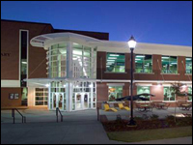
www.aug.edu
Email Project
Testing domain activated for internal IT Services staff – concepts proven
Production domain established well ahead of go live date
Calendar conversions completed for faculty and staff where necessary
Departmental shared calendars created
Email accounts created for all users week before go live
MX Record switch on Sunday at 10pm.
Users given instruction to add legacy account to sync their old mail to new account.
No change in email address
8
of
13
Contact Us
2500 Walton Way Augusta, GA 30904
(706) 737-1484 | www.aug.edu

Slide 9
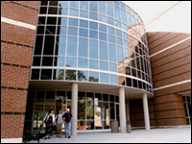

www.aug.edu
Portal Project
MyASU
New portal build. Focus on replacing current content and connectors.
All connectors established in parallel with legacy Luminis portal
Authentication with local directory via VPN tunnel
Initial load of directory users
Password Change Management configured on portal to local directory
“My Courses” established with XML from Banner
Event processing established with Banner
QA/UAT
9
of
13
Contact Us
2500 Walton Way Augusta, GA 30904
(706) 737-1484 | www.aug.edu

Slide 10
www.aug.edu
Timeline
Fall 2009 - Identification of possible portal and Email candidate systems
Jan – Feb 2010 – Comparison of Google and Microsoft Mail
March 2010 – Microsoft Test domain established
August 2010 – Contract with CampusEAI established
September 2010 – Contract work with Microsoft to implement FIM and assist with scripting
October 2010 – Calendar conversions and email list changes
November 2010 – Go Live - Extra helpdesk support
Nov – Dec 2010 - Transition assistance classes
10
of
13
Contact Us
2500 Walton Way Augusta, GA 30904
(706) 737-1484 | www.aug.edu

Slide 11
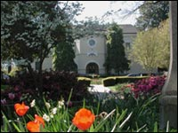
www.aug.edu
Go Live!
Changing Systems in the Middle of the Semester
What were we thinking?
Communications is key
Transition assistance classes
Extra helpdesk support
Luminis portal still active but no new email received in old accounts
11
of
13
Contact Us
2500 Walton Way Augusta, GA 30904
(706) 737-1484 | www.aug.edu

Slide 12

www.aug.edu
Lessons Learned
Post Project Hindsight
Communicate more. You can’t over communicate!
LMS – Get better understanding of use – underestimated
Be prepared to work with distributed staff
Midterm rollout was beneficial
“self help” worked well – move your mail
12
of
13
Contact Us
2500 Walton Way Augusta, GA 30904
(706) 737-1484 | www.aug.edu

Slide 13
Questions?
www.aug.edu
Bill English – benglish@aug.edu
Chip Matson – cmatson@aug.edu
13
of
13
Contact Us
2500 Walton Way Augusta, GA 30904
(706) 737-1484 | www.aug.edu

Slide 14


By the Numbers
www.aug.edu
Over 22,000 Portal and Email Accounts
Students
Student accounts remain active for 2 years after last attendance unless converted to Alumni status.
Alumni
Alumni - lifetime account since the year 2000. Prior alumni accounts have been created as requested.
Applicants
Accounts are deleted unless converted to student status or application is rolled to future term.
Faculty and Staff
Temporary faculty and retirees retain accounts as desired.
5
Contact Us
2500 Walton Way Augusta, GA 30904
(706) 737-1484 | www.aug.edu
5
of
of
6
11

