Slide 1

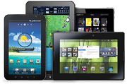

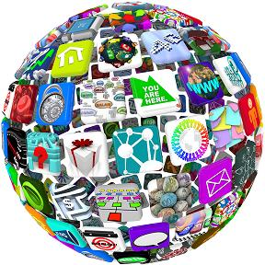
Mobilization in
Higher Education
Tennessee Board of Regents mTBR
eReaders
Tablets
SmartPhones
Apps
Robbie K. Melton
Associate Vice Chancellor
Tennessee Board of Regents eLearning
www.TBReLearning.org

Slide 2
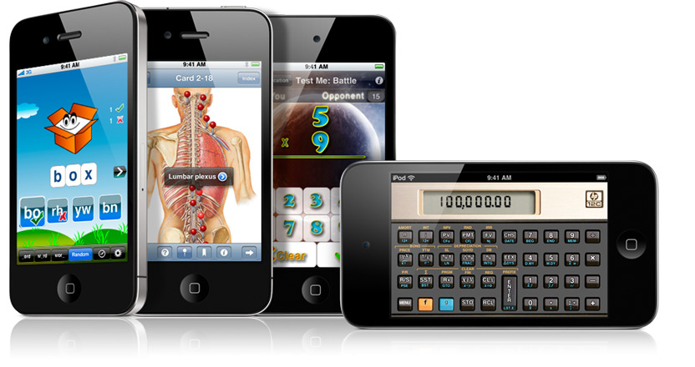
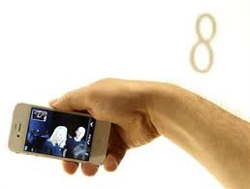
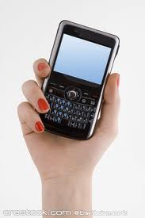
Higher Education Mobilization
LEARNING ON DEMAND and
IN YOUR HAND

Slide 3

Tennessee Board of Regents eLearning
Mobilization Strategic Plan
Mobile Product Sample
  System wide Sample / Purchase
  ADA Compliance
  TBR IT [security/networking]
  IMS Common Cartridge Standards
  Cost & Resources
Mobilization Demonstration
  Vendor Showcase
  Product Demonstration
  Faculty & Student Usability
  Vendor Use References
  Vendor IT & IMS Demos
Mobilization Outcomes
    Program Alignment
    Student Outcomes
    Educational Pricing
    System Wide Purchase
    Annual Evaluations
Mobilization Examination
  30 Days Campus Evaluations
  Faculty & Staff Testers
  Pilot Studies
  Surveys & Observations
  Curriculum /Program Alignment
  Student Outcomes

Slide 4
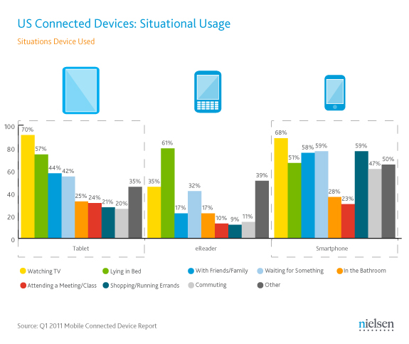

Slide 5
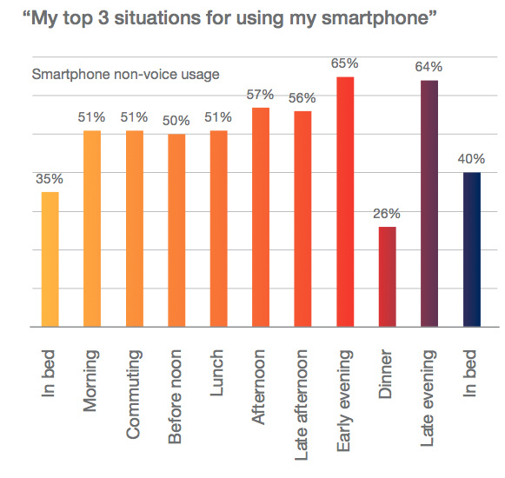

Slide 6
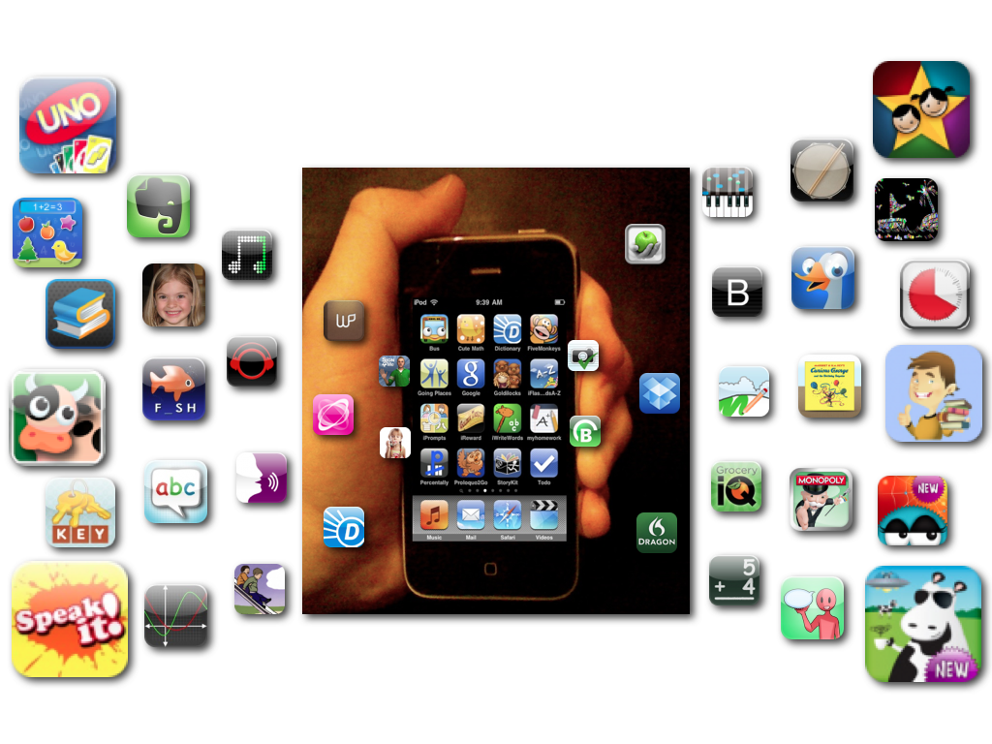
Tennessee Board of Regents eLearning Mobilization Strategic Plan
Mobile Product: Apps
  System wide Sample Purchase
  ADA Compliance
  App Quality Standards
Mobilization Examination
  Faculty & Staff Testers
  Pilot Studies
  Surveys & Observations
  Curriculum /Program Alignment
  Student Outcomes
Mobilization Demonstration
  Podcasting / YouTube viewing
  Hands-On Demo/Curriculum Team
Mobilization Outcomes
    Apple App Volume Pricing
    Annual App Evaluations
    Technology Prediction & Changes

Slide 7
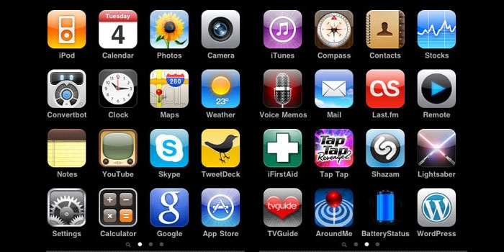
TBReLearning Mobile App Quality Standards for Education and Workforce Development

Slide 8
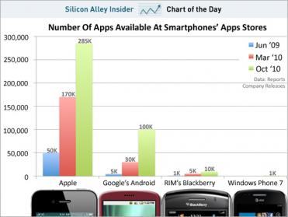

Slide 9
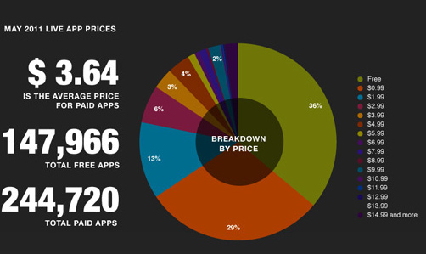
Prices of Mobile Apps

Slide 10

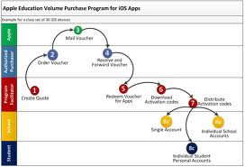
TBR System Wide Scalability of Apps through Apple App Volume Purchase Program
        Frog Dissection App

Slide 11
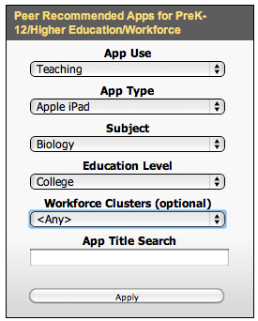
www.TBReLearning.org
*Biology College App

Slide 12
Frog DissectionFrog Dissection from Punflay,
is a greener alternative for teaching dissection in the classroom. This iPad app is suitable for middle-school students who are learning about organs and organ systems as part of their life science curriculum. Students can try dissecting a virtual specimen with all the trappings that come with the real procedure-minus the mess of course! Besides a virtual chloroformed specimen, the app comes with all the dissection tools and detailed instructions to complete the procedure. Once dissection is complete, the frog’s organs are exposed for further study. Vivid 3D images will help students visualize the internal organs very effectively. For enhanced learning experience, the app also has information on the different types of frogs, frogs’ life cycle, anatomical comparison of frogs with humans, an interactive quiz and detailed descriptions of the organs. *Further information regarding the cost, feedback, and how to download: http://itunes.apple.com/us/app/frog-dissection/id377626675?mt=8#

Slide 13
Tennessee Board of Regents eLearning Mobilization Strategic Plan
Mobile Product: Apps
  System wide Sample Purchase
  ADA Compliance
  App Quality Standards
Mobilization Examination
  Faculty & Staff Testers
  Pilot Studies
  Surveys & Observations
  Curriculum /Program Alignment
  Student Outcomes
Mobilization Demonstration
  Podcasting / YouTube viewing
  Hands-On Demo/Curriculum Team
Mobilization Outcomes
    Apple App Volume Pricing
    Annual App Evaluations
    Technology Prediction & Changes

Slide 14
Scalability of Mobilization in
Higher Education
Tennessee Board of Regents mTBR
eReaders
Tablets
SmartPhones
Apps
Robbie K. Melton
Associate Vice Chancellor
Tennessee Board of Regents eLearning
www.TBReLearning.org

