Slide 1

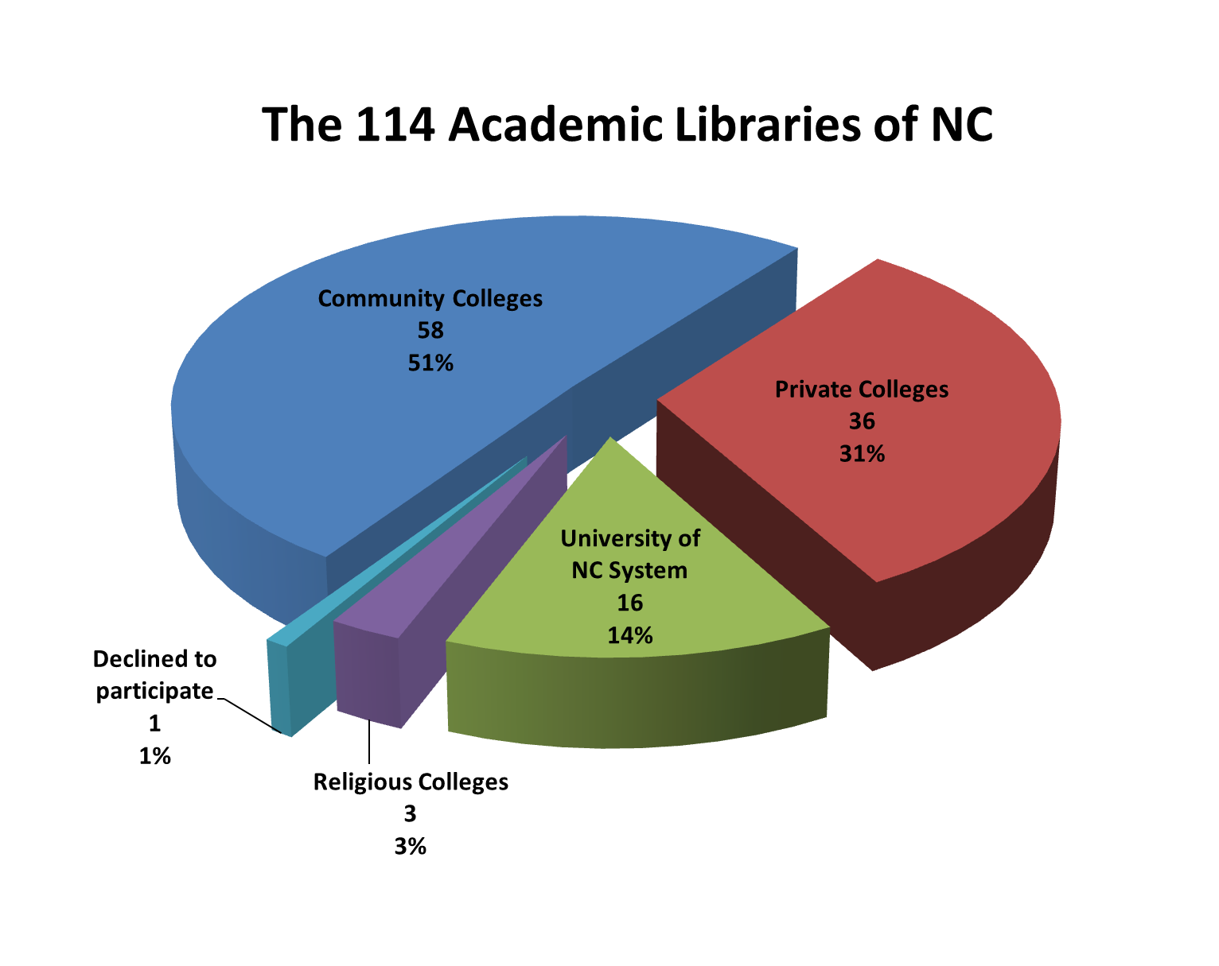
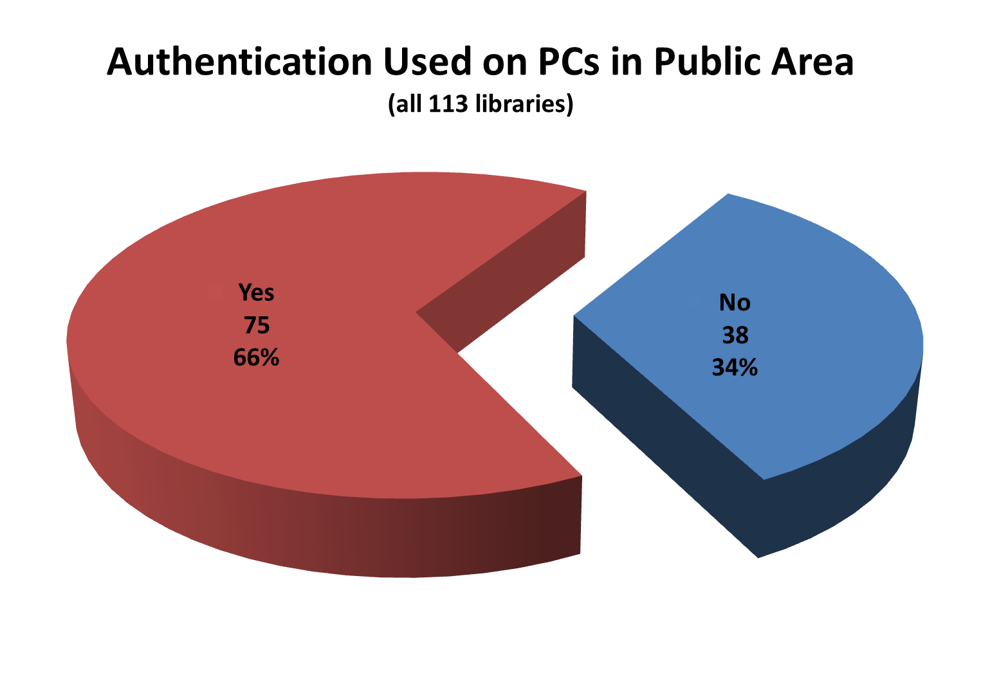
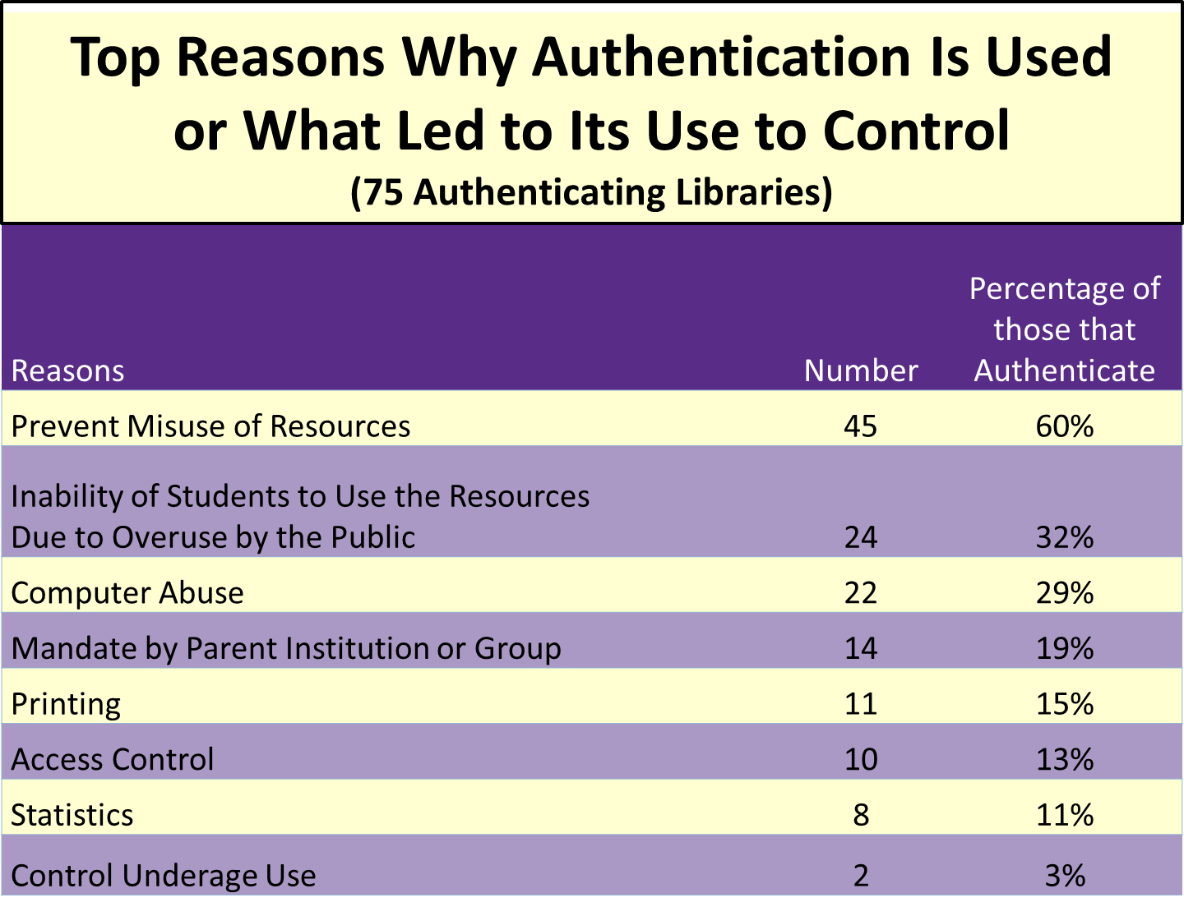
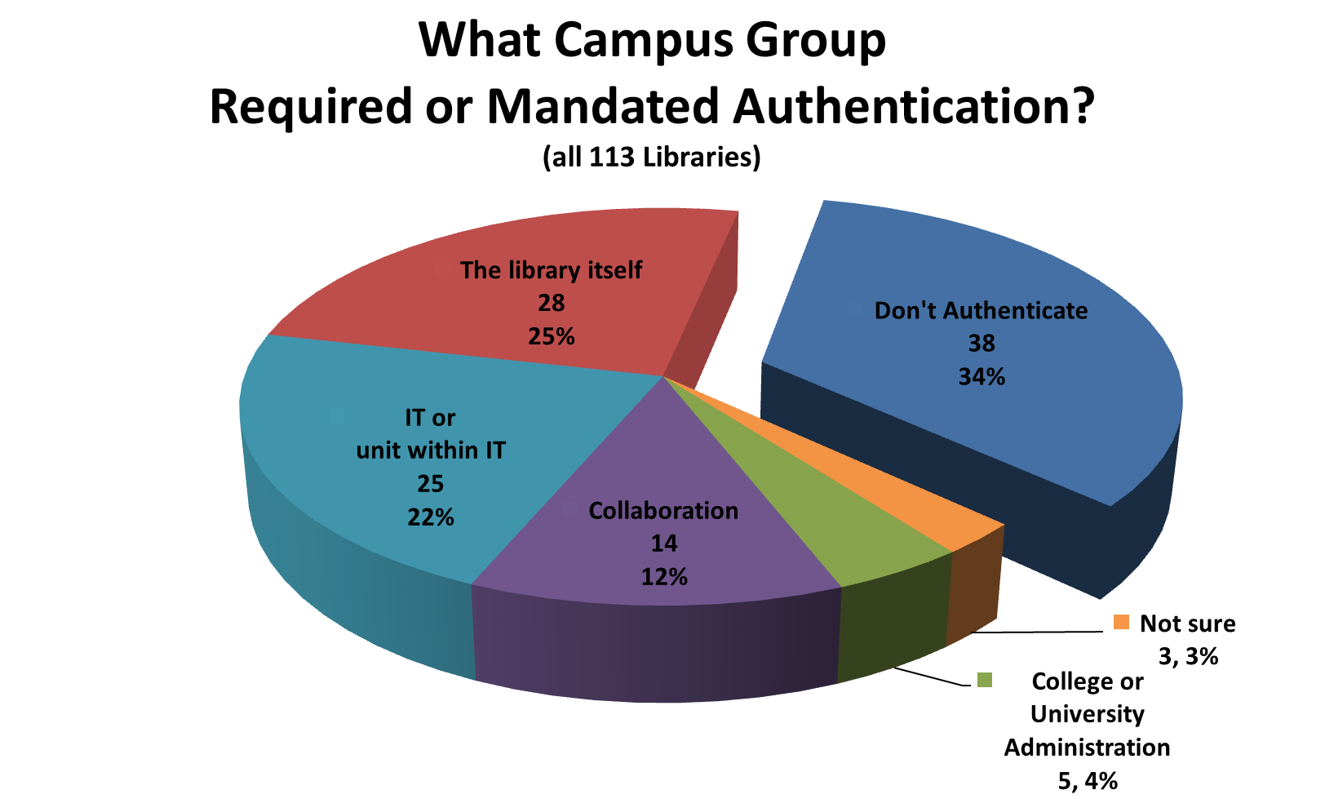
Just What Does Someone Have to Do to Gain Access
to a Computer in the Library?
Jill Ellern and Robin Hitch
Hunter Library
Overview
Study Population
What Do We Mean by “Authentication”?
There is a clash of principles between protecting privacy and that of protecting security that can create an impasse between libraries and campus IT departments and academic administrations over the authentication issues with PCs in the public area of the library.
This is not a new issue. Decreasing budgets; increasing legislation, such as the Patriot Act, CALEA; new licensing agreements for specialized software and web resources; allowing access to secured campus storage; and increased user traffic that requires the need to control the use of the library’s limited computer resources have all made authentication progressively attractive and necessary.
But authentication comes at a high price for librarians. There are ethical dilemmas that come in direct conflict with some basic librarian ethics. In particular, authentication creates a number of issues including patron privacy because it makes it possible to collect, review and use data; freedom of inquiry because it could limit or at least put a damper on a patron’s research interests; increasing the complexity of using public area machines that can create barriers for access as well as be frustrating and time consuming; and open access needs for the public or guest users because these unaffiliated users often have limited access in segregated locations.
While open or anonymous access isn’t a complete safeguard for all these ethical dilemmas, it does help create an environment of free, private and open access equivalent to what is currently the situation with the book collection in most libraries.
To create the list of academic libraries in NC, the researchers used the ALA directory, the NC State Library’s online directories of libraries, and visited each library’s web page to create a database of all 114 of the NC academic libraries. Other data was collected and compiled on each library to augment this data included the type of library, current contact information on a person that might be able to answer questions on authentication, book volume of the library, enrollment figures and the name and population of city or town in which the college/university is located.
By authentication, we mean the action(s) required by the patron in order to obtain access to use the computers in the library’s public area.
Examples of Authentication
Campus centralized or networked login
Manual paper sign-in sheets
Preset or temporary logins
Guest ID Cards
PC scheduling software
Use of the Library system in some form
Staff members logging in guests
Independent authentication systems
Types of NC Academic Libraries
Major Findings
Objective
We wanted to know how many academic libraries in North Carolina authenticate, why they authenticated and if they were forced to authenticate. We also wanted to know if there were any events that led up to a decision to authenticate and the level of knowledge the librarians had about the computer activity logs that were kept. While we were at it, we wanted to ask other general questions about the computers in the public area and how they were organized to meet the needs of the academic community while serving the public.
About the Questions Asked
We asked 36 different questions using a variety of pull down lists, check boxes and fill in the blank questions. In setting up the survey we had 7 branches or skip logic that depends upon the answer given. This is because we knew that the setup of the computers in the public area of libraries can be very variable especially if they differentiate between Student Only and Guest/Public Use Only PCs.
Data is a snapshot in time between October 2010 and March 2011
Methodology
The 7 Different Areas of Inquiry
- Description of the libraries and their public areas
- Authentication practices
- Characteristics of the Student-Only PCs
- Characteristics of the Guest/Public PCs
- Characteristics of the Wireless Access
- Privacy and Misuse Incident Reports
- Knowledge of Computer Activity Logs
Survey using Qualtrics online tool
Set up the questions
and created a database of libraries in NC
Tested survey with the UNC System libraries
from Oct – Dec 2010
Sent surveys to the rest of the NC academic libraries
in Dec 2010
Contact Information
Jill Ellern, Robin Hitch
systems librarian, computer consultant
ellern@email.wcu.edu rhitch@email.wcu.edu
(828) 227-3746 (828) 227- 7109
Western Carolina University
Hunter Library
Cullowhee, NC
www.wcu.edu
Followed up with librarians via phone call and email
from Jan-March 2011
Visited select libraries as a
“Secret Shopper”/Guest User in Sept 2011
Performed data normalizing and statistical analysis
since November 2011

