Slide 1
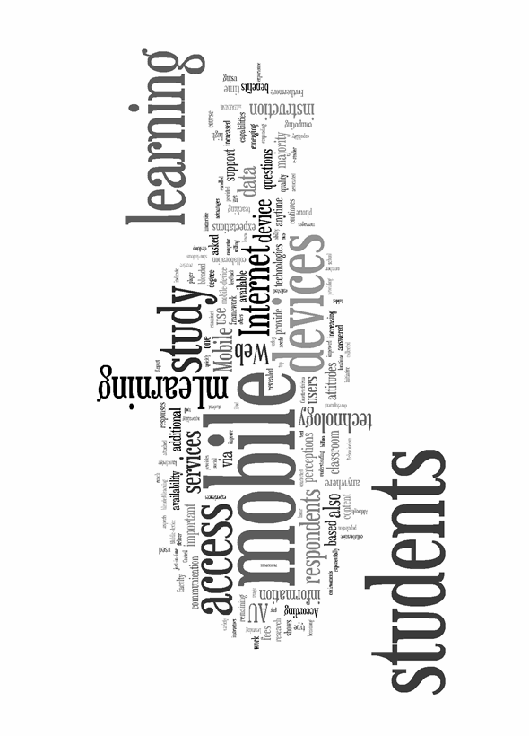
Is Your University Ready for mLearning?
John Shepherd and Brad Semma

Slide 2
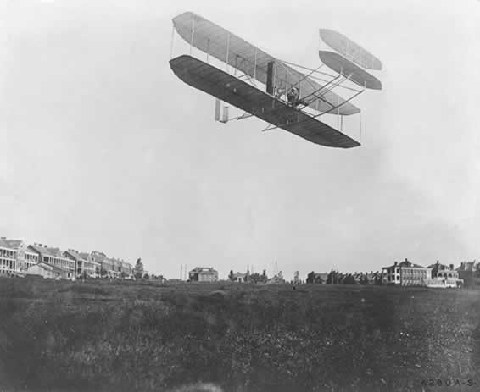
History of AU
1910: The Wright Brothers established the first U.S. civilian flying school in Montgomery, Ala.
1930s: Army Air Corps Tactical School moved to Maxwell AFB, AL
1946: Air University was established

Slide 3
“The Air University”
Headquarters at Maxwell Air Force Base, AL
The Intellectual and Leadership Center of the Air Force
All levels of Airmen, enlisted, officer, or civilian, and joint and coalition service members
Six institutions and several support organizations
Notes:
is a key component of Air Education and Training Command, and is the Air Force's center for professional military education
the Air University is an accredited military education system that produces future leaders and war fighters today…for tomorrow

Slide 4
mLearning Survey
Purpose: Discover important factors that could influence the success of implementing a mobile learning (mLearning) initiative
Study was conducted in the spring of 2011
3,182 students (enlisted and officer), 1,340 students (42%) participated
Areas of study: Availability, Usage, Pricing, Attitudes and Perceptions

Slide 5
Highlights
The majority of students own a variety of mobile devices
Students access the Internet from their mobile devices
Text messaging and social networking sets the stage for a portable, collaborative learning
The majority of respondents believe mLearning could improve the quality of instruction
Notes:
Understanding which devices students are using is important when considering an mLearning solution.
Internet access has become an invaluable tool that can make a difference in how instructors teach and students learn.
Text messaging and social networking sets the stage for a portable, collaborative learning environment based on sharing and communication
Further confirming how mobile devices provide anytime, anywhere access for users on the go

Slide 6
Findings - Availability
95% of all respondents own some type of mobile device
Devices:
  iPod/iPod Touch - 72%
  Smartphone - 62%
  Mobile phone - 49%
  MP3 player - 30%
  Tablet – 17%
Notes:
95% of all respondents own some type of mobile device
For this survey we did not consider the laptop as a mobile device although we do know it has the characteristics' of what is considered to be a mobile device.

Slide 7
Findings - Availability
Pew Internet & American Life Project (2011), the tablet is quickly becoming a device of choice, increasing its penetration in the market from 4% to 8% over a four-month period.
Notes:
The increase in the tablet market is generating much talk about BYOD.

Slide 8
Findings - Usage
Internet Usage:
86% of respondents access the Internet using their mobile devices.
Social Networking
Data revealed 98% of the students subscribed to Facebook, while 17% have Twitter accounts.

Slide 9
Findings - Usage
Students take advantage of a variety of services from their mobile device
Text Messaging
Listening to Music/Podcast
Web Browsing
Social Networking
Research
Notes:
Students need their Google, Facebook, and Twitter
When asked a series of questions about mobile services used, 74% responded that they send or receive text messages from their mobile devices, and 76% send between 1 and 10 multi-media messages (MMS) per day. Also examined was the students’ use of social networks.

Slide 10
Findings - Usage
With so many users accessing the Internet via their mobile devices, understanding from where is equally important
The locations students most access the Internet using their mobile devices are:
Home, School, and Work
Notes:
This question was asked because we thought students access the internet from school mainly…not realizing they are no different than any other student that continues to…..
The locations students most access the Internet using their mobile devices are: home = 87%; work = 50%; and school = 26%.

Slide 11
Findings - Attitudes and Perceptions
Considering the devices you own, which type of instruction would you be willing to access or view on your mobile device?
Class Announcements
Communication with Peers
Reading Assignments
PowerPoint Presentations
Recorded Lectures
Notes:
The question asked, the type of instruction you would be willing to access.

Slide 12
Findings - Attitudes and Perceptions
“Have you been enrolled in a course(s) that utilizes mLearning?”
58% answered, “No”
31% answered, “I am not sure.”

Slide 13
Findings - Attitudes and Perceptions
Students reported the most appealing aspects of mLearning are:
Availability
Access to Content
Collaboration with students/teachers
Receiving supporting educational information via SMS/MMS on demand/request or on a continuous basis ("push" technology)
Taking test and questionnaires for self assessment

Slide 14
Findings - Attitudes and Perceptions
73% agree mobile technology, effectively and judiciously used, can improve the quality of instruction and communication with peers
58% would like the opportunity to receive instruction via a mobile device
Notes:
Examining the students’ attitudes toward mLearning revealed the majority, 73%, agreed that mobile technology, effectively and judiciously used, could improve the quality of instruction. Additionally, 58% of the students would like to have the opportunity to receive instruction via a mobile device.

Slide 15
Findings - Attitudes and Perceptions
mLearning removes time constraints, providing 24/7 access, and vast mobility for learning
mLearning is adaptable to meet the individual needs of the learner
mLearning offers easier access to education materials than traditional classroom or other on-line learning venues
mLearning enhances learning, through inquiry, or the flexibility to discover additional information

Slide 16
Supports types of learning
Mobile technologies support learning experiences
Behaviorism
Constructivism
Situated Learning
Informal/Lifelong and Collaborative Learning
Support/Coordination
Notes:
Mobile technologies support learning experiences that are collaborative, accessible, and integrated with the world beyond the classroom (ELI, 2006). The responses of the students indicate they expect a strong variety of capabilities and support for mobile/mLearning services - In addition, mobile learning is adaptable to, Behaviorism for providing instant feedback, and Constructivism for utilizing immersive environments and simulations. It also complements face-to-face learning by providing cost-effective methods to reach students outside the classroom.
Their expectations can be supported by 6 major types of learning: Behaviorism, to support quick feedback or reinforcement; Constructivism, to support immersive experiences such as simulations or games; Situated Learning, to support authentic learning or context-aware environments; and Informal/Lifelong and Collaborative Learning, as well as Support/Coordination, to provide just-in-time access to learning resources, news, information, and planners

Slide 17
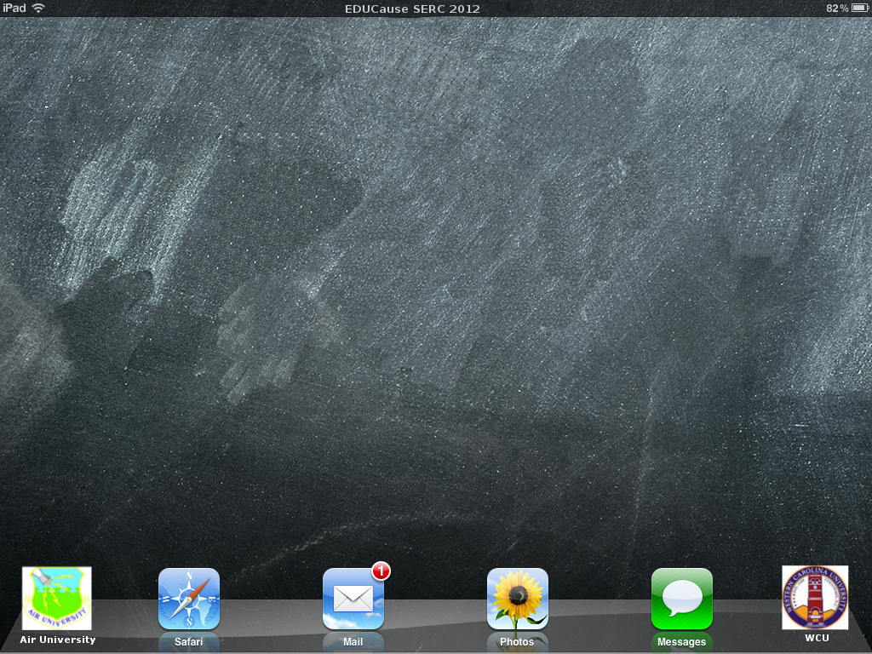
Supporting Mobile Devices in Higher Education

Slide 18
About WCU
Part of the University of North Carolina System
Over 9,800 enrolled students
Approximately 4,100 residential students
Incoming undergraduate class of about 2,500
Approximately 700 full-time faculty
Approximately 650 support staff

Slide 19
Our Support/Services
Best effort support for mobile devices (smartphones, tablets, and ereaders)
WPA2 Enterprise wireless access
Email configuration instructions for student email accounts
Mobile Communication Device Policy for Faculty and Staff

Slide 20
Just the Facts
57% students in a hackcollege survey use smartphones (McAllister)
According to a Pew Research Center survey, tablet and ereader ownership nearly doubled over the holiday season, rising from 10% to 19% (Tippin)
At WCU, average peak daily usage of wireless is up 86% from 2011
WCU Internet utilization has grown >25%, currently at 90% of connection capacity

Slide 21
How’s your connection?
According to the Cisco Visual Networking Index on Global Mobile Data Traffic, smartphone use has tripled since 2011, increasing to 150 MB from 55 MB (Cisco)
The average user has 2.2 IP address obtaining devices (Bowling)
Cisco predicts by 2015, the average smartphone user will use 1,486 MB of data a month (Cisco)

Slide 22
What’s your flavor?
There are 7 base Android OS versions
There are around 10 variant mobile OS’s for the RIM, Symbian, iOS, and Microsoft Mobile platforms
There are 20 vendor installed mobile web browsers
There are 16 different installable mobile browsers

Slide 23
Malware To-Go
McAfee found that in the third quarter of 2011, malware for the Android operating system had doubled since 2009 ("Lookout Mobile Security")
Juniper Networks found a 472% increase in malware for Android since July 2011 (Reeder)
Threats include: Premium-Rate SMS-Sending Trojans, data collection malware, and phone call recording malware (Reeder)

Slide 24
Solutions to Consider

Slide 25
Profile/Management Solutions for Students
iOS Configuration Profiles
  Passcode policies, restriction settings, Wi-Fi, VPN, email servers, exchange, credential keys
Windows Live
  Device encryption, password policies, restriction settings

Slide 26
Profile/Management Solutions for Faculty/Staff
Microsoft Exchange ActiveSync
  Allows for faculty/staff to bring their own device
  Built into Microsoft Exchange
  Exchange ActiveSync (EAS) group policy settings
  Managed Features:
    Password requirements, email attachment settings, remote wipe

Slide 27
Mobile Anti-Virus
AVG for Android
  Remote security, task manager, SMS filtering
GFI Vipre for Android (Beta, Android Only)
  Remote security, task manager, back up/restore
Lookout Security & Antivirus (Android and iOS)
  Web management (non-enterprise), back up/missing device support, active antivirus scan (Android only)

Slide 28
Mobile Security
Passwords
  Nearly half of the robberies committed in New York during the first 10 months of 2011, involved mobile devices such as smartphones and iPad’s
Find My Device Apps
  Lookout Mobile Security (Android and iOS)
  AVG (Android) -GFI Vipre (Android)
  Find My iPhone/iPad

Slide 29
Questions?

Slide 30
Citations
Cisco Visual Networking Index: Global Mobile Data Traffic Forecast Update, 2011–2016." Cisco. Cisco Systems Inc., 2012. Web. 25 Mar 2012. <http://www.cisco.com/en/US/solutions/collateral/ns341/ns525/ns537/ns705/ns827/white_paper_c11-520862.html>.
Bowling, Drew. "Is the Internet Officially a Basic Utility Now?." WebProNews. iEntry Corp., 16 Jan 2012. Web. 30 Mar 2012. <http://www.webpronews.com/tech-utilities-2012-01>.
McAllister, Shep. "Infographic: Generation Mobile." HackCollege. HackCollege, 2011. Web. 20 Mar 2012. <http://www.hackcollege.com/blog/2011/10/31/generation-mobile.html>.
Tippin, Chilton. "American Cell Phone Usage Statistics (2011)." Signal news. Signal News, 2011. Web. 22 Mar 2012. <http://signalnews.com/american-cell-phone-usage-statistics-2011-686>.
"Malwarenomics: 2012 Mobile Threat Predictions." Lookout Mobile Security. Lookout Inc., 13 Dec 2011. Web. 18 Mar 2012. <http://blog.mylookout.com/blog/2011/12/13/2012-mobile-threat-predictions/>.
Reeder, Kara. "Android Malware Sees 'Exponential Growth'." TechRepublic. CBS Interactive, 28 Nov 2011. Web. 10 Mar 2012. <http://www.techrepublic.com/blog/security/android-malware-sees-exponential-growth/6960>.

