Slide 1
Virtualization at VSCC
Brian Kraus
Brian.kraus@volstate.edu

Slide 2
Background
Volunteer State Community College
  Serves 25 counties in middle Tennessee
  Approximately 8,500 students
  Approximately 2,000 computer on campus
  4 full-time client services technicians

Slide 3
Background (cont.)
The Learning Commons
  State of Tennessee mandated new emporium approach to math and developmental courses
    All courses computer based, rather than instructor led
  VSCC needed to add about 500 additional computers
    No money for additional IT support staff

Slide 4
Doing More with Less
Virtualization
  VSCC partnered with Cisco and Citrix to virtualize emporium computers
    Cisco UCS blade servers
      Microsoft Hyper-V
      Citrix Xen Desktop
      Citrix Xen App
    EMC storage arrays
    Cisco VXC terminals

Slide 5
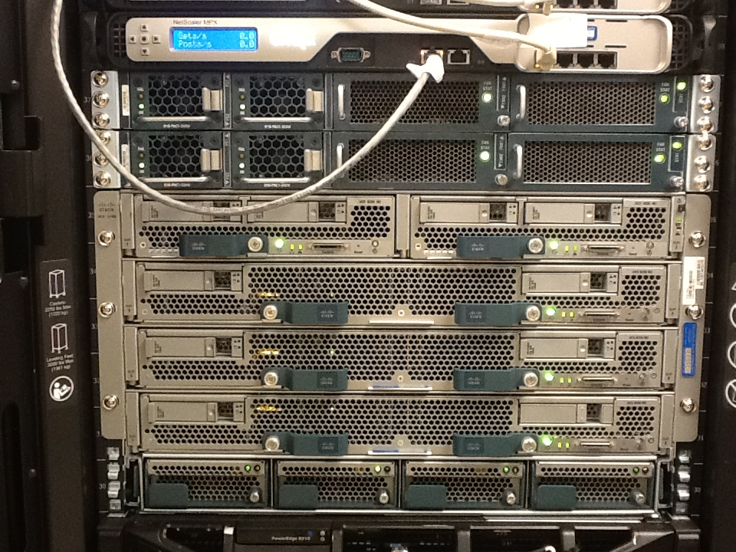

Slide 6
Doing More with Less (cont.)
Pilot
  Replaced half of the computes in Emporium with thin clients
    Students reported faster login times than PCs
    Biggest complaint was lack of desktop shortcuts
    Very few issues reported
Go-Live
  Originally started with 200 thin clients

Slide 7
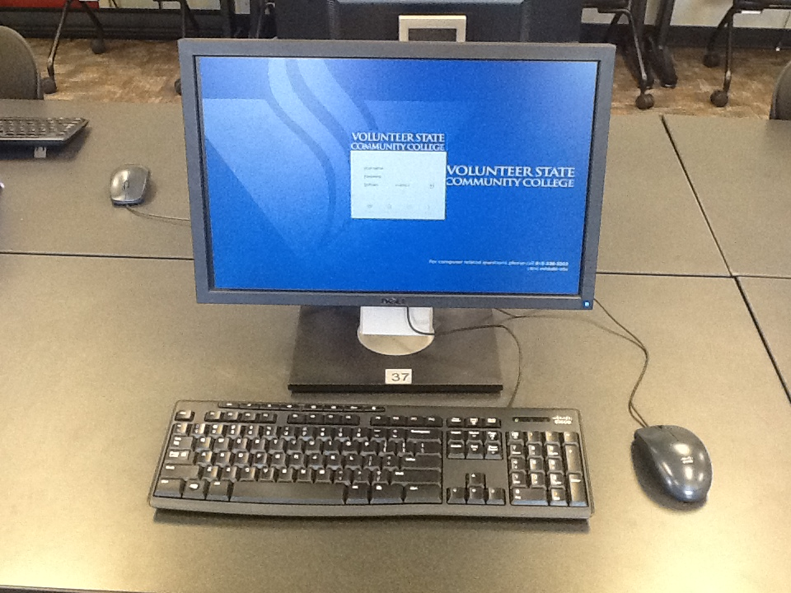

Slide 8
Benefits
Benefits of the Technology
  One image to update and maintain
    New software or new image can be pushed to entire lab in less than 10 minutes
  Less to maintain
    Thin clients do not have hard drives
      Pretty much either works or doesn’t
    Technicians do not have to maintain or repair individual units
Bring your own device
  Full windows desktops or individual applications can be loaded on any device

Slide 9
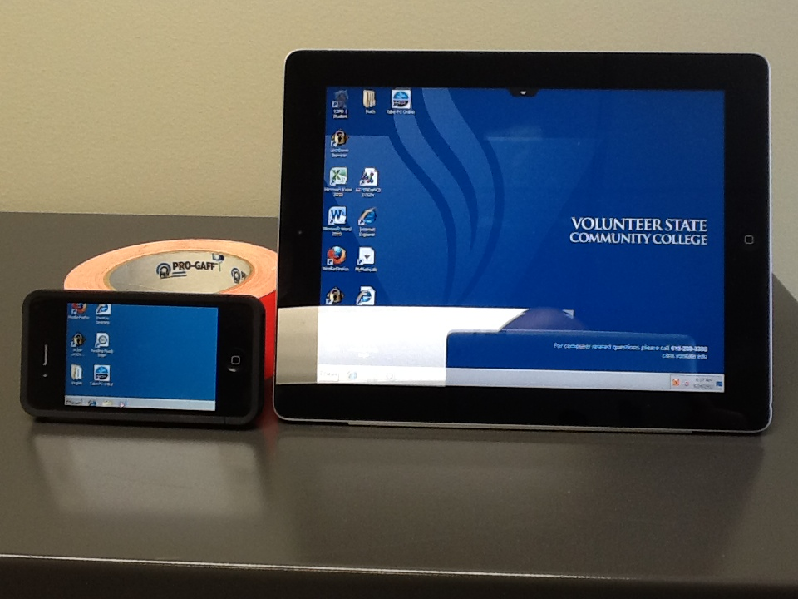

Slide 10
Cost Implications
VXC terminals
  Power Over Ethernet (POE)
    Less electrical outlets required in remodels
    Can easily be scheduled to shut down during off hours and to turn on before classes start
Less need for client services staff

Slide 11
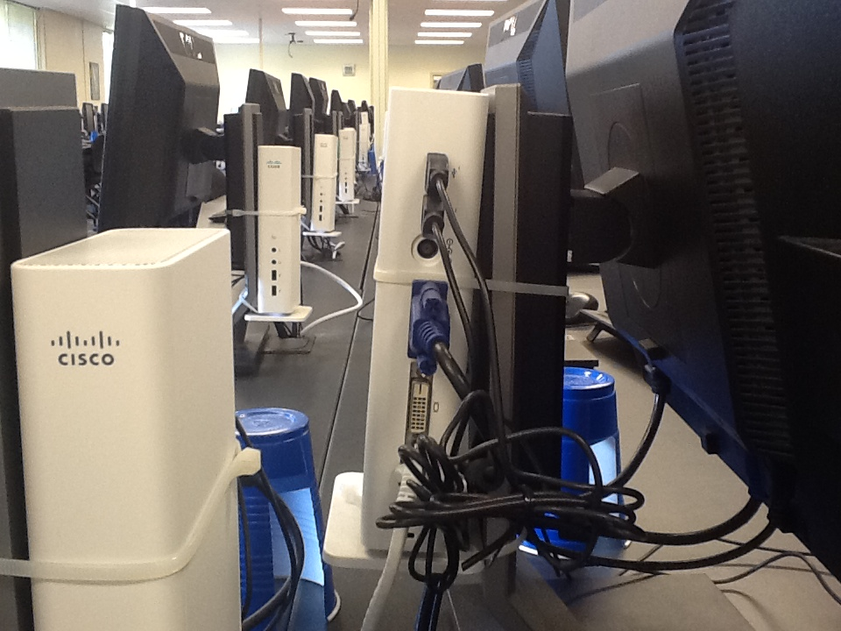

Slide 12
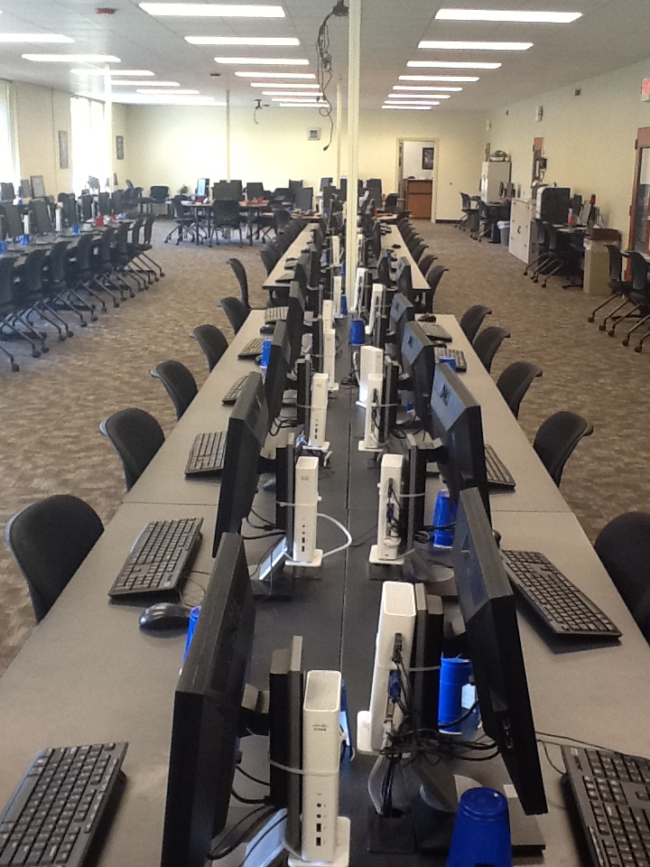

Slide 13
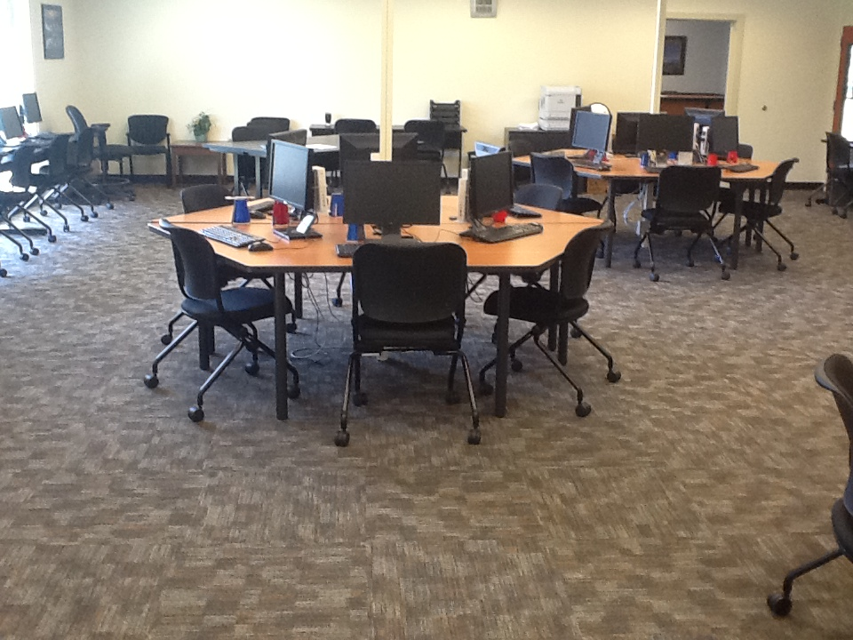

Slide 14
Cost Implications (cont.)
Client Type | Cost | Replacement in Years | Cost per Year
PC | $980 | 3 | $326.67
VXC | $360 | 5 | $72
VXC | $360 | 7 | $51.43

Slide 15
Cost Implications (cont.)
Based on the significant cost investment in the backend, we currently estimate our per thin client cost at $650.
  As we add more the cost will go down
Mid-range goal is thin clients in all computer labs and kiosks
Long-range goal is to virtualize majority of faculty and staff computers as well

Slide 16
Conclusion
Virtualization has greatly reduced VSCC’s costs for computer labs
Labor has been reduced as well as the time necessary for changes
For more information about VSCC’s architecture
  http://www.cisco.com/en/US/solutions/collateral/ns340/ns517/ns224/volunteer_community_cs.pdf

