Slide 1
Talking & Listening: Critical Communications Skills for IT Professionals
90-Minute Workshop
Alison Cruess
University of North Florida
May 31, 2012

Slide 2

Pick up a LEGO® brick!
You need a LEGO® brick for one of the three communication activities!

Slide 3
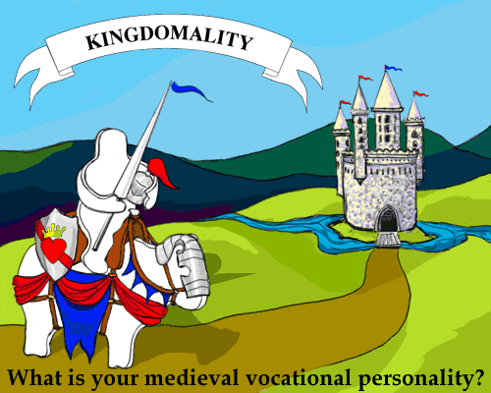
Take the Kingdomality Survey
You need to know your Kindomality vocational personality for one of our workshop activities.
Go to: http://tinyurl.com/KingdomTest

Slide 4
It will ask you for your name, email address, and short job description. Then it will ask you eight questions.
You will be ranking items in order of importance to you.
There is no right or wrong answer.
http://tinyurl.com/KingdomTest
At the end you will be given a “Medieval Vocational Personality” – write it down, please.

Slide 5
Thank you – We’ll get started in a few minutes

