Slide 1
The CAUs of Solid Course Design: Maximizing Student Learning
Jessica I. Vargas
Kathleen Bastedo
Notes:
Introduction:
I’m Jessica Vargas from the University of Central Florida—we’re over 58k students strong—2nd largest in the country; I work as an instructional designer for the Center for Distributed Learning…like everything at UCF, when we do something we do it big…over 30% of our course credit hour is generated by our online program. Because of such high numbers of online courses, we’ve been working on ensuring that anyone who wants to can take an online class. But obviously there’s some concerns and we’ll get into that soon. Furthermore, we work hard in ensuring that these classes maintain the quality that our face-to-face classes. Like other schools, we require our faculty to take a blended professional development program in order to teach online.
So today we’re going to be speaking about the CAUs – a fancy acronym to stand for Copyright, Accessibility, and Universal Design for Learning. This is essentially what we feel builds a solid, functional and accessible course. This presentation represents the second module in our blended professional development course—we present the information early so that as faculty members build their first online course with these things in mind.
So in order to know where we’re headed, it’s always best to learn from where we came or to discuss what’s the current state of higher education content.

Slide 2
ANYTHING GOES…
In Face to Face
Notes:
Face to Face: Anything goes (meaning you can show and use just about anything as long as it is educationally relevant.
Accessibility is generally handled by a student disabilities office on campus. You can get note takers, sign language interpreters and all you would have to do is set these services up with them.
Copyright is handled by Section 110(1), which means anything goes. Section 110(1) only addressed the face-to-face classroom and did not address online. So it was amended in 2002 by the Section 110(2) lovingly called the Teach Act.
And Universal Design for Learning is addressed by learner activity in a limited way.

Slide 3
We’re Still Learning…
In Online…
Notes:
Copyright Example: Citing Sources using APA/MLA/Chicago Turabian → took us some time to figure out how to cite web material but it came and more or less is solidified
Accessibility Example: So this is how we did it: the accommodations are generally provided by Student Disability office (interpreter, note takers, etc.) so the eternal question remains, how do we handle the webstuff?

Slide 4
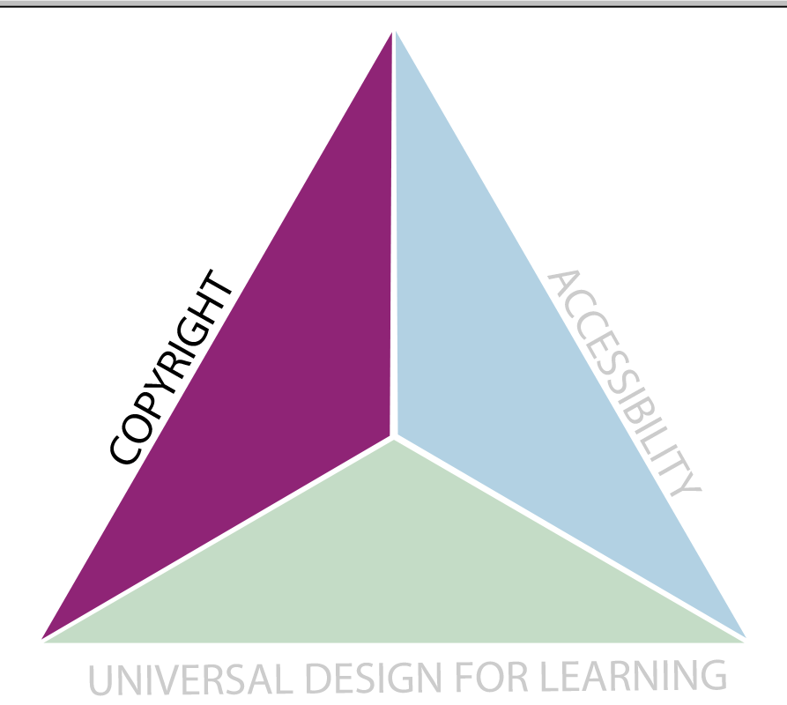
First Consideration

Slide 5
How can I get what I need into my online class without breaking copyright?
Focus Question #1
Notes:
All names for any of our faculty stories have been removed to protect the innocent but yes we do have faculty who say if I can see it, and I can take it then I can have it (or in this case use it)

Slide 6
Obtaining Copyright
Know what to ask by identifying the following:
Include non-profit or for-profit institution status
Password protected course?
Include the name of the work, media type, copyright year
Note what portion you would like to use
Note its purpose (why it’s educationally sound to use)
Is it captioned? If not, identify who can caption it
Notes:
The reason we talk about this is because one of faculty spent quite a bit of time getting responses back from a copyright owner; the faculty member teaches a fully online course on human sexuality—when confronted with moving from face-to-face to fully online he didn’t know what exactly to do since all his material was on vhs tapes; so he tried obtaining copyright permission and every time he sent something it would take two weeks before he’d receive a response…so we came up with a short list of what to include to minimize the back and forth

Slide 7
When We can’t obtain copyright permission?
So What Do We Do
Notes:
Copyright Example: Citing Sources using APA/MLA/Chicago Turabian
Accessibility Example: So this is how we did it: the accommodations are generally provided by Student Disability office (interpreter, note takers, etc.) so the eternal question remains, how do we handle the webstuff?

Slide 8
Fair Use
Purpose - must be for non-profit, educational use meaning it should be educationally sound
Nature - of the material used (factual vs. fictional)
Amount - of material used (the percentage of a work used in relation to the whole)
Effect - on the current market as well as the future, potential market, or value of the work
Notes:
Purpose – don’t make money off of it
Nature – if it’s created by somebody then refer to fair use
Amount – less is more
Effect – harder to determine
Educationally sound example:
Show Boat
I think the scene that you might be referring to that "changed" everything is in "Show Boat". It is commonly called the "miscegenation" scene. Very powerful, addressing issues of racism. (Music by Jerome Kern & Libretto & Lyrics by Oscar Hammerstein.)
Carousel
A more gentle scene that was also very influential is "If I Loved You" from "Carousel". This scene, more commonly called "the bench scene", is influential because it marks the significant integration of "scene" and "music"... we call it "scene-song-scene". (Music by Richard Rodgers & Libretto & Lyrics by Oscar Hammerstein.)

Slide 9
Further Steps
Online password protected environment
New students in, old students out
Link to items directly on the web
Wikipedia’s Fair Use Statement for Non-free Content
http://en.wikipedia.org/wiki/File:Showboatposter.jpg
Syllabus Statement
Notes:
MAKE SCREEN SHOTS

Slide 10
The Syllabus Statement
This course contains copyright protected materials such as audio or video clips, images, text materials, etc. These items are being used with regard to the Fair Use doctrine in order to enhance the learning environment. Please do not copy, duplicate, or distribute these items. The use of these materials is strictly reserved for this online classroom environment and your use only. All copyright materials are credited to the copyright holder.
Phillips, W., & Bastedo, K. (2010)

Slide 11
Always attribute copyright source!
The source from which the material was taken
The copyright holder
Year of the material's publication
Copyright notice ( i.e., The '©' symbol)
Notes:
Another faculty story—this time it’s because some colleges/departments choose to have other faculty members teach another’s course. The new faculty member was slated to teach a course and found all these multimedia elements in it. She was told that it was from the online textbook. Come to find out that none of the material was in that book; she unfortunately had to remove all the images and videos.
So this is something we harp on…always attribute the copyright source.

Slide 12
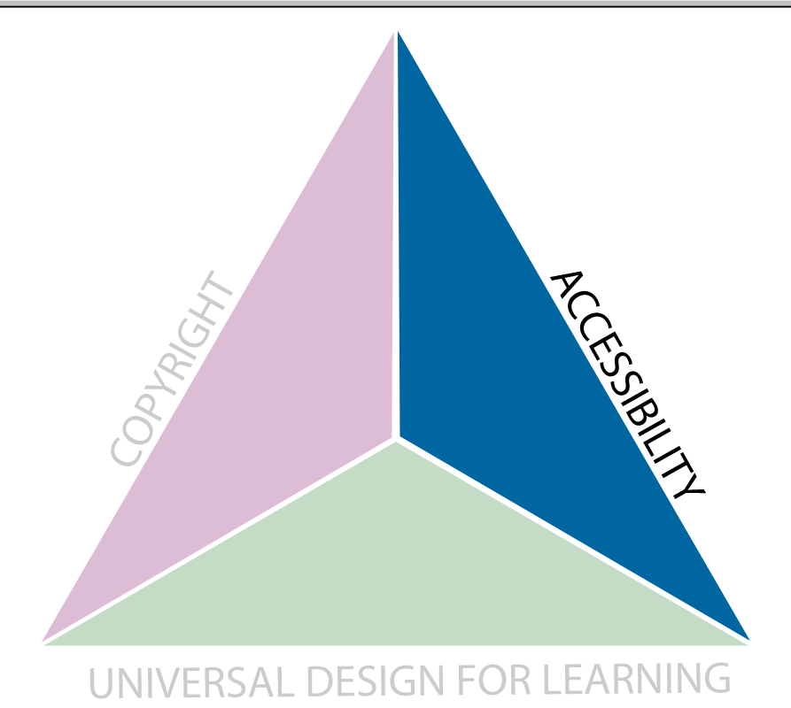
Second Consideration
Notes:
Now that we have our copyright free material the second slice of the triangle to focus on is accessibility. I got my content, my images, etc how do I make sure it’s accessible.

Slide 13
Laws
Rehabilitation Act of 1973
Section 504 and Section 508
Americans with Disabilities Act 1990
Title II and Title III
Private and Public Schools
Includes Programs offered on the Internet (e.g. Online Courses, 1996)
Notes:
You should know this by now but these are the laws that demand that you use accessible.
These laws apply to public and private institutions.
If you want to something to help you fall asleep at night then you can check this powerpoint and google search about it.

Slide 14
Accessibility@UCF
Student Disability Services
Center for Distributed Learning
IDL6543
Teach Site – http://teach.ucf.edu/resources/accessibility-tips/
Accessibility Course Requests
By Usability Checker
Notes:
IDL6543 captures all new incoming faculty to online teaching at UCF
Teach site is for rehabilitation purposes
Our usability checker is a fully blind student—he receives requests from faculty and then looks at the questionable material. He is very thorough and provides great feedback. Although it is limited, it is one of the many ways we’re trying to increase access to our online content at ucf.

Slide 15
Online Content Accessibility
Assessment accommodations
HTML pages/Word documents
PDF
Images
PowerPoint presentations
Audio/Video
Notes:
All of these items mentioned above must be made accessible.
Who is responsible for making these online accommodations varies from institution to institution.
The accommodation is often only made in the time of need and may only benefit one student (depend on the process for providing the accommodation).
So what do we do to increase access for all???

Slide 16
Assessment Accommodations
Additional time
Process varies based on CMS
D2L and Canvas allow settings to be changed
Blackboard Learn 9
Create separate instance
Hide new instance from other students
Manually add the grade to main grade column
Notes:
Transition to the rest of the examples because anything you add to the test can apply
Learn 9: Create separate instance to be created for a particular student, hidden from other students, manually add the grade to main grade column for the exam

Slide 17
HTML Pages/Word Documents
Properly structured documents
Headings
Use headings for Tables
Bullets and numbering
Use of Color
Avoid using red text on white background
Avoid using color to designate information
Notes:
In resources of how to do it

Slide 18
PDFs
When you have control, scan with OCR Text Recognition
Directions to verify the PDF is properly scanned and can be read
View > Read Out Loud > Activate Read Out Loud
Notes:
Best way is to begin with accessibly-formatted Word documents and convert from there.
PDFs become a concern if it was scanned as an image
View sample PDF for audible reader
See handout for more information

Slide 19
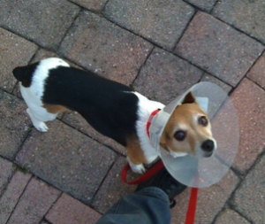
Images
Alt Texts
Why is this non-text content here?
What information is it presenting?
What purpose does it fulfill?
If I could not use the non-text content, what words would I use to convey the same function and/or information?
Graphs in Excel (text descriptions for charts)
http://accessibility.psu.edu/charts
Notes:
Understanding the context of an image is vital. The World Wide Web Consortium (W3C) Web Content Accessibility Guidelines (WCAG) 2.0 recommends editors consider four questions:^{[6]}
Why faculty should provide alt text information
For a veterinary class, the alt text might be: “A dog with an Elizabethan collar to prevent the irritation of wounds.”
For a photography class, the alt text might be: “A bird’s eye view photo of a dog.”
For a Color Theory class the text may read: “A photo of a dog with a red leash against pale red bricks.”
For a dog breeding class the text may read: “A photo of a rat terrier.”

Slide 20
PowerPoint Presentations
Use slide layout templates whenever possible.
Write presenter's notes in the provided area.
Apply ALT text to images
Use built-in accessibility checker
File > info > check for issues > check for accessibility
Notes:
PPT Tips
Use slide layout templates whenever possible. JAWS will read the content in the correct order if these are used. Any text boxes you place manually will be read last.
When you can't use a template, at least use the one with the slide title only. This is the only way JAWS will recognize that text as the slide title.
Write presenter's notes in the provided area. This gives the presentation some context, and helps all viewers understand the content.
Images should have ALT text applied to them. If you are using a complicated image, such as a diagram or map, add a caption to the slide or the presenter's notes that describes what the viewer should notice about the image.
Mention WebAim tutorial on making PowerPoints accessible
Use Microsoft's accessibility checker to help identify and fix any potential accessibility issues.
Add caption to the slide or presenter’s notes for complicated images (e.g. diagrams or maps)

Slide 21
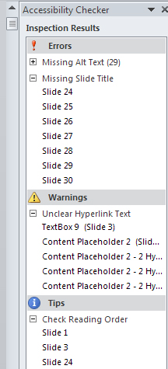
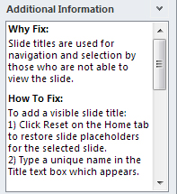
PowerPoint Accessibility Checker

Slide 22
Video
Transcripts
Hearing Impaired: Must provide transcripts
Vision Impaired: Must also provide scene descriptions
Captions
Open Captioned
Closed Captioned
Notes:
Open captioned means it’s automatically turned on
Closed captioned requires the user to know how to turn it on

Slide 23
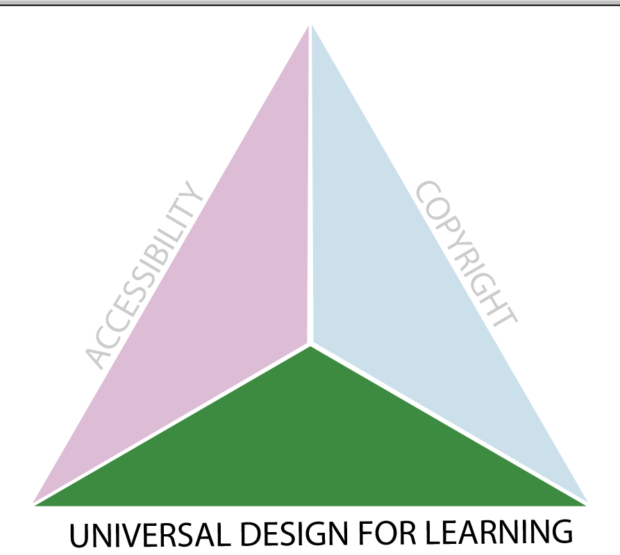
Last Consideration
Notes:
Proactive – we all want to be proactive about how we are designing our courses; no one wants to wait for Student Disabilities to announce that you have a student who needs accommodations so in order to do that we need UNIVERSAL DESIGN FOR LEARNING

Slide 24
What is the purpose of Universal design for Learning?
Focus Question #2

Slide 25
The Purpose is to Ensure Access
Benefits all kinds of Students:
With and without disabilities
With different learning styles
With varying access to technology
With English as a second language
EVERYONE!
Notes:
Barrier free, Ron Mace

Slide 26
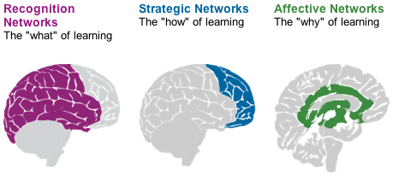
UDL and the Brain
© CAST, 2012
Notes:
CAST
Let’s talk about this from the brain perspective—now don’t be worried, I’m not a neuroscientist and I really couldn’t begin to explain the portions of the brain and what each does but the group from CAST has spent the time comprehending how the brain becomes activated by information—and when that information becomes learned. Really what I’m going to get at is the strategies for enhancing that activation and making your material more accessible.
Recognition networks – the what of learning
Strategic network – the how of learning
And the Affective network – the why of learning

Slide 27
Present information in multiple ways
Highlight important material with a different colored background container
Provide audio/visuals for hard-to-grasp concepts
Provide graphical and narrative organizers to help supply background information
Notes:
So in terms of accommodating the What of Learning, we have to present information in multiple ways
The graphic organizer is essentially the unsung hero to UDL.

Slide 28
Provide opportunities to prove learning
Provide application-based learning opportunities
Ex. Submit art piece for art show
Provide various self-assessment strategies
Ex. Peer review, self-test
Provide opportunities for students to communicate with you
Ex. Email, IM, message boards
Notes:
The How of Learning
Planning and performing tasks. How we organize and express our ideas. Writing an essay or solving a math problem are strategic task.

Slide 29
Provide means for engagement
Allow students the opportunity to choose assignments
Provide authentic tasks directly related to content
Provide students with the means of submitting components of a larger project to encourage reflection
Encourage learning communities to form
Notes:
The Way of Learning
teachers devote considerable effort to recruiting learner attention and engagement. But learners differ significantly in what attracts their attention and engages their interest

Slide 30
UDL Example
The benefits of captioning
Increased retention of material
Provided English as Second Language users the opportunity to comprehend
Engaged learning preferences
Assisted students with disabilities
Notes:
This story is about an engineering faculty member…he likes to build his course content using powerpoint.
Transcripts & Closed Captioning
Colin Archibald – when he added captioning, non native speakers felt they could learn better because they were better visual learners than auditory

Slide 31
Thank You!
Jessica I. Vargas jessica.vargas@ucf.edu
Kathleen Bastedo
kathleen.bastedo@ucf.edu
http://teach.ucf.edu/resources/accessibility-tips/
Notes:
STEM courses – tackling the hard sciences

