Slide 1
MENTORING AS A FACTOR OF SUCCESS
Jim Bradley| May 30th, 2012

Slide 2
WHY MENTOR?
As leaders, we have a critical need to manage the pipeline
  We need to ensure that succession planning works because talented people are ready to step up
  It is core to leadership to try to raise everyone’s game

Slide 3
WHY SEEK A MENTOR?
As future leaders, we have a duty to ourselves and our organizations to always be working to raise our games
It is important to note that leadership is not a function of how many people report to you.

Slide 4
A rising tide lifts all boats
--John F. Kennedy

Slide 5
MENTORING
What we'll do
  Introductions
  Discuss styles and functions of mentoring
  Practice beginning the conversation
Journal
  You should use the journal's you've received to record thoughts and questions and perhaps to reflect on what you've learned
Flip Charts
Notes:
Introduction of the workshop session should take about 10 minutes.

Slide 6
Introductions
Who are you?
Where are you from?
What do you expect to get out of this workshop?
Notes:
Should start this slide around 1135 after and conclude around 1145.

Slide 7
Quick discussion
Mentoring sessions
  Available time
  Types of Settings
How do you prepare
  Have a goal for what you want to get from the session.
  Think also about what you can contribute
How do you make the best use of the time?
  Prepare questions in advance
  Be clear with mentor about what you need

Slide 8
"A mentor is someone who sees more talent and ability within you, than you see in yourself, and helps bring it out of you."
--Bob Proctor

Slide 9
Mentoring benefits (Mentee)
Career planning and development
Enhanced career satisfaction
Enhanced compensation for the mentee
Increased managerial productivity
Increased employee retention
  if relationship is internal to organization
Long-term relationships

Slide 10
Mentoring Benefits (Mentor)
Enhanced career satisfaction
Succession planning
Personal satisfaction
Long-term relationships

Slide 11
"The difference between great people and everyone else is that great people create their lives actively, while everyone else is created by their lives, passively waiting to see where life takes them next. The difference between the two is the difference between living fully and just existing."
Michael E. Gerber

Slide 12
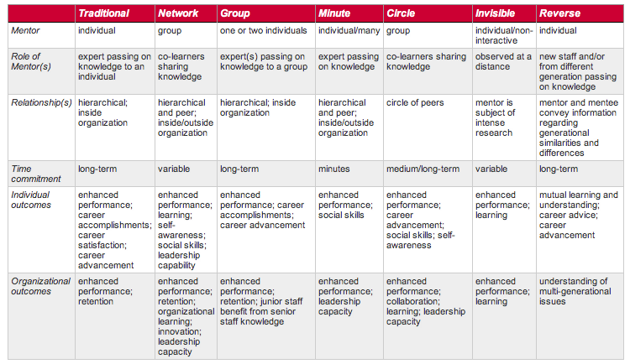
styles

Slide 13
STYLE: Traditional
Expert or senior person
One on one relationship
Based on position or accomplishment

Slide 14
Style: Network
A small group of people to whom you turn
Individuals outside your organization
Based on high degree of mutual learning and trust

Slide 15
Style: Group
1-2 mentors provide mentoring to a group of employees
Enables an organization to mentor more than a 1:1 ratio
Works with a group of mentees that have something in common

Slide 16
Style: Minute mentoring
Based on speed-dating concept
Saves time
Many people meet 1:1 at an event for a few minutes at a time
Meet many people quickly
Convey knowledge, wisdom

Slide 17
Style: mentoring circle
Peer mentoring support network for friends/colleagues
Reciprocal relationships
Members support personal and professional growth

Slide 18
Style: invisible
Invisible mentors: leaders from who you can learn by observing from a distance
Extensive research into mentor’s life and accomplishments
Explore what has been written about him/her, speeches, etc.

Slide 19
Style: reverse
Senior staff paired with new employees
Senior staff learns above future generation
Junior staff gains career advice/interaction

Slide 20
STYLE: ADVISORS
New leader who forms a small group of more experienced leaders
Typically drawn from national level, not internal
Issue/success oriented

Slide 21
"Big goals get big results. No goals get no results or somebody else's results.."
Mark Victor Hansen

Slide 22
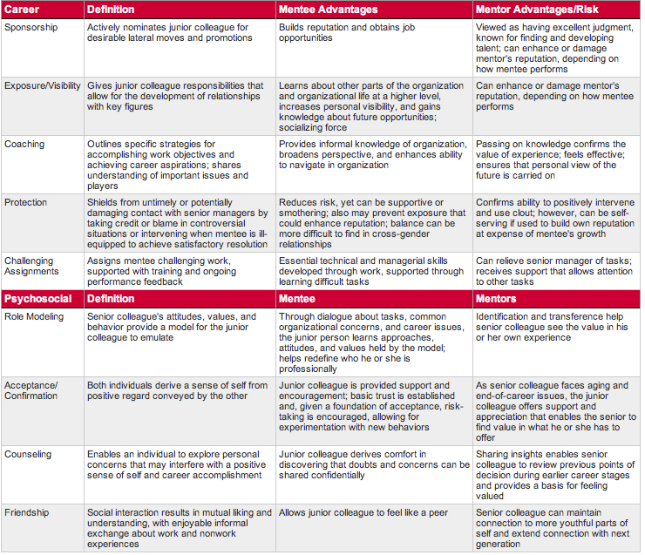
Mentoring functions

Slide 23
Career function: sponsorship
Senior colleague actively nominates junior colleague for desirable lateral moves and promotions
  Mentee gains reputation, job opportunities
  Mentor gains reputation for excellent judgment, finding talent
Risks mentor reputation on mentee performance

Slide 24
Career function: exposure/visibility
Gives junior colleague responsibilities to build relationships with key figures
  Mentee learns about organizational life, increases personal visibility, learns about future opportunities
  Mentor reputation affected by mentee performance

Slide 25
career function: coaching
Outlines strategies for accomplishing work objectives/aspirations
Understanding issues and players
  Mentee gains informal knowledge of organization, broader perspective
  Mentor confirms value of experience, feels effective, ensures personal outlook is carried on

Slide 26
Career function: protection
Shields from untimely contact with senior managers by intervening when mentee unprepared
  Mentee has reduced risk but this can be supportive or smothering. May prevent beneficial exposure. Balance difficult across genders
  Mentor confirms ability to use clout. Can abuse standing at expense of mentee

Slide 27
"I am responsible for my own well-being, my own happiness. The choices and decisions I make regarding my life directly influence the quality of my days."
Kathleen Andrus

Slide 28
Career function: challenging assignments
Assigns mentee challenging work, supported with training and ongoing performance feedback
  Mentee develops essential skills and is supported through learning difficult tasks
  Mentor is able to delegate tasks and can focus attention elsewhere

Slide 29
Psychosocial function: role modeling
Senior colleague’s attitudes, values, behavior provide model
  Mentee is able to emulate successful models, discuss tasks, organizational concerns, and career issues in a context that explains senior leader's approaches, attitudes, and values
  Mentor is able to let others benefit from that they have learned over time and gains a sense of the value in his or her own experience

Slide 30
Psychosocial function: acceptance/confirmation
Both derive sense of self
  Mentee is provided support and encouragement, given basic trust, encouraged to take risks and experiment
  Mentor's junior colleague offers support and appreciation, reminds senior staff of value

Slide 31
Psychosocial function: counseling
Enables individual to explore personal concerns that may interfere with a positive sense of self
  Mentee gains a confidential advisor
  Mentor gains renewed insight into their earlier career decisions and a sense of helping others

Slide 32
Psychosocial function: friendship
It never hurts to have more friends
More personal relationship
More likely to create trust and alliance

Slide 33
Expectations
Should be set upfront
Can use a formal agreement:
  Goals of mentor and mentee
  How accountability is determined
  How progress towards goals will be measured
  Duration of relationship
  Frequency of meetings
  Other unique elements
  Confidential nature

Slide 34
"We make a living by what we get, we make a life by what we give."
Winston Churchill

Slide 35
Beginning the
Conversation
Going to do two 10 minute
sessions
Pair off with another person
Switch roles halfway through

Slide 36
Beginning the conversation
  Why do you choose a mentor
    Who is the person you will or have chosen?
    Why did you chose them?
    What were the characteristics or experiences that helped make the choice?

Slide 37
Beginning the conversation
  The structure of time
    Develop your questions to get the information and answers you need from your mentor
    What are the questions or information you seek?
    What knowledge are you expecting to gain?

Slide 38
Feedback
Please take five minutes to fill out the feedback handout

Slide 39
THANK YOU

