Slide 1
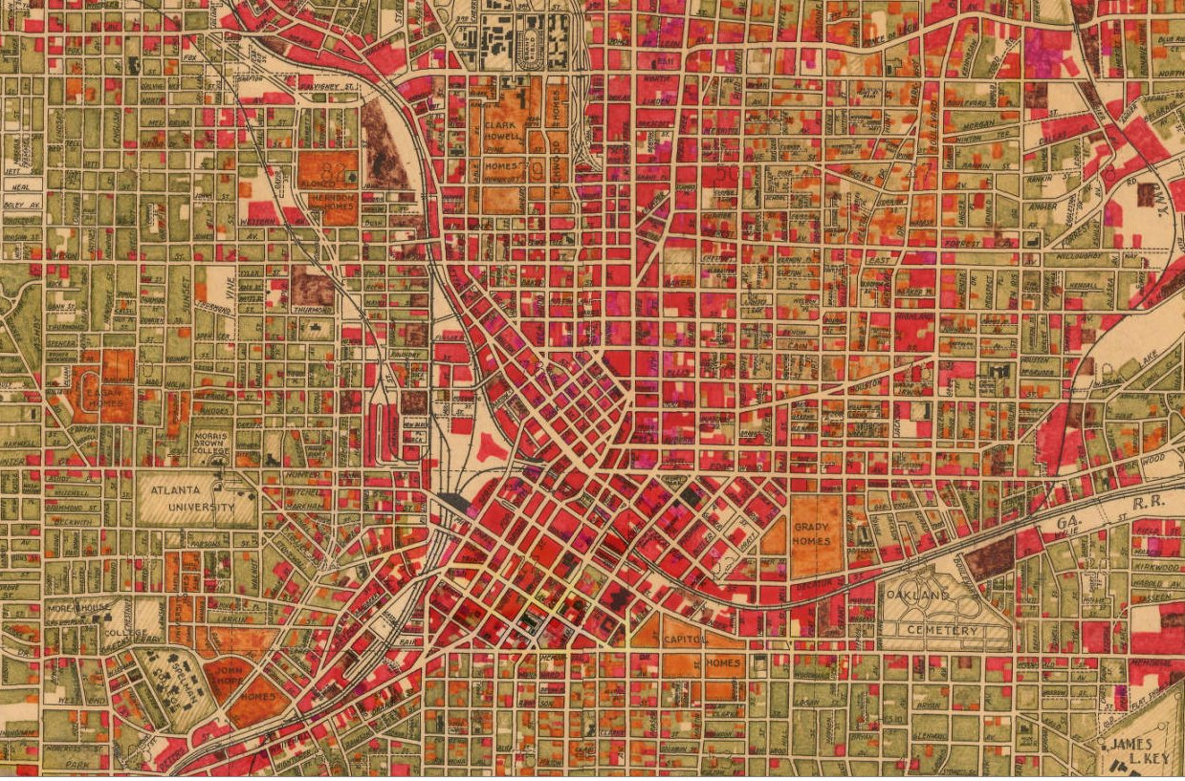


Digital Atlanta
Engaging
Students
in Their Local
Environment
with
Bryan Sinclair &
Joseph A. Hurley
Southeast Regional Conference
Innovation Showcase, May 29, 2013
Notes:
Students, educators, and the public are engaging with their surroundings, discovering connections about the built environment and the past, and changing their perceptions of Atlanta in ways that would not be possible without the aid of this digital portal from Georgia State University Library.

Slide 2
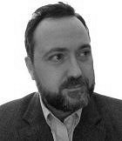
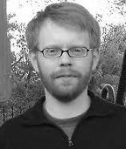
Presenter
Bryan Sinclair, bsinclair@gsu.edu, is Associate Dean, Public Services at Georgia State University Library. His research interests are in collaborative research and discovery spaces, data services, digital humanities, and exploring new roles for librarians.
Project Director/PI
Joseph A. Hurley, jhurley@gsu.edu, is the Data Services, Geosciences, Government Information, Maps and GIS Librarian at Georgia State University. His research interests include access to government information, historical GIS, urban renewal, and demographic and built environment change. He is currently directing the Georgia State University Library digital project Planning Atlanta: A New City in the Making, 1930s – 1990s, and as PI, has recently received an NEH grant to expand this project.

Slide 3
We need digital spaces built around significant questions, important for knowledge creation and excellent for teaching in many contexts…
[that] can sustain original discovery by thousands of students, each of whom will see a unique pattern in complex evidence…
[that] can build bridges of understanding where we seldom have them now – speaking to novices and to experts, to K-12, and to those who continue learning deep into their lives.
Source: Edward L. Ayers, “Discovery in a Digital World,” EDUCAUSE 2012 Annual Conference, Nov. 9, 2012, http://bit.ly/ayers-discovery
Notes:
University of Richmond President Edward Ayers is a pioneer of Digital Humanities (DH) scholarship. Planning Atlanta facilitates what Ayers calls “generative scholarship.” This new type of scholarship “generates new questions, new evidence, new conclusions, and new audiences as it is used.” It is not done and then handed to the student to be quizzed upon; rather, the scholar/presenter is saying, “help us figure this out.”

Slide 4
Philosophy
Engage students and other researchers in their local environment and encourage new perspectives on people and place
Through new technologies, transform existing resources and collections in ways that significantly enhance teaching, learning, and research on our campus and broader community

Slide 5
Why Georgia State University?
Georgia State Strategic Plan – Goal 4
Be a leader in understanding the complex challenges of cities and developing effective solutions.
City-based research university located downtown in the urban center of the Southeast – but connected with the world. Atlanta represents a rich history of race and culture, politics and religion, rural and urban influences, business growth, research and technology…

Slide 6
Presently
Conceived as an digital educational platform
Planning Atlanta: A New City in the Making,
1930s–1990s is being used by students in various disciplines

Slide 7
Presently
Geography and History – visualize urban development, highway creation, neighborhood change, etc. and their effects on the social and built environment
Heritage Preservation – identify significant buildings and their spatial environment over time
Public Policy – understand how public policies and city planning reshape the city
Sociology – visualize the growth and dispersion of public housing (Atlanta was the first city in the nation to have public housing and it was also the first city to demolish all of its public housing)
English – visualize communities and racial themes in literature
Public Health – identify places of potential environmental and public health hazards

Slide 8
Google: planning atlanta

Slide 9
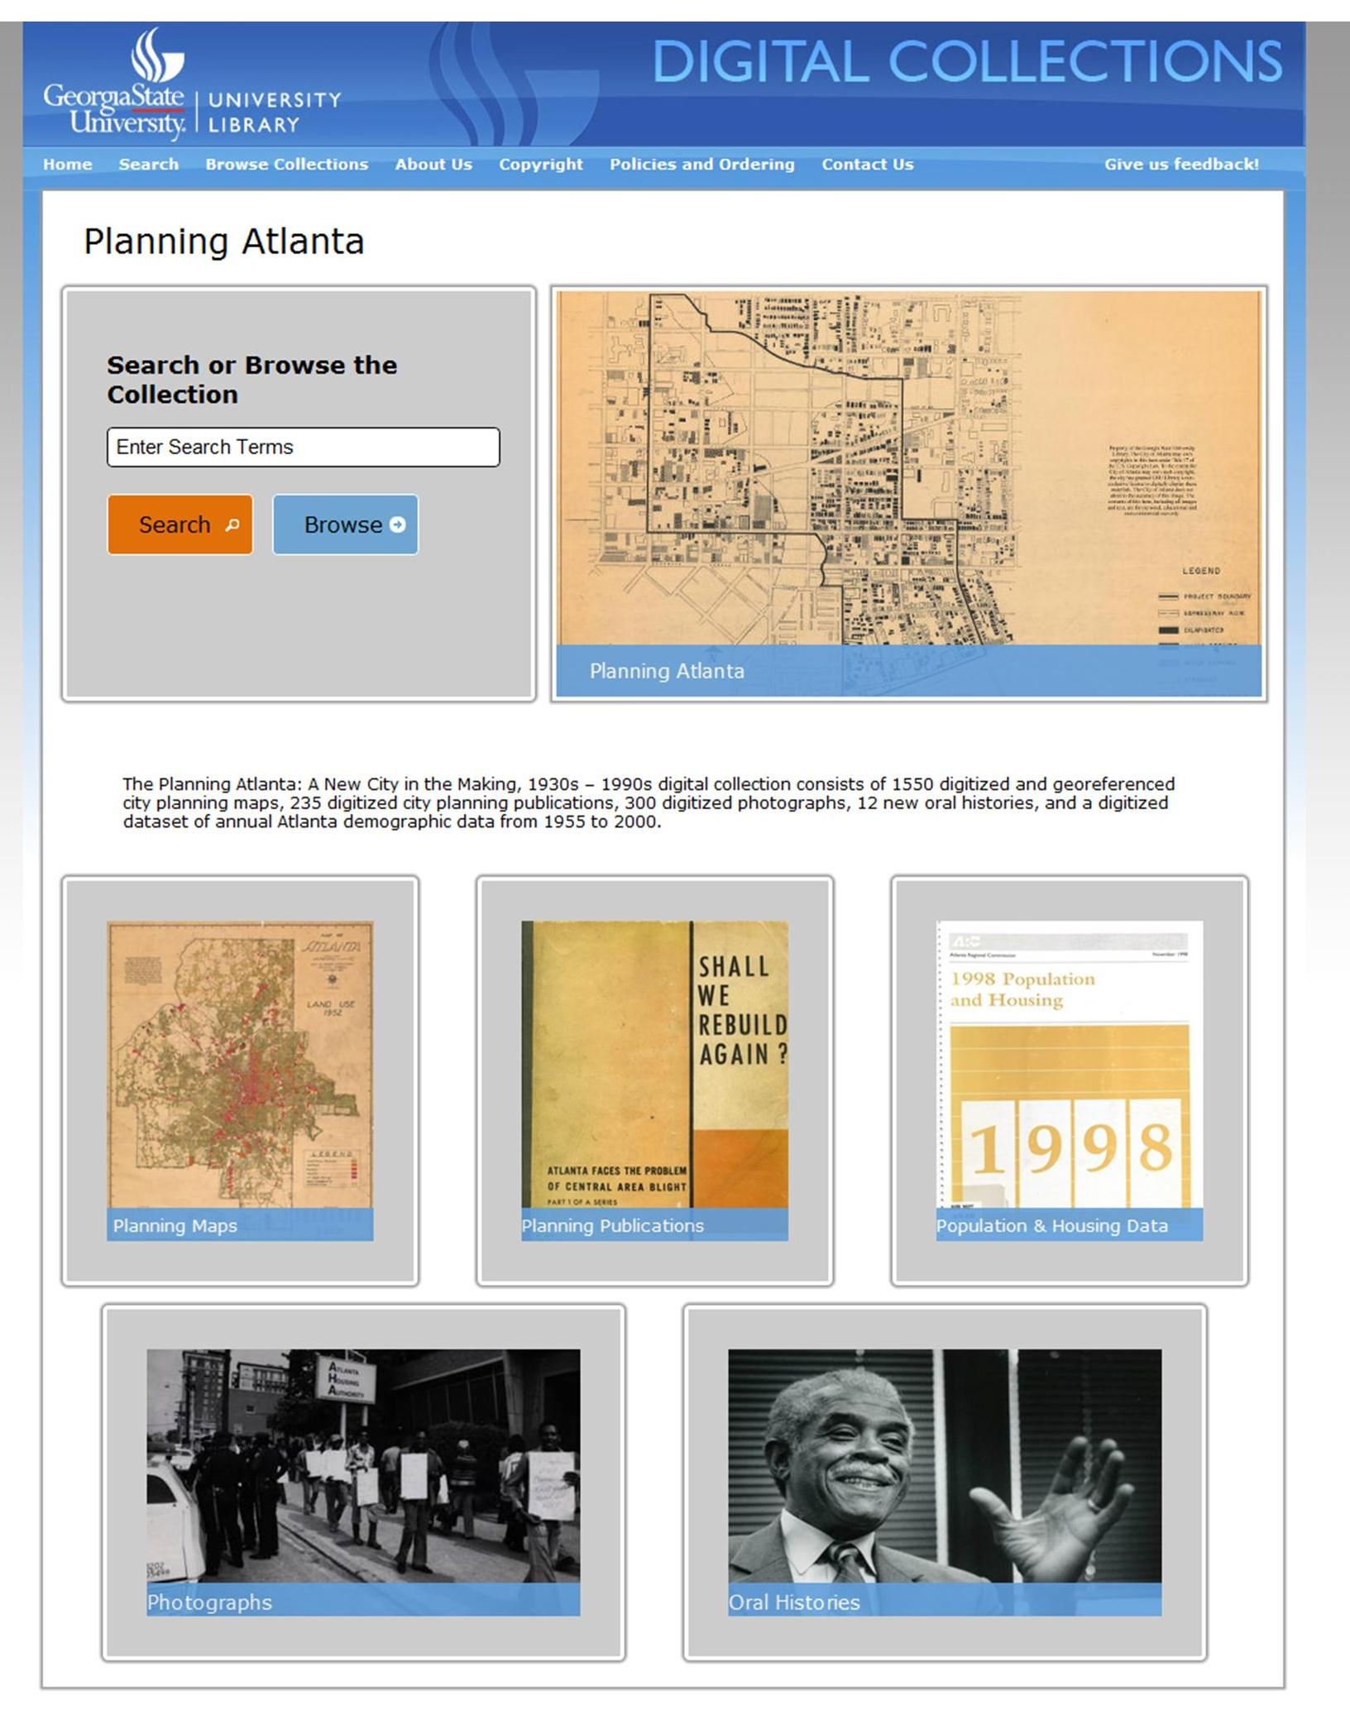

Slide 10
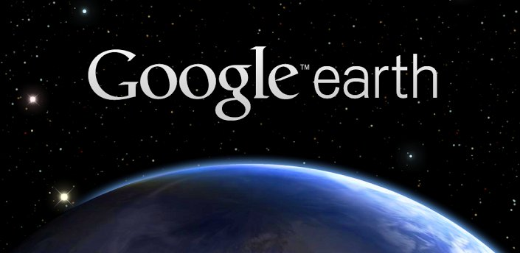

Platform
Digital collection management tool
Web-based discovery interface
Collections reside locally – but hosted solution is available
Customizable - Google Maps and Google Earth tiled overlay with the aid of in-house web developer
Notes:
Search engine optimization – making these maps accessible and useful
Georeference each map
Provide Google Maps and Google Earth overlays
and ability to freely download the GeoTIFF and a high-resolution JPEG

Slide 11
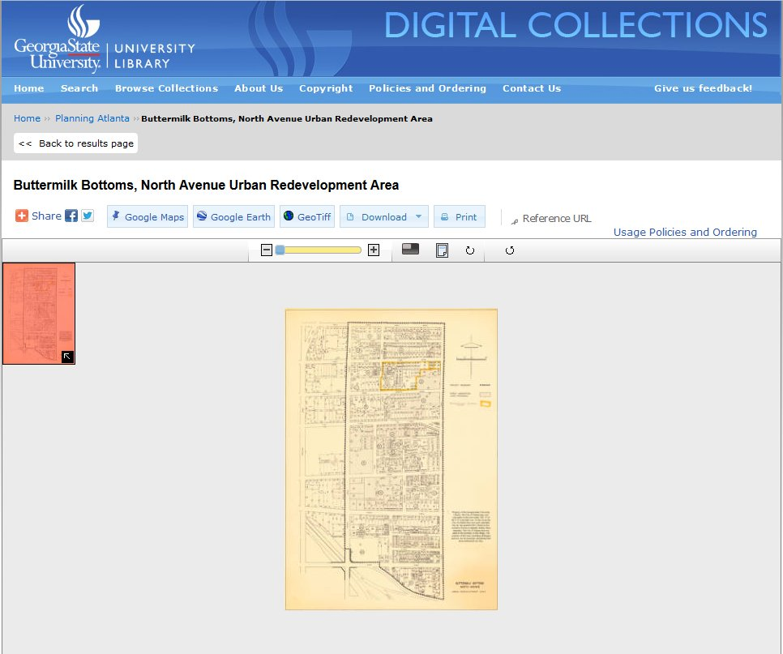
Notes:
Buttermilk Bottoms – North Ave. Urban Redevelopment Area
1960s – almost completely destroyed by urban renewal

Slide 12
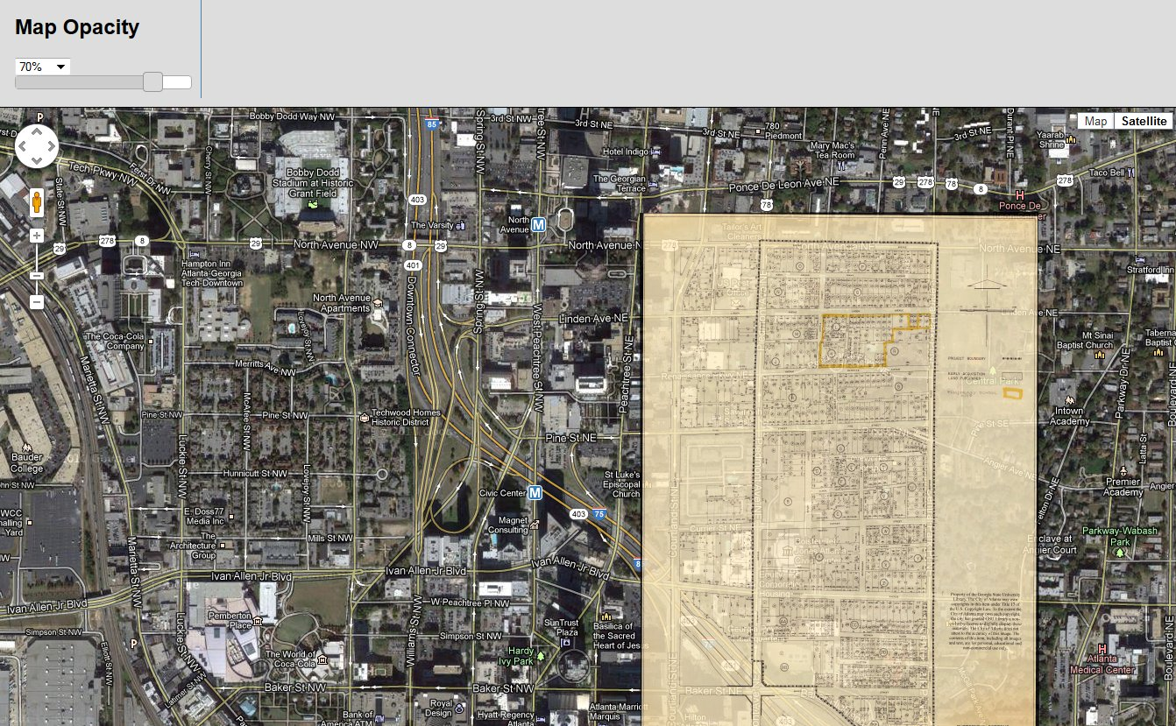

Slide 13
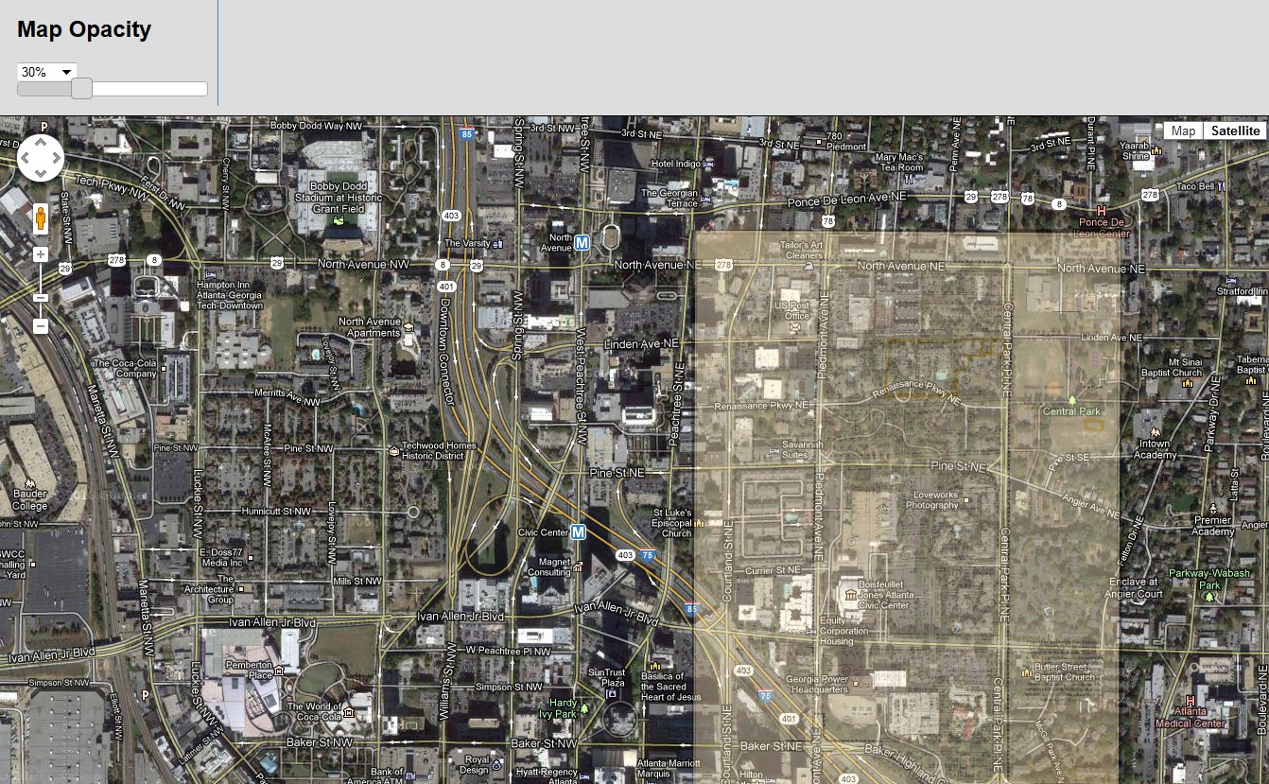

Slide 14
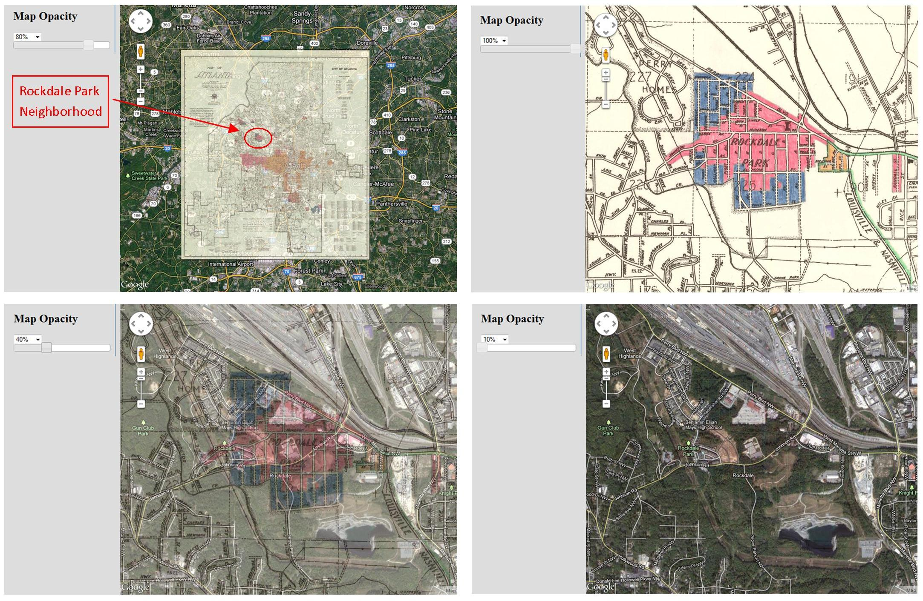

Slide 15
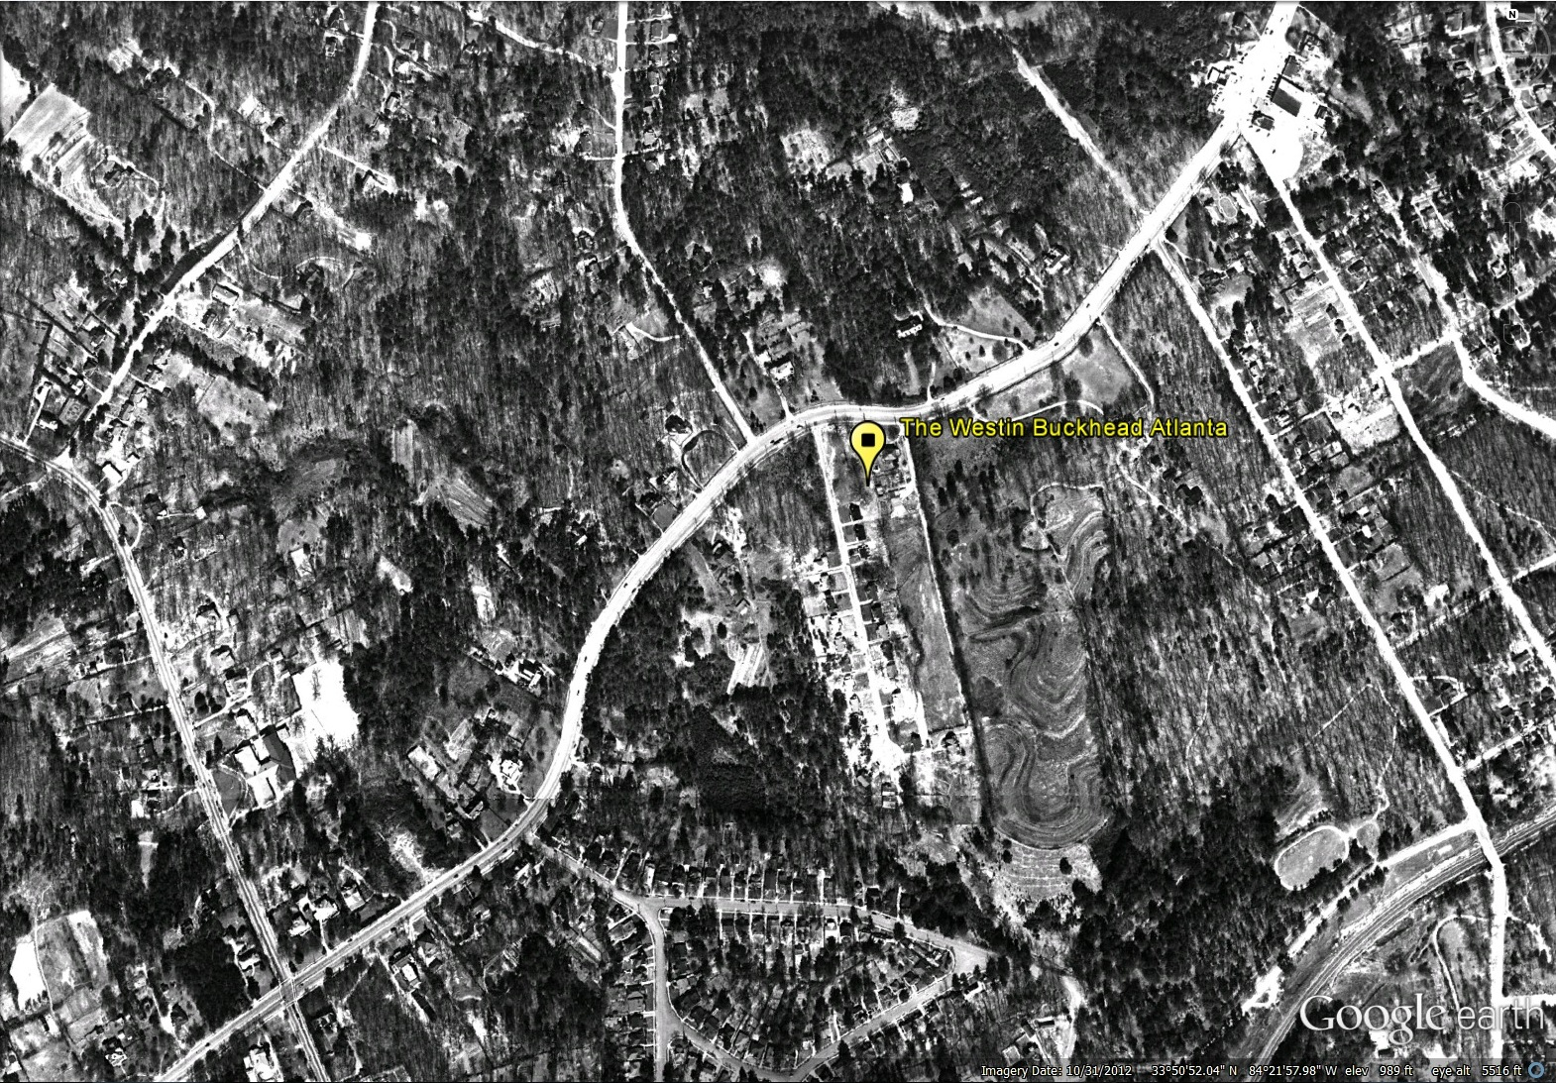
Notes:
1949 aerial photograph of Buckhead
overlaid on a present-day image from Google Earth

Slide 16
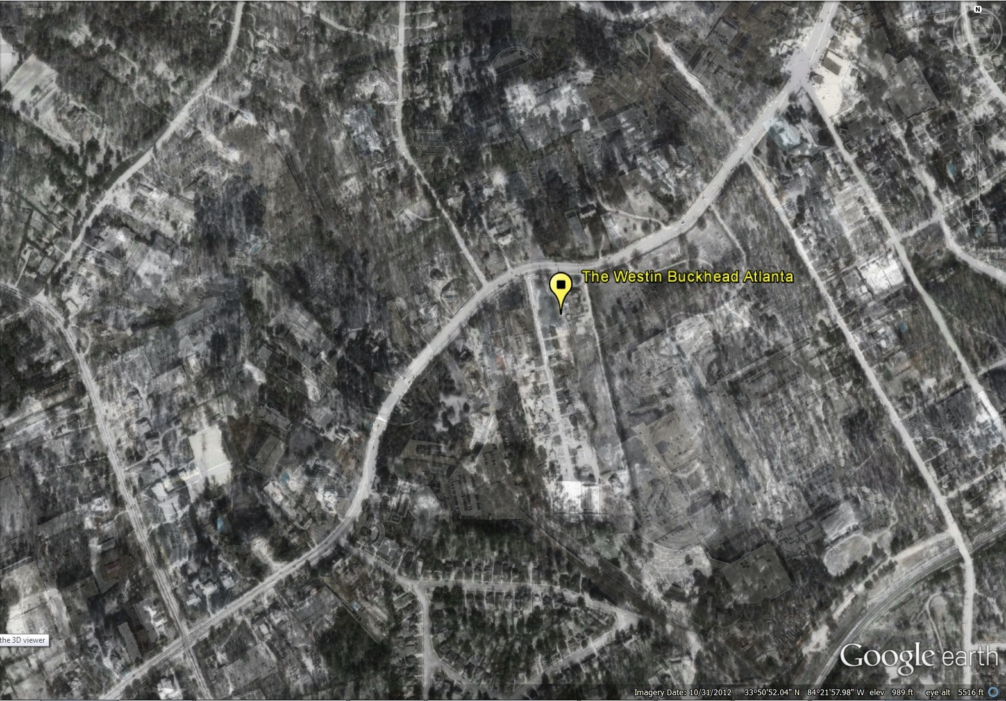
Notes:
Decreasing the opacity…

Slide 17
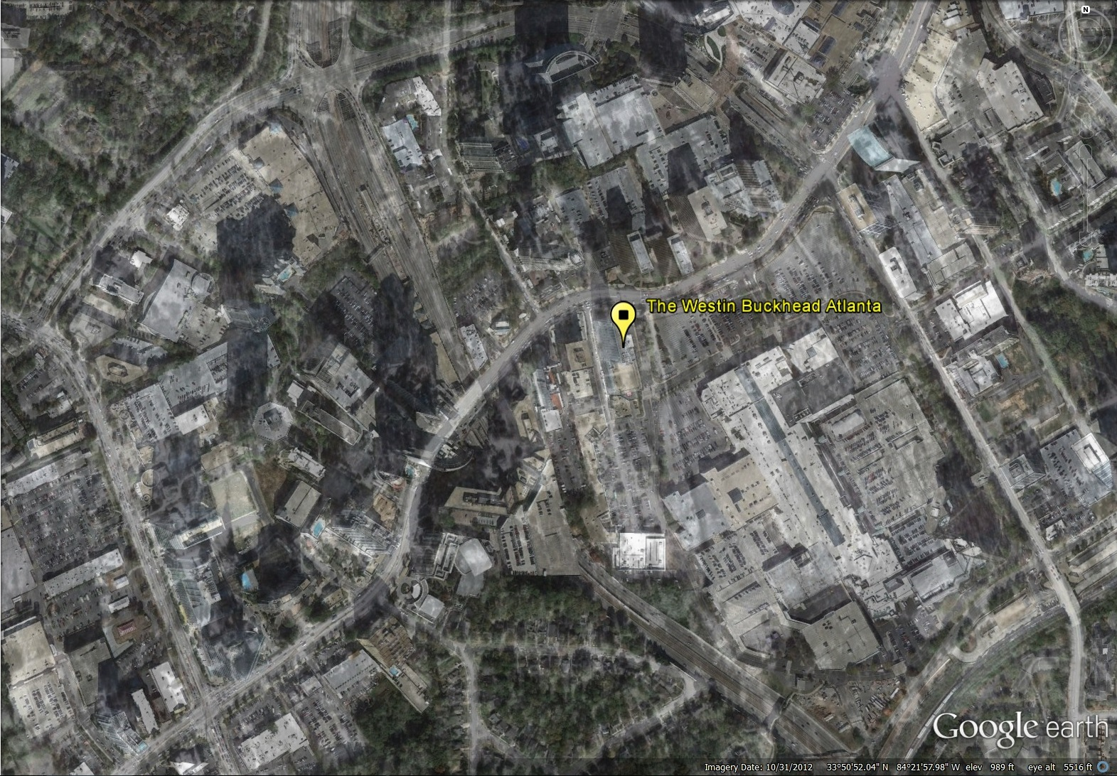
Notes:
Decreasing the opacity…

Slide 18
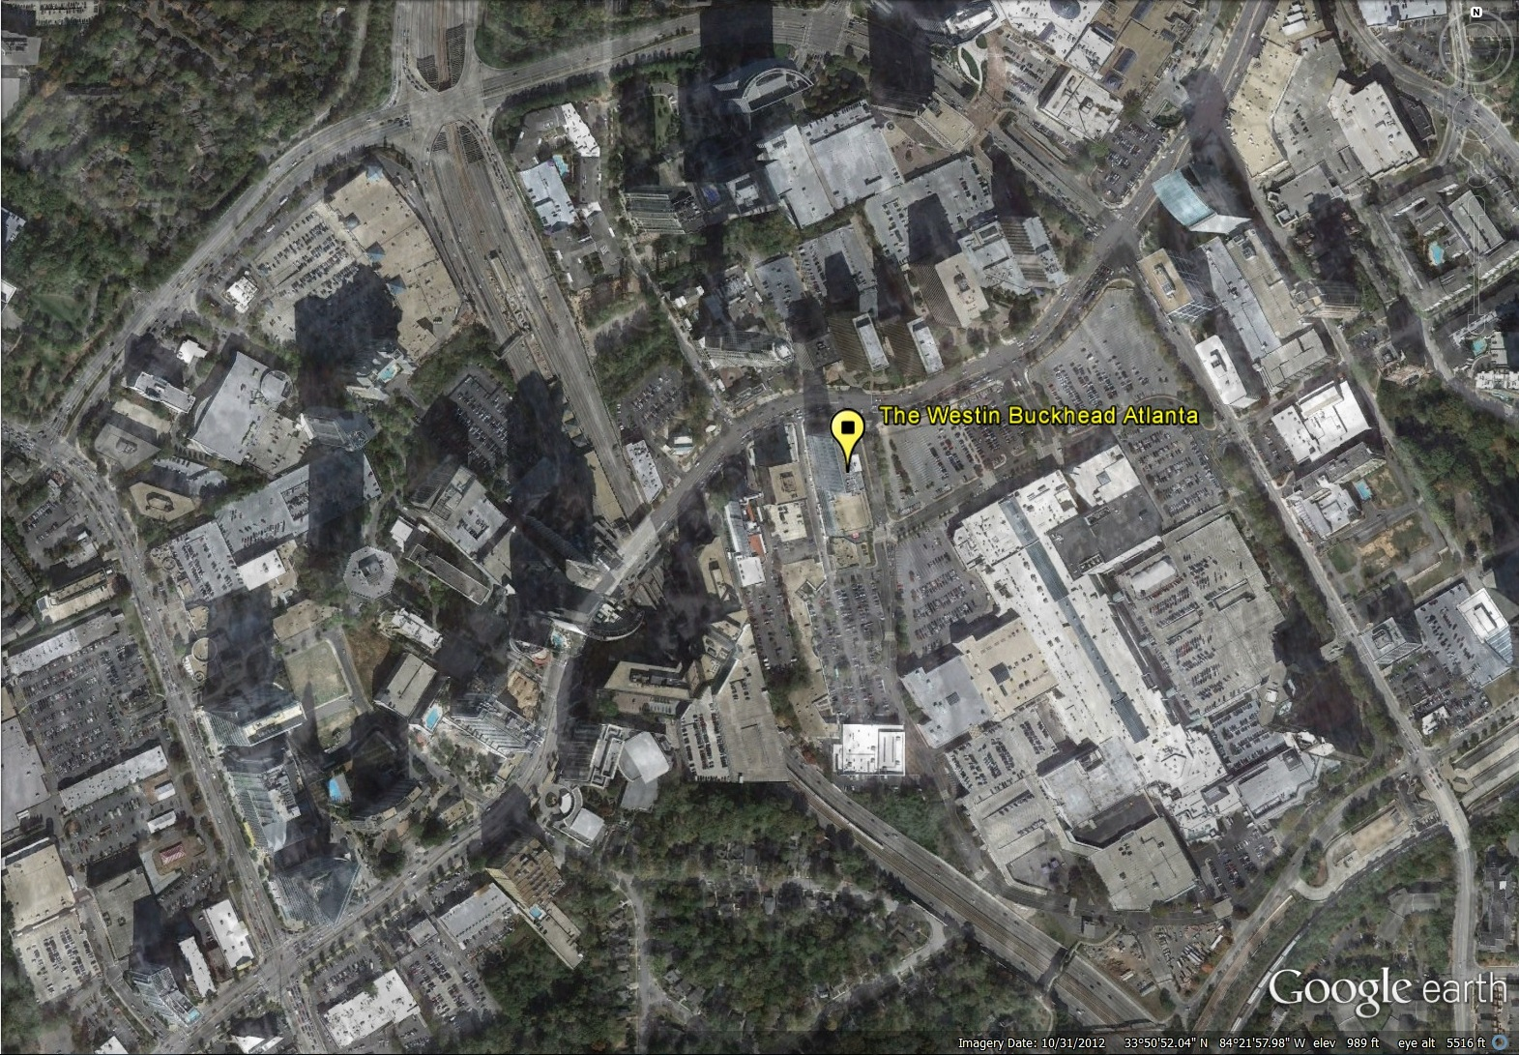

Slide 19
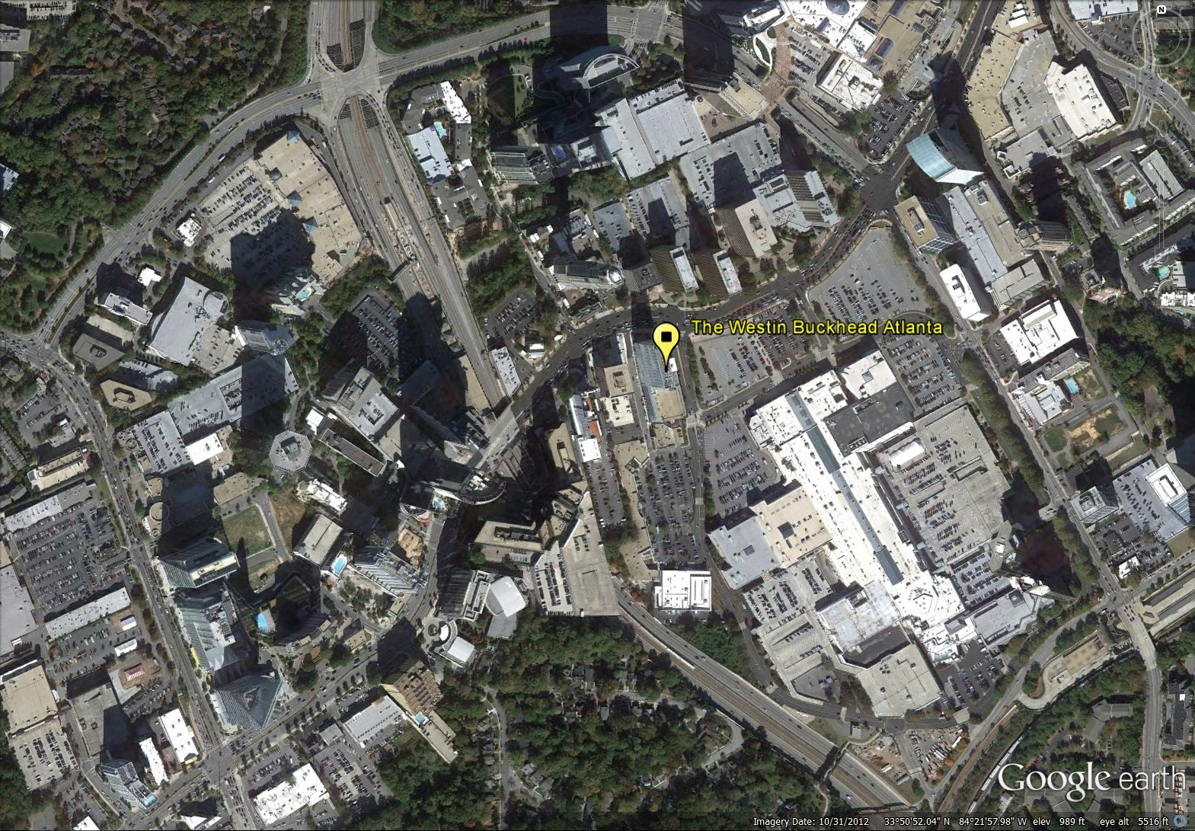

Slide 20
What’s Next?
NEH Grant awarded! – April 2013
Expand to include multimedia
A richer digital humanities experience
Photographs from the Atlanta Journal-Constitution Collection, oral histories, audio files
Notes:
NEH Grant: $210,000

Slide 21

Planning Atlanta: A New City in the Making,
1930s-1990s will provide access to:
1500 maps
235 planning publications
demographic data from the Atlanta Regional Commission’s Population and Housing (1955 – 2003) with geographic identifiers and will be downloadable as Excel and CSV files
300 photographs that illustrate planning activities depicted in the maps
12 oral histories from three Atlanta neighborhoods that experienced urban renewal
Aerial Photograph Mosaic (1949) comprised of 124 aerial photographs

Slide 22
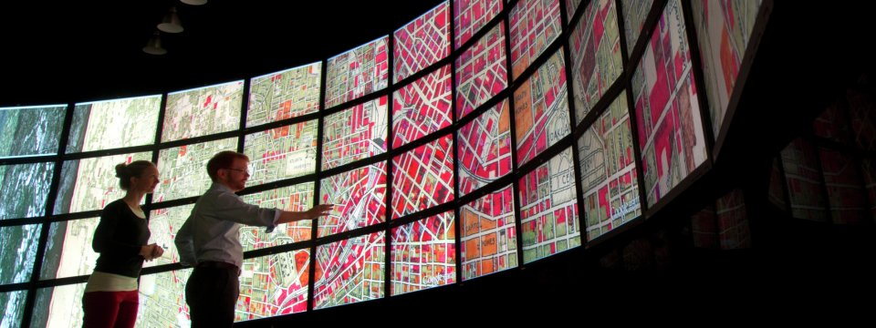
Joe Hurley and student at Viz Wall, Petit Science Center, Georgia State University
Engaging students and other researchers in virtual AND physical spaces
Notes:
Interdisciplinary data services center proposed for main library
CURVE – Collaborative University Research & Visualization Environment

Slide 23

Shout Outs

